Slide 1

Intervention part 1: universal approaches
Professor Courtenay Norbury
April 2020

Slide 2
Overview of the session
What to look for in an intervention trial
Tiered approach to thinking about language interventions
  Universal
  Targeted
  Specialist
What are professional roles at each Tier?
Evidence for effectiveness at each Tier
Remaining questions

Slide 3
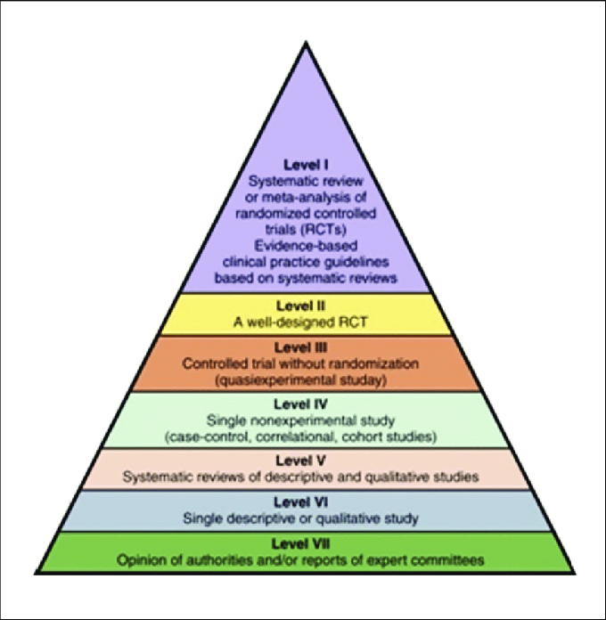
Levels of Evidence
Expert/clinical opinion is valuable, but alone it is not sufficient –we do not see what is happening to those who are NOT receiving our intervention!!
Establish causation (bias --)
**
The evidence has shown that…
*
It is likely that…
There are signs that…
Hypothesis generating (bias ++)
My experience is that…

Slide 4
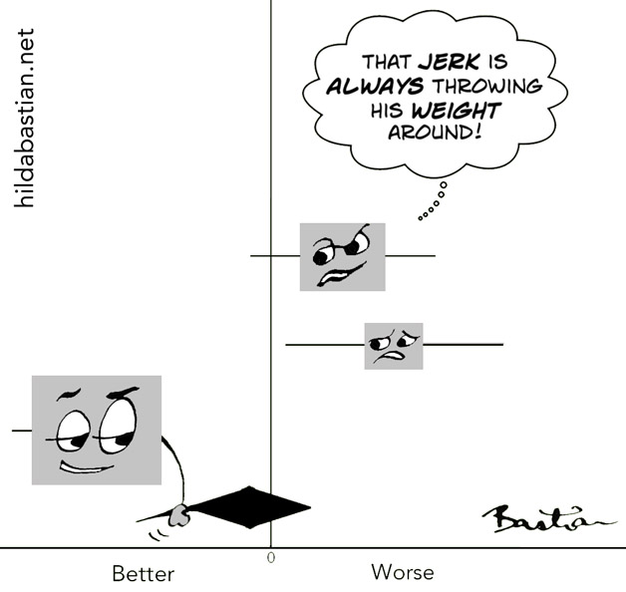
Things to look for in a meta-analysis…
Boxes usually show effect size for individual study – bigger studies have bigger boxes and carry more weight
Horizontal lines are confidence intervals – longer lines indicate less precise estimate
Vertical line indicates ‘no effect’ – if CIs cross this line
Diamond is the summary statistic
Make sure to check what right/left of vertical line means!
Consider inclusion /exclusion criteria (i.e. only RCTs?)
Can be challenging to pool data to interpret vastly different studies…
https://blogs.plos.org/absolutely-maybe/2017/07/03/5-tips-for-understanding-data-in-meta-analyses/

Slide 5
what to look for in an intervention trial…
Duff & Clarke (2011)
Supplementary Material – Checklist
Journal of Child Psychology & Psychiatry, 52(1), pp.3-12
DOI: 10.1111/j.1469-7610.2010.02310.x

Slide 6
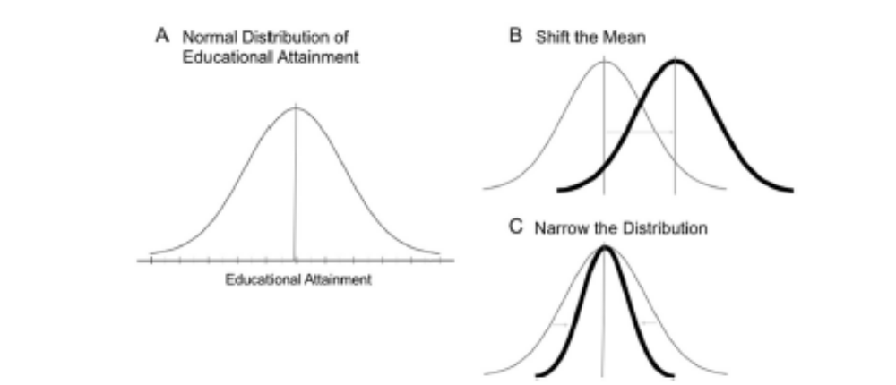
What is the goal of the intervention?
Teach a new skill
Teach a new strategy
‘normalise’ language trajectory
Adapt environment to accommodate current skill level
From Sokolowski & Ansari (2018)

Slide 7
what constitutes good evidence?
a testable and theoretically motivated hypothesis
  What are you trying to change? How best to measure this?
  primary and secondary outcome measures clearly defined before the study starts
  participants are adequately described and sensible diagnostic criteria applied
PEER REVIEWED! (quality control)
  other academics have read and checked statistics, assure claims match the evidence
  forces authors to explicitly acknowledge limitations of their work
Pre-registered
  Study design, hypotheses, outcome measures and analysis plan are recorded prior to the trial taking place
  Any deviation to the plan is clearly laid out in the paper
  Encourage publication of null results

Slide 8
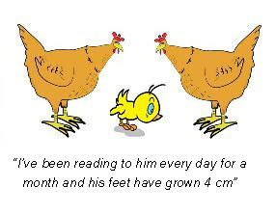
Randomised Controlled Trial (RCT) – Gold Standard
participants are randomly allocated to ‘treatment’ and no treatment/ alternative treatment control groups
this design controls for spurious factors that might influence change in the key behaviour:
development
practice effects
good quality teaching
changes at home
regression to the mean
Image from the BishopBlog…

Slide 9
Trial design is important to interpretation & Generalisation
the therapy is well-defined and manualised
  what is it
  who delivers it
  how long/how many sessions
  what are the discontinue or stepping up criteria
the ‘business as usual’ condition is well-defined
  What does the control group receive?
  Is dosage matched? (i.e. is effect about treatment, or just focused time with skilled adult)
the target population is well-defined
  Age
  Socio-economic demographic
  Inclusion/exclusion criteria

Slide 10
measures of treatment fidelity are included
  is treatment implemented in the way it was intended?
  esp. if delivered by others (parents, teaching assistants)
pre- , post- treatment and follow-up measures are taken
  ‘blind’ assessment – assessors do not know whether the child is in the treatment or the control group
  Primary and secondary outcome measures are specified (to reduce Type I errors)
  mixture of bespoke, standardised, observation, and questionnaire assessments
    In general, largest treatment effects on most proximal measures (i.e. closest to therapy content)
    Very challenging to see treatment effects on standardised tests (WHY??)

Slide 11
conclusions are measured and follow from results
  beware of miracle cures!
  really think about how these results might generalise to the kinds of children you see in everyday clinical and education contexts...
authors entertain possibility that null findings mean treatment (content, duration, frequency, etc) is ineffective… especially if the study has sufficient statistical power (large sample size)
  a null finding does not necessarily mean that the intervention is pointless – just that current form is not sufficient to detect meaningful change
  even with null finding, still possible to consider moderators (i.e. is the treatment more effective under certain conditions)

Slide 12
Approaches to service delivery
Ebbels, McCartney, Slonims, Dockrell, and
Norbury (2019) Evidence-based pathways to intervention for children with language disorders, International Journal of Language & Communication Disorders, VOL. 54, NO. 1, 3–19
https://doi.org/10.1111/1460-6984.12387

Slide 13
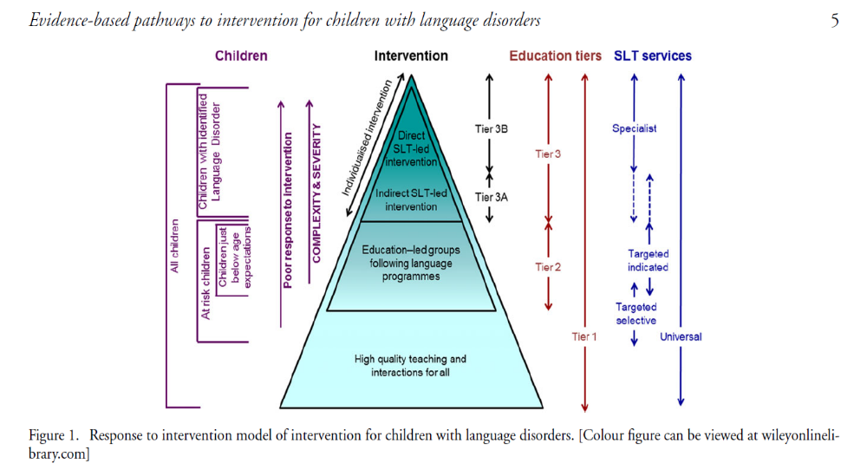
At Tier 3/specialist, the logoped has a ‘duty of care’ to the child with an identified speech/language need. If someone else carrying out individualised plan, logoped should ensure oversight and make sure that individual (usually parent or school support staff) is competent to deliver the treatment and well-supported

Slide 14
High quality teaching and interactions for all…
Communication Supporting Classroom Observation Tool
(Dockrell et al. 2012)
https://www.thecommunicationtrust.org.uk/media/93866/tct_bcrp_csc_final.pdf
Environment Rating Scale – Norwegian translation
(Harms, T., & Clifford, R. M. (2002). Early Childhood Environment Rating Scale-Revised. R.J. Pettersen (Translator), ECERS. Oslo, Norway: SEBU Forlag.)

Slide 15

Communication friendly classrooms…
Language learning environment:
  Some classroom displays invite comments from children.
  Background noise levels are managed, and children and adults are able to hear one another with ease
Language learning opportunities:
  Interactive book reading with adult
  Opportunities for structured conversation with teachers and peers
Language learning interactions:
  Get down to child’s level
  Appropriate pacing of talk
  Mix of questions (open-ended) and comments
  Use of gesture/objects/pictures to support spoken language

Slide 16
Approaches to universal interventions
Professional development programmes for educators
  Markussen-Brown et al. (2017). Early Childhood Research Quarterly.
  Snow et al. (2014) International Journal of Speech-Language Pathology, & Goldfeld et al. (2017) BMJ Open
Whole school/class delivery of specific language interventions
  Bleses et al. (2017). Child Development.
  Lortie-Forgues & Inglis (2019). Education Researcher.
Enhanced early childhood education (ECE) programmes
  NOTE: not usually specific to language, but more holistic child development programmes
  Abernavoli, R. (2020). Psychological Bulletin.

Slide 17


Continuing professional development-early years
Intensity of training: 6-450 hours!
Outcomes: process (interaction) quality; structural (environment) quality; teacher knowledge of language/literacy
Training alone does not improve teacher or child outcomes
Must include element of coaching/lesson planning/continued supervision
Intensity of coaching assoc with better outcomes
Only ~50% report child language outcomes
Vocabulary, phonological awareness & letter knowledge
Improvements in teacher outcomes did not mediate changes in child outcomes!

Slide 18

Continuing professional development-school age
Pilot RCT of 14 schools
Focus on schools in disadvantaged areas
Comprised of:
  6 days professional development
  On-going in-school supervision with member of research team
  One staff member completes post-grad certificate in language/literacy

Slide 19
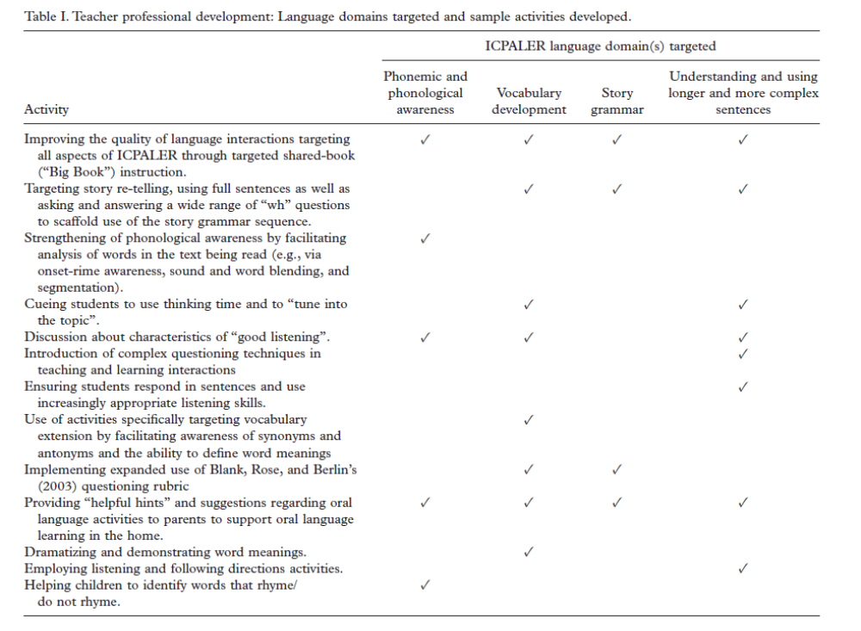

Slide 20

Continuing professional development-school age
Changes in teacher knowledge/behaviour not formally measured
Children in intervention schools show greater improvement in:
Omnibus test of language (vocabulary & grammar comp); narrative information scores
Effect sizes: .27-.42
Story grammar; number of T-units (amount of talk)

Slide 21
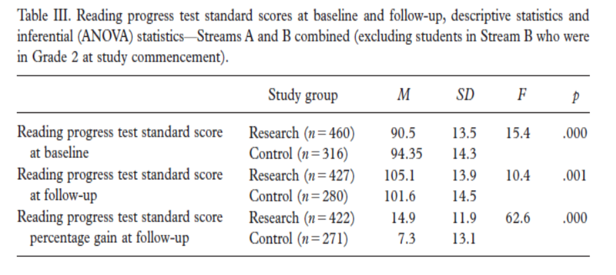
Continuing professional development-school age
Significant gains in reading standard scores
NOTE: children in the low average range – would we see similar gains for children with clinically significant language/reading disorders?
Follow-up over longer period required – do early gains lead to longer term learning advantages?
See study author Patricia Eadie discussing this programme:
https://www.youtube.com/watch?v=4gSjNbHxd5E&feature=youtu.be

Slide 22
Whole school/class delivery of specific language/Literacy interventions (Bleses et al. 2017)
Danish effectiveness trial (RCT) of a storybook intervention (SPELL)
20 weeks, 2x per week
6483 children (aged 3-6 years)
Child outcome measures:
  Vocabulary
  Narrative
  Print knowledge
  Phonological awareness
teaching as usual
SPELL
SPELL +
professional training
SPELL +
home-based programme

Slide 23
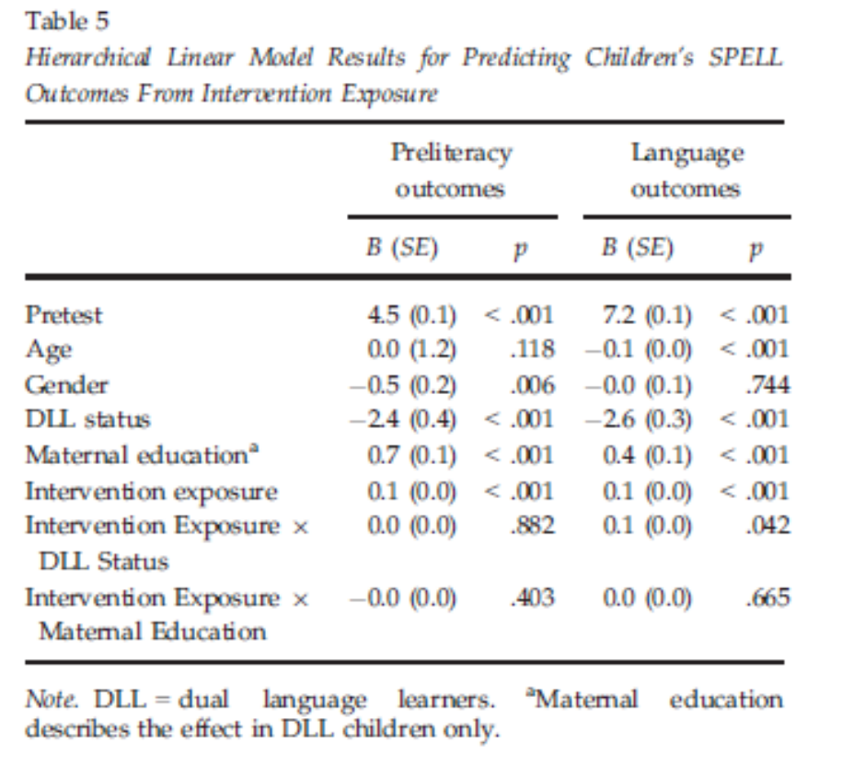
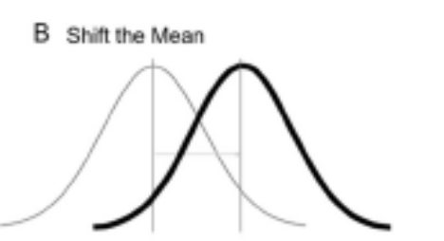
Predictors of intervention gain
Implementation fidelity was poor: 25/40 lessons delivered (on average)
  Efficacy versus effectiveness trials
BUT implementation matters – more exposures = better outcomes!
Children from disadvantaged backgrounds & dual language learners experience same degree of benefit

Slide 24
Enhanced early childhood education programmes – Do they have lasting effects?
Assumptions:
early intervention gains should be maintained over time
It is possible to change a developmental trajectory (i.e. normalise development)
Boosting early skills feeds learning of later skills
  E.g. extending vocabulary knowledge allows you to learn other words from context
Boosting early skills has ‘cascading’ effects on other aspects of development
  E.g. improvements in vocabulary will lead to better reading comprehension

Slide 25

Enhanced early childhood education programmes – Do they have lasting effects?
E.g. Head Start
Long-term, intensive pre-school programmes
Targeting children from disadvantaged backgrounds
Targeting multiple aspects of development
(reasonably) consistent evidence that they have immediate & positive impacts on school readiness
Conflicting evidence about longer term benefits
Abernavoli, R. (2020). Psychological Bulletin

Slide 26
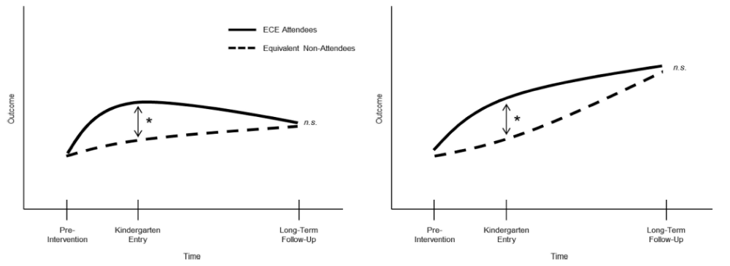
Enhanced early childhood education programmes – Do they have lasting effects?
need to adapt the intervention
need to consider post-intervention environments and align with treatment programme
Abernavoli, R. (2020). Psychological Bulletin

Slide 27
Long term positive impacts more likely when…
Skills are malleable
  IQ improvements fade;
  social-emotional improvements persist
Skills are fundamental for success
  Letter-sound knowledge has direct implications for reading
Skills would not develop without intervention
  vocabulary? – especially if curriculum focused, control group will have opportunities for learning

Slide 28
Other factors that explain variation in long term outcome…
Dosage has surprisingly little impact on treatment success
What happens after pre-school? General educational experiences (quality of provision, alignment of curriculum to pre-school experience) important for maintenance of treatment effects
Persistent impacts more likely in those with greater socio-demographic risk (source of resilience? Remember, very intensive!)
Impact of child-level factors more mixed (e.g. IQ, special educational needs)

Slide 29
“K–12 school experiences have unique effects on children’s development above and beyond the effects of ECE programs, and ECE programs alone cannot bear the burden of permanently altering children’s life chances”

Slide 30
Rigorous Large-Scale Educational RCTs are Often Uninformative:
Should We Be Concerned?
Effect sizes tend to be smaller if:
  Randomisation to treatment versus control
  Employ independent/ standardised test outcome measures
  Active control group (as opposed to ‘business as usual’)
  Intention to treat designs
  Large & heterogeneous populations
Precision
  How wide are the confidence intervals?
  Take a Bayesian approach to analysis in order to interpret null results
Analysed effect sizes and precision estimates for large-scale RCTs funded by Education Endowment Foundation (EEF-UK) & National Center for Education Evaluation (NCEE- USA)
All are rigorous trials
Informative trials give clear indication that intervention either works or it doesn’t (precision as important as effect size)

Slide 31
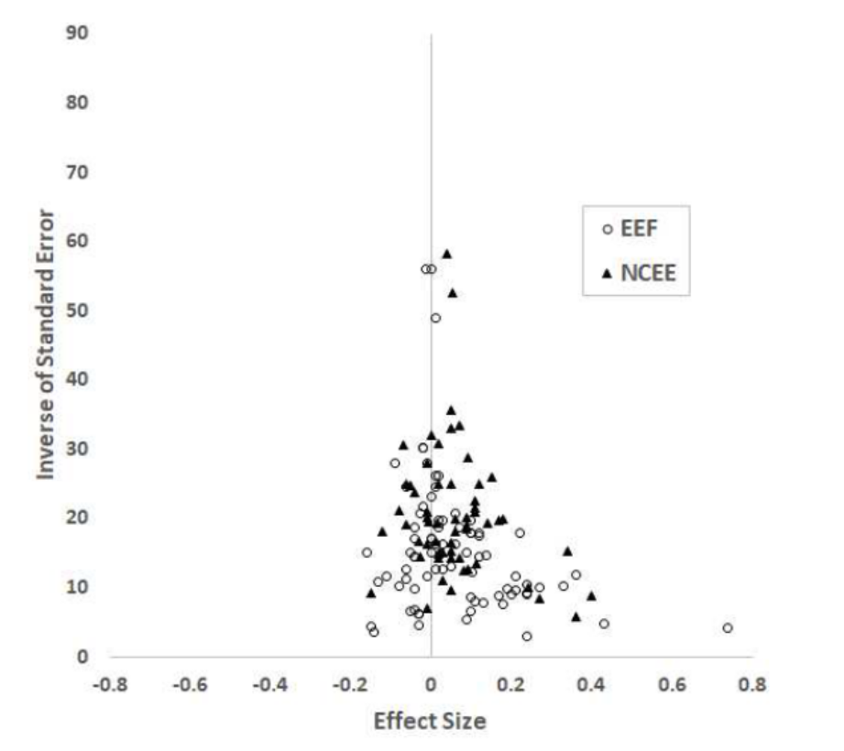
Rigorous Large-Scale Educational RCTs are Often Uninformative:
Should We Be Concerned?
141 independent trials with academic outcomes analysed (math or reading)
Average ES = .06! Width of confidence intervals = .30
Power of trials to detect ES was only 23%
Bayes analysis:
  40% of trials inconclusive
  38% definitely not effective
  22% evidence that intervention is effective

Slide 32
How can we increase informativeness of these trials?
Implementation issues
  Need to improve translational work from research contexts to actual classroom practice
  In reality – need to work with educators to co-device programmes that are feasible and meaningful to schools
Outcome measures
  Measure what you teach, not a distant downstream target
Heterogeneity in population
  Focus evaluation on high-risk groups, rather than whole school populations

Slide 33
What is logoped role in universal provision?
Very few studies measure impact of universal provisions specifically on children with clinically significant language disorders
  we just don’t know if these programmes:
    Reduce numbers of children with DLD
    Improve long-term outcomes for children with DLD
Successful programmes will require considerable involvement of education specialists
Some logopeds may take on a more ‘public health’ role
All of us can raise awareness of the importance of language for learning and social well-being, and the impact of DLD
BUT… short-term staff development/ delivery of language programmes should not be seen as a substitute for individualised therapy…

Slide 34
summary
Universal provision can have immediate, positive (but often small) impacts on language and other aspects of development (esp social-emotional well-being)
Brief episodes of professional development (PD) do NOT work
PD that includes coaching and integrated lesson planning more beneficial
Implementation matters and increased dosage associated with better outcome
BUT… these impacts have a tendency to fade over time
Most evidence for disadvantaged children, little direct evidence for children with DLD
Likely to shift the mean, not reduce the gap

Slide 35
implications
NO QUICK FIX!
Outcomes should focus on therapy content and children of interest (not whole class)
Likely need for booster intervention sessions over the longer term, and staff training of follow-on schools/provisions

Slide 36
References:
Abenavoli, D. (2020). The mechanisms and moderators of "fade-out": Towards understanding why the skills of early childhood program participants converge over time with the skills of other children. Psychological Bulletin, 145(12):1103-1127. DOI: 10.1037/bul0000212
Bleses D, Højen A, Justice LM, et al. The Effectiveness of a Large-Scale Language and Preliteracy Intervention: The SPELL Randomized Controlled Trial in Denmark. Child Dev. 2018;89(4):e342–e363. doi:10.1111/cdev.12859
Duff & Clarke (2011). Practitioner Review: Reading Disorders: What Are the Effective Interventions and How Should They Be Implemented and Evaluated? (Supplementary Material – Checklist) Journal of Child Psychology & Psychiatry, 52(1), pp.3-12. DOI: 10.1111/j.1469-7610.2010.02310.x
Ebbels, McCartney, Slonims, Dockrell, & Norbury (2019) Evidence-based pathways to intervention for children with language disorders, International Journal of Language & Communication Disorders, VOL. 54, NO. 1, 3–19. https://doi.org/10.1111/1460-6984.12387
Goldfeld S, Snow P, Eadie P, et al. Classroom Promotion of Oral Language (CPOL): protocol for a cluster randomised controlled trial of a school-based intervention to improve children's literacy outcomes at grade 3, oral language and mental health [published correction appears in BMJ Open. 2019 Feb 27;9(2):e016574corr1]. BMJ Open. 2017;7(11):e016574. Published 2017 Nov 20. doi:10.1136/bmjopen-2017-016574
Lortie-Forgues, H., & Inglis, M. (2019). Rigorous Large-Scale Educational RCTs Are Often Uninformative: Should We Be Concerned? Educational Researcher, 48(3), 158–166. https://doi.org/10.3102/0013189X19832850
Markussen-Brown, J., Juhl, C. B., Piasta, S. B., Bleses, D., Højen, A., & Justice, L. M. (2017). The effects of language- and literacy-focused professional development on early educators and children: A best-evidence meta-analysis. Early Childhood Research Quarterly, 38, 97–115. https://doi.org/10.1016/j.ecresq.2016.07.002

