Slide 1
Principles of assessment
Professor Courtenay Norbury
March 2020

Slide 2
Overview of this session
Review of Developmental Language Disorder
What to look for in a screening tool
BREAK (11-11.15)
Purposes of in-depth assessment
Case history information and red flags
Norm-referenced versus criterion referenced assessment
Other assessment methods (questionnaires, observation, language samples)

Slide 3
DLD: the story so far
Lecture 1: Introduction to Developmental Language Disorder
  Language characteristics: phonology, semantics/vocabulary, syntax, discourse/pragmatics
  Associated features: cognitive ability, academic underachievement, increased risk for social, emotional, behavioural challenges
  Biological basis: genetic influences on brain development, runs in families
Lecture 2: individual differences in language stability and growth
  Language improves in real terms
  Language (and language disorder) is stable – rate of growth is similar across spectrum of ability, so gaps remain throughout primary school
  Child non-verbal IQ, behaviour problems, and socio-economic disadvantage are associated with initial language scores, but do not associate with rate of language change

Slide 4
screening

Slide 5
Wilson & Junger (1968) (classic epidemiology text)
Screening of a whole population has the potential advantage if:
it can identify an individual whose difficulties might otherwise go undetected
by doing so improve long term outcomes for that individual.
However, any screening program must beware of over-identification of problems, which can lead to resources being diverted to cases that do not need them.

Slide 6
What to look for in a screening measure
Published, peer-reviewed evidence of screening tool accuracy, reliability and validity
  Sample size – need large samples to ensure enough people with condition of interest
  Lag time between screen and diagnostic test – for language esp need to know longer term predictive value

Slide 7
What to look for in a screening measure
Sensitivity: proportion of children with language disorder that will be identified by the screening test
Specificity: how many typically developing are correctly identified by the screen (ie. If specificity = .58, only 58% of typical kids are correctly identified, 42% of typical kids will be flagged as potential cases)
Area under the curve: overall ‘diagnostic accuracy’ of the test. AUC of .80 or better generally ‘acceptable’ but can yield large number of ‘false positives’
Positive predictive value: percentage of children who screen positive who actually have the disorder (takes into account the false positive rate)
Closer values are to ONE, the better the test!

Slide 8
Sensitivity/specificity of (common UK screening test): sensitivity of .88 and specificity of .58
Population base rate prevalence of ~10% (Norbury et al. 2016)
329 correctly identified
567
238 FALSE POSITIVES
630
55 correctly identified
63
8 missed
What will happen to those who screen positive?

Slide 9
US Preventative Services Task Force (Wallace et al., 2015; Siu et al. 2015)
“We found no evidence for the impact of screening on speech and language outcomes.”
In 23 studies evaluating the accuracy of screening tools, sensitivity ranged between 50% and 94% (median 81%), and specificity ranged between 45% and 96% (median 87%).
“The USPSTF concludes that the current evidence is insufficient to assess the balance of benefits and harms of screening for speech and language delay and disorders in children aged 5 years or younger”
  Applies to asymptomatic children aged 5 years or younger whose parents or clinicians do not have specific concerns about their speech, language, hearing, or development.

Slide 10
CATALISE consortium
(Bishop et al., 2016):
International, inter-disciplinary consortium of experts in language disorder (including SLTs, education, psychology, parent organisations)
“We recommend reliance on concerns expressed by those who know the child rather than universal screening…Although screening has been introduced in some places, there is concern that universal screening for language impairment is not advisable in toddlers, because early language delay often resolves and currently available tests lack adequate sensitivity and specificity for predicting longer-term problems.”

Slide 11
Is screening for older (school-aged) children more accurate?
Helland, W. A., Biringer, E. V. A., Helland, T., & Heimann, M. (2009). The usability of a Norwegian adaptation of the Children's Communication Checklist Second Edition (CCC‐2) in differentiating between language impaired and non‐language impaired 6‐to 12‐year‐olds. Scandinavian Journal of Psychology, 50(3), 287-292.
Klem M., Hagtvet B., Hulme C., Gustafsson JE. (2016). Screening for Language Delay: Growth Trajectories of Language Ability in Low- and High-Performing Children. Journal of Speech, Language, and Hearing Research, 59(5):1035-1045. doi: 10.1044/2016_JSLHR-L-15-0289.

Slide 12
Helland et al. (2009)
Children’s Communication Checklist-2 (Bishop, 2003)
Speech
Semantics
Grammar
Coherence
Initiation
Use of context
Non-verbal communication
Stereotyped language
Social Relationships
Interests
c
c
General Communication Composite:
Sum of scaled scores (each with mean of 10 and SD of 3)
Cut-off of 64 or below = 10th centile

Slide 13
Helland et al. (2009)
153 participants aged 6-12 years (included children with co-occurring conditions)
  45 LD (referred for evaluation and judged by psychology/logoped to have language impairment)
  108 TD (no reported communication issues, parents/teachers)
Sensitivity = .86 (86% of LD correctly identified)
Specificity = .91 (91% of TD correctly identified)
PPV not reported
NOTE: diagnostic classification occurred before the screen; teacher ratings not available for the TD children
Parent-teacher agreement ranged from .44 to .76

Slide 14
Taking base rates into account
Your school has 1000 children aged 6-12 years on role. Assuming a prevalence rate of 10%, and sensitivity of .86 / specificity of .91:
How many children with language disorder will be identified?
How many false-positives will there be?
How many children with language disorder will be missed?

Slide 15
Klem et al. (2015)
Longer term predictive value of LANGUAGE4 – universal health screening for language delay administered to all 4-year-olds in Norway
Klem et al. use a statistical technique that takes account of measurement error
  Stability of a latent language construct
  Latent growth trajectories
Screened 600 4-year-olds
Tested ~200 children at three later timepoints

Slide 16
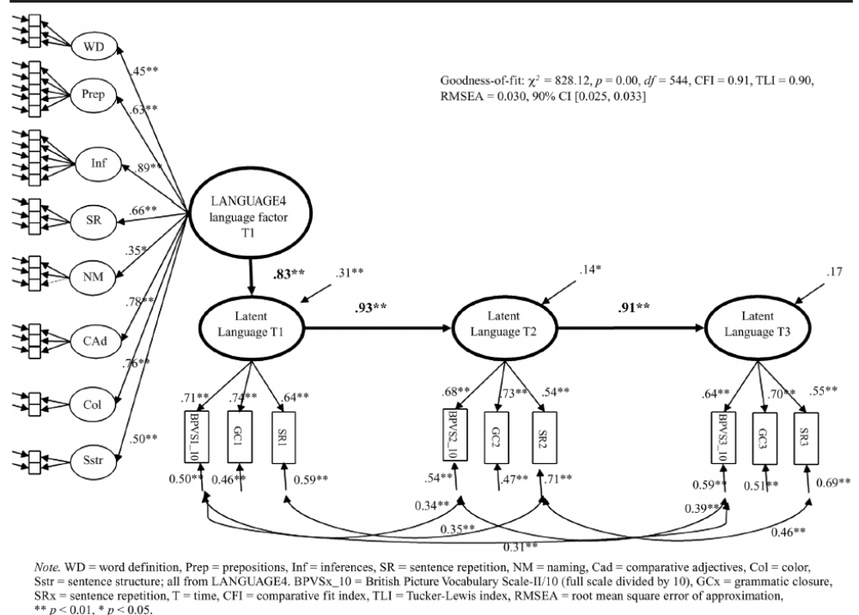
Low performing group (~bottom 10%) showing same rate of language growth as the rest of the group
Language gap remains constant between 4 and 6 years (same as SCALES!)

Slide 17
Wilson & Jungner (1968) (classic epidemiology text)
Screening of a whole population has the potential advantage if:
it can identify an individual whose difficulties might otherwise go undetected
by doing so improve long term outcomes for that individual.
NOTE: even the best current screening tests will identify many more ‘false-positives’ than true cases (especially in the under-fours).

Slide 18

Does screening (at 2) lead to better outcomes for children?
Melissa Wake, Sheena Reilly & colleagues, Murdoch Research Institute, Melbourne
Population health perspective: population screen, low-intensity, parent intervention
RCT of late-talkers taking part in population survey of early language development
  Wake, M. et al. (2011). BMJ.

Slide 19
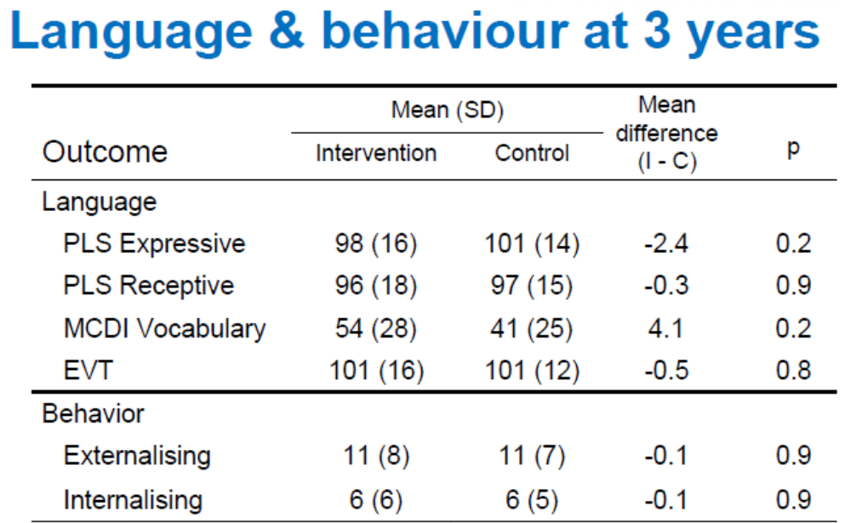
Children have moved from bottom 20th centile to average range – even those in control group who did not receive any additional treatment!
Caveats:
Relatively middle-class sample, limited prior parental concern…

Slide 20
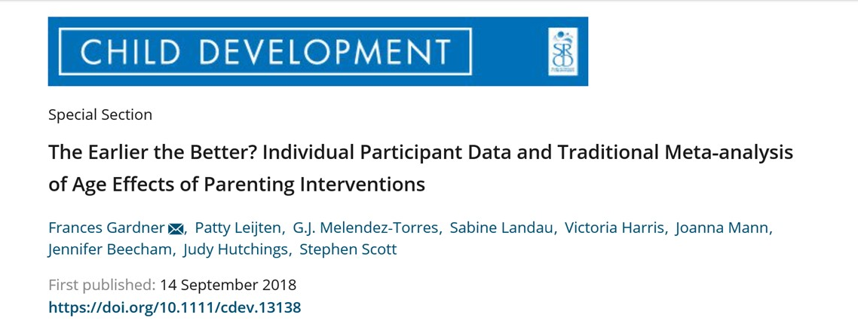
Incredible Years – parenting intervention to reduce challenging behaviour
Looked at effects of intervention delivered between ages 2-11 (n = 1696)
Similar effect size regardless of age (potentially further sensitive periods around adolescence)
Note 1: language *may* behave differently, but we do not have the evidence!
Note 2: long-term follow-up of language interventions (rare) but tend to show ‘fade-out’ of initial treatment effects

Slide 21
Longer term follow-up of similar programmes
Scott, Briskman, and O’Connor (2014):
Reduced risk of anti-social behaviour in late adolescence in clinically referred samples, but “no comparable effects” for children initially identified from screening as potentially at risk.
Level of parent engagement in intervention programme may well vary depending of level of parent concern – those that self-refer may be more engaged in intervention process

Slide 22
When screening works…

Slide 23
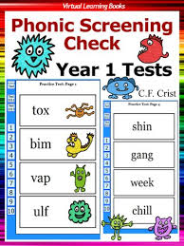
Universal phonics check-uk
Introduced in 2012
Associated with changes in education practice and improving performance in phonics and early reading
No evidence for decreasing rates of dyslexia
Teacher training involves explicit instruction in how to teach phonics
Schools have literacy co-ordinators and daily literacy instruction
Children who ‘fail’ the screening do not require further diagnostic testing – they receive additional small group instruction
In-line with usual school business

Slide 24
Take home messages
At present, screening for language delay can be challenging:
  Screening tools are not sufficiently accurate or predictive
  High number of false-positives is costly – to services and to children and families
  Few high-quality trials evaluating whether screening improves outcomes for children with DLD
Screening at school entry has better long-term predictive value
  But measurement error may still yield high number of false-positives
If screening, plan approach for those who screen positive:
  Referral for in-depth assessment?
  Specialist teaching programme?
  Monitor progress?

Slide 25
Additional references:
Gardner, F. et al. (2018) The Earlier the Better? Individual Participant Data and Traditional Meta‐analysis of Age Effects of Parenting Interventions. Child Development. . doi:10.1111/cdev.13138
Maughan, B. and Barker, E. D. (2018), The Earlier the Better? Pausing for Thought …. Child Development. . doi:10.1111/cdev.13168
McCartney et al. (2019) Why ‘case finding’ is bad science. Journal of the Royal Society of Medicine. Doi: 10.1177/0141076819891422
Scott, S., Briskman, J. & O’Connor, TG (2014) Early prevention of antisocial personality: long-term follow-up of two RCTs comparing indicated and selective approaches. American Journal of Psychiatry, 171, 649-657. https://doi.org/10.1176/appi.ajp.2014.13050697
Siu AL (2015) Screening for speech and language delay and disorders in children aged 5 years or younger: US Preventive Services Task Force recommendation statement. Pediatrics 136: e474. doi: 10.1542/peds.2015-1711 PMID: 26152670
Wallace, IF et al. (2015) Screening for speech and language delay in children 5 years old and younger: a systematic review. Pediatrics, 136: doi: 10.1542/peds.2014-3889
Wilson JMG, Jungner G (1968) Principles and practice of screening for disease. Geneva: World Health Organisation.

Slide 26
BREAK!

Slide 27
Purposes of In-depth assessment
Diagnostic assessment
Establishing baseline performance
Planning an education or therapy plan
Measuring progress or change after specialist input

Slide 28

Diagnostic assessment
Trained clinician(s)
Standardised measures
Differential diagnosis

Slide 29
Diagnostic assessment
May involve these people:
  Family members
  Teacher
  Logoped
  Audiologist
  Educational psychologist
  Clinical psychologist/psychiatrist
  Paediatrician
  Neurologist/geneticist
  Occupational/physio therapist
May involve these components:
  Observation
  Case history/interview
  Standardised language assessment
  Questionnaires from caregivers, teachers, child
  Language sample
  Measure of functional impact

Slide 30
(Developmental) Language Disorder – DSM5 (APA 2013)
child’s language abilities are below chronological age expectations
language deficits are not explained by other developmental concerns such as sensory impairment, autism, extreme deprivation, head injury, global developmental delay
language impairments interfere with everyday life at home or at school

Slide 31


Slide 32

Case history
What are caregivers most concerned about?
How does the child communicate?
Presence of ‘red flags’
What should happen next?
Family history
Socio-economic disadvantage
Behaviour problems
Poor language comprehension
Reported language regression
Global developmental delay
Lack of gesture
Poor social engagement

Slide 33
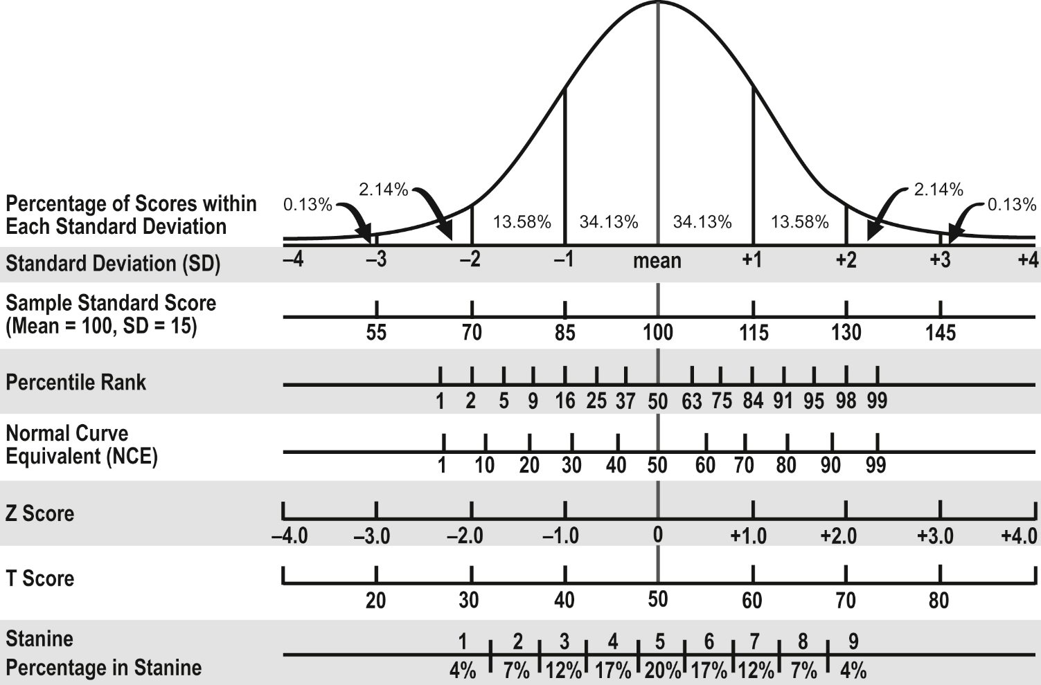
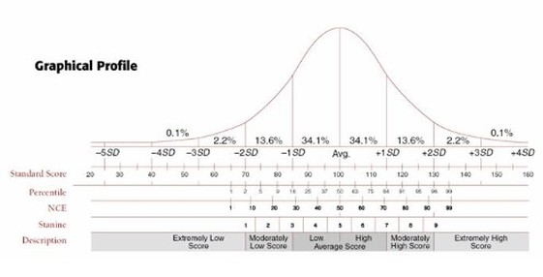
Standardised assessment
Standardised tests allow you to gauge child’s abilities relative to other children of the same age

Slide 34
Standardised assessment – things to check
Appropriate age range?
Are instructions for administration and scoring clear and easy to follow?
Numbers of children contributing to the standardisation
Is your population similar to the standardisation sample? (e.g. dual language learners)
Sensitivity and specificity of the measure
Reliability:
  Test-retest: does the test give you the same score on repeated administration?
  Inter-rater reliability: do different respondents give you the same answers? (Note: teachers and parents often do not agree!)
Validity:
  Is it theoretically sensible to measure the construct of interest in this way?
  Do items on the test ‘hang-together’?

Slide 35
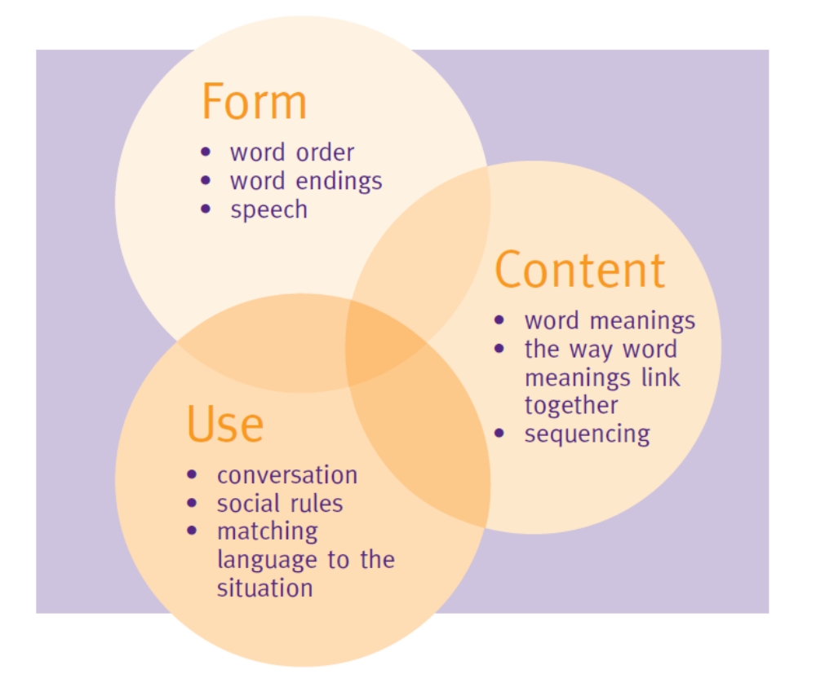
ITPA - Illinois Test of Psycholinguistic Abilities
Språk 6-16
Test for Reception of Grammar
The Norwegian Communicative Development Inventories
Children’s Communication Checklist-2
British Picture Vocabulary Scale II
Narrative assessment??
Assessment of inferencing or figurative language??
Children with depressed scores across a range of measures have poorer prognosis than those with ‘spiky’ profiles (see CATALISE evidence; Bishop et al. 2016)

Slide 36
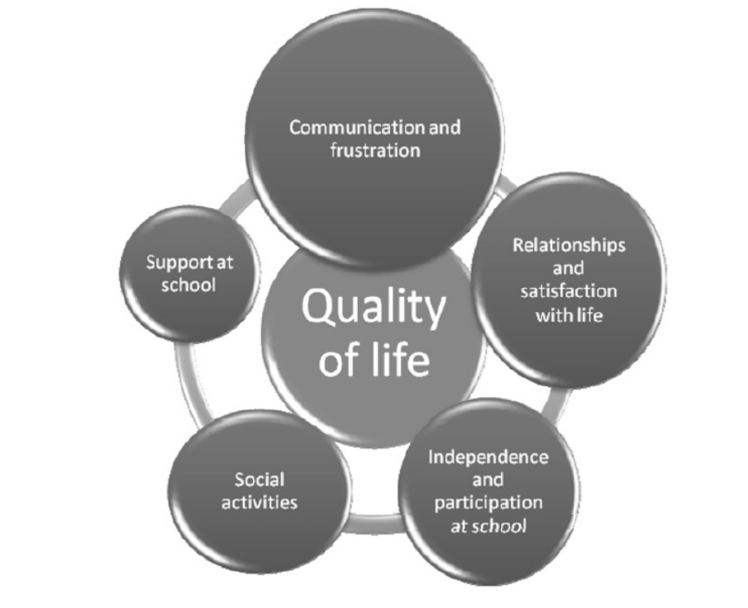
Assessing functional impairment
Academic attainment (Norbury et al. 2015, JCPP)
Quality of life (Eadie et al. 2018, IJLCD)
Social, emotional and behavioural development (both Norbury & Eadie report on this!)
Markham , Van Laar & Dean (2011) Development of a quality of life measure for children and young people with speech, language, and communication needs, Evidence-Based Communication Assessment and Intervention, 5:4, 216-225, DOI: 10.1080/17489539.2012.688342

Slide 37
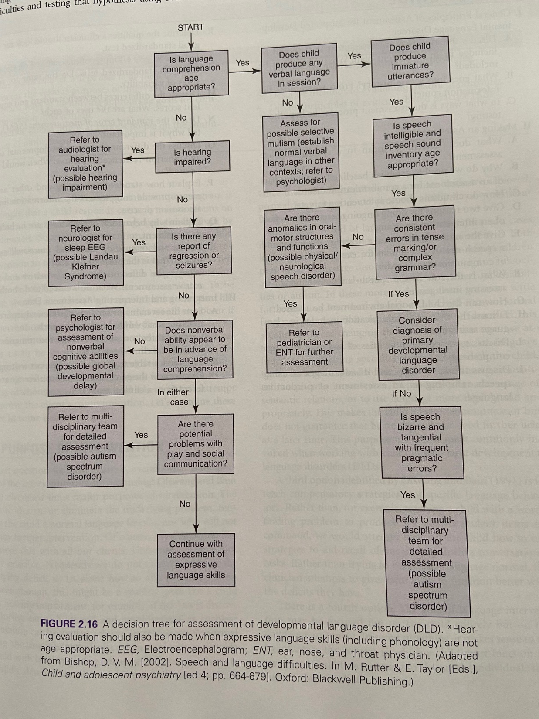

Slide 38
Summarising the diagnostic assessment process
Report should provide:
  Summary of child’s strengths and challenges
  Your ‘best-estimate’ diagnosis and why you have come to that decision
  Indication of functional impact and likely adjustments that might need to be made
  Prognosis – for younger children, important to emphasize that the picture may change; for older children, important to emphasize that there will be improvement, but likely continued need for support – the nature of support may change as needs change as children grow into adults
  Immediate intervention needs and targets (agreed with parents) and how these will be met
  When the child should be reviewed

Slide 39
Establishing a baseline
Teachers and/or therapists
Criterion referenced measures
Developmentally sequenced
Usually tied to specific curriculum or therapy content

Slide 40
Area of grammar | Sentence constituent | Structure | NC year | Example from ACE (in italics if no example in ACE)
Syntax | (Subject) Noun Phrase | Proper Noun | by yr 1 | Sam
 |  | Pron | by yr1 | He talked and talked
 |  | Det+N | by yr1 | A monkey was hanging upside down
 |  | Poss+N | Yr4 | put some pineapple in his beak
 |  | Det+Adj+N | Yr2 | She found a big juicy pineapple
 | Adjective phrase | Adj | by yr 1 | the monkey was so cross
 | Verb phrase | Verb | by yr 1 | he talked
 |  | Verb + NP | by yr 1 | she picked it
 |  | Verb + PP | by yr 1 | A parrot flew onto a branch
 |  | Verb+NP+PP | by yr 1 | She led the parrot along the branch
 |  | Verb+AP | by yr 1 | he monkey was becoming tired
 |  | Verb+NP+NP | by yr 1 | bring me some treasures
 |  | Verb+comp clause | yr2 | she didn't really know what he meant by treasure
 | Adverbials | Place | by 2 | in the sunlight
 |  | Time | yr3 | just then
 |  | Manner (adverb) | yr2 | peacefully
 |  | Subordinate clauses | yr2/3 | She was becoming tired when she reached a village
 |  | Fronted adverbials | yr4 | If you bring me some treasures from the forest, I might leave

Slide 41
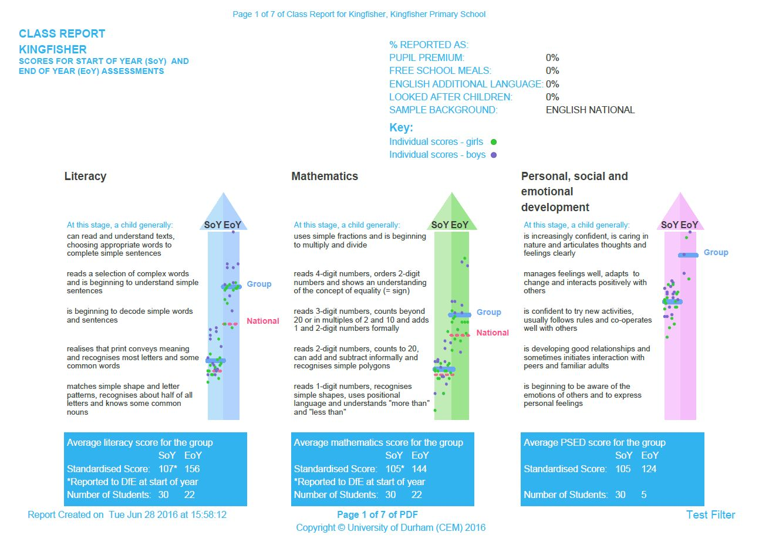

Slide 42
Purposes of In-depth assessment
Planning an education or therapy plan
Measuring progress or change after specialist input
Criterion-referenced measures that are curriculum relevant
Enough examples to demonstrate improvement over time
Think about what constitutes ‘mastery’
Think about generalisation
  Use the newly learned skill in multiple contexts
  Use newly learned structures with untrained exemplars

Slide 43
Should you use standardised tests to evaluate intervention?
CHALLENGES:
  Show child’s rank order in a distribution – can show substantial change in real terms, but still be near the bottom of the distribution! (in which case, the standard score may be unchanged)
  Often measure multiple aspects of language, and may not be close to what was targeted in the intervention – transfer effects are rare!
  Norms are based on cross-sectional data, so difficult to know how much change would be expected naturally between testing periods
You are likely to see more change on criterion-referenced tests that are more aligned to intervention activities and targets
Schmitt MB, Logan JA, Tambyraja SR, Farquharson K, Justice LM. Establishing Language Benchmarks for Children With Typically Developing Language and Children With Language Impairment. J Speech Lang Hear Res. 2017;60(2):364–378. doi:10.1044/2016_JSLHR-L-15-0273

Slide 44
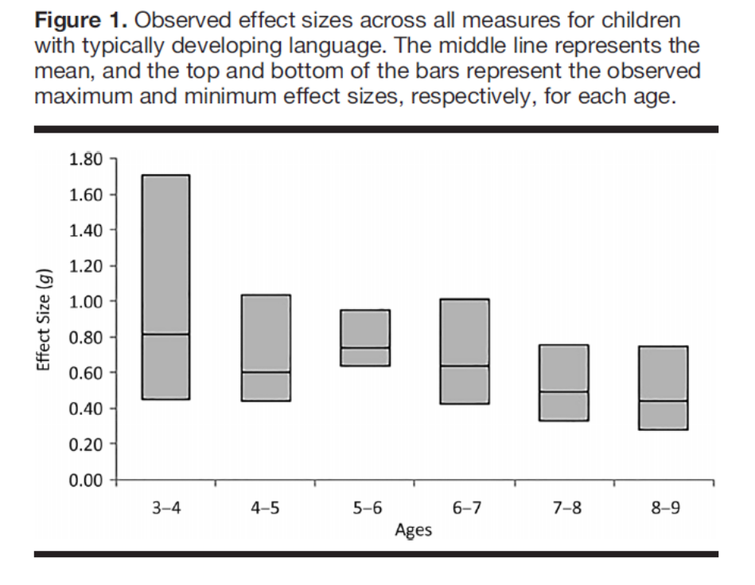
Using Effect sizes to measure language growth
Effect size: the difference between two means in standard deviation units
Effect-size benchmark: the amount of expected change (in standard deviation units) a child might make in a single year
Pooled data from eight standardised language tests
Can then determine if observed change is greater than expected change
(but actually growth similar in TD and LD groups…)
Schmitt MB, Logan JA, Tambyraja SR, Farquharson K, Justice LM. Establishing Language Benchmarks for Children With Typically Developing Language and Children With Language Impairment. J Speech Lang Hear Res. 2017;60(2):364–378. doi:10.1044/2016_JSLHR-L-15-0273

Slide 45
Case study 1: Freya
Freya is 7 years old and her parents are concerned that she is behind at school (particularly with reading) and is often in trouble because she doesn’t seem to follow instructions. Dad says he too had problems with reading when he was younger. Freya doesn’t say much spontaneously during the assessment, but does attend to the activities, makes eye contact with the clinician and her parents and smiles appropriately when praised.
Scores are standard scores – what does this mean in terms of percentile?

Slide 46
For Freya
How would you describe this pattern of results to Freya’s parents/teachers?
What is your prognosis?
What else would you want to know about Freya and from whom?
What might your intervention targets be? Why?

Slide 47
Case study 2: Jonas
Jonas is 4 years old. His parents have brought him for assessment because he scored in the bottom 8th centile on the LANGUAGE4 screen. They are surprised by this as they report that he is very friendly and talks lots. He goes to nursery everyday and though he is reported to be very active and not too interested in books and stories, he has friends and likes talking to the teachers about his toys and favourite cartoon characters. His parents are both working and though they did not go to university, they did not have any language or literacy problems when they were younger. During his visit he is able to follow simple directions, brings new toys to show his parents and the clinician, and can tell a reasonably coherent story about what he did when he was on holiday. On the CELF-4 he obtains a standard score of 88.

Slide 48
For Jonas
How would you describe this pattern of results to Jonas’ parents/teachers?
What is your prognosis?
What else would you want to know about Jonas?
What will you do next? Why?

Slide 49
summary
Assessment serves a variety of purposes
Choose your assessments wisely – look for sensitivity/specificity and estimates of reliability and validity
Combine standardised tools with observation, case history and measures of functional impact
Use criterion-referenced measures for curriculum bench-marking and setting intervention goals
Effect sizes can be used to establish expected rate of language growth against which we can measure child progress

Slide 50
Additional references:
Horn, E., & Dalin, A. (2008). SPRÅK 4: Brukerveiledning [LANGUAGE4: User’s manual] (Revised ed.). Bergen, Norway: Designtrykkeriet.
Kirk, S. A., McCarthy, J. D., & Kirk, W. D. (1968). Illinois Test of Psycholinguistic Abilities.Norwegian version by Gjessing, H. J., & Nygaard, H. D., 1975:
https://eur01.safelinks.protection.outlook.com/?url=https%3A%2F%2Fwww.uv.uio.no%2Fisp%2Fom%2Foslo-assessment-intervention-and-learning-lab-o-aill%2Ftester%2Fsprakutvikling%2Fitpa.pdf&amp;data=02%7C01%7C%7Cfda44a4bdb2846d2e73b08d7bb750082%7C1faf88fea9984c5b93c9210a11d9a5c2%7C0%7C1%7C637183983498743908&amp;sdata=YHKZlbPvMeb%2BFsb9XfYrpKKDg%2BQQkpk0DjKnoX2I6Xg%3D&amp;reserved=0
Lyster, S.-A. H., Horn, E., & Rygvold, A.-L. (2010). Ordforråd og ordforrådsutvikling hos norske barn og unge. Resultater frautprøvingen av British Picture Vocabulary Scale II, second edition (BPVS-II). [Vocabulary and vocabulary development among Norwegian children and youth. Results from the trial of the British Picture Vocabulary Scale II, second edition]. Spesialpedagogikk, (09), 35–43.
Ottem, E., & Frost, J. (2007). Språk 6-16; Screening-test Manual II. Nye normer til bruk i forskning og utredning (New norms for use in research and clinical assessments). Skolepsykologi, 4, 13-23.
Norwegian website for Språk 6-16:
https://eur01.safelinks.protection.outlook.com/?url=https%3A%2F%2Fwww.statped.no%2Flaringsressurs%2Fsprak-og-tale%2FSprak-6-16-screeningtest-av-sprakvansker-for-barn%2F&amp;data=02%7C01%7C%7Cfda44a4bdb2846d2e73b08d7bb750082%7C1faf88fea9984c5b93c9210a11d9a5c2%7C0%7C1%7C637183983498743908&amp;sdata=fwTtRVHcqXwFX6gxlcvverD7BJkLLizQk4ez9lJA2ik%3D&amp;reserved=0
Simonsen, H. G., Kristoffersen, K. E., Bleses, D., Wehberg, S., & Jørgensen, R. N. (2014). The Norwegian Communicative Development Inventories: Reliability, main developmental trends and gender differences. First Language, 34(1), 3-23.

Slide 51
What is level of attention/activity?
Does child initiate interactions with parents? With clinician?
Does child explore environment?
Roughly, what is child’s level of expressive language?
What is play like?
What happens if the child needs help?
Does child respond to name when called?
Is speech intelligible?
Does the child share information for interest?
Can the child follow simple instructions?
Does the child use non-verbal communication appropriately?
Does the child ask questions?
Any physical concerns?

