Slide 1
Econ4921:
Institutions and Economic Systems
Jon Fiva, 2009

Slide 2
Institutions defined
Douglas North:
  ”Institutions are the humanly devised constraints that structure human interaction. They are made up of formal constraints1, informal constraints2 and their enforcement characteristics. Together they define the incentive structure of societies and specificially economies”.
      1) rules, laws, constitutions
      2) norms of behavior, conventions
… or simply ’the rules of the game’

Slide 3
Institutions defined cont.
Examples
  Economic institutions
    Contracts that can be written and enforced
    Presence and perfection of market
  Political institutions
    Form of government
    Extent of checks and balances
    Bureaucracy
    Federalism

Slide 4
Institutions defined cont.
Examples
  Economic institutions
    Contracts that can be written and enforced
    Presence and perfection of market
  Political institutions
    Form of government
    Extent of checks and balances
    Bureaucracy
    Federalism
Economic institutions shape the incentives of economic actors
Political institutions shape the incentives of political actors
Key difference from policies: durability

Slide 5
Institutions defined cont.
  If institutions are the rules of the game, then organizations and their entrepreneurs are the players.
  Organizations are made up of groups of individuals, bound together by some common purpose to achieve certain objectives.
    E.g. political parties, firms, unions…

Slide 6
Economic System
The organizations that come into existence will depend on opportunities provided by the institutions.
But choice of institutions will also depend on the political power of existing organizations.
Interaction between institutions and organizations shape the economic system.
  E.g. Capitalism is an economic system where the predominant form of economic organization is a firm with the intention of making profits.

Slide 7
Course content
The lectures will be built around the question:
    How do different institutions and organizations work?
Topics:
  Institutions and Economic Performance
  The Firm
  Organized Interest and Ownership
  Complementarity of Institutions
  Institutions and Commitment
  Bureaucracy
  Fiscal Federalism
  System Competition

Slide 8
Course content cont.
The course introduces students to theories for how various institutional arrangements work, with an emphasis on economic and political institutions.
The course also deals with questions like:
  Why do particular institutions come into existence?
  How may certain institutions complement each other?
  How are economic systems affected by competitive forces?

Slide 9
Do institutions matter?

Slide 10
Natural Experiments: Korea
Korea gained independence from Japan in August 1945
  Soviet entered N.Korea: Socialism, abolishing private property of land and capital.
  US supported S.Korea: Markets and private incentives.
Completely different sets of institutions, but same geography/history/culture.
Divergent paths of economic development.

Slide 11
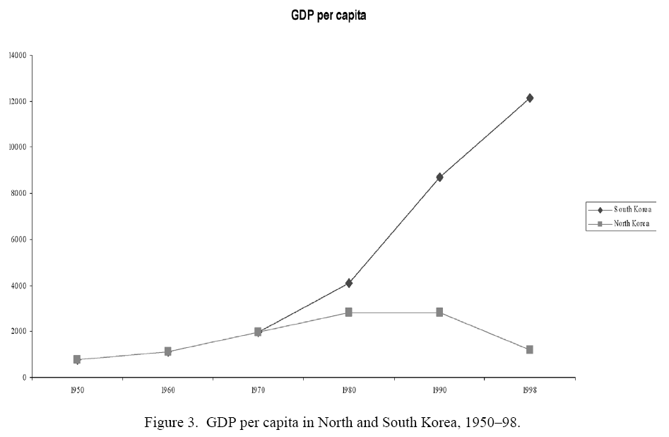
From AJR05. Handbook of Econ.Growth

Slide 12
Natural Experiments: Germany
Another example is West vs East Germany
  One part stagnated under central planning and collective ownership
  The other prospered with private property and market economy.
Illustrate that institutions, not for the benefit of society as a whole, may be kept in place if the ruling elite benefit from them.

Slide 13
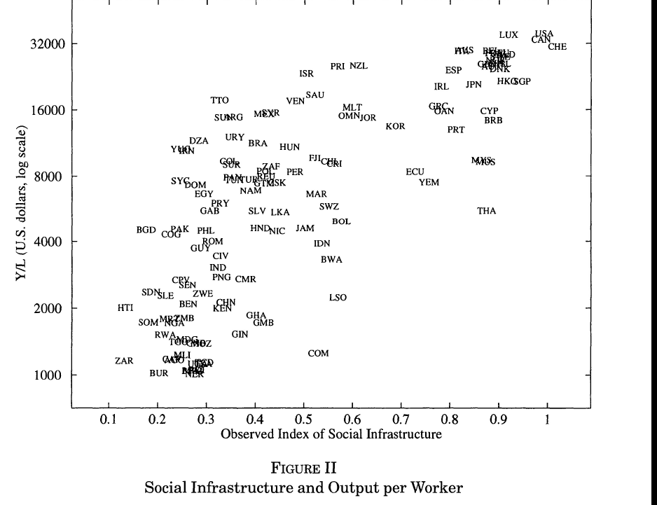
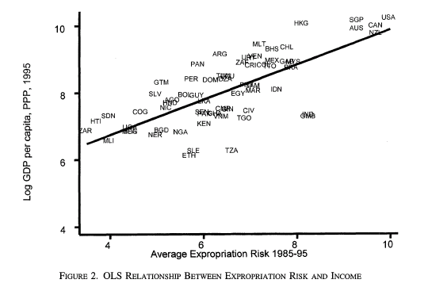
Cross country correlations
Strong positive association between certain institutions and economic performance.
    (FROM AJR) (FROM HJ)

Slide 14
The identification problem
But this hardly demonstrates a causal effect of institutions on economic performance.
  The kind of question we are interested in answering is:
    ”… if the UK were to switch its electoral rule from majoritarian to proportional, how would this affect the size of its welfare state or its budget deficitis?” (PT)
    ”If Argentina were to abondon its presidential regime in favor of a parliamentary form of government, would this facilitate the adoption of sound policy towards economic development?” (PT).
    How would changing institutions in Nigeria to those of Chile affect economic performance? (AJR)
    How would incresing the ’social infrastructure’ of Zaire to that of Switzerland affect productivity? (HJ)
    How did the introduction of universal suffrage affect redistribution levels in western Europe? (AR)
Hard questions to answer empirically. Why?

Slide 15
The identification problem
But this hardly demonstrates a causal effect of institutions on economic performance.
  The kind of question we are interested in answering is:
    ”… if the UK were to switch its electoral rule from majoritarian to proportional, how would this affect the size of its welfare state or its budget deficitis?” (PT)
    ”If Argentina were to abondon its presidential regime in favor of a parliamentary form of government, would this facilitate the adoption of sound policy towards economic development?” (PT).
    How would changing institutions in Nigeria to those of Chile affect economic performance? (AJR)
    How would incresing the ’social infrastructure’ of Zaire to that of Switzerland affect productivity? (HJ)
    How did the introduction of universal suffrage affect redistribution levels in western Europe? (AR)
Hard questions to answer empirically. Why?
Institutions are endogenous to economic performance.
  Causality runs both ways
    E.g. poor countries lack the resources to build effective institutions
  Omitted variable bias
    Underlying conditions (e.g. geography) that lead to institutions and economic performance.
Fundamental problem: cannot observe the counterfactual

Slide 16
The identification problem cont.
What we can learn from correlations and OLS regressions is limited.
Acemoglu (2005, JEL) makes this argument forcefully in a review of Persson and Tabellini (2003).

Slide 17
Endogeneity
Agents understand that different policies will map into different outcomes
  Policy endogeneity
      ”If state policy making is purposeful action, responsive to economic and political conditions within the state, then it may be necessary to identify and control for the forces that lead policies to change if one wishes to obtain unbiased estimates of a policy’s incidence” (Besley and Case 2000,EJ)
Agents understand that different institutions will map into different policies and outcomes.
  Endogeneity of institutions

Slide 18
Endogeneity cont.
Large literature treat institutions as exogenous (e.g. institutions are ’predetermined’ or ’given by history’)
However, the same factors that make policies unappealing to treat as exogenous is relevant for institutions.
  E.g. The introduction of democracy was not ’random’
Important contributions that try to deal with this problem includes Hall and Jones (1999), La Porta et al. (1998), Acemoglu, Johnson and Robinson (2001), Persson and Tabellini (2003), Acemoglu and Johnson (2005).

Slide 19
Proximate vs fundamental causes
Vast differences in prosperity across countries
  Output per worker 32 times higher in top five countries relative to to bottom five countries (HJ).
What can explain this difference?
    1) Physical capital differences
      Poor countries don’t save enough
    2) Human capital differences
      Poor countries don’t invest enough in education
    3) ’Technology’ differences
      Poor countries don’t invest enough in R&D and technology adaption, and fail to organize production efficiently
HJ find that conventional economic explanations (1-2) explain little of differences in output per worker (about 1/8 of actual differences)
1 – 3 are however proximate causes of differences in prosperity.
What are the fundamental causes?

Slide 20
Geography
Jared Diamond
  Proximate causes: guns, germs and steel
  Fundamental causes: geography
    Availability of crops and animals
    Axes of communication across continents
  Geographical differences have determined the timing and nature of settled agriculture. This have shaped societies ability to develop complex societies.
Similar arguments offered by e.g.
  Myrdal (1968): “serious study of the problems of underdevelopment . . . should take into account the climate and its impacts on soil, vegetation, animals, humans and physical assets – in short, on living conditions in economic development.”
  For further discussion see AJR05 (Handbook of Econ. Growth).

Slide 21
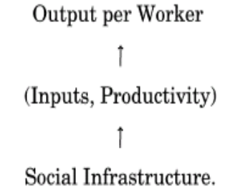
Institutions
Hall and Jones (HJ) argue:
”By social infrastrcture we mean the institutions and government policies that provide the incentives for individuals and firms in an economy”.
  The incentives can encourage productive or predatory behavior…
HJ suggested that origins of good institutions are (partly) driven by western European influence.
“Western Europe discovered the ideas of Adam Smith, the importance of property rights, and the system of checks and balances in government, and the countries that were strongly influenced by Western Europe were, other things equal, more likely to adopt favourable infrastructure”

Slide 22
Institutions
HJ use proximity to Europe as instruments for quality of institutions.
  Distance from equator (latitude)
  The extent of european languages spoken today in these countries.
These instruments are not entirely convincing. Why not?
We focus on the work of Acemoglu, Johnson and Robinson (next week).

Slide 23
Further reading
Acemoglu's review essay of PT: http://www.atypon-link.com/doi/abs/10.1257/002205105775362069
P&T's book: http://mitpress.mit.edu/catalog/item/default.asp?ttype=2&tid=9930
Besley and Case00: http://www.blackwell-synergy.com/doi/pdf/10.1111/1468-0297.00578
Jared Diamonds book 'Guns, germs and steel‘: http://www.amazon.com/Guns-Germs-Steel-Fates-Societies/dp/0393317552
AJR “Institutions as the fundamental cause of long run growth” Handbook of Economic Growth. http://dx.doi.org/10.1016/S1574-0684(05)01006-3
Links to Hall and Jones, Acemoglu, Johnson and Robinson, Acemoglu and Johnson are on the reading list

