Slide 1
Development Economics
ECON 4915
Lecture 7
Andreas Kotsadam

Slide 2
Outline
Typical exam questions and a recap.
Gender and development economics
    Overview (Duflo 2012) WDR (2012).
    The economics of gendercide (WDR 2012 and Qian 2008).

Slide 3
Typical exam question
3a) Banarjee and Duflo (2010) define microcredit as innovations that lower the administrative cost of making small loans. Describe these innovations and discuss their advantages and disadvantages (10 points).

Slide 4
Innovations
Dynamic incentives.
Group liability.
Repayment frequency and social interactions.
Simplified collection technology.

Slide 5
Typical exam question
3b) Evidence from behavioral economics suggests that people are not always rational. Discuss microcredit with reference to problems of temptation and self-control (5 points).

Slide 6
Gender and development
An active research area in economics, partly due to the way the world looks like:
    6 million women a year go missing.
    Labor market opportunities.
    Political representation.
    Legal rights.

Slide 7


Slide 8
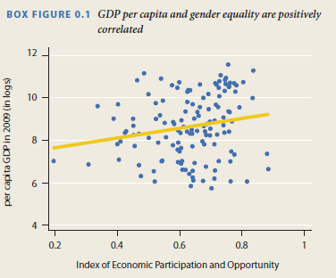

Slide 9
Duflo 2012
How is women’s empowerment related with economic development?
Gender inequality is often greater among the poor, both within and across countries.
Ok, fine, but we also want to know:
    Does development cause empowerment?
    Does empowerment cause development?
    If both are true and/or there are other factors affecting both a virtious cycle could be started.

Slide 10
    Does development cause empowerment?
Common arguments:
    Reduces discrimination.
    Frees up women’s time.
    Changes expectations.
    Technological changes (maternal health, washing machines etc.).

Slide 11
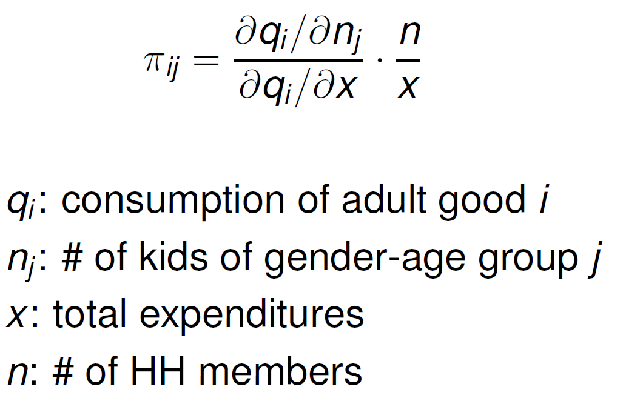
Discrimination in everyday life
Deaton compares π –ratios for boys and girls:

Slide 12
Discrimination under extreme circumstances
Girls are treated differently when ill, e.g. more than twice as likely to die of diarrhea in India.
The excessive mortality rate of girls, relative to boys, spikes during droughts.
When the harvest is bad, due to droughts or floods, and food is scarce, the murder of “witches” is twice as likely to occur as in normal years in rural Tanzania.

Slide 13
Policy implications
General interventions to reduce poverty may help women more.
Access to health services (health insurance or free medical care).
Weather insurance and credit.

Slide 14
Rose (1999) makes these points clear
In India, the excessive mortality rate of girls, relative to boys, spikes during droughts.
Households that can buffer their consumption in a bad year do not show a dramatic increase in relative mortality of girls during droughts.

Slide 15
Summary of general development
Economic development reduces inequality by relaxing the constraints poor households face, thus reducing the frequency at which they are placed in the position to make life or death choices.
By reducing the vulnerability of poor households to risk, economic development, even without specifically targeting women, disproportionately improves their well-being.

Slide 16
Expanding women’s opportunities
Parents have lower aspirations for their daughters than for their sons due to women’s fewer opportunities.
Jensen (2012) did an experiment in India where young women’s increased employment increased schooling and weight of girls.

Slide 17
Maternal mortality also affects expectations
Maternal mortality is also a source of lower parental investment.
Since girls are more likely to die young, parents may choose to invest more in boys.
Reduction in MMR in Sri Lanka led to convergence in education levels.

Slide 18
But economic growth is not enough
Sex ratios in China worsened despite growth.
Women earn less than men in all countries.
Legal rights are still worse for women and does not seem to follow economic development.
Huge gender gap in political participation and power.

Slide 19
Other crucial aspects
Implicit biases (See lecture 8).
Stereotype threats.
Attitudes toward risk and competition.
Informal care.
Rigid power structures.

Slide 20
    Does empowerment cause development?
Common arguments:
    Effects of female education.
    Effects of female decision making in the hh. (Unitary vs. Collective models, see Qian).
    Productivity effects in agriculture. (Unitary vs. Collective models, see Qian).
    Effects of female political leaders (See lecture 9)

Slide 21
Effects of female education
There is a clear correlation between mother’s education and e.g. child health.
Potential empirical problems?
Some effects are found on fertility but the claim that increasing women’s education, rather than men’s, affects child health is shaky.

Slide 22
Things we do not know yet
Effects of legal rules on inheritance, marriage, and divorce.
”Surprisingly little research”.
Even though there is a lot of variation to be exploited and even though it is likely intimately related to women’s agency.

Slide 23
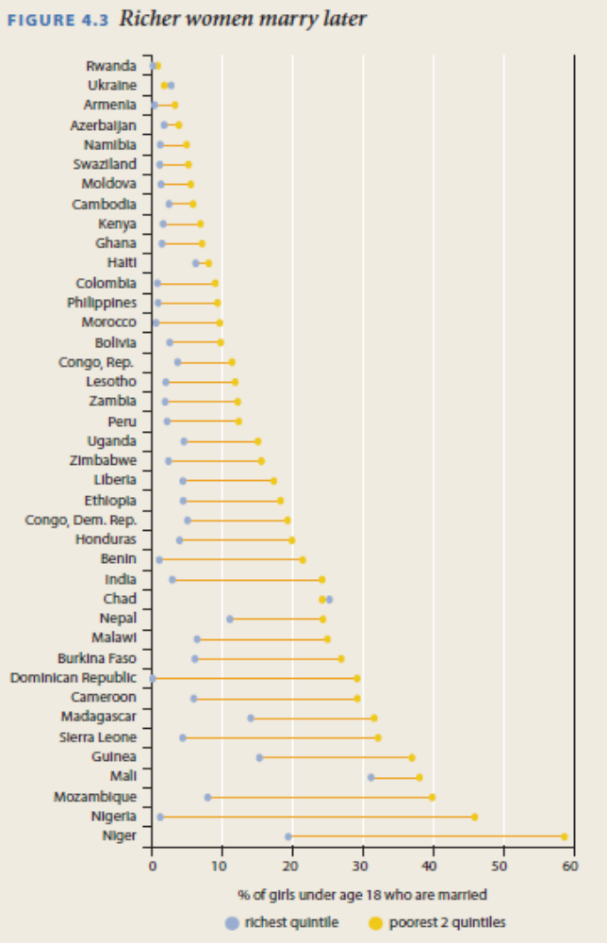

Slide 24
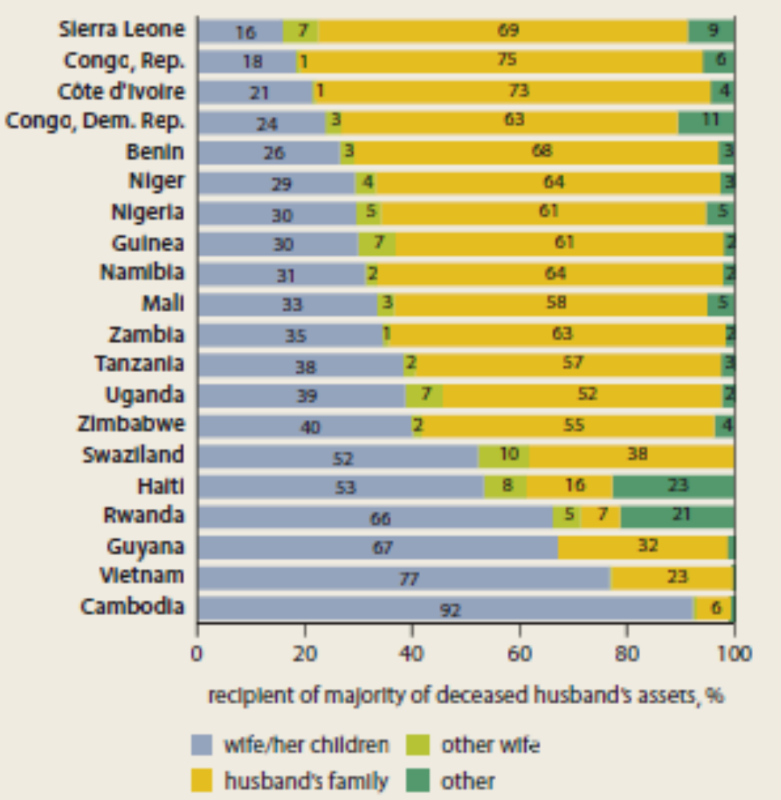

Slide 25
More things we do not know yet
CCT - Should they target women?
Microfinance – if anything the research suggests that targeting women may be bad.
Why? Multiple constraints?

Slide 26
Qian 2008
Research question: The effects of sex-specific earnings on gendercide.
    Interesting? Yes: Important topic (missing women, especially in China), also important topic in household/labor economics.
    Original? Yes: previous empirical studies have faced severe identification problems.
    Feasible? Yes: By exploiting two post-Mao reforms, DD, and IV.

Slide 27
A detour on missing women
Women who ”should be alive” but are not.
MW= (Current population*share of females in reference category) – Current number of women.
Globally, 6 million women a year become missing.
1/5 is never born, 1/10 dies in early childhood, 1/5 in the reproductive years, and 2/5 at older ages.

Slide 28
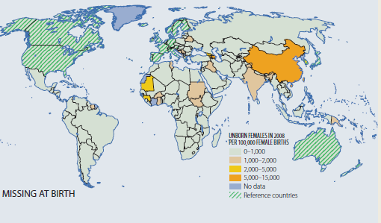
Missing girls at birth

Slide 29
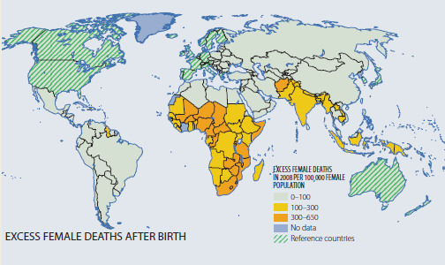
After birth

Slide 30
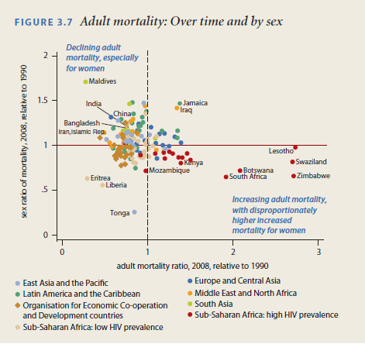
Sex ratio of deaths and changes over time

Slide 31
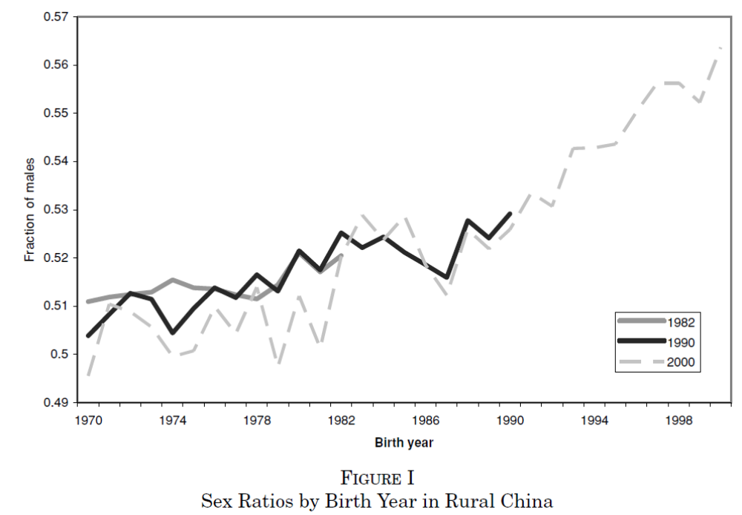

Slide 32
The emplirical problem
In linking female share of income with gendercide there is a fundamental identification problem:
Areas with higher female income may have higher income precisely because women’s status is higher for other reasons.
Only looking at tea areas vs non tea areas is not enough either: regions that choose to plant tea may be regions with weaker boy preference.

Slide 33
The story
Women have a comparative advantage in producing tea.
Men have a comparative advantage in producing orchard fruits.
Reforms increased the price dramatically.
Areas suitable for tea production receive a shock in female incomes.
More girls survive.

Slide 34
Empirical strategy
“… compare sex imbalance for cohorts born before and after the reforms (1st diff), between counties that plant and do not plant sex-specific crops (2nd diff), where the value of those crops increased because of the reform.”
= Difference in differences (DD).

Slide 35
Recap difference in differences (DD)
Requires that data is available both before and after treatment.
Basic idea: Control for pre-period differences in outcomes between T and C.
Crucial assumption. Absent the treatment, the outcomes would have followed the same trend.
Main practical issue: Omitted variable… you must argue your case strongly!

Slide 36
Problems
The main problem is that something else may have happened at the same time.
Or that the trends are different.
More periods is better.

Slide 37
Three effects of the reforms are exploited
The reform increased the value of adult female labor in tea-producing regions.
The reform increased the value of adult male labor in orchard-producing regions.
The reform increased total household income in regions with other cash crops which favor neither male nor female labor.

Slide 38
Data
Censuses from 1990 and 1997.
    Used to get historical fertility and to see which regions plant tea.
ArcGIS data on hilliness.
    Increasingly popular to use GIS data in economics.

Slide 39

Main equation of interest

Slide 40
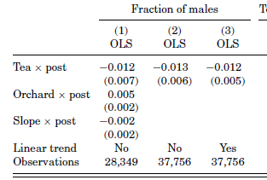
Basic results
Cashcrop
Control for varying cohort trends between counties

Slide 41
Main worries in DD
The effects may be driven by changes in the control crops. (Testable)
There may have been different pre-trends in sex ratios. (Testable)
Increased price may change the reason people pick tea so that the prereform cohort is not a valid counterfactual. (Use IV)
In, general, we may confound the effects of the reform with effects of other things that happened. (Non-testable)

Slide 42
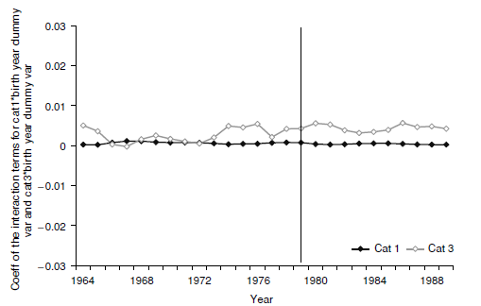
Changes in effects of control crops
Stable and close
to zero.

Slide 43
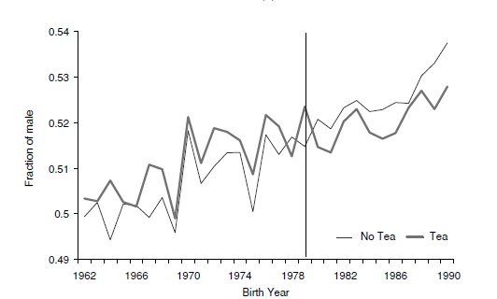
Pre-and post trends

Slide 44
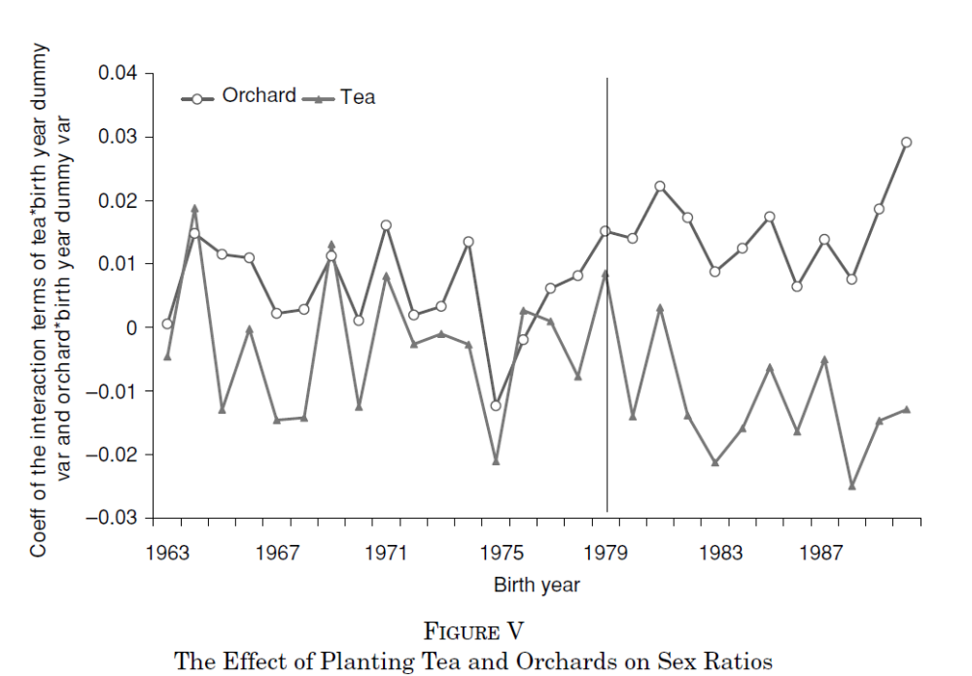
Timing of the effects

Slide 45
Instrumental variables approach
Tea grows only under particular conditions: on warm and semihumid hilltops.
Use slope of land (i.e. hilliness) as an instrument for tea planting.
Condition 1: Relevance, easily tested.
Condition 2: Validity, not testable.

Slide 46
Arguments for validity
Hilliness varies gradually while county boundaries are straight lines.
Estimation with a sample including only adjacent counties gives similar results.
Unless potentially confounding factors change discretely across county boundaries, this increases our belief in the validity.

Slide 47
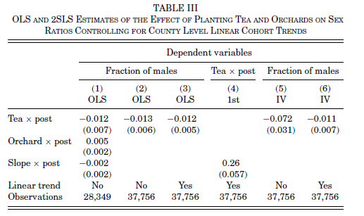
IV Results

Slide 48
Education
Planting tea increased female and male educational attainment.
On the other hand, planting orchards decreased female educational attainment and had no effect on male educational attainment.

Slide 49
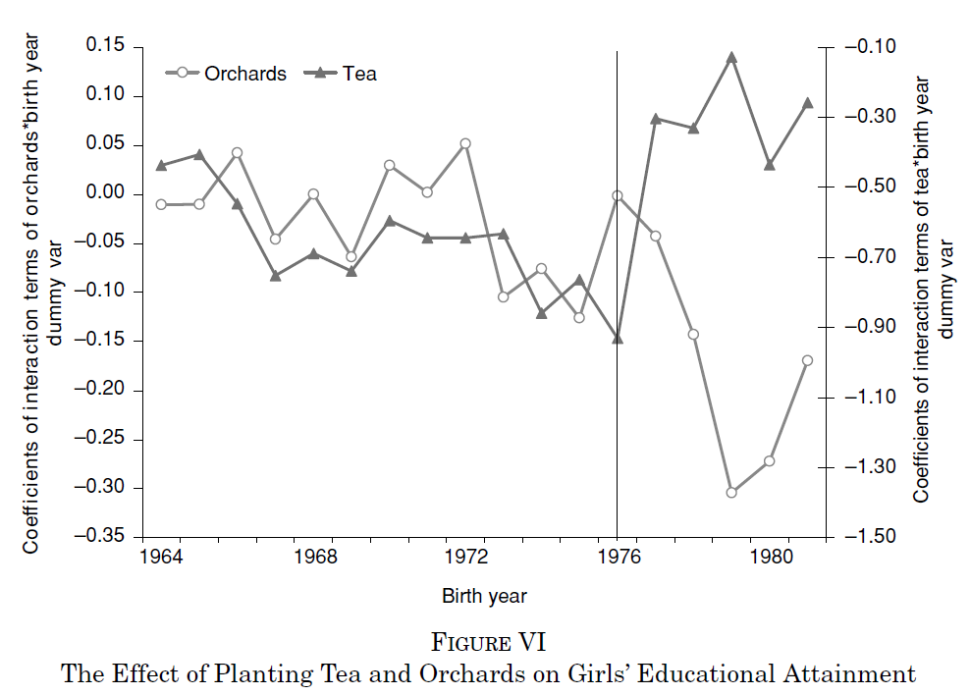
Timing of the education effects

Slide 50
Mechanisms: 4 potential channels
Changed perceptions of daughters’ future earnings.
Girls may be luxury goods. (ruled out by orchard results)
If mothers prefer girls and if it improves mothers’ bargaining power.
Pregnancies are costlier as womens labor is valued more. (ruled out by education results)

Slide 51
Interpretation
Introduction: “The results show that an increase in relative adult female income has an immediate and positive effect on the survival rate of girls” (OK).
“… increasing annual adult female income by US$7.70… increased the fraction of surviving girls by one percentage point … (OK??).

Slide 52
Magnitudes, ITT, and Qian again.
We randomize an intervention whereby students are allocated 10 hours extra teaching time. We have 100 in the treatment group and 100 in the control group.
The treatment group gets 100 points on the exam on average and the control group gets 90 points.

Slide 53
Statements
“The effect of the program was to raise the exam score by 10 points on average.”
“One hour of teaching raises the score by 1 point”

Slide 54
Assume only 50 of the hundred actually went to the extra class.
“The effect of the program was to raise the exam score by 10 points on average”.
“One hour of teaching raises the score by 1 point”.
“One hour of teaching raises the score by 2 points”.

Slide 55
IV vs ITT
ITT = Take program assignment as the mechanism, don’t care about what happens afterwards.
Reduced form argument (total derivative).
IV: Use the program assignment as an instrument for teaching.
More assumptions (especially homogenous treatment effects) but if plausible it provides more precise conclusions.

Slide 56
Interpretation in Qian
“The results show that an increase in relative adult female income has an immediate and positive effect on the survival rate of girls” (OK).
“… increasing annual adult female income by US$7.70… increased the fraction of surviving girls by one percentage point … (OK??).

