Slide 1
Development Economics
ECON 4915
Lecture 3
Andreas Kotsadam
Room 1038
Andreas.Kotsadam@econ.uio.no

Slide 2
Outline
Class contacts, reading list, and seminar.
Empirical methods
    Randomisation
    Other methods: IV, DD, DDD, RD.
    Discussion: Internal vs. External validity.
Possible exam question on expansion of credit and recap from last lecture.

Slide 3
Class contacts and reading list
Mari Solheim and Even Winje are class contacts.
The reading list has been slightly altered so that you should read the whole chapter on insurance for next time.

Slide 4
Seminar
Seminar 1, i.e. the group starting at 14.15 have choosen: Acemoglu et al.; Jensen and Oster; Nunn and Wantchekon.
Seminar 2, i.e. the group starting at 10.15 have choosen: Acemoglu et al.; Jensen and Oster; Qian.
4 sub-groups are missing in total!

Slide 5


Empirical methods in development economics

Slide 6
Other interesting references
Symposium in The Journal of Economic Perspectives, Volume 24, Number 2, Spring 2010. Starting with:
Angrist and Pischke, “The Credibility Revolution in Empirical Economics: How Better Research Design Is Taking the Con out of Econometrics”
See also:
Deaton (2009) ”Instruments of development: Randomization in the tropics, and the search for the elusive keys to economic development”.
Banarjee and Duflo (2009) ”The experimental approach to development economics”.

Slide 7
Some more resources
Lecture notes will be added to the homepage.
For those who know Norwegian, Finseraas and Kotsadam (2013) is also added.
And a recent debate at the Poverty to Power blog.

Slide 8
The fundamental problem of causal inference
Answering any causal question requires knowing the counterfactual.
At the individual level this is impossible.
Maybe we can solve this by using statistics?

Slide 9
We need a comparison group
...that would have had similar outcomes as the treatment group if there was no treatment.
In general, however, those recieving treatment and those that do not usually differ due to:
→ Targeting
→ Screening
→ Self-selection.

Slide 10
This implies
...that those not exposed to a treatment are often a lousy comparison group.
It is often impossible to disentangle treatment effects from selection bias.

Slide 11
Example
A fertilizer program where fertilizers are given for free to some farmers.

Slide 12
We want to know the effect
Effect=
Yield for the farmers who got fertilizer
-
Yield at the same point in time for the same farmers in absence of the program.

Slide 13
Problem
We never observe the same individual with and without program at the same point in time.

Slide 14
We cannot simply compare before and after
Other things may happen over time so that we cannot separate the effect of the treatment and the effect of those other things.
Even if you know ”nothing else happened” it is hard to convince others.
The burden of proof is on you.

Slide 15
We cannot simply compare with those who did not get fertilizers
Some may choose not to participate.
Those not offered the program may differ.
Again, the burden of proof is on you.

Slide 16
Solution
Find a good proxy for what would have happened to the outcome in the absence of program
Compare the farmer with someone who is exactly like her but who was not exposed to the intervention
In other words, we must find a valid Counterfactual
→ only reason for different outcomes between treatment and counterfactual is the intervention

Slide 17
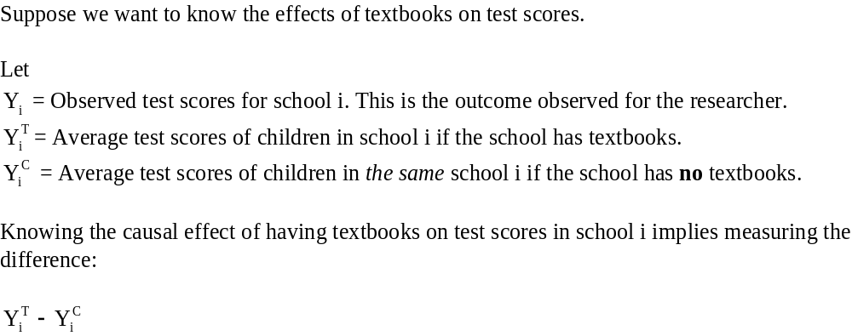
The potential outcomes framework

Slide 18
The problem
The problem is that every school has two potential outcomes and we only observe one of them.
We are obviously not able to observe school i both with and without textbooks at the same time.

Slide 19
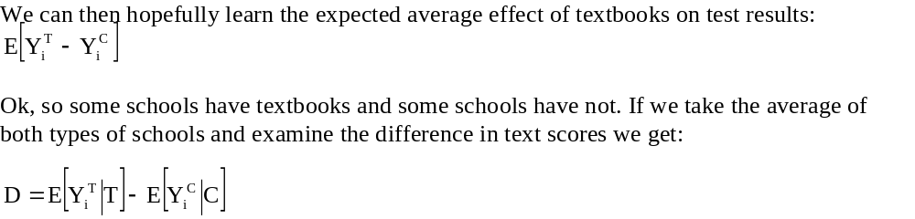
By using data on many schools we can do better

Slide 20
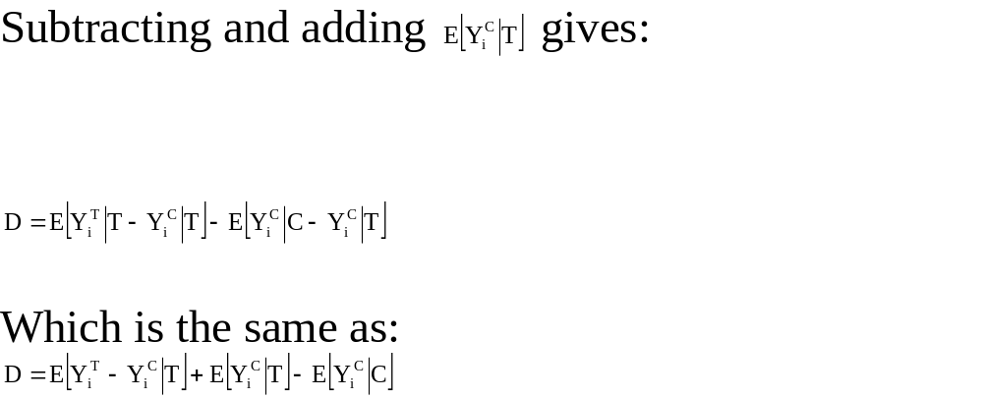

Slide 21
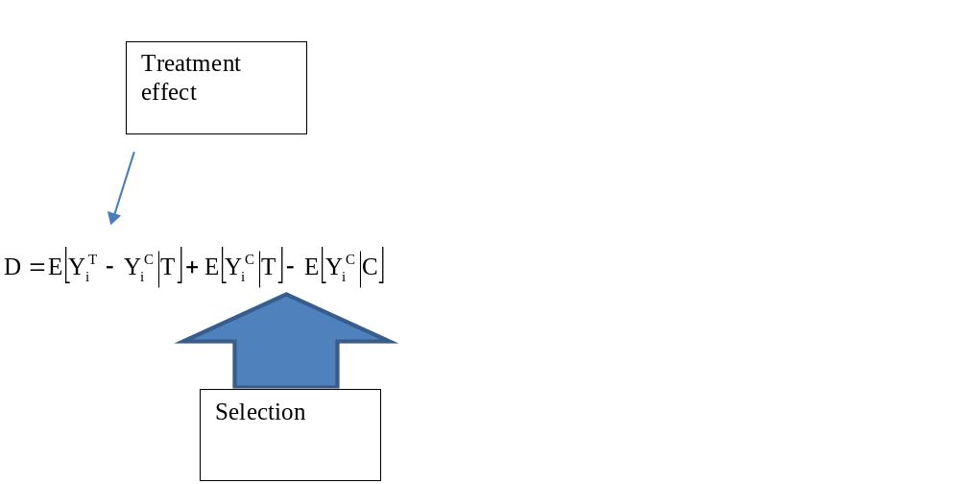
Let us take a closer look

Slide 22
Examples of selection effects in the textbook example:
1)
2)

Slide 23
The general point
In addition to the effect of textbooks there may be other systematic differences between schools with and without textbooks.
The goal is to find situations where selection bias does not exist or where we can correct for it.

Slide 24
Randomization
When individuals, or schools, or countries, are randomly assigned to treatment and comparison groups, the selection bias disappears.
Take a sample of N individuals from a population of interest.
Divide the sample randomly into a treatment and a control group.

Slide 25
Randomization
Then give the treatment group a treatment so that their treatment status is T and nothing to the control group so that their treatment status is C.
Collect outcome data Y and compare the treatment average to the control average.

Slide 26
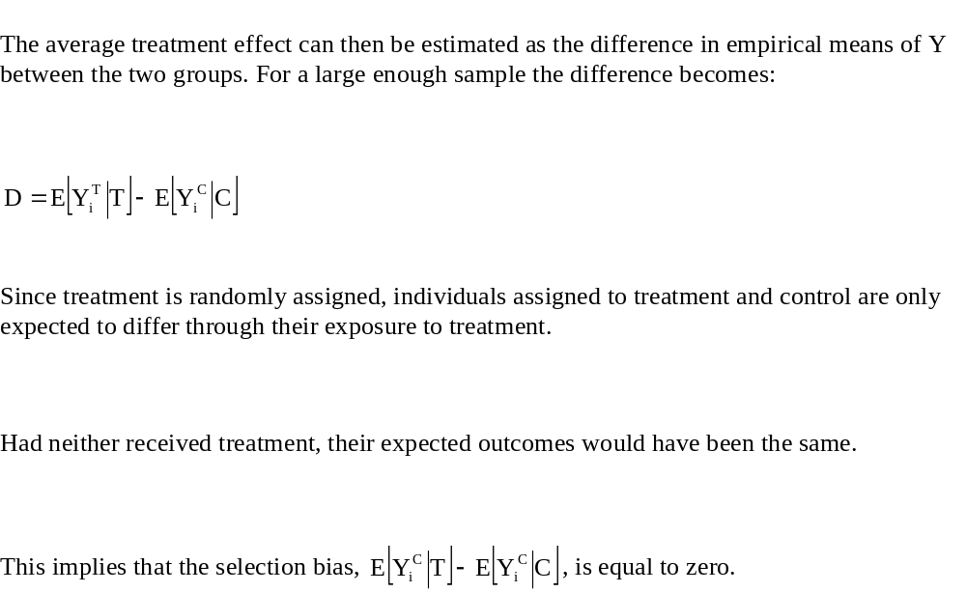

Slide 27
Assuming SUTVA (the Stable Unit Treatment Value Assumption)
Essentially assuming no externalities so that the potential outcomes of an individual are unrelated to the treatment status of any other individual. Then:

Slide 28
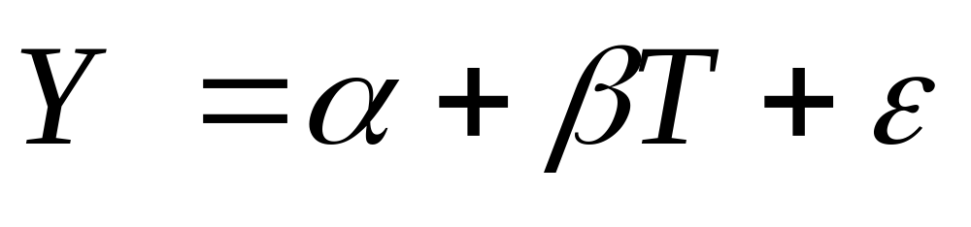
In a regression
Where T is a dummy for belonging to the treatment group.

Slide 29
A detour on the law of large numbers
” For a large enough sample… ”
If we were to draw a line in the middle of India and randomly (e.g. by flipping a coin) provide microcredit in one part this would be a randomized field experiment.
”Large enough” depends on the variance and magnitude of the effects.

Slide 30
What is being estimated?
We get the overall impact of a particular treatment on an outcome.
Note in particular that we allow other things to change as a response to the program.
It is not the all else equal effect.
”Reduced form”: Total derivative.

Slide 31
Main advantages of randomization
A randomized evaluation provides internally valid estimates = It provides an unbiased estimate of the impact of the program in the sample under study.
They are also easy to understand.
Very good for testing theories.

Slide 32
Critiques of randomized experiments
External validity: = Is the effect generalizable to other samples?
A) Environmental dependence:
Would providing free school lunch have the same effect in Norway and in Kenya?
Obviously not, but the trickier question is where to draw the line: Is Argentina more like Norway or Kenya?

Slide 33
External validy continued
B) Implementer effects:
The results may not generalize to other NGO’s for example.
More problematic, not every NGO wants to be evaluated: Probably a selection of more competent NGOs and better programs!
See Bold et al. (2012).

Slide 34
But these issues apply to all empirical work
Argentina is not more like Norway because we build a model.
Countries with better institutions often have better data.

Slide 35
More critique
General equilibrium effects: What happens if we scale up a successful program?
Hawthorne effect: Being monitored changes behavior.
Randomization bias: The fact that the program is evaluated using randomization affects behavior.

Slide 36
Ethics
Is randomization unfair?
Why so many experiments from developing countries?
Generous interpretation: The questions merit it and there is not a lot of data to work with.
More cynical interpretation: It is cheap and feasible (e.g. no ethical review board).

Slide 37
Why not more randomized impact evaluations?
Ignorance may have political advantages.
Technical capacity may be limited.
Benefits are not clearly appropriated to those who bear the costs: Evaluations as a public good.
And randomization is simply not always feasible.
Notes:
37
Mexico:
Ley General de

Slide 38
If randomization is not possible
Other methods can be used to handle selection bias but they all require more assumptions.
These identifying assumptions are not testable and the validity of any particular study depends on how convincing these assumptions appear.
Identification strategy= research design to identify a causal effect.

Slide 39
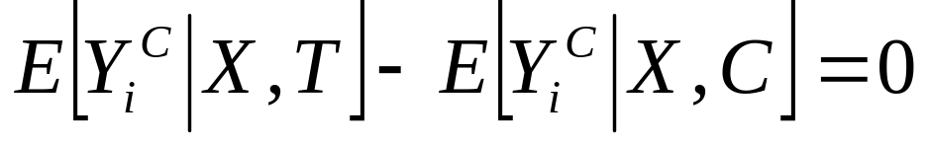
Controlled regression analysis
If there exists some vector X such that,
Then we can estimate the causal effect by including X as control variable in a regression.

Slide 40
Problems
This approach is only valid if there is no difference in potential outcomes between treated and untreated individuals once we have controlled for the observable differences.
It is generally unlikely that this is enough since X must account for all the relevant observed and unobserved differences between the treatment and control groups.

Slide 41
Instrumental variables (IV)
Very common method in empirical economics.
We saw it it B&P in lecture 2 and we will see it in several other papers during the course.
A very good reference for IV is Murray (2006) ”The Bad, the Weak, and the Ugly: Avoiding the Pitfalls of Instrumental Variables Estimation”

Slide 42
Instrumental variables (IV)
What’s the problem?
How can it be solved by IV?
How is it done in practice? Examples.
Instruments can be:
i) Bad,
ii) Weak,
iii) Ugly.

Slide 43
What’s the problem?
IV solves the problem of ”endogeneity”.
Endogeneity: An explanatory variable is correlated with the error term.
Very common in social science.
Most common reasons:
i) Omitted variables
ii) Measurement error
iii) Simultaneity (reversed causation)

Slide 44
A common example
We want to estimate the returns to education.
Wage= a+B1education+ B2X+ ei
We cannot measure ability so it ends up in ei.
Ability increases education and wage.
B1 is most likely overestimated since education is correlated with the error term.

Slide 45
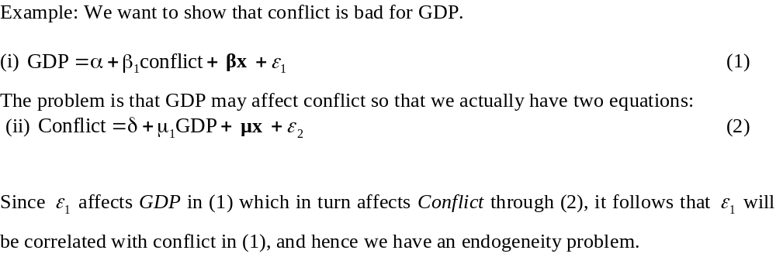
Simultaneity

Slide 46
What can be done?
To overcome the endogeneity problem we can use the Instrumental Variables (IV) approach.

Slide 47
How does it work?
Frequently, regressions requiring IV estimation have a single troublesome explanator (education) and several non-troublesome explanators (X_{i}):
Wage=b₀ + b₁Education+ b₂ X_{i} + e_{i} (1)
For 2SLS with one troublesome estimator:
Education_{predicted}= a₀ + Z_{i} a₁ +X_{i} a₂ + m_{i} (2)
Wage=b₀ + b₁Education_{predicted}+ b₂ X_{i} + e_{i} (3)

Slide 48
Hence
To use the IV approach we need at least one additional variable, referred to as an instrument. The instrument has to satisfy two conditions:
i) Relevance (easy to test)
ii) Validity (cannot be tested)

Slide 49
Proposed instruments for education
Distance to college.
Quarter of birth with compulsory schooling.

Slide 50
Bad instruments
When the instruments are not valid.
Remember that this cannot be tested.
Overidentification tests are always used when possible but they can only help prove that an instrument is bad.

Slide 51
Weak instruments
We call an instrument weak if the correlation with the troublesome variable is low.
One consequence is that the variance of 2SLS estimators become greatly inflated.

Slide 52
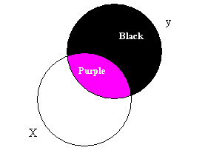
Venn diagrams

Slide 53
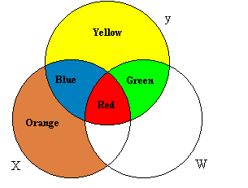
Multiple regression

Slide 54
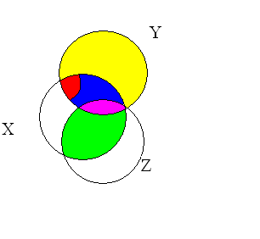
Z as an instrument for X

Slide 55
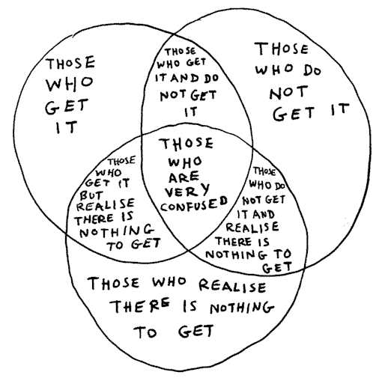
Clear?

Slide 56
Ugly instruments
What are we really measuring?
If heterogeneity is present, IV estimation may reveal results for a specific group which may differ from the average effect.
LATE: Local Average Treatment Effect.

Slide 57
Example
Effect of education.
Those affected by school laws have a high marginal utility of an extra year. Thereby we are not measuring the returns to education in general. Not even the effect of education for those with low education. The effect is rather one for those who would not have studied the extra year absent the schooling law.
So, we must know what we are measuring!

Slide 58
Difference in differences (DD)
Requires that data is available both before and after treatment.
Basic idea: Control for pre-period differences in outcomes between T and C.
Crucial assumption. Absent the treatment, the outcomes would have followed the same trend.
Main practical issue: Omitted variable… you must argue your case strongly!

Slide 59
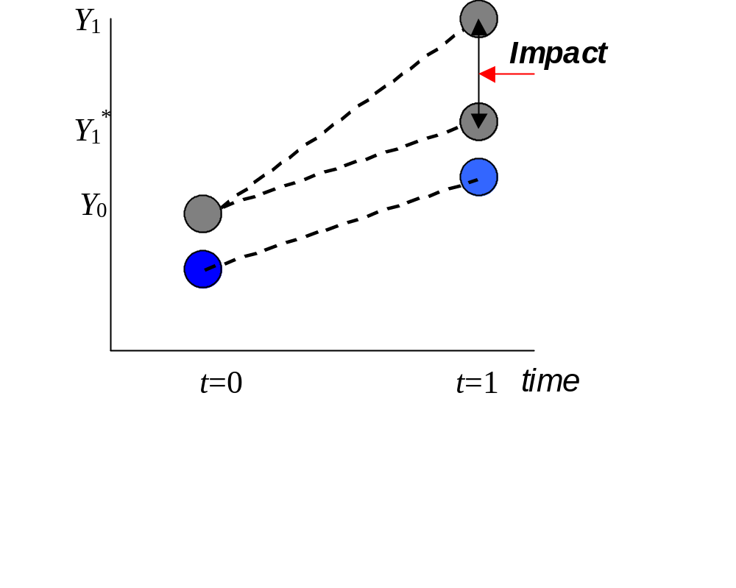
As long as the bias is additive and time-invariant, diff-in-diff will work ….
Notes:
59

Slide 60
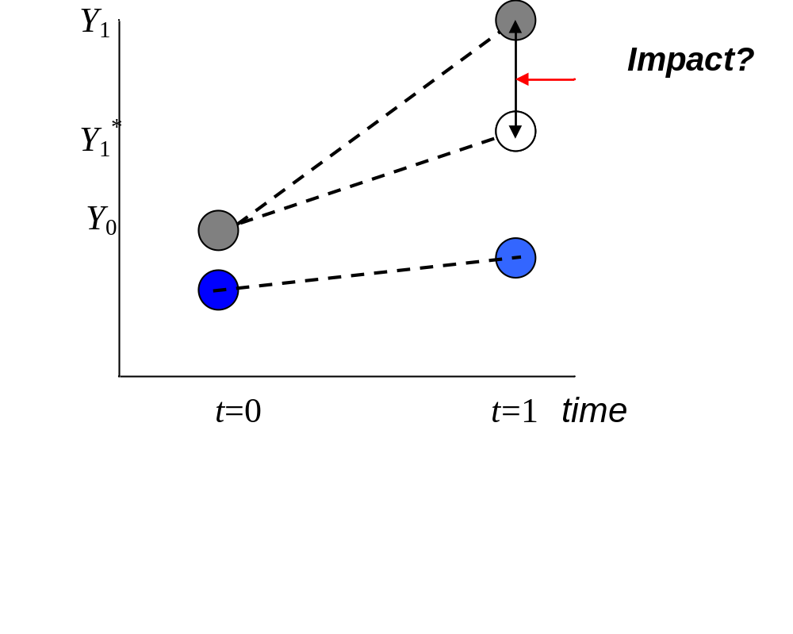
What if the observed changes over time are affected?
Notes:
60

Slide 61
Problems
The main problem is that something else may have happened at the same time.
Or that the trends are different.
More periods is better.

Slide 62
Real world example
Effect of the death penalty on homicide rates.
Donohue and Wolfers (2005) “Uses and abuses of empirical evidence in the death penalty debate”.
Use the trend in Canada as a counterfactual for the trend in the US

Slide 63
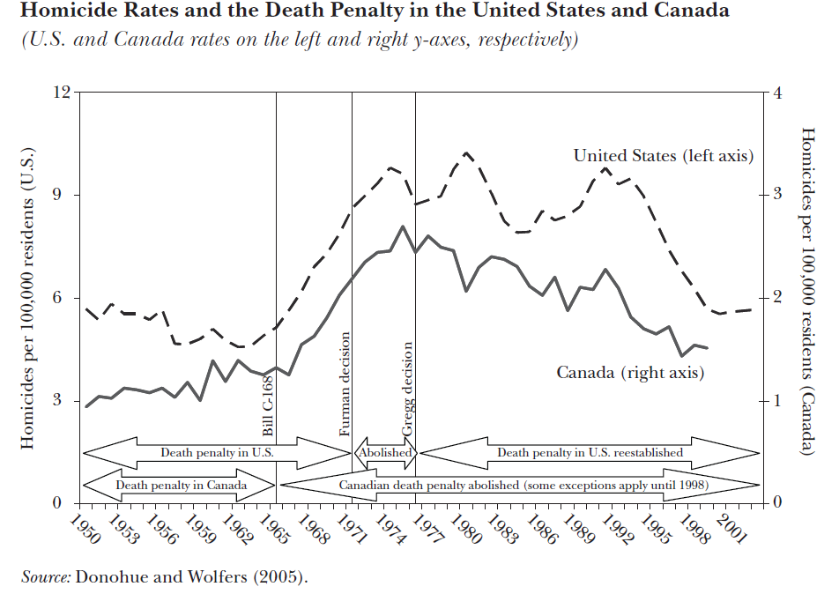

Slide 64
Regression Discontinuity (RD)
Basic idea: Exploit that the probability of treatment is a discontinuous function of at least one observable variable.
Clear right ☺
The idea is to estimate the treatment effect using individuals just below the threshold as a control for those just above.
Examples may be that a poverty relief program is only given to those with less than 40 dollars per month or be that you get into a good university if your exam score is at least 207.

Slide 65
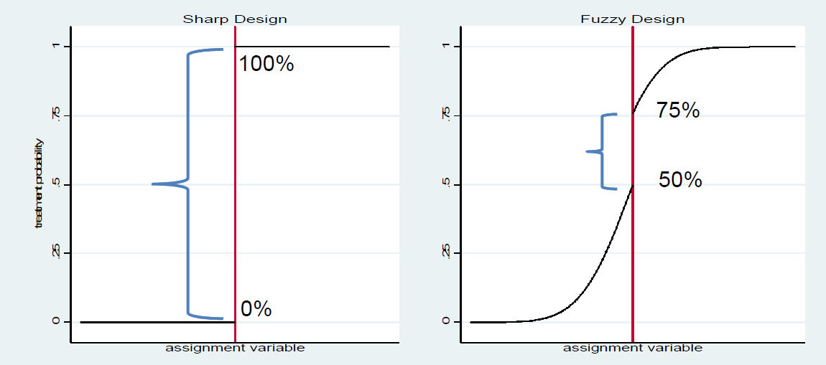
Sharp and fuzzy RD

Slide 66
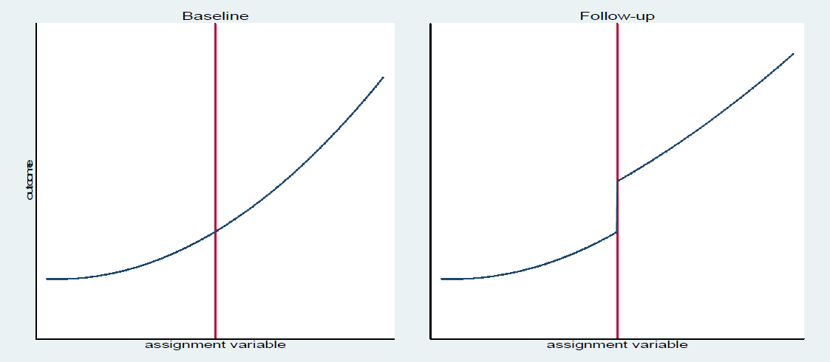
Outcome

Slide 67
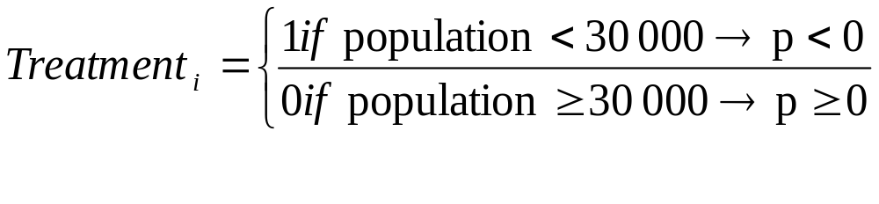
Another example and some terminology
Pension program in rural Mexico:
Rural: Only in places with less than 30 000 inhabitants.
Let p be the ”forcing/running variable”
p= population – 30 000 so that:

Slide 68
So, how do we estimate this?
Say we want to estimate the effects on poverty.
Example on the blackboard.

Slide 69
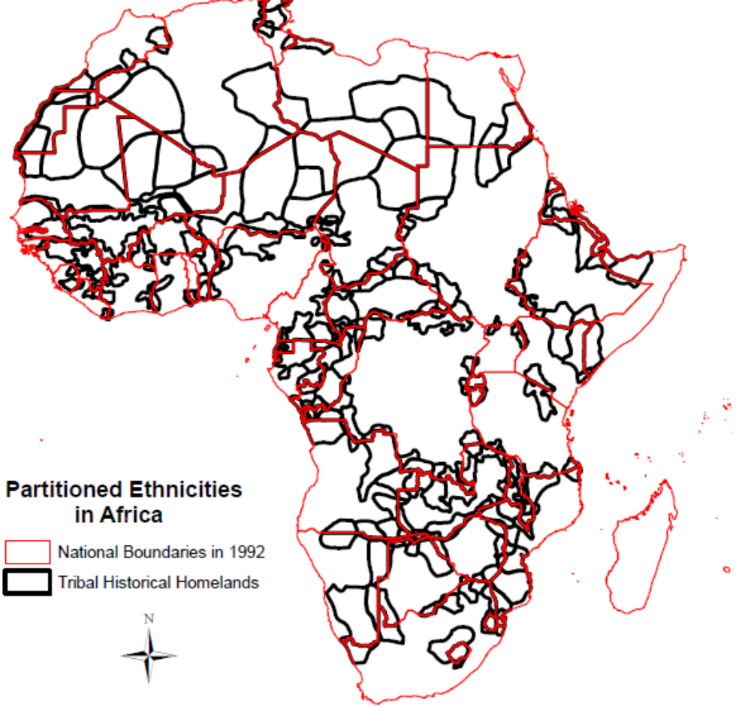
You can also use RD in physical space
Notes:
69

Slide 70
RD
Very popular.
Often a much closer cousin of randomization than the other methods.
Also ethical advantage if distribution is based on needs.
Crucial assumption: No manipulation or sorting around the threshold.

Slide 71
RD
Underexploited: Cf. Burgess and Pande:
“Banks were required to select unbanked locations for branch expansion from a list circulated by the Central Bank. This list identified all unbanked locations with a population above a certain number. As the same population cut-off was applied across India...The list was updated, with a lower population cutoff, every three years.”
They could have used RD.

Slide 72
Summary
72
Randomization requires minimal assumptions.
Non-experimental methods require assumptions that must be carefully assessed.
These assumptions cannot be proven so they must be very well argued.
Notes:
72

Slide 73
Typical exam question
2a) Give some arguments for and against the idea that a state led expansion of rural banks should reduce poverty (2 points).
2b) If we are interested in the effects of rural banks on poverty, why is it a bad idea to draw conclusions by simply comparing poverty in areas that have banks to poverty in areas that do not have banks? (1 point)

Slide 74
Typical exam question
2c) Burgess and Pande (2005) instead use a policy rule in India between 1977 and 1990 that forced banks who wanted to open in a location that already had banks to open banks in four areas that had no banks. In particular, they exploit the trend reversals between 1977 and 1990 and between 1990 and 2000 (relative to the 1961- 1977 trend) in the relationship between a state's initial financial development and rural branch expansion as instruments for branch openings in rural unbanked locations. What arguments are provided for using these instruments? (4 points)

Slide 75
Typical exam question
2d) What are their conclusion and how can it be criticized? (3 points)

Slide 76
Their conclusion
“We provide robust evidence that opening branches in rural unbanked locations in India was associated with reduction in rural poverty.”

Slide 77
Critical questions (1)
Have they really showed that rural banks matter or just that this policy had effects?
Does it matter that the bank openings were not randomly assigned?
Why doesnt the trend shift back after 1990?
Is the result generalizable to other contexts?

Slide 78
Critical questions (2)
What about interactions with other policies? In particular the policy stipulating that 40 percent of the lending should go to ”priority sectors”.
Do we know why the reform had an effect?
What about the long term effects? (See Fulford 2011, “The effects of financial development in the short and long run”, Boston College Working Paper.)
Was it cost effective?

