Slide 1
Development Economics
ECON 4915
Lecture 2
Andreas Kotsadam
Room 1038
Andreas.Kotsadam@econ.uio.no

Slide 2
Outline
Change in the lecture plan and seminar 1.
Possible exam question and a recap.
What can be done to solve the credit problems?
    Government intervention to expand credit (Burgess and Pande 2005).
    Lecture 5, microcredit.
A quick detour on risk (if time).

Slide 3
New lecture plan
Lecture 2: Credit markets for the poor, what about banks?
Lecture 3: Empirical methods in development economics
Lecture 4: Insurance (As before)
Lecture 5: Credit markets for the poor, what about microfinance?
Lecture 8 and 9 have swapped places.

Slide 4
Seminar groups
Apparently, seminar 3 (the one on wednesdays) is not open.
The first seminar is approaching (12th February).
Today you must sign up for a time.
You will work in groups and there is a maximum of 5 groups for each seminar.

Slide 5
The first seminar
Each group will present an article for 20 minutes.
E-mail me which article you choose.
The articles will be distributed on a first come, first served basis. (You are allowed to have the same article across groups but not within group).

Slide 6
Acemoglu, D., S. Johnson, and J. A. Robinson (2001).The colonial origins of comparative development: an empirical investigation, American Economic Review 91(5), 1369-1401.
Beaman, L. Chattopadhyay, R. Duflo, E., Pande, R, and Topolova P. (2009).Powerful Women: Does Exposure Reduce Bias?Quarterly Journal of Economics, 124 (4): 1497-1540.
Jensen, R. and Oster, E. (2009).The Power of TV: Cable Television and Women's Status in India*, The Quarterly Journal of Economics, 124 (3): 1057-1094.
Nunn, N. and Wantchekon, L. (2011), The slave trade and the origins of mistrust in Africa, American Economic Review, Vol. 101, No. 7, 3221-3252.
Qian, N. (2008), Missing women and the price of tea in China: The effect of sex-specific earnings on sex imbalance, The Quarterly Journal of Economics, 123(3): 1251-1285.

Slide 7
Focus on the following
Research question
    What is the precise question to be answered?
    Is it interesting? Why should we care?
    Is it new? What is the contribution of the paper?
Notes:
7

Slide 8
Focus on the following
Evidence
    Is a causal effect identified?
    Is the argument compelling?
    Are alternative explanations ruled out?
    Is the data appropriate?
Notes:
8

Slide 9
Focus on the following
Conclusion
    Can the conclusion be generalized?
    What are the main problems, if any?
    What else would you like to know?
Notes:
9

Slide 10
Typical exam question
1a) Theoretically, informal sector interest rates are very sensitive to the default risk even under perfect competition. Show this using the lender’s risk hypothesis, discuss the implications and relevance. (5 points)

Slide 11
The Lender’s risk hypothesis yelds:

Slide 12
Possible exam question continued
1b) Give two examples of solutions to the information problems on the credit market that may lead to poverty traps (2 points).

Slide 13
Recap (or more hidden exam questions?)
Credit rationing:
    What is it?
    Why does it occur, in particular, why doesn’t the lender just raise the interest to lend out more?
    Explain intuitively how information asymmetries may cause credit rationing.

Slide 14
Policies
A nice (but not so simple) solution would be to build up good institutions and eliminate poverty.
In the meantime, we will discuss:
    Government intervention to expand credit (Burgess and Pande 2005).
    Microfinance (Banarjee and Duflo 2010) (more on lecture 5).

Slide 15
Burgess and Pande (2005)
Research question: Do rural banks matter?
    Interesting? Yes: Important topic (poverty), widespread policy and lots of theory.
    Original? Yes: Credible evidence remains limited.
    Feasible? Yes: By using policy rules as a source of exogenous variation and data exists.

Slide 16
The empirical problem
Bank expansion and economic growth are positively correlated in cross-country data.
Why do we need to know more?
Similarly, areas which have had state led expansion programs are poorer than other areas.
Evidence that state programs not working?

Slide 17
The policy
A branch expansion program introduced in 1977.
This program is the largest branch expansion program undertaken by any single country.
The number of banks opened in rural un-banked locations increased from 105 to 29,109.

Slide 18
The 1:4 rule
To obtain a license for a bank opening in a banked location, the bank must open branches in four unbanked locations as well.
This policy ended in 1990.

Slide 19
Data
State-level data.
Panel data on the number of banks, rural credit and saving shares.
The rural headcount ratio is the main poverty measure.

Slide 20

Why can’t we just run the following OLS regression?

Slide 21
Empirical strategy
Use the imposition and removal of the 1:4 branch licensing policy, as instruments.
Relevance: The policy must be a predictor for the number of banks.
Validity: The policy should not affect rural poverty in other ways than via the number of rural banks.

Slide 22

Relevance
Does the reform predict the number of banks?

Slide 23
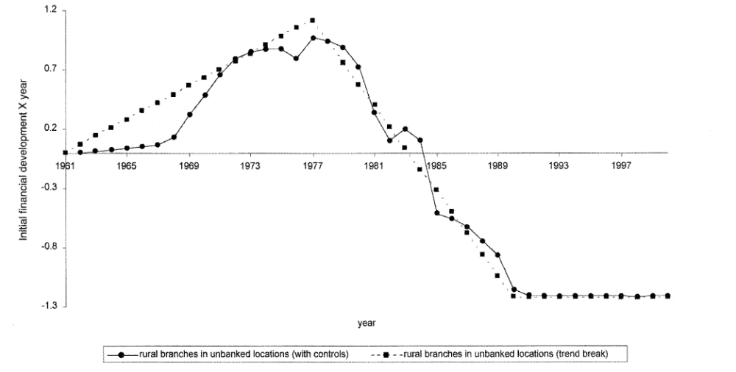
Figure 1

Slide 24
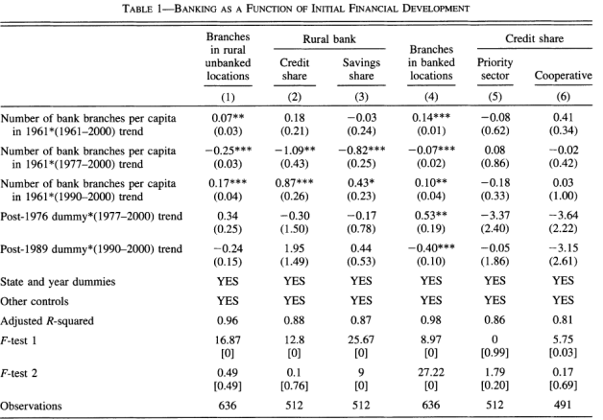
Testing the assumptions

Slide 25
Reduced form argument
We know that the trend breaks affected the number of banks…
… and they argue that that these breaks were exogenous.
Hence, they can look at the relationship between the trends and poverty.

Slide 26
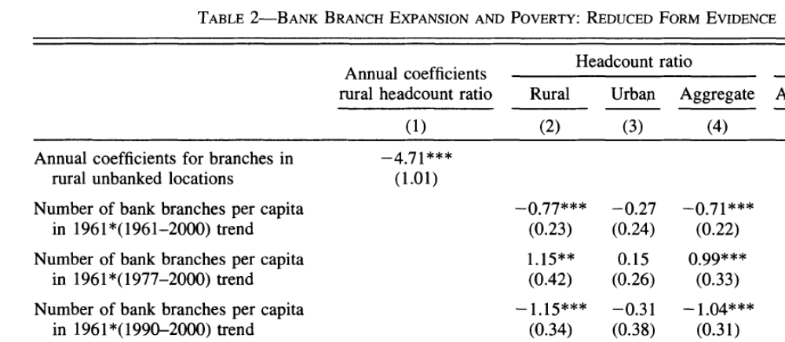
Reduced form effects on poverty

Slide 27
IV argument
We know that the instruments are relevant…
… and they argue that they are valid.
Therefore they can be used to give us the effects of opening up banks in rural areas.

Slide 28
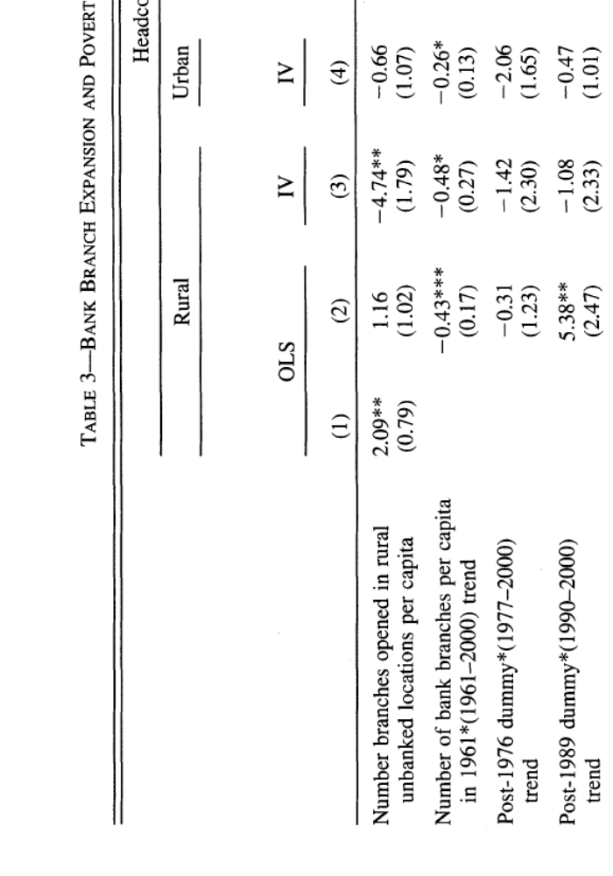
OLS vs IV results on poverty

Slide 29
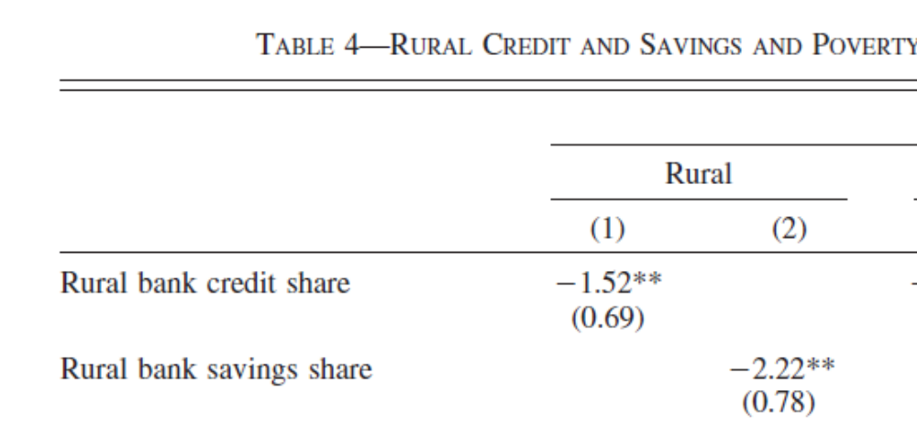
Mechanisms: Via credit and savings

Slide 30
Supporting evidence
The validity assumption is not testable, but arguments can be given for or against it.
What are the arguments against it?
What can be done about this?
How do they account for it?

Slide 31
Their conclusion
“We provide robust evidence that opening branches in rural unbanked locations in India was associated with reduction in rural poverty.”

Slide 32
Rhetoric
p. 781, end of introduction: Main result: This paper's main finding is that branch expansion into rural unbanked locations in India significantly reduced rural poverty. Mechanism: We show that this effect was, at least partially, mediated through increased deposit mobilization and credit disbursement by banks in rural areas. Placebo: In contrast, the rural branch expansion program left urban poverty outcomes unaffected.

Slide 33
Critical questions (1)
Have they really showed that rural banks matter or just that this policy had effects?
Does it matter that the bank openings were not randomly assigned?
Why doesnt the trend shift back after 1990?
Is the result generalizable to other contexts?

Slide 34
Critical questions (2)
What about interactions with other policies? In particular the policy stipulating that 40 percent of the lending should go to ”priority sectors”.
Do we know why the reform had an effect?
What about the long term effects? (See Fulford 2011, “The effects of financial development in the short and long run”, Boston College Working Paper.)
Was it cost effective?

Slide 35
A detour on risk
2 scenarios: 100 kr with p=0.5 or 50 kr with p=1.
EV= Expected value = average payoff
CE= Certainty equivalent = Amount accepted instead of the bet.
Risk premium= EV-CE

Slide 36
Risk attitudes
A person is said to be:
    Risk neutral - if she is indifferent between the bet and a certain 50 kr payment.
    Risk averse - if she would accept a certain payment of less than 50 rather than taking the gamble.
    Risk loving - if the guaranteed payment must be more than 50 to induce her to take the guaranteed option.

Slide 37
Expected utility theory and risk aversion
Expected utility of wealth:
E(u(w)) = (u(0) + u(100)) / 2
An agent possesses risk aversion if and only if the utility function is concave.

Slide 38
E(U(W)) - Expected value of the utility (expected utility) of the uncertain payment.
E(W) - Expected value of the uncertain payment.
U(CE) - Utility of the certainty equivalent.
U(E(W)) - Utility of the expected value of the uncertain payment

Slide 39
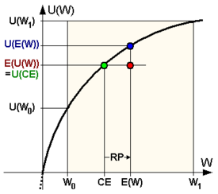
Risk aversion

Slide 40
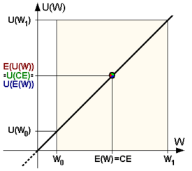
Risk neutrality

Slide 41
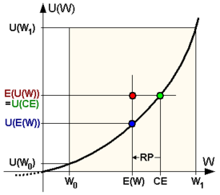
Risk loving

