Slide 1
Development Economics
ECON 4915
Lecture 10
Andreas Kotsadam

Slide 2
Outline
Possible exam question and a recap.
Corruption.
Questions from you.

Slide 3
Questions from you
What is the relationship between democracy and economic development (next lecture).
What is the role of the WB in development and does it matter who runs it? (Today).
Discrimination in Norwegian labor market (Not in this course).

Slide 4
Possible exam questions
Jensen and Oster (2009) analyze whether cable TV affects women’s status. Why should economists care about cable TV? Why would TV have an effect on women’s status? How do they analyze the question and what do they find? Answer briefly.

Slide 5
Possible exam questions
Beaman et al. (2009) investigate whether quotas for women in politics affect bias against women. How do they investigate this? What are their main findings and do you think they are generalizable? Answer briefly.

Slide 6

Corruption

Slide 7
Today we will cover
Olken and Pande (2011, forthcoming in Ann. Rev. Econ. in September).
Overwiev paper asking: How much corruption is there? What are the consequences and determinants?
Will be complemented with a new study (Chong et al. 2012) on transparency and a discussion of culture and corruption.

Slide 8
Corruption
”Abuse of entrusted power for private gain”
Can theoretically be argued to be extremely harmful, not that important, or even good.
Hence we need empirical evidence.

Slide 9
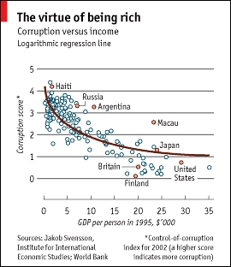

Slide 10
Less corruption in rich countries
Problems of causality of course.
In addition, very few reliable estimates of corruption.
    Hidden activity by nature
    Measuring corruption may alter behavior.
Should we then only analyze corruption theoretically?

Slide 11
Measuring corruption (1)
Perceptions
    Advantage: Easy to collect and good coverage.
    Main disadvantage: May be biased by endogenous institutions such as free media.
Surveys of bribe payers
Low stigma of paying bribes and easily replicable.

Slide 12
Measuring corruption (2)
Direct observation: Example of truck drivers in Indonesia.
During 9 months, RA’s were dressed as truck assistants and recorded 6000 payments on over 300 trips.
13 % of MC (Driver wage 10%).
Survey over report incidence.

Slide 13
Measuring corruption (3)
Estimation by subtraction: Good to measure theft:
Corruption = Measure before – Measure after.
Fisman and Wei (2004) compare Hong Kong exports to China to China’s imports from HK: Large difference, most for goods with high taxes.

Slide 14
Estimation by subtraction (2)
Renikka and Svensson (2004) compare grants to local level education in Uganda to the grants recieved by schools.
Leakage rate of 87 %.
Once publicized it fell to less than 20 %.

Slide 15
Estimation by subtraction (3)
Olken (2007) compares amount spent on roads to their actual cost.
Dug samples to estimate material, collected data on wages, built test roads.
24 % difference in cost.
Olken (2006) finds 18 % of rice from food programs disappears in Indonesia by using survey data.

Slide 16
Measuring corruption (4)
Estimates from market inference.
Fisman (2001) uses this approach in Indonesia and finds lots of corruption.
Connection data from a consulting firm.
See how sjhare prices move with president’s health.
Up 2 23 % of firm value due to political connections.

Slide 17
Estimates from market inference (2)
The approach is replicable in any case where one has data on firms’ connections to prominent politicians and when the politician experiences health shocks.
Fisman replicates it in 2006 in the US and finds no relation between VP Cheney heart attacks (as a candidate and in office) on connected stocks.

Slide 18
What do we learn from these studies?
We still find a strong negative relationship between income and corruption. But note that as this question is not asked in the good studies, causality is not settled.
There is a lot of heterogeneity in corruption levels, even among similarly rich countries.

Slide 19
Does corruption matter?
Again, in theory corruption could have either efficiency costs or lead to efficiency gains.
The endogenous nature of corruption makes finding credible instruments for corruption at the macro level difficult.
But there is some micro evidence.

Slide 20
Impact on firms
Marginal tax rate: May increase or decrease.
More uncertainty with corruption than with tax: Svensson (2003) finds larger negative impact of bribes on firm activity than of taxes.
Corruption may affect production choices.

Slide 21
Impact on government provision
May increase the cost of government goods and services. Projects that would be cost effective at the true costs are no longer cost effective once the costs of corruption are included, and hence are not done. (More research needed!)
Corruption may create additional efficiency costs through distortions, evidence for this exist.

Slide 22
Impact on correcting externalities
The marginal cost of breaking the law is reduced from the official fine to the amount of the bribe.
Or if the police extracts the same bribe regardless of whether the person has broken the law, so that the marginal cost of breaking the law falls to zero.
Evidence from truck drivers in Indonesia: Flat relationship between overweight trucks leading to reduced marginal costs.

Slide 23
Determinants of corruption
Compensation: More evidence needed.
Monitoring and punishment: Randomized experiment from Indonesia on reduced corruption and on electoral punishment from information.
Selection: More evidence needed.
Incentives: Evidence is largely lacking but some exist on education and health.

Slide 24
What to do about it?
Transparency: Should enable monitoring but may worsen the candidate pool.
Cross sectional evidence suggests it reduces corruption, but watch out for reversed causality.
Randomized experiments from Dehli suggests providing information helps as well.
But Chong et al. (2012) show it may even damage the political system.

Slide 25
Short term vs long term
Corrupt officials change behavior in response to laws and measurement.
When we start knowing about one mechanism, another may start.
Better institutions (transparency, checks and balances, etc.) are needed. Of course, but not easy to solve as we will see in coming lectures.

Slide 26
Cultural change
Another approach that is not covered in the overview is cultural change.
The idea is that corruption is partly a cultural phenomenon and that it can or has to be tackled as such as well.
We will look at the case of Bogota and at diplomats in New York.

Slide 27
Bogota
Murder capital of the world.
More than 4000 murders per year.
Other related crimes, in particular kidnapping, as well.
Enter Antanas Mockus

Slide 28
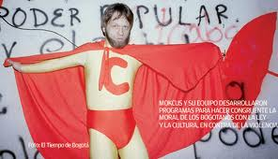
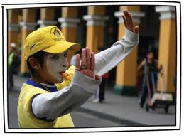
Cultural change in Bogota

Slide 29
But how separate culture from economics or institutions?
Mockus did lot of different things.
Cross nationally the different things often go hand in hand.
Nigeria vs Norway: There are other differences than simply Norwegians being more law abiding.

Slide 30
The perfect experiment
Take government officials from all countries.
Put them in the same environment without any formal law enforcement, like a anarchy fantasy land.
Compare their behavior under these similar institutions.

Slide 31
Diplomats at the UN headquarter
They are from all countries and they have diplomatic immunity.
Fisman and Miguel (2007) use this setting to look at parking tickets.
They find a strong effect of curruption norms.

Slide 32
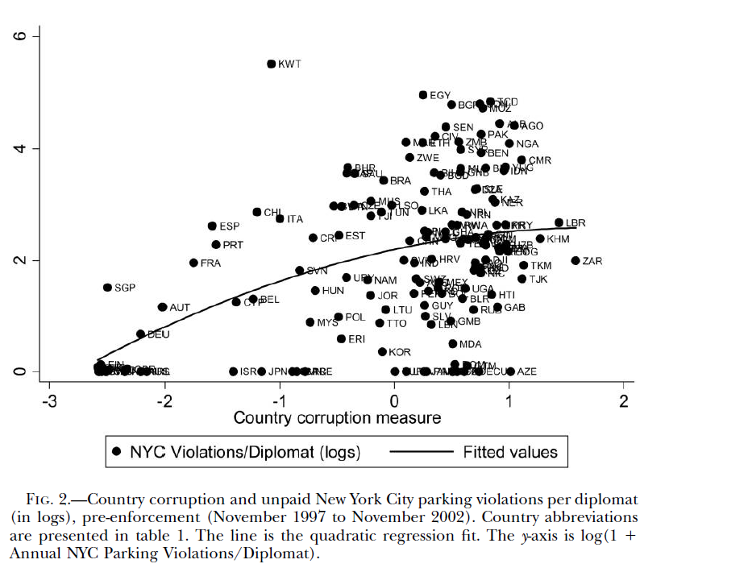

Slide 33
Interpretation
”We find that the number of diplomatic parking violations is strongly correlated with existing measures of home country corruption. This finding suggests that cultural or social norms related to corruption are quite persistent: even when stationed thousands of miles away, diplomats behave in a manner highly reminiscent of government officials in the home country. Norms related to corruption are apparently deeply ingrained, and factors other than legal enforcement are important determinants of corruption behavior.”

Slide 34
Law enforcement also matters
A new rule came in November 2002 with increased enforcement.
New York City began stripping the official diplomatic license plates from vehicles that accumulated more than three unpaid parking violations.
What happened?

Slide 35
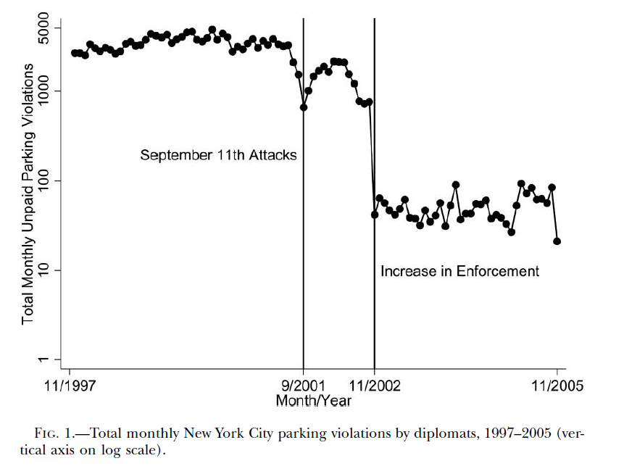

Slide 36
Discussion
Obviously very smart to use this epidemiological approach but:
How do we know the diplomats are not punished once home again, e.g. by media? (i.e. institutions still drive it)
How do we know it is not entirely driven by selection because of institutions in the home country?

Slide 37
The world bank elected a new leader
There was a lot of discussion in the media and on blogs about the election of Jim Yong Kim as president for the WB.
He was nominated by president Obama, which has made some people protest.
Ngozi Okonjo-Iweala, economist from Nigeria was the second candidate.
Should we be angry and why?

Slide 38
The world bank
What is it? A Bank, a charitable organization, a think-tank, research organization, data collector?
What has it done historically? Tried to save the world or reproducing hegemonic power?
What should it do?

Slide 39
Be angry?
Depending on the answers to the questions before you can be angry for several reasons.
My take: The US always gets the WB and Kim is not that bad. The discussion has started and will hopefully spread to more substantive areas.

Slide 40
Why does the US get the WB and Europe the IMF?
Illuminating article by Benn Steil in The New York Times (April 8th last year).
The US was worried that their own candidate at the time (in 1946) was a Soviet spy.
They gave away the IMF seat and took the WB instead.
”Instead of treating the World Bank presidency as a sacred American birthright, we should remember that it was never more than a consolation prize for an administration trying to dodge a spy scandal.”

