Slide 1
The Value of the Brazilian Amazon Rainforest
Jon Strand
Lecture October 25, 2017

Slide 2
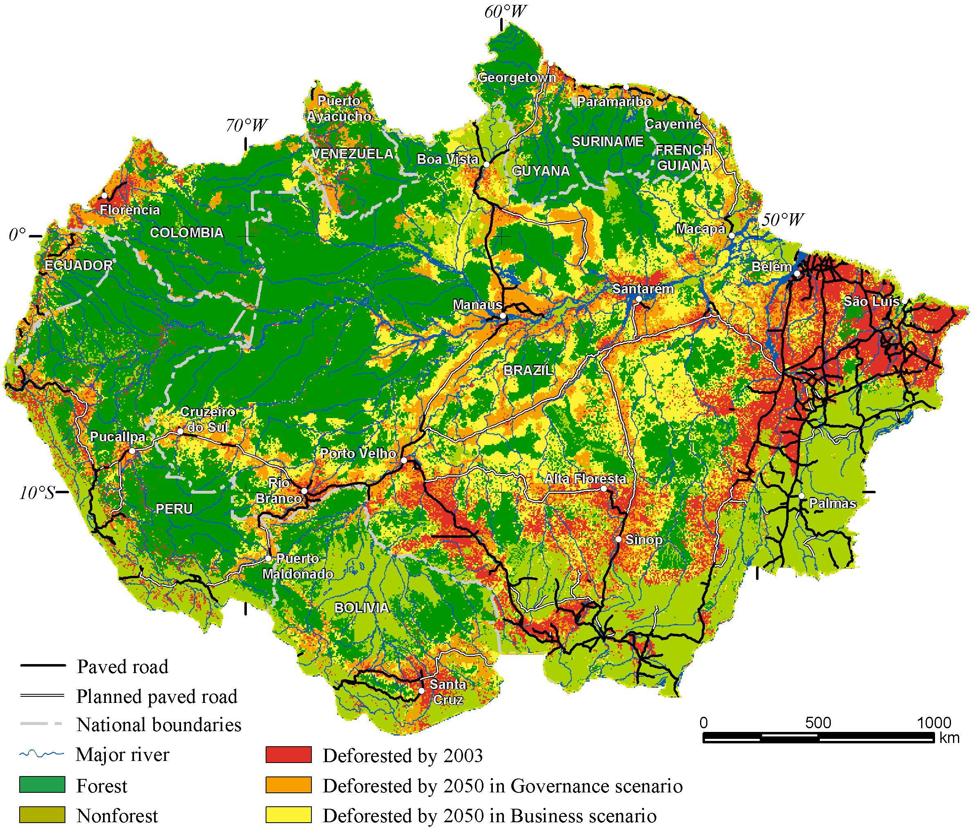
Possible forest losses in the Amazon to 2050

Slide 3
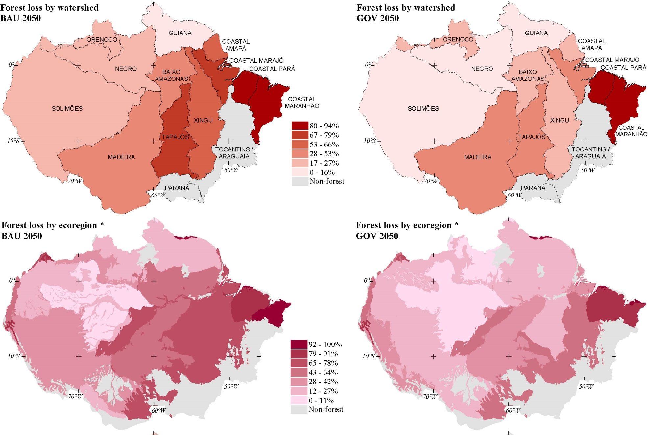
Analyzing the consequences
2/3 of vegetation cover of 15 ecoregions among 32 would be eliminated

Slide 4
What is the value of the Amazon rainforest?
We separate between three classes of value:
1) Local and regional values to the population in South America
2) Carbon values: The global benefit from carbon sequestration by keeping the forest
3) “Other global values”: Willingness to pay in other countries to preserve the Amazon rainforest
The project that is mainly discussed here considers elements 1 and 2 only. Parts of element 3 have been subject to separate research in the World Bank.

Slide 5
Why is spatial economic valuation of the Amazon particularly useful?
Tells us where to most discourage conversion of rainforest to agriculture, by comparing preservation values to local opportunity values.
Where to put most effort to prevent illegal logging.
Where to prevent forest fires, and how hard to work at this.
Where to establish new national parks and indigenous zones.
All these issues are crucially important for governments in the Amazon region.
Value mapping is helpful for these governments in this work.
But – far from all resources in the Amazon can easily be valued at a fine spatial scale. One example is biodiversity, another is recreation and tourism.

Slide 6
Environmental valuation: Types of value
Use value: This is our direct value from the forest (or another environmental good), in terms of products, or services (such as tourism and recreation, health benefits).
Option value: The value we put to have the option to use the resource, even if we are currently not using it.
Existence or preservation («passive-use») value: This is the value we put to the resource, just because we want it to exist and be preserved, for us now and in the future, and for future generations.

Slide 7
3 main groups of goods and services that give rainforests value:
Provisioning services: timber, non-timber products, game, fish, bioprospecting.
Supporting and regulating services: Carbon sequestration, biodiversity and biological resources, hydrological impacts, watershed protection, erosion prevention, forest fire regulation.
Cultural and other human services: Tourism and recreation, human health impacts.
My Amazon project values only some of these services, those easiest to map and value in economic terms (timber; NTFPs; carbon; certain hydrological impacts).

Slide 8
How do we value environmental goods (including rainforests)?
Three types/groups of methods:
1. Using market prices of the outputs produced by the «environmental goods». This is largely what is used in the project presented here.
2. Revealed preference (RP) methods. We look at behavior of individuals in their use of environmental goods, or in revealing their preference for these goods through markets.
3. Stated-preference (SP) methods. This means to ask individuals questions related to how they value environmental goods. This is the most versatile method, which can cover all concepts of environmental value. The method however has problems and must be used with care.
Very often for environmental goods, the value is not directly revealed in markets. Then we must use methods of types 2 and 3.
Existence or preservation («passive-use») value must always be found using SP.
We have two main SP techniques:
Contingent valuation: one asks question(s) about the value of the environmental good.
Choice experiments: one constructs choice situations that permit one to derive trade-offs between environment and money.

Slide 9
The “platform” for mapping of geographically differentiated ecosystem values of the Brazilian Amazon
The valuation platform set up by the Belo Horizonte team, led by Britaldo Soares-Filho
The platform is constructed with two layers for each included elements, with pixel resolution 1 km2:
  1) Biophysical mapping of resource base or impact
  2) Economic valuation of biophysical impacts.

Slide 10
The valuation platform (cont.)
The platform available interactively at:
http://csr.ufmg.br/amazones/
Provides detalied biophysical and economic value maps of local and regional values + carbon values
In the platform, thesse values are mapped for the entire Brazilian Amazon, at resolution 1 km2 pixels

Slide 11
The project’s approach to economic valuation
Convert all forest values, for which we have secure and spatially differentiated money values, to a common metric, money.
Not all potential values have been possible to monetize (yet). This economic value metric is very conservative.
Such a “barebones” set of values can still be useful in deriving minimal values of the forest: It is often sufficient to make decisions on saving given local forest areas.

Slide 12
The valuation platform has 5 main elements:
1. Hydrological impacts of forest losses on main economic activities (agriculture and hydropower)
2. Economic value of sustainable timber and non-timber forest products
3. Biodiversity mapping
4. Carbon emissions when rainforest is lost
5. Forest fire activity, spread and damage in the Amazon are also mapped.

Slide 13
Mapping hydrological impacts of forest losses
A team at the Federal University of Viçosa, Brazil, led by Marcos Costa, is responsible for the work with this element. See this website:
http://www.biosfera.dea.ufv.br/en-US/deforestation-and-rainfall
Value mapping here consists in three steps:
  Impacts of Amazon rainforest losses on rainfall patterns in all of South America, using a global circulation model (CCM3-IBIS)
  Impacts of rainfall changes on agricultural outputs, and net economic returns from soy, beef and hydropower, in Brazil and Argentina
  “Reverse calculations” to ascribe losses for soy, beef and hydropower back to each forest pixel in the Amazon, in US$/ha/year.

Slide 14
Digression on soybeans, livestock and hydropower production in South America, and Amazon deforestatoin
Soybean production had increased dramatically in South America over the last 20 years, and the region now produces about 175 million tons/year, more than half of the global output. For both Brazil and Argentina, soybeans are the largest export article. This has made the region dependent on soybean productivity, which is heavily affected by regional rainfall.
Brazil has the largest number of livestock in the world apart from India (about 220 million), and is the world’s largest exporter of beef.
Brazil is the world’s second largest producer of hydroelectric power (after China). South America/Brazil has three of the five largest installations in the world (Itaipu and Tucurui, and recently Belo Monte).
All these activities are highly dependent on regional rainfall, which is heavily affected by Amazon deforestation.

Slide 15
Element 2: Mapping economic values of sustainable timber and non-timber forest product (NTFP) extraction
Net economic returns from “reduced impact logging” (RIL) modeled and mapped.
RIL not allowed in protected/indigenous areas
RIL returns very sensitive to extraction costs (RIL generally not economically viable in remote areas)
NTFP more widely viable as extraction costs are relatively lower
Economic valuation of sustainable NTFP extraction mapped for two products widely prevalent in the Brazilian Amazon:
  a) Brazil nut
  b) Rubber

Slide 16
Element 3: Biodiversity mapping
  We map several aspects/features of biodiversity including endemicity, phylogenetic composition, species composition, species richness, and biodiversity conservation priority areas.
  No values have been ascribed to spatially explicit, local and regional, economic values of biodiversity in the project. (A pilot stated-preference survey indicates relatively limited valuation of biodiversity in Brazil.)
  No project internationally has succeeded, nor seriously attempted, at such valuation. We have been working on this from various angles, including using stated preferences.

Slide 17
Element 4: Carbon emissions from deforestation
Avoiding carbon emissions is a very important part of the value of protecting the Amazon.
The spatial carbon emissions map is built into the valuation platform.
Average carbon emissions when Amazon rainforest is lost estimated at about 130 ton C/ha (460 ton CO2/ha): but varies a lot across the Amazon.

Slide 18
Element 5: Forest fires and forest value
This is not a value element. But forest fires have (potentially large) impacts on forest value.
Aims of this work:
  a) To model forest fire occurrence and spread using the FISC model
  b) To calculate economic costs due to forest fires using the EcoFire model
  We also aim, in extensions of this project, to create a spatial map of externality impacts of local forest losses, multiplying these losses due to localized forest fragmentation and dryness.

Slide 19
Average and marginal forest values
Average and marginal values of the rainforest very often differ
Marginal rainforest value: What is lost by losing a very small part of the forest, while the rest is intact?
Marginal values are often lower than average values:
For biodiversity valuation: Losing a small part of the forest does not necessarily lead to biodiversity loss
For tourism: Losing a small part of the forest does not necessarily reduce the overall value of the rainforest for tourists, as they may seek other areas.
But marginal values can also be higher than average values, as illustrated in the model discussed in the following.

Slide 20
Marginal rainforest values can be given an analytical basis using asset equations
Forest asset return (undamaged forest):
Asset return to forest damaged by fire:

Slide 21
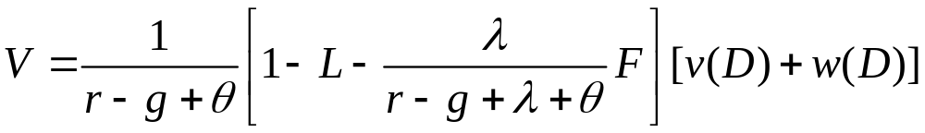
Analytical formulation of asset equations (cont.)
Forest value (total for a given small “unit patch” of forest)
Marginal forest value (value loss when a small forest amount is lost):

Slide 22
Average and marginal forest values (cont.)
Marginal forest values are in some cases higher than average values
This can be due to two externality factors, illustrated by the model on the preceding slides:
  Losing additional rainforest could increase local fire risk
  Losing more rainforest makes the remaining forest drier, increasing fire risks, and reducing the value of standing forest.
These factors, associated with forest fires, increase marginal forest values (of saving a small piece of forest). This is in spite of forest fires reducing average forest values.
The valuation project aims to parameterize these externalities via modeling of forest fire risk. This is not yet done in the platform.

Slide 23
Stated-preference work in Brazil to date: 3 pilot surveys in large cities (together 200 interviews), focusing on forest loss, biodiversity loss, and local climate effects (the three issues found important in initial focus group work).
Results are stated in WTP/hh/month. (All interviews in social groups A-C)

Slide 24
The central valuation platform’s aggregate value feature:
«Query» facility sums up the economic values of the following impacts:
RIL, rubber, Brazil nut, carbon, and net hydrological impacts on soy, beef and hydropower production.
Calculates the protection value per hectare per year, across the entire Brazilian Amazon, related to these elements.
The user can insert desirable parameter values for the prices of carbon, soy, beef, and electricity.
As remarked above, biodiversity values are not (yet) included in the spatially explicit protection value in the platform.
Several other value elements are also not (yet) embedded (see below). This makes the platform values overall very conservative.

Slide 25
Value elements not (yet) part of the valuation platform:
  Tourism and recreation
  Bioprospecting (could be an integrated part of biodiversity values)
  Health impacts of deforestation (contagious diseases; air pollution)
  Watershed protection, including avoidance of droughts and flooding impacts
  Other local products including fishing, hunting and gathering.

Slide 26
Mapping opportunity costs
Opportunity costs are economic values associated with converting Amazon rainforest land to other uses, such as agriculture.
Only when opportunity costs are higher than the true and total value of the protected rainforest (including all value components) should deforestation be allowed.
Work to assess opportunity costs for the Amazon will be addressed in follow-up work.

Slide 27
This work as basis for cost-benefit analysis on Amazon rainforest protection
The total value of protecting the Amazon rainforest has three major components:
1. Local and regional values
2. Carbon values (a global value)
3. Other value related to protecting the Amazon in the rest of the world:
People in other countries are also willing to pay to preserve the Amazon forest. The total magnitude of such values is currently unclear.
Some such results have however been found in a stated-preference survey in the U.S. and Canada, by the World Bank.

Slide 28
Concern among households in U.S. and Canada, related to protecting the Amazon. (Percent of respondents who mention the individual issues.)

Slide 29

Estimation results, using validated respondents estimation sample (n=849).
WTP estimates for a program to reduce by 2050 the area of forest losses by 12 %-points
and the number of species at high risk of extinction by
10 %-points is listed on the bottom row.
Estimates are in terms of US$ per % point for avoided forest loss and reduced species threats.
 |  | Model 1: Mixed Logit Model with Correlated Random Parameters |  |  | Model 1 + Controls for Program Misconceptions
Variable |  | Est. | t-value | p-value | Est. | t-value | p-value
Avoided forest loss, WTP in $ per 1 % point | Mean | 5.48 | 9.75 | 0.00 | 5.57 | -9.70 | 0.00
 | Std. dev. | 2.49 | 1.08 | 0.28 | 2.53 | 0.91 | 0.36
Reduced species threats, WTP in $ per 1 % point | Mean | 6.42 | 6.83 | 0.00 | 6.42 | -6.87 | 0.00
 | Std. dev. | 7.51 | 3.42 | 0.00 | 7.97 | 3.28 | 0.00
L_{F,S} |  | -0.54 | -2.30 | 0.02 | 0.53 | -1.91 | 0.06
Program cost | Mean | -0.53 | -3.05 | 0.00 | -0.51 | -2.84 | 0.00
 | Std. dev. | 0.40 | 5.97 | 0.00 | 0.42 | 5.88 | 0.00
Status Quo, WTP in $ |  | -109.93 | -6.43 | 0.00 | -100.31 | 4.10 | 0.00
_{SQ+1} |  | 0.73 | 3.88 | 0.00 | 0.73 | 3.92 | 0.00
Age 30-44 |  | -0.02 | -0.29 | 0.77 | -0.02 | -0.21 | 0.84
Age 45-59 |  | -0.22 | -2.48 | 0.01 | -0.21 | -2.37 | 0.02
Age 60 or more |  | -0.66 | -4.70 | 0.00 | -0.63 | -4.55 | 0.00
High school or less |  | 0.09 | 1.31 | 0.19 | 0.07 | 1.00 | 0.32
White, non-hispanic |  | 0.12 | 1.39 | 0.17 | 0.11 | 1.30 | 0.19
Black |  | -0.30 | -2.03 | 0.04 | -0.25 | -1.76 | 0.08
Hispanic |  | -0.66 | -3.00 | 0.00 | -0.62 | -2.91 | 0.00
Female |  | 0.19 | 3.14 | 0.00 | 0.20 | 3.40 | 0.00
Self-employed |  | 0.09 | 0.80 | 0.42 | 0.10 | 0.94 | 0.35
Retired |  | 0.15 | 1.10 | 0.27 | 0.11 | 0.82 | 0.41

Slide 30
Calculation of total WTP in U.S. and Canada, for saving 12% of the Amazon forest, and 10% of the species:
$5.50/hh/year per % point forest saved = $66/hh/year for 12% points
$6.40/hh/year per % point species saved = $64/hh/year for 10% points
With 140 million households in the two countries:
$9.24 billion/year for saving Amazon rainforests as such
$8.96 billion/year for protecting the species in the Amazon
Total WTP/year in U.S.+ Canada for protecting the forest and species
= $18.2 billion
Per-hectare value (given 12 % of 500 million has = 60 million has) = $303/ha/year
With 5% discounting (high) this is eqivalent to more than $5,000/ha up to 2050.

Slide 31
Value components in Amazon rainforest valuation (cont.)
Values 1-2 are the objectives the spatial World Bank project.
For carbon values, 100-160 tons of carbon (360-550 tons of CO2) are assumed to be released on average per ha of rainforest deforested. With a (global) social cost of carbon = $30 per ton CO2, this is equivalent to a deforestation cost of about $10,000-16,000 per hectare, as the “carbon value of preventing deforestation”.
For category 3 values, we find from the U.S./Canada survey a protection value of at least about $5,000 per hectare of saved rainforest in the Amazon. (This is, presumably, non-carbon.)

Slide 32
Value components in Amazon rainforest valuation (cont.)
Consider adding all value components 1-3 up to an integrated, spatially explicit and differentiated, value of the Brazilian Amazon rainforest.
These benefits can be compared to program costs, for an overall evaluation in economic terms, of programs for Amazon protection.
(Note again that outside of South America only carbon values, plus other values for U.S./Canada, are included. Several local/regional elements are also not included.)

