Slide 1
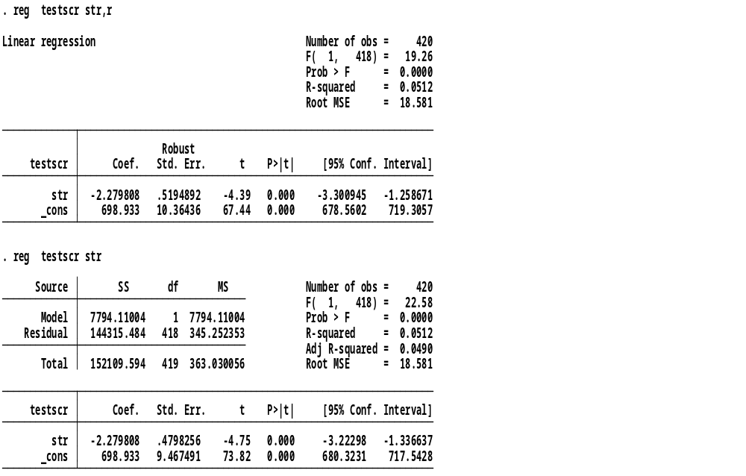
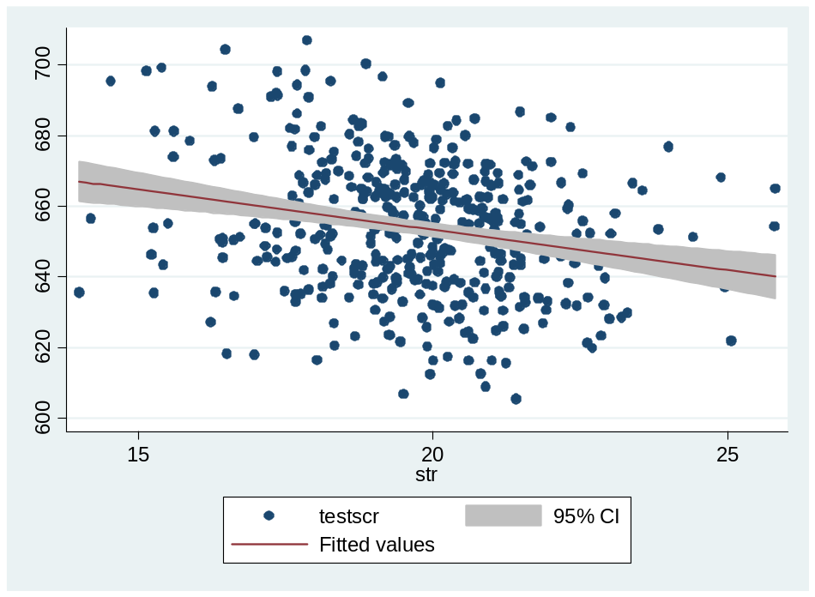
ECON4135, 15.09.11
The testscore example, output from Stata

Slide 2
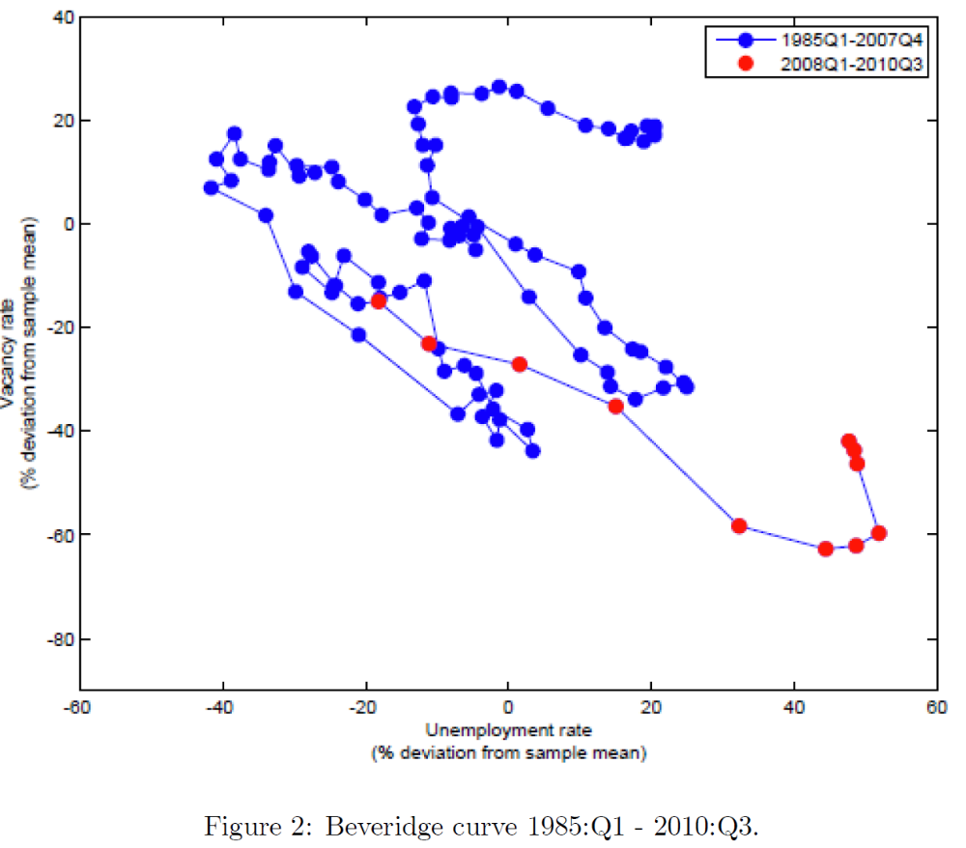
A scatter plot of data (X,Y) that do not staisfie the OLS assumptions.
Why?
From Mismatch shocks and the natural rate of unemployment during the Great Recession
by Furlanetto and Groshenny (Data for USA)

