Slide 1
Non-life insurance mathematics
Nils F. Haavardsson,
University of Oslo and DNB Forsikring

Slide 2
Agenda
The motivation
The sources of risk
Portfolio liabilities by simple approximation
Portfolio liabilities by simulation

Slide 3
The main driver of financial regulation is to avoid bankruptcies and systemic risk
Protecting policy holders across the EU
Optimizing capital allocation by aligning capital requirements to actual risk
Create an equal and consistent regulatory regime across the EU
Create regulations that are consistent with the ones in comparable industries (particularly banking)
Create an improved «platform» for proper regulation and supervision, based on increased transparency, more data and better documentation

Slide 4
SCR
Standard model
Adj
BSCR
Op
Market
Health
Default
Life
Non-life
Intang
Interest rate
SLT Health
H CAT
Non-SLT Health
Mortality
Premium Reserve
Equity
Mortality
Premium Reserve
Longevity
Lapse
Property
16
Longevity
Disability Morbidity
NL CAT
Lapse
Spread
43
Disability
Morbidity
Lapse
Currency
Lapse
Expenses
Nat Cat
Mass accident
Con-centration
30
Expenses
Revision
NP Reins.
Accident conc.
Revision
L CAT
Man made
Pandemic
NL CAT other
https://eiopa.europa.eu/Publications/Standards/A_-_Technical_Specification_for_the_Preparatory_Phase__Part_I_.pdf

Slide 5
Solvency
Financial control of liabilities under nearly worst-case scenarios
Target: the reserve
  which is the upper percentile of the portfolio liability
Modelling has been covered (Risk premium calculations)
The issue now is computation
  Monte Carlo is the general tool
  Some problems can be handled by simpler, Gaussian approximations

Slide 6
10.2 Portfolio liabilities by simple approximation
The portfolio loss for independent risks become Gaussian as J tends to infinity.
Assume that policy risks X1,…,XJ are stochastically independent
Mean and variance for the portfolio total are then
which is average expectation and variance. Then
as J tends to infinfity
Note that risk is underestimated for small portfolios and in branches with large claims

Slide 7
Normal approximations

Slide 8
The rule of double variance
Poisson
Some notions
Examples
Random intensities
Let X and Y be arbitrary random variables for which
Then we have the important identities
Rule of double expectation
Rule of double variance

Slide 9
The rule of double variance
Poisson
Some notions
Examples
Random intensities
Portfolio risk in general insurance
Elementary rules for random sums imply

Slide 10
The rule of double variance
Poisson
Some notions
Examples
Random intensities
This leads to the true percentile qepsilon being approximated by
Where phi epsilon is the upper epsilon percentile of the standard normal distribution

Slide 11
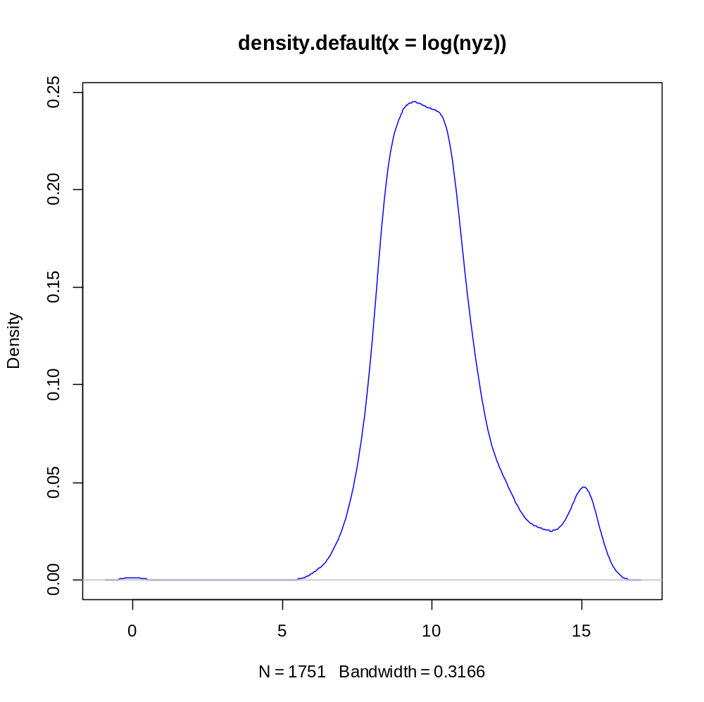
Fire data from DNB

Slide 12
Normal approximations in R
z=scan("C:/Users/wenche_adm/Desktop/Nils/uio/Exercises/Branntest.txt");
# removes negatives
nyz=ifelse(z>1,z,1.001);
mu=0.0065;
T=1;
ksiZ=mean(nyz);
sigmaZ=sd(nyz);
a0 = mu*T*ksiZ;
a1 = sqrt(mu*T)*sqrt(sigmaZ^2+ksiZ^2);
J=5000;
qepsNO95=a0*J+a1*qnorm(.95)*sqrt(J);
qepsNO99=a0*J+a1*qnorm(.99)*sqrt(J);
qepsNO9997=a0*J+a1*qnorm(.9997)*sqrt(J);
c(qepsNO95,qepsNO99,qepsNO9997);

Slide 13
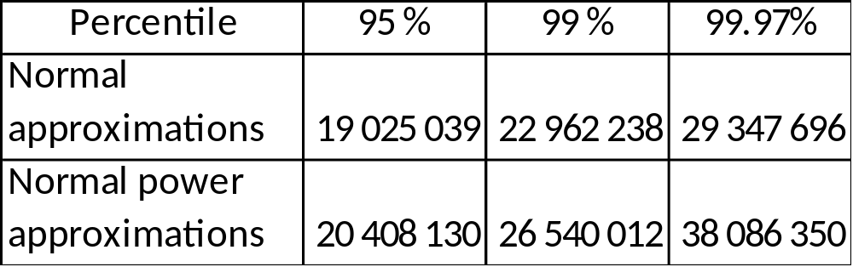
The normal power approximation
ny3hat = 0;
n=length(nyz);
for (i in 1:n)
{
ny3hat = ny3hat + (nyz[i]-mean(nyz))**3
}
ny3hat = ny3hat/n;
LargeKsihat=ny3hat/(sigmaZ**3);
a2 = (LargeKsihat*sigmaZ**3+3*ksiZ*sigmaZ**2+ksiZ**3)/(sigmaZ^2+ksiZ^2);
qepsNP95=a0*J+a1*qnorm(.95)*sqrt(J)+a2*(qnorm(.95)**2-1)/6;
qepsNP99=a0*J+a1*qnorm(.99)*sqrt(J)+a2*(qnorm(.99)**2-1)/6;
qepsNP9997=a0*J+a1*qnorm(.9997)*sqrt(J)+a2*(qnorm(.9997)**2-1)/6;
c(qepsNP95,qepsNP99,qepsNP9997);

Slide 14
Portfolio liabilities by simulation
Monte Carlo simulation
Advantages
  More general (no restriction on use)
  More versatile (easy to adapt to changing circumstances)
  Better suited for longer time horizons
Disadvantages
  Slow computationally?
  Depending on claim size distribution?

Slide 15
An algorithm for liabilities simulation
Assume claim intensities for J policies are stored on file
Assume J different claim size distributions and payment functions H1(z),…,HJ(z) are stored
The program can be organised as follows
  Assume log normal distribution for claim size

Slide 16
An algorithm for liabilities simulation using mixed distribution
Assume p is given, representing the likelihood of being in the extreme right tail
  With likelihood 1-p non-parametric sampling from the data in the normal range is used
  With likelihood p sampling from a distribution selected for the extreme right tail is used.
The program can be organised as follows
  Assume Weibull distribution for claim size in the extreme right tail

Slide 17
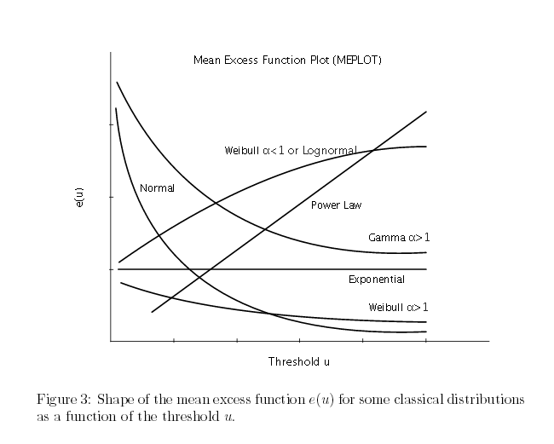

Slide 18
Experiments in R
1. Find the claim size distribution
1a. Try Gamma
1b. Weibull
2. Simulate portfolio liability using Monte Carlo
3. Simulate portfolio liability using normal approximation
4. Compare the results

Slide 19
An algorithm for liabilities simulation
Assume claim intensities for J policies are stored on file
Assume J different claim size distributions and payment functions H1(z),…,HJ(z) are stored
The program can be organised as follows (Algorithm 10.1)

Slide 20
Monte Carlo theory
Suppose X1, X2,… are independent and exponentially distributed with mean 1.
It can then be proved
(1)
for all n >= 0 and all lambda > 0.
From (1) we see that the exponential distribution is the distribution that describes time between events in a Poisson process.
In Section 9.3 we learnt that the distribution of X1+…+Xn is gamma distributed with mean n and shape n
The Poisson process is a process in which events occur continuously and independently at a constant average rate
The Poisson probabilities on the right define the density function
which is the central model for claim numbers in property insurance.
Mean and standard deviation are E(N)=lambda and sd(N)=sqrt(lambda)

Slide 21
An algorithm for liabilities simulation
Assume claim intensities for J policies are stored on file
Assume J different claim size distributions and payment functions H1(z),…,HJ(z) are stored
The program can be organised as follows (Algorithm 10.1)

