Slide 1
STK 4540 Lecture 6
Claim size

Slide 2
The ultimate goal for calculating the pure premium is pricing
Pure premium = Claim frequency x claim severity
Parametric and non parametric modelling (section 9.2 EB)
The log-normal and Gamma families (section 9.3 EB)
The Pareto families (section 9.4 EB)
Extreme value methods (section 9.5 EB)
Searching for the model (section 9.6 EB)

Slide 3
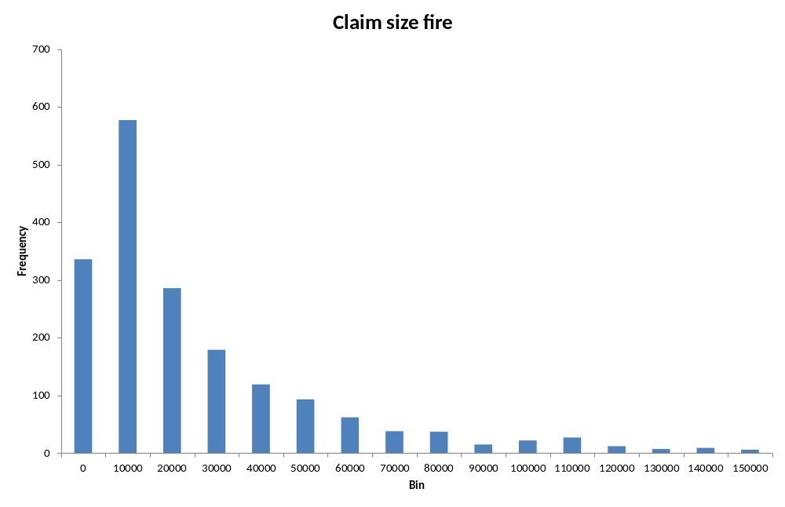
Claim severity modelling is about describing the variation in claim size
Non parametric
Log-normal, Gamma
The Pareto
Extreme value
Searching
The graph below shows how claim size varies for fire claims for houses
The graph shows data up to the 88th percentile
How do we model «typical claims» ? (claims that occur regurlarly)
How do we model large claims? (claims that occur rarely)

Slide 4
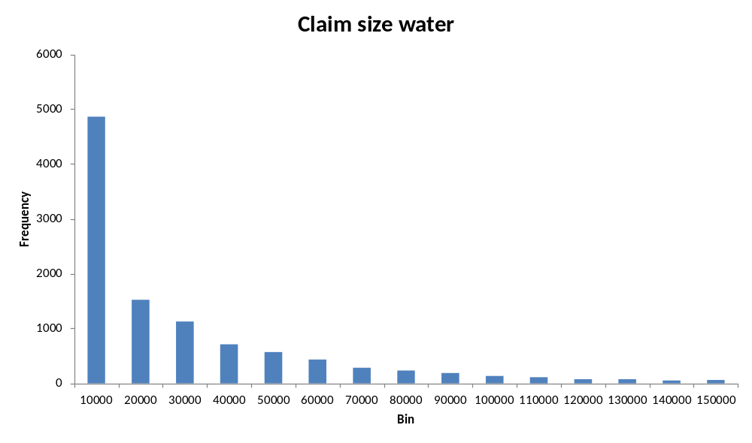
Claim severity modelling is about describing the variation in claim size
Non parametric
Log-normal, Gamma
The Pareto
Extreme value
Searching
The graph below shows how claim size varies for water claims for houses
The graph shows data up to the 97th percentile
The shape of fire claims and water claims seem to be quite different
What does this suggest about the drivers of fire claims and water claims?
Any implications for pricing?

Slide 5
The ultimate goal for calculating the pure premium is pricing
Non parametric
Log-normal, Gamma
The Pareto
Extreme value
Searching
Claim size modelling can be parametric through families of distributions such as the Gamma, log-normal or Pareto with parameters tuned to historical data
Claim size modelling can also be non-parametric where each claim zi of the past is assigned a probability 1/n of re-appearing in the future
A new claim is then envisaged as a random variable for which
This is an entirely proper probability distribution
It is known as the empirical distribution and will be useful in Section 9.5.
Size of claim
Client behavour can affect outcome
Burglar alarm
Tidy ship (maintenance etc)
Garage for the car
Bad luck
Electric failure
Catastrophes
House fires
Where do we draw
the line?
Here we sample from the empirical distribution
Here we use special
Techniques (section 9.5)

Slide 6
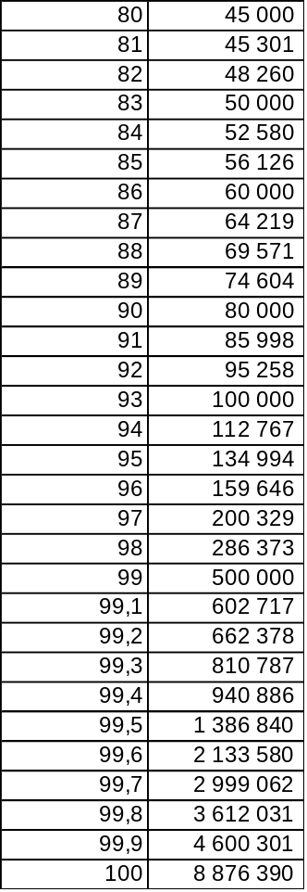
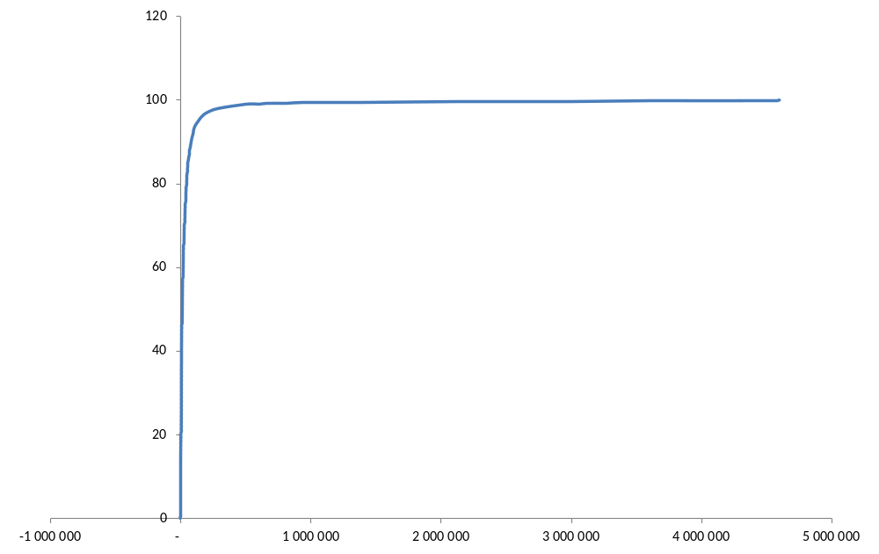
Example
Non parametric
Log-normal, Gamma
The Pareto
Extreme value
Searching
Empirical
distribution
The threshold may be set for example at the 99th
percentile, i.e., 500 000 NOK for this product
The threshold is sometimes called the large claims threshold

Slide 7
Non-parametric modelling can be useful
Scale families of distributions
All sensible parametric models for claim size are of the form
and Z0 is a standardized random variable corresponding to .
The large the scale parameter, the more spread out the distribution

Slide 8
Scale families of distributions
Non parametric
Log-normal, Gamma
The Pareto
Extreme value
All sensible parametric models for claim size are of the form
and Z0 is a standardized random variable corresponding to .
This proportionality is inherited by expectations, standard deviations and percentiles; i.e. if are expectation, standard devation and -percentile for Z0, then the same quantities for Z are
The parameter can represent for example the exchange rate.
The effect of passing from one currency to another does not change the shape of the density function (if the condition above is satisfied)
In statistics is known as a parameter of scale
Assume the log-normal model where and are parameters and . Then . Assume we rephrase the model as
Then
Searching

Slide 9
Fitting a scale family
Non parametric
Log-normal, Gamma
The Pareto
Extreme value
Models for scale families satisfy
where are the distribution functions of Z and Z0.
Differentiating with respect to z yields the family of density functions
The standard way of fitting such models is through likelihood estimation. If z1,…,zn are the historical claims, the criterion becomes
which is to be maximized with respect to and other parameters.
Searching

Slide 10
Shifted distributions
Shifted distributions
The distribution of a claim may start at some treshold b instead of the origin.
Obvious examples are deductibles and re-insurance contracts.
Models can be constructed by adding b to variables starting at the origin; i.e. where Z0 is a standardized variable as before. Now
Example:
  Re-insurance company will pay if claim exceeds 1 000 000 NOK
The payout of the re-insurance company,
given that the total claim amount exceeds 1M
Total claim amount
in NOK
Currency rate for example NOK per EURO, for example 8 NOK per EURO

Slide 11
Shifted distributions
Non parametric
Log-normal, Gamma
The Pareto
Extreme value
Searching
The distribution of a claim may start at some treshold b instead of the origin.
Obvious examples are deductibles and re-insurance contracts.
Models can be constructed by adding b to variables starting at the origin; i.e. where Z0 is a standardized variable as before. Now
and differentiation with respect to z yields
which is the density function of random variables with b as a lower limit.

Slide 12
Skewness as simple description of shape
Skewness
A major issue with claim size modelling is asymmetry and the right tail of the distribution. A simple summary is the coefficient of skewness
Negative skewness
Positive skewness
Negative skewness: the left tail is longer; the mass of the distribution
Is concentrated on the right of the figure. It has relatively few low values
Positive skewness: the right tail is longer; the mass of the distribution
Is concentrated on the left of the figure. It has relatively few high values

Slide 13
Skewness as simple description of shape
Non parametric
Log-normal, Gamma
The Pareto
Extreme value
Searching
A major issue with claim size modelling is asymmetry and the right tail of the distribution. A simple summary is the coefficient of skewness
The numerator is the third order moment. Skewness should not depend on currency and doesn’t since
Skewness is often used as a simplified measure of shape
The standard estimate of the skewness coefficient from observations z1,…,zn is

Slide 14
Non-parametric estimation
Non parametric
Log-normal, Gamma
The Pareto
Extreme value
Searching
The random variable that attaches probabilities 1/n to all claims zi of the past is a possible model for future claims.
Expectation, standard deviation, skewness and percentiles are all closely related to the ordinary sample versions. For example
Furthermore,
Third order moment and skewness becomes
Skewness tends to be small
No simulated claim can be larger than what has been observed in the past
These drawbacks imply underestimation of risk

Slide 15
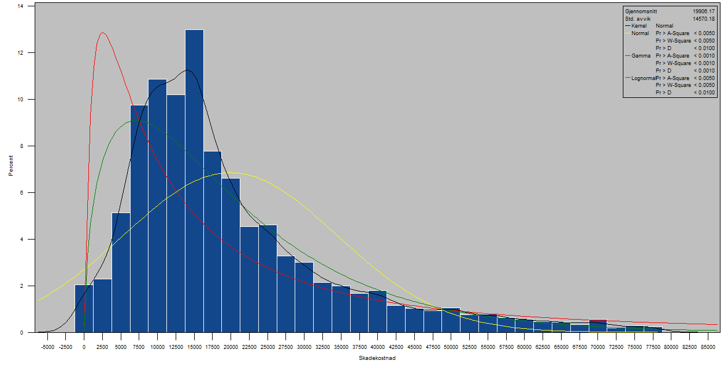
TPL
Non parametric
Log-normal, Gamma
The Pareto
Extreme value
Searching

Slide 16
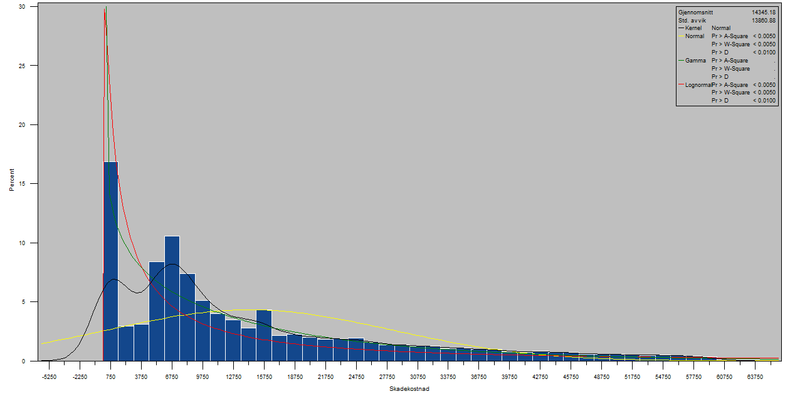
Hull
Non parametric
Log-normal, Gamma
The Pareto
Extreme value
Searching

Slide 17
The log-normal family
Non parametric
Log-normal, Gamma
The Pareto
Extreme value
Searching
A convenient definition of the log-normal model in the present context is
as where
Mean, standard deviation and skewness are
see section 2.4.
Parameter estimation is usually carried out by noting that logarithms are Gaussian. Thus
and when the original log-normal observations z1,…,zn are transformed to Gaussian ones through y1=log(z1),…,yn=log(zn) with sample mean and variance , the estimates of become

Slide 18
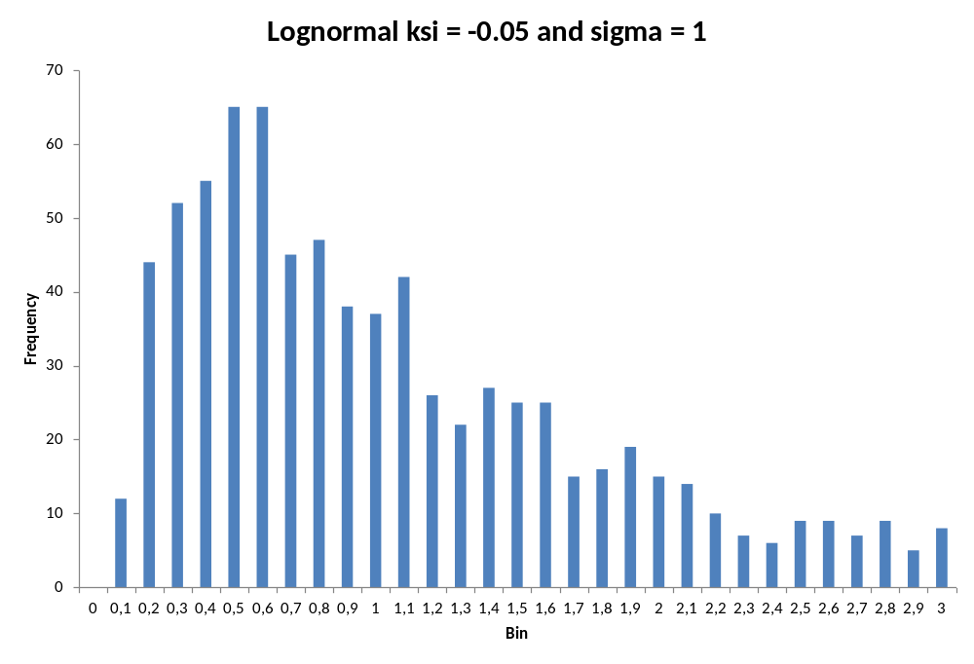
Log-normal sampling (Algoritm 2.5)
Non parametric
Log-normal, Gamma
The Pareto
Extreme value
Searching
Input:
Draw
Return

Slide 19
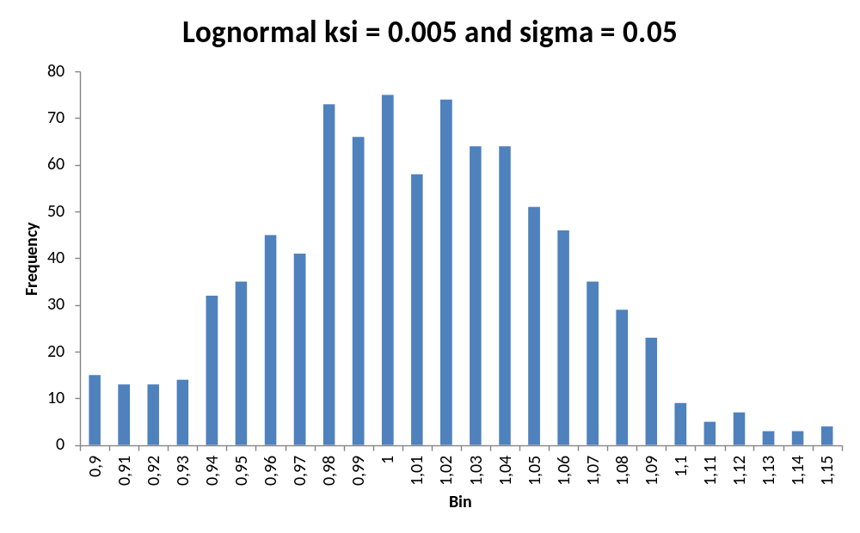
The lognormal family
Non parametric
Log-normal, Gamma
The Pareto
Extreme value
Searching
Different choice of ksi and sigma
The shape depends heavily on sigma and is highly skewed when sigma is not too close to zero

Slide 20
The Gamma family
Non parametric
Log-normal, Gamma
The Pareto
Extreme value
Searching
The Gamma family is an important family for which the density function is
It was defined in Section 2.5 as is the standard Gamma with mean one and shape alpha. The density of the standard Gamma simplifies to
Mean, standard deviation and skewness are
and there is a convolution property. Suppose G1,…,Gn are independent with
. Then

Slide 21
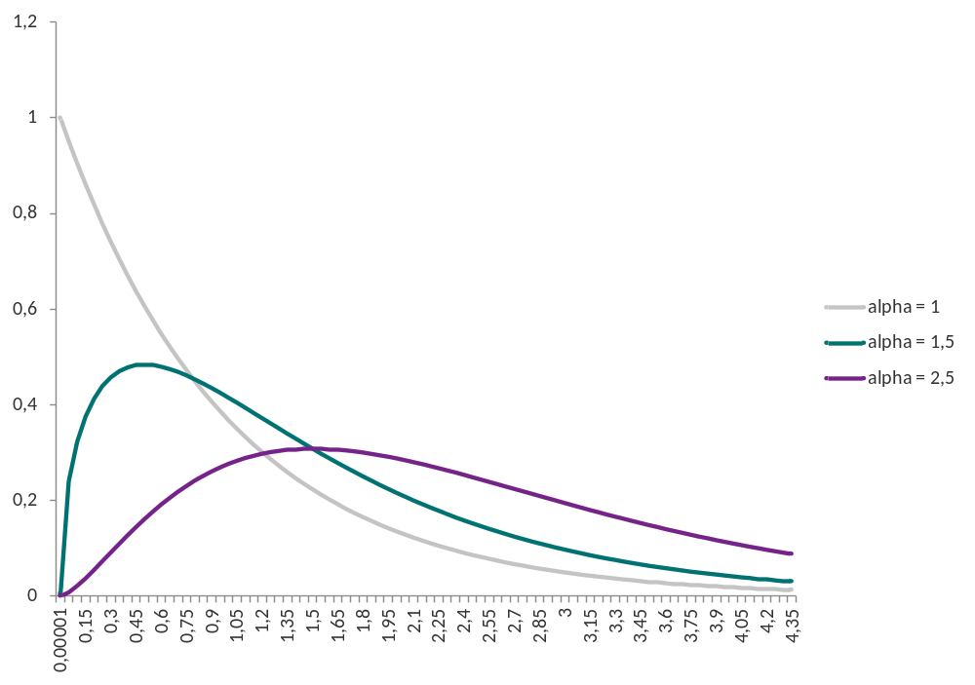
Example of Gamma distribution
Non parametric
Log-normal, Gamma
The Pareto
Extreme value
Searching

Slide 22
Example: car insurance
Non parametric
Log-normal, Gamma
The Pareto
Extreme value
Searching
Hull coverage (i.e., damages on own vehicle in a collision or other sudden and unforeseen damage)
Time period for parameter estimation: 2 years
Covariates:
  Driving length
  Car age
  Region of car owner
  Tariff class
  Bonus of insured vehicle
2 models are tested and compared – Gamma and lognormal

Slide 23
Comparisons of Gamma and lognormal
Non parametric
Log-normal, Gamma
The Pareto
Extreme value
Searching
The models are compared with respect to fit, results, validation of model, type 3 analysis and QQ plots
Fit: ordinary fit measures are compared
Results: parameter estimates of the models are compared
Validation of model: the data material is split in two, independent groups. The model is calibrated (i.e., estimated) on one half and validated on the other half
Type 3 analysis of effects: Does the fit of the model improve significantly by including the specific variable?

Slide 24
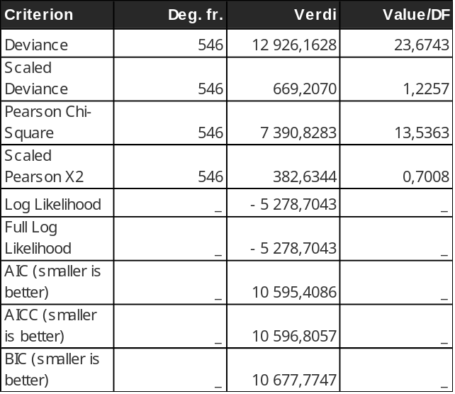
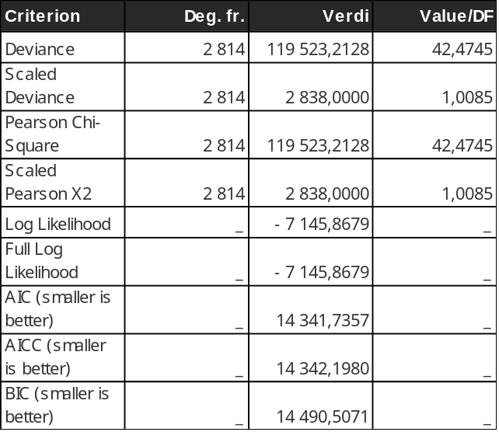
Comparison of Gamma and lognormal - fit
Non parametric
Log-normal, Gamma
The Pareto
Extreme value
Searching
Gamma fit
Lognormal fit

Slide 25
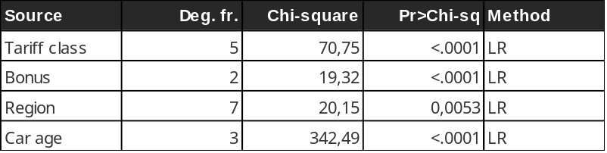
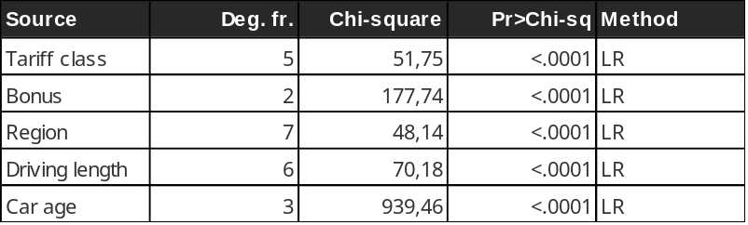
Comparison of Gamma and lognormal – type 3
Non parametric
Log-normal, Gamma
The Pareto
Extreme value
Searching
Gamma fit
Lognormal fit

Slide 26
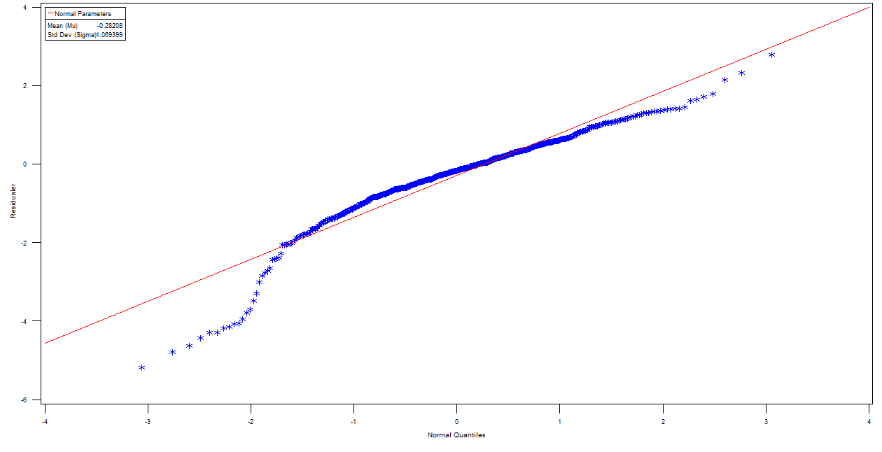
QQ plot Gamma model
Non parametric
Log-normal, Gamma
The Pareto
Extreme value
Searching

Slide 27
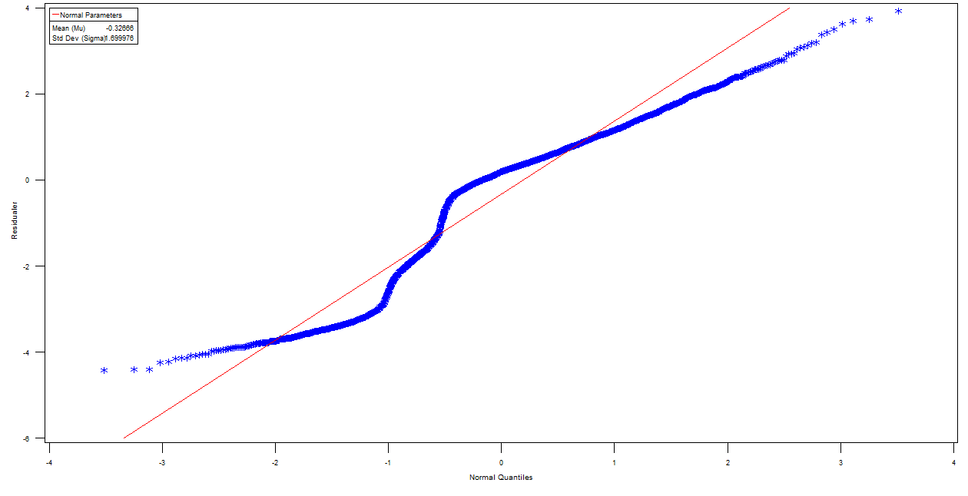
QQ plot log normal model
Non parametric
Log-normal, Gamma
The Pareto
Extreme value
Searching

Slide 28
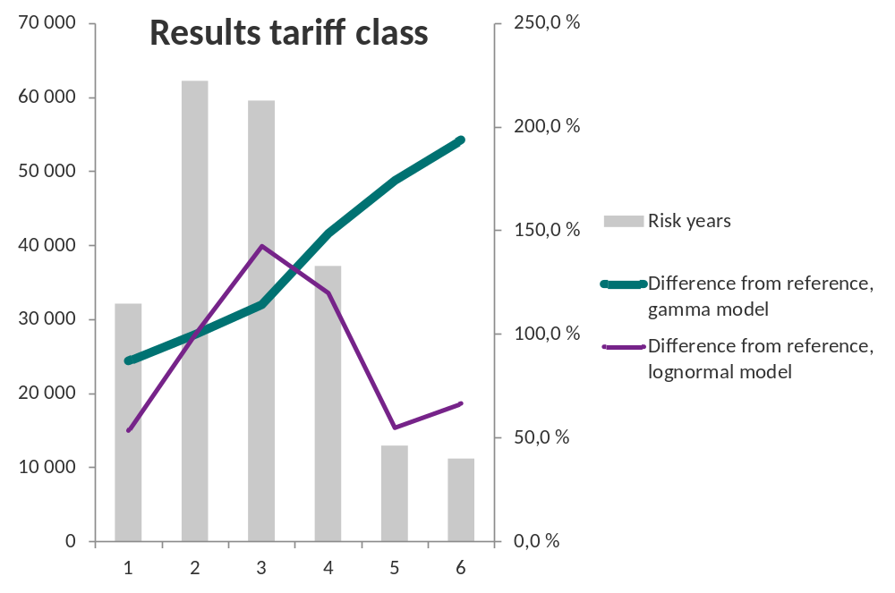
Non parametric
Log-normal, Gamma
The Pareto
Extreme value
Searching

Slide 29
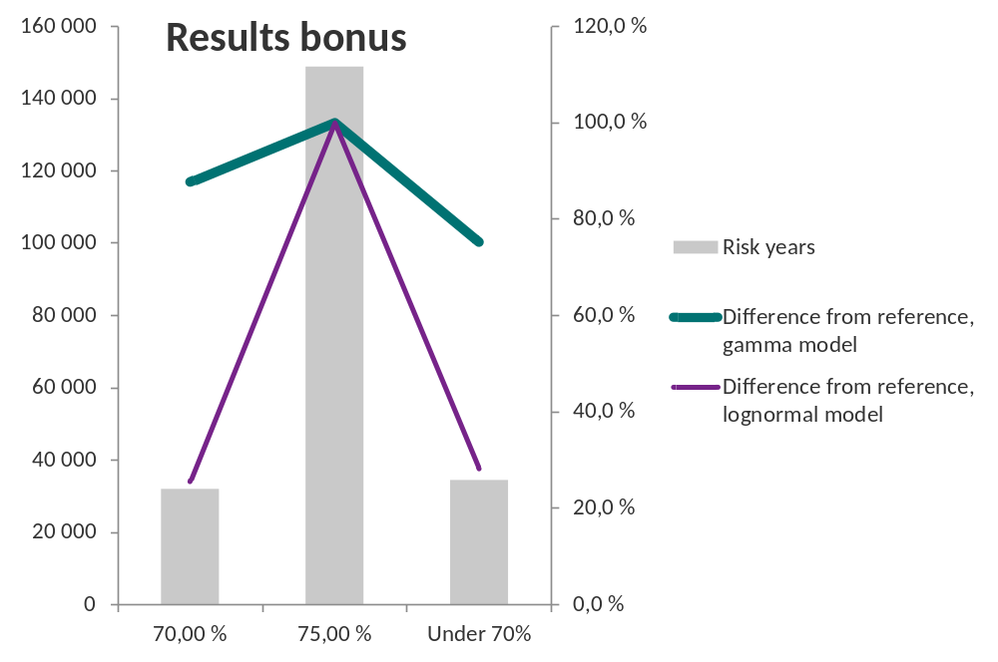
Non parametric
Log-normal, Gamma
The Pareto
Extreme value
Searching

Slide 30
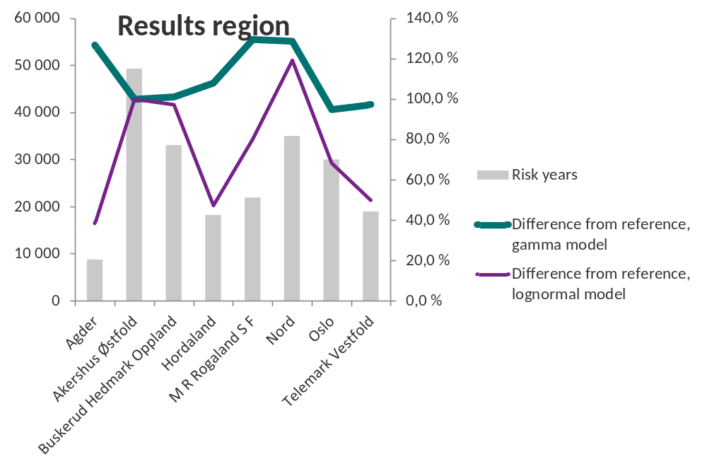
Non parametric
Log-normal, Gamma
The Pareto
Extreme value
Searching

Slide 31
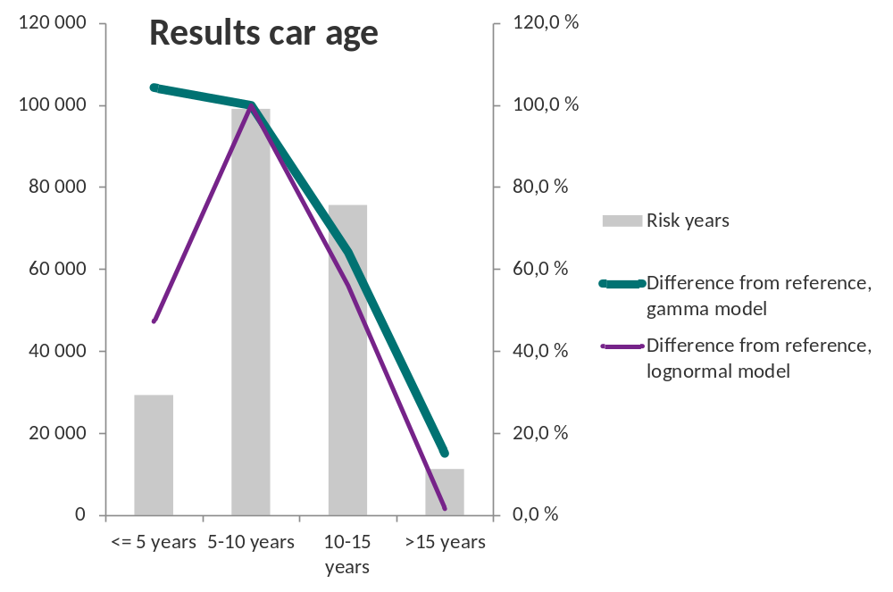
Non parametric
Log-normal, Gamma
The Pareto
Extreme value
Searching

Slide 32
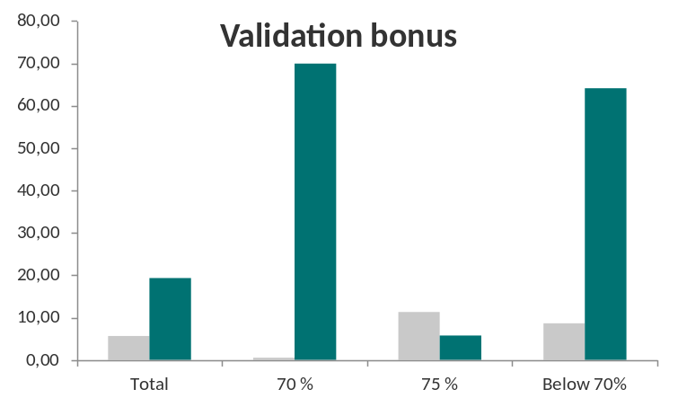
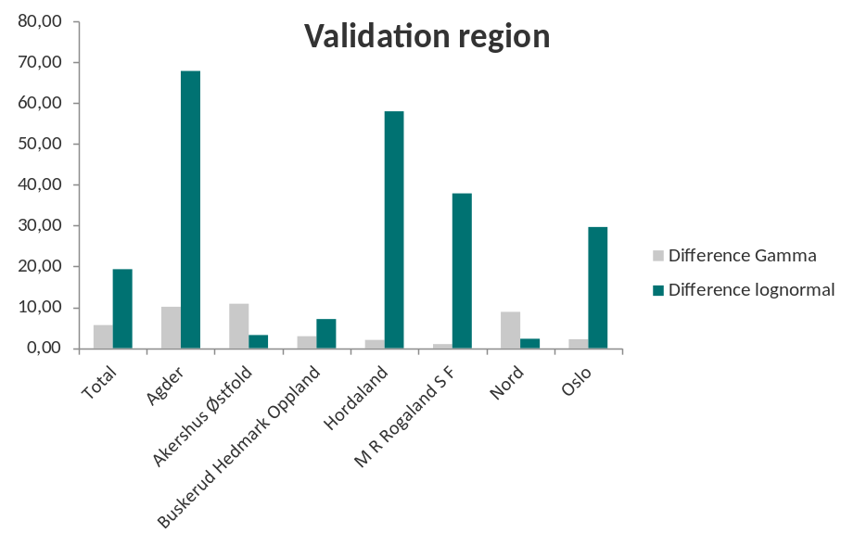
Non parametric
Log-normal, Gamma
The Pareto
Extreme value
Searching

Slide 33
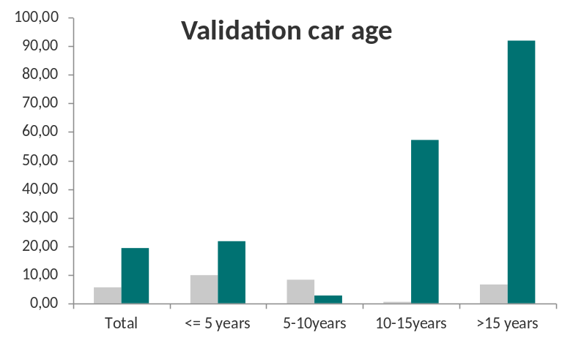
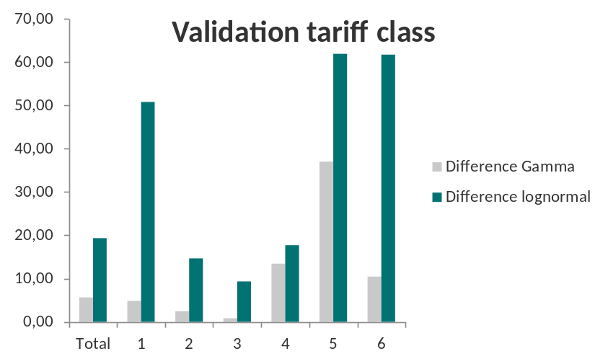
Non parametric
Log-normal, Gamma
The Pareto
Extreme value
Searching

Slide 34
Conclusions so far
Non parametric
Log-normal, Gamma
The Pareto
Extreme value
Searching
None of the models are very good
Lognormal behaves worst and can be discarded
Can we do better?
We try Gamma once more, now exluding the 0 claims (about 17% of the claims)
  Claims where the policy holder has no guilt (other party is to blame)

Slide 35
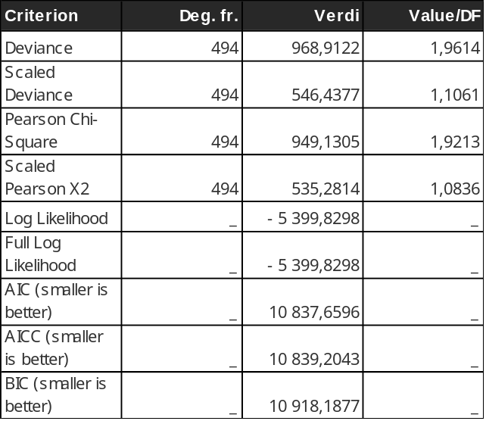
Comparison of Gamma and lognormal - fit
Non parametric
Log-normal, Gamma
The Pareto
Extreme value
Searching
Gamma fit
Gamma without zero claims fit

Slide 36
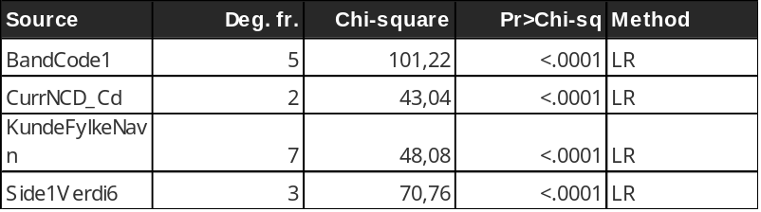
Comparison of Gamma and lognormal – type 3
Non parametric
Log-normal, Gamma
The Pareto
Extreme value
Searching
Gamma fit
Gamma without zero claims fit

Slide 37
QQ plot Gamma
Non parametric
Log-normal, Gamma
The Pareto
Extreme value
Searching

Slide 38
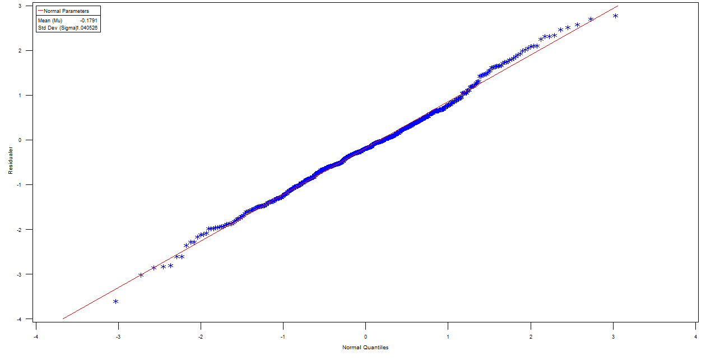
QQ plot Gamma model without zero claims
Non parametric
Log-normal, Gamma
The Pareto
Extreme value
Searching

Slide 39
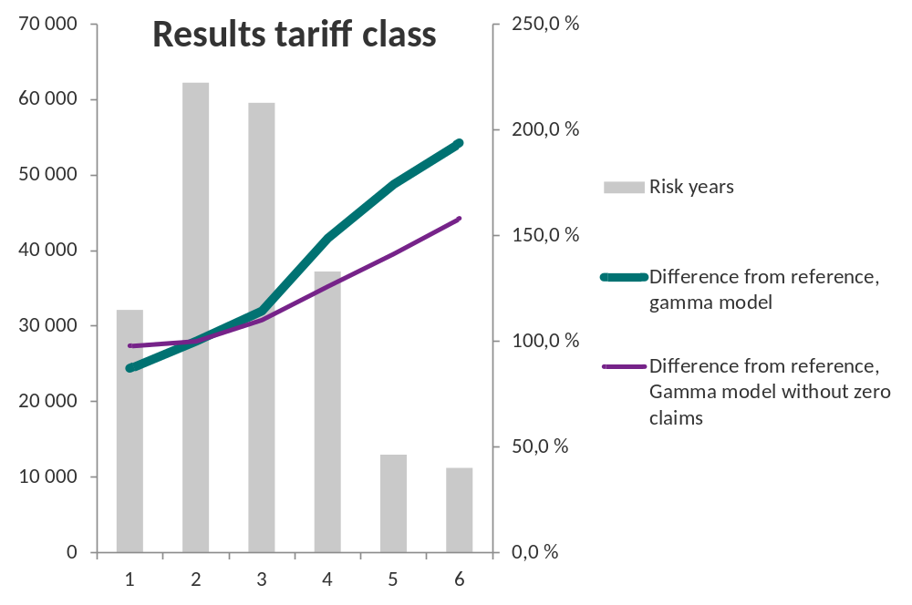
Non parametric
Log-normal, Gamma
The Pareto
Extreme value
Searching

Slide 40
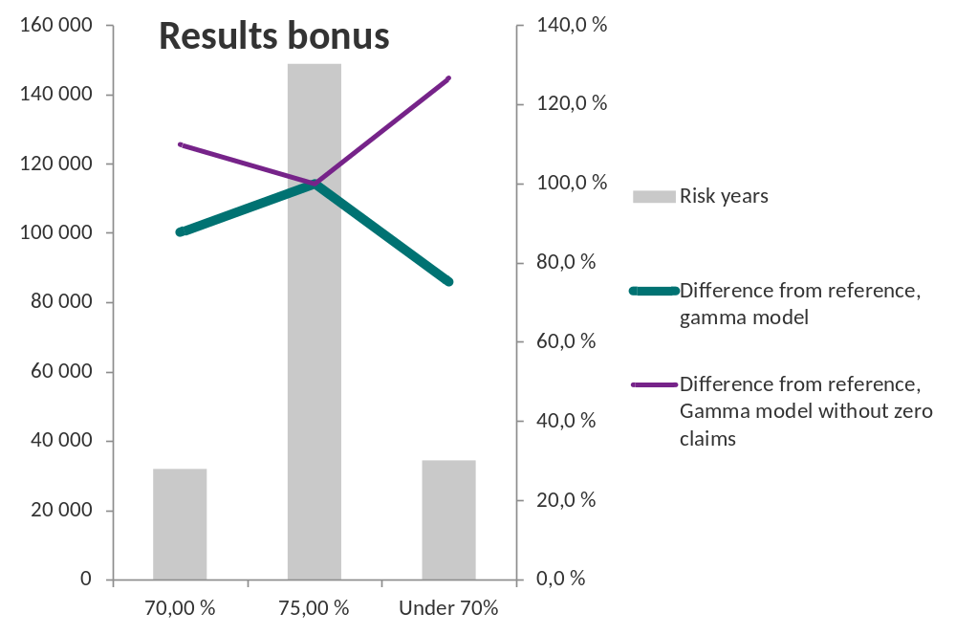
Non parametric
Log-normal, Gamma
The Pareto
Extreme value
Searching

Slide 41
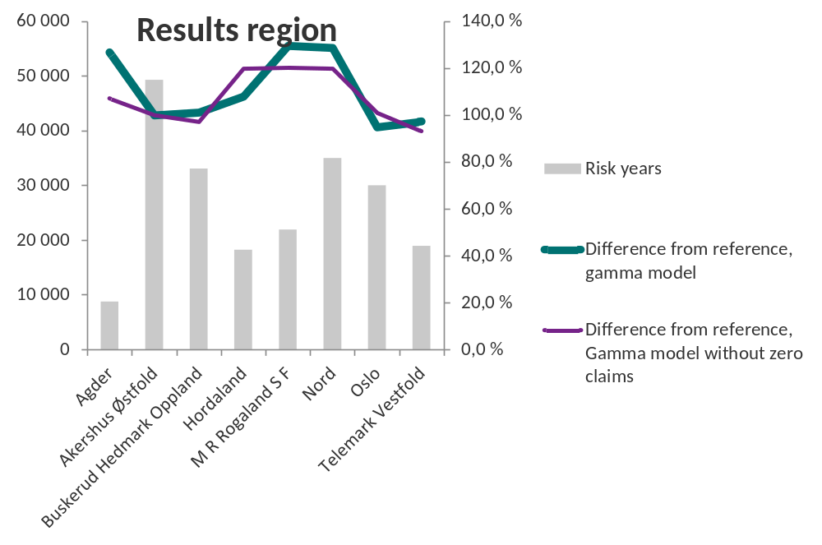
Non parametric
Log-normal, Gamma
The Pareto
Extreme value
Searching

Slide 42
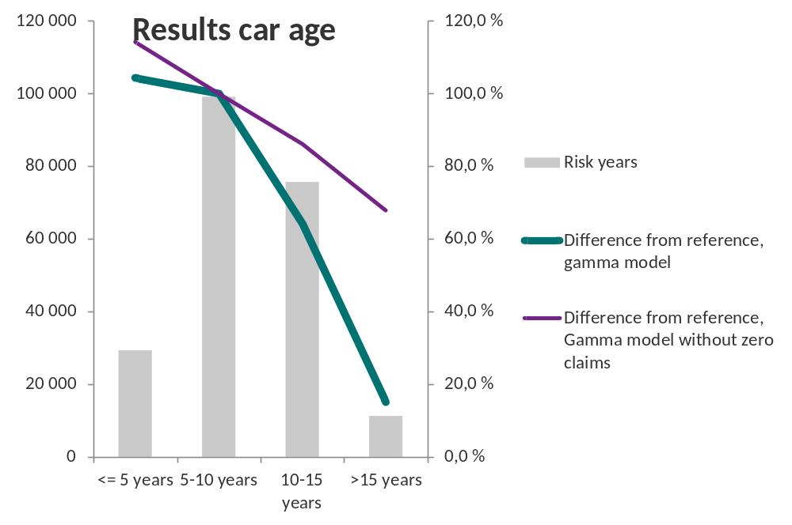
Non parametric
Log-normal, Gamma
The Pareto
Extreme value
Searching

Slide 43
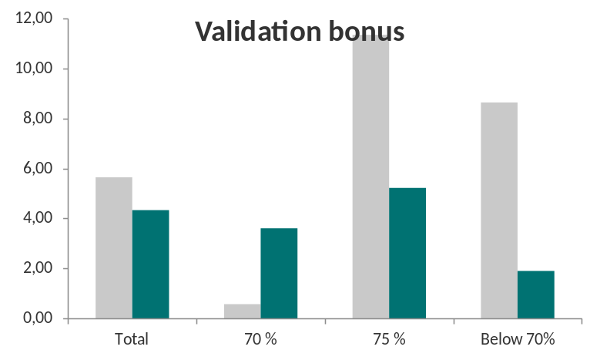
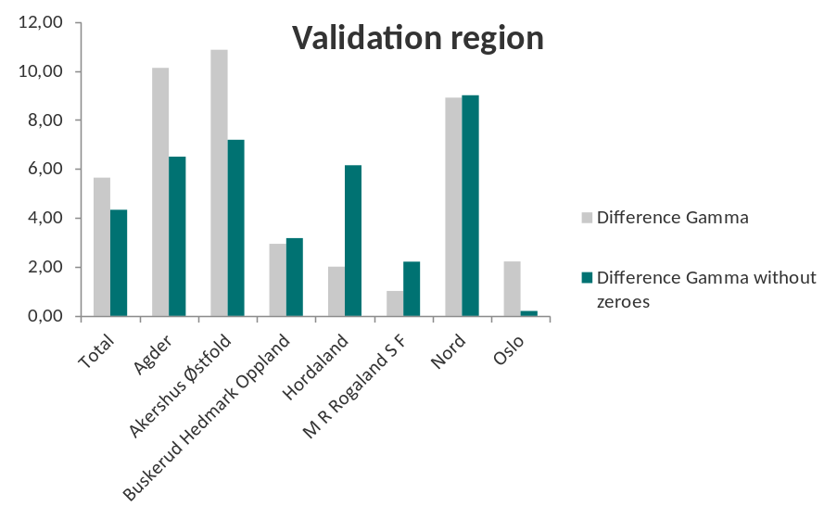
Non parametric
Log-normal, Gamma
The Pareto
Extreme value
Searching

Slide 44
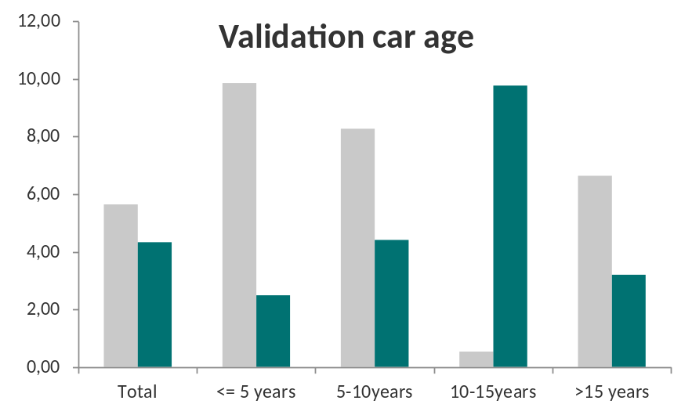
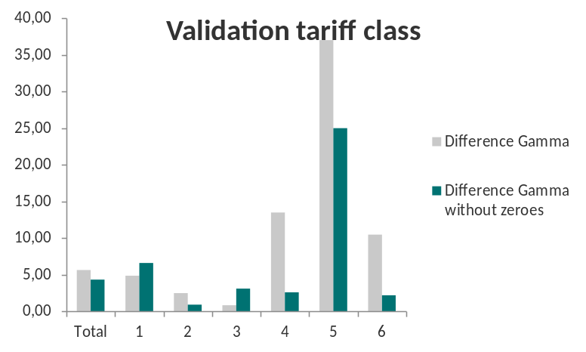
Non parametric
Log-normal, Gamma
The Pareto
Extreme value
Searching

Slide 45
Backup slides

Slide 46
Fitting a scale family
Non parametric
Log-normal, Gamma
The Pareto
Extreme value
Models for scale families satisfy
where are the distribution functions of Z and Z0.
Differentiating with respect to z yields the family of density functions
The standard way of fitting such models is through likelihood estimation. If z1,…,zn are the historical claims, the criterion becomes
which is to be maximized with respect to and other parameters.
A useful extension covers situations with censoring.
Perhaps the situation where the actual loss is only given as some lower bound b is most frequent.
Example:
  travel insurance. Expenses by loss of tickets (travel documents) and passport are covered up to 10 000 NOK if the loss is not covered by any of the other clauses.
Searching

Slide 47
Fitting a scale family
Non parametric
Log-normal, Gamma
The Pareto
Extreme value
Searching
The chance of a claim Z exceeding b is , and for nb such events with lower bounds b1,…,bnb the analogous joint probability becomes
Take the logarithm of this product and add it to the log likelihood of the fully observed claims z1,…,zn. The criterion then becomes
complete information
censoring to the right

