Slide 1
Non-life insurance mathematics
Nils F. Haavardsson, University of Oslo and DNB Skadeforsikring

Slide 2
Introduction to reserving
Introduction
Chain ladder
An example
The naive loss ratio
Loss ratio prediction
Non-life insurance from a financial perspective:
for a premium an insurance company commits itself to pay a sum if an event has occured
Policy holder
signs up for an
insurance
Contract period, in which
premium is earned
claims might occur
Incurred claims will be reported and settled
Policy holder
pays premium.
Issues that need to be solved:
How much premium is earned?
How much premium is unearned?
How do we measure the number and size of unknown claims?
How do we know if the reserves on known claims are sufficient?

Slide 3
Premium reserves
Introduction
Chain ladder
An example
The premium reserve is split in two parts:
Provision for unearned premiums
Provisions for unexpired risks
Earned and unearned premium:
Written premium is earned evenly/uniformly over the cover period
The share of the premium that has been earned is the past time’s proportion of the total period
If a larger premium has been received the difference is the unearned premium
Example:
An insurance policy starts on September 1 2012 and is valid until August 31 2013.
The premium for the entire period is 2400.
At 31 December we have received two quarterly premiums or 1200.
We have then earned (4/12)*2400 = 800.
Unearned is 1200-800=400
Unexpired risk reserve
Regard entire period covered by the insurance
From a point in time, say 31/12-2012, we look forward to all the claims and expenses that could occur after this point. Call them FC3112
If FC3112>Future premiums yet not due (FP)+unearned premium reserve (UP) the difference is accounted as unexpired risk reserve
In example assume FC3112 = 1800>FP+UP=1200+400=1600, so unexpired risk reserve is 200
The naive loss ratio
Loss ratio prediction
1/9-2012
31/12-2012
31/8-2013

Slide 4
Claims reserves
Introduction
Chain ladder
An example
The naive loss ratio
Accident
date
Reporting
date
Claims
payments
Claims close
Claims
reopening
Claims
payments
Claims close
Loss ratio prediction
Claims reserving issues:
How do we measure the number and size of unknown claims? (IBNR reserve, i.e., Incurred Bot Not Reported)
How do we know if the reserves on known claims are sufficient? (RBNS reserve, i.e., Reserved But Not Settled)

Slide 5
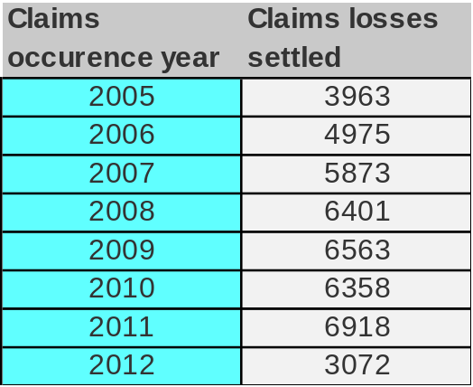
Claims reserves
Introduction
Chain ladder
An example
The naive loss ratio
Claims occuring:
A claim event is an event that gives rise to a claim against an insurer by a policy holder
Gross claim loss: the ultimate cost to the insurer of a claim event, including benefit payments and claims handling expenses
Net claim loss: deduction of reinsurance recoveries
Example: settlement delays are considered (RBNS). The process for estimating future reported claim amounts (IBNR) is similar.
Step 1: Group the claims loss settlement amounts by the year in which the associated claims events occured
Loss ratio prediction
Claim payments plus claims handling expenses

Slide 6
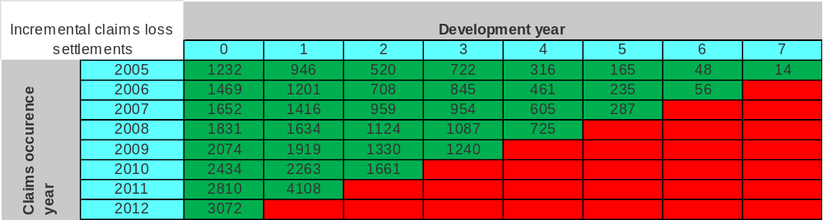
The development of claims losses settled
Introduction
Chain ladder
An example
The naive loss ratio
Claims losses settled for each claims occurence year are often not paid on one date but rather over a number of years
Loss ratio prediction
Incremental claims loss settlement data presented as a run-off triangle
Comments:
The development year for a claims settlement amount reflects how long after the claims occurence year the amount was settled.
  An amount settled during the claims occurence year was settled in development year 0
In the example the largest development year for any claims occurence years is 7
The data shown represents the incremental claims losses settled in the development year
For any cell in the table, the value shown represents the incremental claims loss amount that was settled in calendar year
Each diagonal set of data represents the amounts settled in a single calendar year
Green cells represent observed data – all red represent time periods in the future for which we wish to estimate the expected claims settlements amounts

Slide 7
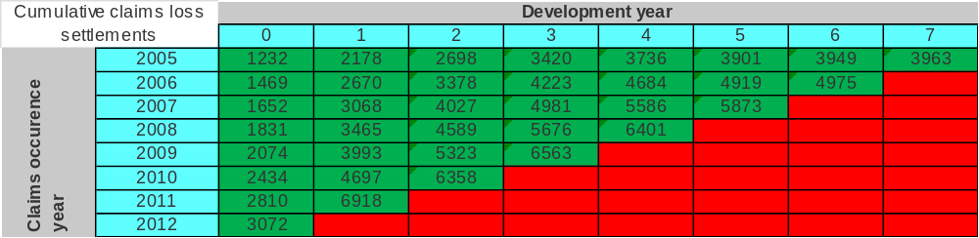
The development of claims losses settled
Introduction
Chain ladder
An example
The naive loss ratio
Claims losses settled for each claims occurence year are not paid on one date but rather over a number of years
Loss ratio prediction
Incremental claims loss settlement data presented as a run-off triangle
Comments:
The data can be presented as cumulative losses settled
For each claims occurence year the incremental claims loss settled for a particular development year is the amount settled in that development year
The cumulative claims losses settled is the total amount settled up to that development year, i.e., the sum of the incremental claims losses settled up to that date.

Slide 8
Assumptions underlying the CLM
Introduction
Chain ladder
An example
The naive loss ratio
Loss ratio prediction
Patterns of claims loss settlement observed in the past will continue in the future
The development of claims loss settlement over the development years follows an identical pattern for every claims occurence year
But the observed claims loss settlement patterns may change over time:
  Changes in product design and conditions
  Changes in the claims reporting, assessment and settlement processes (example: different owners)
  Change in the legal environment
  Abnormally large or small claim settlement amounts
  Changes in portfolio so that the history is not representative for predicting the future (example: strong growth)

Slide 9
Development patterns and development factors
Introduction
Chain ladder
An example
The naive loss ratio
Loss ratio prediction
The insurer may tend towards using any of the following patterns for estimation purposes:
The proportion of the ultimate cumulative claims losses that is settled in a particular development year (development pattern for incremental claims losses settled)
The proportion of the ultimate cumulative claims losses that is settled by a particular development year (development pattern for cumulative claims losses settled)
The ratio of the cumulative losses settled by a particular year to the cumulative claims losses settled by the previous development year (cumulative loss factor)
The three patterns are equivalent
CLM relies on the last pattern above holds for all claims occurence years. For any development year the quotient
  Expected cumulative claims losses settled up to and including the development year/Expected cumulative claims losses settled up to and including the previous development year
is called the cumulative claims loss settlement factor for that development year
Example: the cumulative claims settlement factor for development year 4 is derived from the cumulative settlement amounts for development years 3 and 4.

Slide 10
Estimating future claims settlement amounts
Introduction
Chain ladder
An example
The naive loss ratio
Loss ratio prediction
Underlying assumption (CLM):
  the cumulative claims loss settlement factor for a specific development year is assumed to be the same for all claims occurence years
The CLM estimator for each of the factors is based on the cumulative settlement data for as many claims occurence years as possible

Slide 11
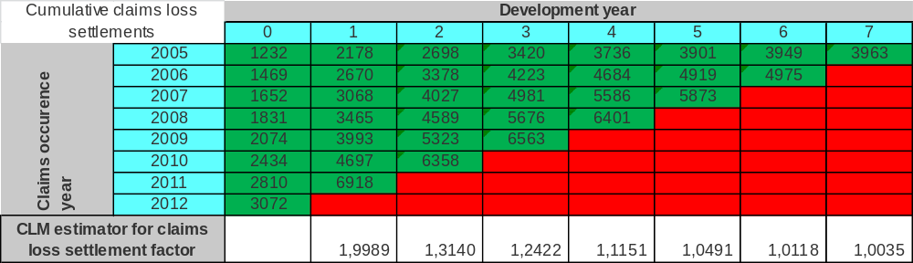
CLM in practice
Introduction
Chain ladder
An example
The naive loss ratio
Loss ratio prediction
Determining the CLM estimator for the cumulative claims loss settlement factor
3736+4684+5586+6401
=20407
3736+4684+5586+6401
=20407
20407/18300=1,1151
Comments:
These CLM estimators for the cumulative claims loss settlement factors are used to estimate the cumulative claims loss settlement amount in the future
For each claims occurence year the last historical observation is used together with the appropriate CLM estimator for the development factor to estimate the cumulative settlement amount in the next development year
This value is, in turn, multiplied by the estimator for the development factor for the next development year and so on.

Slide 12
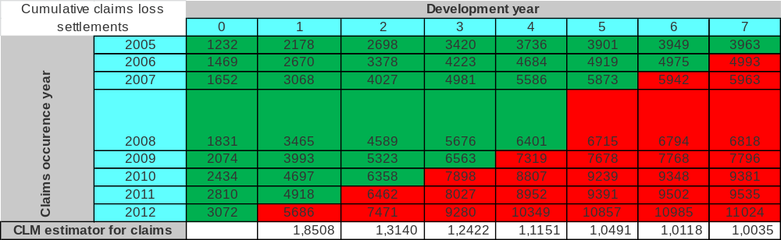
Introduction
CLM in practice
Chain ladder
An example
The naive loss ratio
Loss ratio prediction
Determining the estimated cumulative claims loss settlements in future periods
6401
*1,0491
=
6715
*1,0118
=
6794
*1,0035
=
Comments:
The values shown in the red cells are the estimators for future cumulative claims settled
These estimates are always based on the latest available cumulative claims settlement amounts for the relevant claims occurence year, i.e., the estimated future cumulative claims settlements are always based on the last green diagonal of data
It is now simple to derive the estimated incremental claims settlement amounts for the future periods
An incremental settlement amount is the difference between tow consecutive cumulative settlement amounts

Slide 13
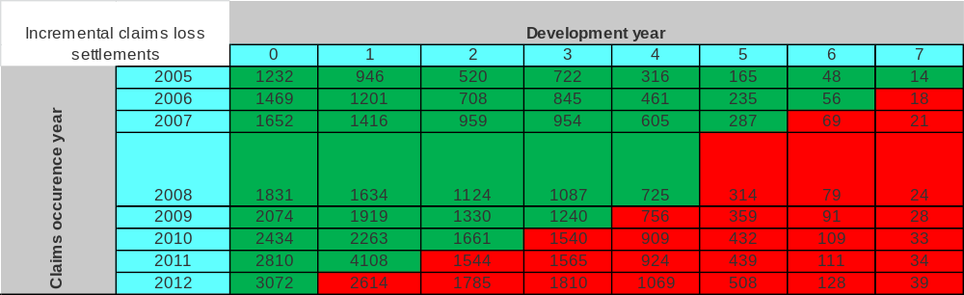
Introduction
CLM in practice
Chain ladder
An example
The naive loss ratio
Loss ratio prediction
Determining the estimated incremental settlement amounts from the estimated cumulative amounts
6715-
6401
=
6794-
6715
=
6818-
6794
=

Slide 14
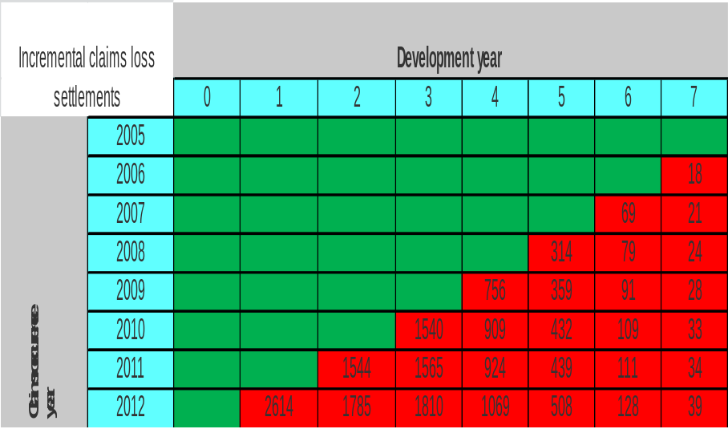
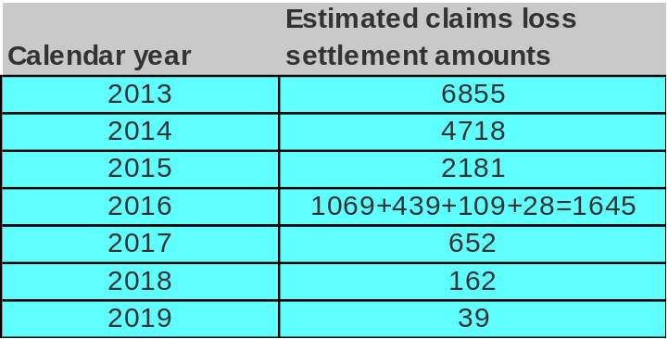
Introduction
CLM in practice
Chain ladder
An example
The naive loss ratio
Determining the estimated incremental settlement amounts from the estimated cumulative amounts
Loss ratio prediction
Comments:
Group the estimated incremental claims loss settlement amounts by the year in which they will be settled
These cash flows can then be discounted to determine the technical provisions
Norwegian State Treasury Bonds (Statsobligasjoner in Norwegian) may be used as discount factor
  Example: a cash flow due in 2017 is discounted with a 4 year old Norwegian State Treasury Bond etc. Why do we hope that the development year does not exceed 10 ??

Slide 15
Claims reserves
Introduction
Chain ladder
An example
The naive loss ratio
Loss ratio prediction
Claims reserving is not only about statistical models:
What is the purpose of the reserving?
Know your data:
  Is the history consistant? (relevant when a company has had several owners)
  Is the history representative when future predictions are to be made? (relevant during strong growth)
  Has there been significant events that affect settlement practice? (relevant for agencies)
Should the reserves be calculated gross or net?
Adjust for inflation
Know your claims department:
  How are provisions set?
  When do they set the provision?
  How will the lead time be affected by the size of the claims?
  Are there any backlogs?
  When do they change the reserves?

Slide 16
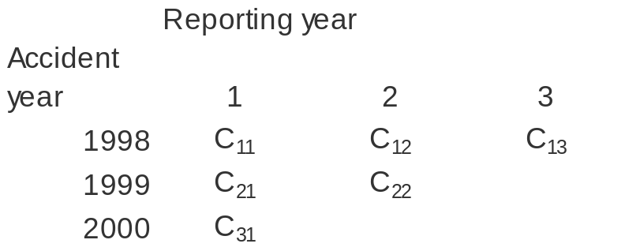
Notation
Introduction
Chain ladder
An example
The naive loss ratio
Loss ratio prediction
Cij Cumulative claims from accident year i, reported through the end of period j
Dij = Cij- Cij-1 Incremental claims from accident year i, reported in period j
Cim Ultimate claims for accident year i, where
m is the last development period that is known and
Ri = E[Cim] – Cij is the reserve for accident year i
fi one period loss development factor. Also called age-to-age factor or link ratio
Fij Development factor from accident year i, period j, to ultimate
Li Claims relative to an exposure for accident year i
Pi A measure of exposure for accident year i
Ak Experience up to development period k

Slide 17
Chain ladder
Introduction
Chain ladder
An example
The naive loss ratio
Loss ratio prediction
Chain ladder builds on that cumulative claims in a period are proportional to the claims in the preceding period. The proportionality factor depends on the number of periods since outset, but is expected to be the same for all periods. It is assumed that:
Observe that fj does not depend on accident year.
CL1 just brings us one step ahead, whereas we want to get to the end. To get there we are going to utilize the rule of double expectation:
Using this lemma and CL1, we find

Slide 18
Chain ladder
Introduction
Chain ladder
An example
The naive loss ratio
Loss ratio prediction

Slide 19
Chain ladder
Introduction
Chain ladder
An example
The naive loss ratio
Loss ratio prediction
We could rewrite CL1 on the following form:
Thus, we could use observed ratios Cij+1/Cij as unbiased estimators of fj. Before combining estimates of the same fj we make a further assumption,
Observe that the last factor in the variance is no depending on accident year. We also need the following Lemma

Slide 20
Chain ladder
Introduction
Chain ladder
An example
The naive loss ratio
Loss ratio prediction

Slide 21
Chain ladder
Introduction
Chain ladder
An example
The naive loss ratio
Proof: Form the Lagrangian
Constraint
Loss ratio prediction
Var , which we want to minimize
Solve the system
(1)
(2)

Slide 22
Chain ladder
Introduction
Chain ladder
An example
The naive loss ratio
Proof: Starting with (1) yields
Loss ratio prediction
Continuing with (2) yields
(4)

Slide 23
Chain ladder
Introduction
Chain ladder
An example
The naive loss ratio
Combining (3) and (4) yields
Loss ratio prediction
(5)
Rewriting CL3 gives
and the weights are thus by (5)

Slide 24
Chain ladder
Introduction
Chain ladder
An example
The naive loss ratio
and
Loss ratio prediction
(6)
To be able to use the algorithm suggested by formula (6.2) with the estimators from (6) above we need to prove that estimates are uncorrelated. Define the set of experience up to development period k by
Then we have

Slide 25
Chain ladder
Introduction
Chain ladder
An example
The naive loss ratio
Loss ratio prediction

Slide 26
Chain ladder
Introduction
Chain ladder
An example
The naive loss ratio
Loss ratio prediction
Thus we have shown that the estimates of fj and fk are uncorrelated. If we combine this with (6.2) it shows that the following ultimate estimator is unbiased,

Slide 27
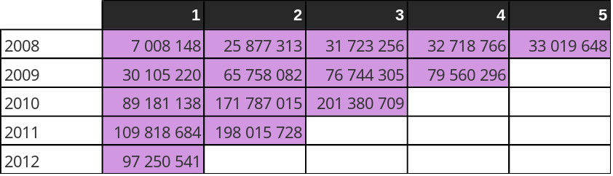
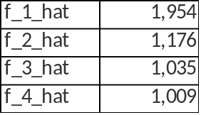
Chain ladder - example
Introduction
Chain ladder
An example
The naive loss ratio
Example: one fire/combined product (fire/combined in Norway includes home, contents and cabin)
The triangle shows the payments for the different years
How do we fill out the blanks?
Loss ratio prediction
We start by estimating f1, f2, f3, f4

Slide 28
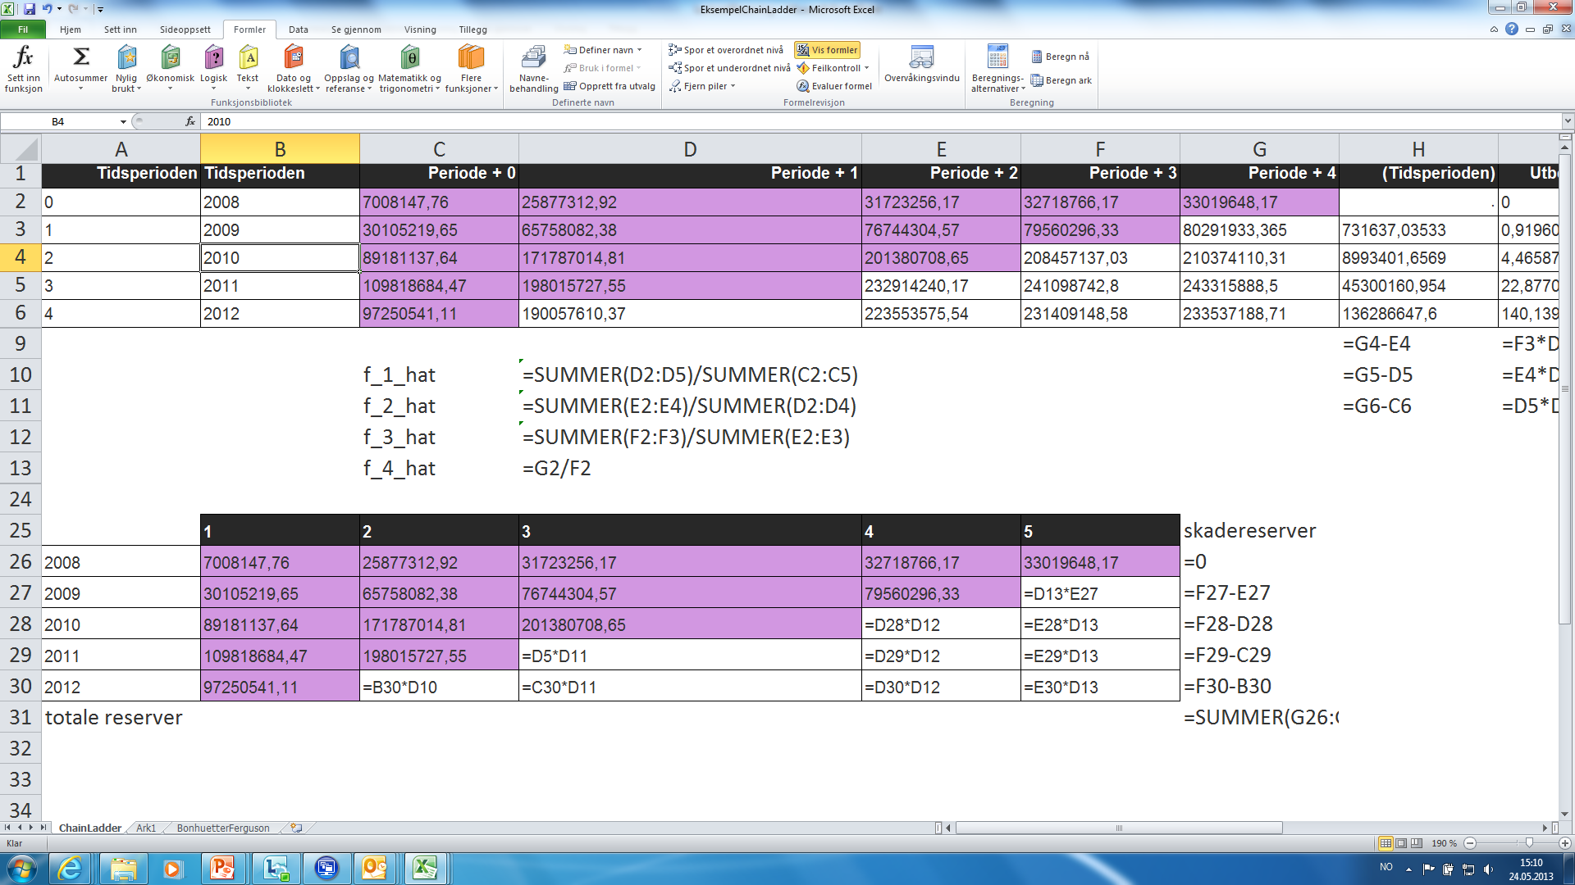
Chain ladder - example
Introduction
Chain ladder
An example
The naive loss ratio
Loss ratio prediction
Then we use the formula to fill out the blanks

Slide 29
Introduction to reserving
Introduction
Chain ladder
An example
The naive loss ratio
Loss ratio prediction
Non-life insurance from a financial perspective:
for a premium an insurance company commits itself to pay a sum if an event has occured
Contract period
retrospective
prospective
Policy holder
signs up for an
insurance
During the duration of the policy, some of
the premium is earned, some is unearned
How much premium is earned?
How much premium is unearned?
Is the unearned premium sufficient?
Policy holder
pays premium.
Insurance company
starts to earn premium
Premium reserve, prospective
During the duration of the policy, claims might or might not occur:
How do we measure the number and size of unknown claims?
How do we know if the reserves on known claims are sufficient?
Claims
reserve,
retrospective
Accident
date
Reporting
date
Claims
payments
Claims close
Claims
reopening
Claims
payments
Claims close

