Slide 2
Recap (1.2.1 in EB)
Property insurance is economic responsibility for incidents such as fires and accidents passed on to an insurer against a fee
The contract, known as a policy, releases claims when such events occur
A central quantity is the total claim X amassed during a certain period of time (typically a year)

Slide 3
Overview pricing (1.2.2 in EB)
Premium
Individual
Insurance company
Claim
Due to the law of large numbers the insurance company is cabable of estimating
the expected claim amount
Distribution of X, estimated with claims data
Risk premium
Expected claim amount given an event
Probability of claim,
Estimated with claim frequency
We are interested in the distribution of the claim frequency
The premium charged is the risk premium inflated with a loading (overhead and margin)
Expected consequence of claim
Notes:
Property insurance is economic responsibility for incidents such as fires and accidents passed on to an insurer against a fee
The contract, known as a policy, releases claims when such events occur
A central quantity is the total claim X amassed during a certain period of time (typically a year)

Slide 4
Control (1.2.3 in EB)
Companies are obliged to aside funds to cover future obligations
Suppose a portfolio consists of J policies with claims X₁,…,X_{J}
The total claim is then
Portfolio claim size
We are interested in as well as its distribution
Regulators demand sufficient funds to cover with high probability
The mathematical formulation is in term of , which is the solution of the equation
where is small for example 1%
The amount is known as the solvency capital or reserve

Slide 5
Insurance works because risk can be diversified away through size (3.2.4 EB)
The core idea of insurance is risk spread on many units
Assume that policy risks X1,…,XJ are stochastically independent
Mean and variance for the portfolio total are then
which is average expectation and variance. Then
The coefficient of variation (shows extent of variability in relation to the mean) approaches 0 as J grows large (law of large numbers)
Insurance risk can be diversified away through size
Insurance portfolios are still not risk-free because
  of uncertainty in underlying models
  risks may be dependent

Slide 6
How are random variables sampled?
Inversion (2.3.2 in EB):
Let F(x) be a strictly increasing distribution function with inverse and let
Consider the specification on the left for which U=F(X)
Note that
since
1
F(x)
U[0,1]

Slide 7
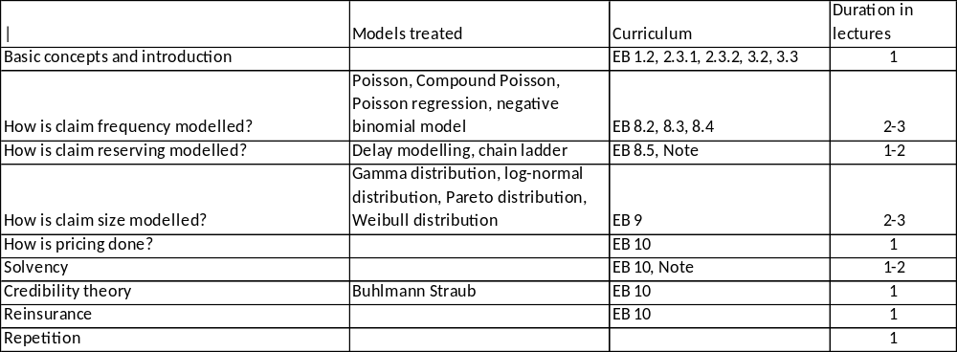
Outline of the course
Binomial models
Monte Carlo simulation

Slide 8
Course literature
Curriculum:
Chapter 1.2, 2.3.1, 2.3.2, 2.5, 3.2, 3.3 in EB
Chapter 8,9,10 in EB
Note on Chain Ladder
Lecture notes by NFH
Exercises
Assignment must be approved to be able to participate
in exame
The following book will be used (EB):
Computation and Modelling in Insurance and Finance, Erik Bølviken, Cambridge University Press (2013)
Additions to the list above may occur during the course
Final curriculum will be posted on the course web site in due time

Slide 9
Overview of this session
The Poisson model (Section 8.2 EB)
Some important notions and some practice too
Examples of claim frequencies
Random intensities (Section 8.3 EB)

Slide 10
Introduction
Poisson
Some notions
Examples
Random intensities
Actuarial modelling in general insurance is broken down on claim frequency and claim size
This is natural due to definition of risk premium:
The Poisson distribution is often used in modelling the distribution of claim numbers
The parameter is lambda = muh*T (single policy) and lambda = J*muh*T (portfolios
The modelling can be made more sophisticated by extending the model for muh, either by making muh stochastic or by linking muh to explanatory variables
Risk premium
Expected claim amount given an event
Probability of claim,
Estimated with claim frequency
Expected consequence of claim

Slide 11
The world of Poisson (Chapter 8.2)
Poisson
Some notions
Examples
Number of claims
Random intensities
I_{k-1}
I_{k}
I_{k+1}
t₀=0
t_{k-2}
t_{k-1}
t_{k}
t_{k+1}
t_{k}=T
What is rare can be described mathematically by cutting a given time period T into K small pieces of equal length h=T/K
On short intervals the chance of more than one incident is remote
Assuming no more than 1 event per interval the count for the entire period is
N=I₁+...+I_{K} , where I_{j} is either 0 or 1 for j=1,...,K
If p=Pr(I_{k}=1) is equal for all k and events are independent, this is an ordinary Bernoulli series
where
Assume that p is proportional to h and set
is an intensity which applies per time unit

Slide 12
The world of Poisson
Poisson
Some notions
Examples
Random intensities
In the limit N is Poisson distributed with parameter

Slide 13
The world of Poisson
Poisson
Some notions
Examples
Random intensities
Let us proceed removing the zero/one restriction on Ik. A more flexible specification is
Where o(h) signifies a mathematical expression for which
It is verified in Section 8.6 that o(h) does not count in the limit
Consider a portfolio with J policies. There are now J independent processes in parallel and if is the intensity of policy j and Ik the total number of claims in period k, then
No claims
Claims policy i only

Slide 14
The world of Poisson
Poisson
Some notions
Examples
Random intensities
Both quanities simplify when the products are calculated and the powers of h identified
It follows that the portfolio number of claims N is Poisson distributed with parameter
When claim intensities vary over the portfolio, only their average counts

Slide 15
When the intensity varies over time
Poisson
Some notions
Examples
Random intensities
A time varying function handles the mathematics. The binary variables I1,...Ik are now based on different intensities
When I1,...Ik are added to the total count N, this is the same issue as if K different policies apply on an interval of length h. In other words, N must still be Poisson, now with parameter
where the limit is how integrals are defined. The Poisson parameter for N can also be written
And the introduction of a time-varying function doesn’t change things much. A time average takes over from a constant

Slide 16
The Poisson distribution
Poisson
Some notions
Examples
Random intensities
Claim numbers, N for policies and N for portfolios, are Poisson distributed with parameters
Policy level
Portfolio level
The intensity is an average over time and policies.
Poisson models have useful operational properties. Mean, standard deviation and skewness are
The sums of independent Poisson variables must remain Poisson, if N1,...,NJ are independent and Poisson with parameters then
~

Slide 17
Poisson
Client
Some notions
Examples
Random intensities
Policies and claims
Policy
Insurable object
(risk)
Claim
Insurance cover
Cover element
/claim type

Slide 18
Poisson
Car insurance client
Some notions
Examples
Random intensities
Car insurance policy
Policies and claims
Insurable object
(risk), car
Claim
Insurance cover third party liability
Third part liability
Legal aid
Driver and passenger acident
Fire
Insurance cover partial hull
Theft from vehicle
Theft of vehicle
Rescue
Accessories mounted rigidly
Insurance cover hull
Own vehicle damage
Rental car

Slide 19
Some notes on the different insurance covers on the previous slide:
Third part liability is a mandatory cover dictated by Norwegian law that covers damages on third part vehicles, propterty and person. Some insurance companies provide additional coverage, as legal aid and driver and passenger accident insurance.
Partial Hull covers everything that the third part liability covers. In addition, partial hull covers damages on own vehicle caused by fire, glass rupture, theft and vandalism in association with theft. Partial hull also includes rescue. Partial hull does not cover damage on own vehicle caused by collision or landing in the ditch. Therefore, partial hull is a more affordable cover than the Hull cover. Partial hull also cover salvage, home transport and help associated with disruptions in production, accidents or disease.
Hull covers everything that partial hull covers. In addition, Hull covers damages on own vehicle in a collision, overturn, landing in a ditch or other sudden and unforeseen damage as for example fire, glass rupture, theft or vandalism. Hull may also be extended to cover rental car.
Some notes on some important concepts in insurance:
What is bonus?
Bonus is a reward for claim-free driving. For every claim-free year you obtain a reduction in the insurance premium in relation to the basis premium. This continues until 75% reduction is obtained.
What is deductible?
The deductible is the amount the policy holder is responsible for when a claim occurs.
Does the deductible impact the insurance premium?
Yes, by selecting a higher deductible than the default deductible, the insurance premium may be significantly reduced. The higher deductible selected, the lower the insurance premium.
How is the deductible taken into account when a claim is disbursed?
The insurance company calculates the total claim amount caused by a damage entitled to disbursement. What you get from the insurance company is then the calculated total claim amount minus the selected deductible.
Poisson
Some notions
Examples
Random intensities

Slide 20
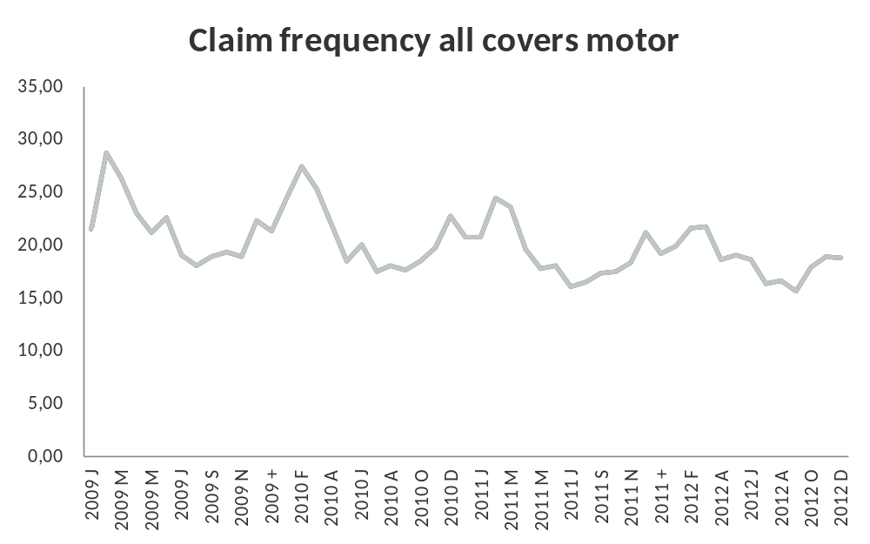
Key ratios – claim frequency
Poisson
Some notions
Examples
Random intensities
The graph shows claim frequency for all covers for motor insurance
Notice seasonal variations, due to changing weather condition throughout the years

Slide 21
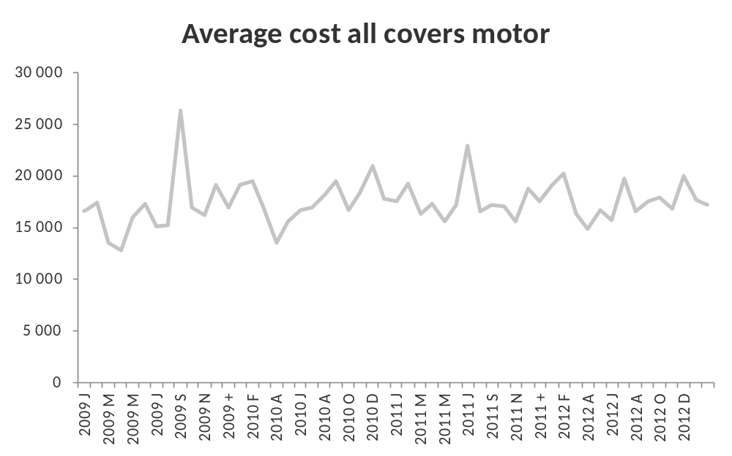
Key ratios – claim severity
Poisson
Some notions
Examples
Random intensities
The graph shows claim severity for all covers for motor insurance

Slide 22
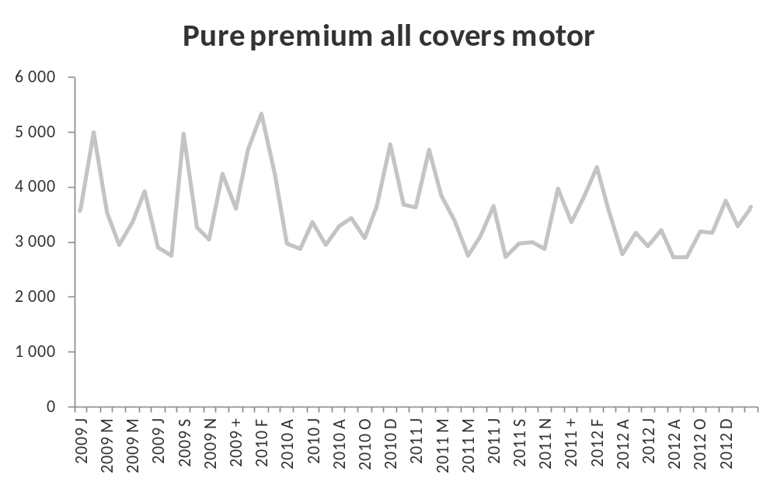
Key ratios – pure premium
Poisson
Some notions
Examples
Random intensities
The graph shows pure premium for all covers for motor insurance

Slide 23
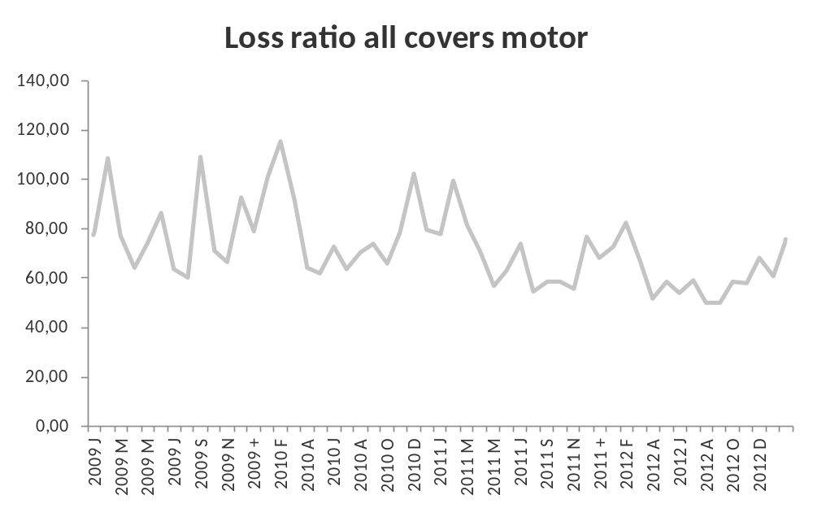
Key ratios – pure premium
Poisson
Some notions
Examples
Random intensities
The graph shows loss ratio for all covers for motor insurance

Slide 24
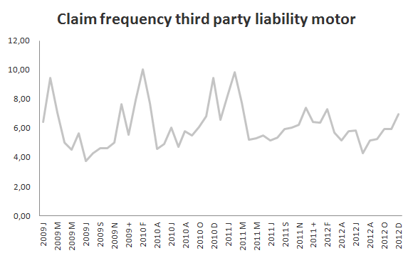
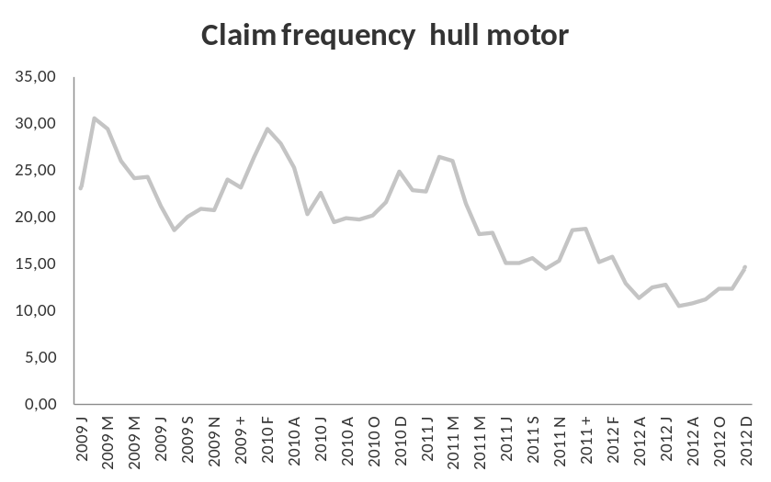
Key ratios – claim frequency TPL and hull
Poisson
Some notions
Examples
Random intensities
The graph shows claim frequency for third part liability and hull for motor insurance

Slide 25
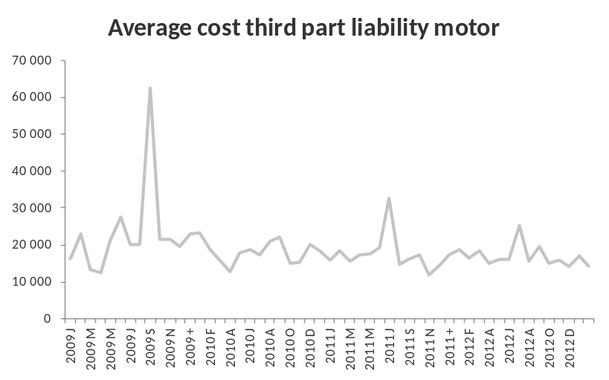
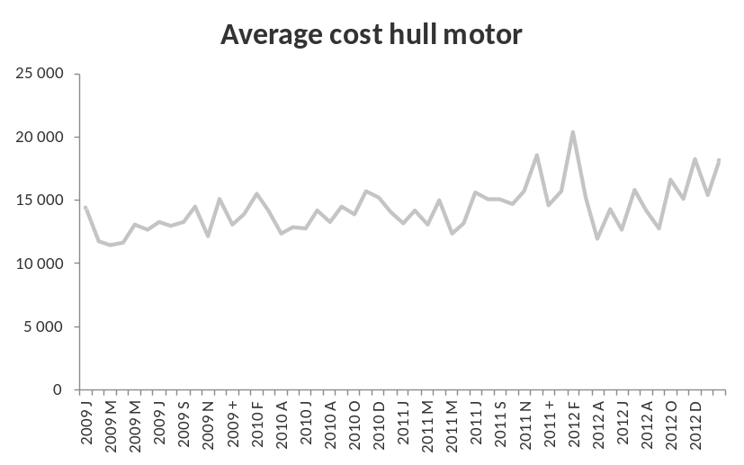
Key ratios – claim frequency and claim severity
Poisson
Some notions
Examples
Random intensities
The graph shows claim severity for third part liability and hull for motor insurance

Slide 26
Random intensities (Chapter 8.3)
Poisson
Some notions
Examples
Random intensities
How varies over the portfolio can partially be described by observables such as age or sex of the individual (treated in Chapter 8.4)
There are however factors that have impact on the risk which the company can’t know much about
  Driver ability, personal risk averseness,
This randomeness can be managed by making a stochastic variable
This extension may serve to capture uncertainty affecting all policy holders jointly, as well, such as altering weather conditions
The models are conditional ones of the form
Let
which by double rules in Section 6.3 imply
Now E(N)<var(N) and N is no longer Poisson distributed
Policy level
Portfolio level

Slide 27
The rule of double variance
Poisson
Some notions
Examples
Random intensities
Let X and Y be arbitrary random variables for which
Then we have the important identities
Rule of double expectation
Rule of double variance
Recall rule of double expectation

Slide 28
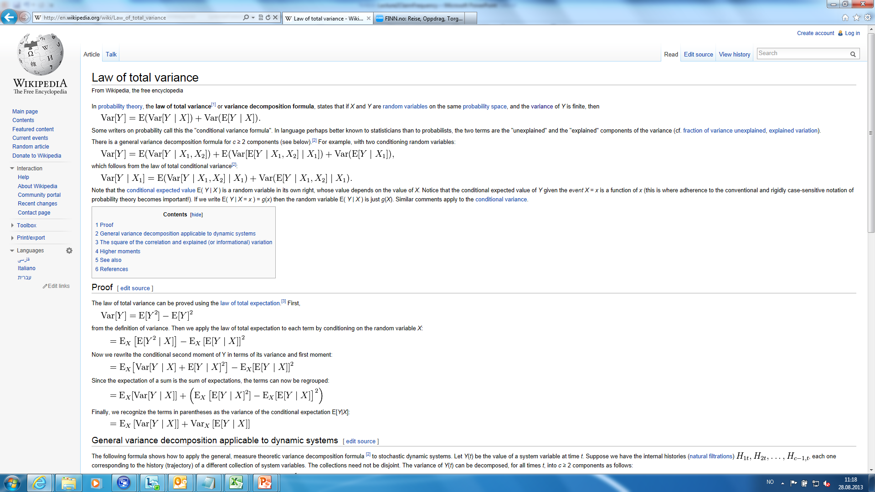
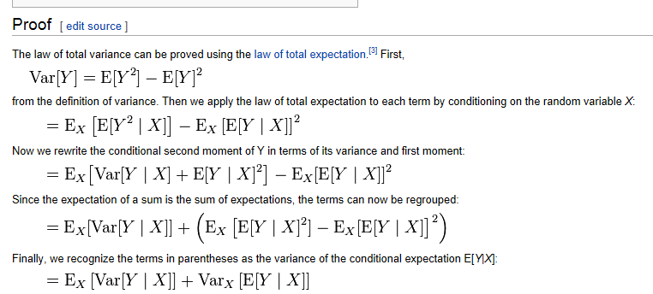
wikipedia tells us how the rule of double variance can be proved
Poisson
Some notions
Examples
Random intensities

Slide 29
The rule of double variance
Poisson
Some notions
Examples
Random intensities
Var(Y) will now be proved from the rule of double expectation. Introduce
which is simply the rule of double expectation. Clearly
Passing expectations over this equality yields
where
which will be handled separately. First note that
and by the rule of double expectation applied to
The second term makes use of the fact that by the rule of double expectation so that

Slide 30
The rule of double variance
Poisson
Some notions
Examples
Random intensities
The final term B3 makes use of the rule of double expectation once again which yields
where
And B3=0. The second equality is true because the factor is fixed by X. Collecting the expression for B1, B2 and B3 proves the double variance formula

Slide 31
Random intensities
Poisson
Some notions
Examples
Random intensities
Specific models for are handled through the mixing relationship
Gamma models are traditional choices for and detailed below
Estimates of can be obtained from historical data without specifying . Let n1,...,nn be claims from n policy holders and T1,...,TJ their exposure to risk. The intensity if individual j is then estimated as .
Uncertainty is huge. One solution is
(1.5)
and
(1.6)
Both estimates are unbiased. See Section 8.6 for details. 10.5 returns to this.

Slide 32
The negative binomial model
Poisson
Some notions
The most commonly applied model for muh is the Gamma distribution. It is then assumed that
Examples
Random intensities
Here is the standard Gamma distribution with mean one, and
fluctuates around with uncertainty controlled by . Specifically
Since , the pure Poisson model with fixed intensity emerges in the limit.
The closed form of the density function of N is given by
for n=0,1,.... This is the negative binomial distribution to be denoted . Mean, standard deviation and skewness are
(1.9)
Where E(N) and sd(N) follow from (1.3) when is inserted.
Note that if N1,...,NJ are iid then N1+...+NJ is nbin (convolution property).

Slide 33
Fitting the negative binomial
Poisson
Some notions
Examples
Random intensities
Moment estimation using (1.5) and (1.6) is simplest technically. The estimate of is simply in (1.5), and for invoke (1.8) right which yields
If , interpret it as an infinite or a pure Poisson model.
Likelihood estimation: the log likelihood function follows by inserting nj for n in (1.9) and adding the logarithm for all j. This leads to the criterion
where constant factors not depending on and have been omitted.

