Slide 1
Non-life insurance mathematics
Nils F. Haavardsson, University of Oslo and DNB Skadeforsikring

Slide 2
Last lecture….
Exame 2011 problem 1, 2 and 3 (1.5-2h)
Repetition, highlighting of important topics from pensum and advice for exame (0.5-1h)
Some brief words about the assignment (0.5h)

Slide 3
About the exame 1
4th of December, 1430-1830
Bring an approved calculator
Bring no books or notes

Slide 4
About the exame 2
The exame aims to reflect the focus of the course, which has been practical and focused on the application of statistical techniques in general insurance
However, since this is a course at the Department of Mathematics, there should be some mathematics in the exame
The exame aims to be comprehensive, i.e., cover as many topics from the pensum as possible
There will be 3 practical and 1 theoretical task
The exame aims to test understanding of important concepts from the course

Slide 5
STK 4540 - main issues
The concept of diversification and risk premium
How can claim frequency be modelled?
How can claim size be modelled?
How can solvency be simulated?
Pricing in general insurance by regression
Pricing in general insurance by credibility theory
Reduction of risk in general insurance using re-insurance

Slide 6
Insurance works because risk can be diversified away through size
The core idea of insurance is risk spread on many units
Assume that policy risks X1,…,XJ are stochastically independent
Mean and variance for the portfolio total are then
which is average expectation and variance. Then
The coefficient of variation approaches 0 as J grows large (law of large numbers)
Insurance risk can be diversified away through size
Insurance portfolios are still not risk-free because
  of uncertainty in underlying models
  risks may be dependent

Slide 7
Risk premium expresses cost per policy and is important in pricing
Risk premium is defined as P(Event)*Consequence of Event
More formally
From above we see that risk premium expresses cost per policy
Good price models rely on sound understanding of the risk premium
We start by modelling claim frequency

Slide 8
The world of Poisson (Chapter 8.2)
Poisson
Some notions
Examples
Number of claims
Random intensities
I_{k-1}
I_{k}
I_{k+1}
t₀=0
t_{k-2}
t_{k-1}
t_{k}
t_{k+1}
t_{k}=T
What is rare can be described mathematically by cutting a given time period T into K small pieces of equal length h=T/K
On short intervals the chance of more than one incident is remote
Assuming no more than 1 event per interval the count for the entire period is
N=I₁+...+I_{K} , where I_{j} is either 0 or 1 for j=1,...,K
If p=Pr(I_{k}=1) is equal for all k and events are independent, this is an ordinary Bernoulli series
where
Assume that p is proportional to h and set
is an intensity which applies per time unit

Slide 9
The world of Poisson
Poisson
Some notions
Examples
Random intensities
In the limit N is Poisson distributed with parameter

Slide 10
The world of Poisson
Poisson
Some notions
Examples
Random intensities
It follows that the portfolio number of claims N is Poisson distributed with parameter
When claim intensities vary over the portfolio, only their average counts

Slide 11
Random intensities (Chapter 8.3)
Poisson
Some notions
Examples
Random intensities
How varies over the portfolio can partially be described by observables such as age or sex of the individual (treated in Chapter 8.4)
There are however factors that have impact on the risk which the company can’t know much about
  Driver ability, personal risk averseness,
This randomeness can be managed by making a stochastic variable
0
1
2
3
0
1
2
3

Slide 12
Random intensities (Chapter 8.3)
Poisson
Some notions
Examples
Random intensities
The models are conditional ones of the form
Let
which by double rules in Section 6.3 imply
Now E(N)<var(N) and N is no longer Poisson distributed
Policy level
Portfolio level

Slide 13
The Poisson regression model (Section 8.4)
The fair price
The model
An example
Why regression?
Repetition of GLM
The idea is to attribute variation in to variations in a set of observable variables x1,...,xv. Poisson regressjon makes use of relationships of the form
(1.12)
Why and not itself?
The expected number of claims is non-negative, where as the predictor on the right of (1.12) can be anything on the real line
It makes more sense to transform so that the left and right side of (1.12) are more in line with each other.
Historical data are of the following form
  n1 T1 x11...x1x
  n2 T2 x21...x2x
  nn Tn xn1...xnv
The coefficients b0,...,bv are usually determined by likelihood estimation
Claims exposure covariates

Slide 14
The model (Section 8.4)
The fair price
The model
An example
Why regression?
Repetition of GLM
In likelihood estimation it is assumed that nj is Poisson distributed where is tied to covariates xj1,...,xjv as in (1.12). The density function of nj is then
or
log(f(nj)) above is to be added over all j for the likehood function L(b0,...,bv).
Skip the middle terms njTj and log (nj!) since they are constants in this context.
Then the likelihood criterion becomes
(1.13)
Numerical software is used to optimize (1.13).
McCullagh and Nelder (1989) proved that L(b0,...,bv) is a convex surface with a single maximum
Therefore optimization is straight forward.

Slide 15
Repetition claim size
The concept
Non parametric modelling
Scale families of distributions
Fitting a scale family
Shifted distributions
Skewness
Non parametric estimation
Parametric estimation: the log normal family
Parametric estimation: the gamma family
Parametric estimation: fitting the gamma

Slide 16
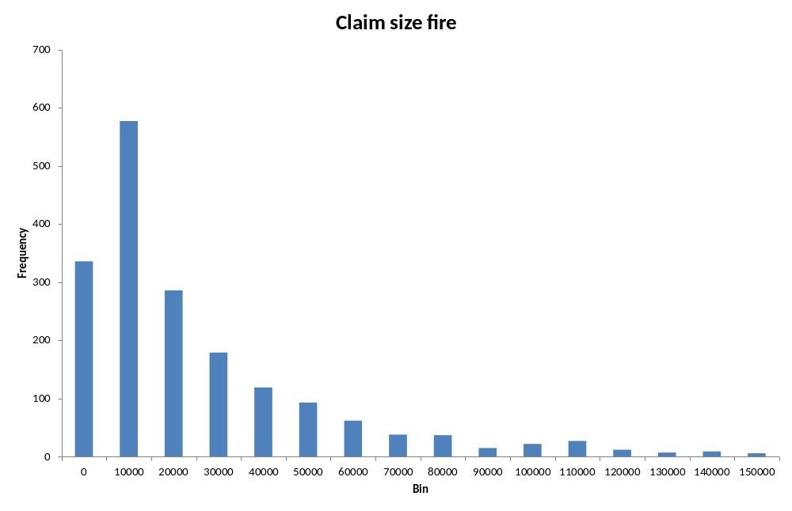
Claim severity modelling is about describing the variation in claim size
The concept
The graph below shows how claim size varies for fire claims for houses
The graph shows data up to the 88th percentile
How does claim size vary?
How can this variation be modelled?
Truncation is necessary (large claims are rare and disturb the picture)
0-claims can occur (because of deductibles)
Two approaches to claim size modelling – non-parametric and parametric

Slide 17
Non-parametric modelling can be useful
Non parametric modelling
Claim size modelling can be non-parametric where each claim zi of the past is assigned a probability 1/n of re-appearing in the future
A new claim is then envisaged as a random variable for which
This is an entirely proper probability distribution
It is known as the empirical distribution and will be useful in Section 9.5.

Slide 18
Non-parametric modelling can be useful
Scale families of distributions
All sensible parametric models for claim size are of the form
and Z0 is a standardized random variable corresponding to .
The large the scale parameter, the more spread out the distribution

Slide 19
Fitting a scale family
Fitting a scale family
Models for scale families satisfy
where are the distribution functions of Z and Z0.
Differentiating with respect to z yields the family of density functions
The standard way of fitting such models is through likelihood estimation. If z1,…,zn are the historical claims, the criterion becomes
which is to be maximized with respect to and other parameters.
A useful extension covers situations with censoring.

Slide 20
Fitting a scale family
Fitting a scale family
Full value insurance:
  The insurance company is liable that the object at all times is insured at its true value
First loss insurance
  The object is insured up to a pre-specified sum.
  The insurance company will cover the claim if the claim size does not exceed the pre-specified sum
The chance of a claim Z exceeding b is , and for nb such events with lower bounds b1,…,bnb the analogous joint probability becomes
Take the logarithm of this product and add it to the log likelihood of the fully observed claims z1,…,zn. The criterion then becomes
complete information
(for objects fully insured)
censoring to the right
(for first loss insured)

Slide 21
Shifted distributions
Shifted distributions
The distribution of a claim may start at some treshold b instead of the origin.
Obvious examples are deductibles and re-insurance contracts.
Models can be constructed by adding b to variables starting at the origin; i.e. where Z0 is a standardized variable as before. Now
Example:
  Re-insurance company will pay if claim exceeds 1 000 000 NOK
The payout of the insurance company
Total claim amount
Currency rate for example NOK per EURO, for example 8 NOK per EURO

Slide 22
Skewness as simple description of shape
Skewness
A major issue with claim size modelling is asymmetry and the right tail of the distribution. A simple summary is the coefficient of skewness
Negative skewness
Positive skewness
Negative skewness: the left tail is longer; the mass of the distribution
Is concentrated on the right of the figure. It has relatively few low values
Positive skewness: the right tail is longer; the mass of the distribution
Is concentrated on the left of the figure. It has relatively few high values

Slide 23
Non-parametric estimation
Non parametric estimation
The random variable that attaches probabilities 1/n to all claims zi of the past is a possible model for future claims.
Expectation, standard deviation, skewness and percentiles are all closely related to the ordinary sample versions. For example
Furthermore,
Third order moment and skewness becomes

Slide 24
The log-normal family
Parametric estimation: the log normal family
A convenient definition of the log-normal model in the present context is
as where
Mean, standard deviation and skewness are
see section 2.4.
Parameter estimation is usually carried out by noting that logarithms are Gaussian. Thus
and when the original log-normal observations z1,…,zn are transformed to Gaussian ones through y1=log(z1),…,yn=log(zn) with sample mean and variance , the estimates of become

Slide 25
The Gamma family
Parametric estimation: the gamma family
The Gamma family is an important family for which the density function is
It was defined in Section 2.5 as is the standard Gamma with mean one and shape alpha. The density of the standard Gamma simplifies to
Mean, standard deviation and skewness are
and there is a convolution property. Suppose G1,…,Gn are independent with
. Then

Slide 26
The Gamma family
Parametric estimation: fitting the gamma
The Gamma family is an important family for which the density function is
It was defined in Section 2.5 as is the standard Gamma with mean one and shape alpha. The density of the standard Gamma simplifies to

Slide 27
The Gamma family
Parametric estimation: fitting the gamma

Slide 28
Solvency
Financial control of liabilities under nearly worst-case scenarios
Target: the reserve
  which is the upper percentile of the portfolio liability
Modelling has been covered (Risk premium calculations)
The issue now is computation
  Monte Carlo is the general tool
  Some problems can be handled by simpler, Gaussian approximations

Slide 29
10.2 Portfolio liabilities by simple approximation
The portfolio loss for independent risks become Gaussian as J tends to infinity.
Assume that policy risks X1,…,XJ are stochastically independent
Mean and variance for the portfolio total are then
which is average expectation and variance. Then
as J tends to infinfity
Note that risk is underestimated for small portfolios and in branches with large claims

Slide 30
Normal approximations

Slide 31
The rule of double variance
Poisson
Some notions
Examples
Random intensities
Let X and Y be arbitrary random variables for which
Then we have the important identities
Rule of double expectation
Rule of double variance

Slide 32
The rule of double variance
Poisson
Some notions
Examples
Random intensities
Portfolio risk in general insurance
Elementary rules for random sums imply

Slide 33
The rule of double variance
Poisson
Some notions
Examples
Random intensities
This leads to the true percentile qepsilon being approximated by
Where phi epsilon is the upper epsilon percentile of the standard normal distribution

Slide 34
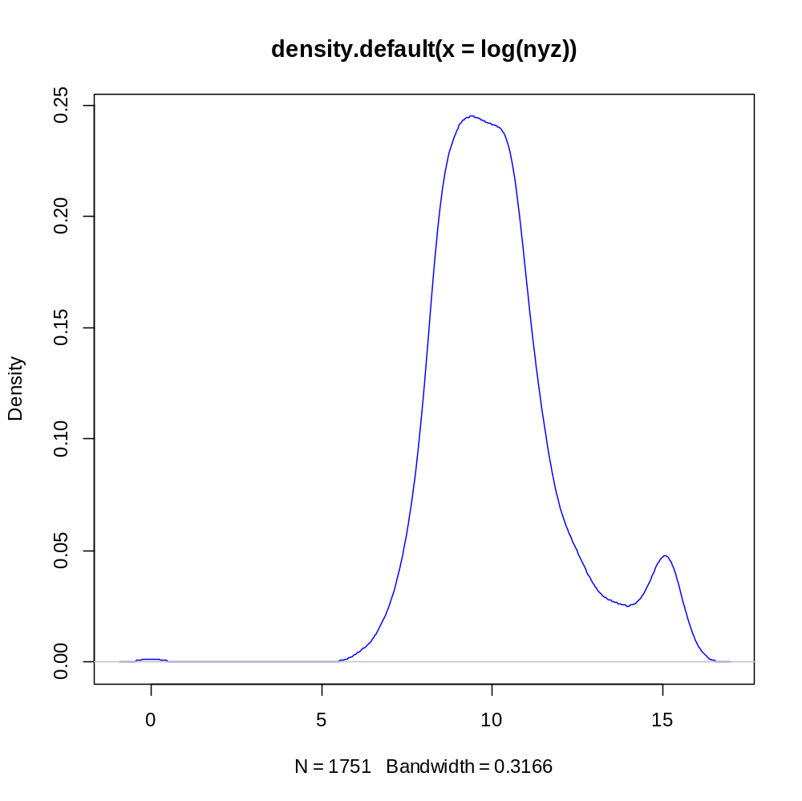
Fire data from DNB

Slide 35
Portfolio liabilities by simulation
Monte Carlo simulation
Advantages
  More general (no restriction on use)
  More versatile (easy to adapt to changing circumstances)
  Better suited for longer time horizons
Disadvantages
  Slow computationally?
  Depending on claim size distribution?

Slide 36
An algorithm for liabilities simulation
Assume claim intensities for J policies are stored on file
Assume J different claim size distributions and payment functions H1(z),…,HJ(z) are stored
The program can be organised as follows (Algorithm 10.1)

Slide 37
Experiments in R
1. Log normal distribution
2. Gamma on log scale
3. Pareto
4. Weibull
5. Mixed distribution 1
6. Monte Carlo algorithm for portfolio liabilities
7. Mixed distribution 2

Slide 38
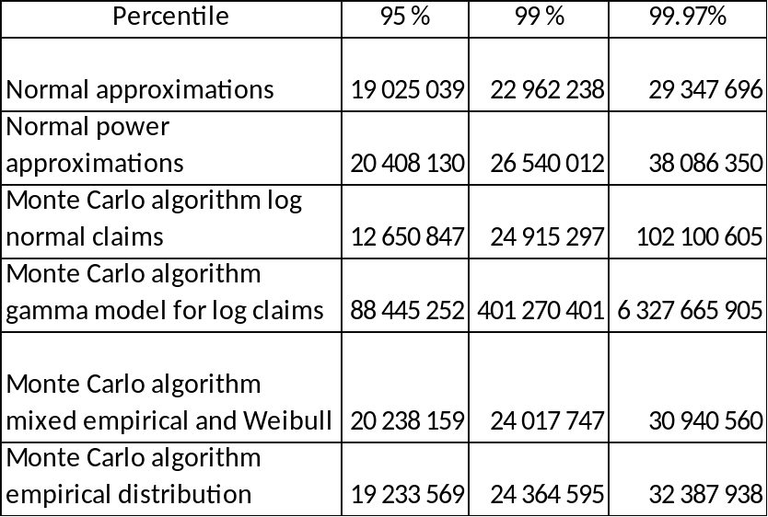
Comparison of results

Slide 39
Monte Carlo theory
Suppose X1, X2,… are independent and exponentially distributed with mean 1.
It can then be proved
(1)
for all n >= 0 and all lambda > 0.
From (1) we see that the exponential distribution is the distribution that describes time between events in a Poisson process.
In Section 9.3 we learnt that the distribution of X1+…+Xn is gamma distributed with mean n and shape n
The Poisson process is a process in which events occur continuously and independently at a constant average rate
The Poisson probabilities on the right define the density function
which is the central model for claim numbers in property insurance.
Mean and standard deviation are E(N)=lambda and sd(N)=sqrt(lambda)

Slide 40
Monte Carlo theory
It is then utilized that Xj=-log(Uj) is exponential if Uj is uniform, and the sum X1+X2+… is monitored until it exceeds lambda, in other words

Slide 41
Monte Carlo theory
(1)

Slide 42
The credibility approach
Motivation
Model
Example
Combining credibility theory and GLM
The basic assumption is that policy holders carry a list of attributes with impact on risk
The parameter could be how the car is used by the customer (degree of recklessness) or for example driving skill
It is assumed that exists and has been drawn randomly for each individual
X is the sum of claims during a certain period of time (say a year) and introduce
We seek the conditional pure premium of the policy holder as basis for pricing
On group level there is a common that applies to all risks jointly
We will focus on the individual level here, as the difference between individual and group is minor from a mathematical point of view

Slide 43
Omega is random and has been drawn for each policy holder
Motivation
Model
Example
Combining credibility theory and GLM
(driving skill)
(poor driver)
(excellent driver)

Slide 44
The most accurate estimate
Motivation
Model
Example
Combining credibility theory and GLM
Let X1,…,XK (policy level) be realizations of X dating K years back
The most accurate estimate of pi from such records is (section 6.4) the conditional mean
where x1,…,xK are the actual values.
A natural framework is the common factor model of Section 6.3 where X,X1,…,XK are identically and independently distributed given omega
This won’t be true when underlying conditions change systematically
A problem with the estimate above is that it requires a joint model for X,X1,…,XK and omega.
A more natural framework is to break X down on claim number N and losses per incident Z.
First linear credibility is considered

Slide 45
Linear credibility
Motivation
Model
Example
Combining credibility theory and GLM
The standard method in credibility is the linear one with estimates of pi of the form
where b0,…,bK are coefficients so that the mean squared error is as small as possible.
The fact that X,X1,…,XK are conditionally independent with the same distribution forces b1=…=bK, and if w/K is their common value, the estimate becomes
To proceed we need the so-called structural parameters
where is the average pure premium for the entire population.
It is also the expectation for individuals since by the rule of double expectation

Slide 46
Linear credibility
Motivation
Model
Example
Combining credibility theory and GLM
Both represent variation. The former is caused by diversity between individuals and the latter by the physical processes behind the incidents.Their impact on var(X) can be understood through the rule of double variance, i.e.,
and represent uncertainties of different origin that add to var(X)
The optimal linear credibility estimate now becomes
which is proved in Section 10.7, where it is also established that
The estimate is ubiased and its standard deviation decreases with K

Slide 47
Linear credibility
The weight w defines a compromise between the average pure premium pi bar of the population and the track record of the policy holder
Note that w=0 if K=0; i.e. without historical information the best estimate is the population average

