Slide 1
Non-life insurance mathematics
Nils F. Haavardsson, University of Oslo and DNB Skadeforsikring

Slide 2
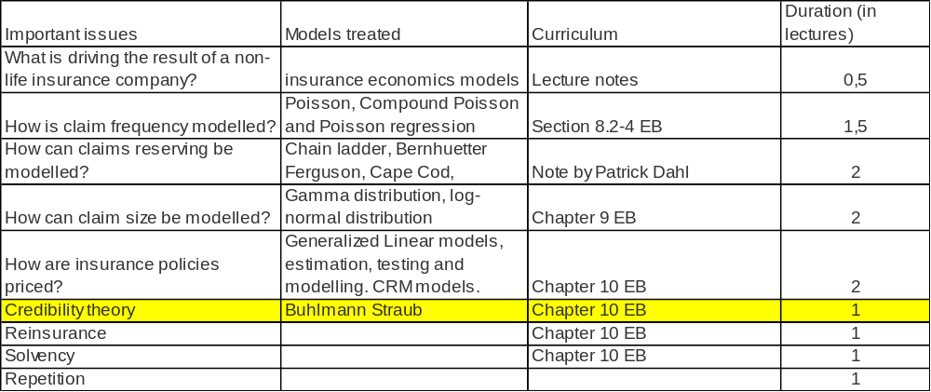
Overview
done
done
done
done
done
done

Slide 3
Credibility theory was used before computers arrived
Motivation
Linear credibility
Example
Optimal credibility

Slide 4
The need for credibility theory
Motivation
Linear credibility
Example
Optimal credibility
So far we have studied how GLMs may be used to estimate relativities for rating factors with a moderate number of levels.
  The rating factors were either categorical with few levels (e.g., gender), or
  formed by grouping of a continuous variable (e.g., policy holder age)
In case of insufficient data levels can be merged
However, for categorical rating factors with a large number of levels without an inherent ordering there is no simple way to form groups to solve the problem with insufficient data

Slide 5
Example 1: car insurance
Motivation
Linear credibility
Example
Optimal credibility
Car model is an important rating factor in motor insurance
  Exlusive cars are more attractive to thieves and more expensive to repair than common cars
  Sports cars may be driven differently (more recklessly?) than family cars
In Norway there are more than 3000 car model codes
How should these be grouped?

Slide 6
Example 2: Experience rating
Motivation
Linear credibility
Example
Optimal credibility
The customer is used as a rating factor
The credibility estimators are used to calibrate the pure premium
The credibility estimators are weighted averages of
  the pure premium based on the individual claims experience
  The pure premium for the entire portfolio of insurance policies

Slide 7
Example 3: Geographic zones
Motivation
Linear credibility
Example
Optimal credibility
How should the premium be affected by the area of residence? (parallel to the car model example)
Example: postcode. There are over 8000 postcodes in Norway
We can merge neighbouring areas
But they may have different risk characteristics

Slide 8
The credibility approach
Motivation
Linear credibility
Example
Optimal credibility
The basic assumption is that policy holders carry a list of attributes with impact on risk
The parameter could be how the car is used by the customer (degree of recklessness) or for example driving skill
It is assumed that exists and has been drawn randomly for each individual
X is the sum of claims during a certain period of time (say a year) and introduce
We seek the conditional pure premium of the policy holder as basis for pricing
On group level there is a common that applies to all risks jointly
We will focus on the individual level here, as the difference between individual and group is minor from a mathematical point of view

Slide 9
Omega is random and has been drawn for each policy holder
Motivation
Linear credibility
Example
Optimal credibility
(driving skill)
(poor driver)
(excellent driver)

Slide 10
Omega is random and has been drawn for each policy holder
Motivation
Linear credibility
Example
Optimal credibility
(Riskyness of car, measured by car model)
(car with little risk (family car))
(car with larger risk (sports car))

Slide 11
Omega is random and has been drawn for each policy holder
Motivation
Linear credibility
Example
Optimal credibility
(Riskyness of geographical area, measured by post code)
(area with good climate)
(area with poor climate )

Slide 12
Goal
Motivation
Linear credibility
Example
Optimal credibility
We want to estimate
These are called structural parameters.
If X1,…,XK are realizations from X, where X is the sum of claims during a year we want the following expression
We want to find what w is in two situations.
The weight w defines a compromise between the average pure premium of the population and the track record of the policy holder.

Slide 13
Linear credibility
Motivation
Linear credibility
Example
Optimal credibility
The standard method in credibility is the linear one with estimates of pi of the form
where b0,…,bK are coefficients tailored to minimized the mean squared error
The fact that X,X1,…,XK are conditionally independent with the same distribution forces b1=…=bK, and if w/K is their common value, the estimate becomes

Slide 14
Linear credibility
Motivation
Linear credibility
Example
Optimal credibility
To proceed we need the so-called structural parameters
where is the average pure premium for the entire population.
It is also the expectation for individuals since by the rule of double expectation
Both represent variation. The former is caused by diversity between individuals and the latter by the physical processes behind the incidents.Their impact on var(X) can be understood through the rule of double variance, i.e.,
and represent uncertainties of different origin that add to var(X)

Slide 15
Linear credibility
Motivation
Linear credibility
Example
Optimal credibility
The optimal linear credibility estimate now becomes
which is proved in Section 10.7, where it is also established that
The estimate is ubiased and its standard deviation decreases with K
The weight w defines a compromise between the average pure premium pi bar of the population and the track record of the policy holder
Note that w=0 if K=0; i.e. without historical information the best estimate is the population average

Slide 16
Estimation of structural parameters
Motivation
Linear credibility
Example
Optimal credibility
Credibility estimation is based on parameters that must be determined from historical data.
Historical data for J policies that been in the company for K1,…,KJ years are then of the form
where the j’th row are the annual claims from client j and
their mean and standard deviation
The following estimates are essentially due to Sundt (1983) and Bühlmann and Straub (1970):
Policies
Annual claims
mean
sd

Slide 17
Estimation of structural parameters
Motivation
Linear credibility
Example
Optimal credibility
For verification see Section 10.7.
The expression for may be negative. If it is let and assume that the underlying variation is too small to be detected.

Slide 18
The most accurate estimate
Motivation
Linear credibility
Example
Optimal credibility
Let X1,…,XK (policy level) be realizations of X dating K years back
The most accurate estimate of pi from such records is (section 6.4) the conditional mean
where x1,…,xK are the actual values.
A natural framework is the common factor model of Section 6.3 where X,X1,…,XK are identically and independently distributed given omega
This won’t be true when underlying conditions change systematically
A problem with the estimate above is that it requires a joint model for X,X1,…,XK and omega.
A more natural framework is to break X down on claim number N and losses per incident Z.
First linear credibility is considered

Slide 19
Optimal credibility
Motivation
Linear credibility
Example
Optimal credibility
The preceding estimates are the best linear methods but the Bayesian estimate is optimal among all methods and offers an improvement.
Break the historical record x1,…,xK down on annual claim numbers n1,…nK and losses z1,…,zn where n=n1+…+nK and assume independence.
The Bayes estimate of now becomes
and there are two parts.
Often claim intensity muh fluctuates more strongly from one policy holder to another than does the expected loss .
We shall disregard all such variation in .
Then is independently of z1,…,zn and the Bayesian estimate becomes

Slide 20
Optimal credibility
Motivation
Linear credibility
Example
Optimal credibility
A model for past and future claim numbers is needed. The natural one is the common factor model where N,N1,…,Nk are conditionally independent and identically distributed given muh with N and all Nk being Poisson (mu T).
For mu assume the standard representation
where E(G)=1. It is shown in Section 10.7 that the estimate now becomes
Note that the population average pi bar is adjusted up or down according to whether the average claim number n bar is larger or smaller than its expectation . The error (proved in Section 10.7) is

