Slide 1
Dynamic claim intensity
Oblig 1

Slide 2
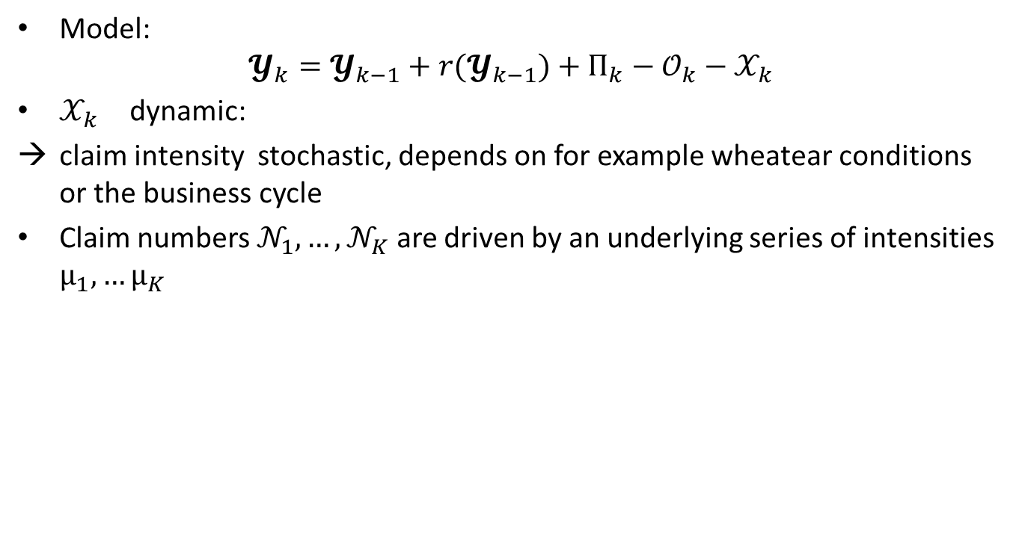
Model for net assets
Model:
$$𝓨_{k}=𝓨_{k−1}+{r(𝓨}_{k−1})+П_{k}−𝒪_{k}−𝒳_{k}$$
$𝒳_{k}$ dynamic:
claim intensity stochastic, depends on for example wheatear conditions or the business cycle
Claim numbers $𝒩_{1},…,𝒩_{K}$ are driven by an underlying series of intensities $µ_{1},…µ_{K}$

Slide 3
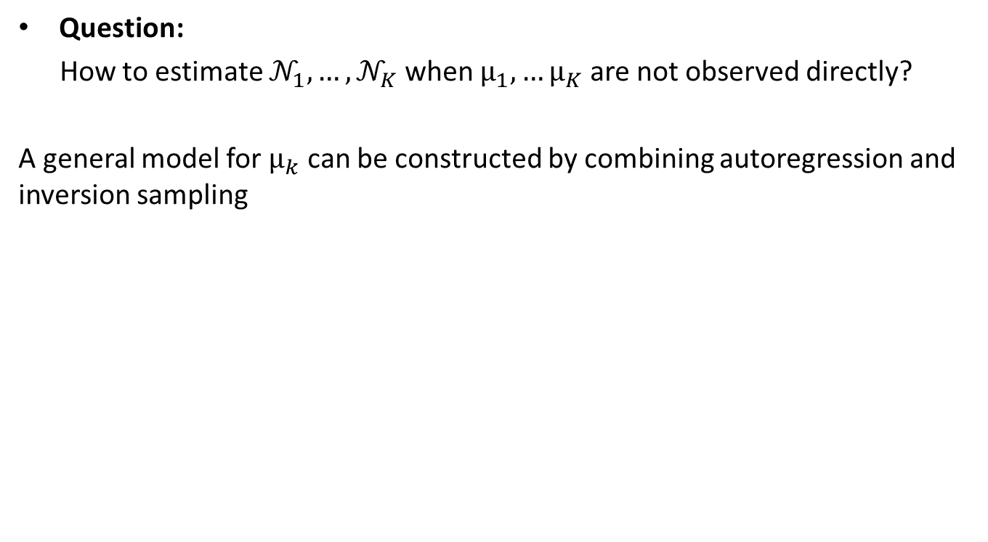
Question:
How to estimate $𝒩_{1},…,𝒩_{K}$ when $µ_{1},…µ_{K}$ are not observed directly?
A general model for $µ_{k}$ can be constructed by combining autoregression and inversion sampling

Slide 4
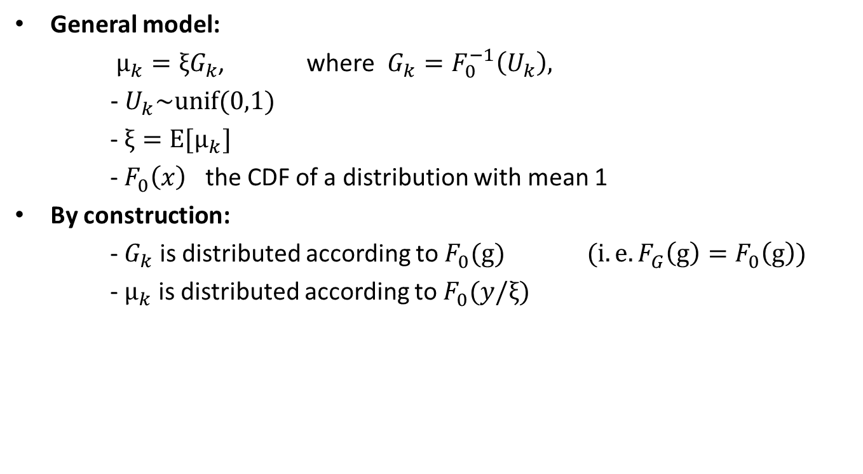
General model for claim intensity
General model:
$µ_{k}=ξG_{k}$, where $G_{k}=F_{0}^{−1}\left(U_{k}\right),$
- $U_{k}\sim unif(0,1)$
- $ξ=E[µ_{k}]$
- $F_{0}^{}\left(x\right)$ the CDF of a distribution with mean 1
By construction:
- $G_{k}$ is distributed according to $F_{0}^{}(g)$ $(i.e. F_{G}^{}\left(g\right)=F_{0}^{}\left(g\right))$
- $µ_{k}$ is distributed according to $F_{0}^{}(y/ξ)$

Slide 5
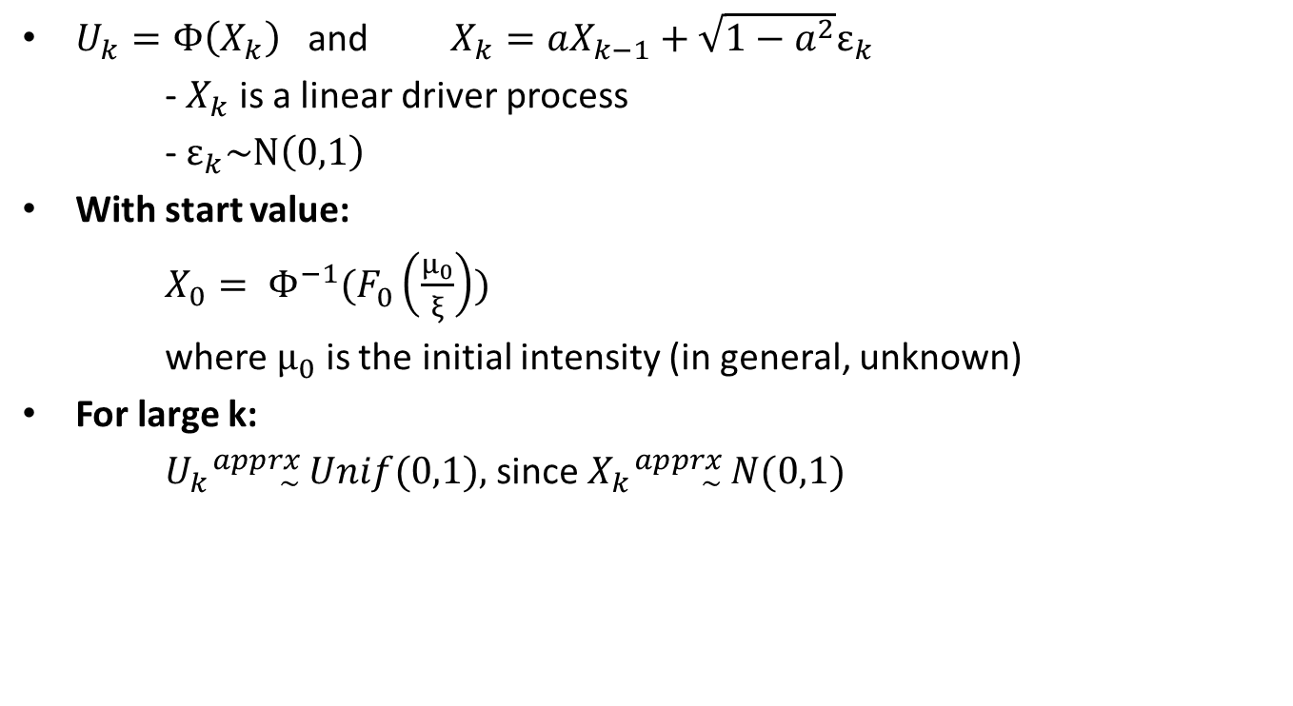
Serial dependence
$U_{k}=Φ\left(X_{k}\right)$ and $X_{k}=aX_{k−1}+\sqrt{1−a^{2}}ε_{k}$
- $X_{k}$ is a linear driver process
- $ε_{k}\sim N\left(0,1\right)$
With start value:
$X_{0}= Φ^{−1}(F_{0}^{}\left(\frac{µ_{0}}{ξ}\right))$
where $µ_{0}$ is the initial intensity (in general, unknown)
For large k:
$U_{k}{}_{\sim }^{apprx}{ Unif(0,1)},$since $X_{k}{}_{\sim }^{apprx}{ N(0,1)}$

Slide 6
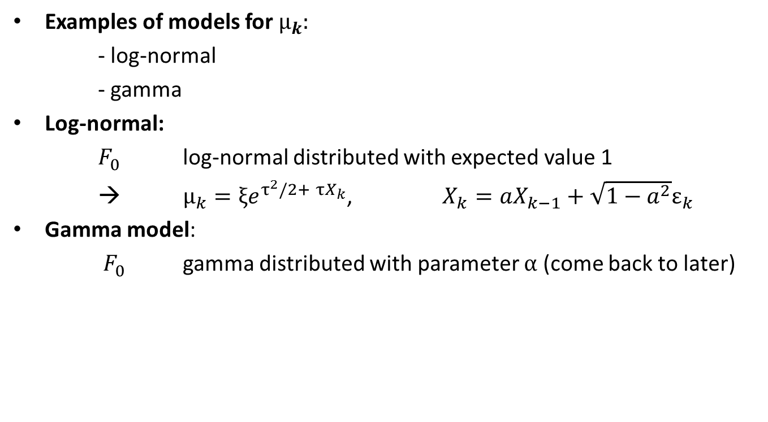

Models for $µ_{k}$
Examples of models for $µ_{k}:$
- log-normal
- gamma
Log-normal:
$F_{0}^{}$ log-normal distributed with expected value 1
→ $µ_{k}=ξe^{τ^{2}/2+ τX_{k}}$, $X_{k}=aX_{k−1}+\sqrt{1−a^{2}}ε_{k}$
Gamma model:
$F_{0}^{}$ gamma distributed with parameter $α$ (come back to later)

Slide 7
Estimation of parameters based on data
The best solution is to estimate all parameters simultaneously using maximum likelihood
Probably won’t fint that in standard software
It is too complicated to do numerically
A simpler method would be the following:

Slide 8
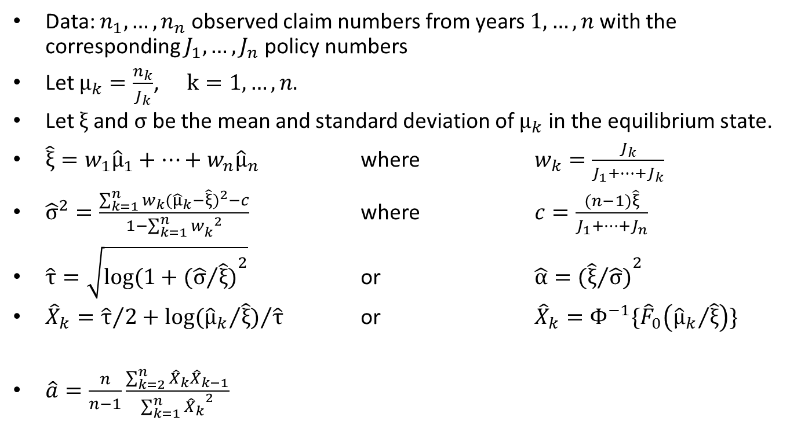
Estimation of parameters
Data: $n_{1},…,n_{n}$ observed claim numbers from years $1,…,n$ with the corresponding $J_{1},…,J_{n}$ policy numbers
Let $µ_{k}=\frac{n_{k}}{J_{k}}$, $k=1,…,n.$
Let $ξ$ and $σ$ be the mean and standard deviation of $µ_{k}$ in the equilibrium state.
$\hat{ξ}=w_{1}{\hat{µ}}_{1}+…+w_{n}{\hat{µ}}_{n}$ where $w_{k}=\frac{J_{k}}{J_{1}+…+J_{k}}$
${\hat{σ}}^{2}=\frac{\sum_{k=1}^{n}{w_{k}{({\hat{µ}}_{k}−\hat{ξ})}^{2}}−c}{1−\sum_{k=1}^{n}{{w_{k}^{}}^{2}}}$ where $c=\frac{(n−1)\hat{ξ}}{J_{1}+…+J_{n}}$
$\hat{τ}=\sqrt{log⁡(1+{{(\hat{σ}}/{\hat{ξ})}}^{2}}$ or $\hat{α}={{(\hat{ξ}}/{\hat{σ})}}^{2}$
${\hat{X}}_{k}={\hat{τ}}/2+{log⁡({{\hat{µ}}_{k}}/{\hat{ξ}})}/{\hat{τ}}$ or ${\hat{X}}_{k}=Φ^{−1}\{{\hat{F}}_{0}\left({{\hat{µ}}_{k}}/{\hat{ξ}}\right)\}$
$\hat{a}=\frac{n}{n−1}\frac{\sum_{k=2}^{n}{{\hat{X}}_{k}{\hat{X}}_{k−1}}}{\sum_{k=1}^{n}{{{\hat{X}}_{k}}^{2}}}$

