Slide 1
KJM 3110 Electrochemistry
Chapter 5. Electrochemical power
With exercises

Slide 2
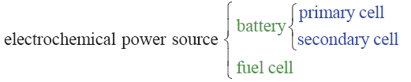
Electrochemical power
Previous chapter: Electrical energy to chemical (Gibbs) energy
  Electrolysis
  Charging battery
    Secondary cells; Accumulators, rechargeable batteries)
This chapter: Chemical (Gibbs) energy to electrical energy
  Fuel cell
  Discharging battery
    Primary cells
    Secondary cells; Accumulators, rechargeable battery

Slide 3
Recap from Ch. 4 Electrosynthesis - Summary
We have seen some industrial examples of electrolytic operation of electrochemical cells for production of high-energy fuels and chemicals
  Some important
    Hall-Hèrault for aluminium
    Chlor-alkali for chlorine products
    Electrolysis for H₂
  Some new trends
    Organic electrosynthesis
Applications of high-temperature solid electrolytes pursued at UiO
Ion-selective membranes give additional possibilities
In electrosynthesis, otherwise impossible reactions become possible
  The electronic energy adds to or – more typically – overpowers the chemical energy
    Thermodynamic
    Kinetic (can also give unique selectivities)
“Control chemistry by controlling electrons”

Slide 4
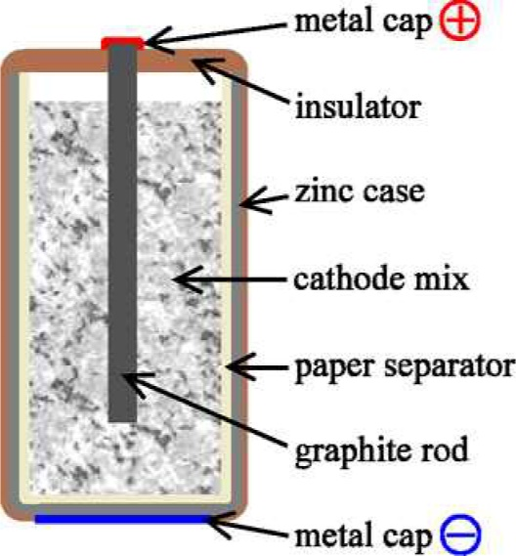
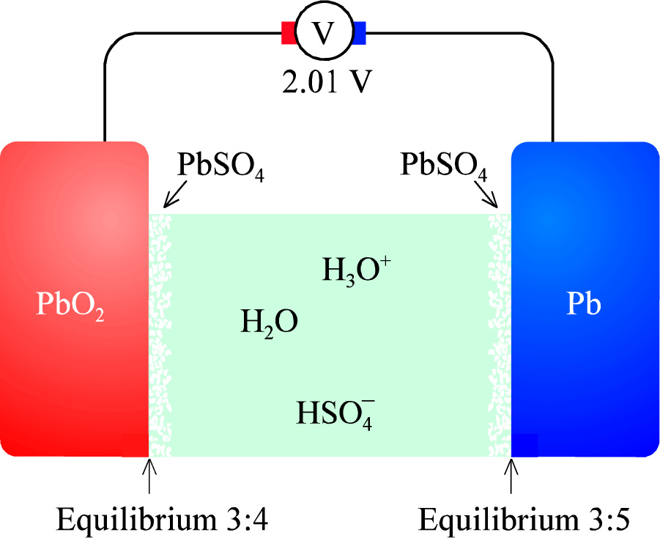
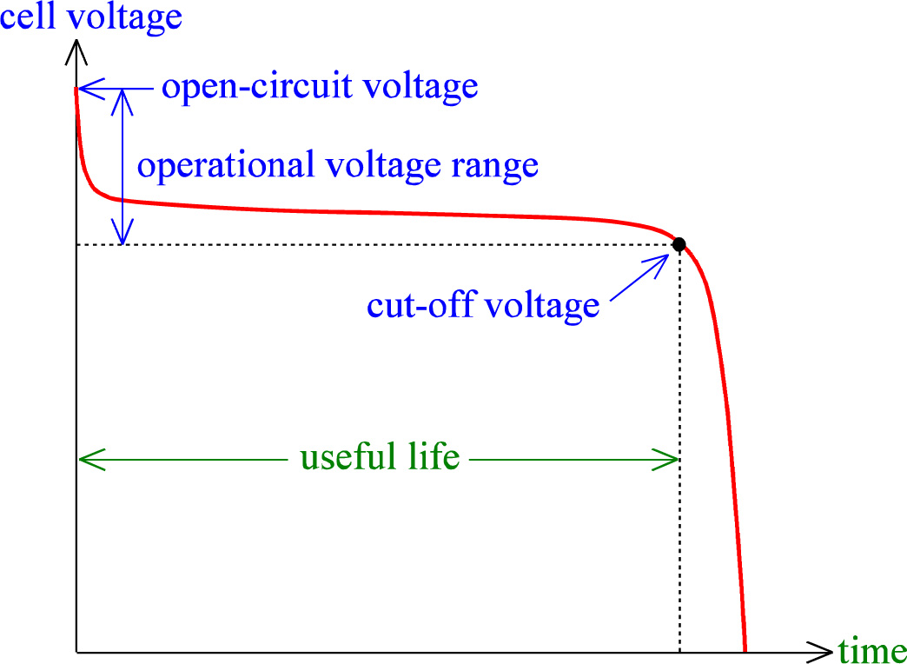
Batteries
Positive and negative electrodes
Positrode and negatrode
Cathode and anode
Nominal voltage
  = OCV full charged
Cut-off voltage
Capacity
  Coulomb, or A s
  1 C = A*s
  1 A h = 3600 A s C
Energy
  Unit?
  Specific energy
  Energy density
Power
  Unit?
  Specific power
  Power density

Slide 5
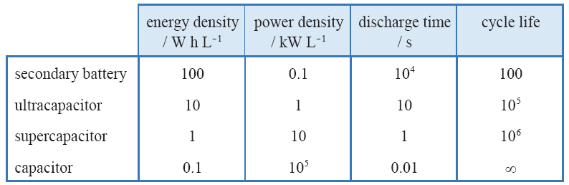
Storage
Battery: Chemistry
Ultracapacitor: Chemistry + electrode interface
Supercapacitor: Electrode interface
Capacitor: Dielectric

Slide 6
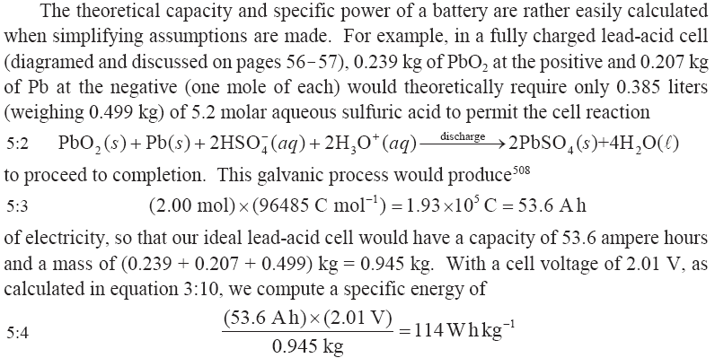
Lead acid battery

Slide 7
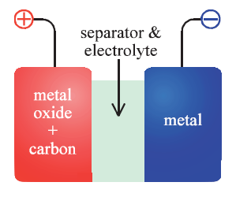


Primary batteries
Volta pile
Daniell cell
Leclanché wet cell with NH₄Cl(aq)
Dry cell
  NH₄Cl + ZnCl₂ paste
  C powder composite cathode

Slide 8
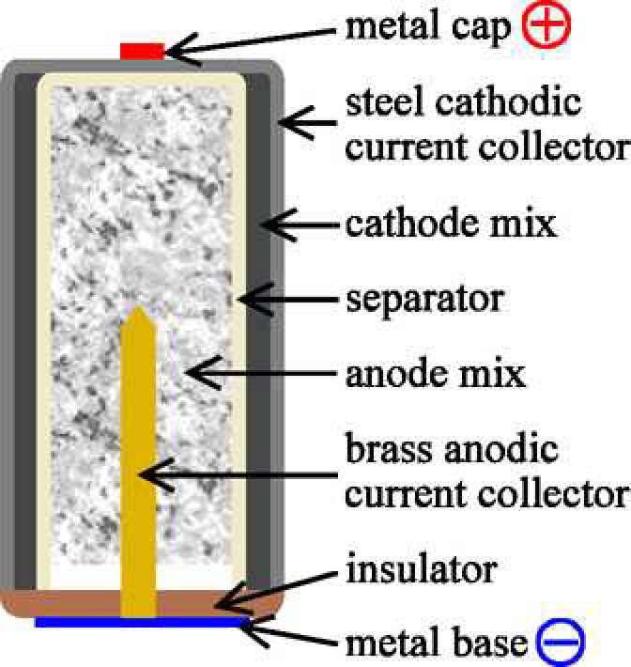
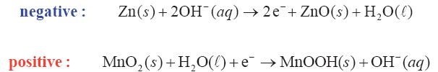
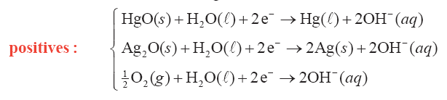
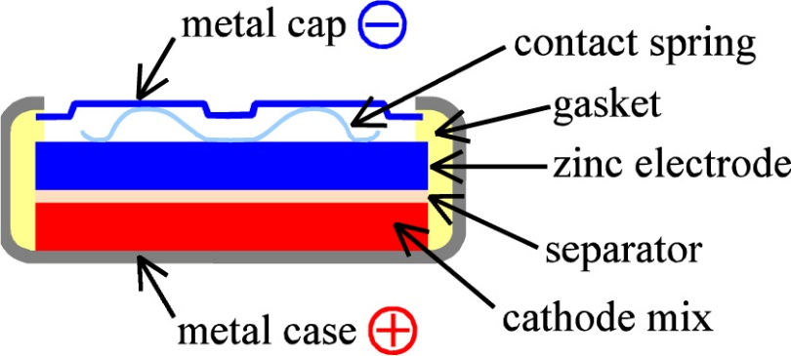
Alkaline batteries
In some ways an inversed design…
Other alkaline positrodes
Air battery

Slide 9
Exercise
Write full cell reactions and Gibbs energy expressions for each of the four alkaline cells in the previous slide

Slide 10
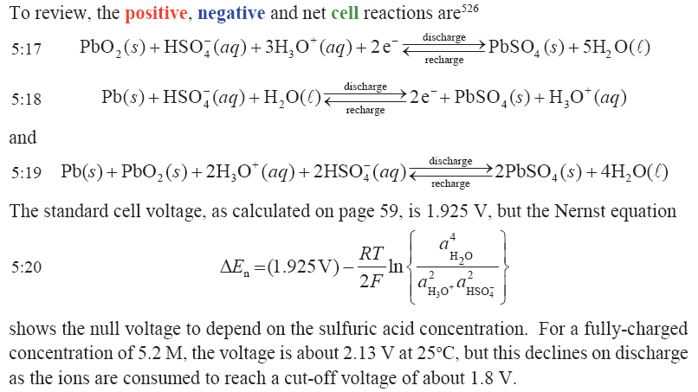
Secondary (rechargeable) batteries (accumulators)
Most widespread: Lead-acid battery.
Repeat from Ch. 3:

Slide 11
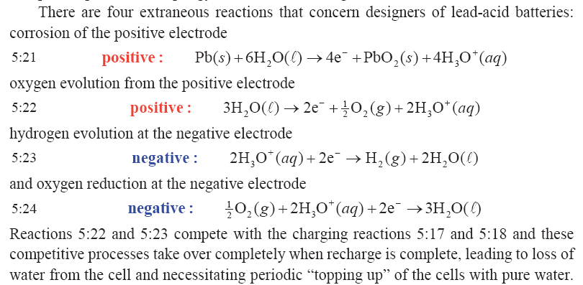
Lead acid batteries: Extraneous reactions
In modern, sealed batteries, diffusion of O₂ + reaction 5.24 replenishes the water.

Slide 12
Exercise: Ni-Cd and Ni-H cells
Write full cell reactions for these cells (se half cell reactions in the book) and Gibbs energy expressions

Slide 13
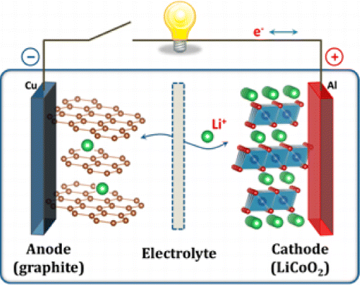
Li-ion batteries
The electrolyte used in most lithium-ion cells is a solution of LiClO₄ or LiAsF₆ in organic carbonates, absorbed in microporous polyolefin separator.
May be represented simple
or more realistic
Copyright 2013, ACS

Slide 14
Exercise
The previous slide shows a realistic, complex example. Write a simple one and the Gibbs energy expression.

Slide 15
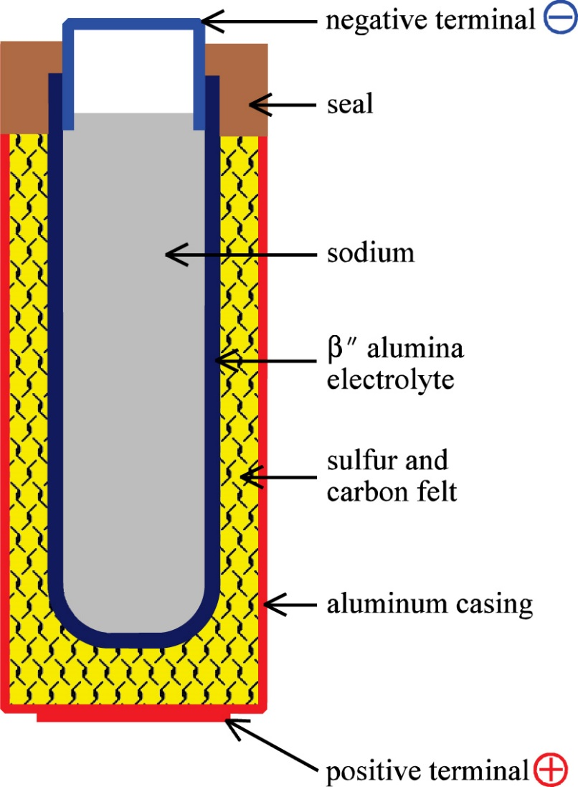
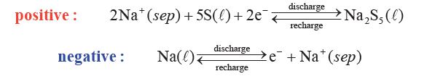
Na-S battery
Exercise: What is the total reaction and Gibbs expression?

Slide 16
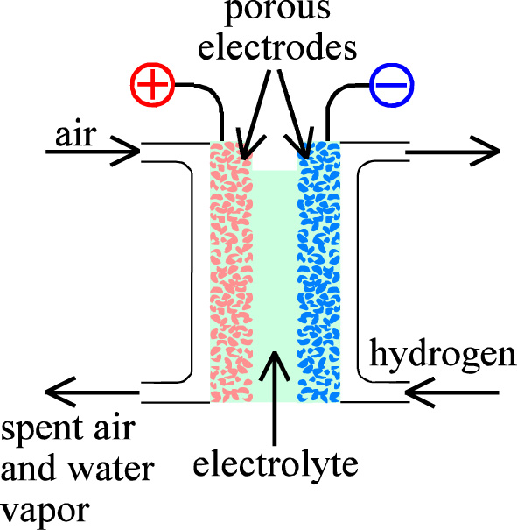
Fuel cells; continuous supply of fuel and oxidant air
Fuels:
  H₂
  Reformed CH₃OH
  Reformed CH₄
Electrolytes:
  Alkaline
  Acid (Phosphoric acid and PEM)
  Molten carbonate
  Solid oxide
  Proton ceramic

Slide 17
Exercise
What is reforming? Write reactions for CH₃OH and CH₄.
What is shift?
What is external vs internal reforming?
Write half and full cell reactions as well as an expression for ΔG for H2 and O2 for the different electrolytes on the previous slide

Slide 18
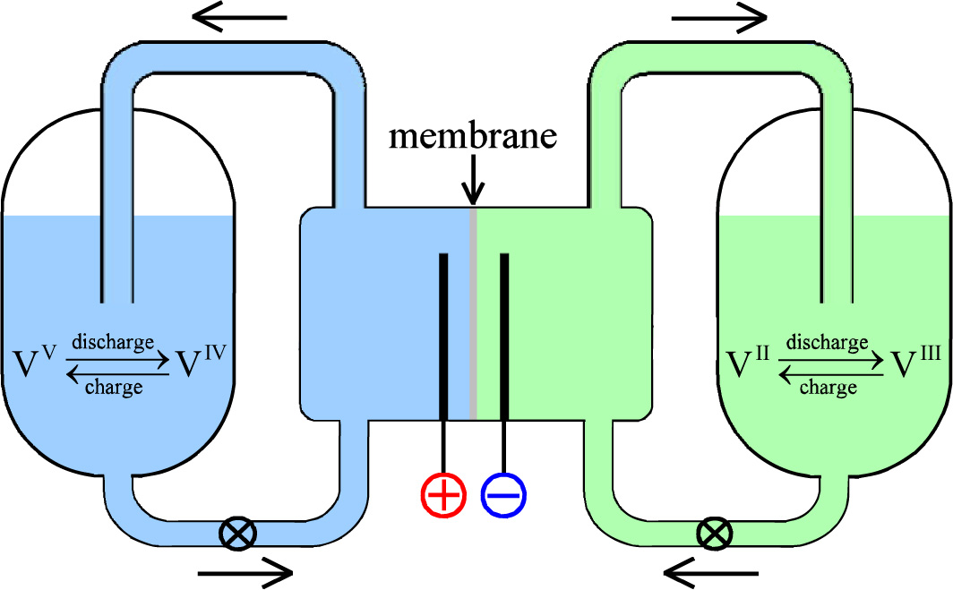
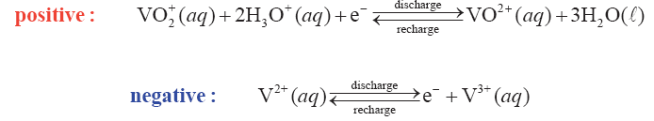
Redox flow battery

Slide 19
Exercise
Write the total reaction and Gibbs energy expression
What are the electrodes?
What goes on in the membrane?

Slide 20
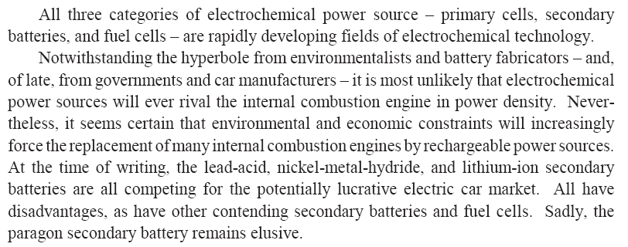
Ch. 5 Summary
Exercise: Discuss each sentence, not least the last one. When was this written?

