Slide 1
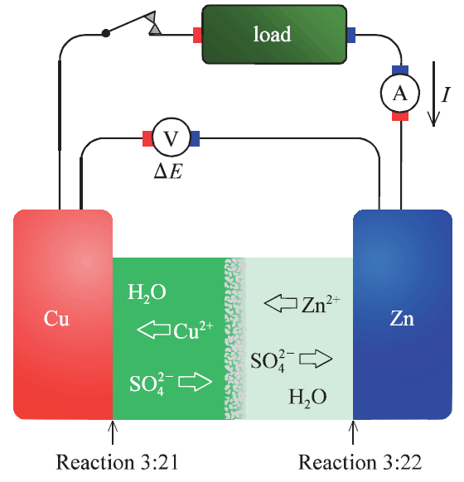
KJM 3110 Electrochemistry
Truls Norby
Department of Chemistry
University of Oslo

Slide 2
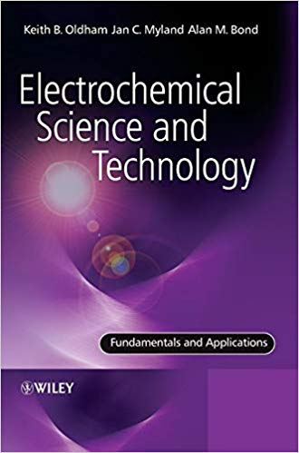
KJM 3110 Curriculum
Keith B. Oldham, Jan C. Myland, Alan M. Bond:
“ELECTROCHEMICAL SCIENCE AND TECHNOLOGY - Fundamentals and Applications”
Wiley (2012)
ISBN: 9780470710852 (HB), ISBN: 9780470710845 (PB)
Chapters 1 and 3-15
+
4 Laboratory exercises

Slide 3
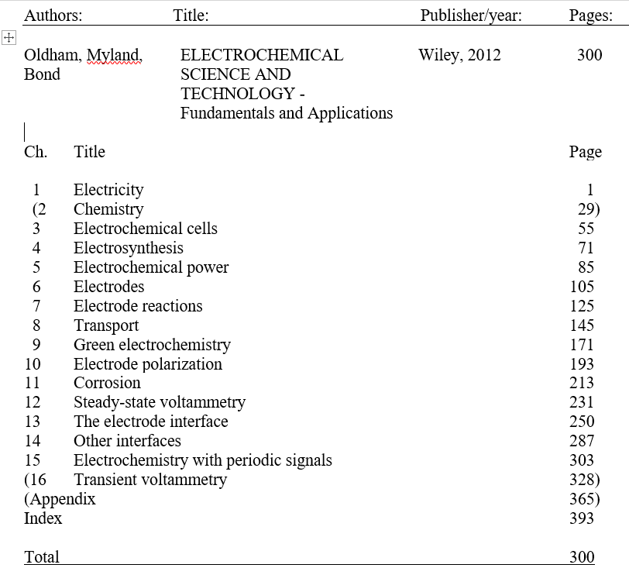

Slide 4
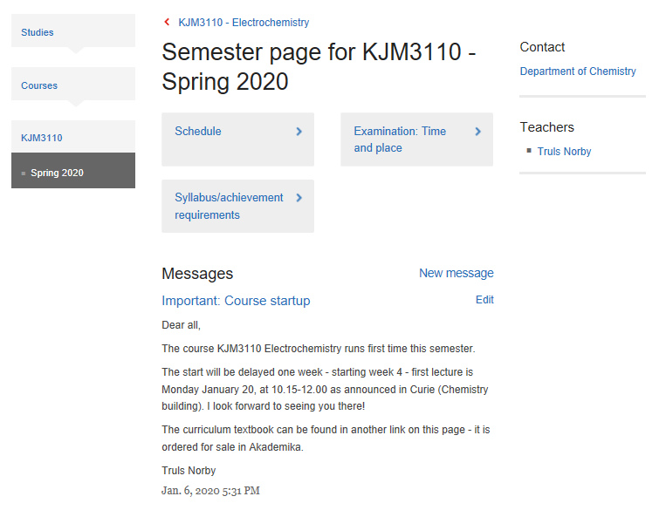
Web: KJM 3110 Course and semester pages

Slide 5
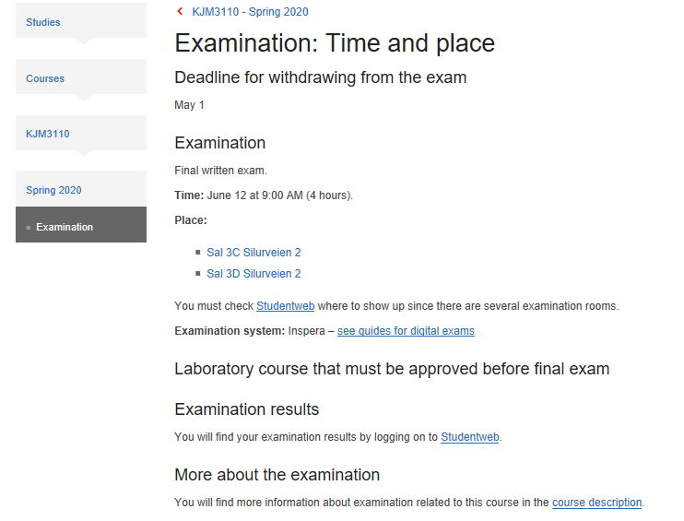
KJM 3110 Exam

Slide 6
Course content (Kursinnhold)
The course provides an introduction to electrochemistry; theory, methods, and applications. It builds on physical chemistry and lays the ground for handling problems and methods of electrochemical nature in master degree projects, research and industry.

Slide 7
Learning outcome (Læringsmål)
After completing the course
  you can identify, define, and classify electrochemical reactions and the components involved - electrolyte, electrodes, and interfaces.
  you have fundamental understanding of definitions, driving forces, mechanisms, and kinetics of electrochemical reactions.
  you know the structure and properties of electrode-electrolyte interfaces.
  you can carry out electrochemical experiments with various types of cells and instrumentation (potentiostat and impedance spectrometer).
  you have knowledge of applications and problems of electrochemical nature of importance in today's society and industry.

Slide 8
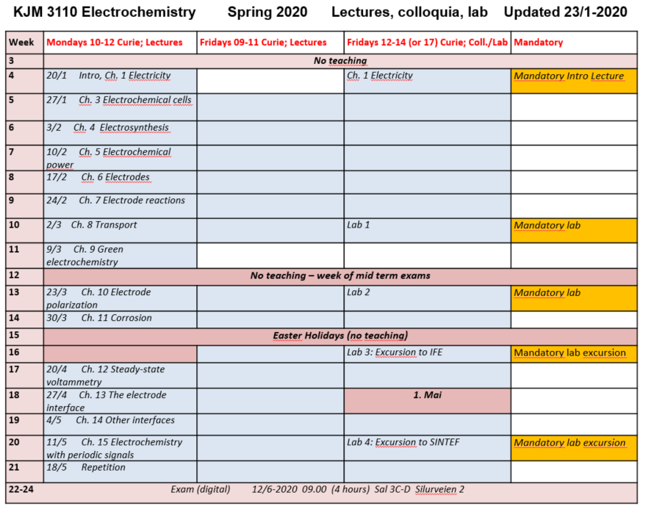
KJM 3110 Semester plan

Slide 9
Preamble
What is electrochemistry?
Importance of electrochemistry

Slide 10

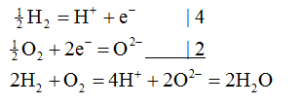
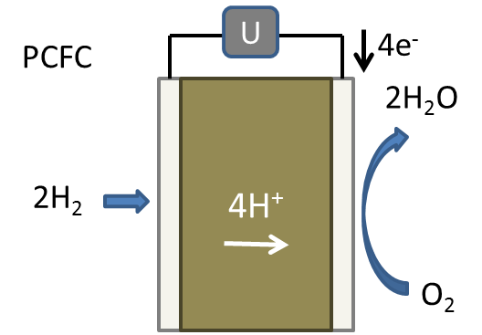
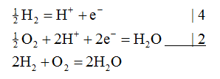
What is electrochemistry? Related to redox chemistry.
In Electrochemistry Red and Ox take place at different locations.
Requires transport of ions and electrons.
Redox reaction
Electrochemical reaction:
Different locations, transport of (the same) ions and of electrons

Slide 11
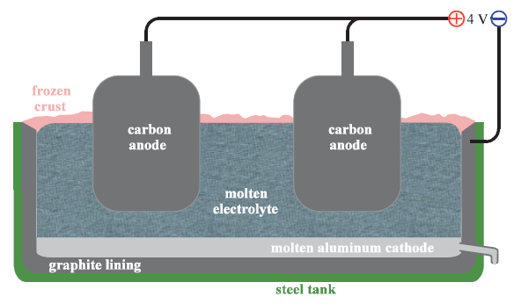
Importance of electrochemistry
Metallurgy
Electroplating
Electrolysis
Fuel cells
Batteries
Sensors
Corrosion
Biology
…

