Slide 1
KJM 3110 Electrochemistry
Chapter 3. Electrochemical cells

Slide 2
Recap from Ch. 1 Electricity
In Chapter 1 we familiarised ourselves with the most fundamental concepts of electricity itself.
Charge
Electrostatic force
Electrical work
Potential and voltage
Capacitance
Current
Conductance and resistance
DC and AC voltage and current and impedance
Different disciplines, textbooks, articles, teachers use different symbols for many of these entities. For instance, e vs q, q vs Q, f vs F, U vs E, i vs I…
We could try to be completely consistent here.
Instead we allow variations, to train ourselves for reality, but aim to always define and/or make clear what we mean.

Slide 3
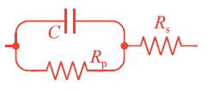
Remaining parts of Ch. 1 we considered non-mandatory for now
Electrical circuits
Models of electrochemical behaviour
AC signals
AC impedance, Fourier transforms
Real and imaginary contributions, loss, and power dissipated

Slide 4




Ch. 1 Summary – four selected important concepts
Charge and field
Charge capacitance of insulator (dielectric)
Current transport in a conductor
Conductivity

Slide 5
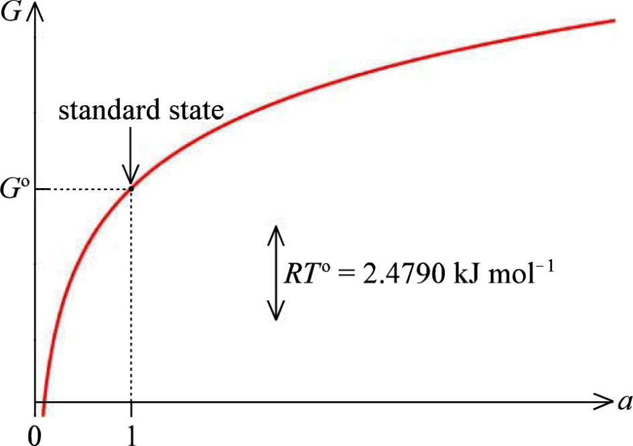
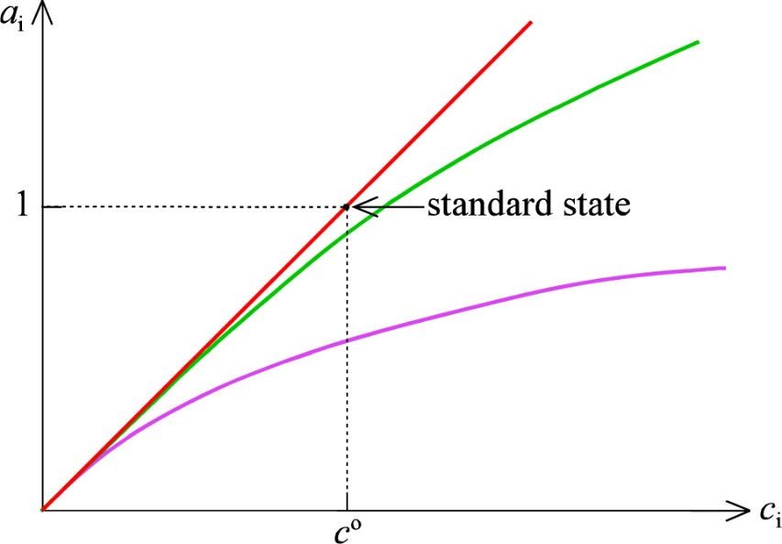
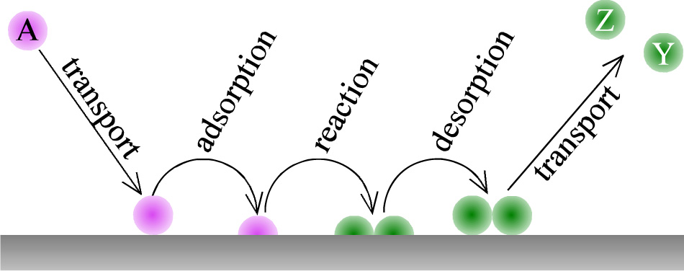
A brief look at Chapter 2 Chemistry; Concepts

Slide 6
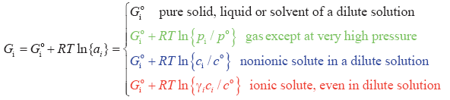


A brief look at Chapter 2 Chemistry; Summary

Slide 7
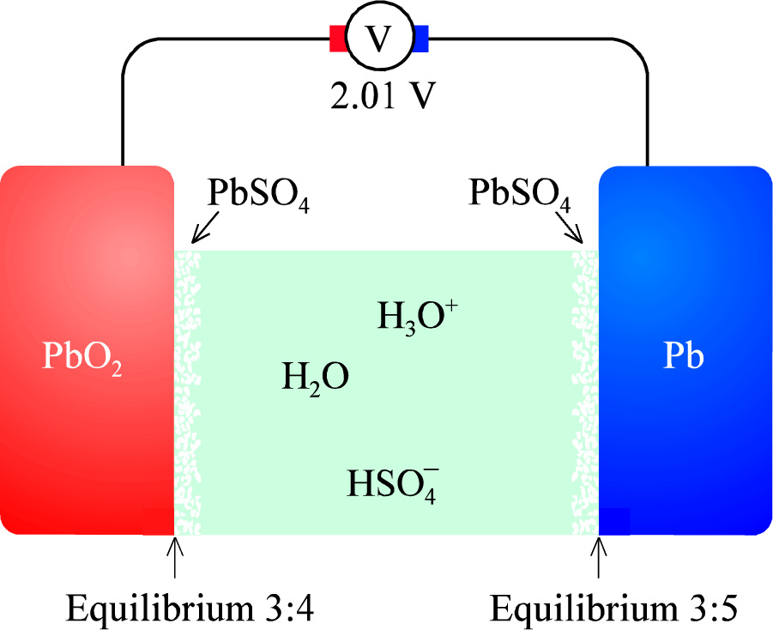
Electrochemical cells
Lead-acid cell as example

Slide 8


The lead-acid cell – half and full cell reactions
Positrode
Negatrode
Total, chemical, cell reaction
Total, electrical

Slide 9
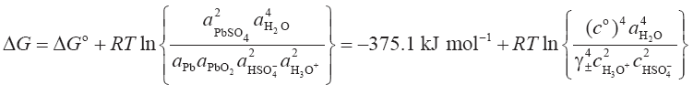
The lead-acid cell – Gibbs energy change
The activity of pure condensed phases is defined as unity. Hence, for instance a_{Pb(s)} = 1

Slide 10


The lead-acid cell – electrical work and cell voltage
Electrical work
w = ΔG (J) = -neΔE
W = N_{A}w = ΔG (J/mol) = -nFΔE

Slide 11

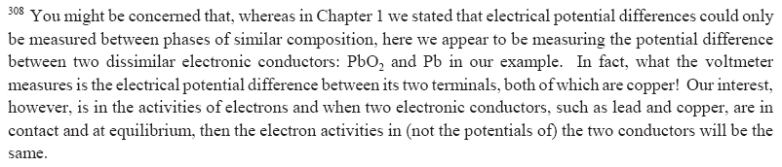
The lead-acid cell – cell voltage

Slide 12


The lead-acid cell – standard state
Standard state: All activities = 1
Temperature can, but need not be, 298.15 K
This is not equilibrium, it is the standard state

Slide 13

The lead-acid cell – equilibrium
From Ch. 2:
Important to understand this
Now becomes:

Slide 14
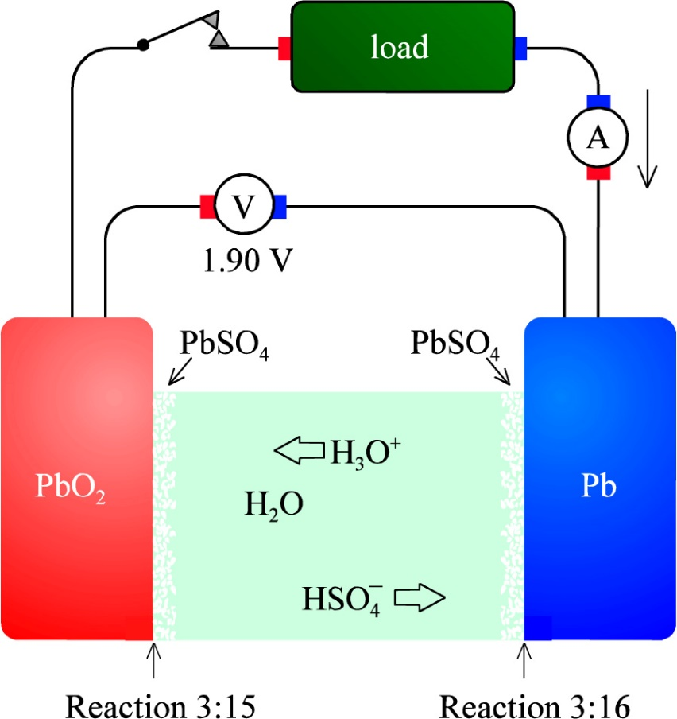
The lead-acid cell – galvanic operation
Galvanic cell:
The chemical potential differences – the spontaneous change according to ΔG – drives the cell.
Battery under discharge
Fuel cell
Cathode (positrode)
Anode (negatrode)

Slide 15
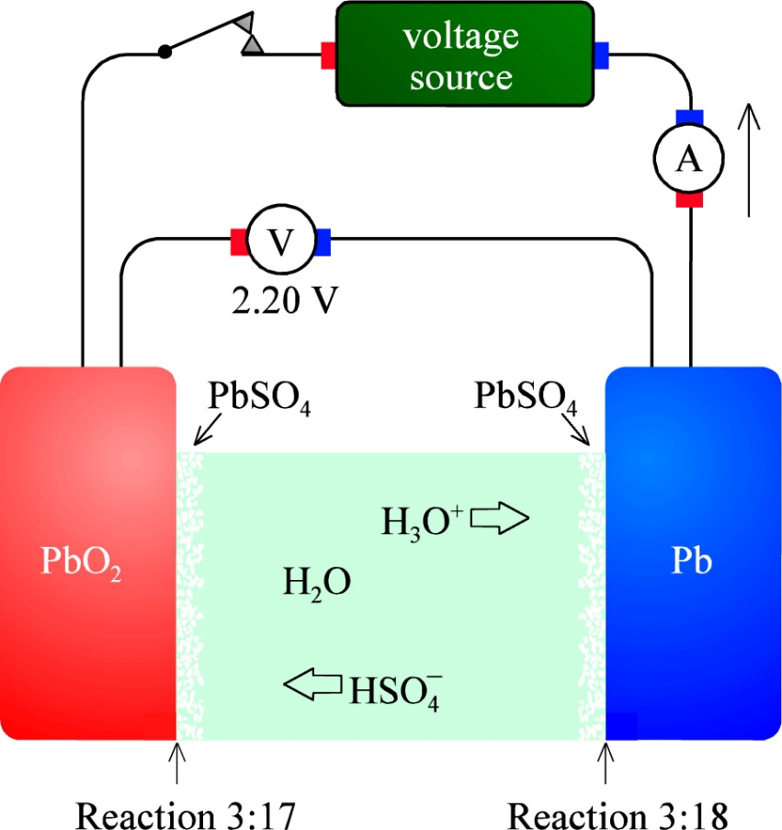
The lead-acid cell – electrolytic operation
Electrolytic cell:
The applied electrical potential difference drives the cell against the spontaneous change according to ΔG.
Battery under charge
Electrolyser
Anode (positrode)
Cathode (negatrode)

Slide 16
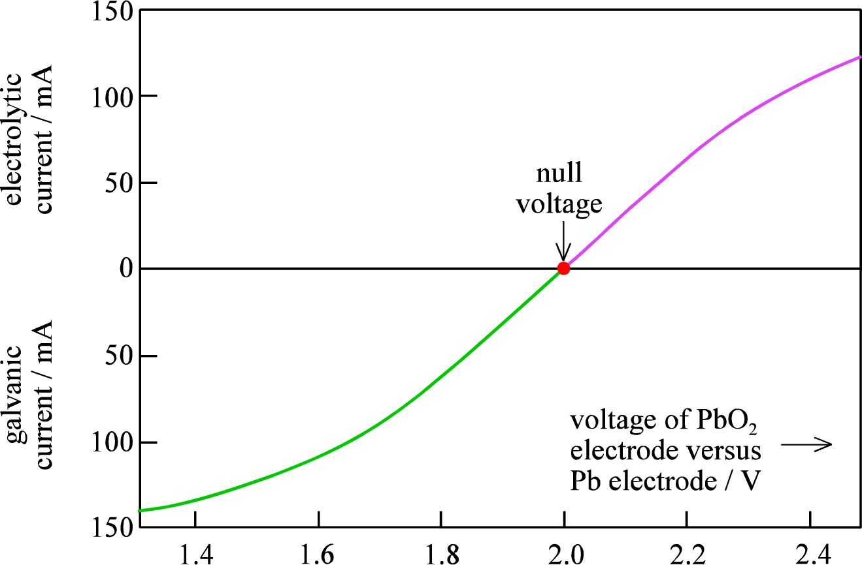
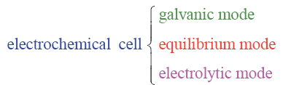
Electrochemical cells – three modes of operation
Polarisation curve for a lead-acid cell
aka Open Circuit Voltage (OCV)

Slide 17
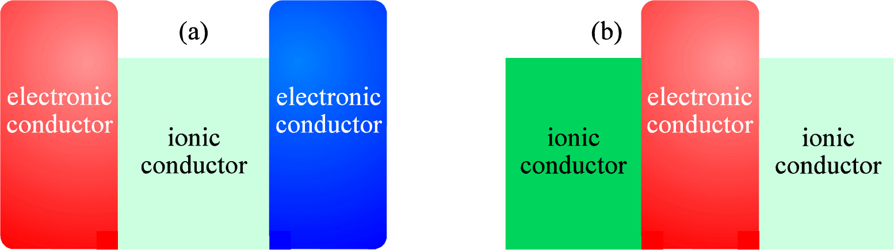
Electrochemical cell and an «impractical» cell…. ?

Slide 18
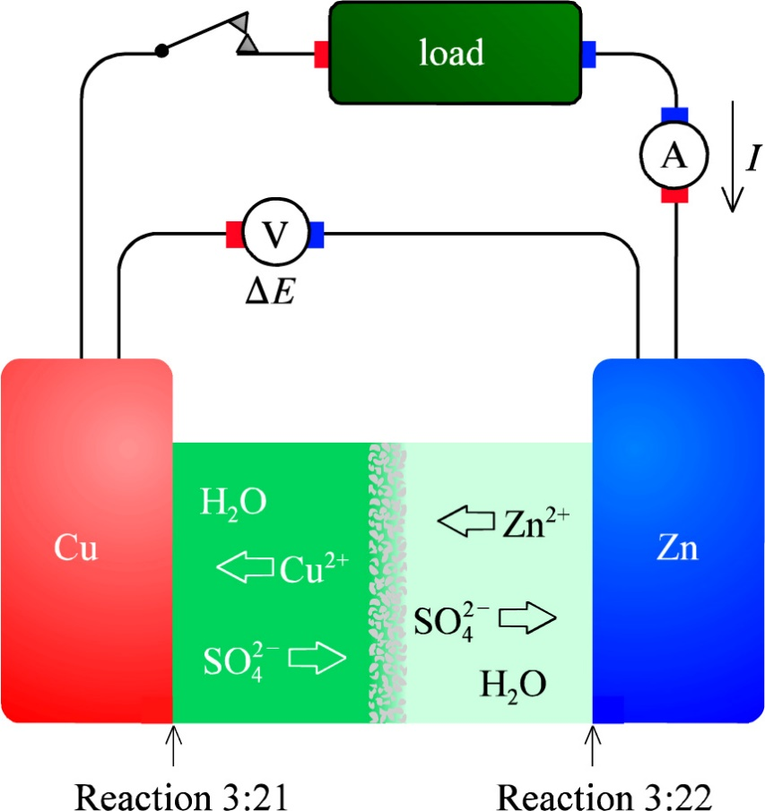
Cells with junctions – The Daniell cell
Self study and check – this and Eqs. 3.20-3.23 is standard from general and physical chemistry.
What goes on at the diaphragm under open circuit and under galvanic conditions?

Slide 19
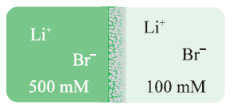

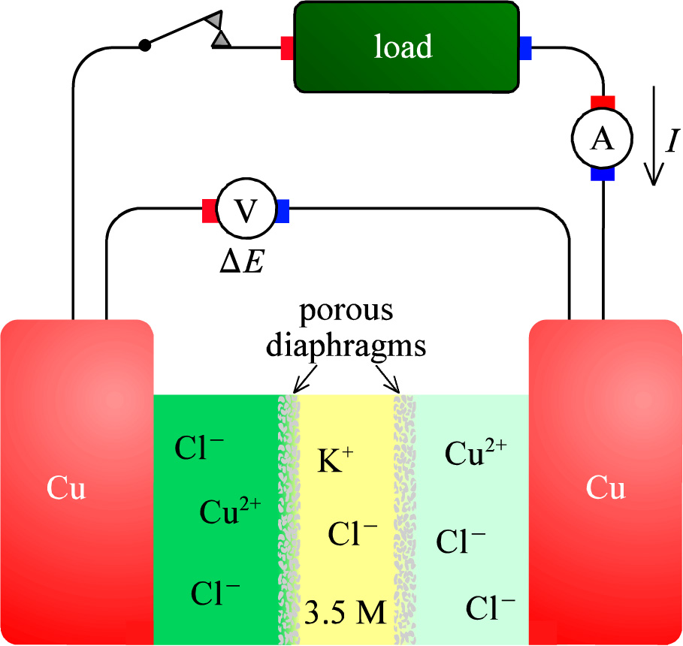
Electrolyte junctions - liquid junctions
Junction potentials arise from different mobilities µ and charges z for anions and cations.
KCl(aq) gives almost zero junction potential

Slide 20
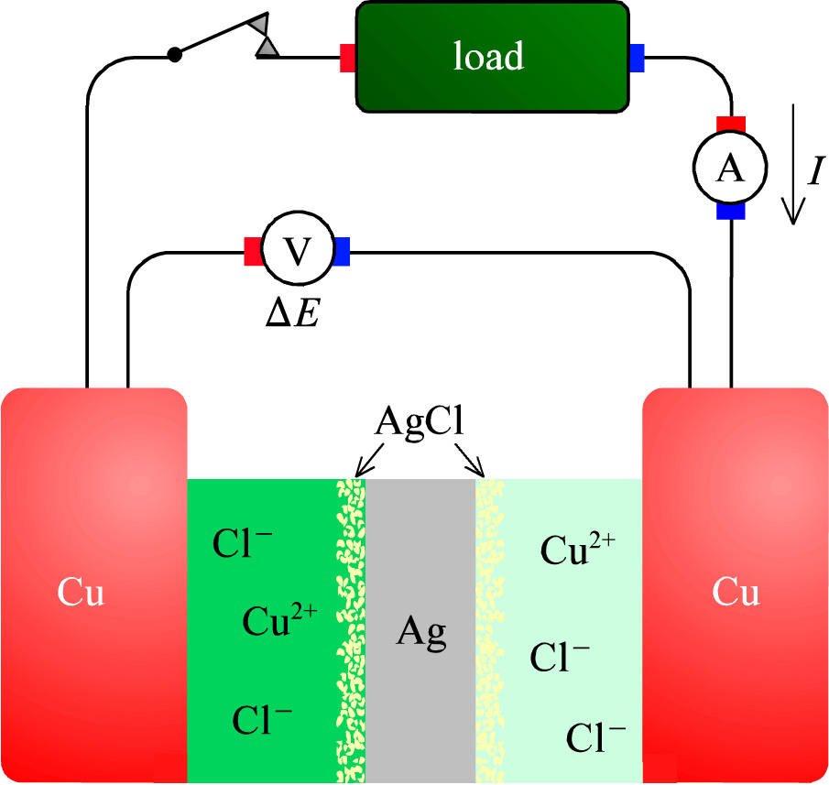
Another solution – bipolar electrodes
We consider taking the details here as part of our colloquium….

Slide 21
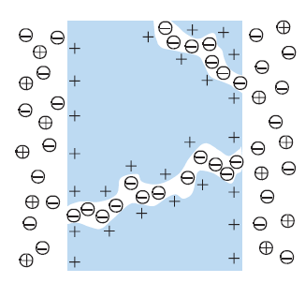
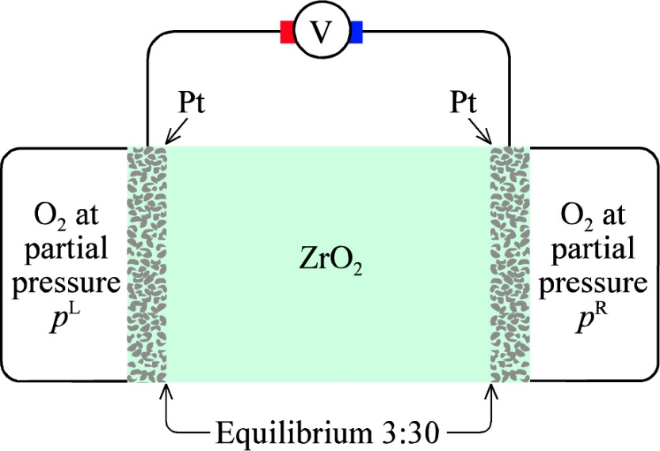


Semipermeable and solid electrolyte membranes
Semipermeable membranes
  Selective permeation
  Allows recharging without e.g. cation intermixing
  Adds resistance
Solid electrolyte membranes
  E.g. Y-stabilized ZrO₂ (YSZ)
  Selective transport
  Proton conducting solids. Other ions?

Slide 22


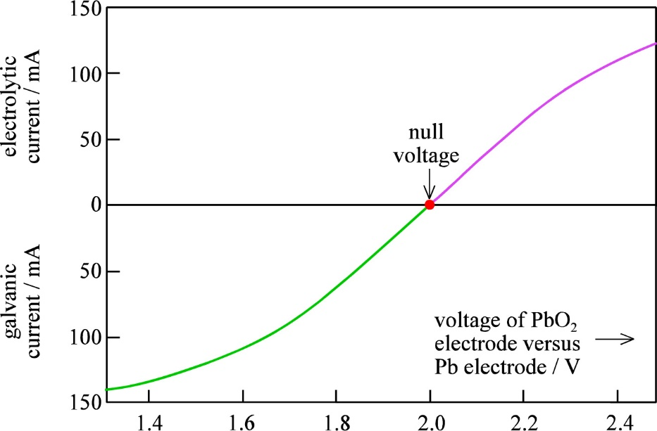
Summary Ch. 3 Electrochemical cells
Equilibrium
  I = 0
Galvanic operation
  I > 0
Electrolytic operation
  I < 0

