Slide 1
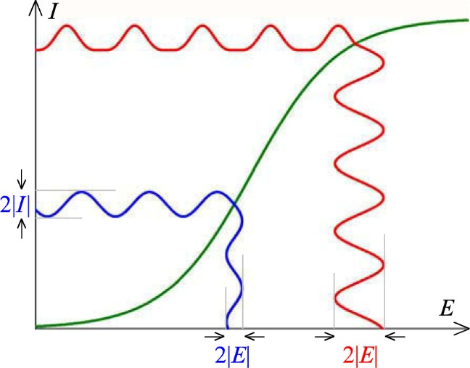
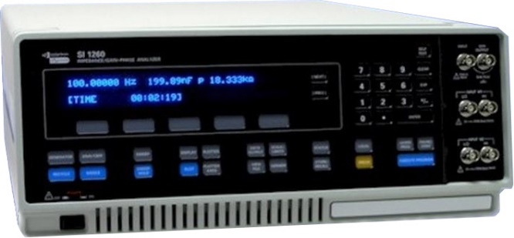
KJM 3110 Electrochemistry
Chapter 15
Electrochemistry with Periodic Signals
Most figures from the textbook we use for the course, via its web resources:

Slide 2
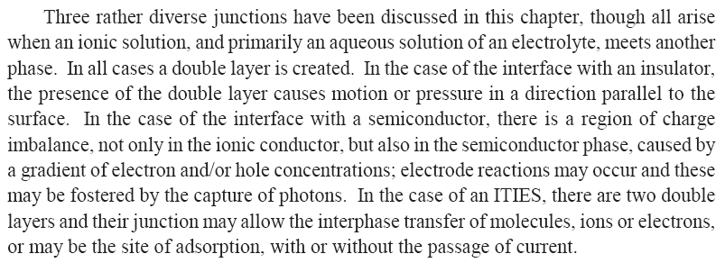
Ch. 14 Other interfaces - Summary

Slide 3
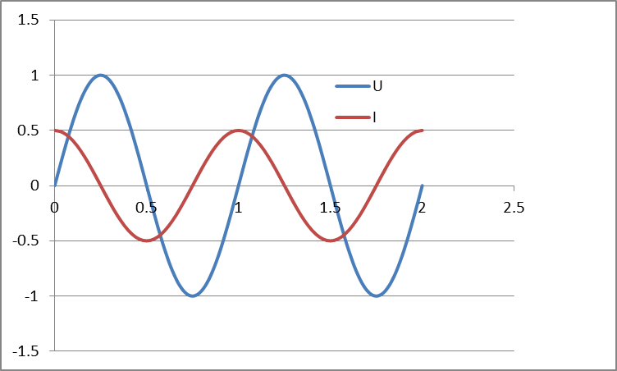


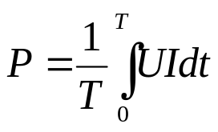
AC voltage and current. Impedance and power.
AC voltage
the amplitude can be expressed as
  Amplitude U₀
  Peak-to-peak voltage, U_{p-p} = 2U₀
  Root mean square (rms) voltage
  U_{rms} = U₀/√2 = U_{p-p}/(2√2)
Resulting AC current can have a different amplitude and phase angle as a result of the impedance:
Impedance Z* = U* / I*
Instantaneous power P = U* I*
Power integrated over time:

Slide 4



Textbook’s introduction to periodicity
Direct current (DC) vs alternating current (AC)
Sinusoidal case:
Angular frequency is ω = 2πf
Phase angle φ
What is the periodicity P here?

Slide 5
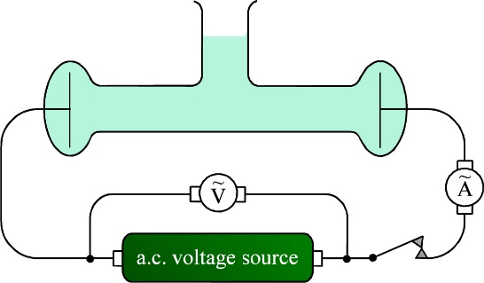





Conductivity cell
Conductivity of the electrolyte
Calibrate the geometrical factors by using a 1 M KCl solution
AC measurement: Current
Will generate voltages
over R:
over C:
Phase shifts? Amplitude ratios?

Slide 6



Faradaic effects of AC. Impedance, harmonics, rectification
Apply AC current, measure AC voltage, or vice versa
Impedance Z (equivalent to resistance R in DC)
Faradaic effects
  Apply (small) AC voltage
  Reaction
  Response on concentrations

Slide 7


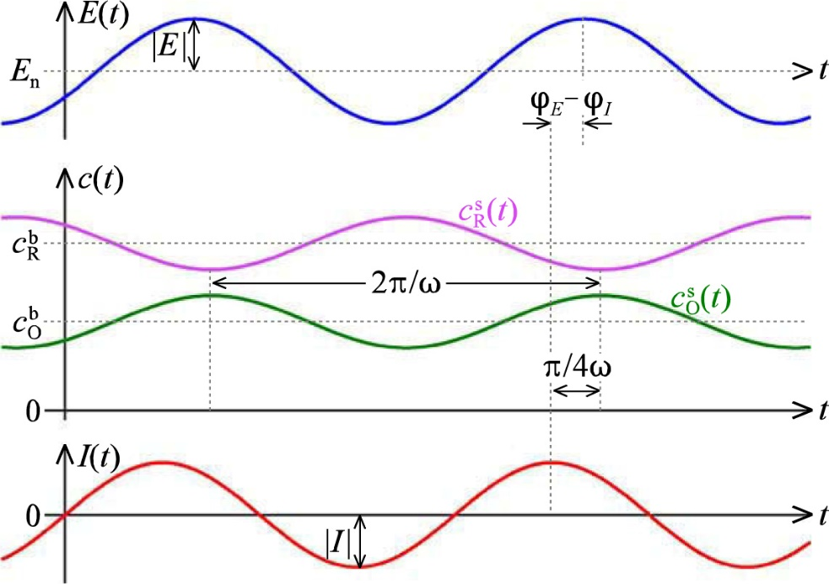
Faradaic effects of AC. Impedance, harmonics, rectification
Semi-integration yields
The product and reactant consentrations are shifted -45° and +135°, respectively, i.e., 180° apart.
Total concentraion close to constant

Slide 8

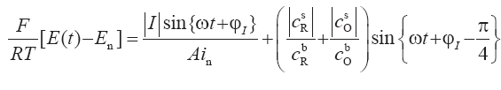
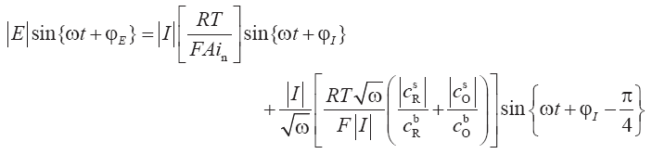

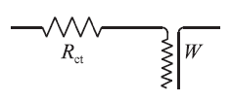
Relation to voltage – Butler-Volmer
From Ch. 7, a version of the Butler-Volmer equation:
Charge transfer resistance R_{ct}
Warburg element W
(transmission line)
_{R/C = W}²

Slide 9


The R_{ct}W impedance

Slide 10
The Warburg impedance
W (unit of ohm s^{-1/2})
Reflects a combination of
  Diffusion
  Chemical capacitance
Appears in AC circuits to represent the impedance of mass transport
  In series with the charge transfer resistance
Imposes a complex impedance Z_{W}(ohm) = W/√(2ω) - jW/√(2ω)
Has a constant, frequency independent phase shift of –π/4 (-45°)

Slide 11

Reversibility index λ
What we have done here is to perturb a reaction which reacts with kinetic and mass transport limitations (R_{ct} and W, respectively)
Reversible: R_{ct} very small, λ >> 1
Quasireversible λ ≈ 1
Irreversible: R_{ct} large, λ << 1. No faradaic periodicity.
Reversibility index for AC impedance

Slide 12

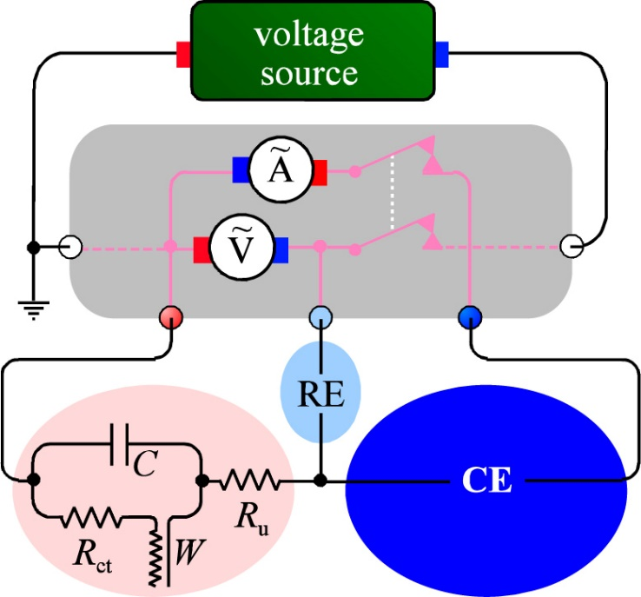
AC impedance measurement
Electrochemical impedance spectroscopy (EIS)
Impedance spectrometer (frequency response analysers)
  E.g. Solartron SI 1260 FRA
  0-3 V rms AC 0.01 mHz – 32 MHz, -42 - +42 V DC
Electrode electrical elements
  R_{u} uncompensated electrolyte resistance (ohmic)
  R_{ct} charge transfer resistance (kinetics)
  W Warburg impedance (diffusion)
  C Capacitance (double layers)

Slide 13

Deviations from ideality at large perturbations
Small perturbations, linear range (blue)
  Near-ideal response
Larger perturbations, non-linear range (red)
  Non-ideal response
  Rectification
  Harmonics
    Response cntains features sharper (of frequencies higher) than the perturbation frequency
    Overharmonics (integer multiple of perturbation frequency)

Slide 14
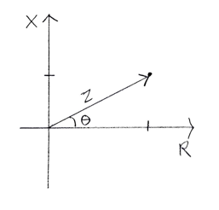
AC impedance representations
Impedance has magnitude but also contains a phase angle between E and I
Vector in 2-dimensional Z space
In-phase and out-of-phase components
Real part Z’
Imaginary part jZ’’
Z = Z’ + jZ’’ or Z* = Z’ + jZ’’ Complex numbers j =√-1 or j² = -1
The value of Z – often denoted |Z| – is the length of the vector:
|Z| = √(Z²) = √(Z’²+Z’’²) = √(Z’²–(jZ’’)²) = √((Z’+jZ’’)(Z’-jZ’’))
Z’’
Z’
Complex conjugate

Slide 15
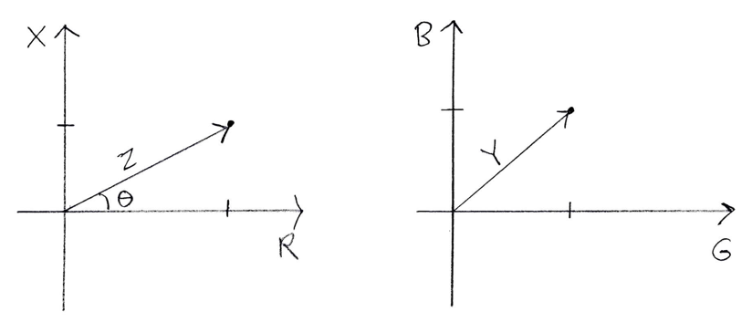
Complex impedance Z* and admittance Y*
Z* = U*/I* = Z/ + jZ// = R + jX
  Z* Complex impedance
  |Z| Impedance
  R Resistance
  X Reactance
Y* = 1/Z* = I*/U* = Y/ + jY// = G + jB
  Y* Complex admittance
  |Y| Admittance
  G Conductance
  B Susceptance

Slide 16
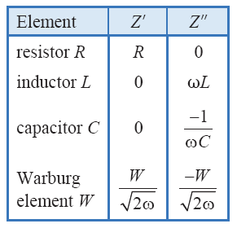
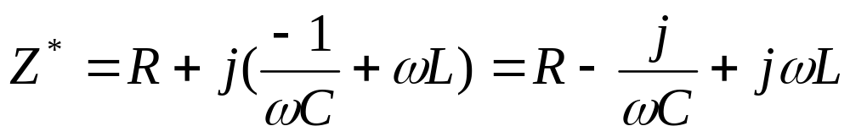
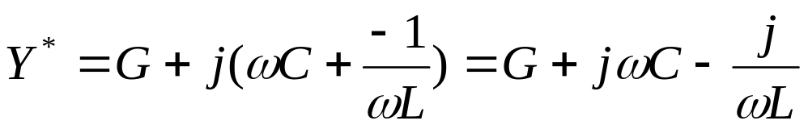
Impedance and admittance of discrete elements
Series RCL
Z* = Z/ + jZ// = R + jX
Parallel (RCL)
Y* = Y/ + jY// = G + jB
Resonance for (RC) when G = ωC or C=G/ω or ω=1/(RC)

Slide 17
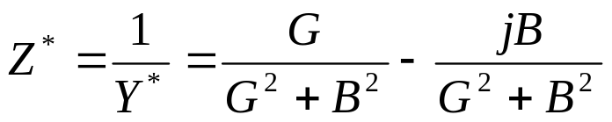
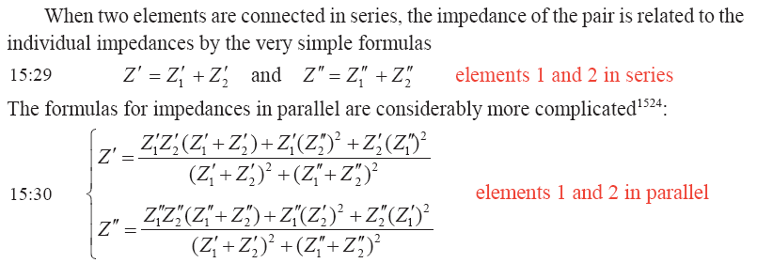
Y*=1/Z* and Z*=1/Y*

Slide 18
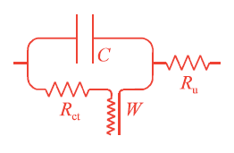
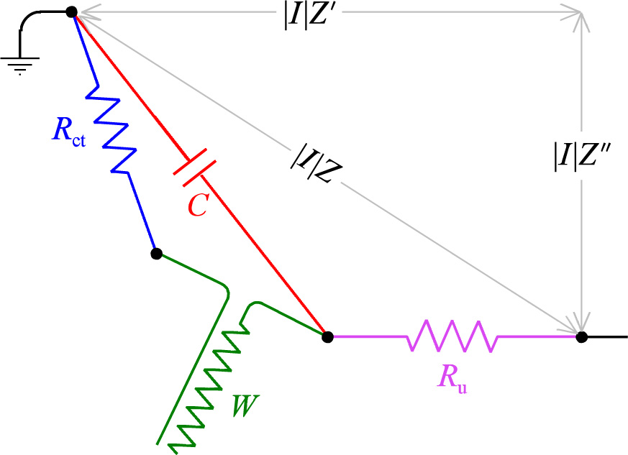
Randles-Erschler circuit
R_{u}(C(R_{ct}W))

Slide 19

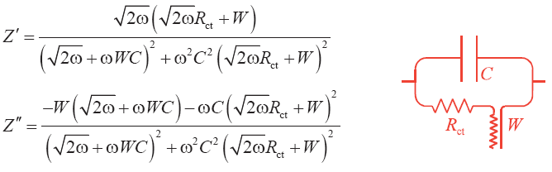
Build the circuit impedance
Add R_{ct} and W in series, real and imaginary parts separate:
Add C in parallel:

Slide 20
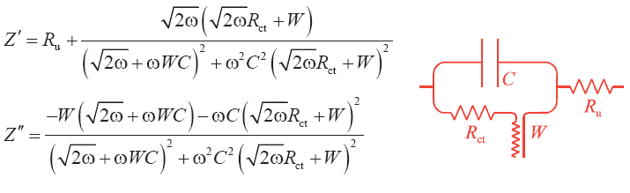
Build the circuit impedance
Add R_{u} in series (has only real part):

Slide 21
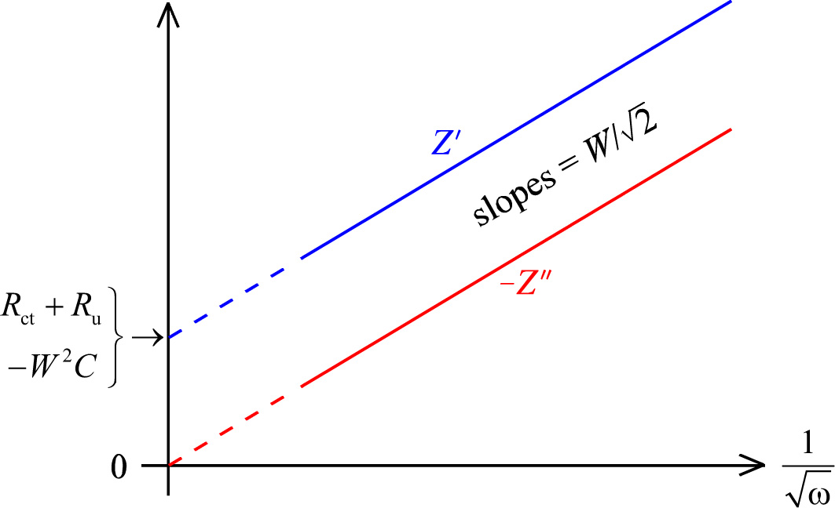
Deconvolute and parameterise the circuit
Low frequencies

Slide 22
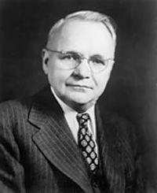
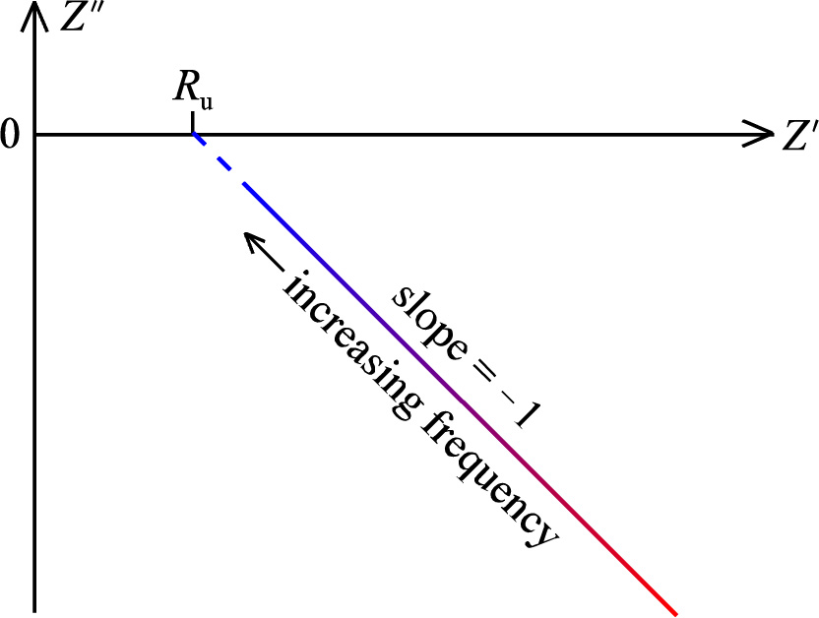
«Impedance plots»
Imaginary part Z’’ vs real part Z’
Or often –Z’’ vs Z’
Argand diagram
Sluyters plot
Cole-Cole plot
Nyquist plot
Reversible, R_{ct} negligible
Harry Nyquist
1889-1976

Slide 23
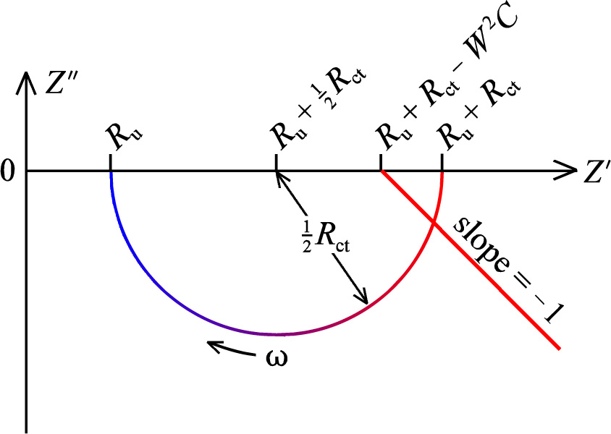
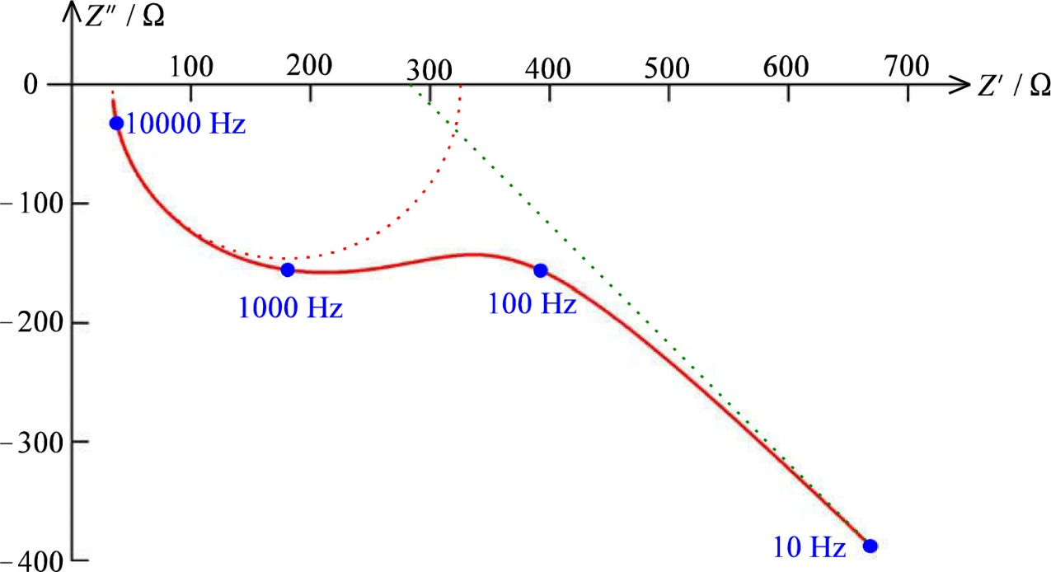
The Z semicircle: (RC)
Irreversible
Fast diffusion; W is negligible
R_{u}(R_{ct}C)
Forms a semicircle distanced from origo
(Case dominated by W shown as the straight line)
Case with all components significant over a large frequency range
Frequency is a dependent variable

Slide 24
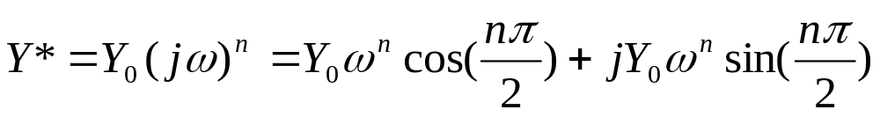
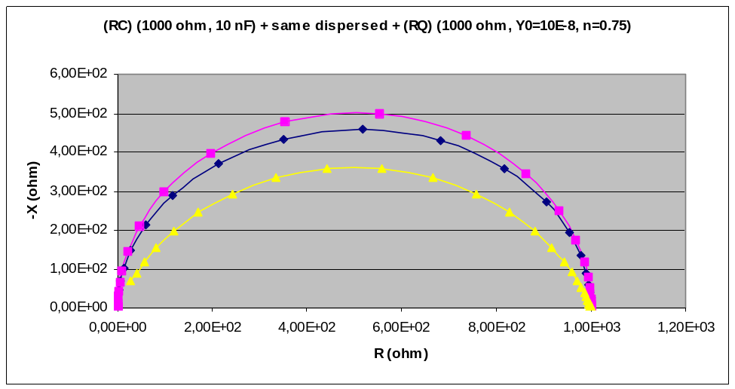
Constant phase elements (CPE)
Constant phase elements (CPE); symbol Q
Mathematically mimics the impedance of real, non-ideal, processes and components; dispersions in time constants
Q has admittance
n = 1 Capacitor
n = 0 Conductor/Resistor
n = -1 Inductance
n = 0.5 Warburg element
Values in between: Intermediate behaviours

Slide 25
A detour to EIS of ceramic electrolytes
Some slides from another course

Slide 26
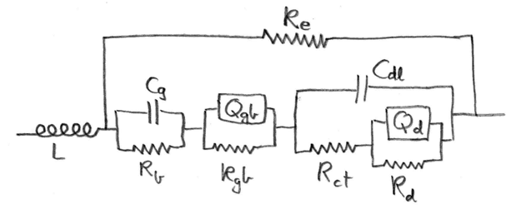
  Circuits of actual materials functions and of discrete elements.
Introductory warm-up:
  The circuit contains discrete elements representing physical properties of a typical ceramic mixed ionic electronic conductor
Upper rail: Electronic transport rail
  R_{e} Electronic conduction (NOTE: No electrode charge transfer resistance assumed for electrons)
Lower rail: Ionic transport rail
  R_{b} ionic bulk conduction (grain interior)
  C_{g} geometric capacitance of the material
  R_{gb} grain boundary resistance
  Q_{gb} grain boundary capacitance element
  R_{ct} Electrode red-ox reaction charge transfer
  C_{dl} Double layer capacitance
  R_{d} Diffusion resistance
  Q_{d} Diffusion-related (chemical) storage
L: inductive element
  From sample, wires, and instrument parasitics
Draw a sample with microstructure and place the elements
What are the assumptions?
How does everything add up?
Microstructure
Equivalent Circuit

Slide 27

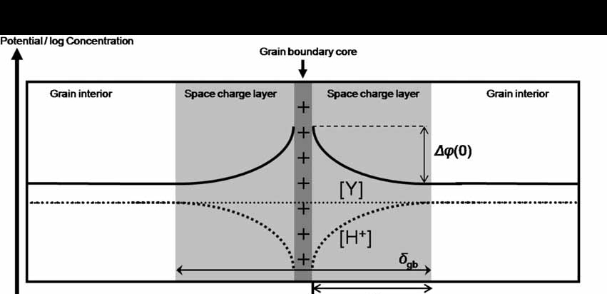
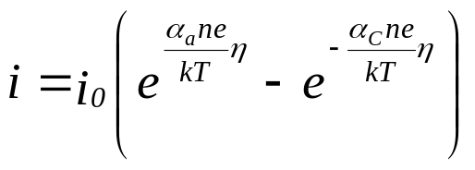
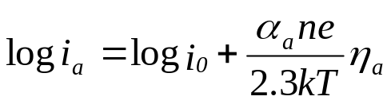
Mathematics of some of the parameters
Bulk conductivity
  Linear property
  Sum of partial conductivity from each charge carrier
  Partial conductivity: Charge, concentration, and mobility
Grain boundary transport
  Linear property
  Dominated by space charge layers
Electrode impedance
  Butler-Volmer theory – linear case
  Tafel behaviour – non-linear case

Slide 28
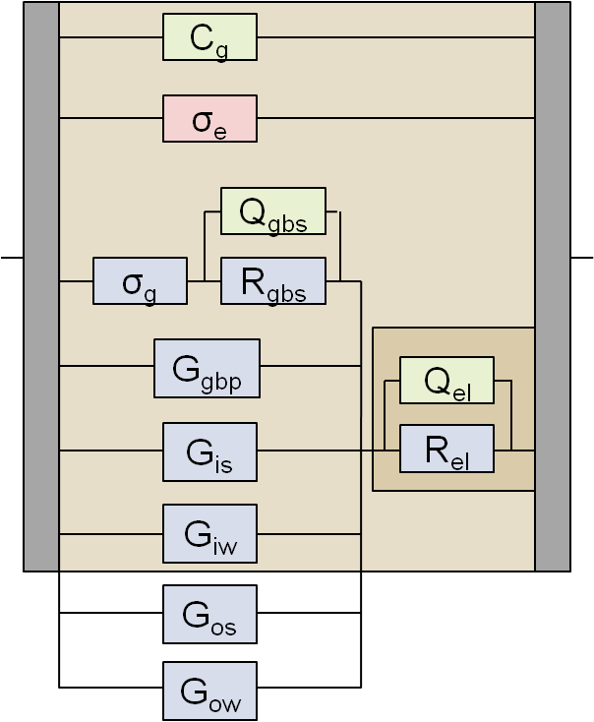
Conduction takes many paths
Bulk (grain interior)
Grain boundaries
  Series resistance (can be delineated by EIS)
  Parallel conductance (can not be delineated by EIS)
  Core region
  Space charge layers
Enhanced transport on external and internal surfaces
Transport in adsorbed water
Electrode impedance

Slide 29
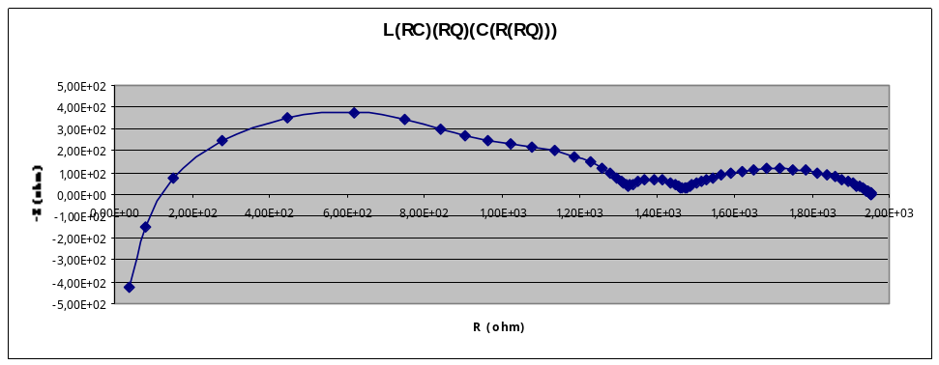
  Measurement, generation, and deconvolution of impedance spectra
Impedance spectra are measured logarithmically
  Often from high to low frequency.
We can generate impedance spectra from equivalent circuits
We can deconvolute impedance spectra
  Generate partial circuits
    fit and subtracted one by one while building up the circuit
    Final non-linear least squares (NLLS) fitting of the whole circuit. Use software “Equivalent Circuit” (EQ) or similar.
  Notation: Each level of parenthesis goes from series to parallel. The start is series by default.

Slide 30
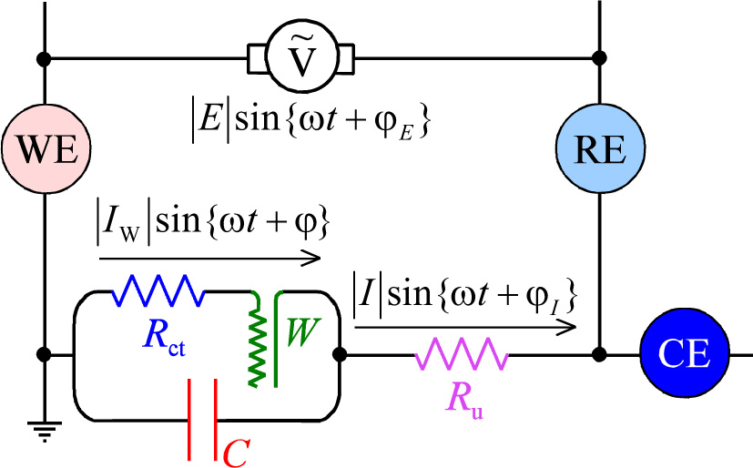
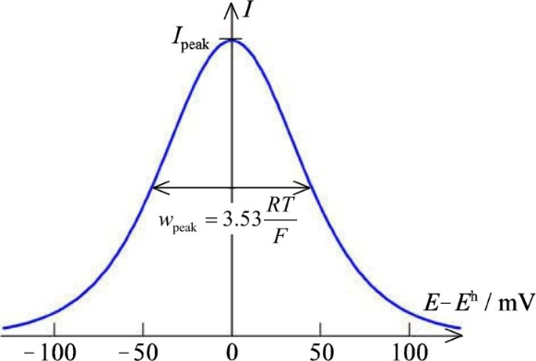
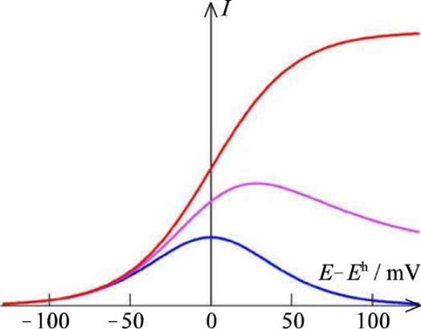
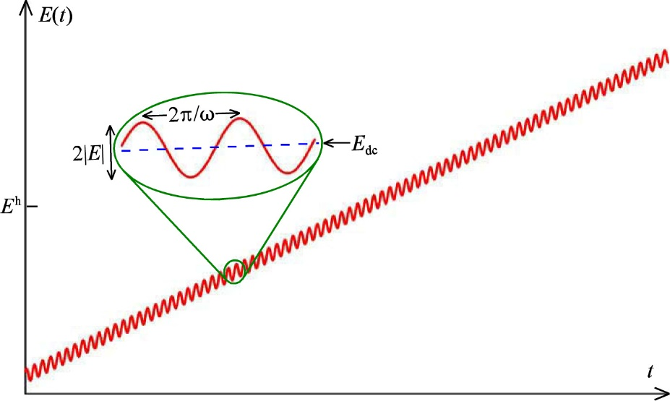
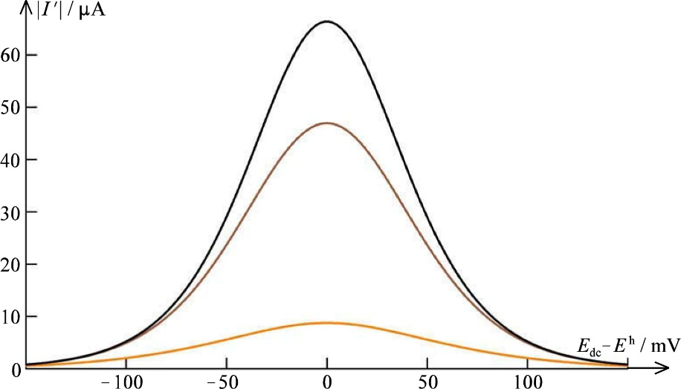
AC voltammetry (qualitative approach only)
«Discriminating against capacitive current»
Superimpose typically 10 mV AC on e.g. +/- 150 mV DC voltammogram
AC current response to AC voltage perturbation
  In-phase with voltage is faradaic
  Out-of-phase is capacitive
E^{h}:
  R and O both present
  maximum in I
  minimum in W

Slide 31
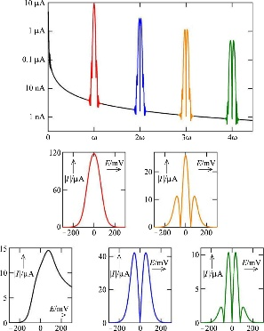
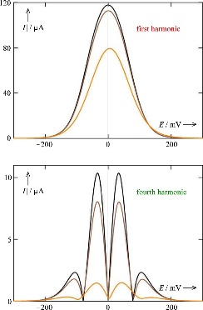
Fourier transform voltammetry
Not curriculum
Fourier transforms convert between frequency and time domains
Example:
An impedance spectrum reflects a circuit’s transient current-voltage relationships in the frequency domain
In the current interruption technique, we polarise the circuit to steady state current, then interrupt it so that current is zero while the voltage decays from all capacitances over the respective resistors. The decay curve contain all the same information, from high to low frequencies, as the impedance spectrum.
One can generate the other and vice versa by fourier transforms.

Slide 32
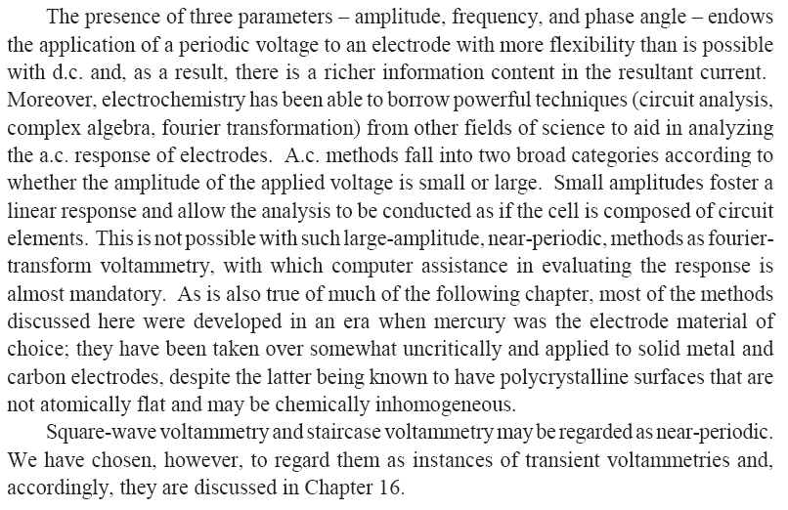
Summary Ch. 15
Electrochemistry with Periodic Signals

