Slide 1
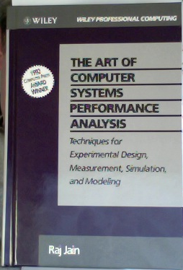
The Art of Computer Performance Analysis
Raj Jain
1992

Slide 2
Simulation
Where is simulation located in the system evaluation ecosystem?
  analysis
  simulation
  emulation
  evaluated prototype
  evaluated deployed system
the distinction between simulation and emulation is fluid
ns2 and other network simulators allow to attach real-world nodes; they can emulate “a network in between”
no common term exists
on these slides:
“live testing”
the distinction between analysis and simulation is fluid
Queuing Theory, Markov Chains and Game Theory can blur the lines

Slide 3
Simulation
Pros
  arbitrary level of detail
  requires less theoretical understanding than analysis
  allows simplifications compared to live systems
  easier to explore parameter space than live systems
Cons
  much slower than analytical approach
  easy to wrongly avoid or oversimplify important real-world effects seen in live systems
  bugs are harder to discover than in both, analytical approach and live systems

Slide 4
Simulation
When to choose simulation for a digital system?
too big to build
hardware not available
too expensive to build
  essential performance parameters too complex to formulate analytically
too many variables to evaluate in a prototypical or deployed system
visual exploration of parameter space desirable

Slide 5
Simulation
Key simulation questions
  common mistakes in simulation
  types of simulation
  how to schedule events in simulations?
  how to verify and validate a model?
  how to determine steady state?
  how long to run a simulation?
  how to generate good random number?
  what random number distributions to use?

Slide 6
Simulation
the set of all variables in a simulation that make it possible to repeat the simulation exactly at an arbitrary simulated time
State
State Variable
one variable contributing to the state
Event
change in the system state

Slide 7
Simulation
Types of simulation
 | option 1 | option 2 | option 3
State | continuous | discrete
Time progression | continuous | discrete | none
State progression | deterministic | probabilistic
Event/state dependency | linear | non-linear
Event source and sink | open | closed
State development | stable | unstable

Slide 8
Simulation
Types of simulation
 | option 1 | option 2 | option 3
State | continuous | discrete
Time progression | continuous | discrete | none
State progression | deterministic | probabilistic
Event/state dependency | linear | non-linear
Event source and sink | open | closed
State development | stable | unstable

Slide 9
Simulation
Types of simulation
Monte Carlo simulation | Trace-driven simulation | Discrete event simulation
no time axis | discrete events drawn from trace | dependent sequence of discrete events
model a pseudo-probabilistic phenomenon | combine real-world input with simulated model | combine simulated input and model
need random numbers | no random numbers needed | need random numbers
evaluate non-probabilistic expression using probabilitistic methods | explore effects of an observed sequence of input events on a system with alternative models | explore (several) models with arbitrary and dependent input sequences
terminated when accuracy threshold reached | terminates when trace replayed | terminated when steady state behaviour is representative

Slide 10
Simulation
Types of simulation
Monte Carlo simulation | Trace-driven simulation | Discrete event simulation
no time axis | discrete events drawn from trace | dependent sequence of discrete events
model a pseudo-probabilistic phenomenon | combine real-world input with simulated model | combine simulated input and model
need random numbers | no random numbers needed | need random numbers
evaluate non-probabilistic expression using probabilitistic methods | explore effects of an observed sequence of input events on a system with alternative models | explore (several) models with arbitrary and dependent input sequences
terminated when accuracy threshold reached | terminates when trace replayed | terminated when steady state behaviour is representative
Monte Carlo simulation often used for assessing static fairness, such as resource assignments (frequencies etc)
in Operating Systems and Networking,
simulations have their origins in queuing theory
trace-driven and
discrete event simulation are prevalent

Slide 11
Simulation
Steady state is ...
  ... in Monte Carlo simulation
    the termination condition
    the Monte Carlo simulation produces a meaningful results when (as soon as) steady state is reached
  ... in discrete event simulation
    reached when the influence of initialization values on state variables is no longer noticeable in simulation output
    a simulation produces meaningful output after steady state is reached
  ... in trace-driven simulation
    like discrete event simulation

Slide 12
Simulation
Steady state in discrete event simulation
  Generally steady state performance is interesting
  Important exceptions exist, e.g. TCP slow start behaviour on a single link
  when only steady state is interesting: transient removal
    perform very long runs (wasting computing time)
  ... or ...
    truncation
    initial (and final) data deletion
    moving average of independent outputs
    batch means

Slide 13
Simulation
How long to run a simulation?
Terminate conditions
  in trace-driven simulation, event density drops, or trace ends
  in discrete event simulation
    termination event given by expert knowledge
    variation in output value is narrow enough
      variance of independent variable’s trajectory
      variance of batch means

Slide 14
Simulation
Common mistakes in simulation
  inappropriate level of detail
  invalid model: lacking realism
  unverified model: bugs
  no achievable goal
  mysterious results
  improper seed selection and too few runs with different seeds: representative situations are not covered
  improperly handled initial conditions
  inadequate user participation
too short: confidence of the results is too low
  inadequate time estimate

Slide 15
Simulation
How to verify and validate a model?
  verify: debug
  validate: check that model reflects the real world

Slide 16
Simulation
Verification
  modular design
  anti-bugging (include self-checks)
  structured walk-through (4 eyes principle)
  deterministic model (known cases are simulated correctly)
  trace (validate each step in simple cases)
  graphical representation (validate visually)
  continuity test (where applicable, small input changes result in small output changes)
  degeneracy test (expected results reached with extreme variable settings)
  consistency tests (more resources allow higher workload)
  seed independence

Slide 17
Simulation
Validation is more difficult to achieve than for any other approach
Validation techniques
  expert intuition
    do results look as expected to an expert
  real-system measurement
    compare with practical results given by live testing
  theoretical results
    compare with analytical results for cases that can be modeled easily

Slide 18
Simulation
The 3 rules of validation according to Jain
Don’t trust the results of a simulation model until they have been validated by analytical modeling or measurements
Don’t trust the results of an analytical model until they have been validated by a simulation model or measurements
Don’t trust the results of a measurement until they have been validated by simulation or analytical modeling

Slide 19
Raj Jain
Intro
  useful for performance analysis
    for systems that are not available
    for workloads that are not observable
Common simulation mistakes
  lack of statistical knowledge
  underestimate development times
  inappropriate level of detail
  unverified model – logic bugs can survive
  invalid model – must reflect reality
  improper initial conditions – state trajectory may (for good reasons) not converge
  too short – steady state not reached
  poor random number generation

Slide 20
Performance evaluation
Commonly used performance metrics
  time
    response time and reaction time
    turnaround time: job start to completion
    stretch factor: parallel vs sequential execution time
  capacity
    nominal: maximal achievable capacity under ideal workload
    usable: maximal achievable with violating other conditions
  throughput
  efficiency
  utilization
  reliability
  availability
  objective quality
subjective metrics
  subjective quality
  mean opinion score
  ranking of comparison pair

Slide 21
Performance evaluation
Workload selection
  level-of-detail
  representativeness
  timeliness
  loading level
    test full load, worst case, typical case, procurement/target case
  repeatability
  impact of external components
    don’t design a workload that is limited by external components

Slide 22
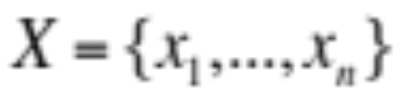
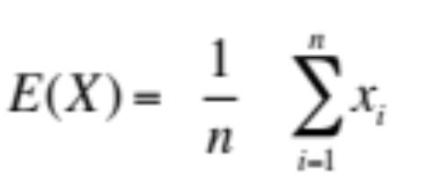

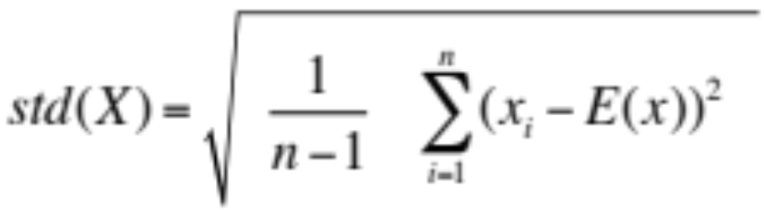



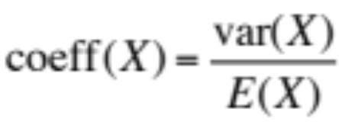
Performance evaluation
Simplest way of evaluating data series: averaging
mean
standard
deviation
variance
coefficient of
variation

Slide 23
Performance evaluation
Simplest way of evaluating data series: averaging
  mode (for categorical variable like on/off or red/green/blue)
  p-percentile
    1st quartile = 25-percentile
    median = 2nd quartile = 50-percentile
    3rd quartile = 75-percentile

Slide 24
Common mistakes in performance eval
no goals
ignore input errors
omitting assumptions and limitations
biased goals
overlook important parameters
unsystematic approach
inappropriate experiment design
assuming no change in the future
ignore significant factors
unrepresentative workload(s)
ignoring social aspects
Notes:
no goals: there is not general purpose model, no usual workload specificied, no metrics defined, NOT TRIVIAL to do
biased goals: “showing that our system is better than theirs”, “evaluators are judges”

Slide 25
Common mistakes in performance eval
no analysis
analyse without understanding the problem
too complex analysis
erroneous analysis
wrong evaluation technique
ignoring variability
improper treatment of outliers
incorrect performance metric
no sensitivity analysis
improper presentation of results
Notes:
no goals: there is not general purpose model, no usual workload specificied, no metrics defined, NOT TRIVIAL to do
biased goals: “showing that our system is better than theirs”, “evaluators are judges”

Slide 26
Performance evaluation
Performance metrics
  include
    performance time, rate, resource
    error rate, probability
    time to failure and duration
  consider including
    mean and variance
    individual and global
  selection criteria
    low variability
    non-redundancy
    completeness

Slide 27
The Art of Data Presentation
Good charts
  require minimal effort from the reader
  maximize information
    use words instead of symbols
    label all axes clearly
  minimize ink
    no grid lines
    more detail
  use common practices
    origin at (0,0)
    cause along the x axis, effect on y axis
    linear scales, increasing scales, equally divided scales

Slide 28
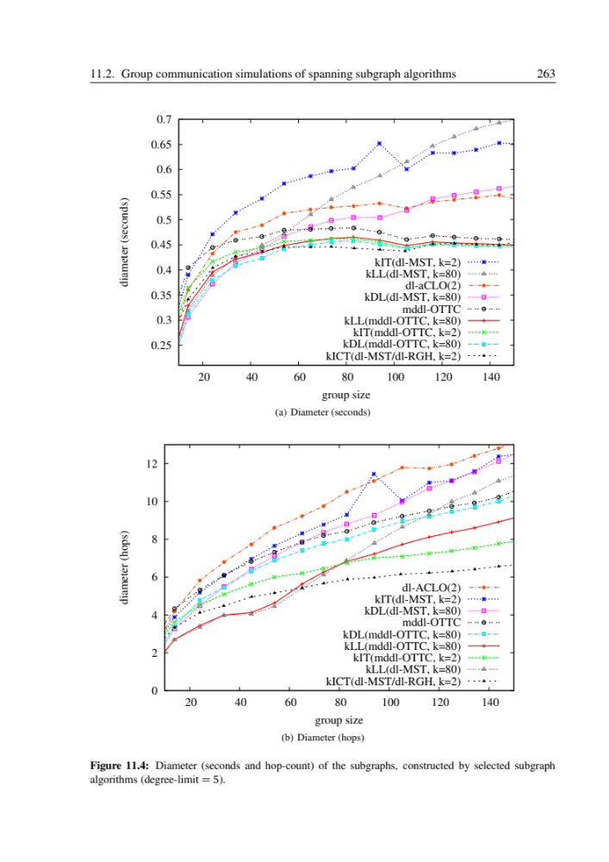
The Art of Data Presentation

Slide 29
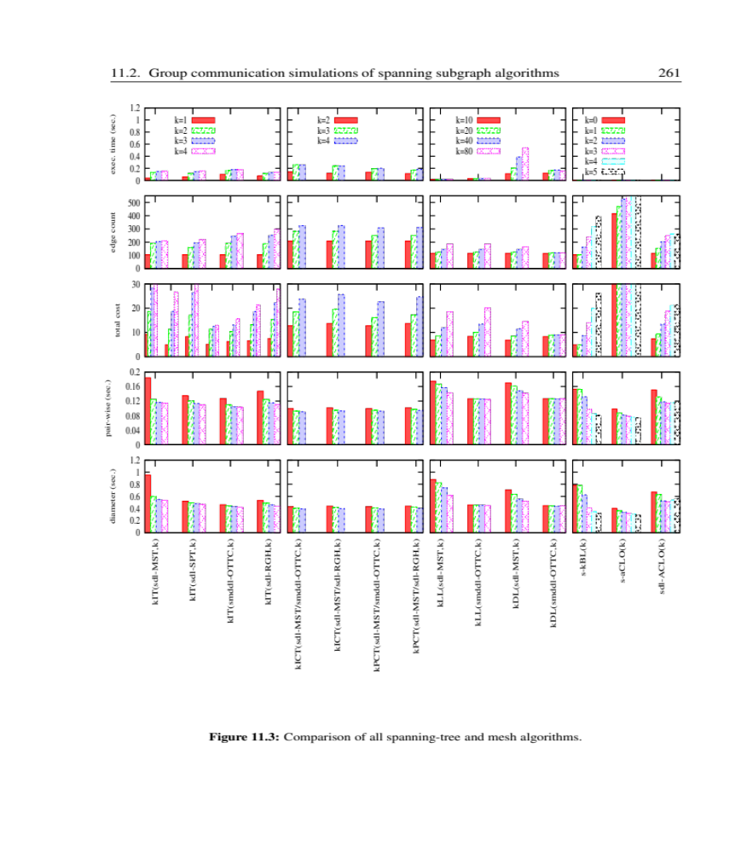
The Art of Data Presentation

Slide 30
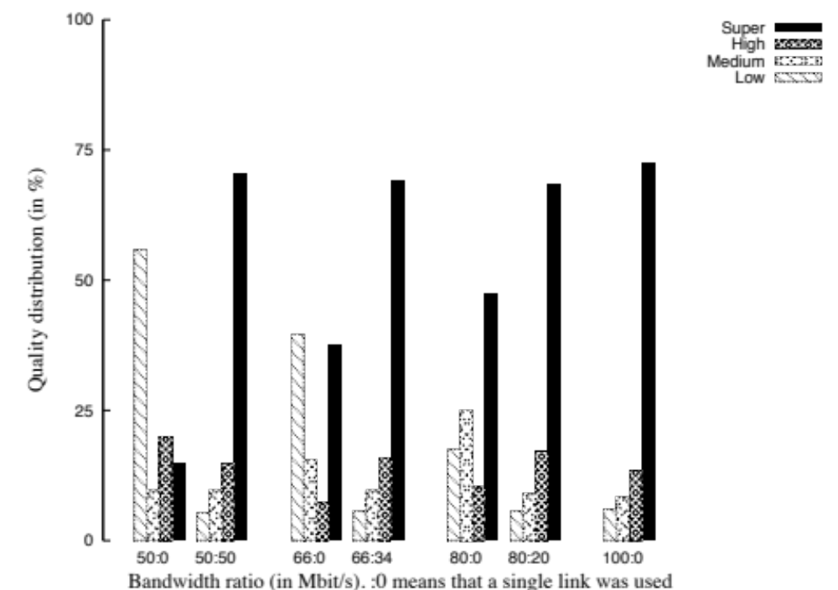
The Art of Data Presentation

Slide 31
The Art of Data Presentation
Checklist for line charts and bar charts (1/4):
Line chart content
  is the number of curves in the graph reasonably small?
  can lines be distinguished from each other?
  are the scales contiguous?
  if the Y-axis presents a random quantity, are the confidence intervals shown?
  is there a curve that can be removed without loosing information?
  are the curves on a line chart labeled individually?
  are all symbols explained?
  if grid lines are shown, do they add information?

Slide 32
The Art of Data Presentation
Checklist for line charts and bar charts (2/4):
Bar chart content
  are the bars labeled individually?
  is the order of bars systematic?
  does the area and width of bar charts represent (unequal) frequency and interval, respectively?
  does the area and frequency of free space between bars convey information?

Slide 33
The Art of Data Presentation
Checklist for line charts and bar charts (3/4):
Labeling
  are both coordinate axes shown and labeled?
  are the axis labels self-explanatory and concise?
  are the minimum and maximum values shown on the axes?
  are measurement units indicated?
  is the horizontal scale increasing left-to-right?
  is the vertical scale increasing bottom-to-top?
  is there a chart title?
  is the chart title self-explanatory and concise?

Slide 34
The Art of Data Presentation
Checklist for line charts and bar charts (4/4):
General
  is the figure referenced and used in the text at all?
  does the chart convey your message?
  would plotting different variables convey your message better?
  do all graphs use the same scale?
  does the whole chart provide new information to the reader?

