Slide 1
Server Resources:
Memory & Disks
INF5071 – Performance in Distributed Systems
September 24, 2010

Slide 2
Overview
Memory management
  caching
  copy free data paths
Storage management
  disks
  scheduling
  placement
  file systems
  multi-disk systems
  …

Slide 3
Memory Management

Slide 4











Why look at a passive resource?
“Dying philosophers problem”
Parking
Lack of space (or bandwidth) can delay applications
 e.g., the dining philosophers would die because the
spaghetti-chef could not find a parking lot

Slide 5

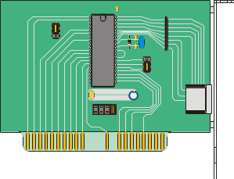
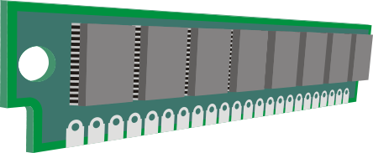
Delivery Systems
Network
bus(es)

Slide 6
Delivery Systems
application
user space
kernel space
file system
communication
system
several in-memory data movements
and context switches
several disk-to-memory transfers
bus(es)

Slide 7
Memory Caching

Slide 8


Memory Caching
How do we manage a cache?
how much memory to use?
how much data to prefetch?
which data item to replace?
…
application
caching possible
buffer cache
file system
communication
system
expensive
disk
network card
vs.

Slide 9
Is Caching Useful in a High-Rate Scenario?
High rate data may need lots of memory for caching…
Tradeoff: amount of memory, algorithms complexity, gain, …
Cache only frequently used data – how?
(e.g., first (small) parts of a movie, allow “top-ten” only, …)
Buffer vs. Rate | 160 Kbps (e.g., MP3) | 1.4 Mbps (e.g., uncompressed CD) | 3.5 Mbps (e.g., average DVD video) | 100 Mbps (e.g., uncompressed HDTV)
100 MB | 85 min 20 s | 9 min 31 s | 3 min 49 s | 8 s
1 GB | 14 hr 33 min 49 s | 1 hr 37 min 31 s | 39 min 01 s | 1 min 20 s
16 GB | 133 hr 01 min 01 s | 26 hr 00 min 23 s | 10 hr 24 min 09 s | 21 min 20 s
32 GB | 266 hr 02 min 02 s | 52 hr 00 min 46 s | 20 hr 48 min 18 s | 42 min 40 s
128 GB | 1064 hr 08 min 08 s | 208 hr 03 min 04 s | 83 hr 13 min 12 s | 2 hr 50 min 40 s
Largest Dell Servers in 2004/2008 –
and all is NOT used for caching

Slide 10
Need For Application-Specific Algorithms?
In this case, LRU replaces
the next needed frame. So
the answer is in many cases
YES…
Most existing systems use an LRU-variant
  keep a sorted list (most recently used at the head)
  replace last element in list
  insert new data elements at the head
  if a data element is re-accessed (e.g., new client or rewind),
  move back to the end of the list
Extreme example – video frame playout:
shortest time
since access
longest time
since access
LRU buffer
play video (7 frames):
1
2
3
4
5
6
7
rewind and restart playout at 1:
1
7
6
5
4
3
2
playout 2:
2
1
7
6
5
4
3
playout 3:
3
2
1
7
6
5
4
playout 4:
4
3
2
1
7
6
5

Slide 11
“Classification” of Mechanisms
Block-level caching consider (possibly unrelated) set of blocks
  each data element is viewed upon as an independent item
  usually used in “traditional” systems
  e.g., FIFO, LRU, LFU, CLOCK, …
  multimedia (video) approaches:
    Least/Most Relevant for Presentation (L/MRP)
    …
Stream-dependent caching consider (parts of) a stream object as a whole
  related data elements are treated in the same way
  research prototypes in multimedia systems
  e.g.,
    BASIC
    DISTANCE
    Interval Caching (IC)
    Generalized Interval Caching (GIC)
    Split and Merge (SAM)
    SHR

Slide 12
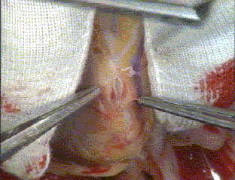
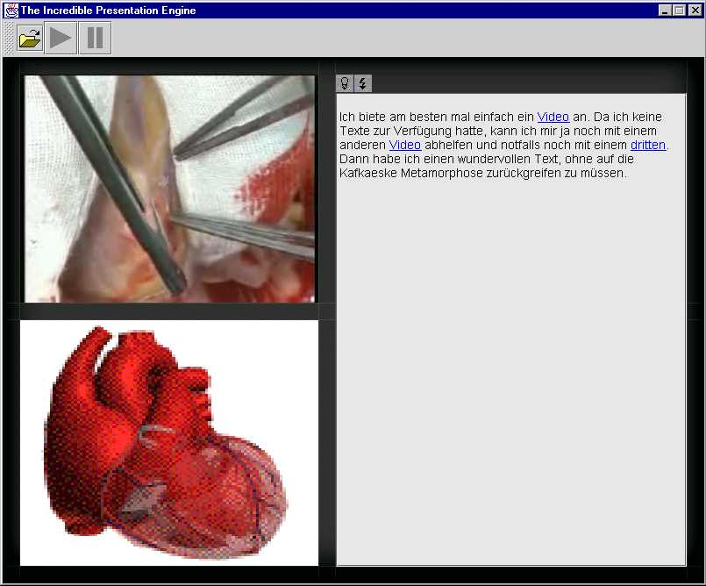

Least/Most Relevant for Presentation (L/MRP)
[Moser et al. 95]
L/MRP is a buffer management mechanism for a single interactive, continuous data stream
  adaptable to individual multimedia applications
  preloads units most relevant for presentation from disk
  replaces units least relevant for presentation
  client pull based architecture
Homogeneous stream e.g., MJPEG video
Continuous Presentation Units (COPU)
e.g., MJPEG video frames
Server
Buffer
Client
request
request

Slide 13
Least/Most Relevant for Presentation (L/MRP)
[Moser et al. 95]
Relevance values are calculated with respect to current playout of the multimedia stream
    presentation point (current position in file)
    mode / speed (forward, backward, FF, FB, jump)
    relevance functions are configurable
COPUs – continuous object presentation units
playback direction
10
11
12
13
14
15
16
17
18
19
20
21
22
23
24
25
26
current
presentation point
relevance value
1.0
15
16
17
18
19
X
referenced
14
16
18
20
0.8
13
20
21
X
history
12
22
0.6
11
23
10
22
24
X
skipped
0.4
25
24
26
0.2
0
26
COPU number
10
11
12
13
14
15
16
17
18
19
20
21
22
23
24
25
26

Slide 14
Least/Most Relevant for Presentation (L/MRP)
[Moser et al. 95]
Global relevance value
  each COPU can have more than one relevance value
    bookmark sets (known interaction points)
    several viewers (clients) of the same
  = maximum relevance for each COPU
Relevance
global relevance value
1
loaded frames
current
presentation
point S₂
current
presentation
point S₁
0
...
89
90
91
92
93
94
95
96
97
98
99
100
101
102
103
104
105
106
...
Bookmark-Set
History-Set
Referenced-Set

Slide 15
Least/Most Relevant for Presentation (L/MRP)
L/MRP …
  … gives “few” disk accesses (compared to other schemes)
  … supports interactivity
  … supports prefetching
  … targeted for single streams (users)
  … expensive (!) to execute
  (calculate relevance values for all COPUs each round)
Variations:
  Q-L/MRP – extends L/MRP with multiple streams and changes prefetching mechanism (reduces overhead) [Halvorsen et. al. 98]
  MPEG-L/MRP – gives different relevance values for different MPEG frames [Boll et. all. 00]

Slide 16
Interval Caching (IC)
Interval caching (IC) is a caching strategy for streaming servers
  caches data between requests for same video stream –
  based on playout intervals between requests
  following requests are thus served from the cache filled by preceding stream
  sort intervals on length, buffer requirement is data size of interval
  to maximize cache hit ratio (minimize disk accesses) the shortest intervals are cached first
: I₃₂
I₃₃
I₁₂
I₃₁
I₁₁
I₂₁
S₁₂
S₁₁
S₁₁
S₁₃
S₁₂
S₁₁
Video clip 1
Video clip 1
Video clip 1
I₁₂
I₁₁
S₂₂
S₂₁
Video clip 2
I₂₁
S₃₄
S₃₃
S₃₂
S₃₁
Video clip 3
I₃₃
I₃₂
I₃₁

Slide 17
Generalized Interval Caching (GIC)
Interval caching (IC) does not work for short clips
  a frequently accessed short clip will not be cached
GIC generalizes the IC strategy
  manages intervals for long video objects as IC
  short intervals extend the interval definition
    keep track of a finished stream for a while after its termination
    define the interval for short stream as the length between the new stream and the position of the old stream if it had been a longer video object
    the cache requirement is, however, only the real requirement
  cache the shortest intervals as in IC
S₂₂
S₂₁
Video clip 2
I₂₁
S₁₂
S₁₁
S₁₁
I₁₁ < I₂₁
 GIC caches I₁₁ before I₂₁
Video clip 1
I₁₁
C₁₁

Slide 18
Generalized Interval Caching (GIC)
Open function:
form if possible new interval with previous stream;
if (NO) {exit} /* don’t cache */
compute interval size and cache requirement;
reorder interval list; /* smallest first */
if (not already in a cached interval) {
if (space available) {cache interval}
else if (larger cached intervals exist
and sufficient memory can be released) {
release memory from larger intervals;
cache new interval;
}
}
Close function
if (not following another stream) {exit} /* not served from cache */ delete interval with preceding stream;
free memory;
if (next interval can be cached in released memory) {
cache next interval
}

Slide 19
LRU vs. L/MRP vs. IC Caching
What kind of caching strategy is best (VoD streaming)?
  caching effect
wasted buffering
global relevance values
loaded page frames
movie X
I₃
I₁
I₂
I₄
S₅
S₄
S₃
S₂
S₁
Memory (L/MRP):
4 streams from disk,
1 from cache
Memory (IC):
2 streams from disk,
3 from cache
Memory (LRU):
4 streams from disk,
1 from cache

Slide 20





LRU vs. L/MRP vs. IC Caching
What kind of caching strategy is best (VoD streaming)?
  caching effect (IC best)
  CPU requirement
LRU
L/MRP
IC
for each I/O request
reorder LRU chain
for each I/O request
for each COPU
RV = 0
for each stream
tmp = rel ( COPU, p, mode )
RV = max ( RV, tmp )
for each block consumed
if last part of interval
release memory element

Slide 21
In-Memory Copy Operations

Slide 22
In Memory Copy Operations
application
expensive
expensive
file system
communication
system
disk
network card
copy:
switch:
- save and restore state
- switch between user and kernel mode
- possible cache/TLB flush
- …
time
#bytes

Slide 23
Basic Idea of Zero–Copy Data Paths
application
user space
kernel space
file system
communication
system
data_pointer
data_pointer
bus(es)

Slide 24
Existing Linux
Data Paths
A lot of research has been performed in this area!!!!
BUT, what is the status of commodity operating systems?

Slide 25
Content Download
application
user space
kernel space
file system
communication
system
bus(es)

Slide 26
Content Download: read / send
application
application
buffer
read
send
kernel
copy
copy
page cache
socket buffer
DMA transfer
DMA transfer
2n copy operations
2n system calls

Slide 27
Content Download: mmap / send
application
mmap
send
kernel
page cache
copy
socket buffer
DMA transfer
DMA transfer
n copy operations
1 + n system calls

Slide 28
Content Download: sendfile
application
sendfile
kernel
gather DMA transfer
page cache
append descriptor
socket buffer
DMA transfer
0 copy operations
1 system calls

Slide 29
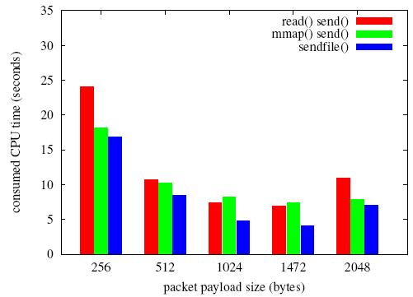
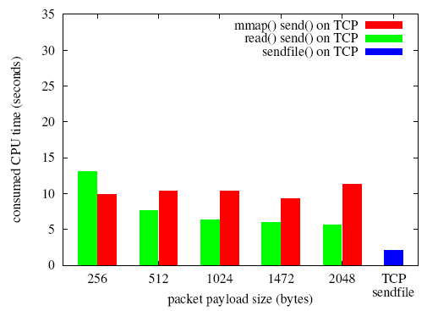
Content Download: Results
Tested transfer of 1 GB file on Linux 2.6
Both UDP and TCP
UDP
TCP

Slide 30
Streaming
application
user space
kernel space
file system
communication
system
bus(es)

Slide 31
Streaming: read / send
application
application buffer
read
send
kernel
copy
copy
page cache
socket buffer
DMA transfer
DMA transfer
2n copy operations
2n system calls

Slide 32
Streaming: read / writev
application
application buffer
read
writev
kernel
copy
copy
copy
page cache
socket buffer
DMA transfer
DMA transfer
3n copy operations
2n system calls
← Previous solution: one less copy per packet

Slide 33
Streaming: mmap / send
application
application buffer
mmap
cork
send
send
uncork
kernel
copy
page cache
copy
socket buffer
DMA transfer
DMA transfer
2n copy operations (but different costs of header and data)
1 + 4n system calls

Slide 34
Streaming: mmap / writev
application
application buffer
mmap
writev
kernel
copy
page cache
copy
socket buffer
DMA transfer
DMA transfer
2n copy operations
1 + n system calls
← Previous solution: three more calls per packet

Slide 35
Streaming: sendfile
application
application buffer
cork
send
sendfile
uncork
kernel
copy
gather DMA transfer
page cache
append descriptor
socket buffer
DMA transfer
n copy operations
4n system calls

Slide 36
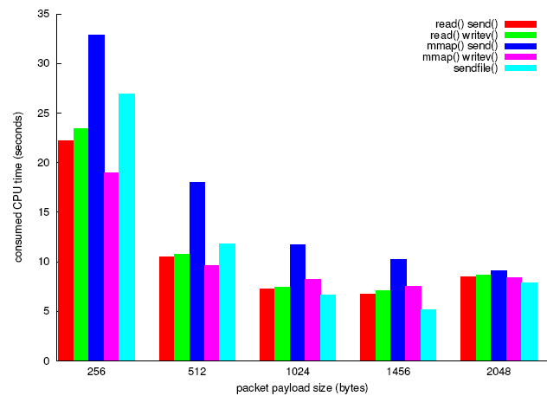
Streaming: Results
Tested streaming of 1 GB file on Linux 2.6
RTP over UDP
Compared to not sending an RTP header
over UDP, we get an increase of 29%
(additional send call)
More copy operations and system calls required
→ potential for improvements
TCP sendfile
(content download)

Slide 37
Enhanced Streaming
Data Paths

Slide 38
Enhanced Streaming: mmap / msend
application
application buffer
msend allows to send data from an
mmap’ed file without copy
mmap
cork
send
msend
send
uncork
kernel
copy
gather DMA transfer
page cache
append descriptor
socket buffer
copy
DMA transfer
DMA transfer
n copy operations
1 + 4n system calls
← Previous solution: one more copy per packet

Slide 39
Enhanced Streaming: mmap / rtpmsend
application
application buffer
RTP header copy integrated into
msend system call
mmap
cork
send
msend
rtpmsend
uncork
kernel
copy
gather DMA transfer
page cache
append descriptor
socket buffer
DMA transfer
n copy operations
1 + n system calls
← previous solution: three more calls per packet

Slide 40
Enhanced Streaming: mmap / krtpmsend
application
application buffer
An RTP engine in the kernel
adds RTP headers
rtpmsend
krtpmsend
kernel
copy
gather DMA transfer
RTP engine
page cache
append descriptor
socket buffer
DMA transfer
0 copy operations
1 system call
← previous solution: one more copy per packet
← previous solution: one more call per packet

Slide 41
Enhanced Streaming: rtpsendfile
application
application buffer
RTP header copy integrated into
sendfile system call
cork
send
sendfile
rtpsendfile
uncork
kernel
copy
gather DMA transfer
page cache
append descriptor
socket buffer
DMA transfer
n copy operations
n system calls
← existing solution: three more calls per packet

Slide 42
Enhanced Streaming: krtpsendfile
application
application buffer
An RTP engine in the kernel
adds RTP headers
rtpsendfile
krtpsendfile
kernel
copy
gather DMA transfer
RTP engine
page cache
append descriptor
socket buffer
DMA transfer
0 copy operations
1 system call
← previous solution: one more copy per packet
← previous solution: one more call per packet

Slide 43
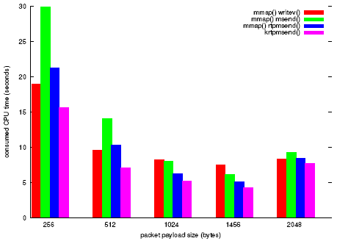
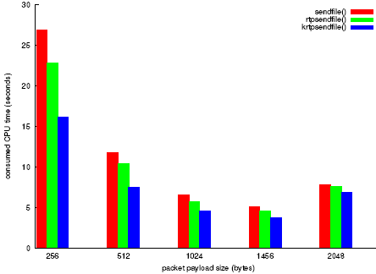
Enhanced Streaming: Results
Tested streaming of 1 GB file on Linux 2.6
RTP over UDP
mmap based mechanisms
sendfile based mechanisms
~25% improvement
~27% improvement
Existing mechanism
(streaming)
TCP sendfile
(content download)

Slide 44
Storage: Disks

Slide 45
Disks
Two resources of importance
  storage space
  I/O bandwidth
Several approaches to manage data on disks:
  specific disk scheduling and appropriate buffers
  optimize data placement
  replication / striping
  prefetching
  combinations of the above

Slide 46

Mechanics of Disks
Spindle
of which the platters
rotate around
Tracks
concentric circles on a
single platter
Platters
circular platters covered with
magnetic material to provide
nonvolatile storage of bits
Disk heads
read or alter the magnetism (bits) passing under it. The heads are attached to an arm enabling it to move across the platter surface
Sectors
segment of the track circle –
usually each contains 512 bytes –
separated by non-magnetic gaps.
The gaps are often used to identify
beginning of a sector
Cylinders
corresponding tracks on the different
platters are said to form a cylinder

Slide 47
Disk Specifications
Some existing (Seagate) disks today:
 | Barracuda 180 | Cheetah 36 | Cheetah X15
Capacity (GB) | 181.6 | 36.4 | 73.4
Spindle speed (RPM) | 7200 | 10.000 | 15.000
#cylinders | 24.247 | 9.772 | 18.479
average seek time (ms) | 7.4 | 5.7 | 3.6
min (track-to-track) seek (ms) | 0.8 | 0.6 | 0.2
max (full stroke) seek (ms) | 16 | 12 | 7
average latency | 4.17 | 3 | 2
internal transfer rate (Mbps) | 282 – 508 | 520 – 682 | 609 – 891
disk buffer cache | 16 MB | 4 MB | 8 MB

Slide 48
Disk Access Time
How do we retrieve data from disk?
  position head over the cylinder (track) on which the block (consisting of one or more sectors) are located
  read or write the data block as the sectors move under the head when the platters rotate
The time between the moment issuing a disk request and the time the block is resident in memory is called disk latency or disk access time

Slide 49
Disk Access Time
I want
block X
block x
in memory
Disk platter
Disk access time =
Disk head
Seek time
+ Rotational delay
+ Transfer time
Disk arm
+ Other delays

Slide 50
Disk Access Time: Seek Time
Seek time is the time to position the head
  the heads require a minimum amount of time to start and stop moving the head
  some time is used for actually moving the head –
  roughly proportional to the number of cylinders traveled
  Time to move head:
number of tracks
seek time constant
fixed overhead
Time
“Typical” average:
10 ms → 40 ms
7.4 ms (Barracuda 180) 5.7 ms (Cheetah 36)
3.6 ms (Cheetah X15)
~ 10x - 20x
x
Cylinders Traveled
1
N

Slide 51
Disk Access Time: Rotational Delay
Time for the disk platters to rotate so the first of the required sectors are under the disk head
head here
Average delay is 1/2 revolution
“Typical” average:
8.33 ms (3.600 RPM)
5.56 ms (5.400 RPM)
4.17 ms (7.200 RPM)
3.00 ms (10.000 RPM)
2.00 ms (15.000 RPM)
block I want

Slide 52
Disk Access Time: Transfer Time
Time for data to be read by the disk head, i.e., time it takes the sectors of the requested block to rotate under the head
Transfer rate =
Transfer time = amount of data to read / transfer rate
Example – Barracuda 180:
406 KB per track x 7.200 RPM ≈ 47.58 MB/s
Example – Cheetah X15:
316 KB per track x 15.000 RPM ≈ 77.15 MB/s
Transfer time is dependent on data density and rotation speed
If we have to change track, time must also be added for moving the head
amount of data per track
time per rotation
Note:
one might achieve these transfer rates reading continuously on disk, but time must be added for seeks, etc.

Slide 53
Disk Access Time: Other Delays
There are several other factors which might introduce additional delays:
  CPU time to issue and process I/O
  contention for controller
  contention for bus
  contention for memory
  verifying block correctness with checksums (retransmissions)
  waiting in scheduling queue
  ...
Typical values: “0”
(maybe except from waiting in the queue)

Slide 54
Disk Throughput
How much data can we retrieve per second?
Throughput =
Example:
for each operation we have
- average seek - average rotational delay
- transfer time - no gaps, etc.
  Cheetah X15 (max 77.15 MB/s)
  4 KB blocks → 0.71 MB/s
  64 KB blocks → 11.42 MB/s
  Barracuda 180 (max 47.58 MB/s)
  4 KB blocks → 0.35 MB/s
  64 KB blocks → 5.53 MB/s
data size
transfer time (including all)

Slide 55
Block Size
The block size may have large effects on performance
Example:
assume random block placement on disk and sequential file access
  doubling block size will halve the number of disk accesses
    each access take some more time to transfer the data, but the total transfer time is the same (i.e., more data per request)
    halve the seek times
    halve rotational delays are omitted
  e.g., when increasing block size from 2 KB to 4 KB (no gaps,...)
  for Cheetah X15 typically an average of:
    3.6 ms is saved for seek time
    2 ms is saved in rotational delays
    0.026 ms is added per transfer time
  increasing from 2 KB to 64 KB saves ~96,4 % when reading 64 KB
}
saving a total of 5.6 ms
when reading 4 KB (49,8 %)

Slide 56
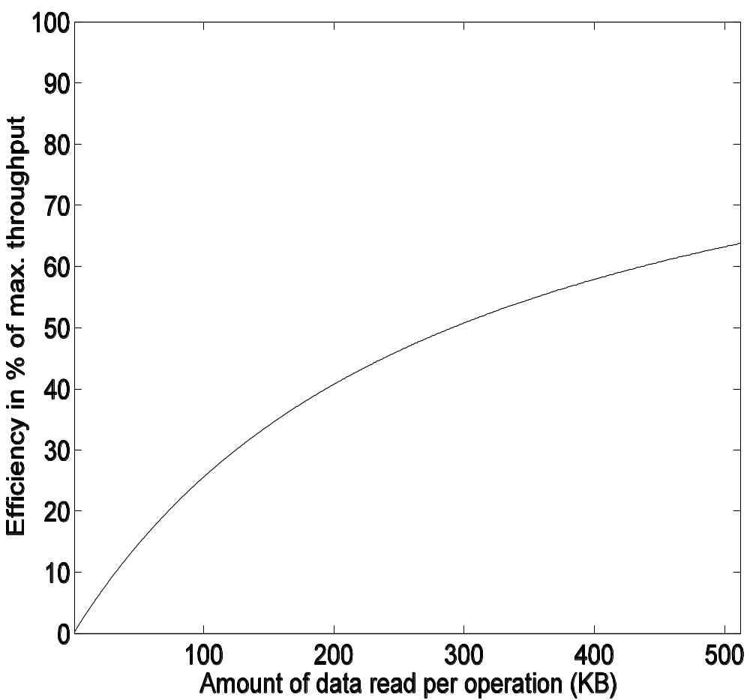
Block Size
Thus, increasing block size
can increase performance
by reducing seek times and
rotational delays
(figure shows calculation on some older device)
But, blocks spanning several
tracks still introduce latencies…
… and a large block size
is not always best
  small data elements may
  occupy only a fraction of the
  block (fragmentation)
Which block size to use therefore
depends on data size and data reference patterns
The trend, however, is to use large block sizes as new technologies appear with increased performance – at least in high data rate systems

Slide 57
Writing and Modifying Blocks
A write operation is analogous to read operations
  must add time for block allocation
  a write operation may has to be verified – must wait another rotation and then read the block to see if it is the block we wanted to write
  Total write time ≈ read time (+ time for one rotation)
Cannot modify a block directly:
  read block into main memory
  modify the block
  write new content back to disk
  (verify the write operation)
  Total modify time ≈ read time + time to modify + write time

Slide 58
Disk Controllers
To manage the different parts of the disk, we use a disk controller, which is a small processor capable of:
  controlling the actuator moving the head to the desired track
  selecting which platter and surface to use
  knowing when right sector is under the head
  transferring data between main memory and disk
New controllers acts like small computers themselves
  both disk and controller now has an own buffer reducing disk access time
  data on damaged disk blocks/sectors are just moved to spare room at the disk – the system above (OS) does not know this, i.e., a block may lie elsewhere than the OS thinks

Slide 59
Efficient Secondary Storage Usage
Must take into account the use of secondary storage
  there are large access time gaps, i.e., a disk access will probably dominate the total execution time
  there may be huge performance improvements if we reduce the number of disk accesses
  a “slow” algorithm with few disk accesses will probably outperform a “fast” algorithm with many disk accesses
Several ways to optimize .....
  block size - 4 KB
  file management / data placement - various
  disk scheduling - SCAN derivate
  multiple disks - a specific RAID level
  prefetching - read-ahead prefetching
  memory caching /replacement algorithms - LRU variant
  …

Slide 60
Disk Scheduling

Slide 61
Disk Scheduling – I
Seek time is the dominant factor of total disk I/O time
Let operating system or disk controller choose which request
to serve next depending on the head’s current position and requested block’s position on disk (disk scheduling)
Note that disk scheduling ≠ CPU scheduling
  a mechanical device – hard to determine (accurate) access times
  disk accesses cannot be preempted – runs until it finishes
  disk I/O often the main performance bottleneck
General goals
  short response time
  high overall throughput
  fairness (equal probability for all blocks to be accessed in the same time)
Tradeoff: seek and rotational delay vs. maximum response time

Slide 62
Disk Scheduling – II
Several traditional (performance oriented) algorithms
  First-Come-First-Serve (FCFS)
  Shortest Seek Time First (SSTF)
  SCAN (and variations)
  Look (and variations)
  …

Slide 63
First–Come–First–Serve (FCFS)
FCFS serves the first arriving request first:
Long seeks
“Short” average response time
incoming requests (in order of arrival):
12
14
2
7
21
8
24
cylinder number
scheduling
queue
1
5
10
15
20
25
12
14
2
7
21
8
Note:
the lines only indicate some time – not exact amount
24
time

Slide 64
Shortest Seek Time First (SSTF)
SSTF serves closest request first:
short seek times
longer maximum seek times – may even lead to starvation
incoming requests (in order of arrival):
12
14
2
7
21
8
24
12
14
2
7
21
8
24
cylinder number
1
5
10
15
20
25
scheduling
queue
time

Slide 65
SCAN
SCAN (elevator) moves head edge to edge and serves requests on the way:
bi-directional
compromise between response time and seek time optimizations
incoming requests (in order of arrival):
12
14
2
7
21
8
24
12
14
2
7
21
8
24
cylinder number
1
5
10
15
20
25
scheduling
queue
time

Slide 66
SCAN vs. FCFS
incoming requests (in order of arrival):
12
14
2
7
21
8
24
Disk scheduling makes a difference!
In this case, we
see that SCAN requires much less head movement compared to FCFS
(37 vs. 75 tracks/cylinders)
cylinder number
1
5
10
15
20
25
FCFS
time
SCAN
time

Slide 67
C–SCAN
Circular-SCAN moves head from edge to edge
serves requests on one way – uni-directional
improves response time (fairness)
incoming requests (in order of arrival):
12
14
2
7
21
8
24
12
14
2
7
21
8
24
cylinder number
1
5
10
15
20
25
scheduling
queue
time

Slide 68
SCAN vs. C–SCAN
Why is C-SCAN in average better in reality than SCAN when both service the same number of requests in two passes?
  modern disks must accelerate (speed up and
  down) when seeking
  head movement formula:
time
number of cylinders
seek time constant
fixed overhead
cylinders traveled
SCAN | C-SCAN
bi-directional | uni-directional
requests: n avg. dist: 2x total cost: | requests: n avg. dist: x total cost:
if n is large:

Slide 69
LOOK and C–LOOK
LOOK (C-LOOK) is a variation of SCAN (C-SCAN):
same schedule as SCAN
does not run to the edges
stops and returns at outer- and innermost request
increased efficiency
SCAN vs. LOOK example:
incoming requests (in order of arrival):
12
14
2
7
21
8
24
cylinder number
1
5
10
15
20
25
2
scheduling
queue
7
8
24
21
14
12
time

Slide 70
V–SCAN(R)
V-SCAN(R) combines SCAN (or LOOK) and SSTF
  define an R-sized unidirectional SCAN window, i.e., C-SCAN, and use SSTF outside the window
  Example: V-SCAN(0.6)
    makes a C-SCAN window over 60 % of the cylinders
    uses SSTF for requests outside the window
  V-SCAN(0.0) equivalent with SSTF
  V-SCAN(1.0) equivalent with C-SCAN
  V-SCAN(0.2) is supposed to be an appropriate configuration
cylinder number
1
5
10
15
20
25

Slide 71
END of This WEEK!!
NOW is the time to stop!!!!
… and start next time!

Slide 72
What About Time-Dependent Media?
Suitability of classical algorithms
  minimal disk arm movement (short seek times)
  but, no provision of time or deadlines
  generally not suitable
For example, a media server requires
  support for both periodic and aperiodic
    never miss deadline due to aperiodic requests
    aperiodic requests must not starve
  support multiple streams
  buffer space and efficiency tradeoff?

Slide 73
Real-Time Disk Scheduling
Traditional algorithms have no provision of time or deadlines
Real–time algorithms targeted for real–time applications with deadlines
Several proposed algorithms
  earliest deadline first (EDF)
  SCAN-EDF
  shortest seek and earliest deadline by ordering/value (SSEDO / SSEDV)
  priority SCAN (PSCAN)
  ...

Slide 74
Earliest Deadline First (EDF)
EDF serves the request with nearest deadline first
non-preemptive (i.e., an arriving request with a shorter deadline must wait)
excessive seeks → poor throughput
incoming requests (<block, deadline>, in order of arrival):
12,5
14,6
2,4
7,7
21,1
8,2
24,3
12,5
14,6
2,4
7,7
21,1
8,2
24,3
cylinder number
1
5
10
15
20
25
scheduling
queue
time

Slide 75
SCAN–EDF
SCAN-EDF combines SCAN and EDF:
the real-time aspects of EDF
seek optimizations of SCAN
especially useful if the end of the period is the deadline (some equal deadlines)
algorithm:
  serve requests with earlier deadline first (EDF)
  sort requests with same deadline after track location (SCAN)
incoming requests (<block, deadline>, in order of arrival):
2,3
14,1
9,3
7,2
21,1
8,2
24,2
16,1
2,3
14,1
9,3
7,2
21,1
8,2
24,2
16,1
cylinder number
1
5
10
15
20
25
scheduling
queue
Note:
similarly, we can combine EDF with C-SCAN, LOOK or C-LOOK
time

Slide 76
Stream Oriented Disk Scheduling
Streams often have soft deadlines and tolerate some slack due to buffering, i.e., pure real-time scheduling is inefficient and unnecessary
Stream oriented algorithms targeted for streaming continuous media data requiring periodic access, e.g., a frame every 40ms:
Several algorithms proposed:
  group sweep scheduling (GSS)
  mixed disk scheduling strategy
  contiguous media file system (CMFS)
  lottery scheduling
  stride scheduling
  batched SCAN (BSCAN)
  greedy-but-safe EDF (GS_EDF)
  bubble up
  …
frame i
frame i+1
frame i+2
frame i+3
frame i+4
time

Slide 77
Group Sweep Scheduling (GSS)
GSS combines Round-Robin (RR) and SCAN
requests are serviced in rounds (cycles)
principle:
  divide S active streams into G groups
  service the G groups in RR order
  service each stream in a group in C-SCAN order
  playout can start at the end of the group
special cases:
  G = S: RR scheduling
  G = 1: SCAN scheduling
tradeoff between buffer space and disk arm movement
  try different values for G giving minimum buffer requirement while remaining efficient enough to reach the deadlines
  a large G → smaller groups, more arm movements
  a small G → larger groups, less arm movements

Slide 78
Group Sweep Scheduling (GSS)
GSS example: streams A, B, C and D → g1:{A,C} and g2:{B,D}
RR group schedule
C-SCAN block schedule within a group
cylinder number
1
5
10
15
20
25
D₃
A₂
D₁
A₃
C₁
B₁
B₂
C₂
C₃
D₂
A₁
B₃
g1
A₁
{A,C}
C₁
g2
B₁
{B,D}
D₁
g1
C₂
{C,A}
A₂
g2
{B,D}
B₂
D₂
g1
{A,C}
A₃
C₃
g2
time
B₃
{B,D}
D₃

Slide 79
Mixed Media Oriented Disk Scheduling
Applications may require both RT and NRT data – desirable to have all on same disk
Several algorithms proposed:
  Felini’s disk scheduler
  Delta L
  Fair mixed-media scheduling (FAMISH)
  MARS scheduler
  Cello
  Adaptive disk scheduler for mixed media workloads (APEX)
  …

Slide 80
MARS Disk Scheduler
Massively-parallel And Real-time Storage (MARS) scheduler supports mixed media on a single system
  a two-level scheduling
  round-based
  top-level:
  1 NRT queue and n (1) RT queue
  (SCAN, but “future” GSS, SCAN-EDF, or…)
  use deficit RR fair queuing to assign
  quantums to each queue per round –
  divides total bandwidth among queues
  bottom-level:
  select requests from queues according to
  quantums, use SCAN order
  work-conserving
  (variable round times, new round starts immediately)
NRT
RT
…
deficit round robin fair queuing
job selector

Slide 81
Cello and APEX
Cello and APEX are similar to MARS, but slightly different in bandwidth allocation and work conservation
  Cello has
    three queues: deadline (EDF), throughput intensive best effort (FCFS), interactive best effort (FCFS)
    static proportional allocation scheme for bandwidth
    FCFS ordering of queue requests in lower-level queue
    partially work-conserving:
    extra requests might be added at the end of the class
    independent scheduler, but constant rounds
  APEX
    n queues
    uses token bucket for traffic shaping (bandwidth allocation)
    work-conserving:
    adds extra requests if possible to a batch & starts extra batch between ordinary batches

Slide 82
Cello
Cello is part of the Symphony FS supporting mixed media
  two-level scheduling
  round-based
  top-level: n (3) service classes (queues)
    deadline (= end-of-round) real-time (EDF)
    throughput intensive best effort (FCFS)
    interactive best effort (FCFS)
  divides total bandwidth among queues
  according to a static proportional allocation scheme
  (equal to MARS’ job selector)
  bottom-level: class independent scheduler (FCFS)
    select requests from queues according to BW share
    sort requests from each queue in SCAN order when transferred
  partially work-conserving
  (extra requests might be added at the end of the class
  independent scheduler if space, but constant rounds)
deadline RT
throughput intensive
best-effort
interactive
best-effort
1
7
4
2
3
1
2
2
8
sort each queue in SCAN order when transferred

Slide 83
Adaptive Disk Scheduler for Mixed Media Workloads
APEX is another mixed media scheduler
  two-level, round-based scheduler similar to Cello and MARS
  uses token bucket for traffic shaping
  (bandwidth allocation)
  the batch builder select requests in
  FCFS order from the queues based on
  number of tokens – each queue must
  sort according to deadline
  (or another strategy)
  work-conserving
    adds extra requests if possible to a batch
    starts extra batch between ordinary batches
Request Distributor/
Queue Scheduler
...
Queue/Bandwidth
Manager
Batch Builder

Slide 84
APEX, Cello and C–LOOK Comparison
Results from Ketil Lund (2002)
Configuration:
  Atlas Quantum 10K
  data placement: random
  round time: 1 second
  block size: 64KB
6 video playbacks and up to 9 user queries
  Video data disk requests are assigned to a real-time queue
  User-query disk requests to a best-effort queue
  Bandwidth is shared 50/50 between real-time and best-effort queues

Slide 85
APEX, Chello and C–LOOK Comparison
 | 1 | 2 | 3 | 4 | 5 | 6 | 7 | 8 | 9
APEX | 0 | 0 | 0 | 0 | 0 | 0 | 0 | 0 | 0
Cello | 0 | 0 | 0 | 0 | 0 | 0 | 0 | 0 | 0
C-LOOK | 0 | 18 | 90 | 288 | 404 | 811 | 1271 | 2059 | 3266
Deadline
violations
(video)

Slide 86
Schedulers today (Linux)?
NOOP
  FCFS with request merging
Deadline I/O
  C-SCAN based
  4 queues: elevator/deadline for read/write
Anticipatory
  same queues as in Deadline I/O
  delays decisions to be able to merge more requests
  (e.g., a streaming scenario)
Completely Fair Scheduler (CFQ)
  1 queue per process (periodic access, but priode depends on load)
  gives time slices and ordering according to priority level
  (real-time, best-effort, idle)
  work-conserving

Slide 87
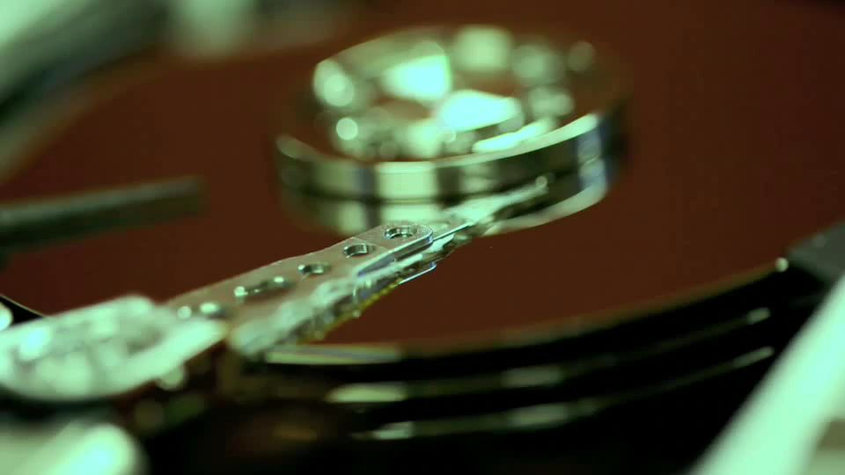
User space vs. kernel space scheduling
Do all applications fully benefit from kernel space scheduling?
File tree traversals
  processing one file after another
  tar, zip, …
  recursive copy (cp -r)
  search (find)
  …
Only application knows access pattern
  use ioctl FIEMAP (FIBMAP)
  to retrieve extent locations
  sort in user space
  send I/O request according to sorted list
GNU/BSD Tar vs. QTAR

Slide 88
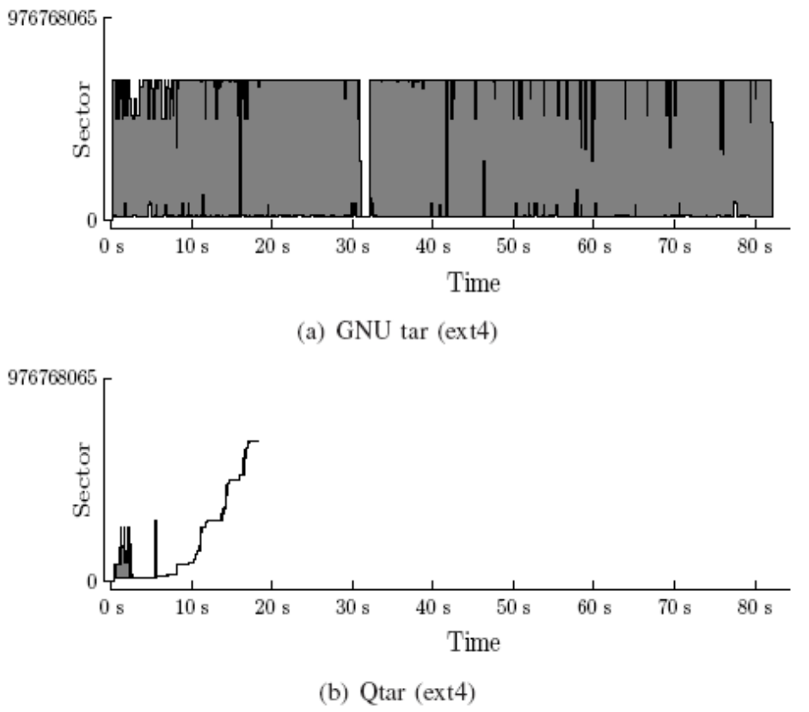
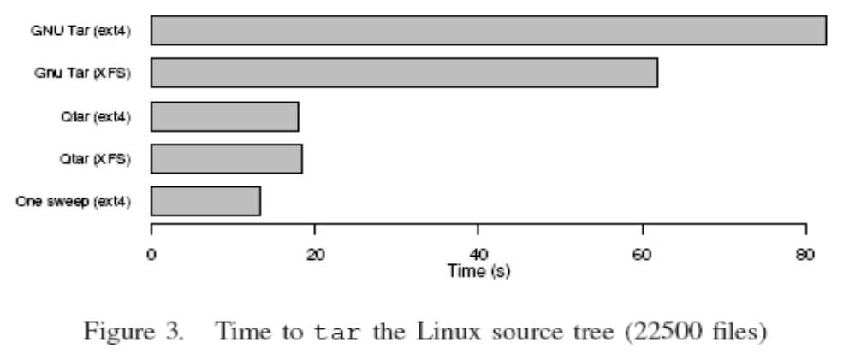
User space vs. kernel space scheduling
Do all applications fully benefit from kernel space scheduling?
File tree traversals
  processing one file after another
  tar, zip, …
  recursive copy (cp -r)
  search (find)
  …
Only application knows access pattern
  use ioctl FIEMAP (FIBMAP)
  to retrieve extent locations
  sort in user space
  send I/O request according to sorted list
GNU/BSD Tar vs. QTAR

Slide 89
Data Placement on Disk

Slide 90
Data Placement on Disk
Disk blocks can be assigned to files many ways, and several schemes are designed for
  optimized latency
  increased throughput
  access pattern dependent

Slide 91
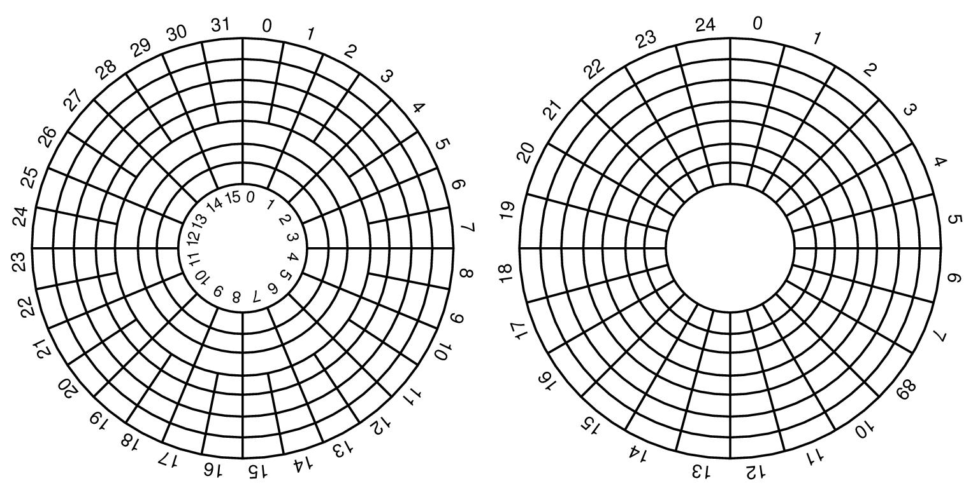
Disk Layout
Constant angular velocity (CAV) disks
  equal amount of data in each track
  (and thus constant transfer time)
  constant rotation speed
Zoned CAV disks
  zones are ranges of tracks
  typical few zones
  the different zones have
    different amount of data
    different bandwidth
    i.e., more better on outer tracks

Slide 92
Disk Layout
non-zoned disk
outer:
constant transfer rate
inner:
zoned disk
outer:
variable
transfer
rate
inner:

Slide 93
Disk Layout
Cheetah X15.3 is a zoned CAV disk:
Zone | Cylinders per Zone | Sectors per Track | Zone Transfer Rate (MBps) | Sectors per Zone | Efficiency | Formatted Capacity (MB)
1 | 3544 | 672 | 890,98 | 19014912 | 77,2% | 9735,635
2 | 3382 | 652 | 878,43 | 17604000 | 76,0% | 9013,248
3 | 3079 | 624 | 835,76 | 15340416 | 76,5% | 7854,293
4 | 2939 | 595 | 801,88 | 13961080 | 76,0% | 7148,073
5 | 2805 | 576 | 755,29 | 12897792 | 78,1% | 6603,669
6 | 2676 | 537 | 728,47 | 11474616 | 75,5% | 5875,003
7 | 2554 | 512 | 687,05 | 10440704 | 76,3% | 5345,641
8 | 2437 | 480 | 649,41 | 9338880 | 75,7% | 4781,506
9 | 2325 | 466 | 632,47 | 8648960 | 75,5% | 4428,268
10 | 2342 | 438 | 596,07 | 8188848 | 75,3% | 4192,690
Always place often used or high rate data on outermost tracks (zone 1) …!?
NO, arm movement is often more important than transfer time

Slide 94
Data Placement on Disk
Contiguous placement stores disk blocks contiguously on disk
  minimal disk arm movement reading the whole file (no intra-file seeks)
  pros/cons
    head must not move between read operations - no seeks / rotational delays
    can approach theoretical transfer rate
    but usually we read other files as well (giving possible large inter-file seeks)
  real advantage
    do not have to pre-determine block (read operation) size
    (whatever amount to read, at most track-to-track seeks are performed)
  no inter-operation gain if we have unpredictable disk accesses
file A
file B
file C

Slide 95
Data Placement on Disk
Interleaved placement tries to store blocks from a file with a fixed number of other blocks in-between each block
  minimal disk arm movement reading the files A, B and C
  (starting at the same time)
  fine for predictable workloads reading multiple files
  no gain if we have unpredictable disk accesses
Non-interleaved (or even random) placement can be used for highly unpredictable workloads
file A
file B
file C

Slide 96
Data Placement on Disk
Organ-pipe placement consider the ‘average’ disk head position
  place most popular data where head is most often
  center of the disk is in average “closest” to the head
  but, a bit outward for zoned disks (modified organ-pipe)
innermost
outermost
disk:
head
organ-pipe:
modified organ-pipe:
Note:
skew dependent on
tradeoff between
zoned transfer time
and storage
capacity vs.
seek time
block access probability
block access probability
cylinder number
cylinder number

Slide 97
Unix/Linux Example: FFS, UFS, …
inode
Flexible block size
e.g. 4KB
mode
Data block
Data block
owner
…
Data block
Direct block 0
Data block
Direct block 1
ca. 1000 entries
per index block
…
Direct block 10
Data block
Data block
Direct block 11
Single indirect
index
Double indirect
Data block
Triple indirect
Data block
Data block
index
index
Data block
index
Data block
Data block
index
index
index
index
index
Data block
Data block

Slide 98
Linux Example: XFS, …, JFS, EXT4…
Count-augmented address indexing in the extent sections
Introduce a new inode structure
  add counter field to original direct
  entries –
    direct points to a disk block
    count indicated how many other
    blocks is following the first block
    (contiguously)
inode
attributes
direct 0
count 0
3
data
data
data
direct 1
count 1
direct 2
count 2
…
…
direct 10
count 10
direct 11
count 11
single indirect
double indirect
triple indirect

Slide 99
Windows Example: NTFS
Each partition contains a master file table (MFT)
  a linear sequence of 1 KB records
  each record describes a directory or a file (attributes and disk addresses)
info about data blocks
record header
standard info
data header
file name
1st extension
run 1
run 2
2nd extension
run 3
run 1
run k
MFT 26
…data…
20
4
30
MFT 27
2
74
10
7
2
run 2, run 3, …, run k-1
78
3
unused
27 - second extension record
26 - first extension record
24 - base record
A file can be …
stored within the record (immediate file, < few 100 B)
represented by disk block addresses (which hold data):
runs of consecutive blocks (<addr, no>, like extents)
use several records if more runs are needed
first 16 reserved for
NTFS metadata

Slide 100
Modern Disks:
Complicating Factors

Slide 101


Complicating Factors
Disk used to be simple devices and disk scheduling used to be performed by OS (file system or device driver) only…
… but, new disks are more complex
  hide their true layout, e.g.,
    only logical block numbers
    different number of surfaces, cylinders, sectors, etc.
OS view
real view

Slide 102

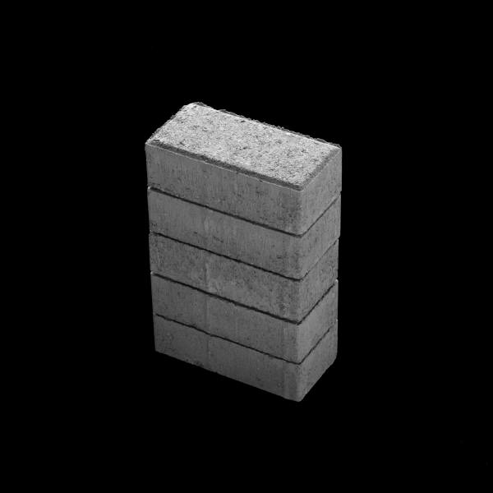

Complicating Factors
Disk used to be simple devices and disk scheduling used to be performed by OS (file system or device driver) only…
… but, new disks are more complex
  hide their true layout
  transparently move blocks to spare cylinders
    Seagate X15.3 - zone 1 - 10: (7,7,6,6,6,5,5,5,5,5)
    e.g., due to bad disk blocks
OS view
real view

Slide 103
Complicating Factors
Disk used to be simple devices and disk scheduling used to be performed by OS (file system or device driver) only…
… but, new disks are more complex
  hide their true layout
  transparently move blocks to spare cylinders
  have different zones
OS view
real view
Constant angular velocity (CAV) disks
  constant rotation speed
  equal amount of data in each track
  thus, constant
  transfer time
Zoned CAV disks
  constant rotation speed
  zones are ranges of tracks
  typical few zones
  the different zones have different amount of data, i.e., more better on outer tracks
  thus, variable transfer time

Slide 104
Complicating Factors
Disk used to be simple devices and disk scheduling used to be performed by OS (file system or device driver) only…
… but, new disks are more complex
  hide their true layout
  transparently move blocks to spare cylinders
  have different zones
  head accelerates – most algorithms assume linear movement overhead
Time
~ 10x - 20x
(7 ms)
x
(0.2 ms)
Cylinders Traveled
1
N

Slide 105
Complicating Factors
Disk used to be simple devices and disk scheduling used to be performed by OS (file system or device driver) only…
… but, new disks are more complex
  hide their true layout
  transparently move blocks to spare cylinders
  have different zones
  head accelerates
  on device (and controller) buffer caches may use read-ahead prefetching
disk
buffer
disk

Slide 106
Complicating Factors
Disk used to be simple devices and disk scheduling used to be performed by OS (file system or device driver) only…
… but, new disks are more complex
  hide their true layout
  transparently move blocks to spare cylinders
  have different zones
  head accelerates
  on device (and controller) buffer caches may use read-ahead prefetching
  gaps and checksums between each sector
track
Notes:
checksums are also stored with each the sectors
read for each track and used to validate the track
usually calculated using Reed-Solomon interleaved with CRC
for older drives the checksum is 16 bytes

Slide 107
Complicating Factors
Disk used to be simple devices and disk scheduling used to be performed by OS (file system or device driver) only…
… but, new disks are more complex
  hide their true layout
  transparently move blocks to spare cylinders
  have different zones
  head accelerates
  on device (and controller) buffer caches may use read-ahead prefetching
  gaps and checksums between each sector
  “smart” with a build-in low-level scheduler (usually SCAN-derivate)
  we cannot fully control the device (black box)

Slide 108
Why Still Do Disk Related Research?
If the disk is more or less a black box – why bother?
  many (old) existing disks do not have the “new properties”
  according to Seagate technical support:
  “blocks assumed contiguous by the OS probably still will be
  contiguous, but the whole section of blocks might be elsewhere”
  [private email from Seagate support]
  delay sensitive requests
But, the new disk properties should be taken into account
  existing extent based placement is probably good
  OS could (should?) focus on high level scheduling only

Slide 109
Next Generation Disk Scheduling?
Thus, due to the complicating factors…
(like head acceleration, disk buffer caches, hidden data layout, built-in “SCAN” scheduler,…)
… a server scheduler can be (???):
  hierarchical high-level software scheduler
    several top-level queues (at least RT & NRT)
    process queues in rounds (RR)
      dynamic assignment of quantums
      work-conservation with variable round length
      (full disk bandwidth utilization vs. buffer requirement)
    only simple collection of requests according to
    quantums in lowest level and forwarding to disk,
    because ...
  ...fixed SCAN scheduler in hardware (on disk)
On-device programmable processors??
RT
NRT
EDF / FCFS
…
No sorting
SCAN

Slide 110
Multiple Disks

Slide 111
Parallel Access
Disk controllers and busses manage several devices
One can improve total system performance by replacing one large disk with many small accessed in parallel
Several independent heads can read simultaneously
Two disks:
Single disk:
Note:
the single disk might be faster, but as seek time and rotational delay are the dominant factors of total disk access time, the two smaller disks might operate faster together performing seeks in parallel...

Slide 112
Striping
Another reason to use multiple disks is when one disk cannot deliver requested data rate
In such a scenario, one
might use several disks
for striping:
  bandwidth disk: B_{disk}
  required bandwidth: B_{consume}
  B_{disk} < B_{consume}
  read from n disks in parallel: n B_{disk} > B_{consume}
Advantages
  higher transfer rate compared to one disk
Drawbacks
  can’t serve multiple clients in parallel
  positioning time increases
  (i.e., reduced efficiency)
Client1
Client2
Client3
Client4
Client5
Server

Slide 113
Interleaving (Compound Striping)
Full striping usually not necessary today:
  faster disks
  better compression algorithms
Interleaving lets each client be serviced
by only a set of the available disks
  make groups
  ”stripe” data in a way such that a consecutive
  request arrive at next group
  one disk group example:
Client1
Client2
Client3
Server

Slide 114
Interleaving (Compound Striping)
Divide traditional striping group into sub-groups, e.g.,
staggered striping
Advantages
  multiple clients can still be served in parallel
  more efficient disks operations
  potentially shorter response time
Potential drawback/challenge
  load balancing (all clients access same group)
X_{0,0}
X_{0,1}
X_{1,0}
X_{1,1}
X_{2,0}
X_{2,1}
X_{3,1}
X_{3,0}
X_{4,0}
X_{4,1}

Slide 115
Mirroring
Multiple disks might do come in the situation where all requests are for one of the disks and the rest lie idle
In such cases, it might make sense to have replicas of data on several disks – if we have identical disks, it is called mirroring
Advantages
  faster response time
  survive crashes – fault tolerance
  load balancing by dividing the requests for the data on the same disks equally among the mirrored disks
Drawbacks
  increases storage requirement
  more expensive write operations

Slide 116
Redundant Array of Inexpensive Disks
The various RAID levels define different disk organizations to achieve higher performance and more reliability
  RAID 0 - striped disk array without fault tolerance (non-redundant)
  RAID 1 - mirroring
  RAID 2 - memory-style error correcting code (Hamming Code ECC)
  RAID 3 - bit-interleaved parity
  RAID 4 - block-interleaved parity
  RAID 5 - block-interleaved distributed-parity
  RAID 6 - independent data disks with two independent distributed parity schemes (P+Q redundancy)
  RAID 10 - striped disk array (RAID level 0) whose segments are mirrored (level 1)
  RAID 0+1 - mirrored array (RAID level 1) whose segments are RAID 0 arrays
  RAID 03 - striped (RAID level 0) array whose segments are RAID level 3 arrays
  RAID 50 - striped (RAID level 0) array whose segments are RAID level 5 arrays
  RAID 53, 51, …

Slide 117
Replication
Replication is in traditional disk array systems often used for fault tolerance (and higher performance in the new combined RAID levels)
Replication can also be used for
  reducing hot spots
  increase scalability
  higher performance
  …
  and, fault tolerance is often a side effect ☺
Replication should
  be based on observed load
  changed dynamically as popularity changes

Slide 118
Dynamic Segment Replication (DSR)
DSR tries to balance load by dynamically replicating hot data
  also known as dynamic policy for segment replication (DPSR)
  assumes read only, VoD-like retrieval
  predefines a load threshold for when to replicate a segment by examining current and expected load
  uses copyback streams
  replicate when threshold is reached, but which segment and where??
    tries to find a lightly loaded device, based on future load calculations
    not necessarily segment that receives additional requests
    (another segment may have more requests)
    replicates based on payoff factor p (replicate segment i with highest p):
n = 10, w = 0.5
n = 10, w = 1.5
number of viewers of replica j
number of replicas
of segment i
weighting factor
factor for expected benefit
for additional copy
this sum considers the number of
future viewers for this segment

Slide 119
Heterogeneous Disks

Slide 120
File Placement
A file might be stored on multiple disks, but how should one choose on which devices?
  storage devices limited by both bandwidth and space
  we have hot (frequently viewed) and cold (rarely viewed) files
  we may have several heterogeneous storage devices
  the objective of a file placement policy is to achieve maximum utilization of both bandwidth and space, and hence, efficient usage of all devices
  by avoiding load imbalance
    must consider expected load and storage requirement
    expected load may change over time

Slide 121
Bandwidth­to­Space Ratio (BSR)
BSR attempts to mix hot and cold as well as large and small (multimedia) objects on heterogeneous devices
  don’t optimize placement based on throughput or space only (use both!!)
  BSR consider both required storage space and throughput requirement
  (which is dependent on playout rate and popularity) to achieve a best combined device utilization
disk
(no deviation):
disk
(deviation):
disk
(deviation):
media object:
wasted space
wasted
bandwidth
space
bandwidth
may vary according
to popularity

Slide 122
Bandwidth­to­Space Ratio (BSR)
The BSR policy algorithm:
  input: space and bandwidth requirements
  phase 1:
    find a device to place the media object according to BSR
    if no device, or stripe of devices, can give sufficient space or bandwidth,
    then add replicas
  phase 2:
    find devices for the needed replicas
  phase 3:
    allocate expected load on replica devices according to BSR of the devices
  phase 4:
    if not enough resources are available, see if other media objects can delete replicas according to their current workload
  all phases may be needed adding a new media object or increasing the workload – for decrease, only the reallocation in needed
Popular, high data rate movies should be on high bandwidth disks

Slide 123
Disk Grouping
Disk grouping is a technique to “stripe” (or fragment) data over heterogeneous disks
  groups heterogeneous physical disks to homogeneous logical disks
  the amount of data on each disk (fragments) is determined so that the service time (based on worst-case seeks) is equal for all physical disks in a logical disk
  blocks for an object are placed (and read) on logical disks in a round-robin manner – all disks in a group is activated simultaneously
X₀ ready
for display
logical disk 0
disk 0
X_{0,0}
X_{2,0}
X₀
X₂
X_{0,0}
X_{2,0}
disk 1
X_{0,1}
X_{2,1}
X_{0,1}
X_{2,1}
X₁ ready
for display
logical disk 1
disk 2
X_{1,0}
X_{3,0}
X₁
X₃
X_{1,0}
disk 3
X_{1,1}
X_{3,1}
X_{1,1}

Slide 124
Staggered Disk Grouping
Staggered disk grouping is a variant of disk grouping minimizing
memory requirement
  reading and playing out differently
  not all fragments of a logical block is needed at the same time
  first (and largest) fragment on most powerful disk, etc.
  read sequentially (must not buffer later segments for a long time)
  start display when largest fragment is read
X_{0,0} ready
for display
X_{0,1} ready
for display
X_{2,0} ready
for display
X_{2,1} ready
for display
logical disk 0
disk 0
X_{0,0}
X_{2,0}
X₀
X₂
X_{0,0}
X_{0,1}
X_{2,0}
X_{2,1}
disk 1
X_{0,1}
X_{2,1}
X_{1,0} ready
for display
X_{1,1} ready
for display
logical disk 1
disk 2
X_{1,0}
X_{3,0}
X₁
X₃
X_{1,0}
X_{1,1}
disk 3
X_{1,1}
X_{3,1}

Slide 125
Disk Merging
Disk merging forms logical disks from capacity fragments of a physical disk
  all logical disks are homogeneous
  supports an arbitrary mix of heterogeneous disks (grouping needs equal groups)
  starts by choosing how many logical disks the slowest device shall support
  (e.g., 1 for disk 1 and 3) and calculates the corresponding number of more powerful devices (e.g., 1.5 for disk 0 and 2 if these disks are 1.5 times better)
  most powerful: most flexible (arbitrary mix of devices) and can be adapted to zoned disks (each zone considered as a disk)
X ready
for display
logical disk 0
disk 0
X₀
X₀
X₀
X_{2,0}
logical disk 1
X₁
X₁
disk 1
X₁
logical disk 2
X₂
X₂
logical disk 3
disk 2
X_{2,1}
X₃
X₃
X₃
logical disk 4
disk 3
X₄
X₄
X₄

Slide 126
File Systems

Slide 127
File Systems
Many examples of application specific storage systems
  integrate several subcomponents (e.g., scheduling, placement, caching, admission control, …)
  often labeled differently: file system, file server, storage server, …
  → accessed through typical file system abstractions
  need to address applications distinguishing features:
    soft real-time constraints (low delay, synchronization, jitter)
    high data volumes (storage and bandwidth)

Slide 128
Classification
General file systems: “support” for all applications
e.g.: file allocation table (FAT), windows NT file system (NTFS), extended file system (Ext2/3/4), journaling file system (JFS), Reiser, fast file system (FFS), …
Multimedia file systems: address multimedia requirements
  general file systems with multimedia support e.g.: XFS, Minorca
  exclusively streaming
  e.g.: Video file server, embedded real-time file system (ERTFS), Shark, Everest,
  continuous media file system (CMFS), Tiger Shark
  several application classes
  e.g.: Fellini, Symphony, (MARS & APEX schedulers)
High-performance file systems: primarily for large data operations in short time
e.g.: general parallel file system (GPFS), clustered XFS (CXFS), Frangipani, global file
system (GFS), parallel portable file system (PPFS), Examplar, extensible file system (ELFS)
“Strange file systems”:
e.g., Google FS (BigTable), OceanStore, FAST, FUSE, …

Slide 129
Example: Fellini Storage System
Fellini (now CineBlitz)…
  supports both real-time (with guarantees) and non-real-time by assigning resources for both classes
  SGI (IRIX Unix), Sun (Solaris), PC (WinNT & Win95)
Admission control
  deterministic (worst-case) to make hard guarantees
  services streams in rounds
  used (and available) disk BW is calculated using
    worst-case
      seek (inner to outer)
      rotational delay (one round)
      settle (servicing latency) - transfer rate of inner track
    T_{period} > total disk time = 2 x seek + Σ[blocks_{i} x (rotation delay + settle)]
  used (and available) buffer space is calculated using
    buffer requirement per stream = 2 x rate x service round
  a new client is admitted if enough free disk BW and buffer space
  (additionally Fellini checks network BW)
  new real-time clients are admitted first

Slide 130
Example: Fellini Storage System
Cache manager
  pages are pinned (fixing) using a reference counter
  replacement in three steps
    search free list
    search current buffer list (CBL) for the unused LRU file
    search in-use CBLs and assign priorities to replaceable buffers (not pinned) according to reference distance (depending on rate, direction)
      sort (using Quicksort)
      replace buffer with highest weight

Slide 131
Example: Fellini Storage System
Storage manager
  maintains free list with grouping contiguous blocks → store blocks contiguously
  uses C-SCAN disk scheduling
  striping
    distribute the total load
    add fault-tolerance (parity data)
  simple flat file system
Application interface
  non-real-time: more or less as in other file systems, except that when opening one has an admittance check
  real-time:
    begin_stream (filename, mode, flags, rate)
    retrieve_stream (id, bytes)
    store_stream (id, bytes)
    seek_stream (id, bytes, whence)
    close_stream(id)

Slide 132
Discussion:
We have the Qs, you have the As!

Slide 133
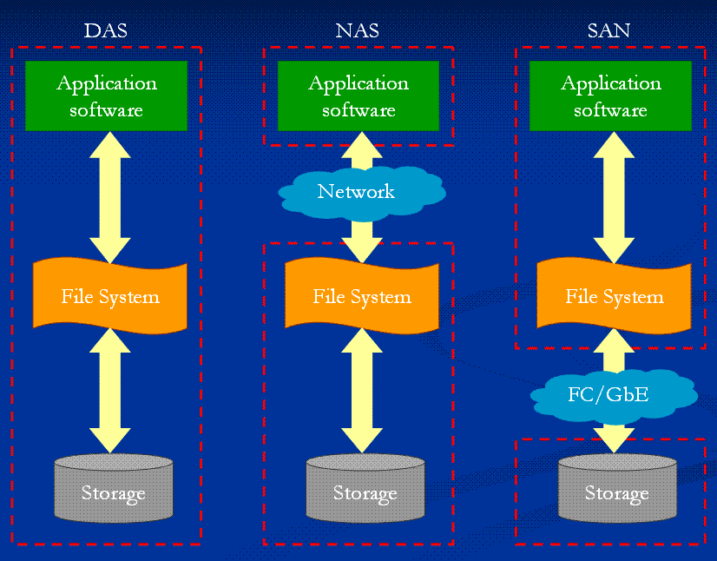
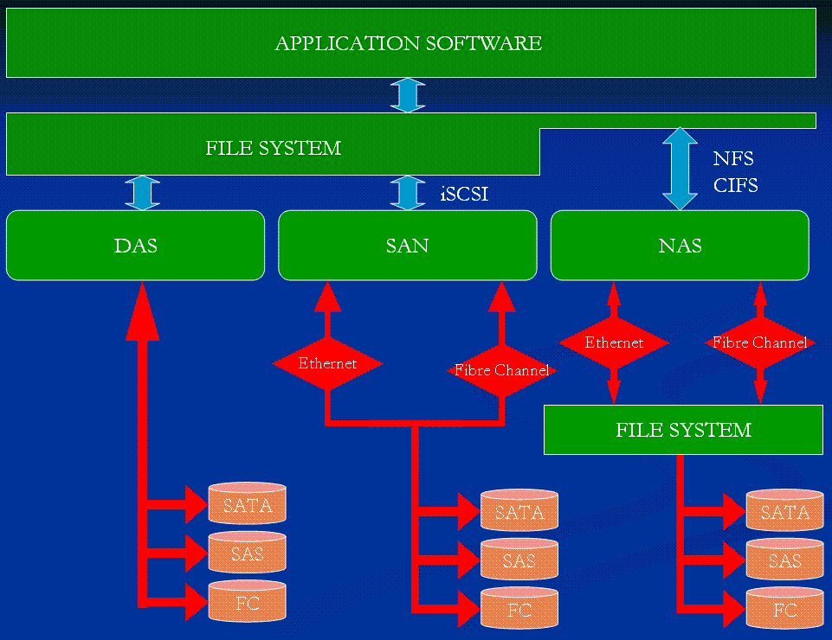
DAS vs. NAS vs. SAN??
How will the introduction of network
attached disks influence storage?
Direct attached storage
Network attached storage
  uses some kind of file-based protocol to attach remote devices non-transparently
  NFS, SMB, CIFS
Storage area network
  transparently attach remote storage devices
  iSCSI (SCSI over TCP/IP), iFCP (SCSI over Fibre Channel), HyperSCSI (SCSI over Ethernet), ATA over Ethernet

Slide 134
Mechanical Disks vs. Solid State Disks???
How will the introduction of SSDs influence storage?
(numbers from 2008) | Storage capasity (GB) | Average seek time / latency (ms) | Sustained transfer rate (MBps) | Interface (Gbps)
Seagate Cheetah X15.6 (3.5 inch) | 450 | 3.4 (track to track 0.2) | 110 - 171 | SAS (3) FC (4)
Seagate Savvio 15K (2.5 inch) | 73 | 2.9 (track to track 0.2) | 29 - 112 | SAS (3)
OCM Flash Media Core Series V2 | 250 | < .2 - .3 | up to 170 | SATA (3)
Intel X25-E (extreme) | 64 | 0.075 | 250 | SATA (3)
Intel X25-M (mainstream) | 160 | 0.085 | 250 | SATA (3)
Mtron SSD Pro 7500 series | 128 | 0.100 | 130 | SATA (1.5)
Gigabyte GC-Ramdisk | 4 | 0.000xxx | GBps | SATA (1.5)
Notes:
FC = fibre channel
SAS = serial attached SCSI

Slide 135
Evolution: New Requirements
Architectural considerations [Prashant Shenoy et al]:
  integrated file system support for a variety of applications
  modernizing the multimedia file system
    server-independent
    self managing
    self healing
    networked
    disk processors
Trend in research towards high-performance file systems
  usually no timeliness guarantees, but performance is maximized
  several build on multimedia file systems (Tiger Shark → GPFS, XFS → CXFS), but have gained scalability while still supporting reservation
  efficient support for operations like strided (non-continuous) I/O will be increasingly important (edition, interactions, scalable streaming, non-linearity)

Slide 136
The End:
Summary

Slide 137
Summary
All resources needs to be scheduled
Scheduling algorithms have to…
  … be fair
  … consider real-time requirements (if needed)
  … provide good resource utilization
  (… be implementable)
Memory management is an important issue
  caching
  copying is expensive → copy-free data paths

Slide 138
Summary
The main bottleneck is disk I/O performance due to disk mechanics: seek time and rotational delays
(but in the future??)
Much work has been performed to optimize disks performance
Many algorithms trying to minimize seek overhead
(most existing systems uses a SCAN derivate)
World today more complicated
  both different media
  unknown disk characteristics –
  new disks are “smart”, we cannot fully control the device
Disk arrays frequently used to improve the I/O capability
Many existing file systems with various application specific support

Slide 139
Some References
Halvorsen, P.: “Improving I/O Performance of Multimedia Servers”, Thesis for the Dr. Scient. degree at University of Oslo, Unipub forlag, ISSN 1501-7710, No. 161, Oslo, Norway, August 2001
Halvorsen, P., Dalseng, T.A., Griwodz, C.: Assessment of Data Path Implementations for Content Download and Streaming, Proc. of 11th Int. Conf. on Distributed Mulrimedia Systems, Banff, Canada, September 2005
Liu, C.L., Layland, J.W.: "Scheduling Algorithms for Multi-Programming in a Hard Real-Time Environment“, Journal of the Association for Computing Machinery 20, 1 (January 1973): 40-61
Nieh, J., Lam, M.S.: “The Design, Implementation and Evaluation of SMART: A Scheduler for Multimedia Applications”, Proc. of 16th ACM Symp. on Operating System Principles (SOSP’97), St. Malo, France, October 1997, pp. 184-197
Plagemann, T., Goebel, V., Halvorsen, P., Anshus, O.: "Operating System Support for Multimedia Systems", The Computer Communications Journal, Elsevier, Vol. 23, No. 3, February 2000, pp. 267-289
Solomon, D.A., Russinovich, M.E.: “Inside Microsoft Windows2000”, 3rd edition, Microsoft Press, 2000
Steinmetz, R., Nahrstedt, C.: “Multimedia: Computing, Communications & Applications”, Prentice Hall, 1995
Tanenbaum, A.S.: “Modern Operating Systems” (2nd ed.), Prentice Hall, 2001
Wolf, L.C., Burke, W., Vogt, C.: “Evaluation of a CPU Scheduling Mechanism for Multimedia Systems”, Software - Practice and Experience, Vol. 26, No. 4, 1996, pp. 375 – 398
Boll, S., Heinlein, C., Klas, W., Wandel, J.: “MPEG-L/MRP: Adaptive Streaming of MPEG Videos for Interactive Internet Applications”, Proceedings of the 6th International Workshop on Multimedia Information System (MIS’00), Chicago, USA, October 2000, pp. 104 - 113
Halvorsen, P., Goebel, V., Plagemann, T.: “Q-L/MRP: A Buffer Management Mechanism for QoS Support in a Multimedia DBMS”, Proceedings of 1998 IEEE International Workshop on Multimedia Database Management Systems (IW-MMDBMS'98), Dayton, Ohio, USA, August 1998, pp. 162 – 171
Moser, F., Kraiss, A., Klas, W.: “L/MRP: a Buffer Management Strategy for Interactive Continuous Data Flows in a Multimedia DBMS”, Proceedings of the 21th VLDB Conference, Zurich, Switzerland, 1995

Slide 140
Some References
Advanced Computer & Network Corporation: “RAID.edu”, http://www.raid.com/04_00.html, 2002
Halvorsen, P., Griwodz, C., Goebel, V., Lund, K., Plagemann, T., Walpole, J.: “Storage System Support for Continuous-Media Applications” (part 1 & 2), DSonline, Vol. 5, No. 1 & 2, January/February 2004
C. Martin, P.S. Narayan, B. Ozden, R. Rastogi, and A. Silberschatz, ``The Fellini Multimedia Storage System,'' Journal of Digital Libraries , 1997, see also http://www.bell-labs.com/project/fellini/
Plagemann, T., Goebel, V., Halvorsen, P., Anshus, O.: “Operating System Support for Multimedia Systems”, Computer Communications, Vol. 23, No. 3, February 2000, pp. 267-289
Shenoy, P., Goyal, P., Rao, S.S., Vin, H.M.: “Symphony: An Integrated Multimedia Files System”, MMCN’98, San Jose, CA, USA, 1998, pp. 124 – 138 (also as CS-TR-97-09)
Sitaram, D., Dan, A.: “Multimedia Servers – Applications, Environments, and Design”, Morgan Kaufmann Publishers, 2000
Zimmermann, R., Ghandeharizadeh, S.: “Continuous Display using Heterogeneous Disk-Subsystems”, Proceedings of the 5th ACM International Multimedia Conference, Seattle, WA, November 1997
Anderson, D. P., Osawa, Y., Govindan, R.:”A File System for Continuous Media”, ACM Transactions on Computer Systems, Vol. 10, No. 4, Nov. 1992, pp. 311 - 337
Elmasri, R. A., Navathe, S.: “Fundamentals of Database Systems”, Addison Wesley, 2000
Garcia-Molina, H., Ullman, J. D., Widom, J.: “Database Systems – The Complete Book”, Prentice Hall, 2002
Lund, K.: “Adaptive Disk Scheduling for Multimedia Database Systems”, PhD thesis, IFI/UniK, UiO
Plagemann, T., Goebel, V., Halvorsen, P., Anshus, O.: “Operating System Support for Multimedia Systems”, Computer Communications, Vol. 23, No. 3, February 2000, pp. 267-289
Seagate Technology, http://www.seagate.com

