Slide 1
Server Resources:
Server Examples, Resources and CPU Scheduling
INF5071 – Performance in Distributed Systems
September 10, 2010

Slide 2

Motivation
In a distributed system, the performance of every single machine is important
  poor performance of one single node might be sufficient to “kill” the system (not better than the weakest)
Managing the server side machines are challenging
  a large number of concurrent clients
  shared, limited amount of resources
  strict bandwidth and latency requirements
We will see examples where simple, small changes improve performance
  decrease the required number of machines
  increase the number of concurrent clients
  improve resource utilization
  enable timely delivery of data

Slide 3
Overview
Server examples
Resources, real-time, “continuous” media streams, …
(CPU) Scheduling
Next time, memory and storage

Slide 4
Server Examples

Slide 5
(Video) Server Product Examples
1) Real server, VXtreme, Starlight, Netscape Media Server,
MS MediaServer, Apple Darwin, Move Networks, MS Smooth Streaming …
user level server
RTSP
RTP
HTTP
standard
OS
all standard HW
2) IBM Mediastreamer,
Oracle Video Cartridge, N-Cube,…
user level layer
DSM CC, private
3) SGI/Kassena Media Base,
SUN Media Center,
IBM VideoCharger, …
ATM, analog, …
scalable, RT-aware OS,
RT OS, or
OS derivation
user level server
RTSP
RTP
custom/special HW
MM
FS
standard
OS
RT
extensions
selected
standard HW

Slide 6

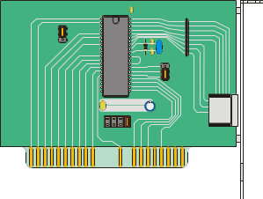
Real Server
User space implementation
  one control server
  several protocols
  several versions of data
  in same file
  adapts to resources
Several formats, e.g.,
  Real’s own
  MPEG-2 version with
  “stream thinning”
  (dropped with REAL )
  MPEG4, QT, …
Does not support
  Quality-of-Service
  load leveling
request
server
3
1
2
Real’s
protocol
RTP/
RTCP
user
kernel
TCP
UDP
feedback
backpressure
index
track 1
track 2
IP

Slide 7





Torrent-like HTTP streaming
Data object:
For load-balancing and scaling multiple servers, taking the best from several worlds….
Downloads segments
Tracker manages information
about segment locations
The user contacts the tracker
for segment locations
Users send HTTP GET requests to download video segments

Slide 8







Torrent-like HTTP streaming
Move use
2 second segments
  coded in on2`s VP7 (but other formats could be used)
  a 2-hour move contains 3600 segments
To support adaptation to
available resources, each
segment is coded
in many quality levels
playout time
quality

Slide 9
IBM VideoCharger
“IBM® Content Manager VideoCharger delivers
high-quality audio and video streams over
corporate intranet or the Internet.
It provides users the latest standard formats,
including MPEG-4 and Apple QuickTime 6,
and does not require that the file be downloaded
or saved before being played.
Effective 07/15/09,
IBM withdrew Content Manager VideoCharger
from marketing.”
http://www-01.ibm.com/software/data/videocharger/
Notes:
Control server API som kan brukes for å utvikle protokoller, f.eks. RTSP
Lavere lags API for å kontrollere viseostrømmer, f.eks. sette inn komponenter som filtere, …
5L – Linux compatible
TigerShark → GPFS (general parallel )
VSD – remote, looks local + BW managed by switch

Slide 10
IBM VideoCharger
May consist of one machine only, or …
… several Advanced Interactive eXecutive
(AIX) machines
Servers
  control
  data
Lightly modified
existing components
  OS AIX4/5L
  virtual shared disks
  (guaranteed disk I/Os)
Special components
  TigerShark MMFS
  (buffers, data rate, prefetching, codec, ...)
  stream filters, control server, APIs, …
specific
control server
RTSP
control
video stream API
distributed computing
environment RPC
AIX SP2 crossbar switch
mlib API
filter
encrypt
RTP
TigerShark
MMFS
UDP
VSD
with
EDF
VSD
IP
DESCRIBE
SETUP
PLAY
TEARDOWN
Notes:
Control server API som kan brukes for å utvikle protokoller, f.eks. RTSP
Lavere lags API for å kontrollere viseostrømmer, f.eks. sette inn komponenter som filtere, …
5L – Linux compatible
TigerShark → GPFS (general parallel )
VSD – remote, looks local + BW managed by switch

Slide 11
nCUBE
n4x media hubs:
Intel 860 Chip Set
Intel 1.5 GHz Xeon CPU
Up to 2 GB Rambus Memory
Five 64 bit 66Mhz PCI slots
“Special” PCI slot (HIB board)
nHIO hypercube I/O
Original research from Cal Tech/Intel (‘83)
Bought by C-COR in Jan. 05 (~90M$)
One server scales from 1 to 256 machines,
2^{n}, n ∈ [0, 8], using a hypercube architecture
Why a hypercube?
  video streaming is a switching problem
  hypercube is a high performance scalable switch
  no content replication and true linear scalability
  integrated adaptive routing provides resilience
Highlights
  scales from 5,000 to 500,000 clients
  exceeds 60,000 simultaneous streams
  6,600 simultaneous streams at 2 - 4 Mbps each
  (26 streams per machine if n = 8)
Special components
  boards with integrated components
  TRANSIT operating system
  n4 HAVOC (1999)
    Hypercube And Vector Operations Controller
    ASIC-based hypercube technology
  n4x nHIO (2002)
    nCUBE Hypercube I/O controller (8X performance/price)
request
8 hypercube
connectors
configurable
interface
SCSI ports
memory
PCI bus
vector processor
Notes:
Transit = Real Time Operating System for n4/n4x
Derived from AT&T Plan9 – child of Unix V10
Low overhead – optimized for n4x MediaHUB
Leading TCP/IP protocol stack from Mentat
Transit 3.4 functionality includes:
Distributed volume manager & video file system
On line repair
Disk bad block handling
Automatic root hub failover
Automatic IP address failover
Online re-striping of disk farm for growth

Slide 12
nCUBE: Naturally load-balanced
Disks connected to All MediaHubs
  Each title striped across all MediaHUBs
  Streaming Hub reads content
  from all disks in the video server
Automatic load balancing
  Immune to content usage pattern
  Same load if same or different title
  Each stream’s load spread over all nodes
RAID Sets distributed across MediaHubs
  Immune to a MediaHUB failure
  Increasing reliability
Only 1 copy of each title ever needed
  Lots of room for expanded content,
  network-based PVR or HDTV content
Content striped across
all disks in the n4x server
Video Stream

Slide 13
Small Video Server Comparison
Real, Move,… | VideoCharger | nCUBE
standard HW | selected HW | special HW
each machine its own storage, or NFS | shared disk access, replication for load leveling and fault tolerance | shared disk access, no replication
single OS image | cluster machines using switch | cluster machines using wired cube
user space server | user space server and loadable kernel modules | server in both kernel and user space
available and frequently used | still available, but withdrawn from marketing june 2009 | ????

Slide 14



Funcom’s Anarchy Online
World-wide massive multiplayer
online roleplaying game
  client-server
    point-to-point TCP connections
    virtual world divided into many regions
    one or more regions are managed by one machine

Slide 15



Funcom’s Anarchy Online
To scale, a new instance of a region may be created
  players do not interact with all other players – only a subset
  dynamic region-of-interest

Slide 16


Blizzard: World of Warcraft
To scale
  many copies of the world, choose one…
  one world does not influence another
  players do not interact with all other players – only a subset

Slide 17

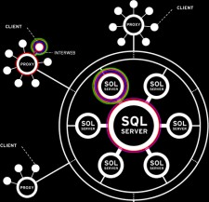
EVE online
One SINGLE, SHARED world
Client-server model with proxies
300.000 users, 56.000 concurrent
  150.000 database entries per day
  400.000 random I/O per second
  everyone in the same (virtual) location
  can interact
  large lags in popular areas
  have had player limitations in popular areas
  couple incidents of memory problems

Slide 18
Small Comparison: Video vs. Games
Video | Games
Many users, lots of hardware
few (VCR) interactions | highly interactive
replication possible | replication changes user perception
high bandwidth per stream | hardly any bandwidth per stream
Bottleneck: I/O bandwidth | Bottleneck: computation
Hardware: special or standard | Hardware: standard
OS: special or standard | OS: standard

Slide 19
Server Structures

Slide 20
(Video) Server Components & Switches
[Tetzlaff & Flynn 94]
IP, …
HP, DEC, Novell, …
network attachment
RPC in application, …
switch
IBM VideoCharger
memory management
HP, DEC, Novell,
Move, MS Smooth Streaming….
switched network
NFS, …
switch
switched network
file system
switch
AFS, CODA, …
switch
switch
storage management
IBM TigerShark
switch
distributed OS, …
switch
controller
Disk arrays (RAID), …
switch
storage device
Notes:
Video servers are constructed of the basic 6 functions represented as layers
Successive layers make service requests to lower layers
Paralellism require that somewhere there must be a switch – ”any-to-any connectivity”
Switches might be both outside and inside the system, also more than one switch

Slide 21
Server Topology – I
Single server
  easy to implement
  scales poorly
Partitioned server
  users divided into groups
  content : assumes equal groups
  location : store all data on all servers
  load imbalance
Network
Network
Network

Slide 22
Server Topology – II
Externally switched servers
  use network to make server pool
  manages load imbalance
  (control server directs requests)
  still data replication problems
  (control server doesn’t need to be a physical box - distributed process)
  include also P2P and hierarchical structure
“Fully” switched server
  server pool
  storage device pool
  additional hardware costs
  e.g., Oracle, Intel, IBM
data
data
Network
data
control
data
I/O
switch
Network
data
control

Slide 23
Data Retrieval
Pull model:
  client sends several requests
  deliver only small part of data
  fine-grained client control
  favors high interactivity
  suited for editing, searching, etc.
Push model
  client sends one request
  streaming delivery
  favors capacity planning
  suited for retrieval, download, playback, etc.
server
client
server
client

Slide 24
Resources and Real-Time

Slide 25
Resources
Resource:
“A resource is a system entity required by a task for manipulating data”
[Steimetz & Nahrstedt 95]
Characteristics:
  active: provides a service,
  e.g., CPU, disk or network adapter
  passive: system capabilities required by active resources, e.g., memory
  exclusive: only one process at a time can use it,
  e.g., CPU
  shared: can be used by several concurrent processed,
  e.g., memory

Slide 26
Deadlines and Real-Time
Deadline:
“A deadline represents the latest acceptable time for the presentation of the processing result”
  Hard deadlines:
    must never be violated → system failure
  Soft deadlines:
    in some cases, the deadline might be missed, but …
      not too frequently
      not by much time
    result still may have some (but decreasing) value
Real-time process:
“A process which delivers the results of the processing in a given time-span”
Real-time system:
“A system in which the correctness of a computation depends not only on obtaining the result, but also upon providing the result on time”

Slide 27
Admission and Reservation
To prevent overload, admission may be performed:
  schedulability test:
    “are there enough resources available for a new stream?”
    “can we find a schedule for the new task without disturbing the existing workload?”
    a task is allowed if the utilization remains < 1
  yes – allow new task, allocate/reserve resources
  no – reject
Resource reservation is analogous to booking (asking for resources)
  pessimistic
    avoid resource conflicts making worst-case reservations
    potentially under-utilized resources
    guaranteed QoS
  optimistic
    reserve according to average load
    high utilization
    overload may occur
  “perfect”
    must have detailed knowledge about resource requirements of all processes
    too expensive to make/takes much time

Slide 28
Real-Time Support
The operating system manages local resources
(CPU, memory, disk, network card, busses, ...)
In a real-time scenario, support is needed for
  timely processing
  high-rate, timely I/O
This means support for proper …
  scheduling –
  high priorities for time-restrictive tasks
  timer support –
  clock with fine granularity and event scheduling with high accuracy
  kernel preemption –
  avoid long periods where low priority processes cannot be interrupted
  efficient memory management –
  prevent code and data for real-time programs from being paged out
  (replacement)
  fast switching –
  both interrupts and context switches should be fast

Slide 29
Timeliness

Slide 30
Timeliness: Streaming
Start presenting data (e.g., video playout) at t₁
Consumed bytes (offset)
  variable rate
  constant rate
Must start retrieving
data earlier
  Data must arrive before
  consumption time
  Data must be sent
  before arrival time
  Data must be read from
  disk before sending time
arrive function
data offset
send function
read function
consume function
time
t₁

Slide 31
Timeliness: Streaming
Need buffers to hold data between the functions,
e.g., client B(t) = A(t) – C(t), i.e., ∀ t : A(t) ≥ C(t)
Latest start of data arrival
is given by
min[B(t,t₀,t₁) ; ∀ t B(t,t₀,t₁) ≥ 0],
i.e., the buffer must at all
times t have more data to
consume
arrive function
data offset
consume function
time
t ₀
t₁

Slide 32
Timeliness: Streaming
“Continuous Media” and “continuous streams” are ILLUSIONS
  retrieve data in blocks from disk
  transfer blocks from file
  system to application
  send packets to communication system
  split packets into appropriate MTUs
  ... (intermediate nodes)
  ... (client)
  different optimal sizes
  pseudo-parallel processes
  (run in time slices)
  need for scheduling
  (to have timing and
  appropriate resource allocation)
application
file system
communication
system

Slide 33
(CPU) Scheduling

Slide 34
Scheduling
A task is a schedulable entity
(a process/thread executing a job, e.g.,
a packet through the communication
system or a disk request through the file system)
In a multi-tasking system, several
tasks may wish to use a resource
simultaneously
A scheduler decides which task
that may use the resource,
i.e., determines order
by which requests are serviced,
using a scheduling algorithm
Each active (CPU, disk, NIC) resource needs a scheduler
(passive resources are also “scheduled”, but in a slightly different way)
requests
scheduler
resource

Slide 35
Scheduling
Scheduling algorithm classification:
  dynamic
    makes scheduling decisions at run-time
    flexible to adapt
    considers only actual task requests and execution time parameters
    large run-time overhead finding a schedule
  static
    makes scheduling decisions at off-line (also called pre-run-time)
    generates a dispatching table for run-time dispatcher at compile time
    needs complete knowledge of task before compiling
    small run-time overhead
  preemptive
    currently executing tasks may be interrupted (preempted) by higher priority processes
    the preempted process continues later at the same state
    potential frequent contexts switching
    (almost!?) useless for disk and network cards
  non-preemptive
    running tasks will be allowed to finish its time-slot (higher priority processes must wait)
    reasonable for short tasks like sending a packet (used by disk and network cards)
    less frequent switches

Slide 36
Scheduling
Preemption:
  tasks waits for processing
  scheduler assigns priorities
  task with highest priority will be
  scheduled first
  preempt current execution if a higher priority (more urgent) task arrives
  real-time and best effort priorities
  (real-time processes have higher priority
  - if exists, they will run)
  to kinds of preemption:
    preemption points
      predictable overhead
      simplified scheduler accounting
    immediate preemption
      needed for hard real-time systems
      needs special timers and
      fast interrupt and context switch handling
requests
scheduler
preemption
resource

Slide 37
Scheduling
Scheduling is difficult and takes time – RT vs NRT example:
RT process
delay
request
round-robin
process 1
process 2
process 3
process 4
…
process N
RT process
RT process
request
delay
priority,
non-preemtive
process 1
process 2
RT process
process 3
process 4
…
process N
RT process
request
only delay of switching and interrupts
priority,
preemtive
process 1
p 1
RT process
p 1
process 2
process 2
p 1
process 3
process 3
process 2
process 4
process 4
process 3
…
…
process 4
process N
process N
…
process N

Slide 38
Scheduling in Linux
Preemptive kernel
Threads and processes used to be equal,
but Linux uses (in 2.6) thread scheduling
SCHED_FIFO
  may run forever, no timeslices
  may use it’s own scheduling algorithm
SCHED_RR
  each priority in RR
  timeslices of 10 ms (quantums)
SCHED_OTHER
  ordinary user processes
  uses “nice”-values: 1≤ priority≤40
  timeslices of 10 ms (quantums)
Threads with highest goodness are selected first:
  realtime (FIFO and RR):
  goodness = 1000 + priority
  timesharing (OTHER):
  goodness = (quantum > 0 ? quantum + priority : 0)
Quantums are reset when no ready
process has quantums left (end of epoch):
quantum = (quantum/2) + priority
SCHED_FIFO
1
2
...
98
99
SCHED_RR
1
2
...
98
99
nice
-20
-19
...
18
19
SCHED_OTHER
default (20)

Slide 39
Scheduling in Linux
http://kerneltrap.org/node/8059
The 2.6.23 kernel used the new
Completely Fair Scheduler (CFS)
  address unfairness in desktop and server workloads
  uses ns granularity, does not rely on jiffies or HZ details
  uses extensible hierarchical scheduling classes
    SCHED_FAIR (SCHED_NORMAL) – the CFS desktop scheduler – replace SCHED_OTHER
      no run-queues, a tree-based timeline of future tasks
    SCHED_BATCH – similar to SCHED_OTHER, but always assumes CPU intensive workloads (actually new from 2.6.16)
    sched_rt replaces SCHED_RR and SCHED_FIFO
      uses 100 run-queues
Notes:
http://linux.die.net/man/2/sched_setscheduler

Slide 40
Real-Time Scheduling
Resource reservation
  QoS can be guaranteed
  relies on knowledge of tasks
  no fairness
  origin: time sharing operating systems
  e.g., earliest deadline first (EDF) and rate monotonic (RM)
  (AQUA, HeiTS, RT Upcalls, ...)
Proportional share resource allocation
  no guarantees
  requirements are specified by a relative share
  allocation in proportion to competing shares
  size of a share depends on system state and time
  origin: packet switched networks
  e.g., Scheduler for Multimedia And Real-Time (SMART)
  (Lottery, Stride, Move-to-Rear List, ...)

Slide 41
Earliest Deadline First (EDF)
Preemptive scheduling based on dynamic task priorities
Task with closest deadline has highest priority (dynamic)
→ stream priorities vary with time
Dispatcher selects the highest priority task
Optimal: if any task schedule without deadline violations exits, EDF will find it
Assumptions:
  requests for all tasks with deadlines are periodic
  the deadline of a task is equal to the end on its period (starting of next)
  independent tasks (no precedence)
  run-time for each task is known and constant
  context switches can be ignored

Slide 42
Earliest Deadline First (EDF)
Example:
priority A < priority B
priority A > priority B
Task A
deadlines
Task B
time
Dispatching

Slide 43
Rate Monotonic (RM) Scheduling
Classic algorithm for hard real-time systems with one CPU
[Liu & Layland ‘73]
Pre-emptive scheduling based on static task priorities
Optimal: no other algorithms with static task priorities can schedule tasks that cannot be scheduled by RM
Assumptions:
  requests for all tasks with deadlines are periodic
  the deadline of a task is equal to the end on its period (starting of next)
  independent tasks (no precedence)
  run-time for each task is known and constant
  context switches can be ignored
  any non-periodic task has no deadline

Slide 44
Rate Monotonic (RM) Scheduling
shortest period,
highest priority
Process priority based on task periods
  task with shortest period gets
  highest static priority
  task with longest period gets
  lowest static priority
  dispatcher always selects task requests with highest priority
Example:
priority
longest period,
lowest priority
period length
P_{i} = period for task i
p₁
Task 1
p₂
P₁ < P₂
→ Task₁ highest priority
Task 2
Dispatching

Slide 45
EDF Versus RM
It might be impossible to prevent deadline misses in a strict, fixed priority system:
Task A
deadlines
Task B
time
deadline miss
Fixed priorities,
A has priority, no dropping
waste of time
deadline miss
Fixed priorities,
A has priority, dropping
waste of time
deadline miss
Fixed priorities,
B has priority, no dropping
waste of time
deadline miss
Fixed priorities,
B has priority, dropping
Earliest deadline first
RM may give some
deadline violations
which is avoided by EDF
deadline miss
Rate monotonic (as the first)

Slide 46
SMART (Scheduler for Multimedia And Real–Time applications)
Designed for multimedia and real-time applications
Principles
  priority – high priority tasks should not suffer degradation due to presence of low priority tasks
  proportional sharing – allocate resources proportionally and distribute unused resources (work conserving)
  tradeoff immediate fairness – real-time and less competitive processes (short-lived, interactive, I/O-bound, ...) get instantaneous higher shares
  graceful transitions – adapt smoothly to resource demand changes
  notification – notify applications of resource changes

Slide 47
SMART (Scheduler for Multimedia And Real–Time applications)
Tasks have…
  urgency – an immediate real-time constraint, short deadline
  (determine when a task will get resources)
  importance – a priority measure
    expressed by a tuple:
    [ priority p , biased virtual finishing time bvft ]
    p is static: supplied by user or assigned a default value
    bvft is dynamic:
      virtual finishing time: measure for the degree to which the proportional
      share has been given
      bias: bonus for interactive and real-time tasks
Best effort schedule based on urgency and importance
  find most important tasks integrating priorities and weighted fair queuing – compare tuple:
  T₁ > T₂ ⇔ (p₁ > p₂) ∨ (p₁ = p₂ ∧ bvft₁ > bvft₂)
  sort each group after urgency (EDF based sorting)
  iteratively select task from candidate set as long as schedule is feasible
  (select the task with shortest deadline as long as it does not influence the deadline of tasks with higher importance)

Slide 48
Evaluation of a Real-Time Scheduling
Tests performed
  by IBM (1993)
  executing tasks with and without EDF
  on an 57 MHz, 32 MB RAM, AIX Power 1
Video playback program:
  one real-time process
    read compressed data
    decompress data
    present video frames via X server to user
  process requires 15 timeslots of 28 ms each per second
  → 42 % of the CPU time

Slide 49
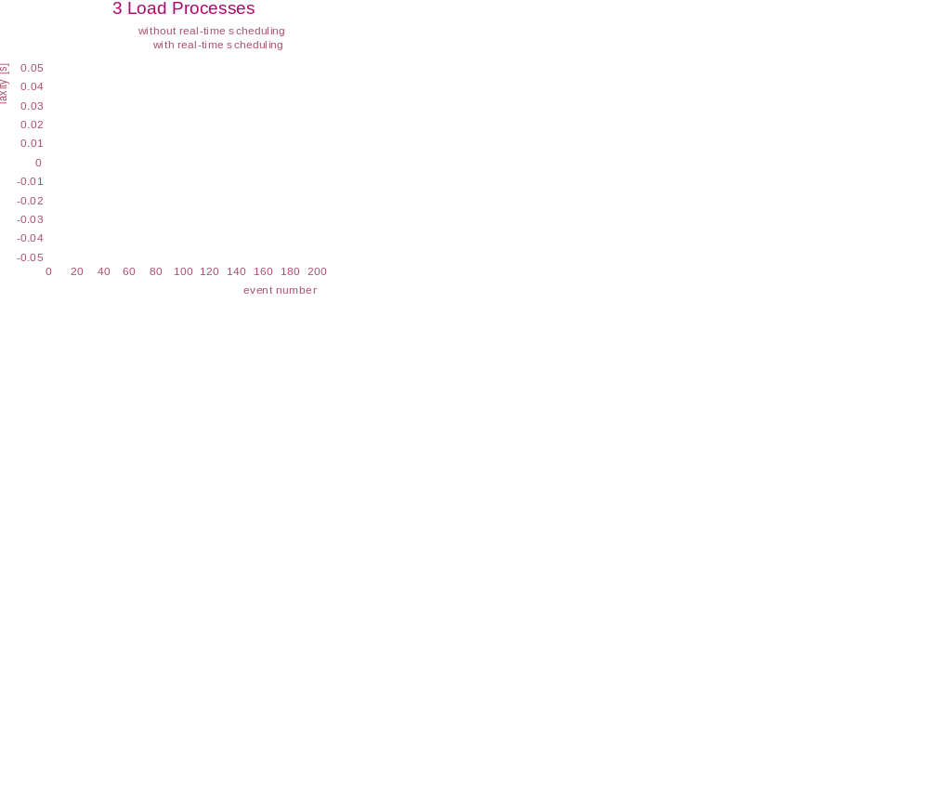
Evaluation of a Real-Time Scheduling
3 load processes
(competing with the video playback)
the real-time scheduler reaches all its deadlines
laxity (remaining time to deadline)
several deadline
violations by the
non-real-time
scheduler
task number

Slide 50
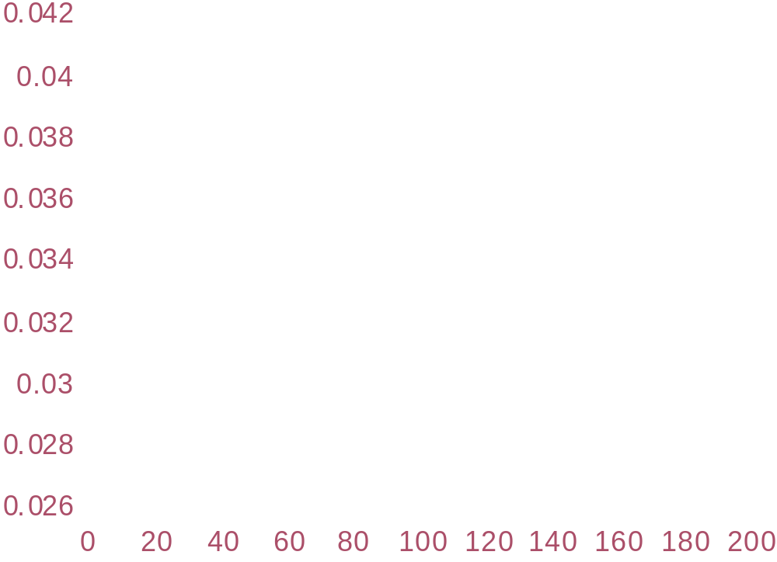
Evaluation of a Real-Time Scheduling
Varied the number of load processes
(competing with the video playback)
Only video process
4 other
processes
laxity (remaining time to deadline)
16 other processes
NB! The EDF scheduler kept its deadlines
task number

Slide 51
Evaluation of a Real-Time Scheduling
Tests again performed
  by IBM (1993)
  on an 57 MHz, 32 MB RAM, AIX Power 1
“Stupid” end system program:
  3 real-time processes only requesting CPU cycles
  each process requires 15 timeslots of 21 ms each per second
  → 31.5 % of the CPU time each
  → 94.5 % of the CPU time required for real-time tasks

Slide 52
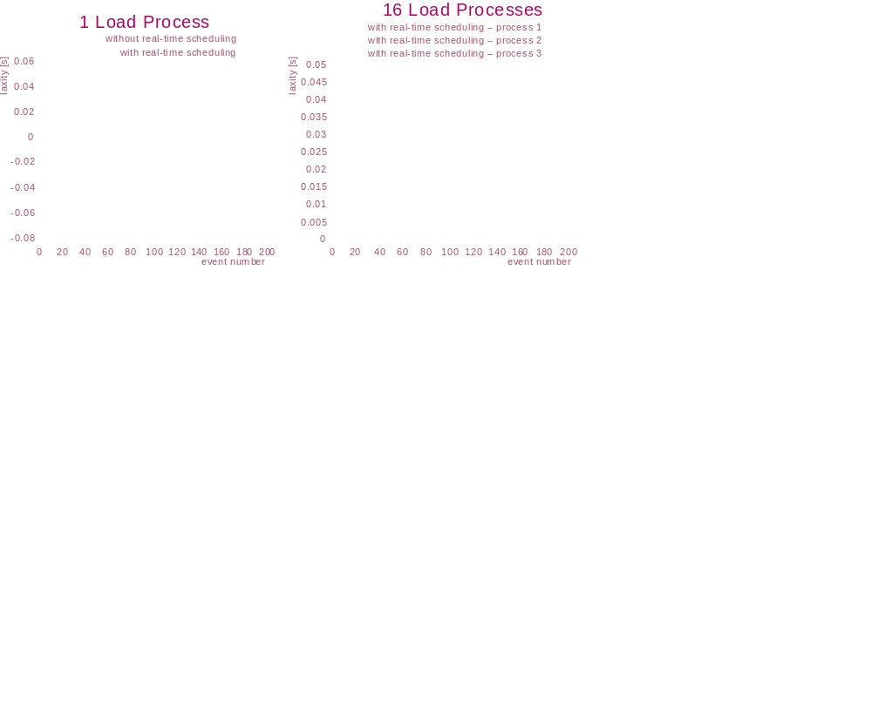
Evaluation of a Real-Time Scheduling
1 load process
(competing with the
real-time processes)
the real-time scheduler reaches all its deadlines
laxity (remaining time to deadline)
task number

Slide 53
Evaluation of a Real-Time Scheduling
16 load processes
(competing with the real-time processes)
process 1
Regardless of
other load, the
EDF-scheduler reach
its deadlines
(laxity almost equal
as in 1 load process
scenario)
laxity (remaining time to deadline)
process 2
NOTE: Processes are
scheduled in same
order
process 3
task number

Slide 54



Multicore
So far, one single core…
… multiple cores/CPUs
  1 single queue
    potential bottleneck?
    locking/contention on the single queue
  Multiple queues
    potential bottleneck?
    load balancing
  Load balancing
    Linux checks every 200 ms
    But where to place a new process?
    And where to wake up a blocked process?

Slide 55
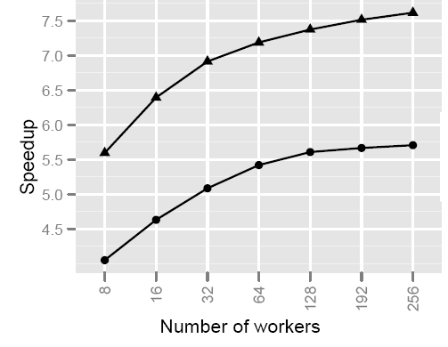
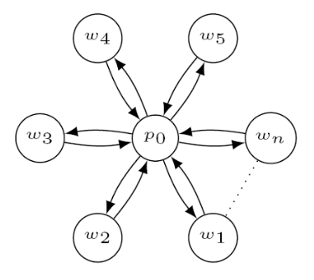
Multicore: Work Stealing
Scheduling mechanism in the Intel Tread Building Block (TBB) framework
LIFO queues (insert and remove from beginning of queues)
One master CPU
  new processes are placed here
  awaken processes are placed here
If own queue is empty, STEAL:
  select random CPU_{x}
  if CPU_{x} queue not empty
    steal from the back of the queue
    place first in own queue
Importance of process placement?
  change CPU of where wake up a process
  scatter-gather workload
  (100 μs work per thread, 12500 iterations,
  8 over 1 CPU speedup)
⇨ 300.000 more steal attempts per second

Slide 56
Future Chips: Intel’s Single-chip Cloud Computer (SCC)
What does introduction of such processors mean in terms of scheduling?
memory controller
memory controller
memory controller
memory controller
P54C core
L2 cache
L1 cache
mesh interface unit
router
P54C core
L2 cache
L1 cache
message passing buffer

Slide 57
Summary
Resources need to be properly scheduled
CPU is an important resource
Many ways to schedule depending on workload
Hierarchical, multi-queue priority schedulers have existed a long time already, and newer ones usually try to improve upon this idea
Next week, memory and persistent storage

Slide 58
Some References
AMD, http://multicore.amd.com/en/Products
C-COR, http://www.c-cor.com
Haskin, R.L: “Tiger Shark--A scalable file system for multimedia”, IBM Journal of Research and Development, Vol. 42, No. 2, 1997, p. 185
IBM: http://www-306.ibm.com/software/data/videocharger/
Intel, http://www.intel.com
MPEG.org, http://www.mpeg.org/MPEG/DVD
nCUBE, http://ncube.com (not available after Jan. 2005)
Sitaram, D., Dan, A.: “Multimedia Servers – Applications, Environments, and Design”, Morgan Kaufmann Publishers, 2000
Tendler, J.M., Dodson, S., Fields, S.: “IBM e-server: POWER 4 System Microarchitecture”, Technical white paper, 2001
Tetzlaff, W., Flynn, R.: “Elements of Scalable Video Servers”, IBM Research Report 19871 (87884), 1994

