Slide 1
INF5062 – GPU & CUDA
Håkon Kvale Stensland
Simula Research Laboratory

Slide 2
PC Graphics Timeline
Challenges:
  Render infinitely complex scenes
  And extremely high resolution
  In 1/60th of one second (60 frames per second)
Graphics hardware has evolved from a simple hardwired pipeline to a highly programmable multiword processor
DirectX 6
DirectX 7
DirectX 8
DirectX 9
DirectX 9.0c
DirectX 9.0c
DirectX 10
DirectX 5
Multitexturing
T&L TextureStageState
SM 1.x
SM 2.0
SM 3.0
SM 3.0
SM 4.0
Riva 128
Riva TNT
GeForce 256
GeForce 3
Cg
GeForceFX
GeForce 6
GeForce 7
GeForce 8
1998
1999
2000
2001
2002
2003
2004
2005
2006
INF5062, Håkon Kvale Stensland
Notes:
Spill driver markedet

Slide 3
(Some) 3D Buzzwords!!
GPU: Graphics Processing Unit: A graphics chip with integrated programmable geometry and pixel processing
Fill Rate: How fast the GPU can generate pixels, often a strong predictor for application frame rate
Shader: A set of software instructions, which is used by the graphic resources primarily to perform rendering effects.
API: Application Programming Interface – The standardized layer of software that allows applications (like games) to talk to other software or hardware to get services or functionality from them – such as allowing a game to talk to a graphics processor
DirectX: Microsoft’s API for media functionality
Direct3D: Portion of the DirectX API suite that handles the interface to graphics processors
OpenGL: An open standard API for graphics functionality. Available across platforms. Popular with workstation applications
INF5062, Håkon Kvale Stensland
Notes:
Important to be ”Buzzword-capatible”!!

Slide 4
Basic 3D Graphics Pipeline
Application
Host
Scene Management
Geometry
Rasterization
Frame
Buffer
Memory
GPU
Pixel Processing
ROP/FBI/Display
INF5062, Håkon Kvale Stensland
Notes:
Geometry = Setter opp vertexer (kanter i triangler), og lager triangler
Rasterization = Finne ut hvilke pixler som hører hjemme i trianglet
Pixel = Manipulere, gjøre effekter med pixler
ROP = Render Out Put = Siste ”touch” på triangler, eller på AA, osv. Finner også ut om vi trenger pixlen (er den synlig (Hidden Surface Removal))

Slide 5
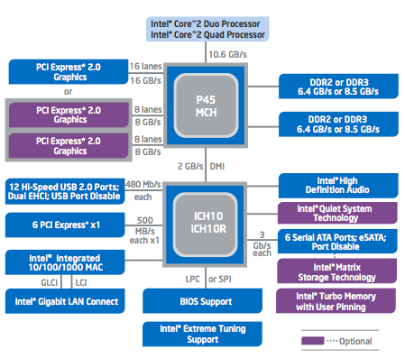
Graphics in the PC Architecture
FSB connection between processor and Northbridge (P45)
  Memory Control Hub
Northbridge handles PCI Express 2.0 to GPU and DRAM.
  PCIe 2 x16 bandwidth at 16 GB/s (8 GB in each direction)
Southbridge (ICH10) handles all other peripherals
INF5062, Håkon Kvale Stensland
Notes:
PCI Express = Seriel bus, flere kanaler…. 0,5 GB/sec hver vei
Mer strøm!
Snart PCI Express 3.0

Slide 6
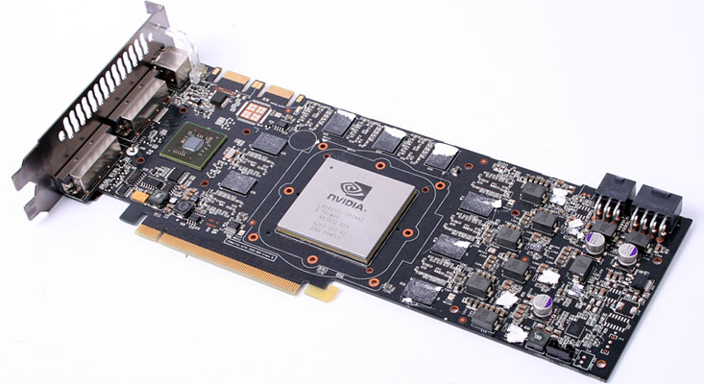
High-end Hardware
nVidia GeForce GTX 280
Based on the latest generation GPU, codenamed GT200
1400 million transistors
240 Processing cores (SP) at 1296MHz
1024 MB Memory with 141.7GB/sec of bandwidth.
933 GFLOPS of computing power
INF5062, Håkon Kvale Stensland
Notes:
65nm største hos TSMC
Bruker mye strøm. 2 kontakter i tillegg til PCI Express
Ikke mye i idle….
Støtte for SLI, per nå opp til 3 grafikkort

Slide 7
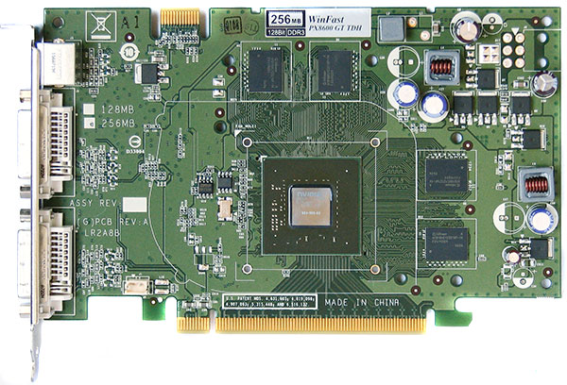
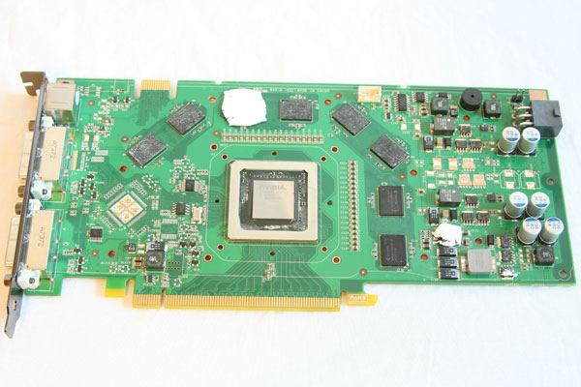
Lab Hardware
nVidia GeForce 8600GT
Based on the G84 chip
  289 million transistors
  32 Processing cores (SP) at 1190MHz
  512/256 MB Memory with 22.4GB/sec bandwidth
nVidia GeForce 8800GT
Based on the G92 chip
  754 million transistors
  112 Processing cores (SP) at 1500MHz
  256 MB Memory with 57.6GB/sec bandwidth
INF5062, Håkon Kvale Stensland
Notes:
Begge er Compute 1.1

Slide 8
GeForce G80 Architecture
Host
Data Assembler
Setup / Rstr / ZCull
Vtx Thread Issue
Geom Thread Issue
Pixel Thread Issue
SP
SP
SP
SP
SP
SP
SP
SP
SP
SP
SP
SP
SP
SP
SP
SP
Thread Processor
TF
L1
TF
L1
TF
L1
TF
L1
TF
L1
TF
L1
TF
L1
TF
L1
L2
L2
L2
L2
L2
L2
FB
FB
FB
FB
FB
FB
INF5062, Håkon Kvale Stensland
Notes:
A ”mile-high” overview

Slide 9
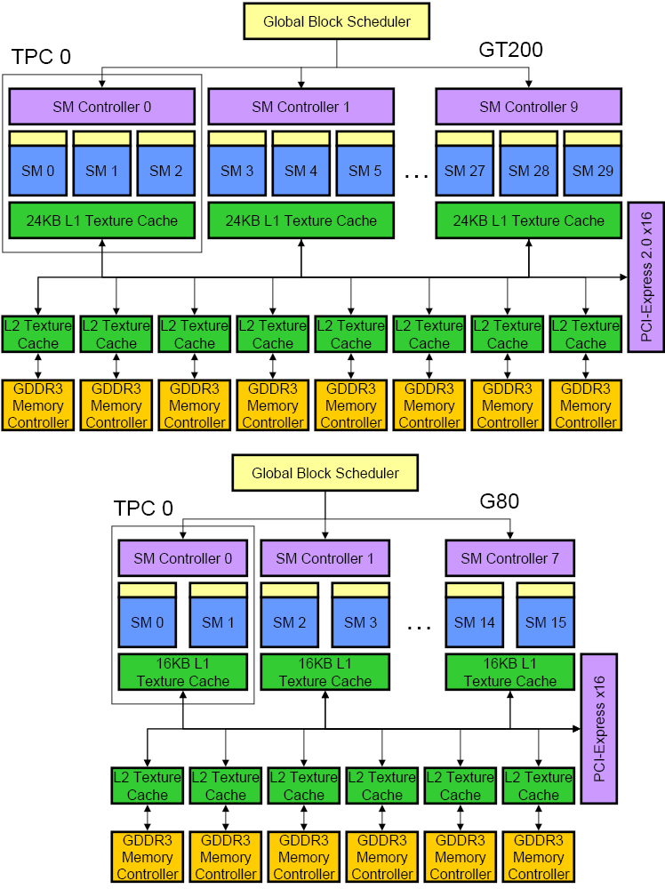
nVIDIA G80 vs. GT92/GT200 Architecture
INF5062, Håkon Kvale Stensland
Notes:
TPC = Texture Processor Cluster
SM = Streaming Multiprocessor
SP = Stream Processor (Oppererer med Scalar-verdier)
SFU = Special Function Unit
TEX = Texturing Unit

Slide 10
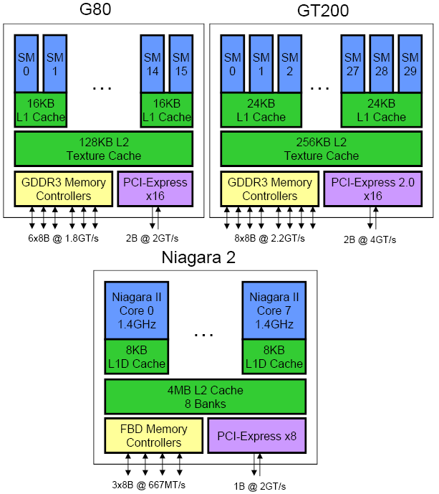
Compared with a multicore RISC-CPU
INF5062, Håkon Kvale Stensland
Notes:
Niagara (UltraSPARC T2) = 8 Threads per Core, 8 cores
NVIDIA har asymetrisk klokke… SHADER CLOCK, GPU CLOCK

Slide 11
TPC… SM… SP… Some more details…
TPC
  Texture Processing Cluster
SM
  Streaming Multiprocessor
  In CUDA: Multiprocessor, and fundamental unit for a thread block
TEX
  Texture Unit
SP
  Stream Processor
  Scalar ALU for single CUDA thread
SFU
  Super Function Unit
TPC
TPC
TPC
TPC
TPC
TPC
TPC
TPC
Texture Processor Cluster
Streaming Multiprocessor
Instruction L1
Data L1
SM
SM
Instruction Fetch/Dispatch
Shared Memory
TEX
SM
SP
SP
SP
SP
SM
SFU
SFU
SP
SP
SP
SP
INF5062, Håkon Kvale Stensland

Slide 12
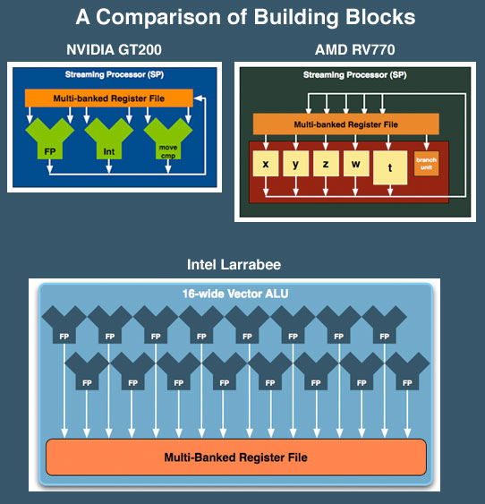
SP: The basic processing block
The nVIDIA Approach:
  A Stream Processor works on a single operation
AMD GPU’s work on up to five operations, and Intel’s Larrabee will work on up to 16
Now, let’s take a step back for a closer look!
INF5062, Håkon Kvale Stensland

Slide 13
Streaming Multiprocessor (SM)
Streaming Multiprocessor (SM)
  8 Streaming Processors (SP)
  2 Super Function Units (SFU)
Multi-threaded instruction dispatch
  1 to 768 threads active
  Try to Cover latency of texture/memory loads
Local register file (RF)
16 KB shared memory
DRAM texture and memory access
Streaming Multiprocessor
(
SM
)
Instruction Fetch
Instruction L
1
Cache
L
1
Fill
Thread
/
Instruction Dispatch
Work
Shared Memory
Control
SP
0
RF
0
RF
4
SP
4
Results
S
SP
1
RF
1
RF
5
SP
5
S
F
F
U
SP
2
RF
2
RF
6
SP
6
U
SP
3
RF
3
RF
7
SP
7
Load Texture
Constant L
1
Cache
L
1
Fill
Load from Memory
Store to
Store to Memory
Foils adapted from nVIDIA
INF5062, Håkon Kvale Stensland

Slide 14
SM Register File
Register File (RF)
  32 KB
  Provides 4 operands/clock
TEX pipe can also read/write Register File
  3 SMs share 1 TEX
Load/Store pipe can also read/write Register File
I
$
L
1
Multithreaded
Instruction Buffer
R
C
$
Shared
F
L
1
Mem
Operand Select
MAD
SFU
INF5062, Håkon Kvale Stensland
Notes:
TEX er mer viktig for grafikk

Slide 15
Constants
Immediate address constants
Indexed address constants
Constants stored in memory, and cached on chip
  L1 cache is per Streaming Multiprocessor
I
$
L
1
Multithreaded
Instruction Buffer
R
C
$
Shared
F
L
1
Mem
Operand Select
MAD
SFU
INF5062, Håkon Kvale Stensland

Slide 16
Shared Memory
Each Stream Multiprocessor has 16KB of Shared Memory
  16 banks of 32bit words
CUDA uses Shared Memory as shared storage visible to all threads in a thread block
  Read and Write access
I
$
L
1
Multithreaded
Instruction Buffer
R
C
$
Shared
F
L
1
Mem
Operand Select
MAD
SFU
INF5062, Håkon Kvale Stensland

Slide 17
Execution Pipes
Scalar MAD pipe
  Float Multiply, Add, etc.
  Integer ops,
  Conversions
  Only one instruction per clock
Scalar SFU pipe
  Special functions like Sin, Cos, Log, etc.
    Only one operation per four clocks
TEX pipe (external to SM, shared by all SM’s in a TPC)
Load/Store pipe
  CUDA has both global and local memory access through Load/Store
I
$
L
1
Multithreaded
Instruction Buffer
R
C
$
Shared
F
L
1
Mem
Operand Select
MAD
SFU
INF5062, Håkon Kvale Stensland
Notes:
FMUL = Floating point multipler, FADD = Floating point add,
Hot clock/shader clock

Slide 18
GPGPU
Foils adapted from nVIDIA

Slide 19

What is really GPGPU?
General Purpose computation using GPU
in other applications than 3D graphics
  GPU can accelerate parts of an application
Parallel data algorithms using the GPUs properties
  Large data arrays, streaming throughput
  Fine-grain SIMD parallelism
  Fast floating point (FP) operations
Applications for GPGPU
  Game effects (physics) nVIDIA PhysX
  Image processing (Photoshop CS4)
  Video Encoding/Transcoding (Elemental RapidHD)
  Distributed processing (Stanford Folding@Home)
  RAID6, AES, MatLab, etc.
INF5062, Håkon Kvale Stensland
Notes:
Mark Harris, of Nvidia, runs the gpgpu.org website

Slide 20
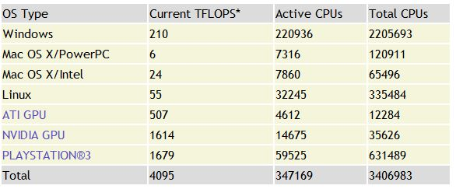
Performance?
Let’s look at Standfords Folding@Home....
Distributed Computing
Folding@Home client is available for CUDA
  Windows
  All CUDA-enabled GPUs
Performance GFLOPS:
  Cell: 28
  nVIDIA GPU: 110
  ATI GPU: 109
INF5062, Håkon Kvale Stensland

Slide 21
Previous GPGPU use, and limitations
Working with a Graphics API
  Special cases with an API like Microsoft Direct3D or OpenGL
Addressing modes
  Limited by texture size
Shader capabilities
  Limited outputs of the available shader programs
Instruction sets
  No integer or bit operations
Communication is limited
  Between pixels
per thread
per Shader
per Context
Input Registers
Fragment Program
Texture
Constants
Temp Registers
Output Registers
FB Memory
INF5062, Håkon Kvale Stensland

Slide 22
nVIDIA CUDA
“Compute Unified Device Architecture”
General purpose programming model
  User starts several batches of threads on a GPU
  GPU is in this case a dedicated super-threaded, massively data parallel co-processor
Software Stack
  Graphics driver, language compilers (Toolkit), and tools (SDK)
Graphics driver loads programs into GPU
  All drivers from nVIDIA now support CUDA.
  Interface is designed for computing (no graphics ☺)
  “Guaranteed” maximum download & readback speeds
  Explicit GPU memory management
INF5062, Håkon Kvale Stensland

Slide 23
”Extended” C
Integrated source
(foo.cu)
cudacc
EDG C/C++ frontend
Open64 Global Optimizer
GPU Assembly
foo.s
CPU Host Code
foo.cpp
OCG
gcc / cl
G80 SASS
foo.sass
INF5062, Håkon Kvale Stensland
Notes:
TBD: Define SASS = SPA Assembly language.

Slide 24
Outline
The CUDA Programming Model
  Basic concepts and data types
The CUDA Application Programming Interface
  Basic functionality
More advanced CUDA Programming
  24th of October
INF5062, Håkon Kvale Stensland
Notes:
I dag skal skjelettet frem…. Om to uker blir det mer kjøtt på bena

Slide 25
The CUDA Programming Model
The GPU is viewed as a compute device that:
  Is a coprocessor to the CPU, referred to as the host
  Has its own DRAM called device memory
  Runs many threads in parallel
Data-parallel parts of an application are executed on the device as kernels, which run in parallel on many threads
Differences between GPU and CPU threads
  GPU threads are extremely lightweight
    Very little creation overhead
  GPU needs 1000s of threads for full efficiency
    Multi-core CPU needs only a few
INF5062, Håkon Kvale Stensland

Slide 26
Thread Batching: Grids and Blocks
A kernel is executed as a grid of thread blocks
  All threads share data memory space
A thread block is a batch of threads that can cooperate with each other by:
  Synchronizing their execution
    Non synchronous execution is very bad for performance!
  Efficiently sharing data through a low latency shared memory
Two threads from two different blocks cannot cooperate
Host
Device
Grid 1
Kernel 1
Block
(0, 0)
Block
(1, 0)
Block
(2, 0)
Block
(0, 1)
Block
(1, 1)
Block
(2, 1)
Grid 2
Kernel 2
Block (1, 1)
Thread
(0, 0)
Thread
(1, 0)
Thread
(2, 0)
Thread
(3, 0)
Thread
(4, 0)
Thread
(0, 1)
Thread
(1, 1)
Thread
(2, 1)
Thread
(3, 1)
Thread
(4, 1)
Thread
(0, 2)
Thread
(1, 2)
Thread
(2, 2)
Thread
(3, 2)
Thread
(4, 2)
INF5062, Håkon Kvale Stensland
Notes:
1 kernel eksekverer 1 grid…
1 block kjører på 1 SM (Multiprosessor)

Slide 27
Block and Thread IDs
Threads and blocks have IDs
  Each thread can decide what data to work on
  Block ID: 1D or 2D
  Thread ID: 1D, 2D, or 3D
Simplifies memory
addressing when processing multidimensional data
  Image and video processing (e.g. MJPEG…)
Device
Grid 1
Block
(0, 0)
Block
(1, 0)
Block
(2, 0)
Block
(0, 1)
Block
(1, 1)
Block
(2, 1)
Block (1, 1)
Thread
(0, 0)
Thread
(1, 0)
Thread
(2, 0)
Thread
(3, 0)
Thread
(4, 0)
Thread
(0, 1)
Thread
(1, 1)
Thread
(2, 1)
Thread
(3, 1)
Thread
(4, 1)
Thread
(0, 2)
Thread
(1, 2)
Thread
(2, 2)
Thread
(3, 2)
Thread
(4, 2)
INF5062, Håkon Kvale Stensland

Slide 28
CUDA Device Memory Space Overview
Each thread can:
  R/W per-thread registers
  R/W per-thread local memory
  R/W per-block shared memory
  R/W per-grid global memory
  Read only per-grid constant memory
  Read only per-grid texture memory
The host can R/W global, constant, and texture memories
(Device) Grid
Block (0, 0)
Block (1, 0)
Shared Memory
Shared Memory
Registers
Registers
Registers
Registers
Thread (0, 0)
Thread (1, 0)
Thread (0, 0)
Thread (1, 0)
Local
Memory
Local
Memory
Local
Memory
Local
Memory
Host
Global
Memory
Constant
Memory
Texture
Memory
INF5062, Håkon Kvale Stensland
Notes:
Global, constant, and texture memory spaces are persistent across kernels called by the same application.

Slide 29
Global, Constant, and Texture Memories
Global memory:
  Main means of communicating R/W Data between host and device
  Contents visible to all threads
Texture and Constant Memories:
  Constants initialized by host
  Contents visible to all threads
(Device) Grid
Block (0, 0)
Block (1, 0)
Shared Memory
Shared Memory
Registers
Registers
Registers
Registers
Thread (0, 0)
Thread (1, 0)
Thread (0, 0)
Thread (1, 0)
Local
Memory
Local
Memory
Local
Memory
Local
Memory
Host
Global
Memory
Constant
Memory
Texture
Memory
INF5062, Håkon Kvale Stensland

Slide 30
Terminology Recap
device = GPU = Set of multiprocessors
Multiprocessor = Set of processors & shared memory
Kernel = Program running on the GPU
Grid = Array of thread blocks that execute a kernel
Thread block = Group of SIMD threads that execute a kernel and can communicate via shared memory
Memory | Location | Cached | Access | Who
Local | Off-chip | No | Read/write | One thread
Shared | On-chip | N/A - resident | Read/write | All threads in a block
Global | Off-chip | No | Read/write | All threads + host
Constant | Off-chip | Yes | Read | All threads + host
Texture | Off-chip | Yes | Read | All threads + host
INF5062, Håkon Kvale Stensland

Slide 31
Access Times
Register – Dedicated HW – Single cycle
Shared Memory – Dedicated HW – Single cycle
Local Memory – DRAM, no cache – “Slow”
Global Memory – DRAM, no cache – “Slow”
Constant Memory – DRAM, cached, 1…10s…100s of cycles, depending on cache locality
Texture Memory – DRAM, cached, 1…10s…100s of cycles, depending on cache locality
INF5062, Håkon Kvale Stensland

Slide 32
CUDA – API

Slide 33
CUDA Highlights
The API is an extension to the ANSI C programming language
Low learning curve than OpenGL/Direct3D
The hardware is designed to enable lightweight runtime and driver
High performance
INF5062, Håkon Kvale Stensland

Slide 34
CUDA Device Memory Allocation
cudaMalloc()
  Allocates object in the device Global Memory
  Requires two parameters
    Address of a pointer to the allocated object
    Size of allocated object
cudaFree()
  Frees object from device Global Memory
    Pointer to the object
(Device) Grid
Block (0, 0)
Block (1, 0)
Shared Memory
Shared Memory
Registers
Registers
Registers
Registers
Thread (0, 0)
Thread (1, 0)
Thread (0, 0)
Thread (1, 0)
Local
Memory
Local
Memory
Local
Memory
Local
Memory
Host
Global
Memory
Constant
Memory
Texture
Memory
INF5062, Håkon Kvale Stensland

Slide 35
CUDA Device Memory Allocation
Code example:
  Allocate a 64 * 64 single precision float array
  Attach the allocated storage to Md.elements
  “d” is often used to indicate a device data structure
BLOCK_SIZE = 64;
Matrix Md
int size = BLOCK_SIZE * BLOCK_SIZE * sizeof(float);
cudaMalloc((void**)&Md.elements, size);
cudaFree(Md.elements);
INF5062, Håkon Kvale Stensland

Slide 36
CUDA Host-Device Data Transfer
cudaMemcpy()
  memory data transfer
  Requires four parameters
    Pointer to source
    Pointer to destination
    Number of bytes copied
    Type of transfer
      Host to Host
      Host to Device
      Device to Host
      Device to Device
Asynchronous in CUDA 1.3
(Device) Grid
Block (0, 0)
Block (1, 0)
Shared Memory
Shared Memory
Registers
Registers
Registers
Registers
Thread (0, 0)
Thread (1, 0)
Thread (0, 0)
Thread (1, 0)
Local
Memory
Local
Memory
Local
Memory
Local
Memory
Host
Global
Memory
Constant
Memory
Texture
Memory
INF5062, Håkon Kvale Stensland

Slide 37
Memory Management
Device memory allocation
  cudaMalloc(), cudaFree()
Memory copy from host to device, device to host, device to device
  cudaMemcpy(), cudaMemcpy2D(), cudaMemcpyToSymbol(), cudaMemcpyFromSymbol()
Memory addressing
  cudaGetSymbolAddress()
INF5062, Håkon Kvale Stensland
Notes:
cudaMemcpy2D() copies a rectangular piece of memory from one memory area to another. Both areas may not overlap.
cudaMemcpyToSymbol() copies bytes from the memory area pointed to by a host pointer to the memory area pointed to by a device variable.
cudaMemcpyFromSymbol() copies bytes from the memory area pointed to by a device variable to the memory area pointed to by a host pointer.
cudaGetSymbolAddress() returns the address of a device variable.

Slide 38
CUDA Host-Device Data Transfer
Code example:
  Transfer a 64 * 64 single precision float array
  M is in host memory and Md is in device memory
  cudaMemcpyHostToDevice and cudaMemcpyDeviceToHost are symbolic constants
cudaMemcpy(Md.elements, M.elements, size, cudaMemcpyHostToDevice);
cudaMemcpy(M.elements, Md.elements, size, cudaMemcpyDeviceToHost);
INF5062, Håkon Kvale Stensland

Slide 39
CUDA Function Declarations
 | Executed on the: | Only callable from the:
__device__ float DeviceFunc() | device | device
__global__ void KernelFunc() | device | host
__host__ float HostFunc() | host | host
__global__ defines a kernel function
  Must return void
__device__ and __host__ can be used together
INF5062, Håkon Kvale Stensland

Slide 40
CUDA Function Declarations
__device__ functions cannot have their address taken
Limitations for functions executed on the device:
  No recursion
  No static variable declarations inside the function
  No variable number of arguments
INF5062, Håkon Kvale Stensland

Slide 41
Calling a Kernel Function
A kernel function must be called with an execution configuration:
__global__ void KernelFunc(...);
dim3 DimGrid(100, 50); // 5000 thread blocks
dim3 DimBlock(4, 8, 8); // 256 threads per block
size_t SharedMemBytes = 64; // 64 bytes of shared memory
KernelFunc <<< DimGrid, DimBlock, SharedMemBytes >>>(...);
Any call to a kernel function is asynchronous from CUDA 1.0 on, explicit synch needed for blocking
INF5062, Håkon Kvale Stensland

Slide 42
Some Information on Toolkit

Slide 43
Compilation
Any source file containing CUDA language extensions must be compiled with nvcc
nvcc is a compiler driver
  Works by invoking all the necessary tools and compilers like cudacc, g++, etc.
nvcc can output:
  Either C code
    That must then be compiled with the rest of the application using another tool
  Or object code directly
INF5062, Håkon Kvale Stensland

Slide 44
Linking
Any executable with CUDA code requires two dynamic libraries:
  The CUDA runtime library (cudart)
  The CUDA core library (cuda)
INF5062, Håkon Kvale Stensland

Slide 45
Debugging Using Device Emulation
An executable compiled in device emulation mode (nvcc -deviceemu) runs completely on the host using the CUDA runtime
  No need of any device and CUDA driver
  Each device thread is emulated with a host thread
When running in device emulation mode, one can:
  Use host native debug support (breakpoints, inspection, etc.)
  Access any device-specific data from host code and vice-versa
  Call any host function from device code (e.g. printf) and vice-versa
  Detect deadlock situations caused by improper usage of __syncthreads
INF5062, Håkon Kvale Stensland

Slide 46
Lab Setup
frogner.ndlab.net
  GeForce 8600GT 256MB (G84)
  4 Multiprocessors, 32 Cores
majorstuen.ndlab.net
  GeForce 8600GT 512MB (G84)
  4 Multiprocessors, 32 Cores
uranienborg.ndlab.net
  GeForce 8600GT 512MB (G84)
  4 Multiprocessors, 32 Cores
montebello.ndlab.net
  GeForce 8800GT 256MB (G92)
  14 Multiprocessors, 112 Cores
INF5062, Håkon Kvale Stensland

Slide 47
Before you start…
Four lines have to be added to your group users .bash_profile file
  PATH=$PATH:/usr/local/cuda/bin
  LD_LIBRARY_PATH=$LD_LIBRARY_PATH:/usr/local/cuda/lib
  export PATH
  export LD_LIBRARY_PATH
When you use a machine, remember to update the message of the day! (etc/motd)
INF5062, Håkon Kvale Stensland

Slide 48
Compile and test SDK
SDK is downloaded in the /opt/ folder
Copy and build in your users home directory
Test machines uses Fedora Core 9, with gcc 4.3, SDK is for Fedora Core 8, and some fixing is needed to compile…
  Add the following #include in these files:
  common/src/paramgl.cpp: <cstring>
  projects/cppIntegration/main.cpp: <cstdlib>
  common/inc/exception.h: <cstdlib>
  common/inc/cutil.h: <cstring>
  common/inc/cmd_arg_reader.h: <typeinfo>
INF5062, Håkon Kvale Stensland

Slide 49
Some usefull resources
nVIDIA CUDA Programming Guide 2.0
http://developer.download.nvidia.com/compute/cuda/2_0/docs/NVIDIA_CUDA_Programming_Guide_2.0.pdf
nVIDIA CUDA Refference Manual 2.0
http://developer.download.nvidia.com/compute/cuda/2_0/docs/CudaReferenceManual_2.0.pdf
nVISION08: Getting Started with CUDA
http://www.nvidia.com/content/cudazone/download/Getting_Started_w_CUDA_Training_NVISION08.pdf
INF5062, Håkon Kvale Stensland

