Slide 1
Context-aware communication
Moquan Chen & Stian Kilaas

Slide 2
Introduction
Context-aware communication: the way a user is contacted depends on his/her context
This article examines projects and gives them points on a context-aware vs. autonomous actions graph
Notes:
2)
A device must not only be able to deduce the context, but also know what to do with it.

Slide 3
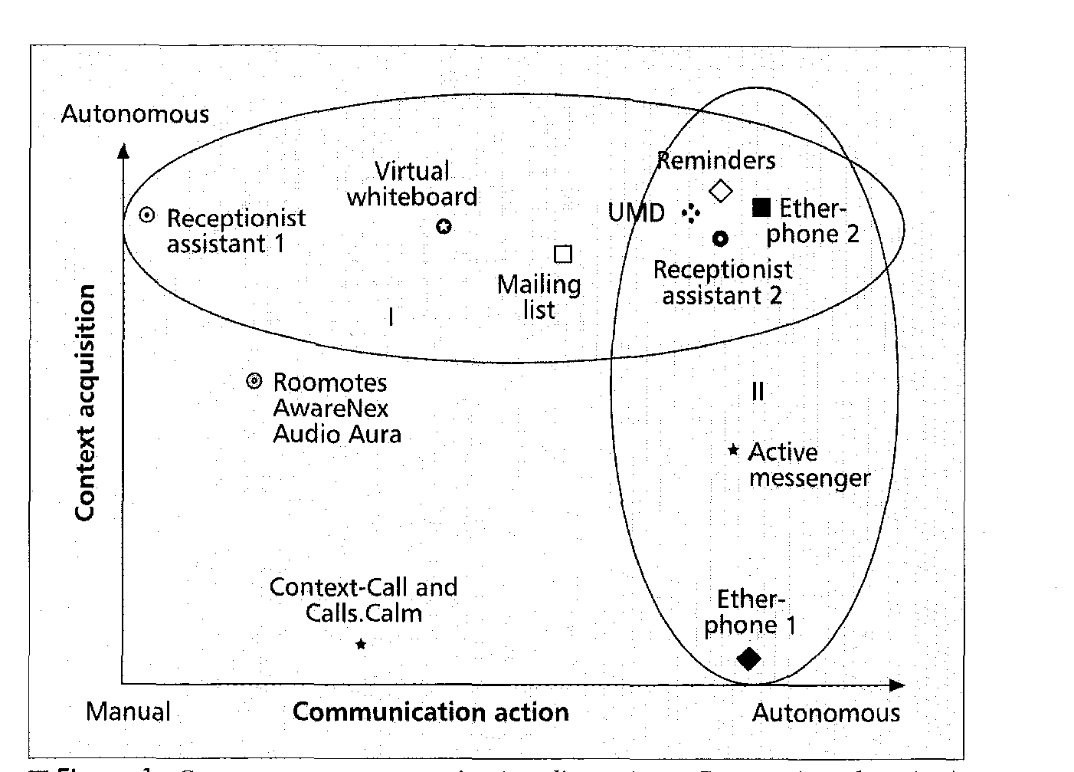
Early projects
Good at deducing location through IR sensors, but requires manual actions
Good at autonomous actions, and good at deducing context. But actions had to be pre-scripted.
Good at autonomous actions, but users had to manually input their location
Notes:
Etherphone 1: Very autonomous. Users entered their location, and the device forwarded calls and messages to that location.
Receptionist assistant 1: Used IR sensors and badges to find out where people were, but only presented it to a receptionist who decided what to do.
Receptionist assistant 2: Used same technology, but rang the nearest phone to the user. Each user had his own ringtone.
Other projects include MIT’s AM which scans your calendar and messages and prioritises the messages based on your location, deduced from where you last checked your messages.
Dynamic mailinglists: you could send a message to everyone in a room, eg.

Slide 4
Conclusions
A context-aware communication device should:
  Improve relevance
  Minimize disruption
  Reduce overload
  Select channels
Notes:
Improve relevance: only accept business calls during work hours
Do not receive calls during a movie
MIT AM prioritize messages depending on your context

Slide 5
Conclusions
Challenges:
  Sensor precision
  Autonomous action
Notes:
Sensor precision: what is recieved from the sensors may not reflect what is actually happening. A GPS may give wrong data.
Social impact: removes common sense as it would become much easier to contact someone

Slide 6
iAide
Moquan Chen & Stian Kilaas

Slide 7
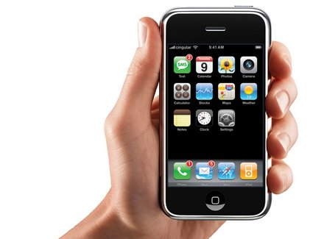
Introduction
It’s mobile
It gives you a lot of info
But you have to filter by context yourself
You shouldn’t have to do that!
Notes:
A mobile communication device such as an iPhone is mobile and gives you a lot of information.
But you still have to manually filter through all the info to get to what’s relevant to your context. Why should you have to do that when you have a very sophisticated device with you?

Slide 8
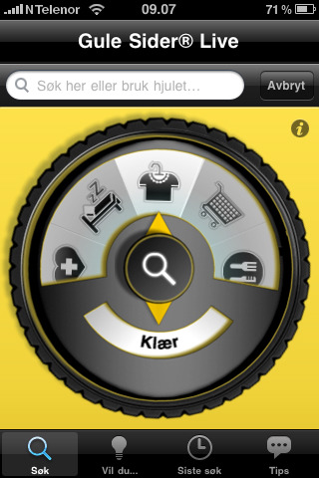
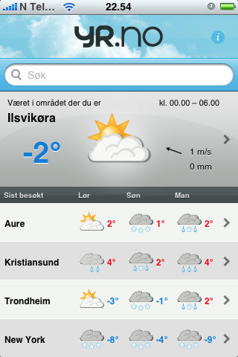
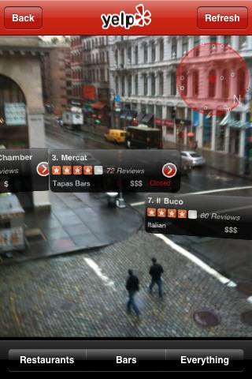
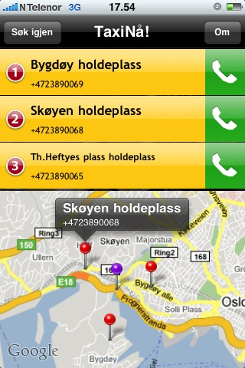

Existing solutions
Is location-aware enough?
Notes:
There are quite a few applications for the iPhone that takes context into consideration.
For example GulesiderLive, Yr.no, Yelp and TaxiNå. But they have one thing in common → They only consider the user’s location.
So is a location-aware device enough to be considered context-aware?
Or more importantly, is the user’s location enough input for the application be able to filter out all irrelevant info, or does it need more input to become even more context-aware?

Slide 9
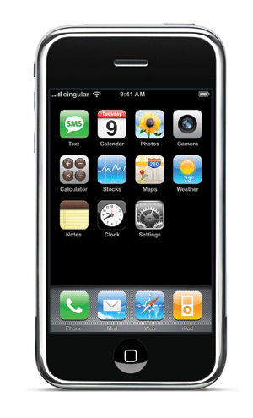

Understanding Users
User group: us
I am context aware!
GPS
Where am I?
Calendar
What info do I want?
What’s going on?
How would I get that info?
Clock
What time is it?
Contact list & social networks
Any friends here?
Notes:
So we began by defining ourselves as the user group, since we both owned iphones and ipod touches.
[CLICK]
We asked ourselves, given a specific situation/context, what kind of information would we be interested in?
And 2; how would we find that information?
And 3; how can a device deduce the context it is in?

Slide 10


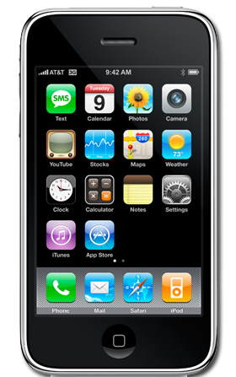
Pre-prototype
Today
Without iAide

Slide 11
Pre-prototype
Future
With iAide

Slide 12
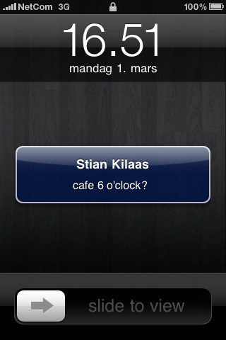
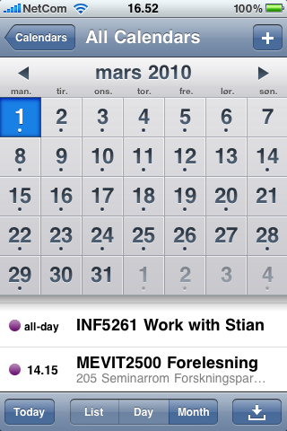
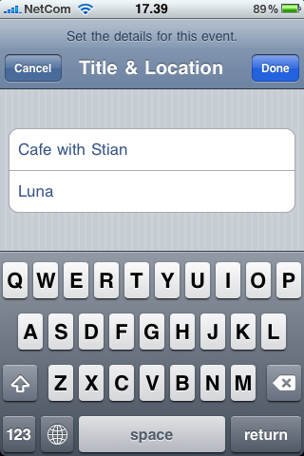
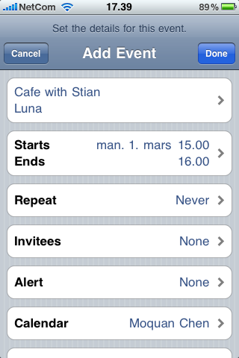
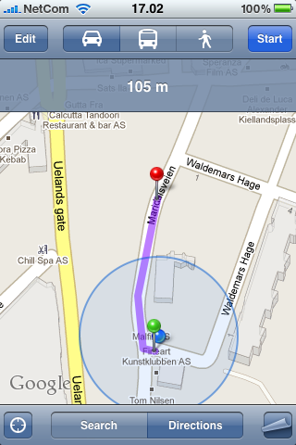

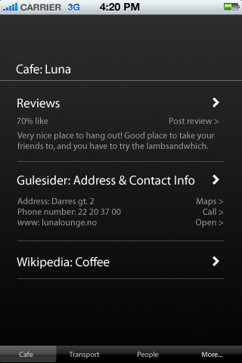
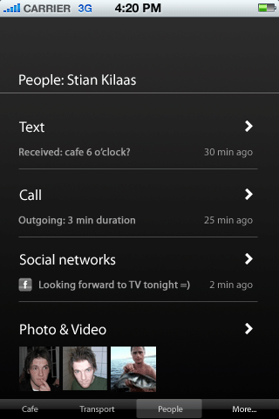
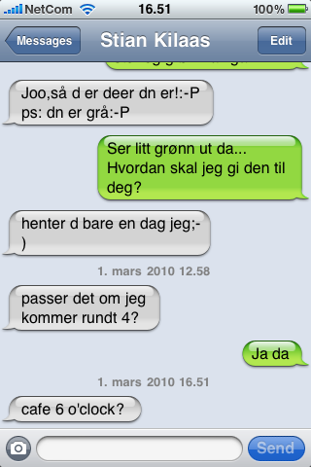
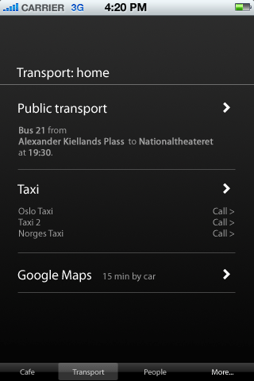



Prototype

Slide 13
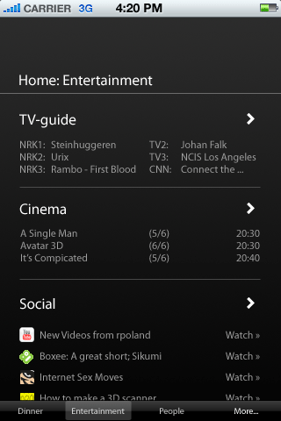
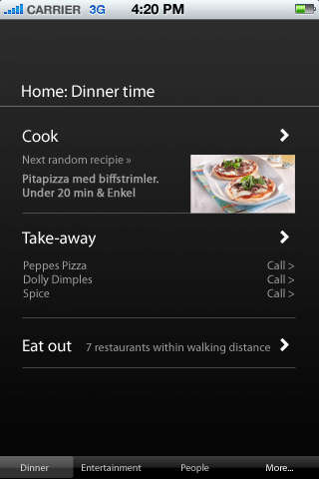
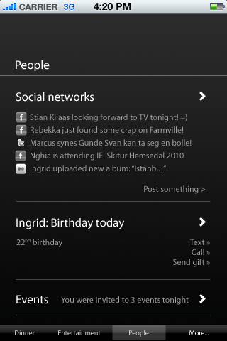
Prototype

Slide 14
Evaluation
To come...

Slide 15
Next iteration
Expand user-group to other iPhone users
Make higher fidelity prototype

Slide 16
Goals
How do users find contextually relevant info today?
How can this be automated in the future?
(make iPhone app)
Notes:
Through understanding users we would like to know how they find contextually relevant info today on their mobile devices.
And through our prototyping and evaluation we would like to investigate how this can be automated in the future.

