Slide 1

INF 5261 - Development of mobile systems and services
1. September 2015
Department of Informatics, University of Oslo
johe@ifi.uio.no

Slide 2
Today
Establish groups and projects
About the wonder document; delivery tomorrow
Curriculum - continue
Guests
Planning – dates groups and articles
Feathery

Slide 3
Wonder document
It is meant to be a project brief (1-2 pages), where you present:
  project of choice with title
  your group members
  why have you chosen that particular project,
  what you plan to examine (some initial research questions)
  how you plan to do that (methods)
These are stepping stones to guide your ideas and project work forward
Send ifi user name and title of project to hanim, and upload your wonder document

Slide 4
Syllabus
http://www.uio.no/studier/emner/matnat/ifi/INF5261/h15/pensumliste/index.html
Overview

Slide 5
Guests
John Olav Olsen;
  Now: PayEx
  Designaspekter for mobile IKT systemer, en studie av mobile medarbeidere og bruk av håndholdte personlige datamaskiner, Cand. Scient thesis, University of Oslo, November 1998.
Stein Erik Skotkjerra
  Vision to Access
  Universal Design
Ola Norbryhn
  Mobile developer at NRK
Other invitations?

Slide 6
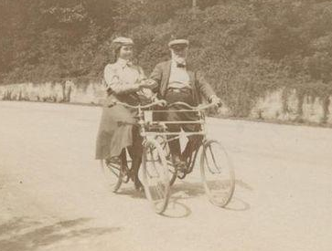
Feathery – activities on the move
“Next to a leisurely walk I enjoy a spin on my tandem bicycle. It is splendid to feel the wind blowing in my face and the springy motion of my iron steed. The rapid rush through the air gives me a delicious sense of strength and buoyancy, and the exercise makes my pulse dance and my heart sing.” Helen Keller, My Life

Slide 7
Next week
Projects
Planning

