Slide 1






Magda
Tom
Natalia
Georg
Sandra
Notes:
*international team

Slide 2
Content
Introduction
The current app
Theoretical background
Expert interviews
Framework & implications
Limitations & further research

Slide 3






Introduction - Problem
Time intensive
New person or without social network
Topics for the project
Size of the team
Roles inside the team
Knowledge distribution
Notes:
If you want to create a group for a project you have to consider the following problems:
*
*
*
*
*
*

Slide 4


Introduction - The idea
An app which is supporting the group forming procedure in an educational environment.

Slide 5

Introduction – Research questions
What group forming strategies are currently used in an educational environment?
Is there any existing technology, which is in use related to group formation in class?
How should be a prototype designed in order to assist the group forming procedure?

Slide 6
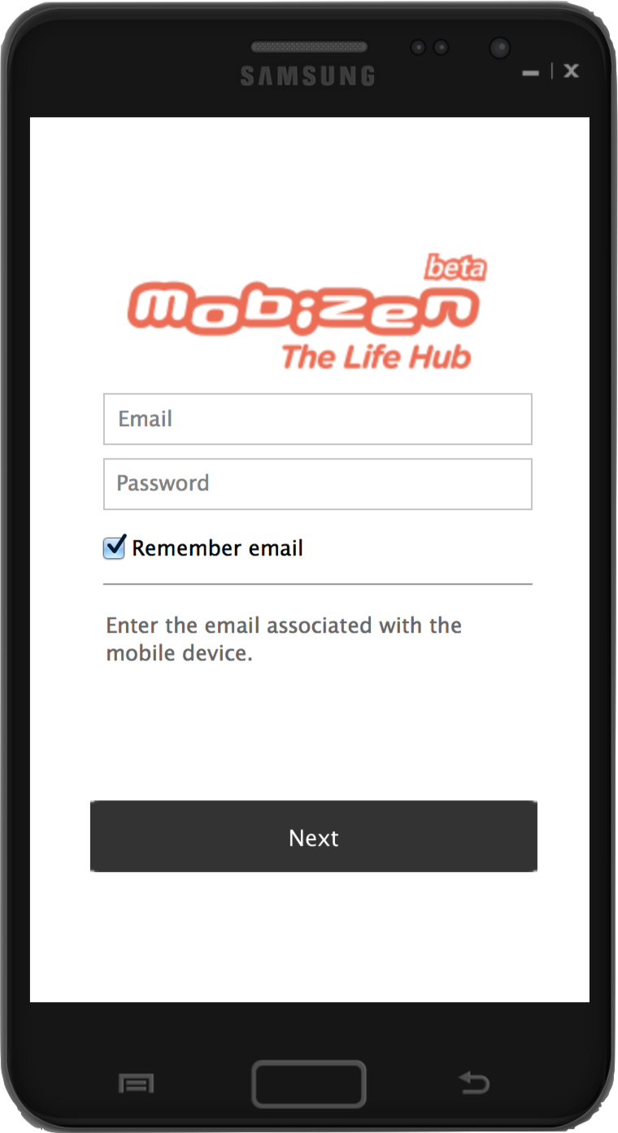
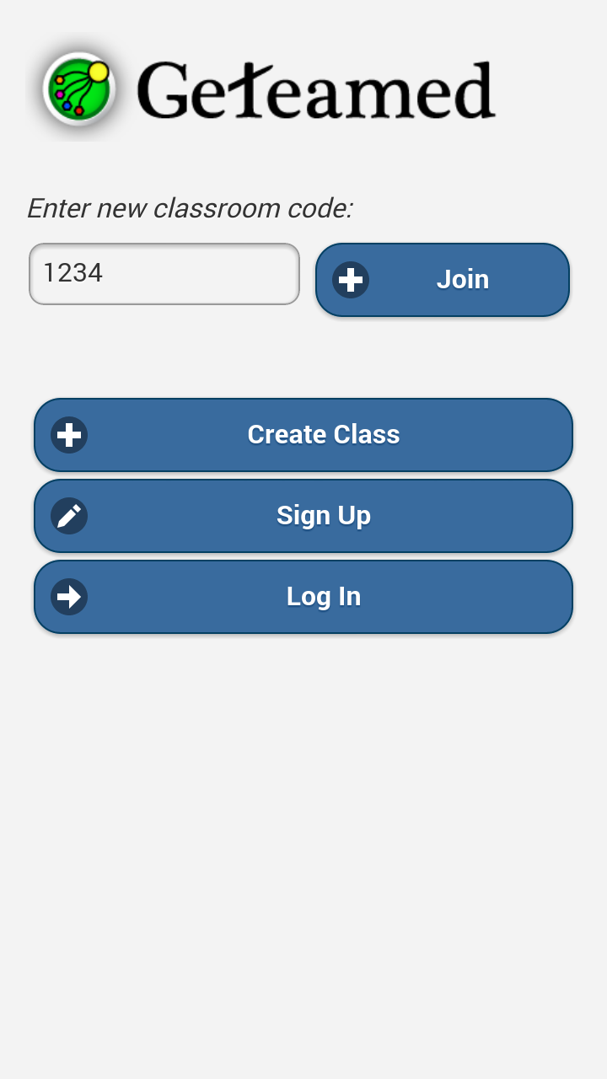
The current app
The prototype works on Android, iOS, Windows Phone & web
Designed for mobile devices
Developed in Appery.io Cloud Service
Applies some universal design patterns

Slide 7
Theoretical background –
Mobile concepts & context
Kakihara & Sørensen, 2001: Expanding the Mobility Concept
  spatial - virtual classroom
  temporal - shift from the linear time slot paradigm
  contextual - how/under what circumstances. Ephemeral announcement from instructor becomes temporal message for the students
Agre, 2001: Changing Places: Contents of Awareness in Computing
  uncouples institutions and architectures
Luff & Heath, 1998: Mobility in Collaboration
  3 notions of mobility encompass synchronicity and asynchronicity
  Attention to the practical concerns of the human actors, how they interact with the artifacts and each other.
Notes:
Kakihara and Sørensen transcend the traditional notion of mobility that implies independence from geographical constraints, and link it with interaction with others. They suggest that mobility should be examined under three dimensions.
spatial refers to the conventional sense of mobility and applies to both physical, symbolic objects and space itself.
when it comes to temporal mobility, the authors differentiate between monochronicity and polychronicity. In the latter case, allocation of time slots to specific activities is no longer necessary - people can work on multiple tasks simultaneously
contextual mobility answers questions such as how and under what circumstances regarding human interactions. It is further categorized to obtrusive/unobtrusive and ephemeral/temporal. The application could allow for temporal contextual mobility.
The article “Changing Places: Contexts of awareness in computing” breaks down the traditional mapping between institutions and places. The author distinguishes between architectures, practices and institutions. The architecture provides structure and constraints for the interaction, the practices are embodied routines and institutions encompass structures roles and rules. Institutions and architectures have been closely coupled, imposing strict mappings between activities and places, but mobile applications tend to resolve these couplings. In our case students will be able to join from home.
Mobility in Collaboration examines ways in which mobility is critical in collaborative work. The authors recognize aspects of mobility: micro mobility, remote mobility, and remote and local mobility. In all cases different actors require different levels of access, and may work synchronously or asynchronously.

Slide 8
Theoretical background –
Mobile concepts & context
Tamminen et al., 2004 define 5 characteristics of mobile contexts
  situational acts within planned ones : not being able to join a group because the position is filled
  claiming personal and group spaces:
    user profile
    group page
    class page
  social solutions to problems in navigation: exchange student scenario
  temporal tensions : acceleration, normal proceeding, slowing down, stopping.
  Multitasking
Notes:
multitasking occurs mostly while waiting, interactions with other students, everyday distractions.

Slide 9
Theoretical background –
Group forming strategies
real life practice : ad hoc
Gross Davis (1999), Hilton & Phillips (2010) + Interviews
  Social formation strategy: no intervention from instructor, students join themselves.
  Requirements based algorithm: stratified random assignment. The students categorize themselves on predefined strata/roles. Yields balanced groups.
  Coordinator based formation strategy: Drag & Drop, Random assignment to groups.

Slide 10
Expert interviews
Strategies:
  Creation themselves by lecture, balance allocation of skills
  Lecturers support self-reliant creation
Group work support self-reliant creation
  Projects, discussion, …
3 – 5 persons per group
Absence of students is frustrating
Need short time to some hours for creation

Slide 11
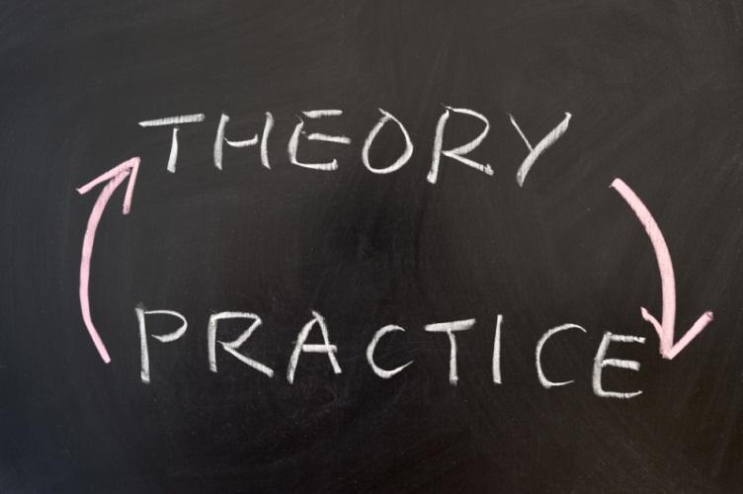
Framework & implications
Mobility maintenance
Context transfer
Group forming flexibility and support
Notes:
summary of theories + UD

Slide 12

Limitation & further steps
Survey, workshop, focus group
Connection to Kahoot
Application environments
Implementation
Testing in real setting

Slide 13
Thank you for your attention!

