Slide 1

Raissa, Espen, Kenneth, Erlend

Slide 2
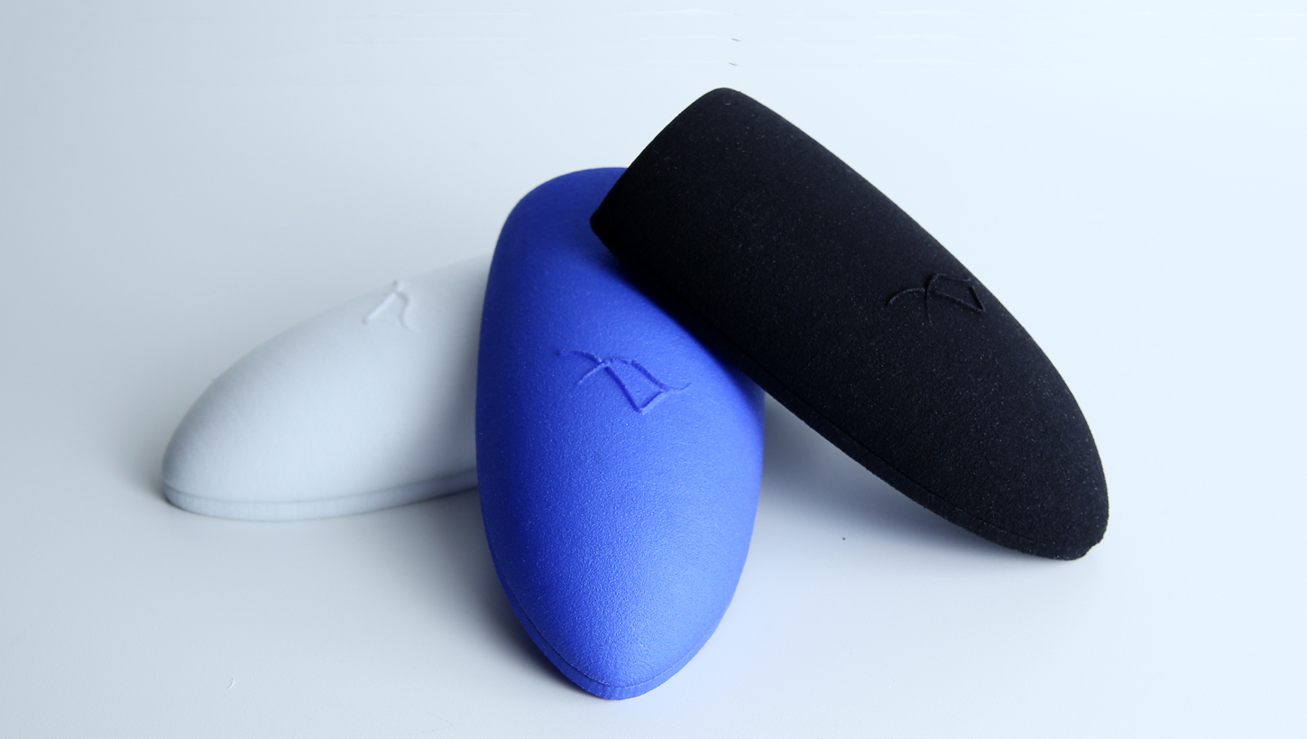

Slide 3
Theory
A longitudinal review of Mobile HCI research Methods. (Kjeldskov, J., 2012)
On the Move with a Magic Thing: Role Playing in Concept Design of Mobile Services and Devices (Iacucci, G. 2000)
Universal Design for Mobile Phones (Ornella Plos, 2006)
Negotiating Privacy Boundaries in Social Applications for Accessibility Mapping (Harald Holone., Jo Herstad, 2010)

Slide 4
Methodology
Functional part of the app (participatory design):
  Research of existing products
  Role playing
  Focus group with target group
Stylistic dimension
  Study of existing competing products
  Study of apps with the best designs (some reliable sources)
  Creating a trend board
  Testing UI

Slide 5
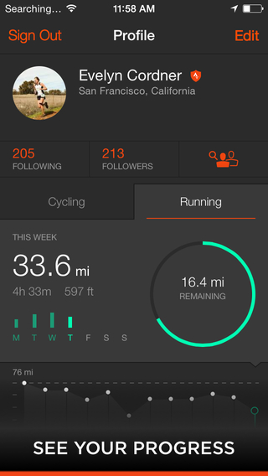
Functional dimension
Research of existing products
  Strava
  LG-health
  Edomondo
  Trace

Slide 6
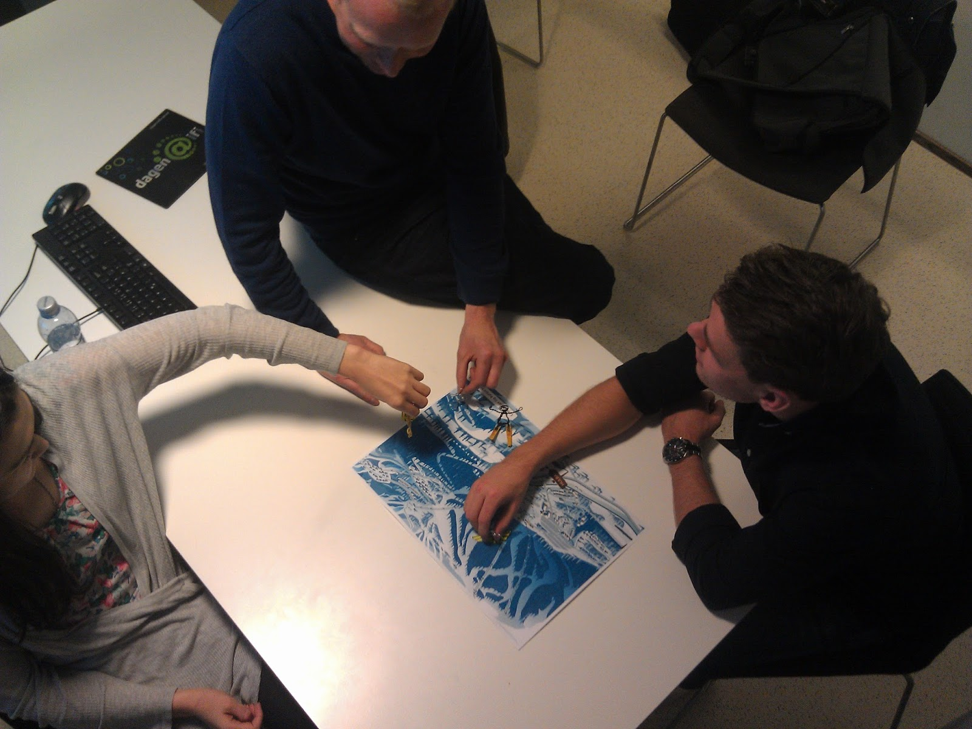
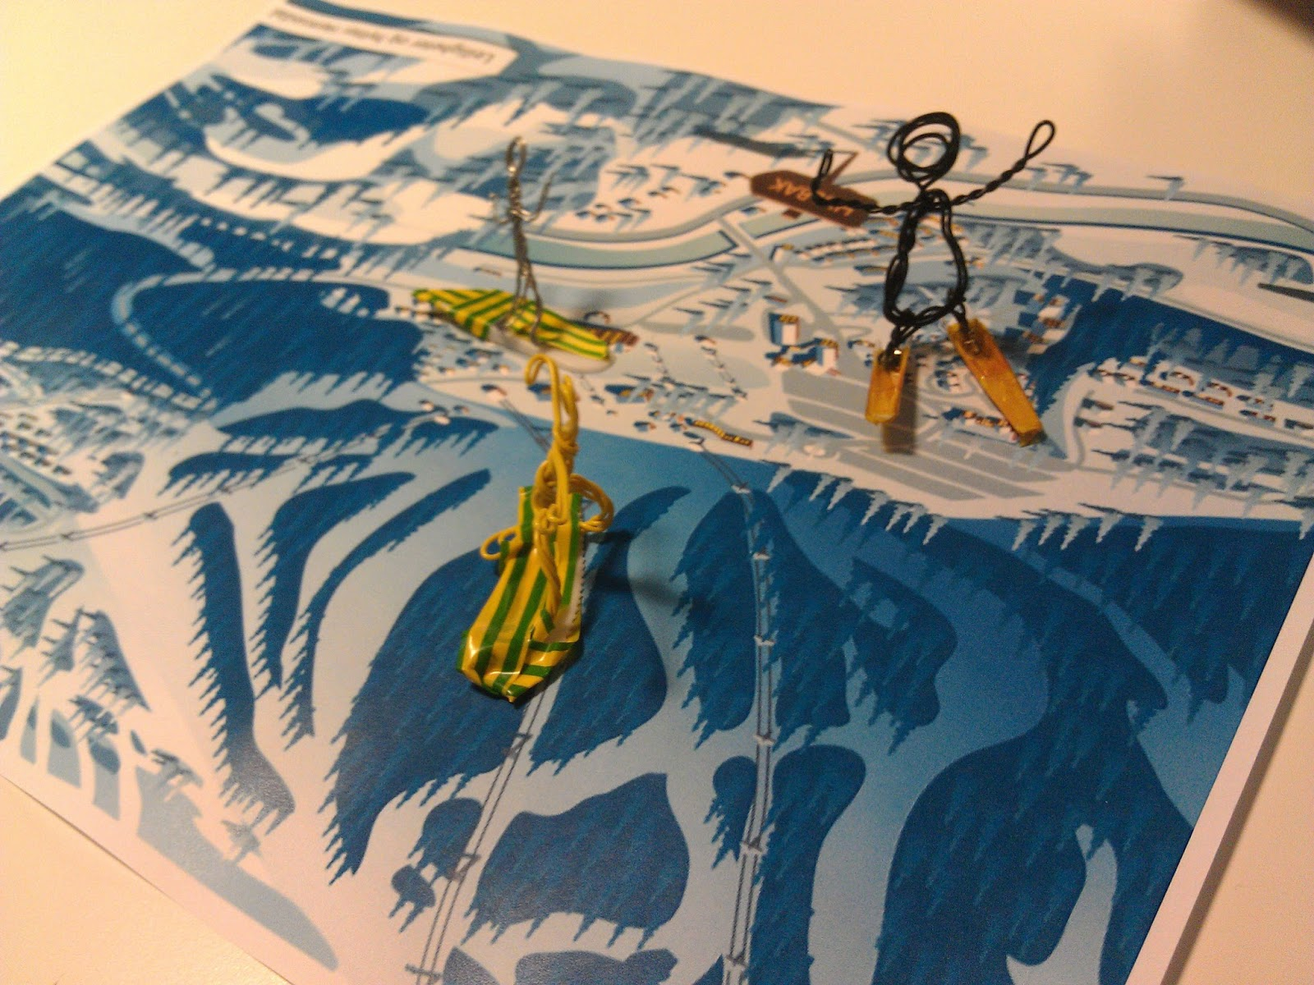
Functional dimension
Role playing session
    Challenge system
    Gamification
    Crowd search
    Automatic on/off

Slide 7
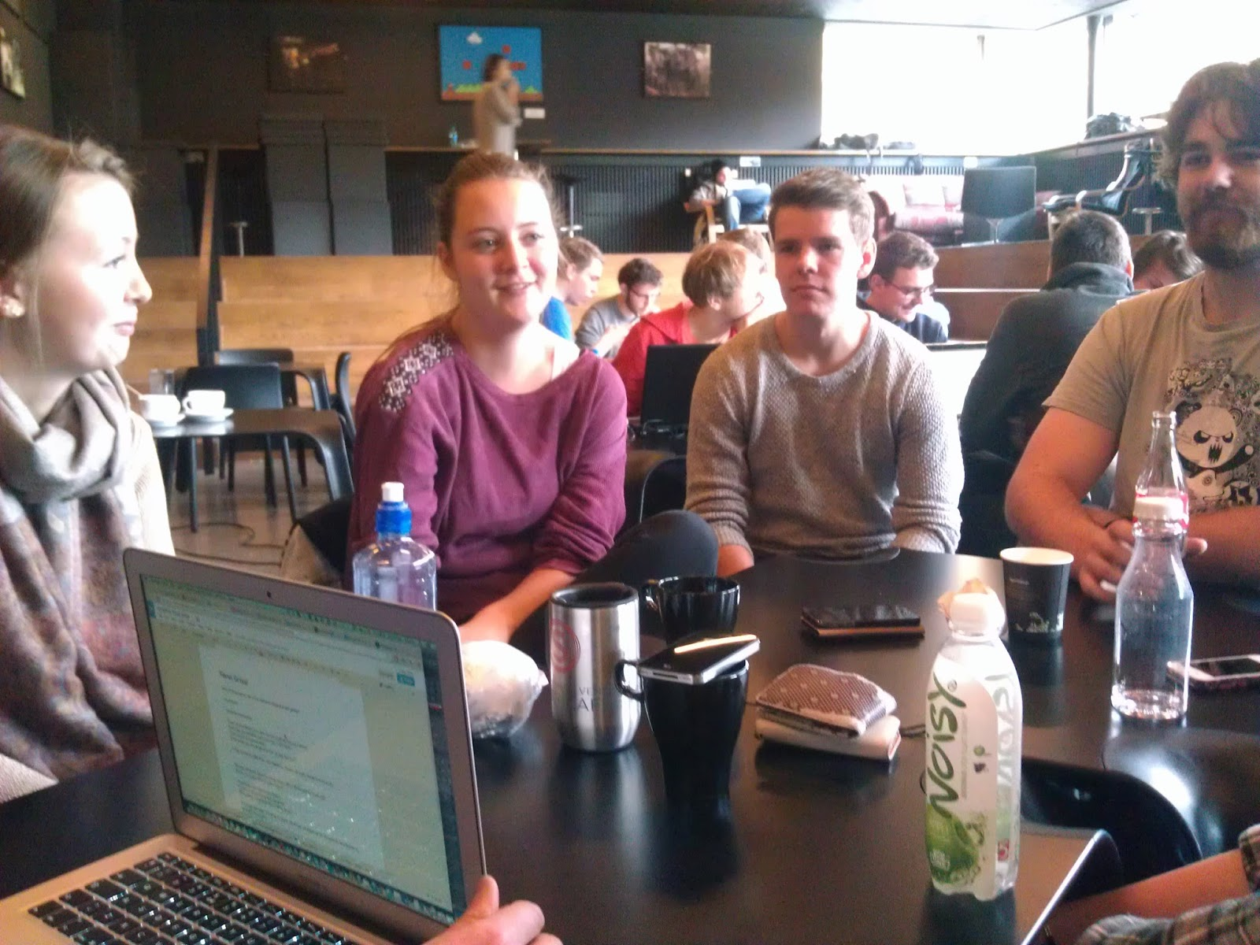
Functional dimension
Focus Group
    Track feedback
    Slope mapping

Slide 8

Stylistic dimension
Skeuomorphic design or flat (pictures)
Important aspects to consider: Colors, Typography, Transitions, Thumb-focus interactions, Icons...

Slide 9
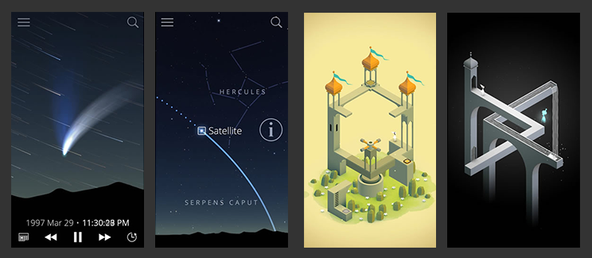
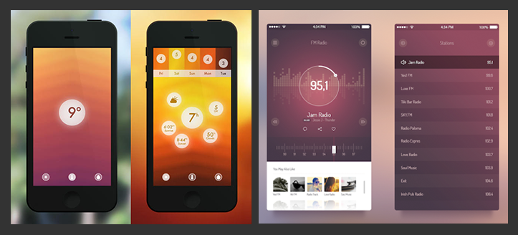
Stylistic dimension

Slide 10
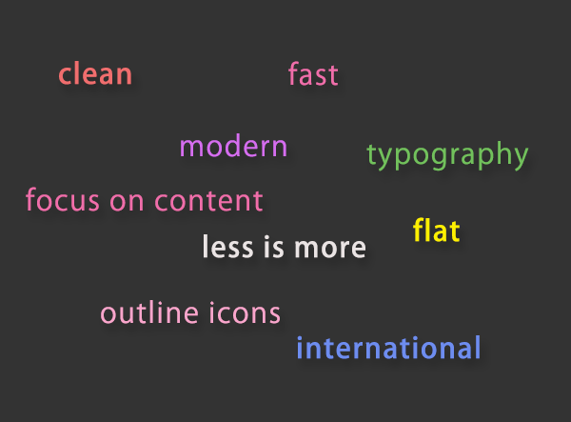
Stylistic dimension

Slide 11
Functionality of the app
Core functionality
  Pair the device
  Anti theft core function
    Button on/off
    Volume
  Off piste mode
Challenge
  Throw a challenge
    Competition type
    Privacy
  Incoming challenges
  Challenge statistics
Statistics
  Basic statistic
  Map

Slide 12
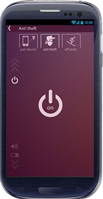
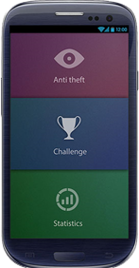
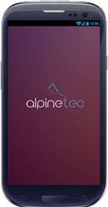
UI of the app
Flat design, Color separation for each logical part of the app, High contrast color scheme and bright “calls to action” (buttons), Thumb - focused interactions, Internationally understandable icons, Adequate size of the buttons

Slide 13
Feedback
Nice design
Challenge part needed more info
Sidebar a bit confusing

Slide 14
Conclusion
Future possibilities
High usefulness
High entertainment
Good feedback from user

Slide 15
Thank you for your attention

