Slide 1
Worldwide
Khiem-Kim Ho Xuan
Simen Skogly Russnes
Thiseas Mengos
Georgios Patounas
Henrik Kaizer Stene

Slide 2
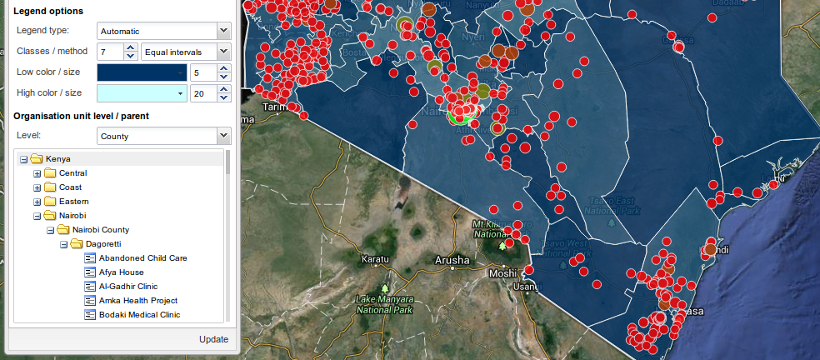
INTRODUCTION
What are Health Information Systems(HIS)?
Data collection | Statistics
Data management | Graphical analysis - GIS

Slide 3
INTRODUCTION
Users
Community health workers
Medical Doctors
Epidemiology researchers
Government officials
Purposes
Collection of patient data
Diagnostics assistance
Access to central knowledge bases
Early warning

Slide 4
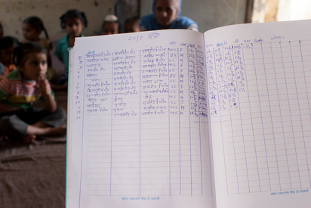
CHALLENGES OF HIS
Collection of irrelevant or redundant data
Poor feedback
Limited power resources or
network
Limited accessibility
Notes:
feedback might not be enough for the date collected

Slide 5
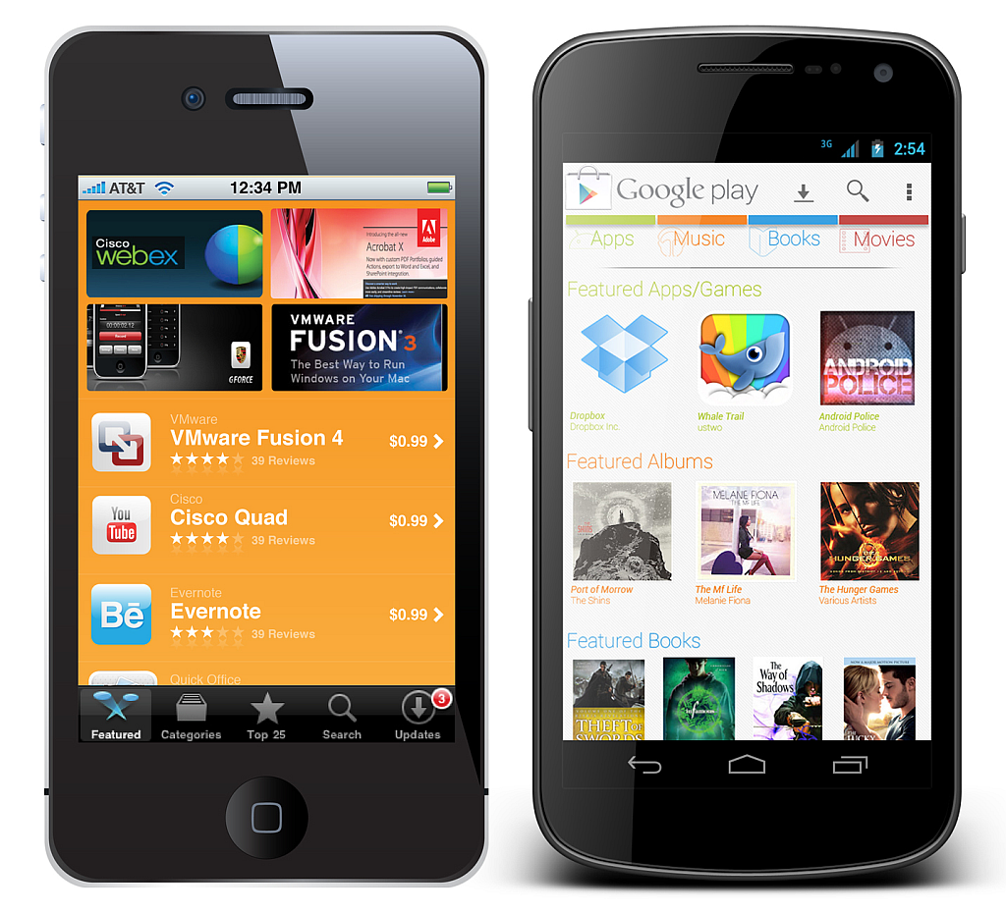
MOBILE DEVICES: A POSSIBLE SOLUTION?
Wireless technology is rapidly-deployable
  Less infrastructure
Low-cost
  Devices becoming cheaper every year
Use of mobile devices are increasing
  Improved accessibility
Ability to work offline

Slide 6

DISTRIC HEALTH INFORMATION SYSTEM 2 (DHIS 2)
Open source software for governments and health organizations in developing countries
Remote data collection
Disease and epidemic outbreak tracking
Diagnostic and treatment support

Slide 7
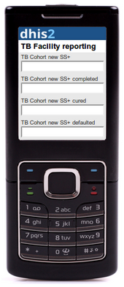
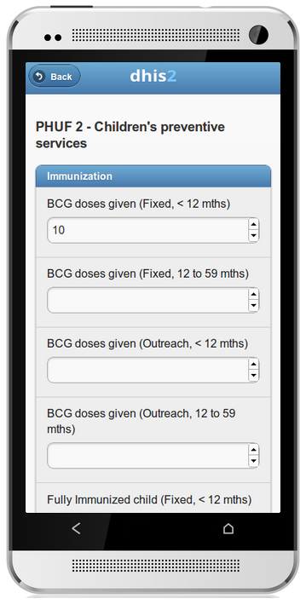
DHIS 2: TODAY
Existing mobile platforms
Java Mobile Clients
Browser Mobile Client
SMS Based Solutions

Slide 8
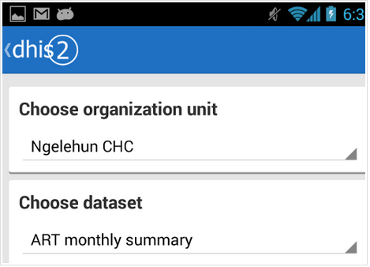
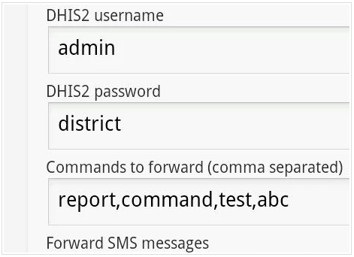
DHIS 2: TODAY
Other applications
            Data Capture
SMS Gateway

Slide 9
INTERVIEWS
Contacted key people in the DHIS2 team
Questions focused on:
Challenges posed by the current infrastructure that can be addressed by mobile systems
“availability of hardware and services - power and network coverage”
Introduction and popularity of the various mobile platforms
“Java and SMS based solutions have been deployed”
Effect of mobile accessibility of data on the use of information
“no empirical data yet - mixed feedback”

Slide 10
OUR PROJECT
Using mobile phones in health sector could improve health services services
Sub-Saharan countries have more mobile subscribers than fixed line subscribers
This is the motivation to build functionality for mobile phones

Slide 11

OUR PROJECT
Are native android applications applicable for developing countries’ HIS?
Can native android applications increase the use of available analytical health data in developing countries?

Slide 12
OUR PROJECT
Where would our app fit in?
Data managers and evaluation officers
Government officials
Less tech-savvy chiefs

Slide 13
THE APPLICATION
Three main modules: Dashboard, messaging and interpretation
Got feedback from the GI groups,the main DHIS2 developer, that this was a good start for what they needed

Slide 14
THE APPLICATION
The dashboard: a collection of
  Graphs
  Maps
  Pivot Tables
Based on aggregate data collected by health workers

Slide 15
THE APPLICATION
Messaging:
  Send messages
  Participate in group conversations
  Send messages to organization units, i.e:
    District Hospitals
    Health Facilities
    Clinics
    Health Posts

Slide 16
THE APPLICATION
Interpretations: a way to form discussions around
  charts,
  graphs,
  maps
  pivot tables
  like shown in the dashboard

Slide 17
THE APPLICATION
Caching:
  Loading big images with bad internet
  Usable when losing connection
  Using the apache httpcache to simplify

Slide 18
FEEDBACK
Testing problems
Test subjects
  R. Wilson: Senior HMIS and Data use Advisor, Ministry of health
  A. Muhire: System Administrator, Ministry of health
  G. Umutoni: HMIS database administrator, Ministry of Health

Slide 19
CONCLUSION
Summary:
Familiarized with DHIS 2
Tested DHIS 2 Desktop
Tested Android client with real users in Rwanda
Interviewed Lars Roland

Slide 20
CONCLUSION
Small test base
Mobile devices are given a warm welcome
DHIS 2 is facing many migration challenges
Mobile applications will be beneficial

