Slide 1
Digital Infrastructure as Assemblage: The Co-Functioning of Architecture, Governance and Process Strategy
Joan Rodón, ESADE, Universitat Ramón Llull, Spain
Ole Hanseth, University of Oslo, Norway
April 29th 2014, InfraGlobe Workshop

Slide 2
AT – Key concepts (I)
Assemblages are “wholes characterized by relations of exteriority”. Each part “may be detached from it and plugged into a different assemblage in which its interactions are different.” (DeLanda 2006; p. 10).
  iOS or Android are assemblages compromising multiple heterogeneous parts (e.g. telecom carriers, content providers, APIs, SDKs, app developers, app, end users, legal contracts, OEMs) which in turn are assemblages that might participate in other assemblages (e.g. OEMs might manufacture devices for diverse mobile DIs)
Whole-part: Properties, Capacities
  The properties of an entity are given, actual and determine its identity. They are what an entity takes when plug into another assemblage
  Capacities refer to potentialities that become actual when they are exercised in interactions.
  Capacities are relational (a capacity to affect goes with a capacity to be affected)

Slide 3
AT – Key concepts (II)
The roles of component parts: material and expressive.
Processes in which (material) component parts are involved:
  Territorialization: stabilize the identity by increasing the degree of homogeneity or the degree of sharpness of the boundaries, by exclusion.
  For instance, a hub-and-spoke architecture for a DI can territorialize a business sector by standardizing the practices and roles of actors.
  Deterritorialization: destabilizes and dissolves the identity of the assemblage by e.g. increasing the heterogeneity of the components, promoting geographical dispersion, decreasing density and blurring the boundaries of the assemblage.
  For instance, the sponsor of a DI might decide to open it by creating an API or an SDK in order to boost innovation from 3rd-party developers by e.g. increasing the heterogeneity of developers and the kind of apps.
Processes of coding and decoding (in which participate expressive components) that consolidate and rigidify the identify of the assemblage.

Slide 4
AT – Key concepts (III)
Structure generating processes.
  Stratification:
    sorting of dissimilar parts into homogeneous groups (a territorialization process) forming a relatively hierarchical structure, and
    consolidating those parts into a coherent entity with emergent properties (usually a coding process).
  Meshwork formation:
    heterogeneous elements are brought together in terms of functional complementarities.
    a special class of operators, or intercalary elements, to affect those interconnections.
    a stable pattern of behavior, endogenously generated, that results from the interlocked heterogeneities.
Assemblages expand and endure through intensifications of flows passing through their structure.

Slide 5
Research method
5-year longitudinal case study research
The formation and evolution of an electronic prescription DI (EPDI) from 2000 to 2013.
Data collected mainly through archival records, interviews, and ethnographic observations.
Data analysis:
  Construction of a timeline of events
  Thick descriptive narrative of the case
  Analysis of the narrative from the lens of assemblage theory
Case narrative: formation & evolution of the EPDI from the side of pharmacists.

Slide 6
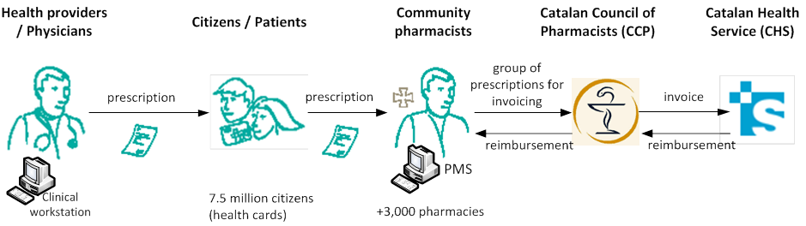
Narrative: The paper-based prescription
A National (Spanish) top-down initiative (PISTA) for electronic prescription started on 2000.
Parallel pilot of electronic prescription in Catalonia in 2001. The computerization of pharmacists.
Introduction of the PISTA is presented in 2002 and rejected by professionals.
Following the decentralized health care system in Spain, autonomous regions started their own EPDI projects.

Slide 7
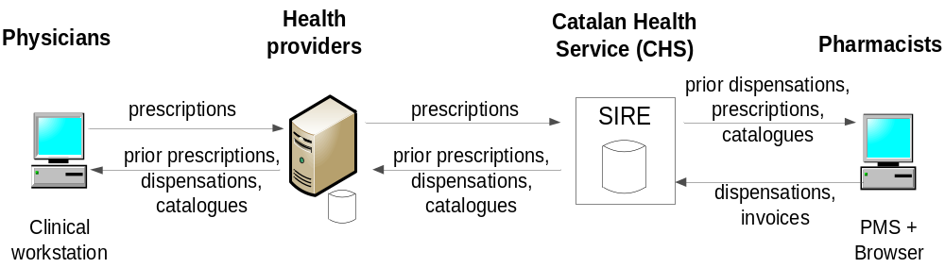
Narrative: CHS – centered architecture
2004 : starts the project in Catalonia
2 main requirements: 1) all data should be integrated and accessible online; 2) processes of prescribing and dispensing should run in real-time (and visible by the CHS).
Governance structure where the CHS is at the center.

Slide 8
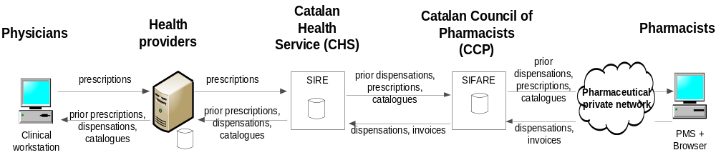
Narrative: Dual architecture
Change in the distribution of rights and obligations over the project.

Slide 9
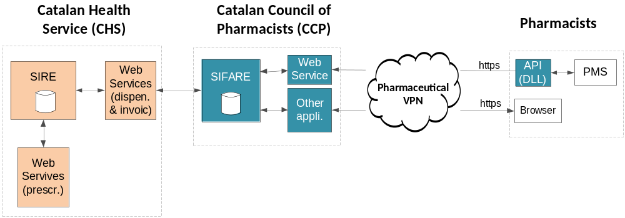
Narrative: Organizing the pharmacists side
Respect the installed base of pharmacists through a recognition program for PMS vendors + Create a governance structure with PMS vendors
Modularize the architecture + API (exposed in a DLL) for PMS vendors
Homogenize their access through a VPN
Homogenize their security level
Decoupling of the development and implementation

Slide 10
Narrative: Adaptations and Endurance
Funding
Agreement with bank
Re-scaling the processing capacity with the rollout
Organizing the roll-out to minimize destabilizing effects (political consequences)
Growth of the EPDI through evolution of current functionalities, new functionalities from CHS (approved by law) and new functionalities for pharmacists.
New services for pharmacists that were not initially considered (“paperless pharmacy” project, TICFarma,….)
New destabilizing forces: Economic crisis (reduction of drug consumption, new taxes on drugs, reduction of margins of pharmacists), defaults from the CHS to pharmacists, etc.
Leveraging on the architecture of the EPDI pharmacists have launched new services.

Slide 11
Analysis: Structure generating processes (I)
Process of “stratification” that produced a dual and hierarchical architecture and a centralized governance regime.
Elements | Analysis of the case
Sorting of dissimilar parts into homogeneous groups forming a relatively hierarchical structure | Negotiation and definition of the roles, rights and obligations of actors (e.g. pharmacists, patients), and a sorting out and distribution of technical parts into more or less uniform layers. (Territorialization)
Consolidating those parts into a coherent entity with emergent properties | Reification and consolidation of roles and layers through processes (of coding) involving expressive components such as the appendix to the pharmaceutical agreement, and the act for the rollout

Slide 12
Analysis: Structure generating processes (II)
Followed by a process of “meshwork creation” that produced a modular architecture (that decoupled the central node from the periphery) and a more decentralized governance regime.
Elements | Analysis of the case
Heterogeneous elements are brought together in terms of functional complementarities. | Recognition the installed base of pharmacists and extend it with new actors (e.g. PMS vendors, a telecom provider, a bank) the fulfill the needs of the former
A special class of operators, or intercalary elements, to affect those interconnections | Creation of gateways (e.g. recognition program, API, tender for VPN, bank account with a minimum balance) that link the installed base of pharmacists with the central node.
A stable pattern of behavior, endogenously generated, that results from the interlocked heterogeneities. | Those interconnections generated stable patterns of interaction of pharmacists with patients, pharmacists with the CCP, and pharmacists with the CHS, that boosted the generation of feedback loops underlying EPDI evolution.

Slide 13
Analysis: DI evolution
The EPDI as continuously going through processes of deterritorialization and re-territorialization that were triggered (resulted from) intensifications of flows.
Five kind of flows:
  actors (e.g. physicians and pharmacists using the EPDI, PMS vendors passing the recognition program, patients migrated into the EPDI);
  information services (e.g. medication plans, dispensations, invoices, digital signature, web apps, CHS-independent web services);
  technological resources (e.g. processing capacity of the web, application and database servers, of pharmacists’ computers, bandwidth of the VPN, software bugs);
  financial resources (e.g. the reimbursement of invoices to pharmacists, funds for the infrastructure);
  skills and capacities (e.g. skills and capacities of pharmacists to adopt a new service, and of PMS vendors to adapt their solutions to a new API).

Slide 14
Analysis: DI evolve through intensifications
Incentives for physicians
Number of HPOs & physicians adopting EPDI
+
+
+
+
Number of patients incorporated into EPDI
Amount of technological resources
+
Number of prescriptions through EPDI
+
Number of information services for pharmacists
+
+
+
Number of PMS vendors passing the recog. program
+
+
+
+
Number of pharmacists dispensing with EPDI
+
Number of pharmacists ready to use EPDI
Number of invoices reimbursed
Number of invoices through EPDI
+
+
+
Amount of funding infrastructure
+
+
-
+
+
-
Revenues for the CCP from processing invoices
Speed of reimbursement
Variety of drugs dispensed in pharmacists
Speed of rollout
Training & support services to pharmacists
-
-

Slide 15
The conditioning of interactions among….
Architecture | Governance | Process Strategies
Dual architecture at the core (two central nodes) Loosely coupling of the two central nodes Hierarchical relations between the two central nodes and the sides Modular architecture decoupling one central node (SIFARE) from side (pharmacists with their PMS) Service oriented architecture | Hybrid centralized and decentralized consisting of two parts: the core, and the periphery. Governance of the core: 1) Appendix to the pharmaceutical agreement; 2) Steering & follow-up committee for EPDI; 3) Decree regulating the EPDI; 4) Act for the roll-out; and 5) Security model (encryption of communications between SIRE and SIFARE; CCP as a Registration Authority). Governance of the periphery: 1) Advisory committee between CCP and PMS vendors; 2) Recognition program for PMS vendors; 3) Agreement with telecom provider; and 4) Security model (digital certificate for pharmacists). | The two core specifications (data integration and real-time execution of processes) were driven by the CHS (top-down). Control and responsibility devolution of the CHS to the CCP. The CCP used of gateways (not standards) such as recognition program, or API exposed in DLL to minimize disruption of installed base The CCP accommodated the inclusion of new services pushed by the CHS to capacities, available resources and needs of pharmacists and PMS vendors The CCP pushed new innovations leveraging it control over certain parts of the EPDI assemblage, e.g. the architecture.

Slide 16
Thank you very much for your attention
Q&A

