Slide 1



INF3110: Exercises Part 6
Object Orientation
Comments and solutions
Eyvind W. Axelsen
eyvinda@ifi.uio.no
@eyvindwa
http://eyvinda.at.ifi.uio.no
Slides are based on material from previous years, made by Weiqing Zhang and Henning Berg.

Slide 2
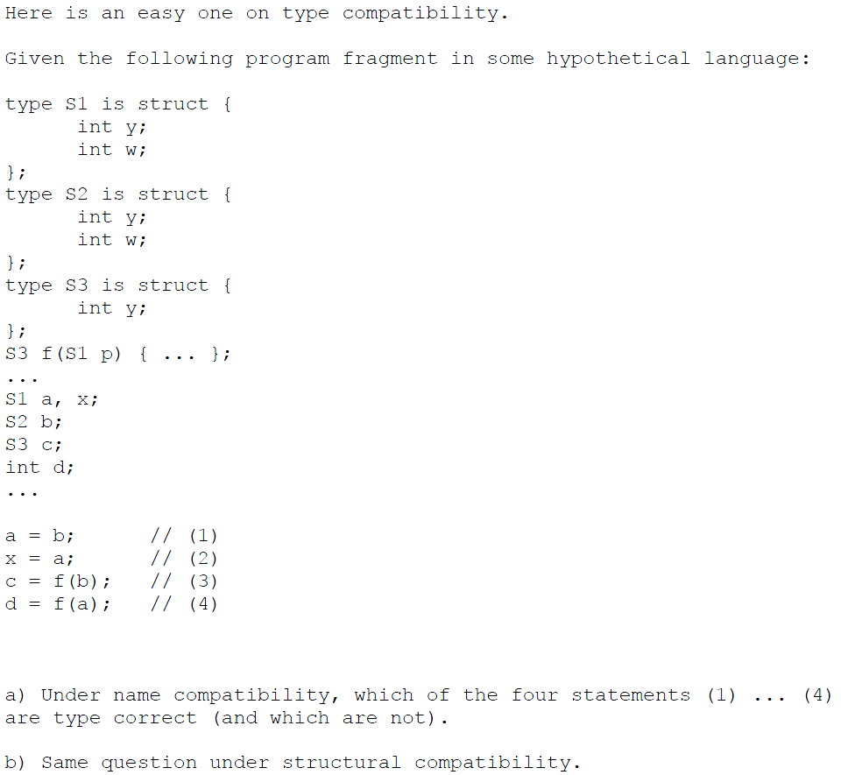
Problem 1
Which of these four statements are correct under
a) name compatibility?
b) structural compatibility?

Slide 3
Problem 1
a)
Incorrect
Correct
Incorrect
Incorrect
Which of these four statements are correct under
a) name compatibility?
b) structural compatibility?

Slide 4
Problem 1
b)
Correct
Correct
Correct
Incorrect
Which of these four statements are correct under
a) name compatibility?
b) structural compatibility?

Slide 5
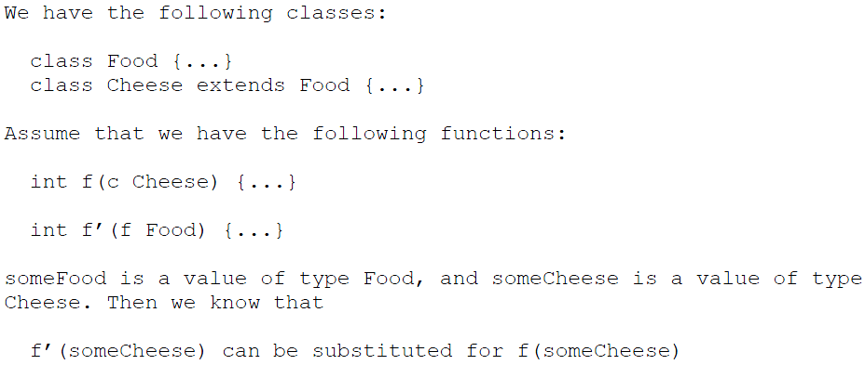
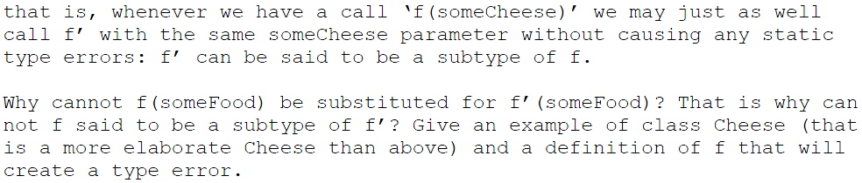
Problem 2
class Food { … }
class Cheese extends Food { … }
int f (Cheese c) { … }
int f’ (Food f) { .. } // in this language, f’ is just an ordinary name

Slide 6
Problem 2
The answer is of course that f expects a more specific type than Food, namely Cheese. Cheese might have properties that Food does not.
For instance, imagine this definition of Cheese:
class Cheese extends Food { void melt() { … } }
and this definition of f:
int f (Cheese c) { … c.melt(); … }
Clearly, a call to f(someFood) would not work here.

Slide 7
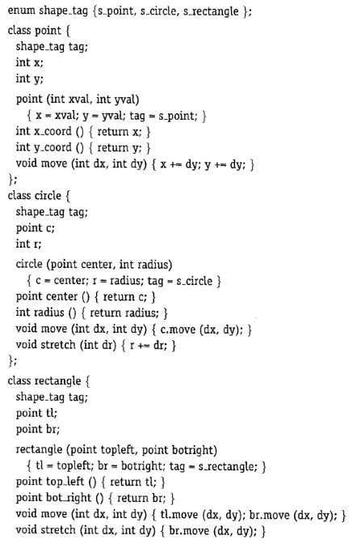
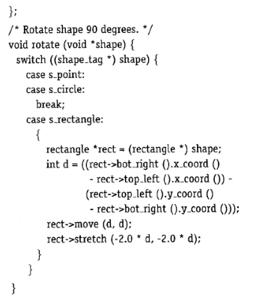
Problem 3 – Exercise 10.2 in Mitchell
Switch on type tag
Type cast
a) Rewrite this so that each class has a Rotate method, and no tag field
(in other words, make an OO solution)

Slide 8
Problem 3 - 10.2 a)
class Point {
int x, y;
void move(int dx, int dy){
x +=dx;
y +=dy
};
void rotate(){};
};
class Circle extends Point {
// the inherited point can be the center
int radius;
// no new move() or rotate() methods are needed
};
class Rectangle extends Point {
// the inherited point can be the center, although the original
// did not have that
Point topLeft, bottomRight;
void rotate(){ /* implement rotate here */ };
};

Slide 9
Problem 3 - 10.2 a)
class Point {
int x, y;
void move(int dx, int dy){
x +=dx;
y +=dy
};
void rotate(){};
};
class Circle extends Point {
// the inherited point can be the center
int radius;
// no new move() or rotate() methods are needed
};
class Rectangle extends Point {
// the inherited point can be the center, although the original
// did not have that
Point topLeft, bottomRight;
void rotate(){ /* implement rotate here */ };
};
Another option would be to add a Shape class at the top of the hierarchy, and letting Point, Circle and Rectangle inherit from this class.

Slide 10
Problem 3 - 10.2 b)
What if we add a Triangle class? What modifications would be necessary with the original version, and our new version?
  Original:
    modify the shape tag enum to include a triangle tag
    add a new triangle class
    change the rotate procedure

Slide 11
Problem 3 - 10.2 b)
What if we add a Triangle class? What modifications would be necessary with the original version, and our new version?
  New, OO, version:
    add a new triangle class (with required methods)
class Rectangle extends Point {
Point p1, p2, p3 // the three points defining the triangle
void rotate(){ /* implement rotate here */ };
void move(){ /* implement move here */ };
};

Slide 12
Problem 3 – 10.2 c)
Discuss the differences between changing the definition of the rotate method in the original and new (OO) version. (Remember that we have added the Triangle.)
  Both versions would require invasive changes
    The Mitchell only to one procedure (the common rotate), while our new solution would require changes to all non-trivial rotate methods.

Slide 13
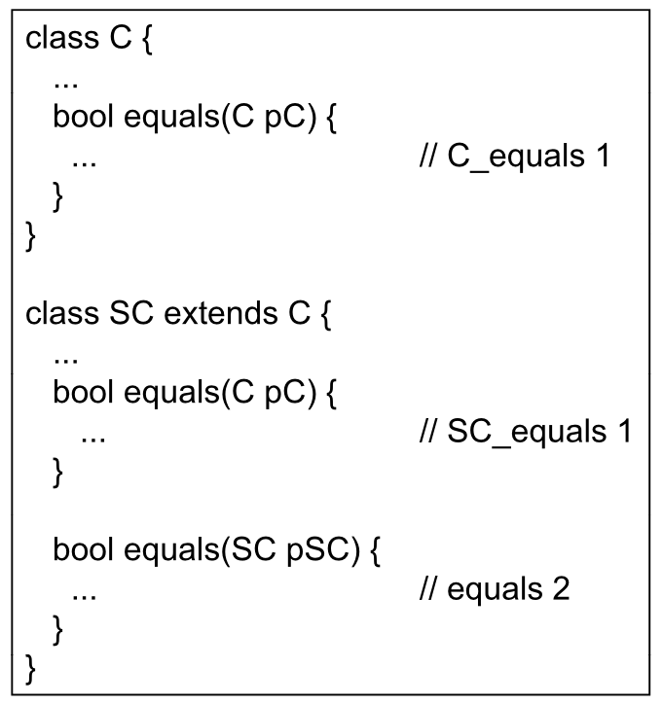

Problem 4
a) Which of the methods C_equals 1 or SC_equals 1 will be called by the statements below?
Remember that which overload to call is determined at compile-time, while which override to call is determined at runtime.
c.equals(c)
c.equals(c’)
c.equals(sc)
c’.equals(c)
c’.equals(c’)
c’.equals(sc)
sc.equals(c)
sc.equals(c’)
sc.equals(sc)
C_equals 1
C_equals 1
C_equals 1
SC_equals 1
SC_equals 1
SC_equals 1
SC_equals 1
SC_equals1
equals 2
Notes:
C’ 和 C是相同的
subtype表示实质的概念级的继承，往往符合is-a关系
subclass表示结构上的继承（的确是为了复用），不一定符合is-a关系
从这个角度区分subclass和subtype可以得到同样的结果：
父类的任何子类都可以在运行时可无缝的代替父类的工作，那么是subtype（因为符合了概念上的is-a）

Slide 14
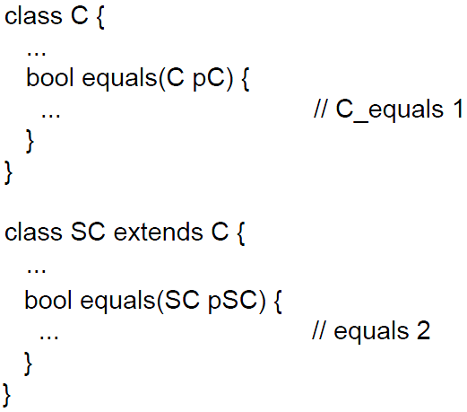
Problem 4
b) Suppose that SC_equals 1 is no longer there.
Remember that which overload to call is determined at compile-time, while which override to call is determined at runtime.
c.equals(c)
c.equals(c’)
c.equals(sc)
c’.equals(c)
c’.equals(c’)
c’.equals(sc)
sc.equals(c)
sc.equals(c’)
sc.equals(sc)
C_equals 1
C_equals 1
C_equals 1
C_equals 1
C_equals 1
C_equals 1
C_equals 1
C_equals1
equals 2
Notes:
C’ 和 C是相同的
subtype表示实质的概念级的继承，往往符合is-a关系
subclass表示结构上的继承（的确是为了复用），不一定符合is-a关系
从这个角度区分subclass和subtype可以得到同样的结果：
父类的任何子类都可以在运行时可无缝的代替父类的工作，那么是subtype（因为符合了概念上的is-a）

Slide 15
Problem 5 a)
Write in Java an abstract data type and a class for a data type Date, with year, month and day, and operations before, after and daysBetween.
Abstract data type:
meaning of an operation is always the same
operation (operands)
Class:
Meaning of operation might depend on runtime type of object (polymorphism/dynamic dispatch)
object.operation(arguments)
Abstract data type:
class Date {
int year, month, day;
Date date(int y, m, d) {.. ; return new Date(...) ; ..}
boolean static before(Date d1,Date d2) {
if (d1.year < d2.year) {return true} else
if (d1.year > d2.year) {return false} else
if (d1.month < d2.month) {return true} else
if (d1.month > d2.month) {return false} else
return d1.day < d2.day;
};
..
}

Slide 16
Problem 5 a)
Write in Java an abstract data type and a class for a data type Date, with year, month and day, and operations before, after and daysBetween.
Abstract data type:
meaning of an operation is always the same
operation (operands)
Class:
Meaning of operation might depend on runtime type of object (polymorphism/dynamic dispatch)
object.operation(arguments)
Class
class Date {
int year, month, day;
Date date(int y, m, d) {.. ; return new Date(...) ; ..}
boolean before(Date d) {
if (year < d.year) {return true} else
if (year > d.year) {return false} else
if (month < d.month) {return true} else
if (month > d.month) {return false} else
return day < d.day;
};
..
}

Slide 17
Problem 5 b)
class Month {
int mAsInt;
Boolean before(Month m) {
return mAsInt < m.mAsInt;
}
};
class Year {/* correspondingly */};
class Day {/* correspondingly */};
class Date {
Year year; Month month, Day day;
Date date(Year y, Month m, Day d) {..}
boolean before(Date d) {
if year.before(d.year)
{return true} else
if month.before(d.month)
{return true} else
return day.before(d.day); }
}
How would you make the Date class independent of the representation of years, months and days?
  Abstraction is key!

