Slide 1
Interactive art
Tom Abelse, Bente Bratvold, Ewa Kabza

Slide 2
Collaboration
EU Creative Europe Peoples Smart Sculpture and Djenana Voljevica-Cicic, modern artist

Slide 3
Research question
How is the digitalized, interactive version of the work experienced (compared to the original work)? What does the ability to interact with the abstract art bring in terms of experience? Is doing so enhancing taking away understanding, liking, exploring, and experiencing the work? Does the perception of art change when people are allowed to interact with it in more physical way?

Slide 4
The project
Creating a product through which you can interact and participate with art while learning about its compostition.
Brainstorming – Ideas
Finaly chose an interactive Frame
Participate in the compostion/creation of art

Slide 5
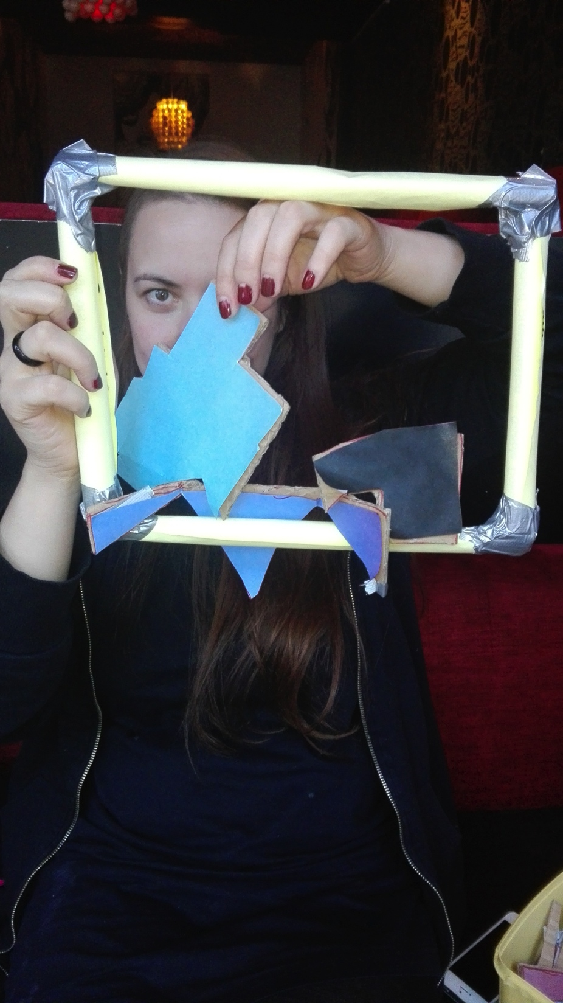
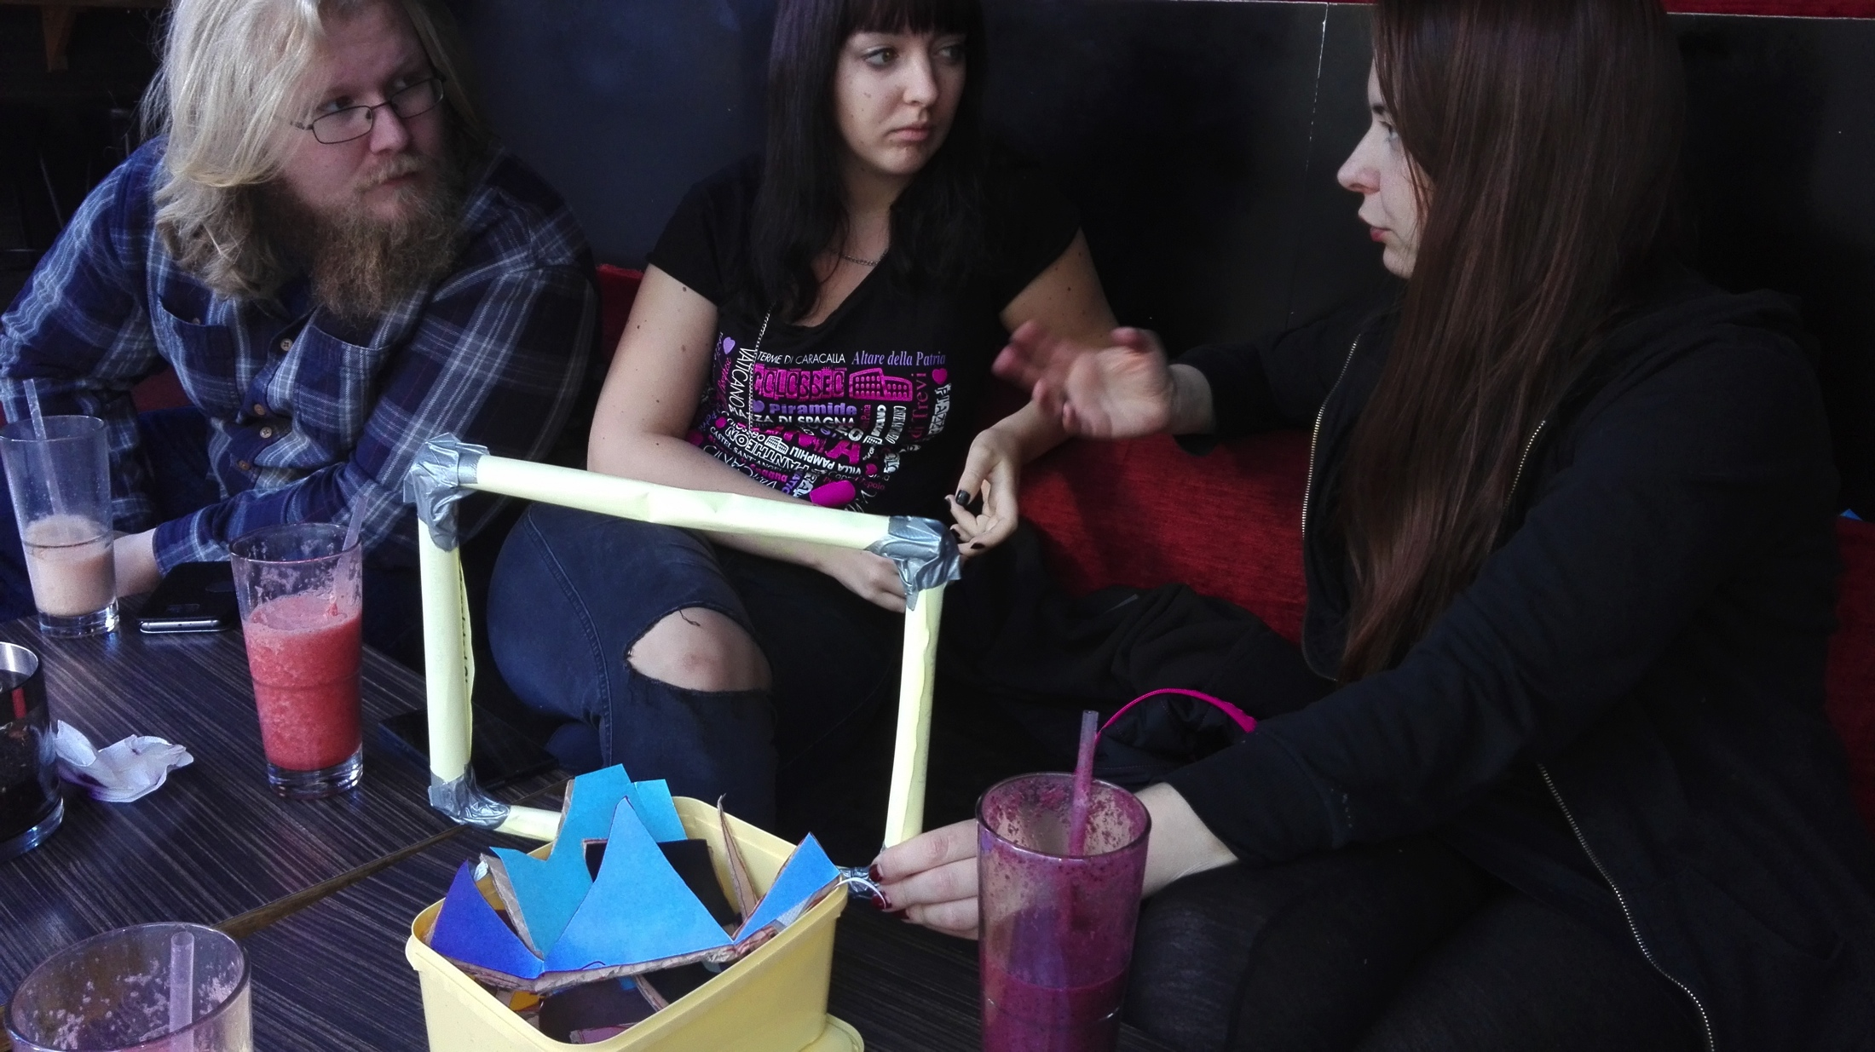
Planning phase with Joana
Low-fidelity prototyping
Meeting an expert

Slide 6
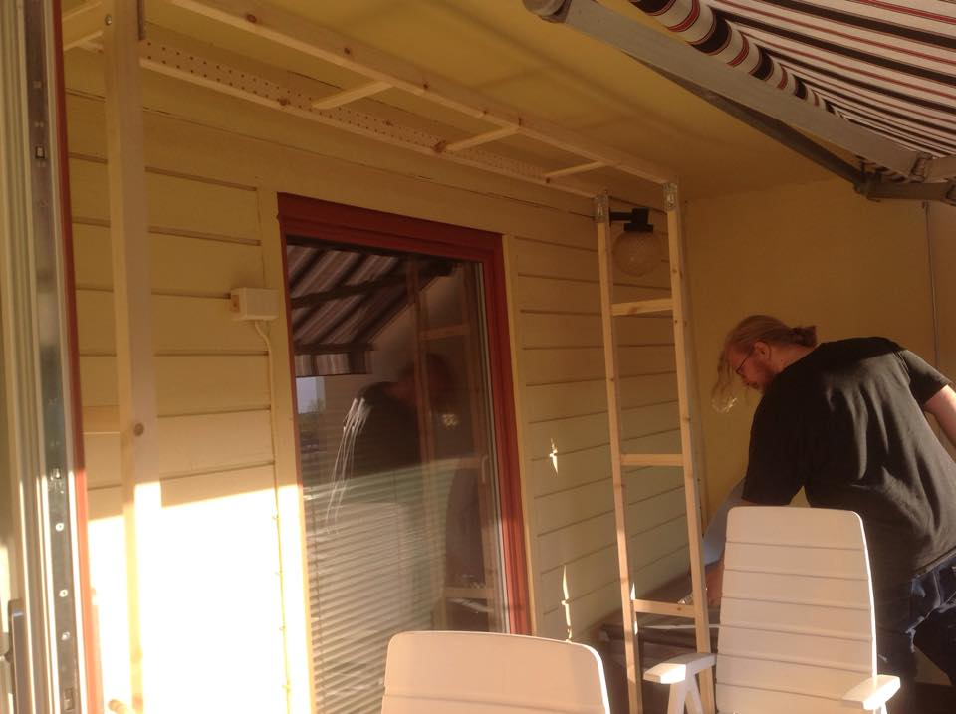
Building a high-fidelity prototype

Slide 7
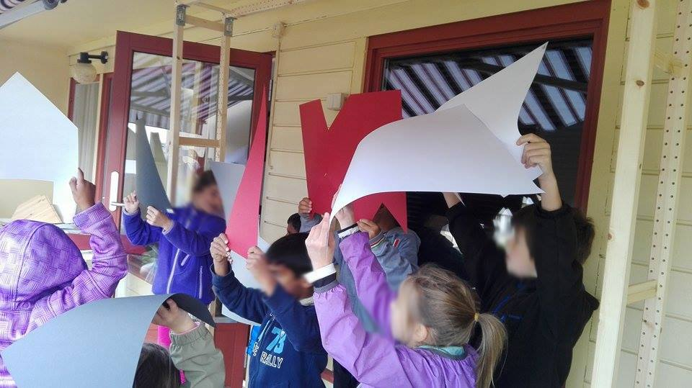
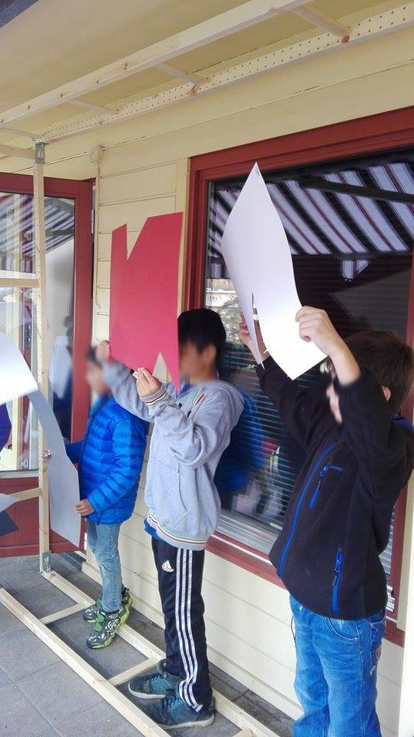
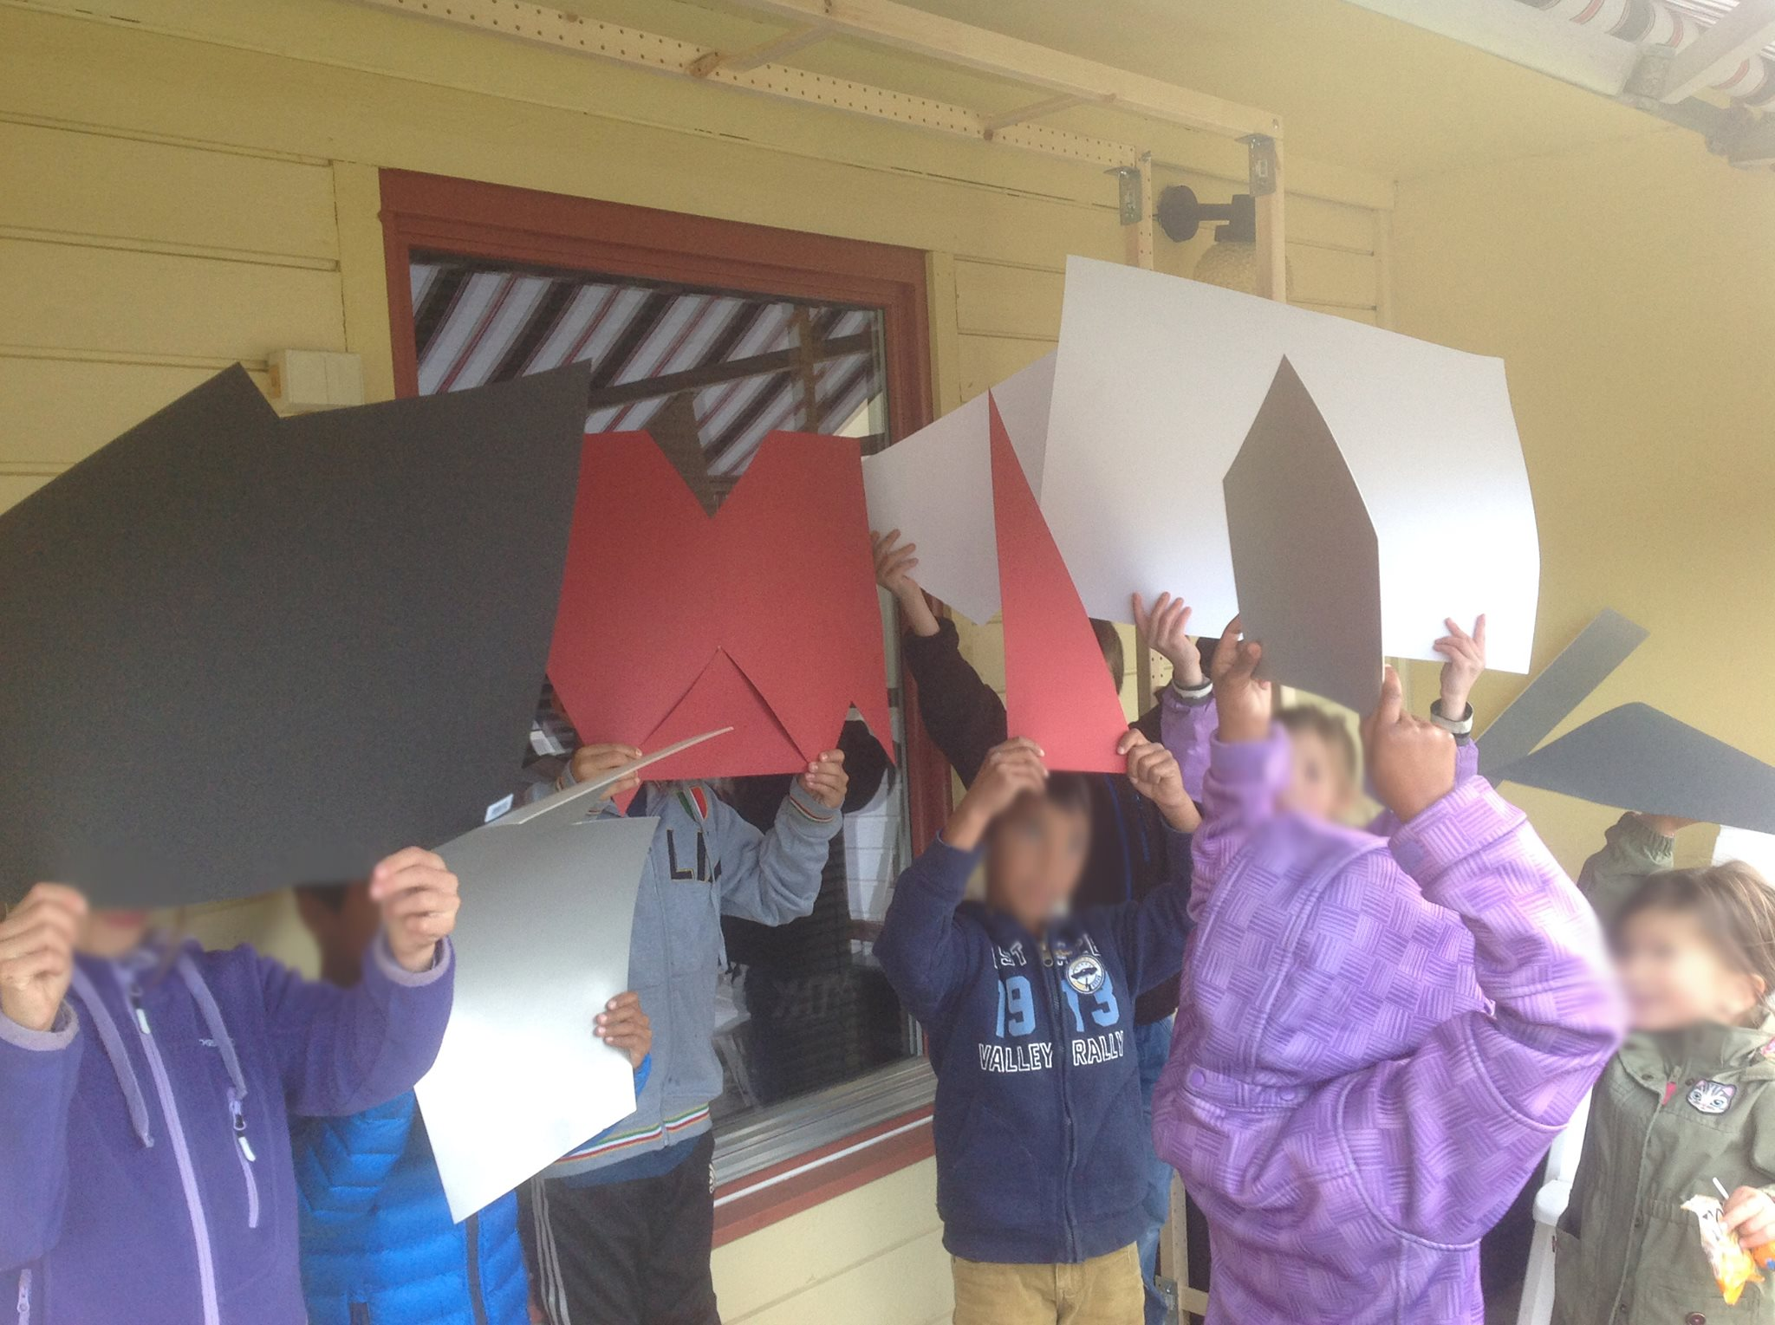
First user tests

Slide 8
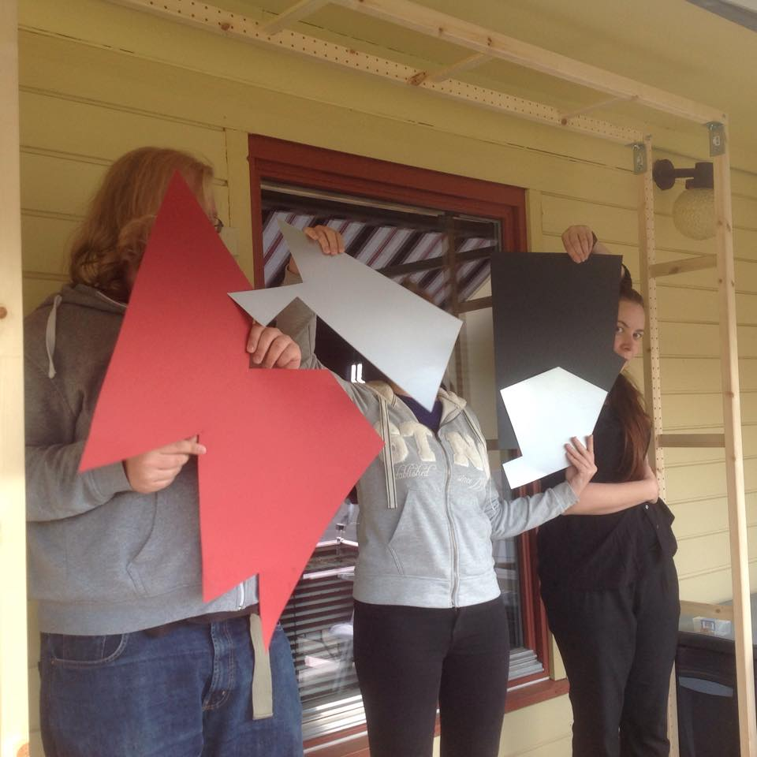
Second : Expert testing

Slide 9
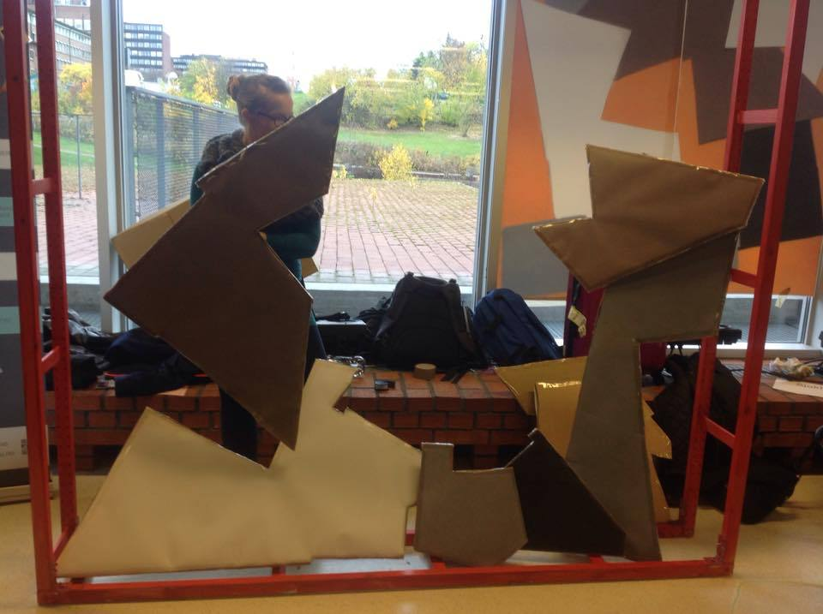
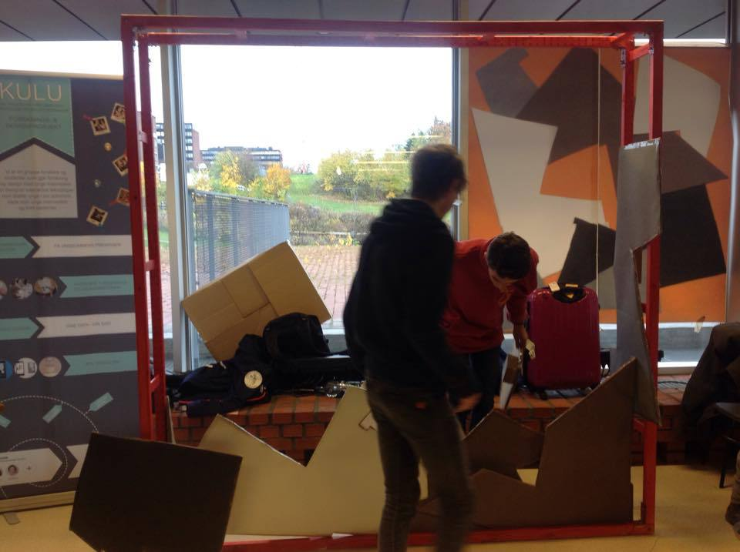
Testing ”in the wild”
Testing with the IT crowd at dagen@ifi

Slide 10
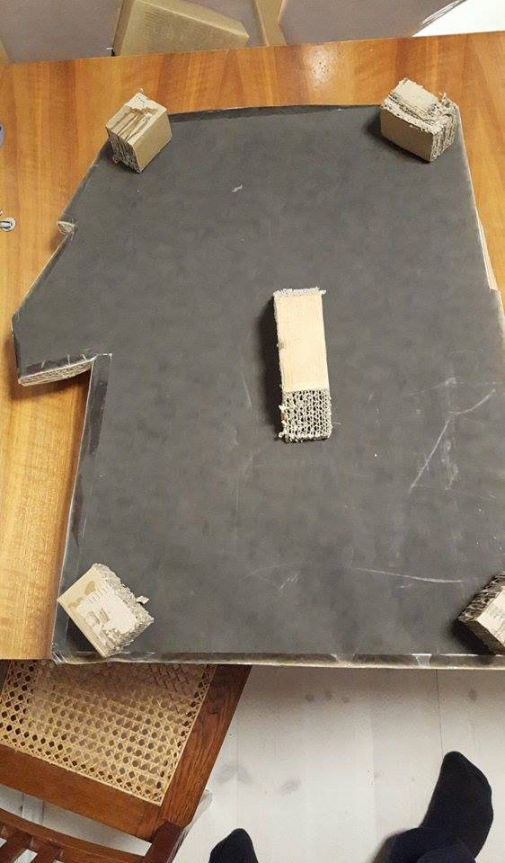
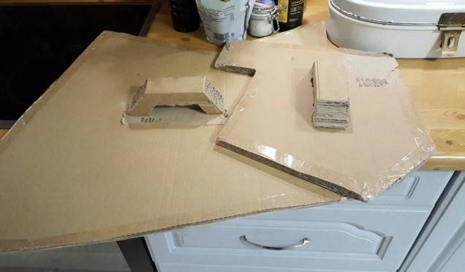
New elements

Slide 11
Final tests
Testing
  Joana
  Kids
Overall experience
Potentialy different size frame for kids.
Notes:
We feel that our project has the potential to change the way people interact with art in the shift to participatory culture.

Slide 12
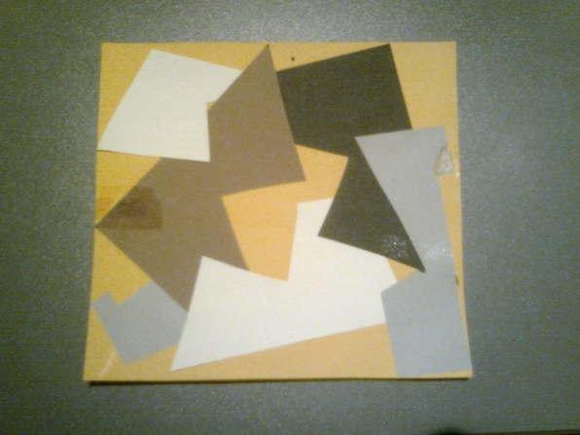
Potential
Participatory culture.
Museum
Learning about:
  Composition
  Art

