Slide 1
SURVEYS
Chapter 5.5 – 5.8

Slide 2
Non-Probabilistic Sampling
In HCI research, population estimates are often not the goal.
Users are often recruited in non-probabilistic manner.
HCI community – using surveys without strict random sampling, but still valid and acceptable.
HCI researchers must collect the data themselves. They go out, find users, collect data and analyze it. That makes both probability and non-probability samples valid in HCI research.

Slide 3
How to increase validity?
?
Demographic data
Oversampling
Random sampling of usage(not users)
Self-selected surveys
Uninvestigated populations

Slide 4
Demographic data
Fair amount of demographic data to ensure that the responses represent a diverse, cross-section of respondents or the responses are somewhat representative of already-established, baseline data(if any exists).
Age, Gender, Education, Computer usage can help the validity of survey responses when respondents are self-selected.
It is Poorer than population estimate and random sampling, but better than no check on the validity of the survey responses.

Slide 5
Oversampling
In non-probabilistic sample 20 survey responses may not be sufficient. Why? Biases.
Oversampling - When survey response reaches a certain number that is considered large in proportion to the estimated or perceived population size.
This can help establish some informal validity.
Having a large response reduces the likelihood of excluding any segment of the population.
Estimating well is important.
500 for whole country like France is not that large but for population of 5000 is too big.
30 as baseline minimum!
GUIDE: https://www.surveymonkey.com/mp/sample-size/

Slide 6
Random sampling of usage
every n^{th} time a web page is loaded, the user is asked to fill out a survey (pop-up window)
known as Intercept sampling.
Disadvantage: those that use web page often – over-represented, those who don’t – under – represented

Slide 7
Self-selected surveys
intercept sampling but everyone is invited
self-selected, non-probability-base survey may be the most natural data collection method for investigating new user populations or new phenomena of usage
if there is no data about a certain user population/usage pattern – self-selected survey of users might make the most sense.
Posting to a newsgroup, list server, chat room, bulletin board where members of the population are known to congregate (panel.no)

Slide 8
Uninvestigated populations
Surprisingly, there are user groups that have still not been investigated in much detail.
People with certain types of cognitive impairments (in HCI) (noen andre eksempler?)
There might be some data about where they live, but no data about how many people with certain impairment are using computer technology
Baseline is to establish the baseline data and get as large response as possible.

Slide 9
Example
No studies on computer/internet use of people with Down syndrome before 2005.
56-question survey developed covering – demographic info, usage patterns, interaction techniques, use of other electronic devices. Parents were recruited (data could be not accurate enough). Use of surveymonkey and sending it to National Down Syndrome Congress and National Down Syndrome Society. 516 surveys collected that provide a rich foundation of data on which other studies and research projects can be built.
Snowball sampling- responding to a survey and recruiting someone else to take part(friends, family).
Easier to reach, sometimes challenging to come into a community of individuals.

Slide 10

Developing survey questions
Two survey structures:
of single questions
of entire survey
Two question structures:
Open-ended questions
Closed-ended questions
Ordered response
Unordered response

Slide 11
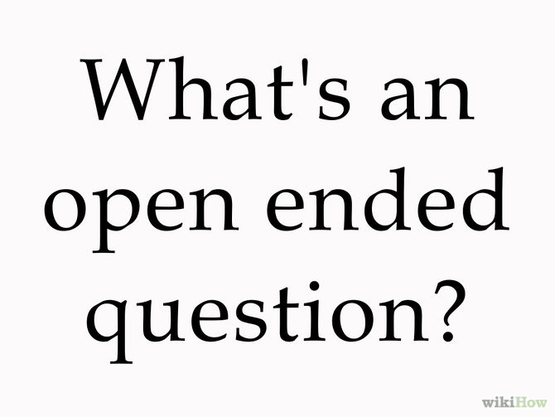
Open-ended questions
Complex flexibility in answers
Better understanding of phenomena
Must be carefully worded

Slide 12
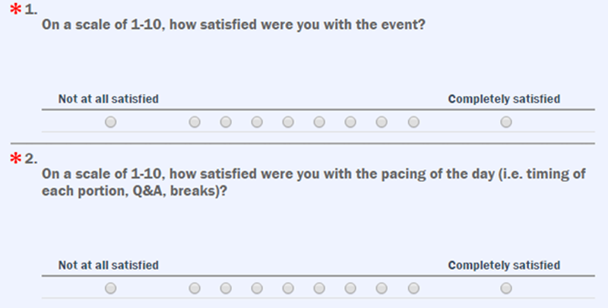
Close-ended questions (ordered response)
there is a logical order
excellent to poor; strongly agree to strongly disagree
Likert scale (from 1-5 ,7,9)
Choose only one item

Slide 13
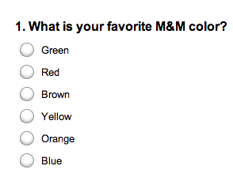
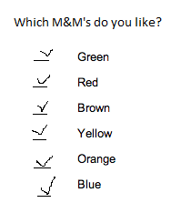
Closed-ended questions (unordered response)
allows choices that do not have a logical order
Often asks respondents to select more than one choice
Different interface widgets! Option buttons (often only one choice) vs. checkboxes

Slide 14
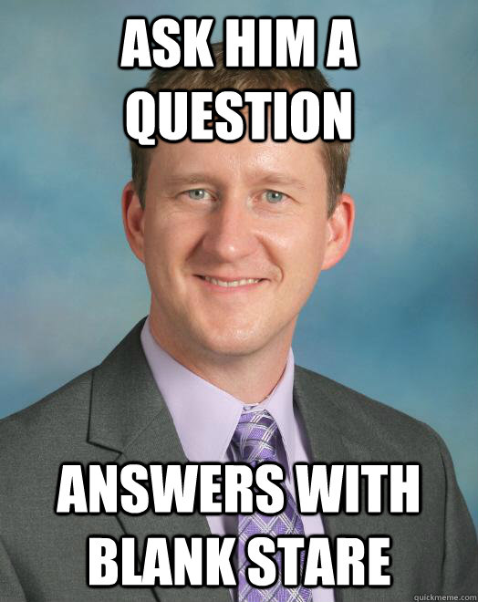
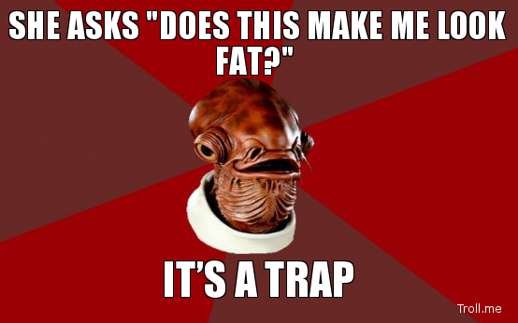
Common problems
“Double-barreled question”
Use of negative words
Biased wording
“hot-button” words
Excercise
(one question including at least two of these problems; one correct)
Topic: Election.

Slide 15
Overall Structure (1)
Ovals/checkboxes; should checkmark/ X be placed in the box or the box filled in; items circled; all questions has to be filled?
Age of respondents in introduction (60+)
Use appropriate heading, provide navigation no matter the form (paper, e-mail, web-based). Provide your email or telephone number in case respondents has any questions.
enough white space, only white paper, large enough font in standard text, staple in left upper corner (in any case of unusual folding remember to make it clear), don’t use abbreviations

Slide 16
Overall Structure (2)
First question should always apply to everybody
Questions can be asked in any order, but it is important to group questions relevant to a similar topic or idea. It allows them think more deeply about the topic (rather than “switching gear”).
Ask interesting questions in the beginning to motivate reading and completing the rest of it.
Demographic questions at the end (less interesting), sensitive or objectionable questions (health,income etc.) since they already filled out most of the survey.
Long surveys – low response rate
Contigent questions – questions that filter the questions not relevant for the respondent.
a) On paper- intended box with an arrow from original question
b) In web- based – automatically jump over the irrelevant questions

Slide 17
Existing Surveys
For most research purposes you need to create new survey tool. For usability testing and evaluation there are some existing tools. They can be modified in minimal ways.
www.oldwww.acm.org/perlman/question.html
www.hcirn.com/atoz/atozu/usaques.php
p.116 full list of existing tools and places to find them.

Slide 18
SURVEY GUIDE
1. Based on format, apply existing standards:
a.Paper:
- enough white space, boxes in case of contingent questions
b. Web:
- layout, jumping over irrelevant questions (in case you use contingent questions)
2. Applicable for all forms:
- Different interface widgets! Option buttons (often only one choice) vs. checkboxes
3. Choose questions:
- open ended
-closed-ended (ordered or unordered response)
4. Avoid common problems like:
- “double barreled questions”(use two separate instead)
- bias (use of negative words, sensible topics etc.)
5. Any ambiguity should be clarified!
6. Ask questions that provide you relevant information.
7. First question should apply to everybody.
8. Interesting questions first, motivate respondent to fulfill the survey.
9. Ask less interesting questions towards the end of survey.
10. Save some time and check for existing surveys(full list p.116 in book)

