Slide 1

Virtual Emergency Operation System
Project by Christine Ye, Hans Rødtang,
Mette Sundal & Thomas Persson

Slide 2
Our mission
SINTEF
Will Google Glass be an useful tool in the displaying of relevant information during emergency response?

Slide 3
Process
Worked with Mentors
Found a solution during our first meeting with our mentors
Iterations
Genius Design
Made a prototype without input from our user group.
More Iterations regarding the design of the prototype
Feedback from Mentors
TO DO:
Show prototype to our user group, and get feedback.
Analyze data, and do a new iteration of the prototyping
Create High Fidelity Prototype
Notes:
Worked with mentors:
We came with ideas of different ideas and then met up with the mentors/clients to either get the ideas confirmed or disproved, so we know that we’re on the right track
Genius design:
because we believe that the users are familiar with this kind of technology with Google Glass yet, which makes it hard for them to know what they need and the possibilities and limitations of the use of Google Glass.

Slide 4
Our solution
- Have Google Glass show certain objects in its compass view
- Make it possible to filter what objects you see
- Create icons for the objects that are easily recognized
- Easy to use

Slide 5
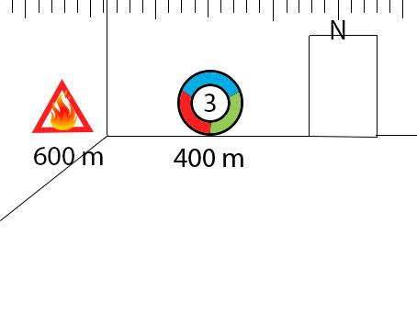
First paper-prototype
- What information to show
- How to show it
- How much information to be shown
- How to distinguish between different elements

Slide 6
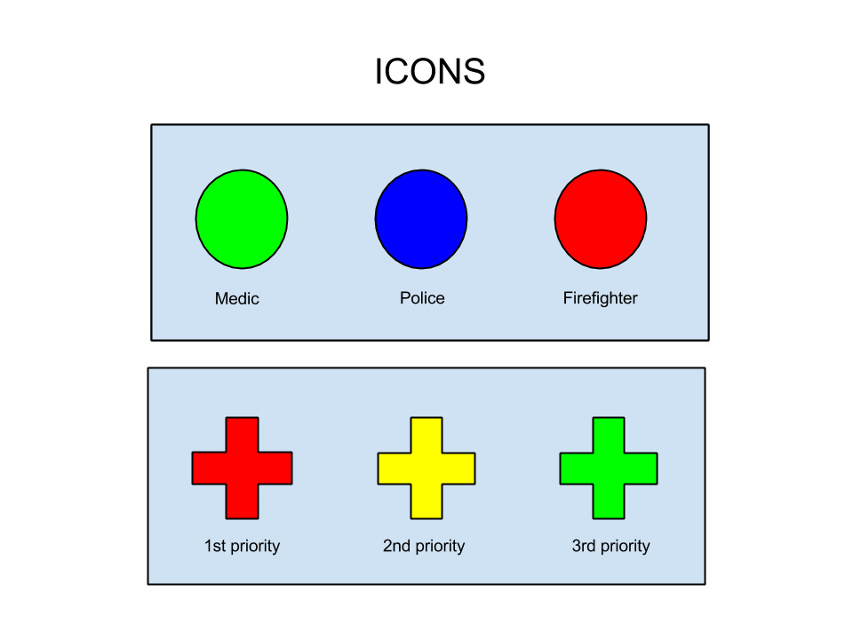
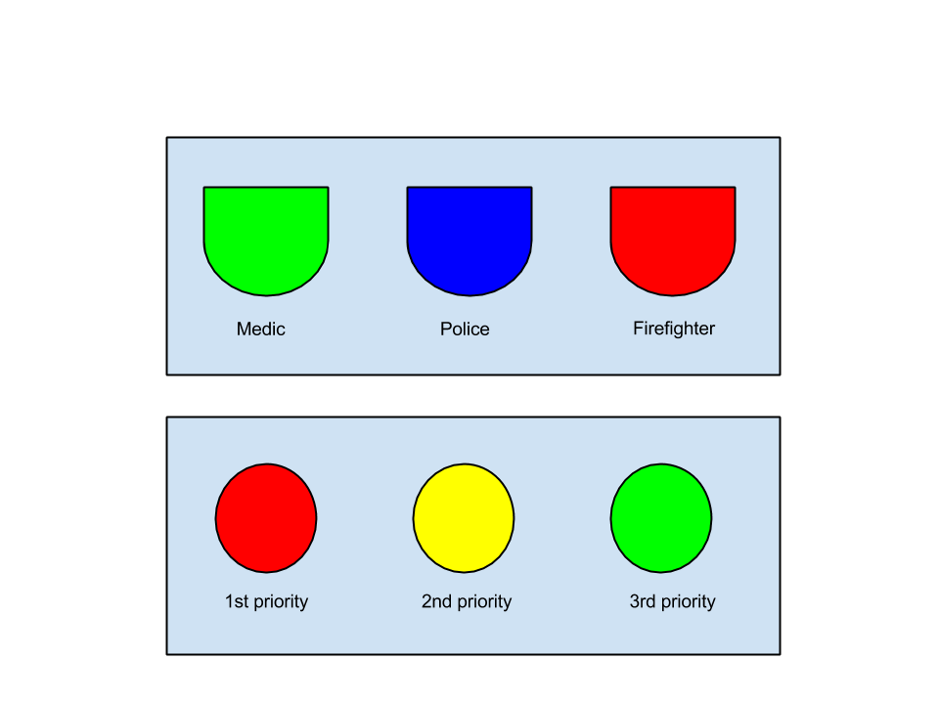
Icons
First iteration Second iteration

Slide 7
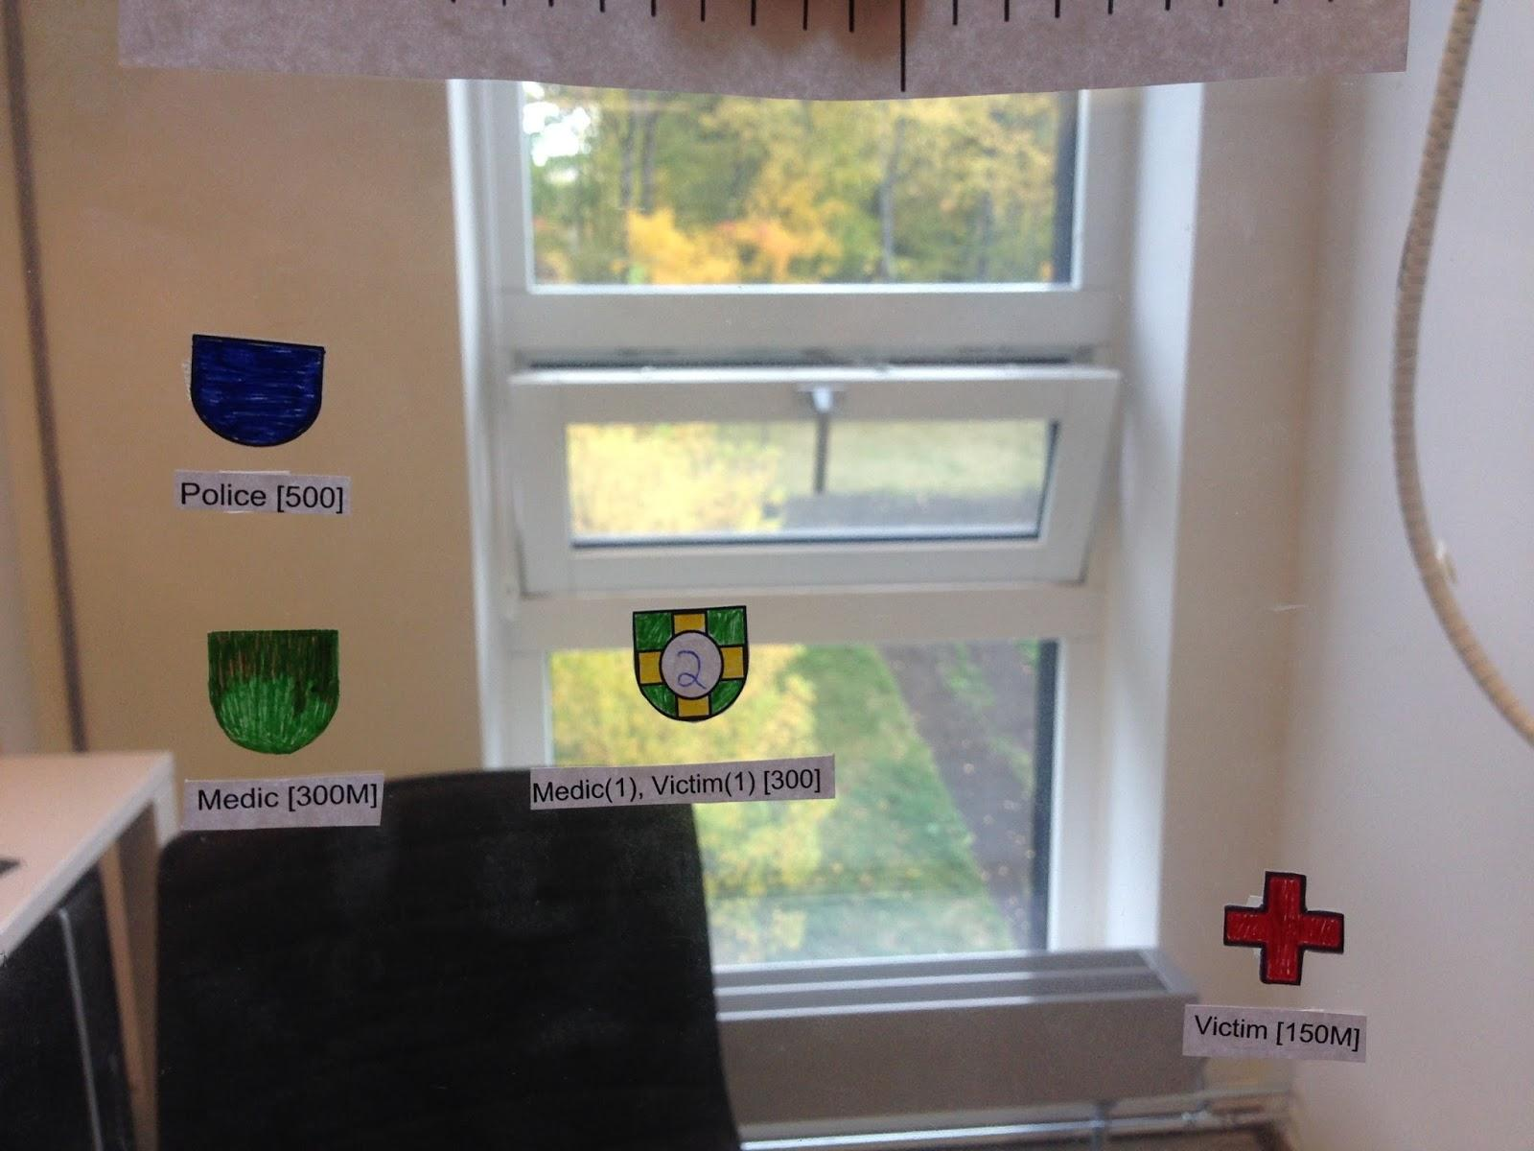
Low fidelity prototype
- Different shapes for each element
- Color codes to distinguish difference
- Size on icons will represent quantity
and distance
Notes:
We have tried to simulate what will be shown on the Google Glass, by printing out and putting our icons on transparent paper
By holding this paper approximately 1,5 meter away from the user, the transparent paper will simulate the glass on Google Glass

Slide 8
Use
We hope that this solution will prove useful in scenarios where the users
view are partially blocked or there are too many obstacles between the user
and the victim(s).
Scenarios
Snowstorms
Fog
Areas with a lot of smoke
Urban areas
Forests

Slide 9
Questions?

