Slide 1
MARTIN
Sunnaas gr 2.
Jon-Robert, Ying, Linett og Ingvild

Slide 2
Our user group-
Brain damage department at Sunnaas hospital
Patients and relatives
Typical problems
Complex disease picture
Notes:
Typical problems
bad memory
lack of hunger and satiety
lack of cognition
Complex disease picture
Overweight
Diabetes

Slide 3
The development process
Meeting at Sunnaas
Brainstorming
Dialogue with nutritionist and psychologist
Prototyping workshop
Usertesting and contact
Notes:
Meeting at sunnaas
Nutritionist
IT- departement
Innovative leader
we Got to know the background, how they work and what the needs are.
BRAINSTORMING
We took all the information that we got and brainstormed around what could be cool, fun, posible
DIALOGUE
Than we sendt our thougst to the nutritionist and the psycologist at sunnaas and got feedback and their thoughts
THey were really positive to our suggestions, and brainstormed around the questions we asked.
Than we got a kravspec from sunnaas,
PROTOTYPING WORKSHOP
With the kravspec and all the info and suggestions we den sat down and had a brainstorm for prototyping.
we sketched on a whiteboard and than on paper.
User testing and contact-
Scene it is a hospital it is not that easy to get in contact with the users, we need the right access, so we should get that about mid october. But we use what we have the nutritionist and the psychologist who know the users their needs and their abilities well.

Slide 4
Our product
A nutrition application,
choose the food you eat
Need to be:
Easy to use
Easy to understand
Notes:
Inspiration
Recipes
QR code

Slide 5
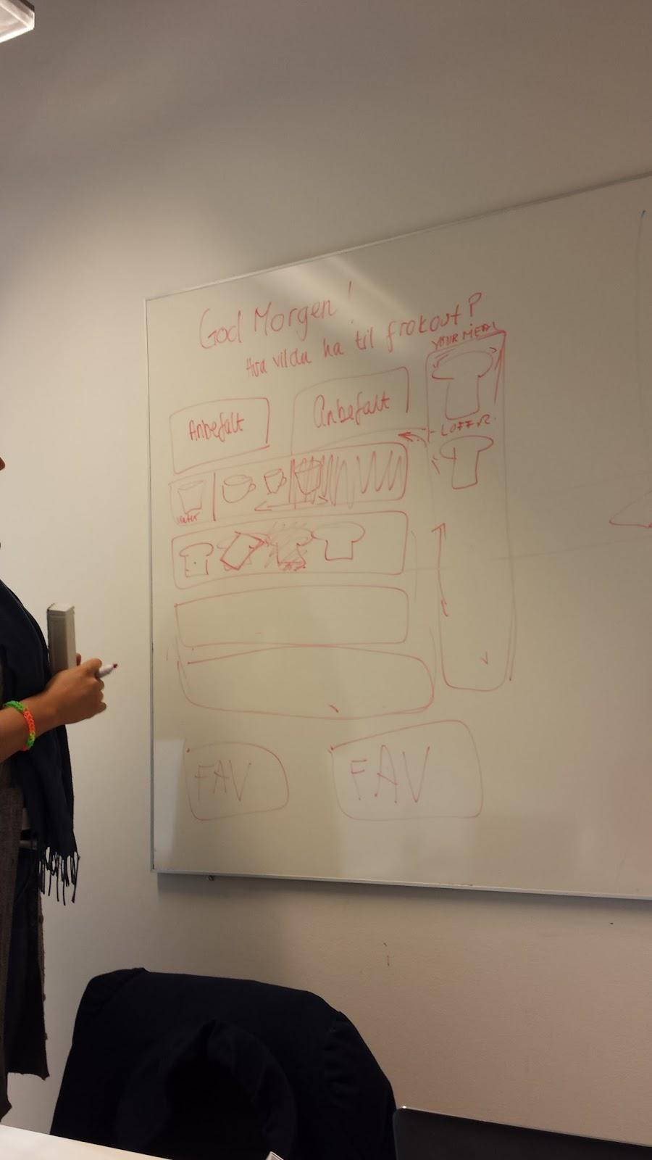
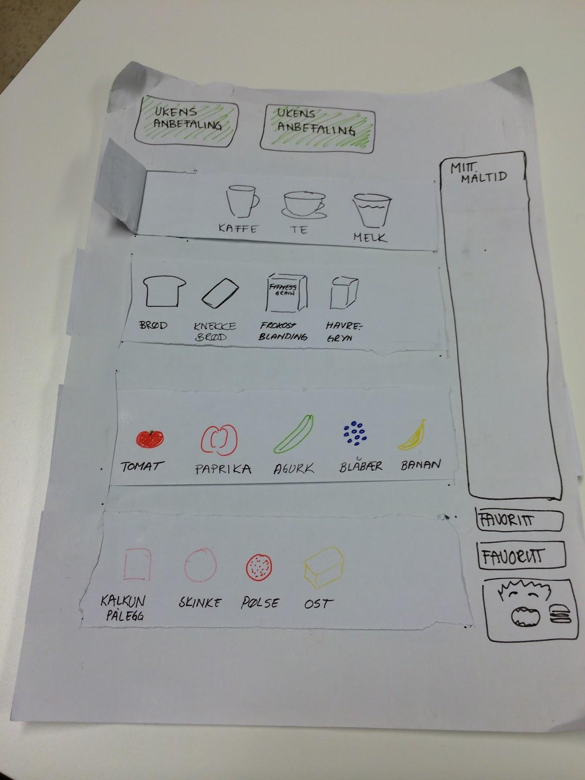
Prototype
Notes:
Easy to understand
few interfaces to keep it simple for the users, not to get lost in the architecture
PROTOTYPE
the healthy/recommendation first
you clik to a collective terms like “bread”, then the bread types get filtered, SHOW
easy marking of the healthiness of the product, with colours red, orange and green
favorites- what you often eat
QR code scanning (learning language)

Slide 6
The app
Image just a rough sketch
HTML5 webpage
Must work on devices 4 inches and larger
Tablets (Android and iOS) and pc
Simple layout with swiping

Slide 7
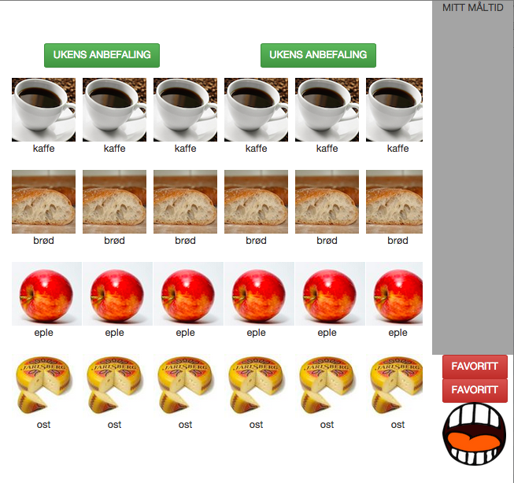
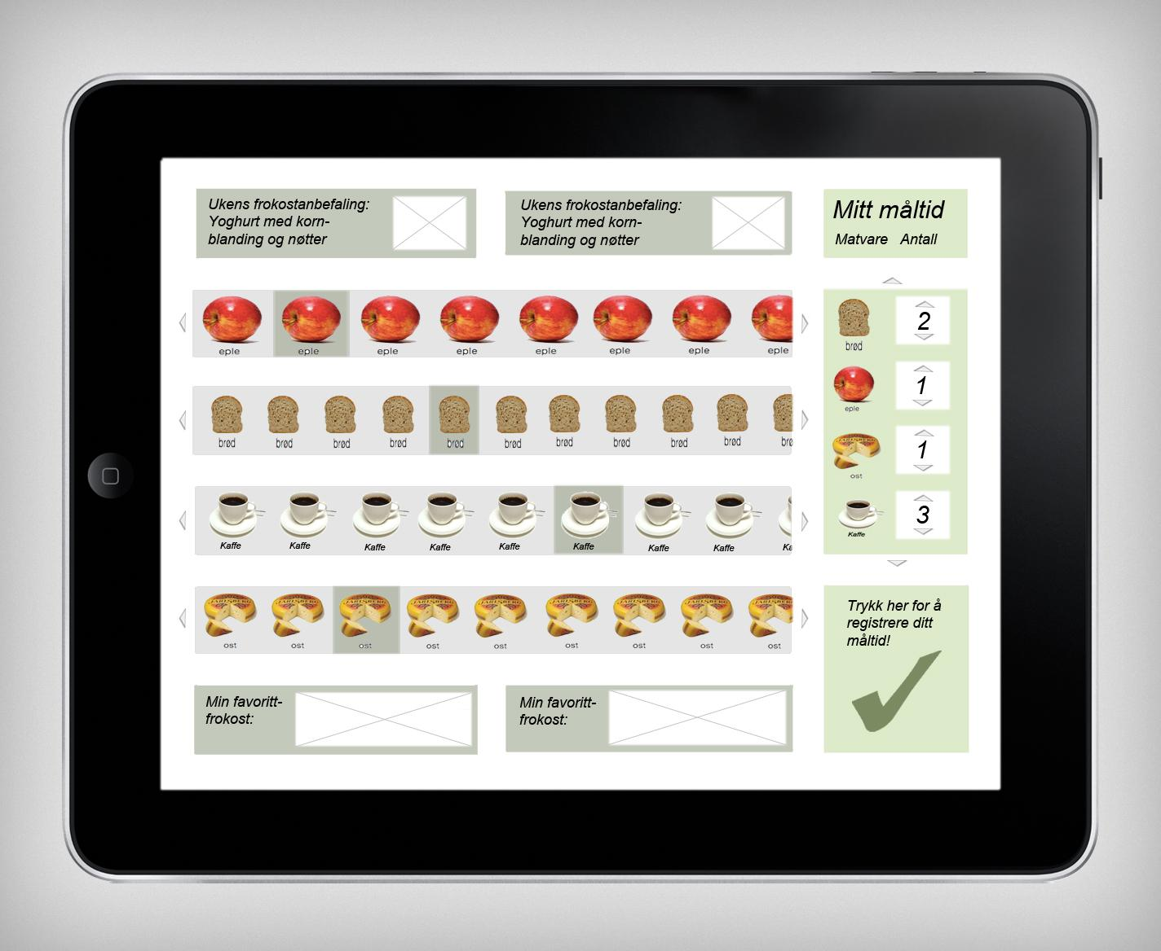
Current state and future

Slide 8
How to get to goal
Further development
User testing
Keep a good dialog with Sunnaas personnel

