Slide 1
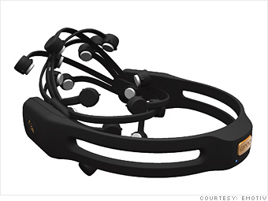
emotiv EPOC
Schlumberger Group

Slide 2
Goal
To be able to learn and demonstrate ways to use Emotiv EPOC to compliment or replace the use of a mouse and to be able to integrate it to an application.

Slide 3
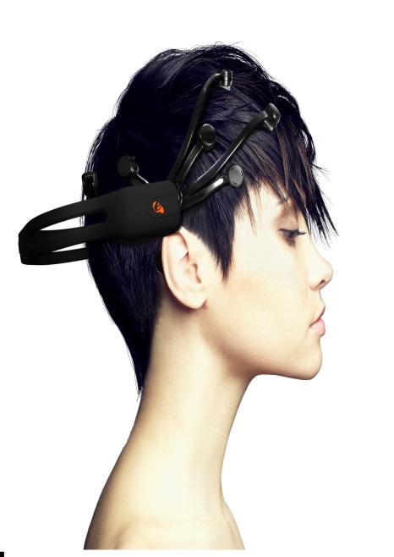
Emotiv EPOC
Wireless Neuroheadset
16 Sensor units
USB Transceiver Dongle
Gyroscope
Based on EEG technology

Slide 4





Affective Suite

Slide 5

Expressiv Suite

Slide 6
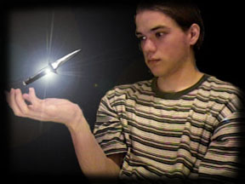
Cognitiv Suite

Slide 7
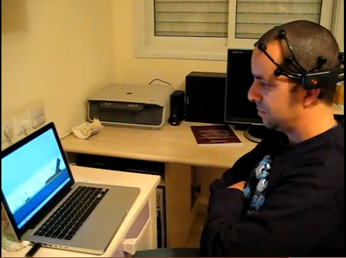


Gaming
Assistive technology
Smart house

Slide 8

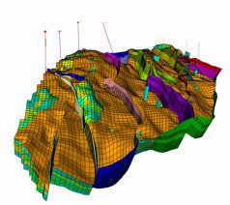
Google Earth
Petrel - 3D model

Slide 9
Video
Clip 1
Clip 2

Slide 10
Thank you!

