Slide 1

Kjell Martin Lee Anderson, Lars Kleven, Michelle Cheung, Thanh Minh Duong

Slide 2
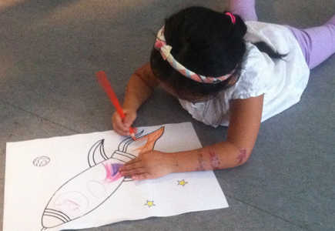
Introduction
Oslo Barnemuseum wants new activities for their mobile museum, which is going to bring interaction and fun for their young guests.
An interactive space-
ship that teaches
children various facts
about outer space
and space travelling.

Slide 3
Requirements and Goals
Oslo Barnemuseum’s requirements:
- No reading required
- No (or minimal) queues or waiting
- Engage multiple senses
- Bring strangers together for a meaningful interaction
- Built in child-size proportions(easy to reach)
- Easy transport, low cost
Make children interested in a exciting subject, outer space and space travelling, by using HCI to create a different and interesting solution

Slide 4
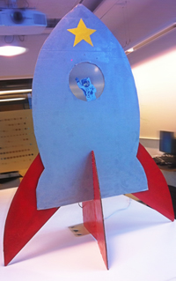
Stjerneskipet
Our prototype is a recognizable model of a space rocket.
It is based on the Arduino platform using RFID technology.
Objects that can be ”loaded” onto the ship.
Sound file containing facts about the object in question related to space will be played.
After three objects are scanned the loading phase is completed and the space rocket will launch.

Slide 5
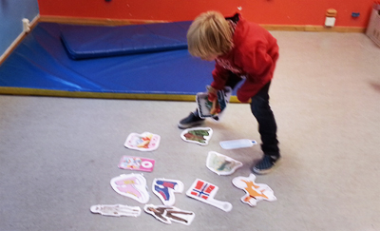
Video demonstration
http://www.youtube.com/watch?v=rhsqayY2TTw

Slide 6
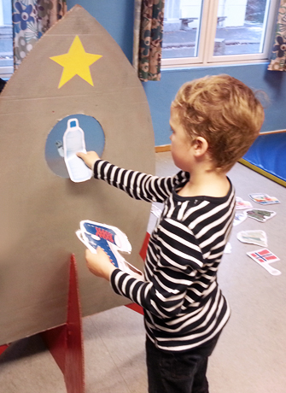
Potential
Very popularily recived by the children under testing
RFID is flexible, and it is possible for an unlimited amount of objects.
Also easy to use for children and children with impairments
A new interesting way to teach kids about space and spacecraft

Slide 7


