Slide 1
Operating Systems:
Introduction
INF1060:
Introduction to Operating Systems and Data Communication
Pål Halvorsen
Wednesday, September 11, 2013

Slide 2
Overview
Basic execution environment – an Intel example
What is an operating system (OS)?
OS components and services
(extended in later lectures)
Booting
Kernel organization

Slide 3
Hardware
Central Processing Units (CPUs)
Memory
(cache(s), RAM, ROM, Flash, …)
I/O Devices
(network cards, disks, CD, keyboard, mouse, …)
Links
(interconnects, busses, …)

Slide 4
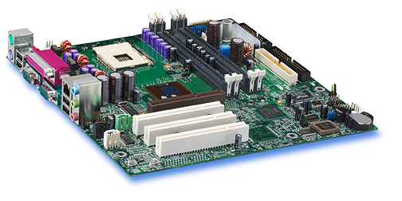
Example:
Intel Hub Architecture (850 Chipset)
Intel D850MD Motherboard:
Source: Intel® Desktop Board D850MD/D850MV Technical Product Specification

Slide 5
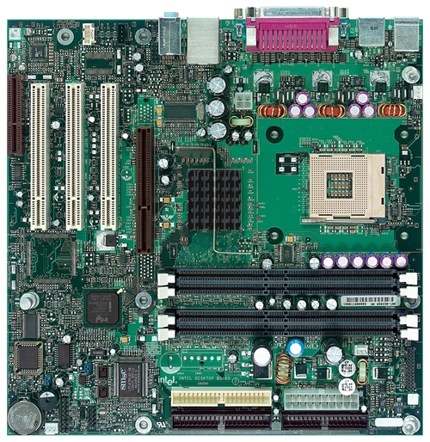
Example:
Intel Hub Architecture (850 Chipset)
Intel D850MD Motherboard:
Source: Intel® Desktop Board D850MD/D850MV Technical Product Specification
mouse, keyboard, parallel, serial, network and USB connectors
Video
PCI Connectors (slots)
Memory Controller Hub
AGP slot
system bus
Pentium 4 socket
hub
interface
RDRAM
interface
I/O Controller Hub
PCI
bus
RAMBUS RDRAM –
2 banks (4 slots)
Firmware Hub – including BIOS
Power connector
Speaker
Diskette connector
Battery
IDE drive connectors

Slide 6
Example:
Intel Hub Architecture (850 Chipset)
application
Pentium 4
Processor
file system
registers
cache(s)
disk
system bus
(64-bit, 400/533 MHz
→~24-32 Gbps)
RDRAM
memory
controller
hub
RAM interface
(two 64-bit, 200 MHz
→ ~24 Gbps)
RDRAM
RDRAM
RDRAM
hub interface
(four 8-bit, 66 MHz
→ 2 Gbps)
I/O
controller
hub
PCI slots
PCI bus
(32-bit, 33 MHz
→ 1 Gbps)
PCI slots
PCI slots
disk
Notes:
Talk about bottlenecks

Slide 7

Example:
Intel Platform Controller Hub Architecture
Sandy Bridge
Core i7
integrated
memory
controller
Pentium 4
Processor
cache(s)
registers
iGraphics
PCIe
registers
cache(s)
Flexible Display
Interface (FDI)
Direct Media Interface (DMI) /
QuickPath Interconnect (QPI)
RDRAM
memory
controller
hub
PCH
Platform
Controller
Hub
RDRAM
Peripherals
RDRAM
RDRAM
I/O
controller
hub
PCI slots
PCIe slots
PCI slots
PCIe slots
PCI slots
PCIe slots
Notes:
PCIe – ×1, ×4, ×8, ×16, ×32 , version1 = 2 Gb/s, v2 = 4Gb, v3 = 8Gb, v4 = 16Gb per lane, both directions
QPI = 12.8 GBytes/s each way (26.6) → 100 Gb/s each way

Slide 8
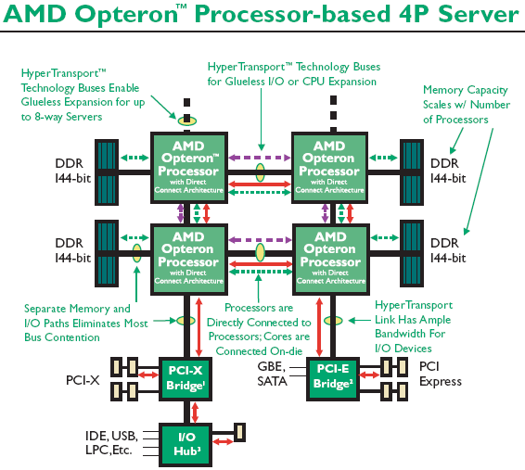
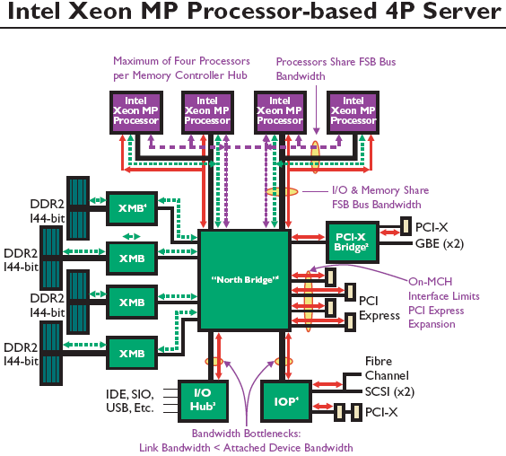
Example:
AMD Opteron & Intel Xeon
Intel Xeon MP Processor-based 4P
Different hardware may have different bottlenecks
==> nice to have an operating system to control the HW?

Slide 9
Different Hardware
Application program
Application program
Operating System
Application
Application
Operating System
Hardware X
Hardware Y

Slide 10
Intel 32-bit Architecture (IA32): Basic Execution Environment
Address space: 1 – 2³⁶ (64 GB),
each process may have a linear address space of 4 GB (2³²)
Basic program execution registers:
  8 general purpose registers (data: EAX, EBX, ECX, EDX, address: ESI, EDI, EBP, ESP)
  6 segment registers (CS, DS, SS, ES, FS and GS)
  1 flag register (EFLAGS)
  1 instruction pointer register (EIP)
Stack – a continuous array of memory locations
  Current stack is referenced by the SS register
  ESP register – stack pointer
  EBP register – stack frame base pointer (fixed reference)
  PUSH – stack grows, add item (ESP decrement)
  POP – remove item, stack shrinks (ESP increment)
Several other registers like Control, MMX/FPU,
Memory Type Range Registers (MTRRs),
SSEx (XMM), performance monitoring, …
GPRs:
X
PUSH %eax
EAX:
EBX:
ECX:
EDX:
ESI:
EDI:
EBP:
ESP: see arrow
PUSH %ebx
Y
PUSH %ecx
Z
<do something>
POP %ecx
POP %ebx
POP %eax
STACK:
...
0x0...
Z
Y
X
ESP pointer:
0xfff...
Notes:
General data registers
All of the four following registers may be used as general purpose registers. However each has some specialized purpose as well. Each of these registers also have 16-bit or 8-bit subset names.
EAX (At 000) Dedicated accumulator which is used for all major calculations.
ECX (At 001) The universal loop counter which has a special interpretation for loops.
EDX (At 010) The data register, which is an extension to the accumulator, stores data relevant to the operation applied to the accumulator.
EBX (At 011) Currently used for free storage but was originally used as a pointer in 16-bit mode
General address registers
Used only for address pointing. They have 16-bit subset names, but no 8-bit subsets.
ESP (At 100) Stack pointer. Is used to hold the top address of the stack.
EBP (At 101) Base pointer. Is used to hold the address of the current stack frame. It is also sometimes used as free storage.
ESI (At 110) Source index. Commonly used for string operations. It has a one-byte opcode for loading data from memory to the accumulator.
EDI (At 111) Destination index. Commonly used for string operations. Has a one-byte STOS instruction to write data out of the accumulator.
EIP Instruction pointer. Holds the current instruction address
STACK-FRAME BASE POINTER
The stack is typically divided into frames. Each stack frame can then contain local variables,
parameters to be passed to another procedure, and procedure linking information. The stackframe
base pointer (contained in the EBP register) identifies a fixed reference point within the
stack frame for the called procedure. To use the stack-frame base pointer, the called procedure
typically copies the contents of the ESP register into the EBP register prior to pushing any local
variables on the stack. The stack-frame base pointer then permits easy access to data structures
passed on the stack, to the return instruction pointer, and to local variables added to the stack by
the called procedure.

Slide 11
Intel 32-bit Architecture (IA32): Basic Execution Environment
Example:
code segment:
…
…
8048314 <main>:
8048314: push %ebp
8048315: mov %esp,%ebp
8048317: sub $0x18,%esp
804831a: and $0xfffffff0,%esp
804831c: mov $0x0,%eax
8048322: sub %eax,%esp
8048324: movl $0x4,0xfffffffc(%ebp)
804832b: movl $0x2,0xfffffff8(%ebp)
8048332: movl $0x0,0xfffffff4(%ebp)
8048339: mov 0xfffffff8(%ebp),%eax
804833c: add 0xfffffffc(%ebp),%eax
804833f: mov %eax,0xfffffff4(%ebp)
8048342: leave
8048343: ret
main (void)
{
int a = 4, b = 2, c = 0;
c = a + b;
}
objdump -d
insert value 4 in variable a on stack:
0xfffffffc = -(0xffffffff – 0xfffffffc) = -0x4
a’s memory address = EBP - 4
stack:
0x0...
...
...
...
sub 24 (0x18) bytes
(add space for 24 bytes)
alignment – sub "X" (here 8) bytes
0
6
2
4
old EBP
EAX:
6
EBP:
0
Accumulator for operands and results data
2
???
0xfffffff0
Pointer to data on stack (base)
ESP:
EPI:
0xffffffd8
0xffffffd0
0xfffffff4
0xfffffff0
804832b
8048314
8048315
8048317
8048322
8048324
8048332
8048339
8048342
8048343
804831a
804831c
804833c
804833f
0xfff...
Stack pointer
…
Pointer to next instruction to be executed

Slide 12
C Function Calls & Stack
A calling function does
  push the parameters into stack in reverse order
  push return address (current EIP value) onto stack
When called, a C function does
  push frame pointer (EBP) into stack - saves frame pointer register and gives easy return if necessary
  let frame pointer point at the stack top, i.e., point at the saved stack pointer (EBP = ESP)
  shift stack pointer (ESP) upward (to lower addresses) to allocate space for local variables
When returning, a C function does
  put return value in the return value register (EAX)
  copy frame pointer into stack pointer - stack top now contains the saved frame pointer
  pop stack into frame pointer (restore), leaving the return program pointer on top of the stack
  the RET instruction pops the stack top into the program counter register (EIP), causing the CPU to execute from the "return address" saved earlier
When returned to calling function, it does
  copy the return value into right place
  pop parameters – restore the stack

Slide 13
C Function Calls & Stack
int add (int a, int b)
{
return a + b;
}
main (void)
{
int c = 0;
c = add(4 , 2);
}
code segment:
Example:
…
...
8048314 <add>:
8048314: push %ebp
8048315: mov %esp,%ebp
8048317: mov 0xc(%ebp),%eax
804831a: add 0x8(%ebp),%eax
804831d: pop %ebp
804831e: ret
804831f <main>:
804831f: push %ebp
8048320: mov %esp,%ebp
8048322: sub $0x18,%esp
8048325: and $0xfffffff0,%esp
8048328: mov $0x0,%eax
804832d: sub %eax,%esp
804832f: movl $0x0,0xfffffffc(%ebp)
8048336: movl $0x2,0x4(%esp)
804833e: movl $0x4,(%esp)
8048345: call 8048314 <add>
804834a: mov %eax,0xfffffffc(%ebp)
804834d: leave
804834e: ret
804834f: nop
objdump -d
Wouldn't it be nice if this could be automatically managed!!??
→ operating system
Pop return instruction pointer
into the EIP register
Release parameters (ESP)
Resume caller execution
stack:
0x0...
“main” EBP
...
...
804834a
4
2
Push EIP register
Loads the offset of the called
procedure in the EIP register
Begin execution
6
0
old EBP
0xfff...

Slide 14
C Function Calls & Stack
extra copy
for handout
int add (int a, int b)
{
return a + b;
}
main (void)
{
int c = 0;
c = add(4 , 2);
}
code segment:
…
...
8048314 <add>:
8048314: push %ebp
8048315: mov %esp,%ebp
8048317: mov 0xc(%ebp),%eax
804831a: add 0x8(%ebp),%eax
804831d: pop %ebp
804831e: ret
804831f <main>:
804831f: push %ebp
8048320: mov %esp,%ebp
8048322: sub $0x18,%esp
8048325: and $0xfffffff0,%esp
8048328: mov $0x0,%eax
804832d: sub %eax,%esp
804832f: movl $0x0,0xfffffffc(%ebp)
8048336: movl $0x2,0x4(%esp)
804833e: movl $0x4,(%esp)
8048345: call 8048314 <add>
804834a: mov %eax,0xfffffffc(%ebp)
804834d: leave
804834e: ret
804834f: nop
Pop return instruction pointer
into the EIP register
Release parameters (ESP)
Resume caller execution
stack:
0x0...
“main” EBP
...
...
804834a
4
2
Push EIP register
Loads the offset of the called
procedure in the EIP register
Begin execution
6
0
old EBP
0xfff...

Slide 15




Many Concurrent Tasks
Better use & utilization
  many concurrent processes
    performing different tasks
    using different parts of the machine
  many concurrent users
Challenges
  “concurrent” access
  protection/security
  fairness
  …
Operating System Layer
Notes:
Bedre utnyttelse av maskinen ved at
Man kjører flere programmer samtidig
Skriver i en teksteditor samtidig som
mailsystemet sjekker om det er mail til deg, og
Klokken på skjermen oppdateres hvert sekund
...
Flere brukere på samme maskin
Flere kan være logget inn på ”mjollnir” samtidig
Hver av disse kan kjøre flere programmer
Flere prosesser på samme maskin
En som trenger mye diskIO (Web-server), og
en som trenger mye CPU-kapasitet (f.eks. vitenskapelige beregninger)
De forskjellige former for samtidighet gir tilleggsproblemer
Hvordan kjøre flere programmer ”samtidig” på en CPU?
Hvordan sørge for at de forskjellige programmene ikke går i bena på hverandre (overskriver hverandres data f.eks.)
Hvordan kontrollere de forskjellige programmenes tilgang til skjerm, disk, skriver, nettverk?

Slide 16
Many Concurrent Tasks
extra copy
for handout
Better use & utilization
  many concurrent processes
    performing different tasks
    using different parts of the machine
  many concurrent users
Challenges
  “concurrent” access
  protection/security
  fairness
  …
Operating System Layer

Slide 17
What is an Operating System (OS)?
“An operating system (OS) is a collection of programs that acts as an intermediary between the hardware and its user(s), providing a high-level interface to low level hardware resources, such as the CPU, memory, and
I/O devices. The operating system provides various facilities and services that make the use of the hardware convenient, efficient and safe”
Lazowska, E. D.: Contemporary Issues in Operating Systems , in: Encyclopedia of Computer Science, Ralston, A., Reilly, E. D. (Editors), IEEE Press, 1993, pp.980
It is an extended machine (top-down view)
  Hides the messy details
  Presents a virtual machine, easier to use
It is a resource manager (bottom-up view)
  Each program gets time/space on the resource
user
application
operating system
hardware

Slide 18



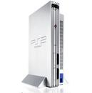


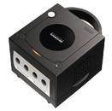

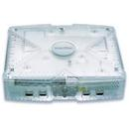




Where do we find OSes?
Computers
Game Boxes
Phones
Cars
cameras,
other vehicles/crafts,
set-top boxes,
watches,
sensors,
…

Slide 19
Operating System Categories
Single-user, single-task:
historic, and rare (only a few PDAs use this)
Single-user, multi-tasking:
PCs and workstations may be configured like this
Multi-user, multi-tasking:
used on large, old mainframes; and handhelds, PCs, workstations and servers today
Distributed OSes:
support for administration of distributed resources
Real-time OSes:
support for systems with real-time requirements like cars, nuclear reactors, etc.
Embedded OSes:
built into a device to control a specific type of equipment like cellular phones, micro waves, etc.

Slide 20
History
OSes have evolved over the last 60 years
Early history (’40s and early ’50s):
  first machines did not include OSes
  programmed using mechanical switches or wires
Second generation (’50s and ’60s):
  transistors introduced in mid-’50s
  batch systems
  card readers

Slide 21
History
Third generation (mid-’60s to the ’80s)
  integrated circuits and simple multiprogramming
  timesharing
  graphical user interface
  UNIX (’69-’70)
  BSD (’77)
Newer times (’80s to present)
  personal computers & workstations
  MS-DOS (’82), Win (’85), Minix (’87), Linux (’91), Win95, …

Slide 22
Why Study OSes?
Understand how computers work under the hood
  “you need to understand the system at all abstraction levels or you don’t” (Yale Patt)
  Easier to do things right and efficient if one knows what happens
Magic to provide infinite CPU cycles, memory, devices
and networked computing
Tradeoffs between performance and functionality,
division of labor between HW and SW
An OS is therefore a key component in many systems

Slide 23
Primary Components
"Visible" to user
  Shell
  File system
  Device management
"(Semi)Transparent"
  Processor management
  Memory management
  Communication services
Application program layer
Operating system layer
User interface
File
Device
(shell)
management
management
Processor
Memory
Communication
(or process)
management
services
management
Hardware layer
Notes:
Visible / transparent depend on the level…

Slide 24
Primary Components
File Management (file system):
provides a mechanism for the user to
create, delete, modify and manipulate files
Application program layer
User Interface:
provides a mechanism for user and
application to communicate with OS
and use the machine resources
Operating system layer
Device Management:
provides the system with means to
control the systems peripheral devices
like keyboard, display, printer and disk
User interface
File
Device
(shell)
management
management
Processor
Management of processes:
provides a mechanism for the system
to efficiently and fair manage the
machine CPU cycles for the running
processes
Memory
Communication:
provides a mechanism for the system
communicate with other processes (on
same or another machine)
(or process)
Communication
management
management
services
Hardware layer
Note: this list of components is
not complete. Some OSes have
fewer, others more. Some have
sub-components
Memory Management:
provides a mechanism for the system
to efficiently manage the system’s
memory recourses – allocating space
to processes
Notes:
A file is identified by a name and logically organize data instead of directly accessing for a device to read data
A file system manages files in the OS
structure, name, access, protection, implementation, storage, …
A process is a running program
A CPU can perform one task at a time (though pipelined) but process interleaving gives an illusion of parallelism
each process runs for a small time period the scheduling mechanism determine how to order according to a policy
Each process have metadata about itself, like
memory location, status, open files, …
which is stored in a process control block (PCB)
Each running process needs space to store data and instructions
each must be loaded removed from memory
keep track of free memory
prevent a process to use other memory areas than it has been assigned
select which memory item to remove if full
Internal communication is often performed using
mail boxes, messages, shared memory, …
Network communication is built on the I/O services
protocols like IP, TCP, UDP
services like file transfer, remote login, remote procedure calls,...
MORE IN THE LAST PART OF THE COURSE

Slide 25
Device Management
The OS must be able to control pheripal devices such as disk, keyboard, network cards, screen, speakers, mouse, memory sticks, camera, DVD, michrophone, printers, joysticks, ...
  large diversity
  varying speeds
  different access modes
Device
Device
controller
Device
driver
Rest of the
operating
system
Device
Device
controller
Device
driver
.
.
.
.
.
.
Device
Device
controller
Device
driver
Device

Slide 26
Device Management
Device controllers often have
registers to hold status, give commands, …
  port I/O – special instructions to talk to device memory
  memory mapped I/O – registers mapped into regular memory
Each device may be different and require device-spesific software
The software talking to the controller and giving commands is often called a device driver
  usually running within the kernel
  mostly provided by the device vendors
  translating device-independent commands, e.g.,
  read from file on disk: logical block number → device interface (device, cylinder, head, sector(s))
A huge amount of code (95% of the Linux code!!??)
Device
Device
controller
Device
driver
Rest of the
operating
system
Device
Device
controller
Device
driver
.
.
.
.
.
.
Device
Device
controller
Device
driver
Device

Slide 27
Device Management
extra copy
for handout
Device controllers often have
registers to hold status, give commands, …
  port I/O – special instructions to talk to device memory
  memory mapped I/O – registers mapped into regular memory
Each device may be different and require device-spesific software
The software talking to the controller and giving commands is often called a device driver
  usually running within the kernel
  mostly provided by the device vendors
  translating device-independent commands, e.g.,
  read from file on disk: logical block number → device, cylinder, head, sector(s)
A huge amount of code (95% of the Linux code!!??)

Slide 28
Interfaces
A point of connection between components
The OS incorporates logic that support interfaces with both hardware and applications, e.g.,
  command line interface, e.g., a shell
  graphical user interface (GUI)
    interface consisting of windows, icons, menus and pointers
    often not part of the OS (at least not kernel), but an own program
  …
Example: X (see man X)
  network transparent window system running on most ANSI C and POSIX (portable OS interface for UNIX) compliant systems
  uses inter-process communication to get input from and send output to various client programs
  xdm (X Display Manager) – usually set by administrator to run automatically at boot time
  xinit – manually starting X (startx, x11, xstart, …)

Slide 29
Windows Interfaces
The GUI incorporates a
command line shell similar
to the MS-DOS interface
Applications access HW
through the API consisting of
a set of routines, protocols and
other tools

Slide 30

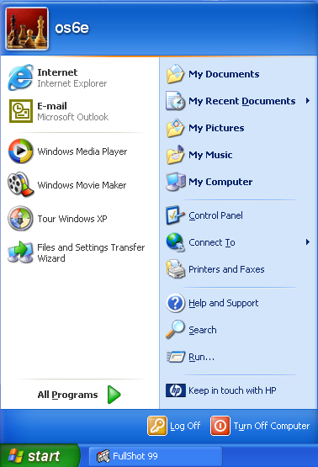
The WinXP Desktop Interface
Start button
Taskbar
Notification area

Slide 31
UNIX Interfaces
Applications are accessed HW through
the API consisting of a set of routines,
protocols and other tools (e.g., POSIX –
portable OS interface for UNIX)
A user can interact with the system
through the application interface or
using a command line prosessed by
a shell (not really a part of the OS)
A plain command line interface may
be hard to use. Many UNIX systems
therefore have a standard graphical
interface (X Windows) which can run
a desktop system (like KDE, Gnome,
Fvwm, Afterstep, …)
Windows is more or less similar…

Slide 32
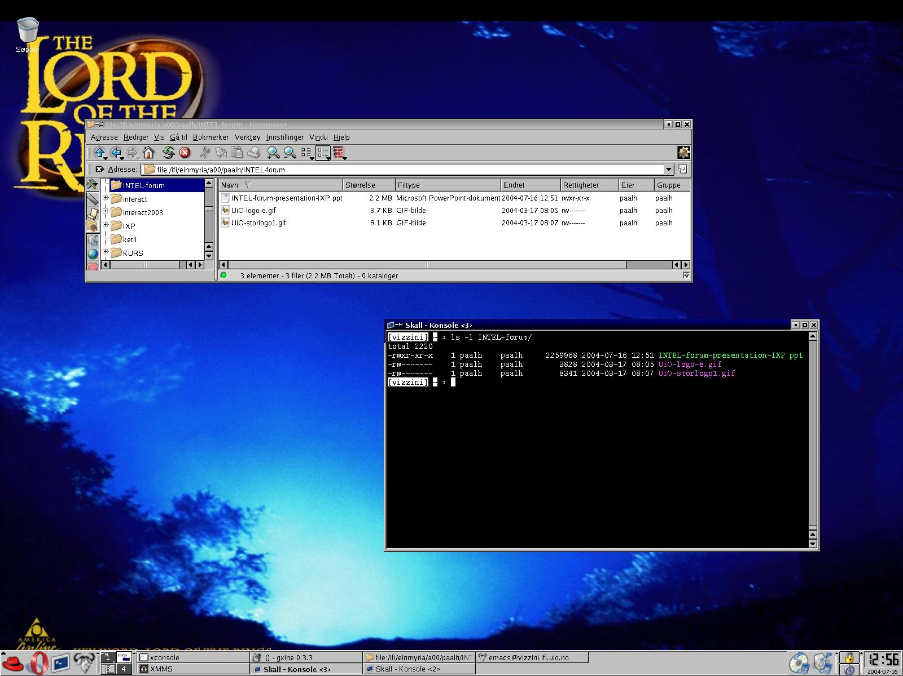
A Linux (KDE) Desktop Interface
Desktop
Application Starter
Virtual Desktops
Panel
Taskbar

Slide 33
Typical (UNIX) Line Commands

Slide 34
System Calls
sys_acct(const char *name)
sys_acct(const char * filename)
sys_capget(cap_user_header_t header, cap_user_data_t dataptr)
sys_capset(cap_user_header_t header, const cap_user_data_t data)
sys_exit(int error_code)
sys_wait4(pid_t pid,unsigned int * stat_addr, int options, struct rusage * ru)
sys_waitpid(pid_t pid,unsigned int * stat_addr, int options)
sys_futex(void *uaddr, int op, int val, struct timespec *utime)
sys_sysinfo(struct sysinfo *info)
sys_getitimer(int which, struct itimerval *value)
sys_setitimer(int which, struct itimerval *value,
sys_sync(void); /* it's really int */
sys_syslog(int type, char * buf, int len)
sys_nice(int increment)
sys_sched_setscheduler(pid_t pid, int policy,
sys_sched_setparam(pid_t pid, struct sched_param *param)
sys_sched_getscheduler(pid_t pid)
sys_sched_getparam(pid_t pid, struct sched_param *param)
sys_sched_setaffinity(pid_t pid, unsigned int len,
sys_sched_getaffinity(pid_t pid, unsigned int len,
sys_sched_yield(void)
sys_sched_get_priority_max(int policy)
sys_sched_get_priority_min(int policy)
sys_sched_rr_get_interval(pid_t pid, struct timespec *interval)
sys_ni_syscall(void)
sys_setpriority(int which, int who, int niceval)
sys_getpriority(int which, int who)
sys_reboot(int magic1, int magic2, unsigned int cmd, void * arg)
sys_setregid(gid_t rgid, gid_t egid)
sys_setgid(gid_t gid)
sys_setreuid(uid_t ruid, uid_t euid)
sys_setuid(uid_t uid)
sys_setresuid(uid_t ruid, uid_t euid, uid_t suid)
sys_getresuid(uid_t *ruid, uid_t *euid, uid_t *suid)
sys_setresgid(gid_t rgid, gid_t egid, gid_t sgid)
sys_getresgid(gid_t *rgid, gid_t *egid, gid_t *sgid)
sys_setfsuid(uid_t uid)
sys_setfsgid(gid_t gid)
sys_times(struct tms * tbuf)
sys_setpgid(pid_t pid, pid_t pgid)
sys_getpgid(pid_t pid)
sys_getpgrp(void)
sys_getsid(pid_t pid)
sys_setsid(void)
sys_getgroups(int gidsetsize, gid_t *grouplist)
sys_setgroups(int gidsetsize, gid_t *grouplist)
sys_newuname(struct new_utsname * name)
sys_sethostname(char *name, int len)
sys_gethostname(char *name, int len)
sys_setdomainname(char *name, int len)
sys_getrlimit(unsigned int resource, struct rlimit *rlim)
sys_old_getrlimit(unsigned int resource, struct rlimit *rlim)
sys_setrlimit(unsigned int resource, struct rlimit *rlim)
sys_getrusage(int who, struct rusage *ru)
sys_umask(int mask)
sys_socket(int family, int type, int protocol)
sys_socketpair(int family, int type, int protocol, int usockvec[2])
sys_bind(int fd, struct sockaddr *umyaddr, int addrlen)
sys_listen(int fd, int backlog)
sys_accept(int fd, struct sockaddr *upeer_sockaddr, int *upeer_addrlen)
sys_connect(int fd, struct sockaddr *uservaddr, int addrlen)
sys_getsockname(int fd, struct sockaddr *usockaddr, int *usockaddr_len)
sys_getpeername(int fd, struct sockaddr *usockaddr, int *usockaddr_len)
sys_sendto(int fd, void * buff, size_t len, unsigned flags,
sys_send(int fd, void * buff, size_t len, unsigned flags)
sys_recvfrom(int fd, void * ubuf, size_t size, unsigned flags,
sys_recv(int fd, void * ubuf, size_t size, unsigned flags)
sys_setsockopt(int fd, int level, int optname, char *optval, int optlen)
sys_getsockopt(int fd, int level, int optname, char *optval, int *optlen)
sys_shutdown(int fd, int how)
sys_sendmsg(int fd, struct msghdr *msg, unsigned flags)
sys_recvmsg(int fd, struct msghdr *msg, unsigned int flags)
sys_socketcall(int call, unsigned long *args)
sys_tux (unsigned int action, user_req_t *u_info)
sys_io_setup(unsigned nr_reqs, aio_context_t *ctxp)
sys_io_destroy(aio_context_t ctx)
sys_io_submit(aio_context_t ctx_id, long nr,
sys_io_cancel(aio_context_t ctx_id, struct iocb *iocb,
sys_io_getevents(aio_context_t ctx_id,
sys_sync(void)
sys_fsync(unsigned int fd)
sys_fdatasync(unsigned int fd)
sys_bdflush(int func, long data)
sys_getcwd(char *buf, unsigned long size)
sys_uselib(const char * library)
sys_dup2(unsigned int oldfd, unsigned int newfd)
sys_dup(unsigned int fildes)
sys_fcntl(unsigned int fd, unsigned int cmd, unsigned long arg)
sys_fcntl64(unsigned int fd, unsigned int cmd, unsigned long arg)
sys_nfsservctl(int cmd, void *argp, void *resp)
sys_ioctl(unsigned int fd, unsigned int cmd, unsigned long arg)
sys_flock(unsigned int fd, unsigned int cmd)
sys_mknod(const char * filename, int mode, dev_t dev)
sys_mkdir(const char * pathname, int mode)
sys_rmdir(const char * pathname)
sys_unlink(const char * pathname)
sys_symlink(const char * oldname, const char * newname)
sys_link(const char * oldname, const char * newname)
sys_rename(const char * oldname, const char * newname)
sys_umount(char * name, int flags)
sys_oldumount(char * name)
sys_mount(char * dev_name, char * dir_name, char * type,
sys_pivot_root(const char *new_root, const char *put_old)
sys_statfs(const char * path, struct statfs * buf)
sys_fstatfs(unsigned int fd, struct statfs * buf)
sys_truncate(const char * path, unsigned long length)
sys_ftruncate(unsigned int fd, unsigned long length)
sys_truncate64(const char * path, loff_t length)
sys_ftruncate64(unsigned int fd, loff_t length)
sys_fchdir(unsigned int fd)
sys_chroot(const char * filename)
sys_open(const char * filename, int flags, int mode)
sys_creat(const char * pathname, int mode)
sys_close(unsigned int fd)
sys_vhangup(void)
sys_lseek(unsigned int fd, off_t offset, unsigned int origin)
sys_llseek(unsigned int fd, unsigned long offset_high,
sys_read(unsigned int fd, char * buf, size_t count)
sys_write(unsigned int fd, const char * buf, size_t count)
sys_readv(unsigned long fd, const struct iovec * vector,
sys_writev(unsigned long fd, const struct iovec * vector,
sys_pread(unsigned int fd, char * buf,
sys_pwrite(unsigned int fd, const char * buf,
sys_getdents(unsigned int fd, void * dirent, unsigned int count)
sys_getdents64(unsigned int fd, void * dirent, unsigned int count)
sys_poll(struct pollfd * ufds, unsigned int nfds, long timeout)
sys_stat(char * filename, struct __old_kernel_stat * statbuf)
sys_newstat(char * filename, struct stat * statbuf)
sys_lstat(char * filename, struct __old_kernel_stat * statbuf)
sys_newlstat(char * filename, struct stat * statbuf)
sys_fstat(unsigned int fd, struct __old_kernel_stat * statbuf)
sys_newfstat(unsigned int fd, struct stat * statbuf)
sys_readlink(const char * path, char * buf, int bufsiz)
sys_stat64(char * filename, struct stat64 * statbuf, long flags)
sys_lstat64(char * filename, struct stat64 * statbuf, long flags)
sys_fstat64(unsigned long fd, struct stat64 * statbuf, long flags)
sys_sysfs(int option, unsigned long arg1, unsigned long arg2)
sys_ustat(dev_t dev, struct ustat * ubuf)
sys_sendfile(int out_fd, int in_fd, off_t *offset, size_t count)
sys_readahead(int fd, loff_t offset, size_t count)
sys_msync(unsigned long start, size_t len, int flags)
sys_madvise(unsigned long start, size_t len, int behavior)
sys_mincore(unsigned long start, size_t len,
sys_mlock(unsigned long start, size_t len)
sys_munlock(unsigned long start, size_t len)
sys_mlockall(int flags)
sys_munlockall(void)
sys_brk(unsigned long brk)
sys_munmap(unsigned long addr, size_t len)
sys_mprotect(unsigned long start, size_t len, unsigned long prot)
sys_mremap(unsigned long addr,
sys_swapoff(const char * specialfile)
sys_swapon(const char * specialfile, int swap_flags)
sys_msgget (key_t key, int msgflg)
sys_msgctl (int msqid, int cmd, struct msqid_ds *buf)
sys_msgsnd (int msqid, struct msgbuf *msgp, size_t msgsz, int msgflg)
sys_msgrcv (int msqid, struct msgbuf *msgp, size_t msgsz,
sys_semget (key_t key, int nsems, int semflg)
sys_semctl (int semid, int semnum, int cmd, union semun arg)
sys_semop (int semid, struct sembuf *tsops, unsigned nsops)
sys_shmget (key_t key, size_t size, int shmflg)
sys_shmctl (int shmid, int cmd, struct shmid_ds *buf)
sys_shmat (int shmid, char *shmaddr, int shmflg, ulong *raddr)
sys_shmdt (char *shmaddr)
sys_semget (key_t key, int nsems, int semflg)
sys_semop (int semid, struct sembuf *sops, unsigned nsops)
sys_semctl (int semid, int semnum, int cmd, union semun arg)
sys_msgget (key_t key, int msgflg)
sys_msgsnd (int msqid, struct msgbuf *msgp, size_t msgsz, int msgflg)
sys_msgrcv (int msqid, struct msgbuf *msgp, size_t msgsz, long msgtyp,
sys_msgctl (int msqid, int cmd, struct msqid_ds *buf)
sys_shmget (key_t key, size_t size, int shmflag)
sys_shmat (int shmid, char *shmaddr, int shmflg, ulong *addr)
sys_shmdt (char *shmaddr)
sys_shmctl (int shmid, int cmd, struct shmid_ds *buf)
sys_ioperm(unsigned long from, unsigned long num, int turn_on)
sys_iopl(unsigned long unused)
sys_modify_ldt(int func, void *ptr, unsigned long bytecount)
sys_fork(struct pt_regs regs)
sys_clone(struct pt_regs regs)
sys_vfork(struct pt_regs regs)
sys_execve(struct pt_regs regs)
sys_ptrace(long request, long pid, long addr, long data)
syscall_trace(void)
sys_sigreturn(unsigned long __unused)
sys_rt_sigreturn(unsigned long __unused)
sys_pipe(unsigned long * fildes)
sys_mmap2(unsigned long addr, unsigned long len,
old_mmap(struct mmap_arg_struct *arg)
sys_select(int, fd_set *, fd_set *, fd_set *, struct timeval *);
old_select(struct sel_arg_struct *arg)
sys_ipc (uint call, int first, int second,
sys_uname(struct old_utsname * name)
sys_olduname(struct oldold_utsname * name)
sys_pause(void)
system_call(void);
trace_real_syscall_entry(struct pt_regs * regs)
trace_real_syscall_exit(void)
sys_vm86old(struct vm86_struct * v86)
sys_vm86(unsigned long subfunction, struct vm86plus_struct * v86)
sys_prctl(int option, unsigned long arg2, unsigned long arg3,
sys_sysctl(struct __sysctl_args *args)
sys_sysctl(struct __sysctl_args *args)
ys_time(int * tloc)
sys_stime(int * tptr)
sys_gettimeofday(struct timeval *tv, struct timezone *tz)
sys_settimeofday(struct timeval *tv, struct timezone *tz)
sys_adjtimex(struct timex *txc_p)
sys_alarm(unsigned int seconds)
sys_getpid(void)
sys_getppid(void)
sys_getuid(void)
sys_geteuid(void)
sys_getgid(void)
sys_getegid(void)
sys_gettid(void)
sys_nanosleep(struct timespec *rqtp, struct timespec *rmtp)
sys_chown(const char *, uid_t,gid_t);
sys_lchown(const char *, uid_t,gid_t);
sys_fchown(unsigned int, uid_t,gid_t);
sys_setregid(gid_t, gid_t);
sys_setgid(gid_t);
sys_setreuid(uid_t, uid_t);
sys_setuid(uid_t);
sys_setresuid(uid_t, uid_t, uid_t);
sys_setresgid(gid_t, gid_t, gid_t);
sys_setfsuid(uid_t);
sys_setfsgid(gid_t);
sys_chown16(const char * filename, old_uid_t user, old_gid_t group)
sys_lchown16(const char * filename, old_uid_t user, old_gid_t group)
sys_fchown16(unsigned int fd, old_uid_t user, old_gid_t group)
sys_setregid16(old_gid_t rgid, old_gid_t egid)
sys_setgid16(old_gid_t gid)
sys_setreuid16(old_uid_t ruid, old_uid_t euid)
sys_setuid16(old_uid_t uid)
sys_setresuid16(old_uid_t ruid, old_uid_t euid, old_uid_t suid)
sys_getresuid16(old_uid_t *ruid, old_uid_t *euid, old_uid_t *suid)
sys_setresgid16(old_gid_t rgid, old_gid_t egid, old_gid_t sgid)
sys_getresgid16(old_gid_t *rgid, old_gid_t *egid, old_gid_t *sgid)
sys_setfsuid16(old_uid_t uid)
sys_setfsgid16(old_gid_t gid)
sys_getgroups16(int gidsetsize, old_gid_t *grouplist)
sys_setgroups16(int gidsetsize, old_gid_t *grouplist)
sys_getuid16(void)
sys_geteuid16(void)
sys_getgid16(void)
sys_getegid16(void)
sys_utime(char * filename, struct utimbuf * times)
sys_utimes(char * filename, struct timeval * utimes)
sys_access(const char * filename, int mode)
sys_chdir(const char * filename)
sys_fchmod(unsigned int fd, mode_t mode)
sys_chmod(const char * filename, mode_t mode)
sys_chown(const char * filename, uid_t user, gid_t group)
sys_lchown(const char * filename, uid_t user, gid_t group)
sys_fchown(unsigned int fd, uid_t user, gid_t group)
Linux system calls
(2.4.19):
The interface between the OS and users is defined by a set of system calls
Making a system call is similar to a procedure/function call, but system calls enter the kernel:
application
application
application
user space
kernel space
system call interface
Linux:
x86 v2.4.19 entry.S → 242
x86 v3.0-rc4 syscall_table_32.S → 347
FreeBSD:
v9 syscalls.c → 531
OS components

Slide 35

System Calls: read
C example:
count = read(fd,buffer,nbyte)
push parameters on stack
call library code
put system call number in register
call kernel (TRAP)
  kernel examines system call number
  finds requested system call handler
  execute requested operation
return to library and clean up
  increase instruction pointer
  remove parameters from stack
resume process
read library
procedure
register
X (read)
count = read (fd , buffer , nbytes)
application
memory (stack)
buffer
nbytes
buffer
user space
kernel space
fd
system call
handler
X
sys_read()

Slide 36
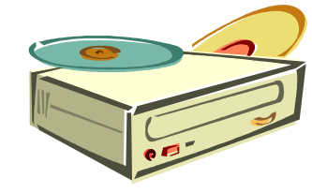










Interrupt Program Execution
CPU

Slide 37
Interrupts
Interrupts are electronic signals that (usually) result in a forced transfer of control to an interrupt handling routine
  alternative to polling
  caused by asynchronous events like finished disk operations, incoming network packets, expired timers, …
  an interrupt descriptor table (IDT) associates each interrupt with a code descriptor (pointer to code segment)
  can be disabled or masked out

Slide 38
Exceptions
Another way for the processor to interrupt program
execution is exceptions
  caused by synchronous events generated when the processor detects a predefined condition while executing an instruction
  TRAPS: the processor reaches a condition the exception handler can handle (e.g., overflow, break point in code like making a system call, …)
  FAULTS: the processor reaches a fault the exception handler can correct (e.g., division by zero, wrong data format, …)
  ABORTS: terminate the process due to an unrecoverable error
  (e.g., hardware failure) which the process itself cannot correct
  the processor responds to exceptions (i.e., traps and faults) essentially as for interrupts

Slide 39





Interrupt (and Exception) Handling
The IA-32 has an interrupt description table (IDT) with 256 entries for interrupts and exceptions
  32 (0 - 31) predefined and reserved
  224 (32 - 255) is "user" (operating system) defined
Each interrupt is associated with a code segment through
the IDT and a unique index value giving management like this:
  process running while interrupt occur
  capture state, switch control
  and find right interrupt handler
  execute the interrupt handler
  restore interrupted process
  continue execution
user
kernel
disk interrupt (x)
IDT:
Interrupt routines:

Slide 40
Booting
Memory is a volatile, limited resource: OS usually on disk
Most motherboards contain a basic input/output system (BIOS) chip (often flash RAM) – stores instructions for basic HW initialization and management, and initiates the …
... bootstrap: loads the OS into memory
  read the boot program from a known location on secondary storage typically first sector(s), often called master boot record (MBR)
  run boot program
    read root file system and locate file with OS kernel
    load kernel into memory
    run kernel

Slide 41
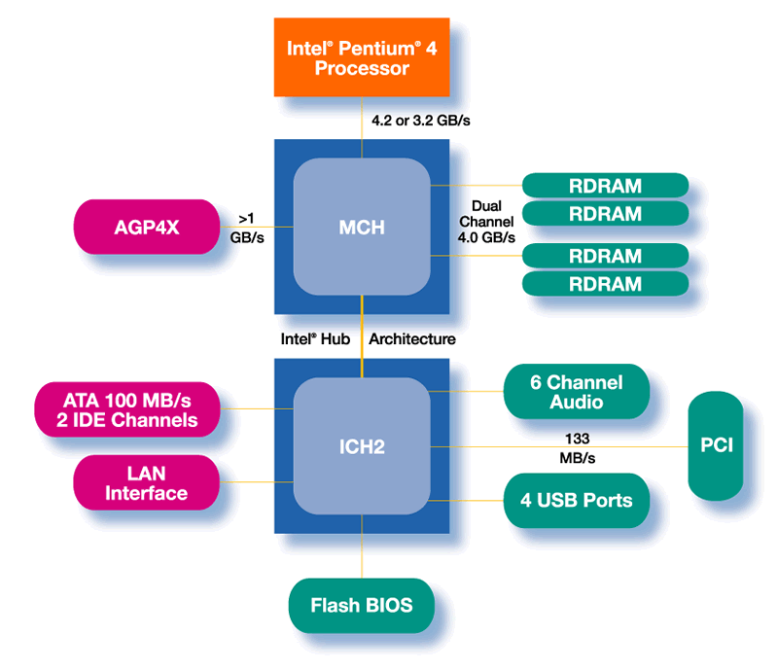

Booting
Gather HW information and set up system
Load data from boot sector
Execute boot program an CPU
Load OS from disk
Run OS
boot
OS
boot
OS

Slide 42
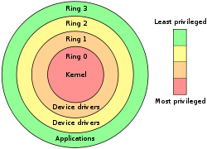
User Level vs. Kernel Level (Protection)
Many OSes distinguish user and kernel level,
i.e., due to security and protection
Usually, applications and many sub-systems
run in user mode (pentium level 3)
  protected mode
  not allowed to access HW or device drivers
  directly, only through an API
  access to assigned memory only
  limited instruction set
OSes run in kernel mode
(under the virtual machine abstraction, pentium level 0)
  real mode
  access to the entire memory
  all instructions can be executed
  bypass security

Slide 43
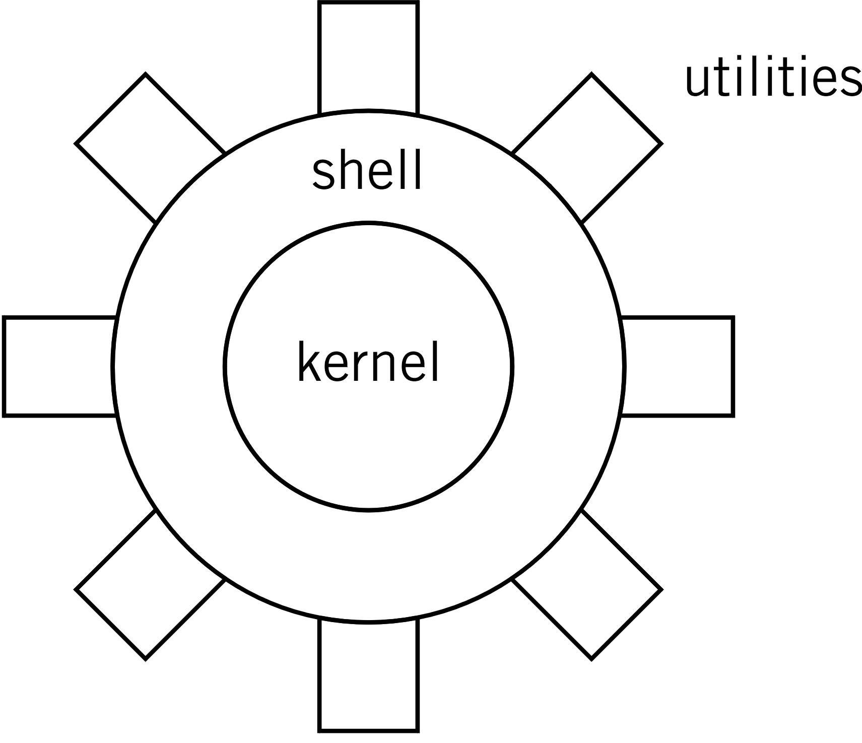
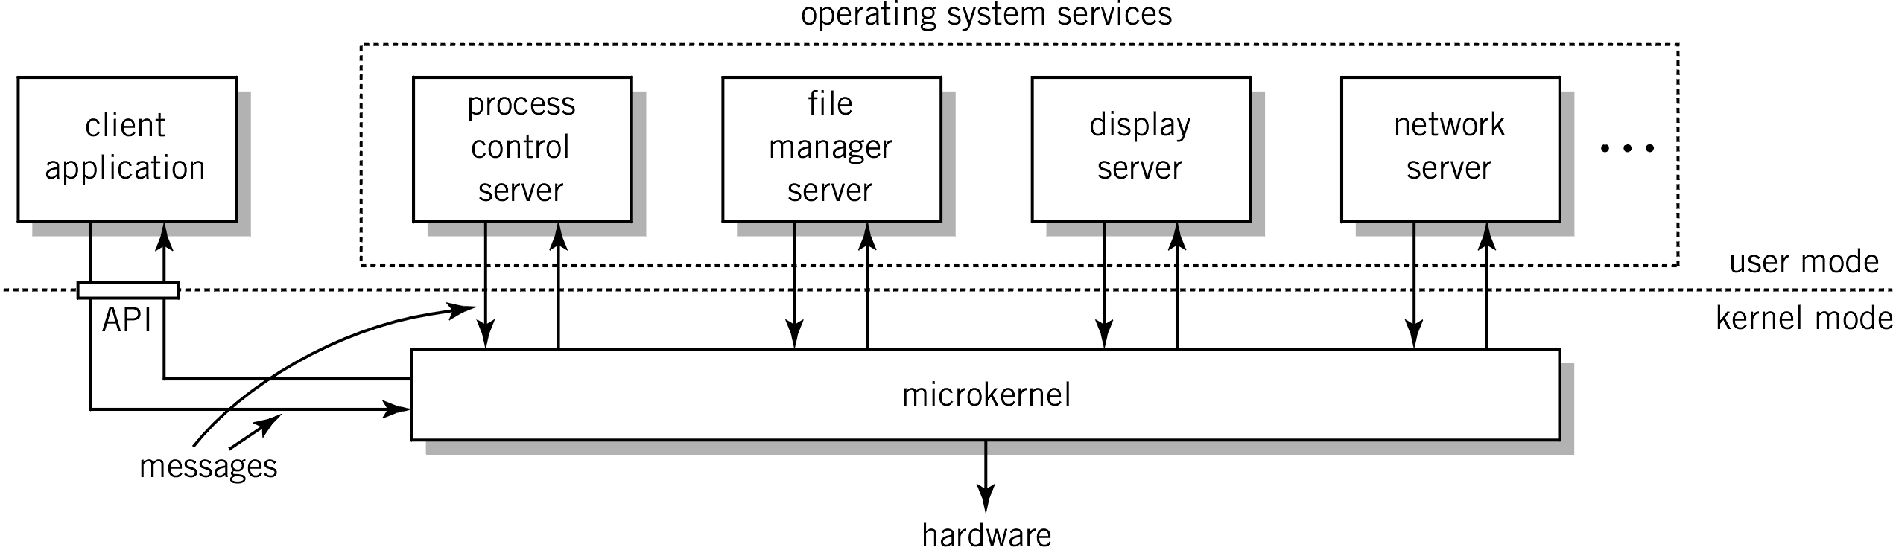
OS Organization
No standard describing how to organize a kernel (as it is for compilers, communication protocols, etc.) and several approaches exist, e.g.:
Monolithic kernels (“the big mess”):
  written as a collection of functions linked into a single object
  usually efficient (no boundaries to cross)
  large, complex, easy to crash
  UNIX, Linux, …
Micro kernels
  kernel with minimal functionality (managing interrupts, memory, processor)
  other services are implemented in server processes running in user space
  used in a client-server model
  lot of message passing
  (inefficient)
  small, modular,
  extensible, portable, …
  MACH, L4, Chorus, …

Slide 44
Summary
OSes are found “everywhere” and provide virtual machines and work as a resource managers
Many components providing different services
Users access the services using an interface like system calls
In the next lectures, we look closer at some of the main components and abstractions in an OS
  processes management
  memory management
  storage management
  local inter-process communication
  inter-computer network communication is covered in the
  last part of the course

