Slide 1
“Oh sorry,
I thought you were a chatbot 😳”

Slide 2
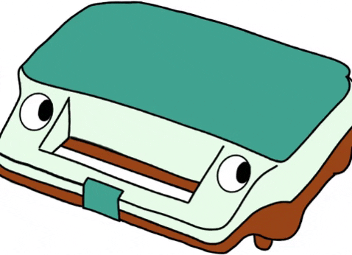
Area of interest & motivation
Chatbot
  ToastBot
Language
Notes:
We used the chatbot we had in oblig 1 (wanted to investigate the mechanics of this one further)

Slide 3
Research question
“Are users less formal when they know they are chatting with a robot compared to when they think they are chatting with a human?”

Slide 4
Hypothesis
“Users are less formal when they know they are chatting with a robot compared to when they think they are chatting with a human.”
Notes:
The hypothesis we want to investigate through our project

Slide 5

Background
There is no consensus in the scientific community regarding language (Elgan and Elgan 2018; Gupta, Walker, and Romano 2007; Needleman 2017)
Cultural component of politeness (Benotti and Blackburn 2016; Gupta, Walker, and Romano 2007).
Lack of contextual information (Benotti and Blackburn 2016;Luger and Sellen 2016).
Politeness ≈ formality (?)

Slide 6
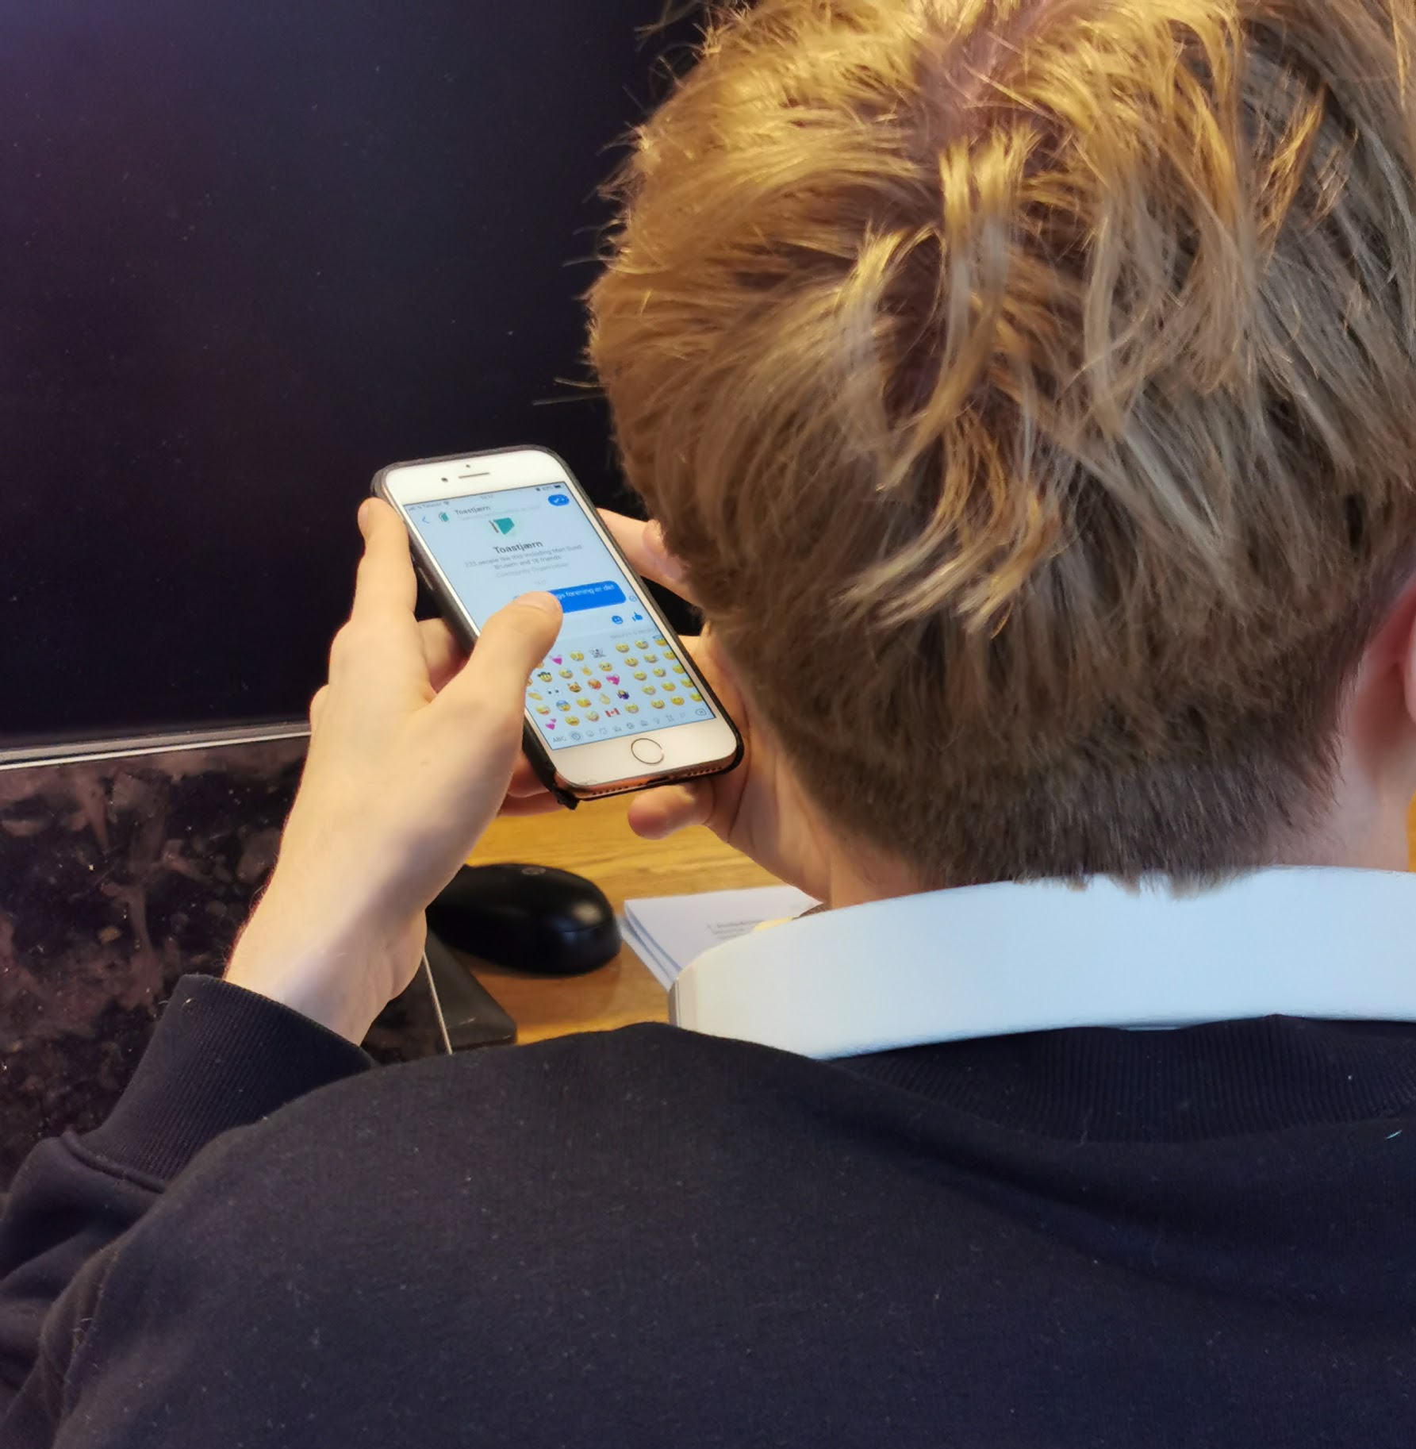
Method
Experimental research
Between-group
Chatbot versus human
Wizard of Oz

Slide 7
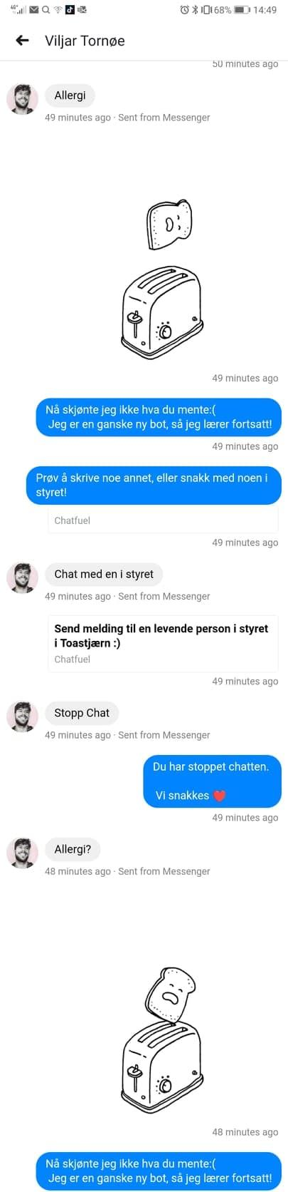
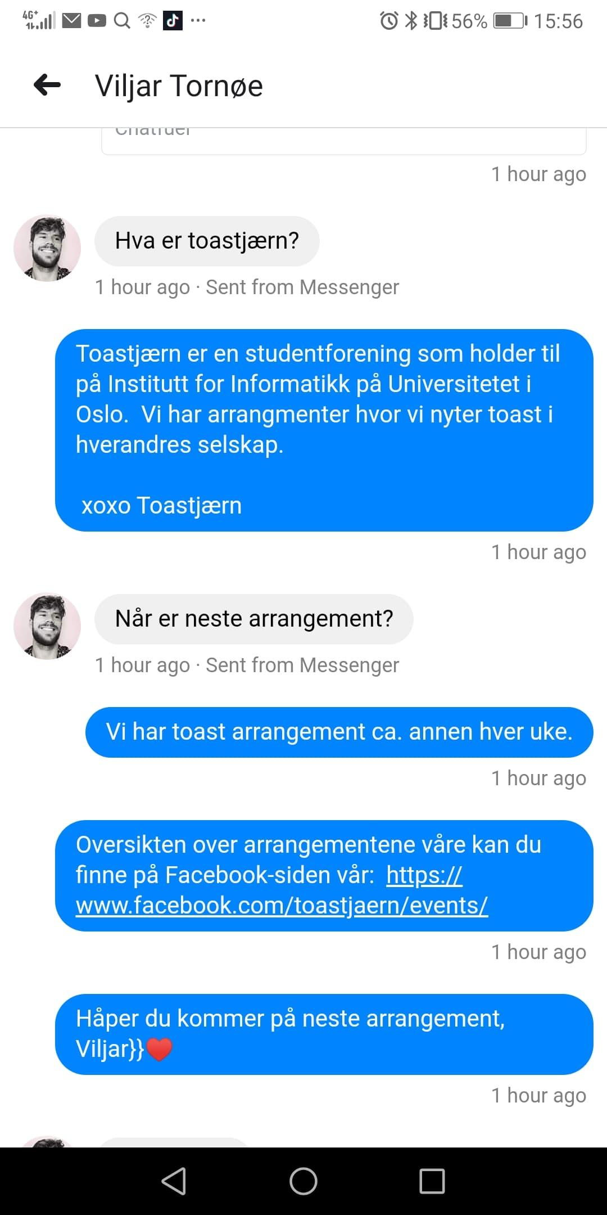
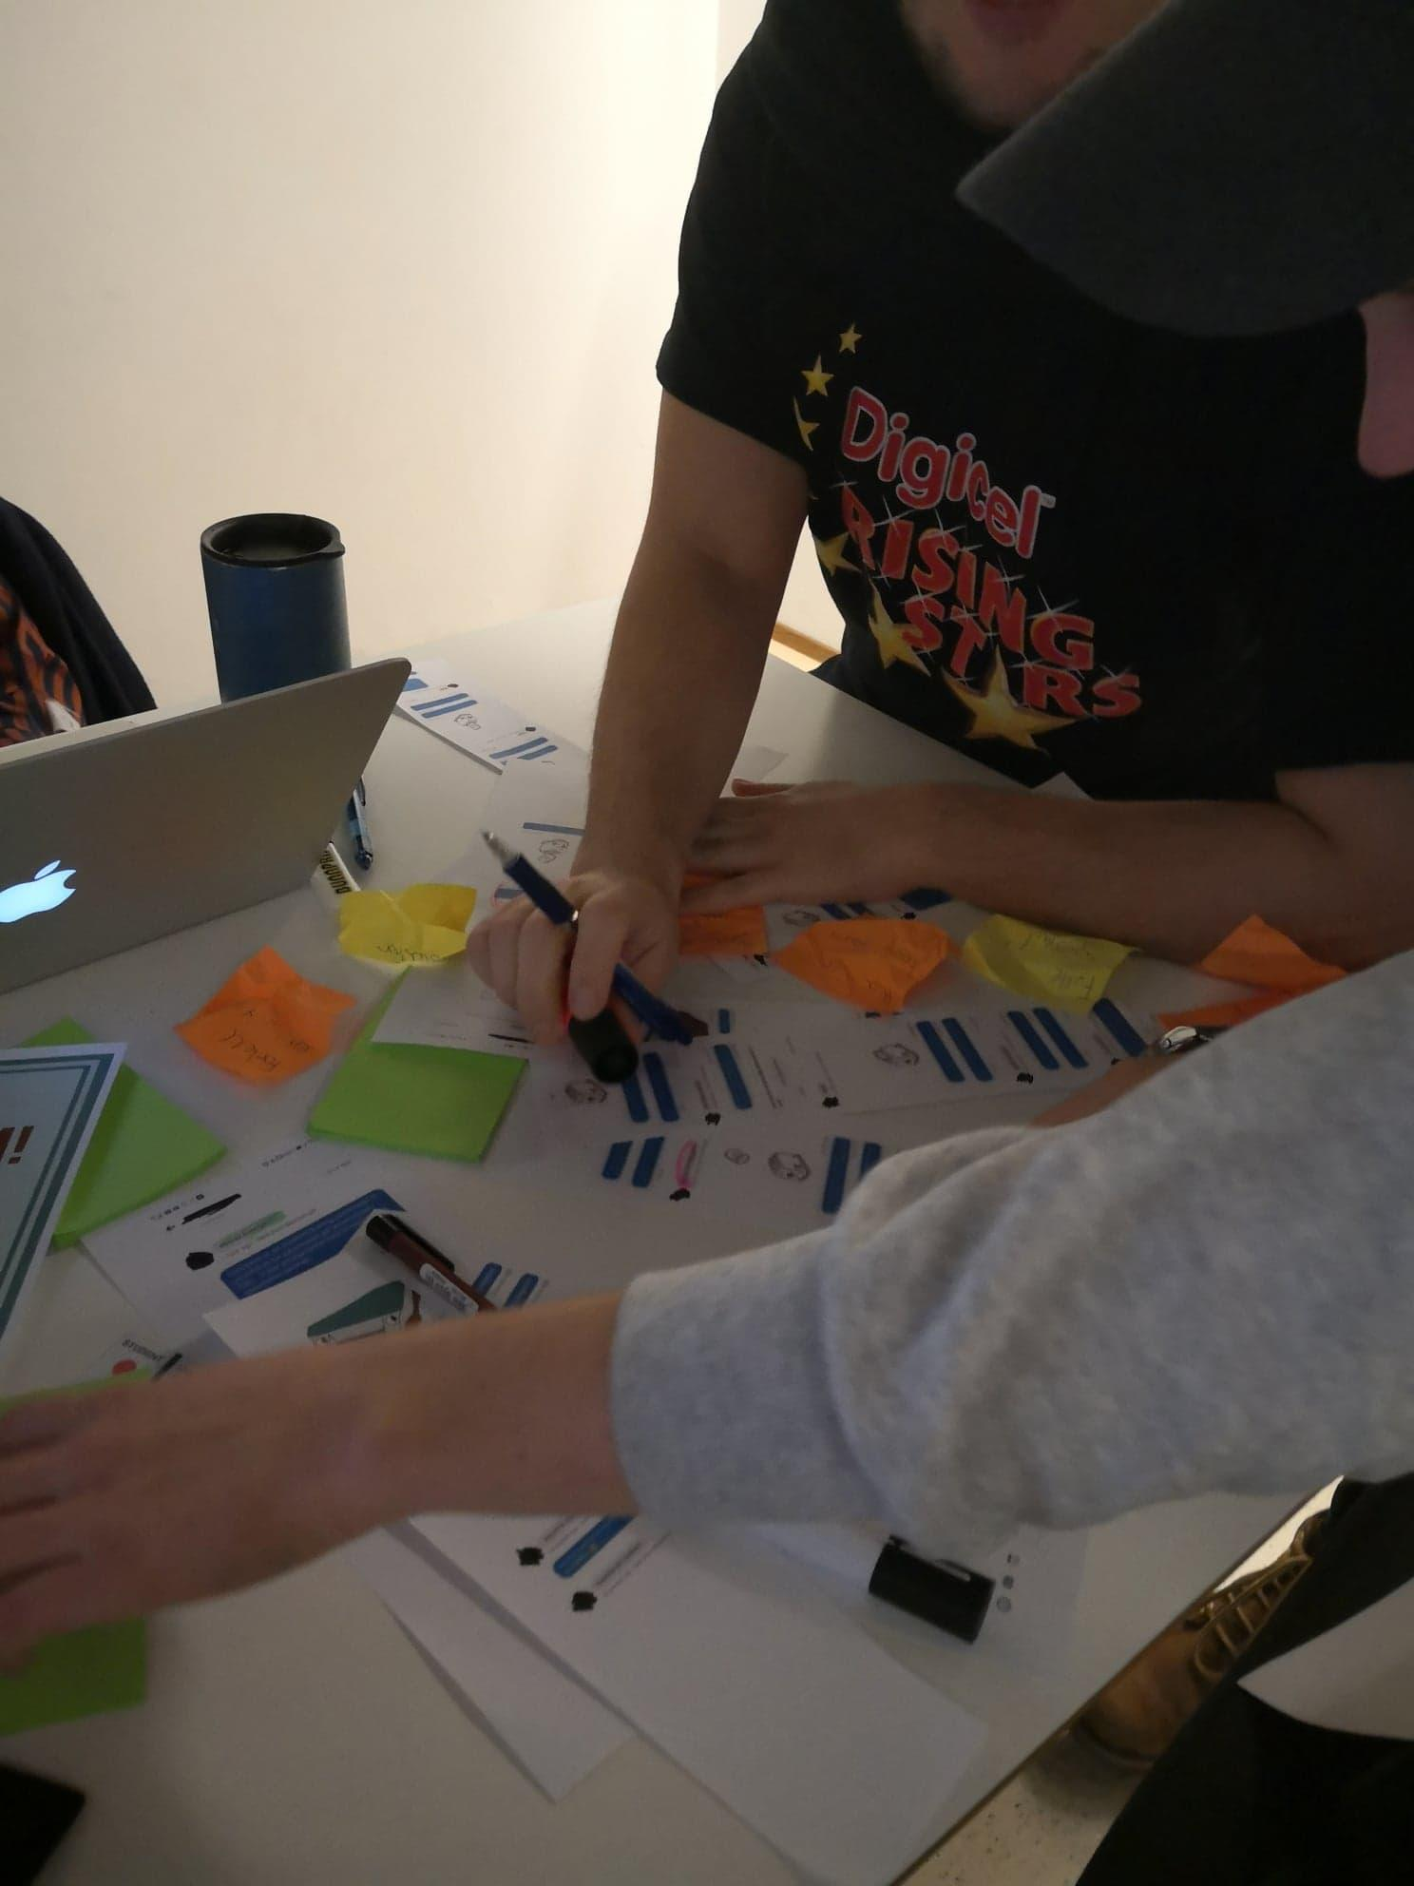
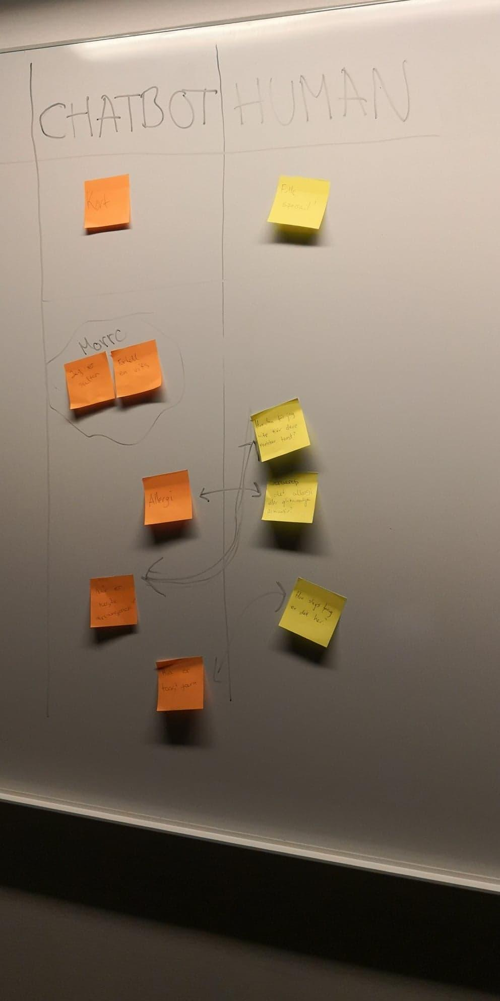
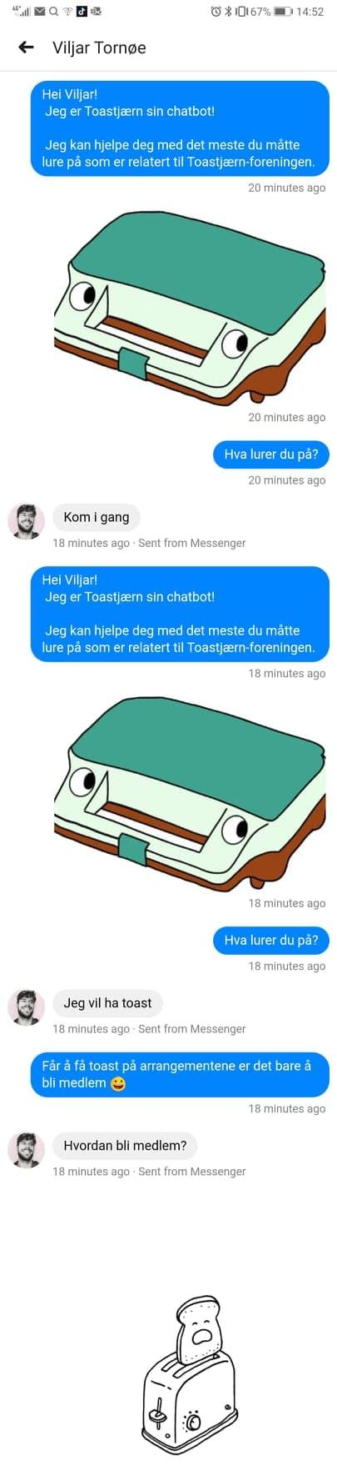
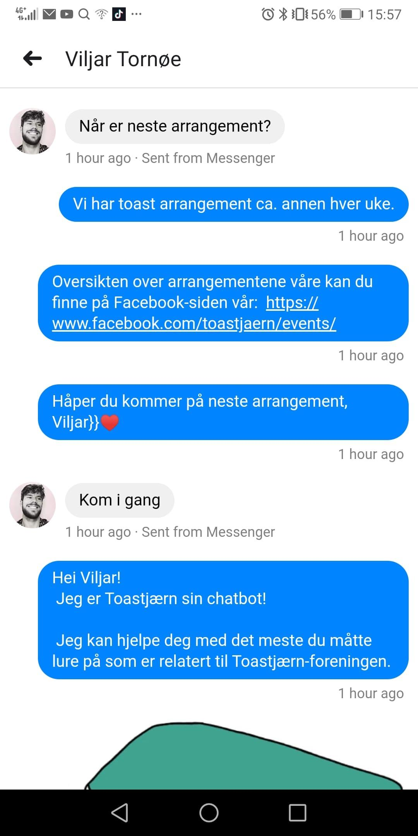

Slide 8
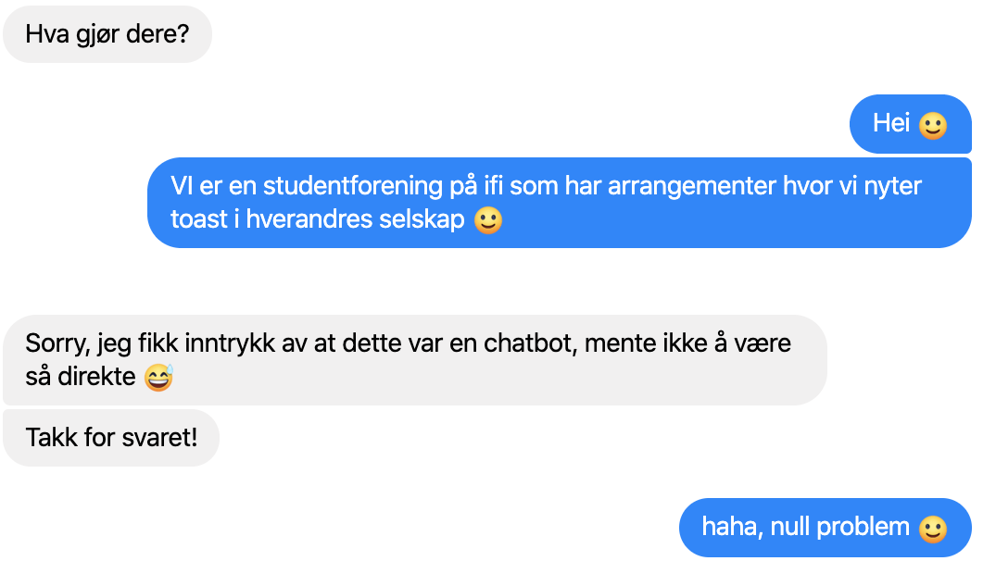
Findings

Slide 9
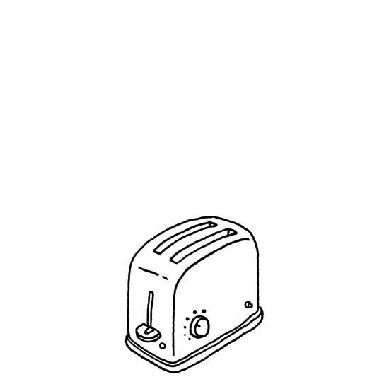
Findings
Technology savvy are less formal and more direct when they are addressing a bot
Drop pleasantries and formalities - less personable
Make use of a particular economy of language
  Keywords
  Luger and Sellen - similar user approach
  Different motivation - Trying to make it work/explore
Humour is useful to in error handling

Slide 10
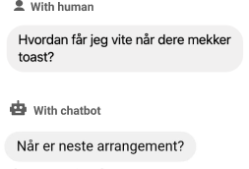
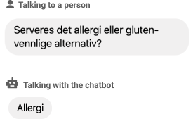
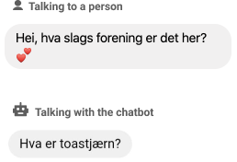

Findings
Miscellaneous::
Human vs computer - frequently asked
Allergies:
Toastjærn?:

Slide 11

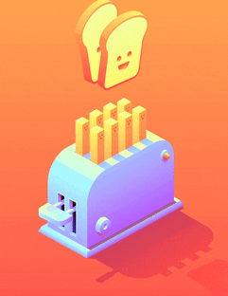
“Users are less formal when they know they are chatting with a robot compared to when they think they are chatting with a human.”
Notes:
The hypothesis we want to investigate through our project

Slide 12
Conclusion
Students at IFI have good mental models of chatbots
Emulating human conversations is unnecessary for some groups
Similar approach to chatbots - different motivations
Interesting area of research for further investigation

Slide 13
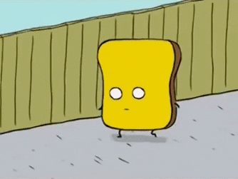
The road ahead
Interviews
More representative users
More bots

Slide 14
