Slide 1

Can Norwegian dialects impact
interaction with Home?
Anton Lilleby & Steffen Marstein

Slide 2
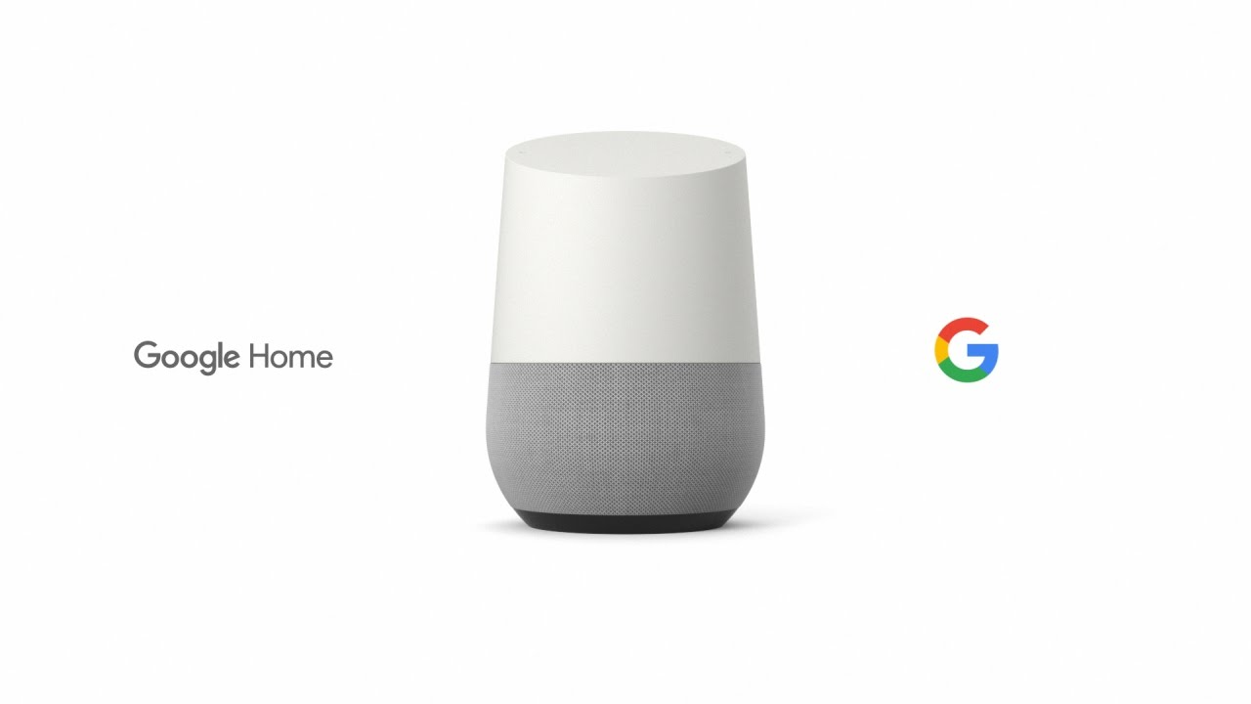
What is Google Home?

Slide 3
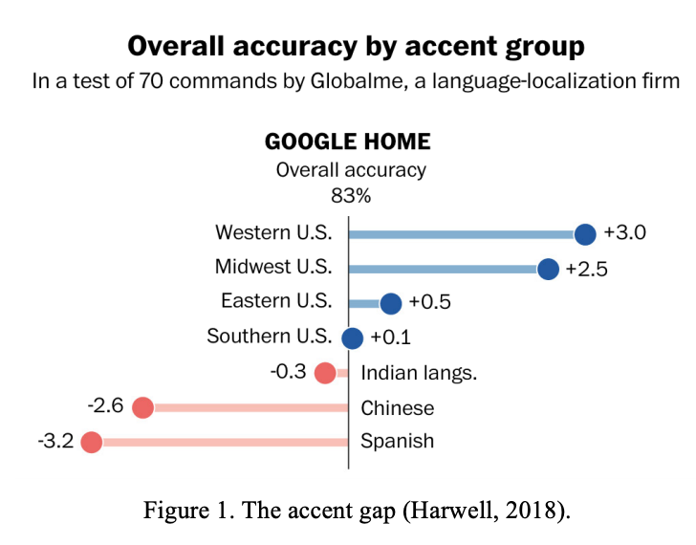
Background
Apple’s Siri 2011
Washington Post study
Diverse dataset

Slide 4
Google’s claim
Google’s communications manager in Norway, claims to digi.no that Google Assistant will take account for the many different dialects in Norway (Lekanger, 2018)

Slide 5

Experiment

Slide 6
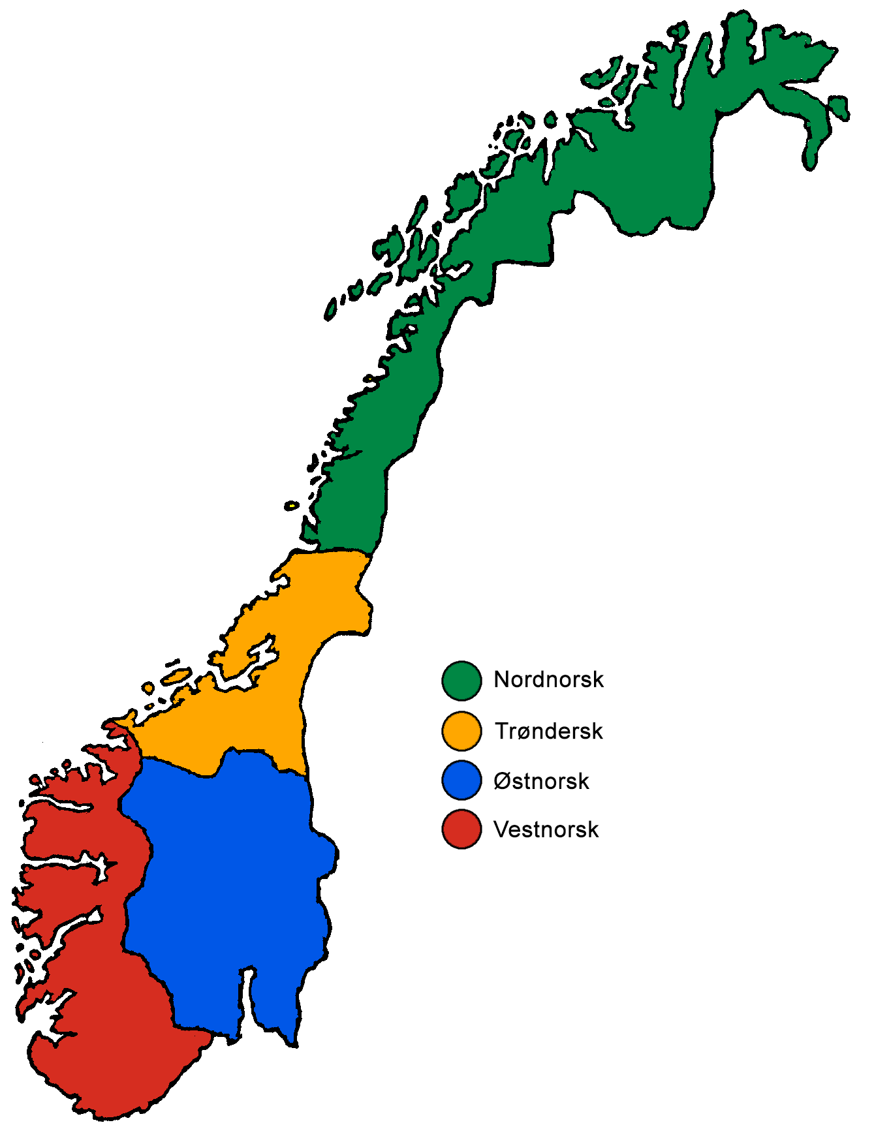
Participants

Slide 7

Interview findings
The most common is Apple’s Siri
Little to no expectation
Perceived them wrong
Testing purposes

Slide 8
Interview findings
Machine generated
Ok/Hey Google
Useful and surprised
Benefit in Norwegian
Privacy concern
None was interested in owning Google Home

Slide 9
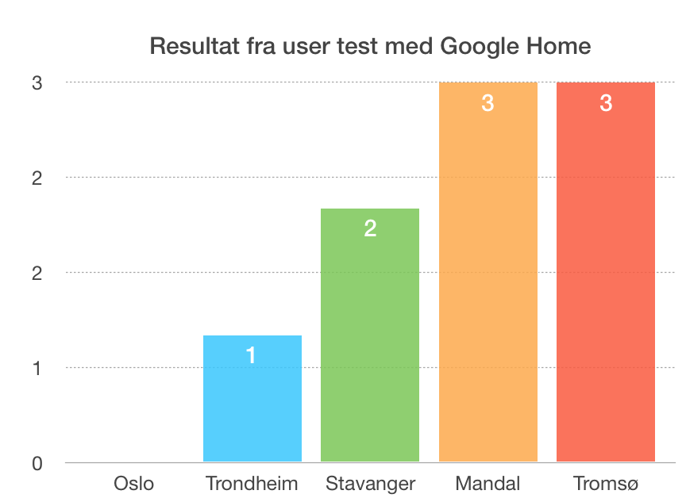
User test finding

Slide 10
Discussion
Our assumption
Bugs in Google Assistant
Design of predefined commands
Participants students at IFI
Data gathering
Generate a hypothesis

Slide 11

Demo

