Slide 1
IN5430
Seminar class
29.01.2019
Alexander Kempton and Kristoffer Fossum

Slide 2
Introduction to seminar classes
Who are we?
  Alexander Kempton
  Kristoffer Fossum
Who are you?
  Studies?
  Work experience?
  Expectations to the seminar classes?

Slide 3
Introduction to seminar classes
Seminar groups as an environment for learning
  Type:
    High student activity
    Group and class discussions based on small assignments
    Cooperation between you and us
  Content:
    Themes and concepts from last week lecture
    Connecting themes and concepts from previous lectures to get the «big picture»
  Feedback
    We want that the seminar classes are useful for your learning – please give feedback
    We will make it easy for you by using mentimeter

Slide 4
Group discussion
From IT applications to Information infrastructures
Form groups of 3-5 persons and discuss the following (10min):
- IT systems may be categorized according to how complex they are, and how complex they are to manage/govern.
  Mention the main categories as shown in a previous lecture
  Provide concrete examples of IT systems from each category
  Discuss differences between the categories
    What do you think are main governance challenges in each category?

Slide 5
IT Categorization related to lecture threads

Slide 6
Group project assignment
Items | Date
Deadline for group formation | Feb. 5
Deadline for securing organization/platform | Feb. 12
Deliverable 1 – group work | March 12
Presentation of del. 1 in class* | March 13
Feedback per group | March 19
Deliverable 2 – group work | April 8
Presentation of del. 2 in class* | April 9
Deliverable 3 – individual assignment | May 22
Assignment text
*Each group member has to present at least once. You can decide how to distribute it.

Slide 7
Typical Challenges in group work
Finding an organization
  The elusive informant
  Finding the right informant
Leaving it for too late
Doing assignment without reading/understanding course material and/or assignment requirments
Group dynamics (dealing with stragglers)

Slide 8
Break!
….but only for those of you who have found a group…
The rest of you stay to find groups!

Slide 9
Group discussion
Central concepts this far
Find the one sitting next to you, and discuss:
  What are side-effects?
  Find examples and discuss why they are side-effects
3+5 min

Slide 10
Group discussion
Central concepts this far
Make groups of 3 – 5, and discuss:
  What do we mean by «multi-sided»
  Discuss examples from the real world
5+5 min

Slide 11
Group discussion
Central concepts this far
Stay in your groups, and:
  Find the drawing about network effects in Parker Ch.2. page 31 (link on lecture web-site)
  Which types of network effects are described in the drawing
    Explain and discuss why, and what it actually means for Uber
12 + 13 min

Slide 12
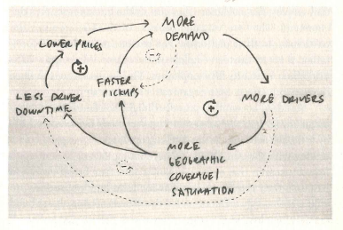

Slide 13
More Demand
Lower Prices
Less Driver Downtime
Faster Pickups
More Drivers
More Geographical
coverage / Saturation

Slide 14
Demand
Prices
More Driver Downtime
Slower Pickups
More Drivers
Geographical coverage
/ Saturation

Slide 15
Demand
Prices
Driver Downtime
Pickup time
More Drivers
Geographical coverage
/ Saturation

Slide 16
Find your mobile phones (finally)!
We want your feedback about us and what we discuss!
Please help us to improve, and answer the following questions at menti.com
Code: 993243

Slide 17
end

