Slide 1
  Complex Event Processing (CEP)
  Vera Goebel
History: 2 origins
- Active DBS
- Publish/Subscribe
Concepts, terminology
Esper (Espen Volnes)
Assignment 1 (Garth Theron)
Overview of CEP Systems (Espen Volnes)
Adaptive windows in DSMS (health monitoring)

Slide 2
Event Processing

Slide 3
Information Flow Processing
Database Systems (DBS):
- require persistent data storage & indexing
- asynchronous data processing on demand
Data Stream Management Systems (DSMS):
- transformation based processing of data streams from
different sources
- SQL operators: selection, aggregation, joins, …
Complex Event Processing (CEP):
- flow of information as notification of events
(happening in the real world)
- detecting occurrences of higher-level events
- detecting occurrences of patterns of low-level events
representing higher-level events

Slide 4
Publish/Subscribe versus CEP
Publish/Subscribe:
- handling each event separately
- filtering based on topic or content
CEP:
- more expressive subscription language
- handle complex event patterns
- occurrence of multiple, related events

Slide 5
DSMS versus CEP
DSMS: produce query answers, which are cont. updated to adapt to constantly changing contents of input data.
CEP: Detection and notification of complex patterns of elements involving sequences and ordering relations.

Slide 6
Information Flow Processing (IFP)
Collect information produced by multiple, distributed sources, to process it in a timely way, to extract new knowledge as soon as the relevant information is collected.
Need to process information as it flows from the periphery to the center of the system without persistent storage of information.
IFP engine: tool that operates according to a set of processing rules.
Processing rules: describe how incoming flows of information have to be processed to timely produce new flows as outputs.
Information sources: entities that create the information flows entering the IFP engine.
Information items: that are part of the same flow are neither necessarily ordered nor of the same kind.
Information sinks: recipient of output(s).
Rule managers: entities in charge of adding or removing processing rules.

Slide 7
CEP Application Domains
Internet-of-Things (Sensor Networks)
Financial transactions: algorithmic stock trading
Credit card fraud detection
Business activity monitoring
Security monitoring
Health care:
  Integrated patient monitoring
  Telemonitoring of human physiological data
  Tracking and monitoring doctors and patients inside a hospital
  Tracking and monitoring patients and rescue personnel during rescue operations

Slide 8
Motivation I
DSMS technology
  A data stream of tuples
    A tuple consists of attributes
      Values
      Timestamps
    In-memory real-time processing
  Perform projections and aggregations
    Give me all tuples from company X
    Give me the average packet size in the network from the last five minutes
    Tell me if the temperature is lower than 15 degrees
  Uses windowing for blocking operators
  Based on SQL

Slide 9


Motivation II
Beyond projections and aggregation: We want to know more about the data stream!
  When does a specific pattern occur?
    Tell me when the stock prize from company X increases by 10% for ten minutes before decreasing
  Order of consecutive events
    Only tell me when the goods have been taken out of the shop without being purchased in the counter
    How long does it take from a person falls until he gets help?
  Concurrency
    Tell me when the cooker is on while the person has left the home

Slide 10
Events … (Terminology)
Event: change of state
Event Processing: method of tracking and analyzing (processing) of streams of information (data) about things that happen (events).
Complex Event Processing (CEP): event processing that combines data from multiple sources to infer events or patterns for complicated situations.

Slide 11
Adaptive Sized Windows To Improve Real-Time Health Monitoring – A Case Study on Heart Attack Prediction
Application: Real-time health monitoring
^{Problem:}
DSMS mainly support windows of static size
Goal: Adapt data stream processing to physiological processes (variable durations), such as heartbeats or cardiac cycle
-> DSMS with time-based sliding windows of adaptive size

Slide 12
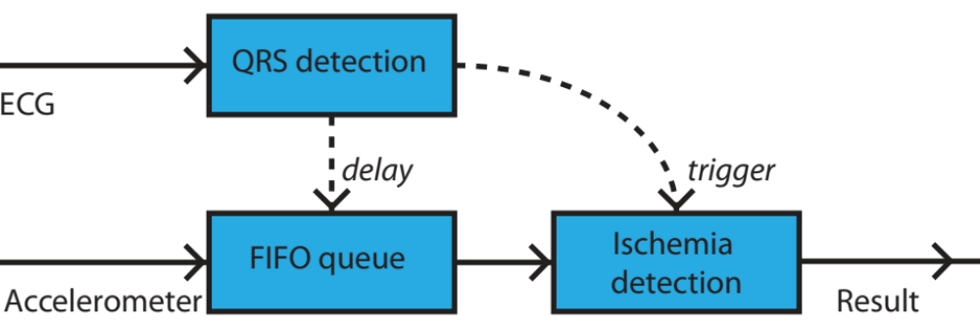
Idea
External events (tuple results from external query) determine the window size of a sliding window
ECG stream to detect heartbeats (QRS detection)
Accelerometer stream to detect heart displacement (Ischemia detection)
Output of QRS detection (delay) determines when to trigger the flushing of the sliding window in Ischemia detection query
‘Delay’ is used to slow down accelerometer stream to account for QRS detection delay in the FIFO queue

Slide 13
Experiment Goal #1
Recreate off-line technique (Elle et al. 2005) conducted in MATLAB
Early recognition of regional cardiac ischemia
3-way accelerometer placed on left ventricle of the heart
Single metric:
  Fast Fourier Transformation (FFT) is used to examine the accelerometer signal in the frequency-domain
  Euclidian distance vector (EDV(i)) between reference vector RV(0) and current vector CV(j), where j is the latest sample number
  CV(j) : FFT over sliding window (size 512 over y-axis)
  RV(0) : FFT over baseline window (first 512 samples)
Data set from surgery performed on pigs at the Interventional Centre
We can conduct experiments with the same data set (data set 1)

Slide 14
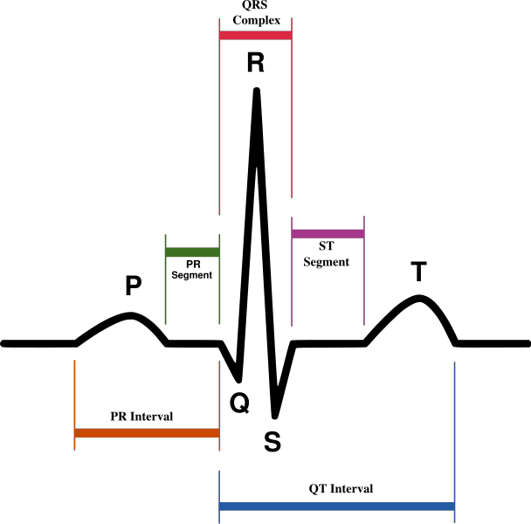
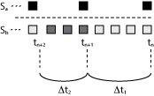
Experiment Goal #2
[ image from http://www.wikipedia.org ]
Improve results by adding beat-to-beat detection using a QRS detection algorithm on ECG signals
  Each ECG trace of a normal heartbeat typically contains a QRS event
  A good reference for separating heartbeats
We need to perform FFT over sliding windows of variable size!
Cannot use the same data, use new data set that include ECG (data set 2)

Slide 15
Challenges
Incorporate signal processing operations
  Problem: Not supported in the query language
  Fast Fourier Transformation of the accelerometer signals
  Euclidian distance vector from baseline window
  QRS detection for detecting the heartbeats from the ECG signals
  Solution: Custom aggregate functions
  QRSD(v): QRS detection based on algorithm from (Hamilton et al. 1986)
  edv(v): Euclidian distance from baseline
Static sized windows are not feasible for beat-to-beat detection
  Problem: Heartbeat duration is not a static pre-known size. DSMS window techniques only describe static time-based or tuple-based windows.
  Solution: Introduce variable length triggered tumbling windows
Synchronize the two streams
  Problem: QRS detection introduces variable delay (approx. 91 samples)
  Solution: Introduce variable buffer, that “slows” down the accelerometer stream

Slide 16
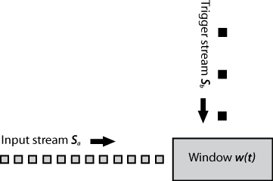
Variable length triggered tumbling windows
The ECG stream is aggregated into a stream consisting of QRS events S_{b.}
This stream (S_{b}) triggers the flushing of the sliding window w(t) where the custom aggregation over the stream S_{a} is performed.
This window technique is not supported by Esper => We implemented a “workaround” exploiting functionality of externally timed windows .

Slide 17
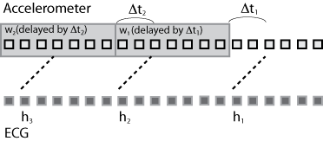
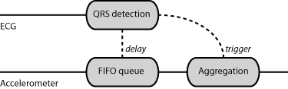
Stream Synchronization
The QRS detection algorithm over the ECG stream introduces a variable delay Δt.
Introduce the same delay to the accelerometer stream.
Accelerometer stream is sent through a FIFO queue with dynamic size.
QRS detection function sets the dynamic size of the FIFO queue (also triggers the flushing of the aggregate window, in order to obtain dynamic windows).

Slide 18
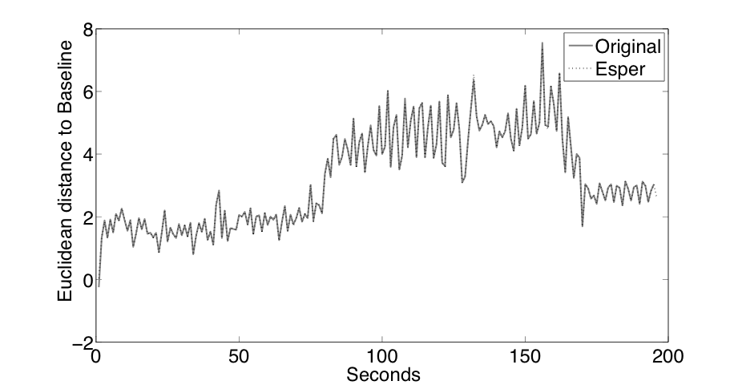
Results #1 (data set 1)
Easier than MATLAB
SELECT edv(y)
FROM Accelerometer
WINDOW LENGTH(512)
Occlusion occurs after 80 seconds
Perfusion after 170 seconds
Figure shows a perfect overlap, the technique by Elle et al. 2005 can be recreated online using Esper

Slide 19
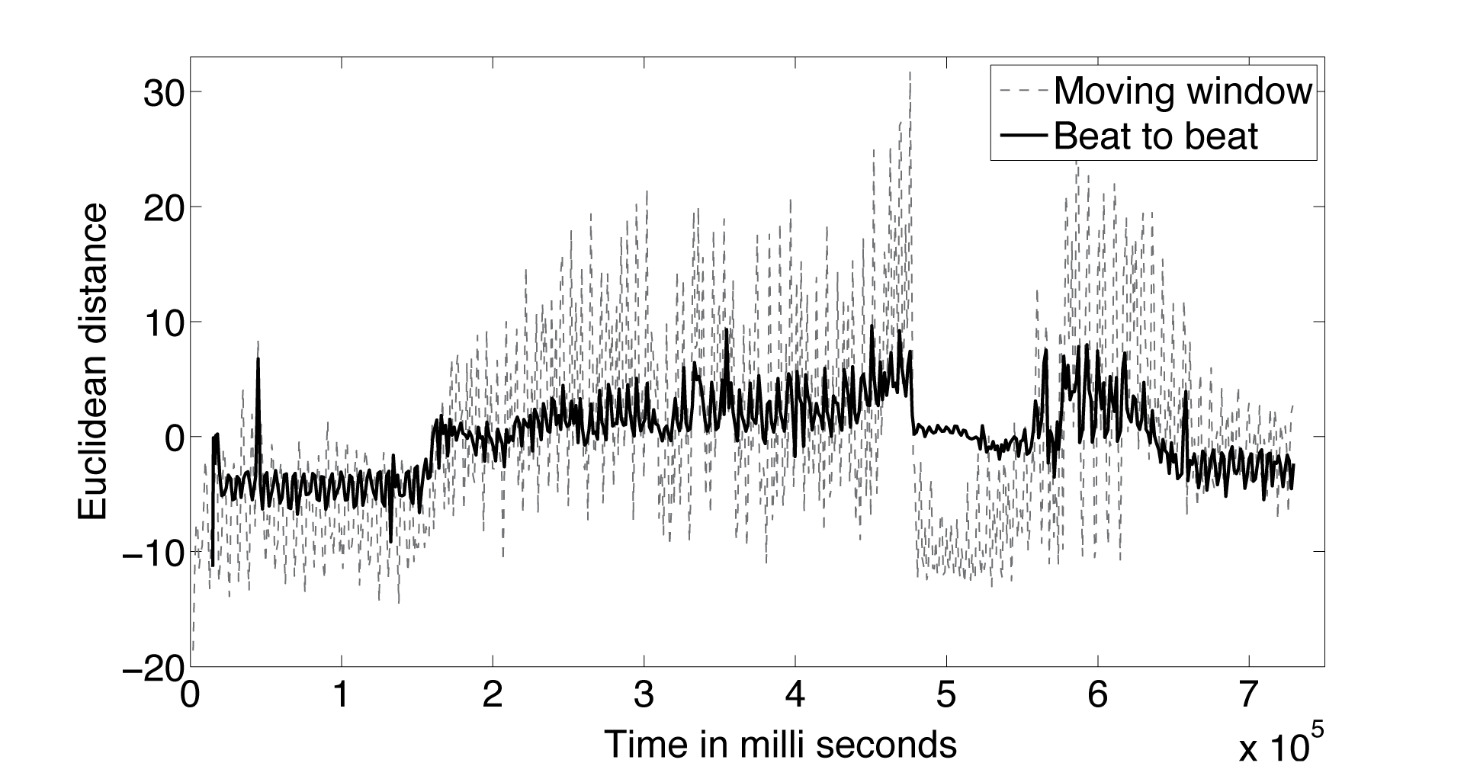
Results #2 (data set 2)
Plot shows fixed sliding window (512 samples) and dynamic triggered window (based on QRS detection) => less variance!
SELECT edv(y)
FROM Accelerometer TRIGGER WINDOW BY QRSD(ECG.value)
Occlusion
Perfusion
Sudden drop caused by ultra sound probe
Notes:
Include notes!

Slide 20
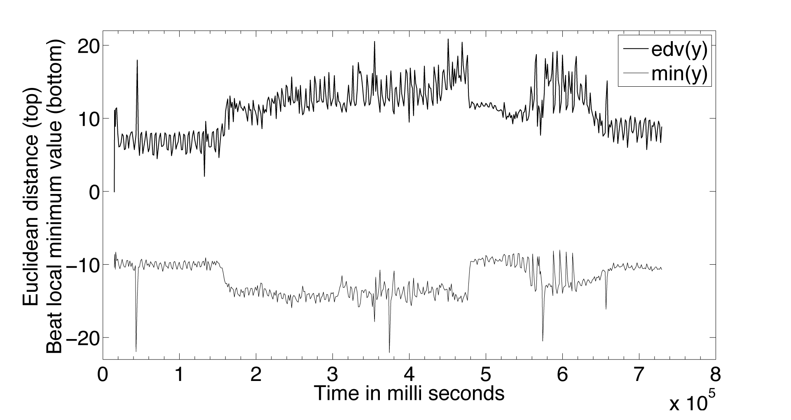
Results #3 (data set 2)
Query with added local minimum value => easy to change!
SELECT edv(y), min(y) FROM Accelerometer TRIGGER WINDOW BY QRSD(ECG.value)
The bottom plot represents local minimum value for the accelerometer stream

Slide 21
Implementation
Java and Esper (open source component for event processing available at http://esper.codehaus.org/)
Use existing window model, Esper is not changed
Base window boundaries on the manipulated timestamps (registered as external timestamps in the Esper query) calculated from external / trigger query

Slide 22
Conclusion
DSMSs can be used for real-time analysis
=> easy to model and investigate new methods
Method of online analysis of medical sensor data focusing on detection of myocardial ischemia
Added beat-to-beat detection by using ECG
  -> Results with less variance
New window type for DSMS
-> Variable length triggered tumbling windows

