Slide 1
Assignment 1
IN5040
TA: Marta Quemada López
Email: martaq@ifi.uio.no

Slide 2
Important information
 Deadline: Friday 6 October – 11:59 AM
 Deliverable: PDF file containing:
-> Query and results for questions: 1 -3 - 4 – 6 – 7 – 8
-> Query, results and a short-written answer for question 2
-> Short written answer for question 5

Slide 3
Overview
 In this assignment we simulate a meteorological institute which receives summarised daily weather recordings from two weather stations
 Period:
2014 – 2018
 Weather stations: JFK airport – New York
San Francisco Airport

Slide 4
Purpose of the Assignment
 To gain an understanding of some of the basic techniques used for analysing stream data.
 For this task, we will be using Esper, which is a software for Complex event processing (CEP) and Stream processing

Slide 5
Esper
Language, compiler and runtimefor DSM & CEP
Basic version is a librarythat can be imported in Java or .NET
Event Processing Language(EPL) enables rich expressionsover events and time
We will be using version 8.2.0
http://esper.espertech.com/release-8.2.0/reference-esper
  Look at page 3 points 2.1 - 2.10 and 2.17 for some of the most
    importantpoints for the assignment
Documentation: http://esper.espertech.com/release-8.2.0/reference-esper
Try online: https://esper-epl-tryout.appspot.com/epltryout/mainform.html

Slide 6
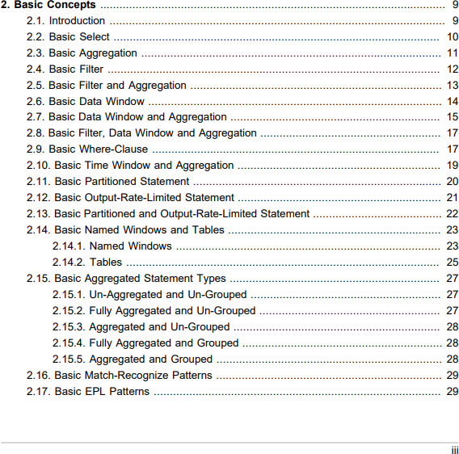
How to learn syntax and features?
Documentation
  Focus on the basic concepts to begin with
Esper notebook
  https://www.esperonline.net/
Esper EPL online
  https://esper-epl-tryout.appspot.com/epltryout/index.html
http://esper.espertech.com/release-8.2.0/reference-esper/pdf/esper_reference.pdf

Slide 7
Getting Started
 Download assignment1.tar.gz from the IN5040 course page
 Extract:
tar –xzvf assignment1.tar.gz

Slide 8
Assignment 1 contents
 Assignment1.pdf
 Assignment1.java
 WeatherTuple.java
 Makefile
 jfk.csv
 san_francisco.csv
 query1 – 8.epl
 lib folder

Slide 9
Compilation
 make all:
Cleans java class files Compiles java files
 make runX
Runs the java files and the queryX, where X is the query number.
Documentation: http://esper.espertech.com/release-8.2.0/reference-esper
Try online: https://esper-epl-tryout.appspot.com/epltryout/mainform.html

Slide 10
Assignment1.java
 You don't have to make changes here, but it's useful to understand what's happening
 What the program does
 creates runtime system and deploys the selected query
 Reads from the two data set files
 Sets up two threads, one for each data set
 The threads sleep between each processed event
 You can comment out the sleep invocation in the java program to speed up the execution, but don't do it for the last query (query 8)
 Reason is that query 8 looks at both data streams

Slide 11
Structure of a WeatherTuple
 timestamp
 weatherStation
 stationName
 averageTemperature
 minimumTemperature
 maximumTemperature
 averageWindSpeed
 precipitation
 weather
Documentation: http://esper.espertech.com/release-8.2.0/reference-esper
Try online: https://esper-epl-tryout.appspot.com/epltryout/mainform.html

Slide 12
Query Structure
 SELECT *
FROM jfk
 SELECT *
FROM san_francisco
Documentation: http://esper.espertech.com/release-8.2.0/reference-esper
Try online: https://esper-epl-tryout.appspot.com/epltryout/mainform.html

Slide 13
Esper architecture
Documentation: http://esper.espertech.com/release-8.2.0/reference-esper
Try online: https://esper-epl-tryout.appspot.com/epltryout/mainform.html

Slide 14
EPL Syntax
Create schema
create schema SchemaName(field_name1 type, field_name2 type)
Data Stream Management:
select ID as sensorId, sum(countTags) as numTagsPerSensor from AutoIdRFIDExample#win:time(60 seconds)
where Observation[0].Command = 'READ_PALLET_TAGS_ONLY’
group by ID
CEP:
select a.custId, sum(a.price + b.price) from pattern [every a=ServiceOrder ->
b=ProductOrder(custId = a.custId)
where timer:within(1 min)]#win:time(2 hour)
where a.name in ('Repair', b.name) group by a.custId
having sum(a.price + b.price) > 100
Documentation: http://esper.espertech.com/release-8.2.0/reference-esper
Try online: https://esper-epl-tryout.appspot.com/epltryout/mainform.html

Slide 15
Window
Called a view in Esper
Choose correctwindow when writing EPL queries!
Examples of windows/views:
View | Syntax | Description
Time window | win:time(time period) | Sliding time window
Externally-timed window | win:ext_timed(timesta mp expression, time period) | Sliding time window, based on themillisecond time value supplied by an expression
Time batch window | win:time_batch(time period[,optional reference point] [, flow control]) | Tumbling window that batches events and releases them every specified timeinterval, withflow control options
Externally-timed batch window | win:ext_timed_batch(timestamp _ expression, time_period [,optional_reference_point]) | Tumbling window, based on the millisecond time value supplied by an expression
Documentation: http://esper.espertech.com/release-8.2.0/reference-esper
Try online: https://esper-epl-tryout.appspot.com/epltryout/mainform.html

Slide 16
Example: https://esper-epl-tryout.appspot.com/epltryout/mainform.html
EPL Statements
EPL Module Text
Enter EPL Here:
Time And Event Sequence
Beginning Of Time
Provide a timestamp to start at:
2001-01-01 08:00:00.000
Scenario Results
All Output Events
create schema ProductOrder(custId string, name string, price double);
create schema ServiceOrder(custId string, name string, price double);
@Name('Out') select a.custId, sum(a.price + b.price) from pattern [every a=ServiceOrder -> b=ProductOrder(custId =a.custId) where timer:within(1 min)]#win:time(20 min)
where a.name in ('Repair', b.name) group by a.custId having sum(a.price + b.price) > 100;
ServiceOrder={custId='customer1', name='Repair', price=60.5}
t=t.plus(5 seconds)
ProductOrder={custId='customer1', name='12345', price=53}
t=t.plus(60 seconds)
ServiceOrder={custId='customer2', name='6789', price=90}
t=t.plus(25 seconds)
ProductOrder={custId='customer2', name='6789', price=60}
t=t.plus(120 seconds)
ServiceOrder={custId='customer1', name='Repair', price=60.5}
t=t.plus(10 seconds)
ProductOrder={custId='customer1', name='7654', price=0.5}
At: 2001-01-01 08:00:05.000
Statement: Out
Insert
Out-output={a.custId='customer1', sum(a.price+b.price)=113.5}
At: 2001-01-01 08:01:30.000
Statement: Out
Insert
Out-output={a.custId='customer2', sum(a.price+b.price)=150.0}
At: 2001-01-01 08:03:40.000
Statement: Out
Insert
Out-output={a.custId='customer1', sum(a.price+b.price)=174.5}

