Slide 1
Group Seminar Week 2:
Homogeneous Transform
Tony Nguyen
Responsible for correcting the mandatory assignment
Backup Group-teacher
Email: hpnguyen@ifi.uio.no

Slide 2
Session’s plan
Brief talk on mandatory assignments
A short example on homogeneous transform
Walkthrough on weekly exercise 2.10-2.11, 2.38.

Slide 3
Delivery
Start early on the assignments, each task becomes solvable for each lecture
All assignments must be ”PASSED” in order to take exam
Devilry -
Postponing the delivery, send an e-mail to one of us
- Preferably early and couple of days beforehand

Slide 4
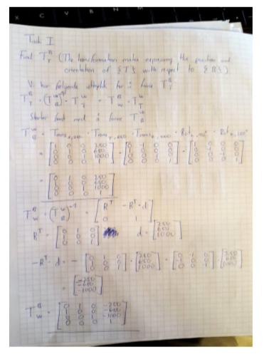
Delivering the assignment
Try not to do this!

Slide 5
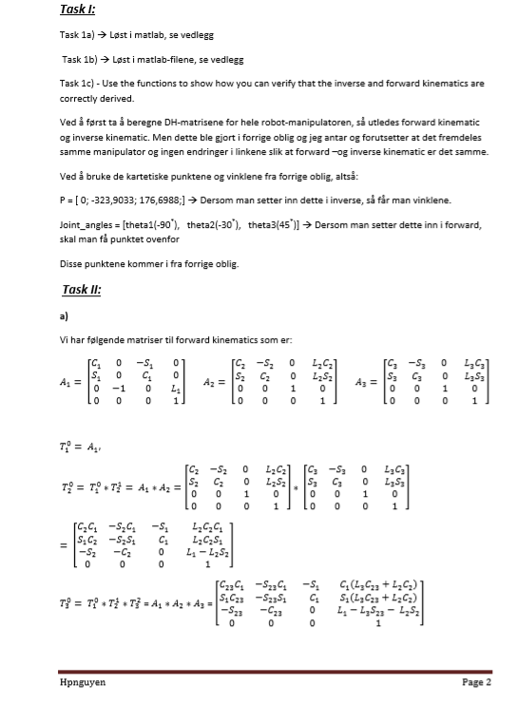
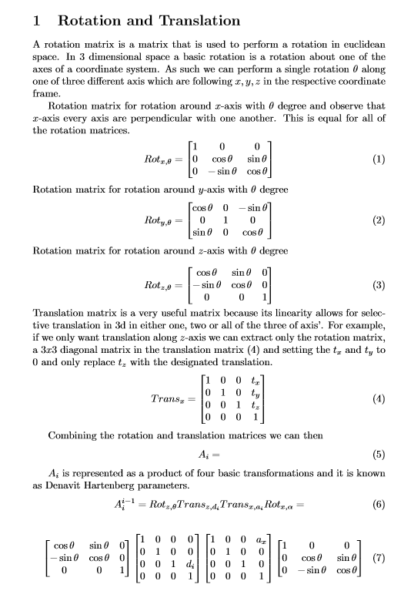
Do one of these two methods:
LaTeX, Word and etc...
Scan the documents on UiO’s printers
Word
LaTeX

Slide 6
LaTeX
Download on your personal laptops
Use Overleaf.com → I highly recommend this
Question to you guys:
Raise your hand if you want me to put out a simple template on LaTeX on the course page.

Slide 7
Word
Intuitively simple to use, but can be tedious on long equations.
Raise your hand if you want me to put out a simple template on Word on the course-page or type in chat if you guys want me to create a template

Slide 8
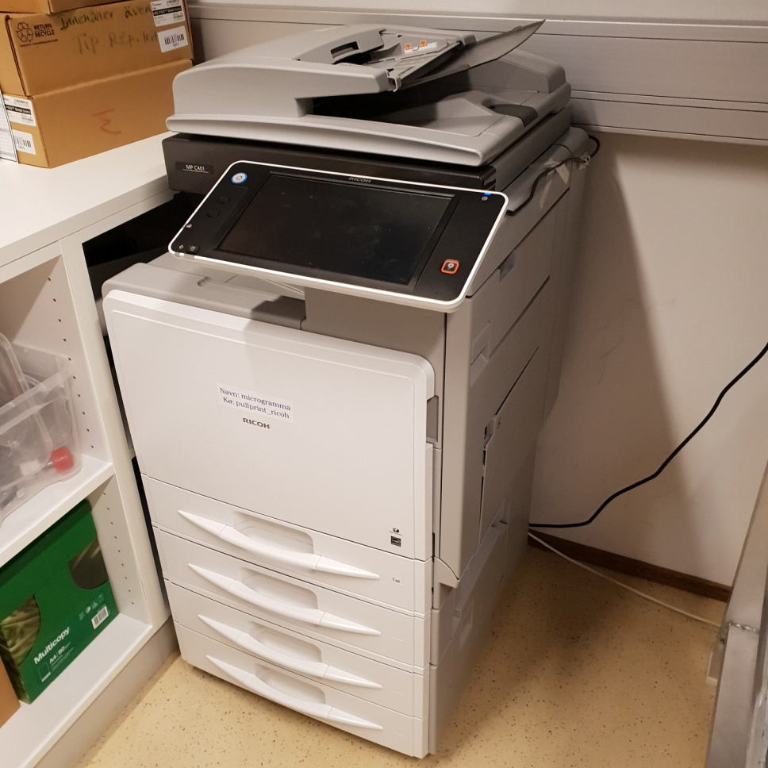
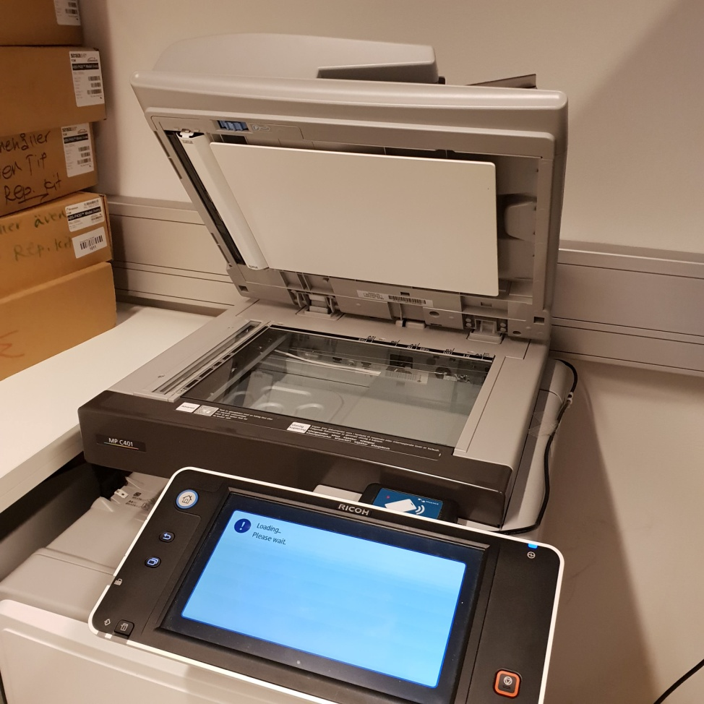

Slide 9
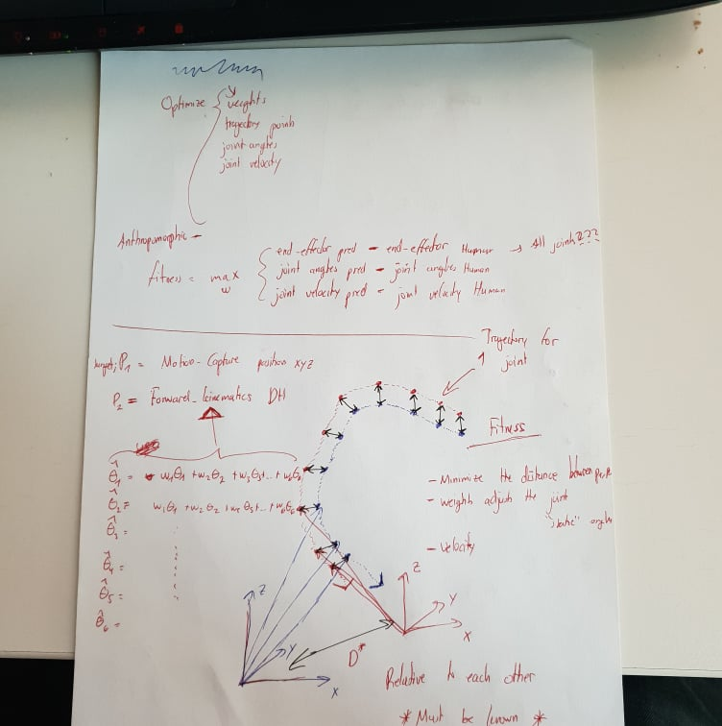
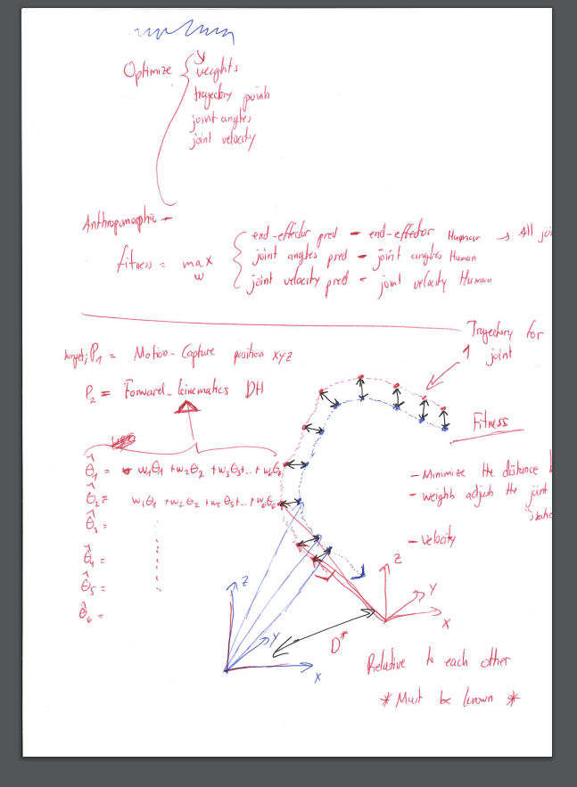
Before Scan
After Scan

Slide 10
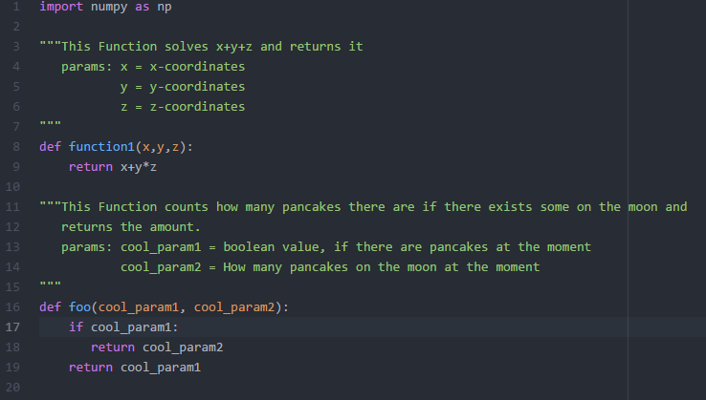
Programming Code:
Don’t copy-paste code into your documents
Write ”Look attachments”, ”Solved in matlab/python”, or something similar and include source-files instead
Examples: ”Look attachments Task1.py, Task2.py and etc...”
”Solved in matlab, look attachments Task1.m, Task2.m and etc...”
You MUST comment your code

Slide 11
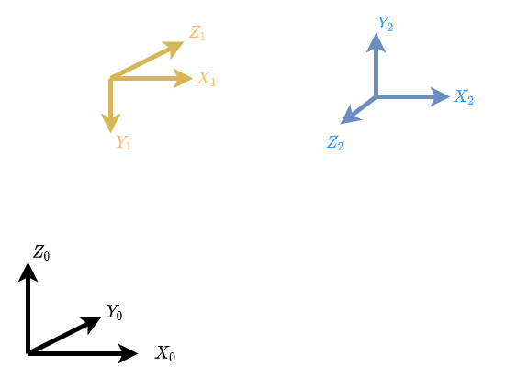
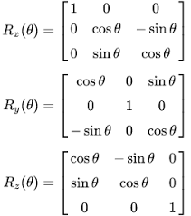



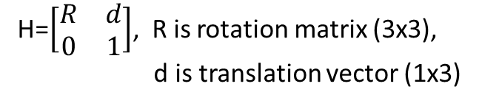
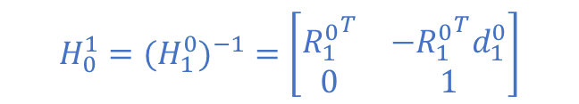

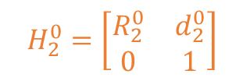


Homogeneous Transform
Represents position and orientation of rigid-body relative to another frame
$$H_{2}^{1}=\left[\begin{matrix}R_{2}^{1} & d_{2}^{1} \\ 0 & 1\end{matrix}\right]$$
$$H_{2}^{1}$$
H=$\left[\begin{matrix}R & d \\ 0 & 1\end{matrix}\right]$, R is rotation matrix (3x3),
d is translation vector (1x3)
$$H_{1}^{0}=\left[\begin{matrix}R_{1}^{0} & d_{1}^{0} \\ 0 & 1\end{matrix}\right]$$
$$H_{1}^{0}$$
$$H_{0}^{1}$$
$$H_{2}^{0}$$
$$H_{0}^{1}={{(H}_{1}^{0})}^{−1}=\left[\begin{matrix}{R_{1}^{0}}^{T} & {{−R}_{1}^{0}}^{T}d_{1}^{0} \\ 0 & 1\end{matrix}\right]$$
$$H_{2}^{0}=\left[\begin{matrix}R_{2}^{0} & d_{2}^{0} \\ 0 & 1\end{matrix}\right]$$

Slide 12
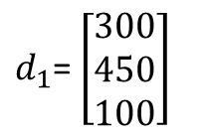
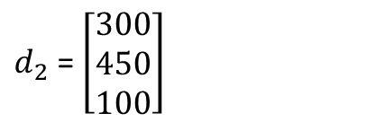
Homogeneous Transform Cont.
(500,650,100)
(300,450,100)
$d_{1}$= $\left[\begin{matrix}300 \\ 450 \\ 100\end{matrix}\right]$
Rotate -90 degrees along X-axis
$d_{2}$ = $\left[\begin{matrix}300 \\ 450 \\ 100\end{matrix}\right]$
Rotate +90 degrees along X-axis
(0,0,0)

Slide 13
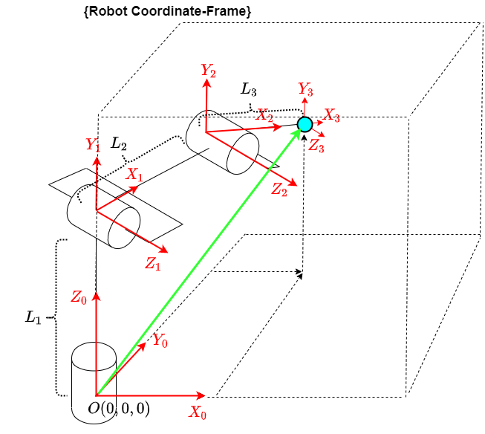
Robot Coordinate Frame
A robot performs task in its own coordinate frame.
The next lecture will focus on modeling a robotic manipulator using forward-kinematics

Slide 14
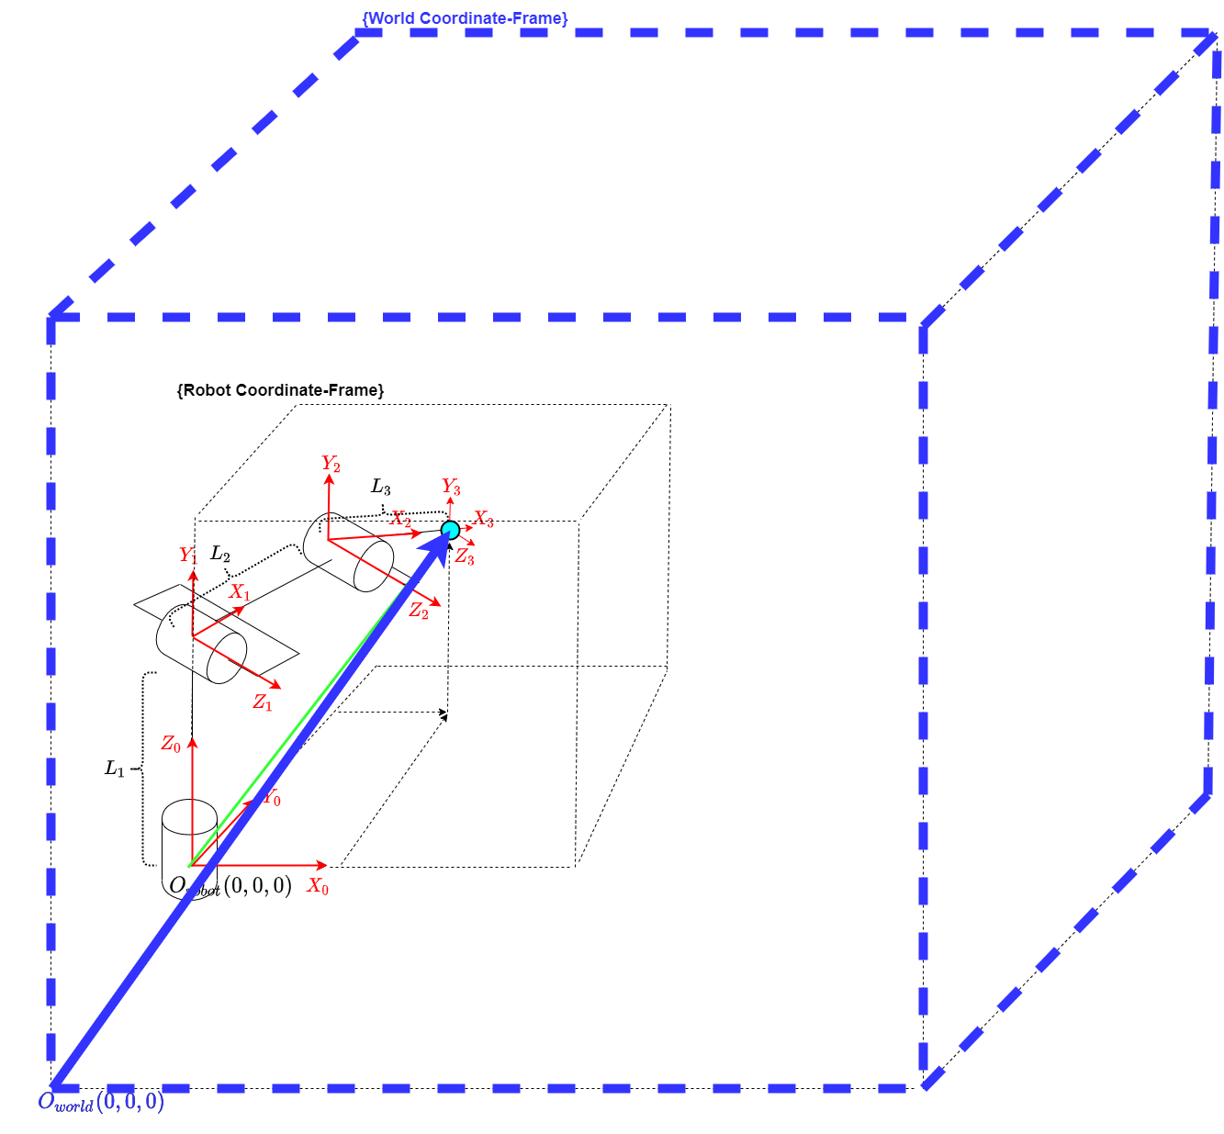
Two coordinate frames
A robot is placed on another coordinate frame. Let’s call this world coordinate frame.

Slide 15
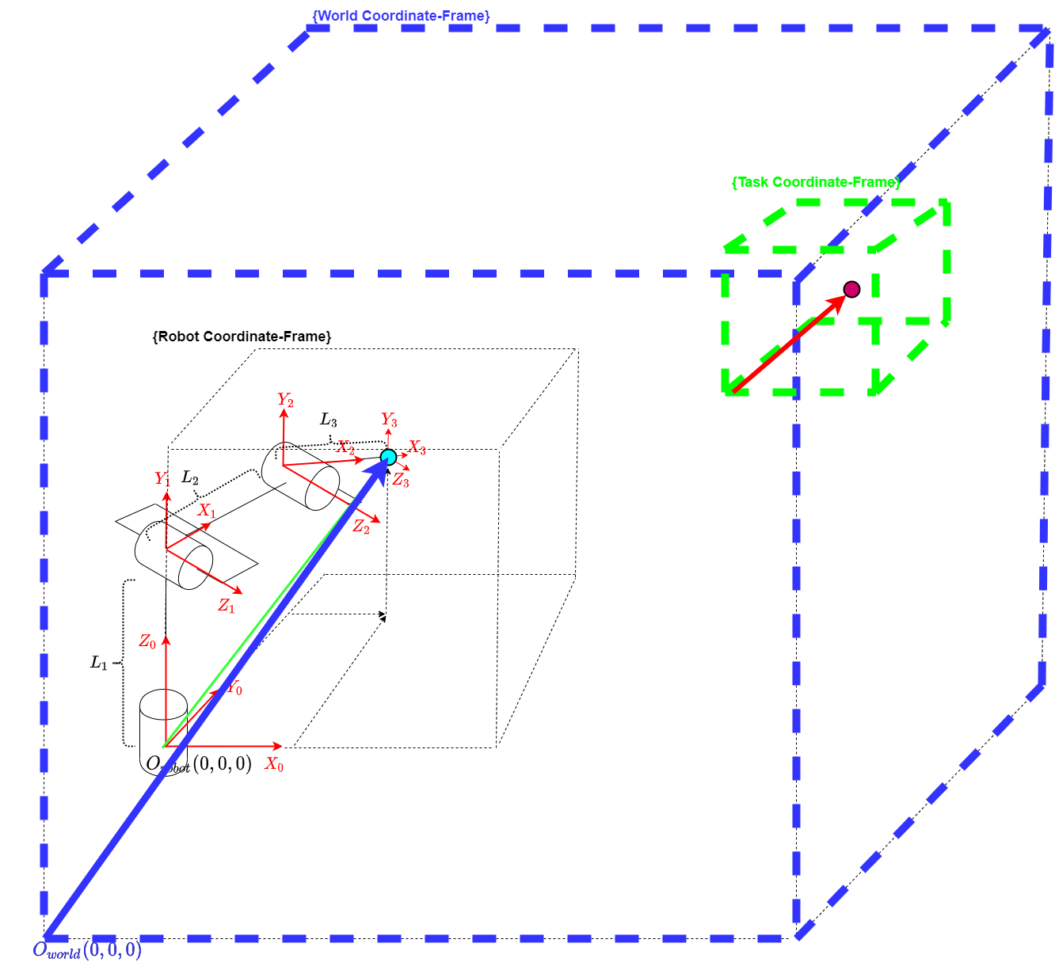
Three Coordinate frames
- With homogeneous transforms we can represent the points amongst the coordinate frames
Converting

Slide 16
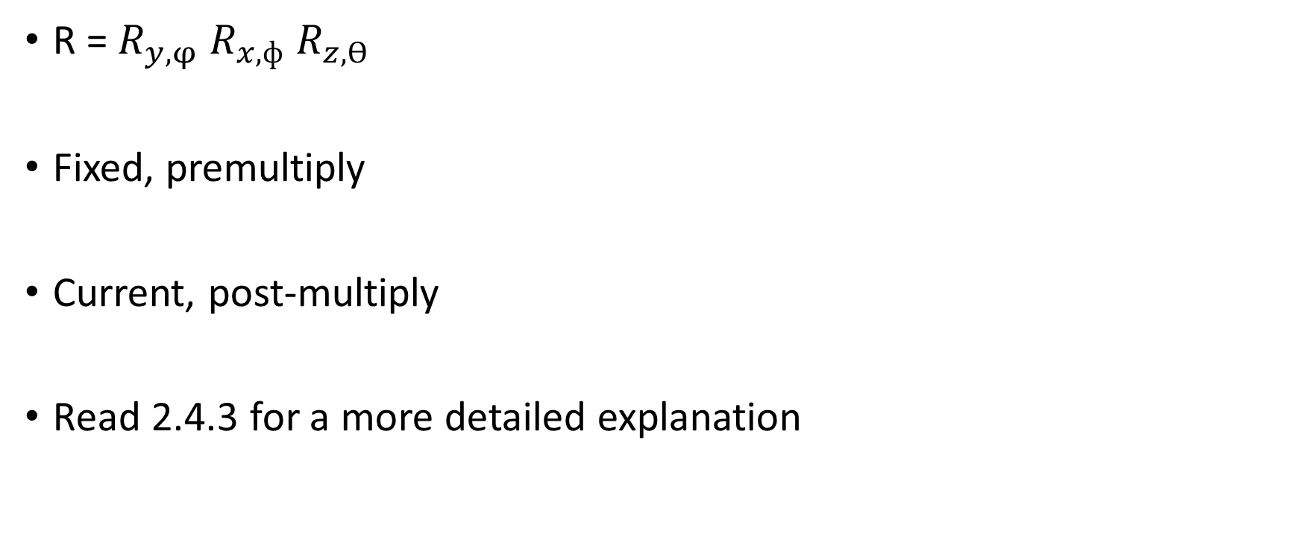
2.10
R = $R_{y,φ}$ $R_{x,ф}$ $R_{z,ϴ}$
Fixed, premultiply
Current, post-multiply
Read 2.4.3 for a more detailed explanation

Slide 17
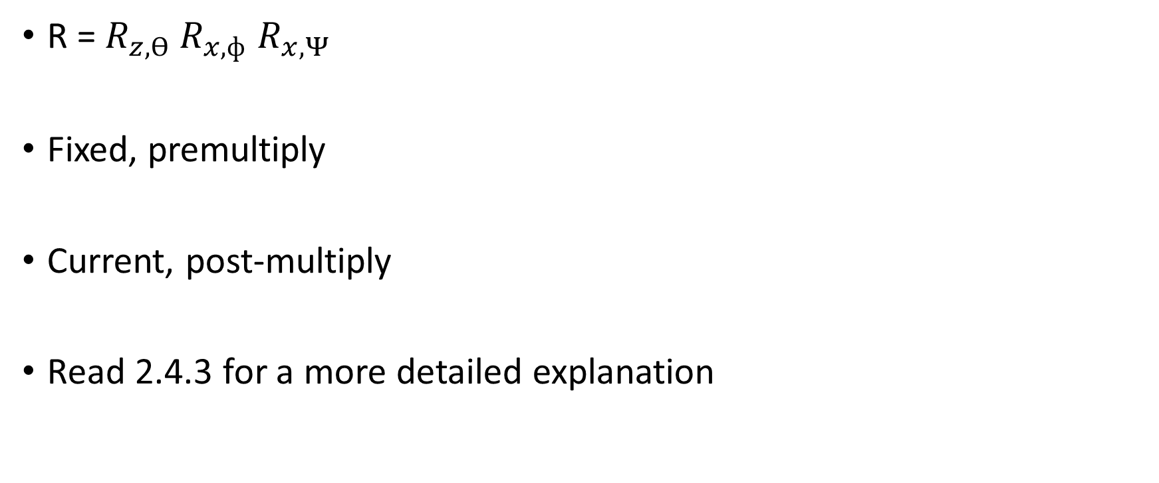
2.11
R = $R_{z,ϴ} R_{x,ф}$ $R_{x,Ψ}$
Fixed, premultiply
Current, post-multiply
Read 2.4.3 for a more detailed explanation

Slide 18
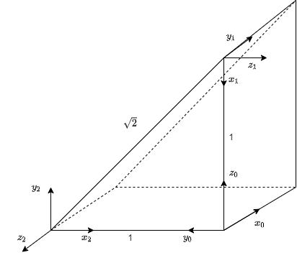
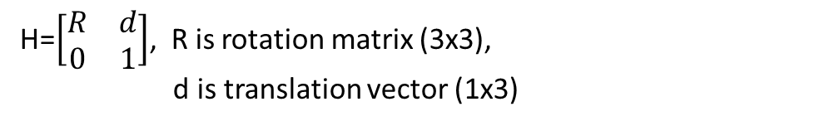
2.38
Find $H_{1}^{0}$, $H_{2}^{0},H_{2}^{1}$
H=$\left[\begin{matrix}R & d \\ 0 & 1\end{matrix}\right]$, R is rotation matrix (3x3),
d is translation vector (1x3)

Slide 19
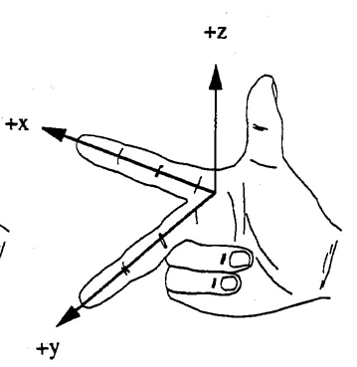
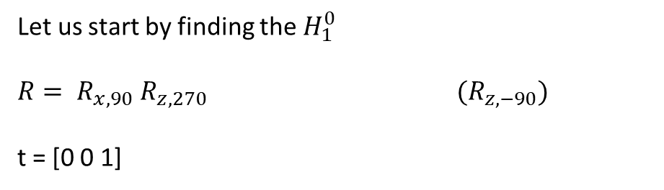
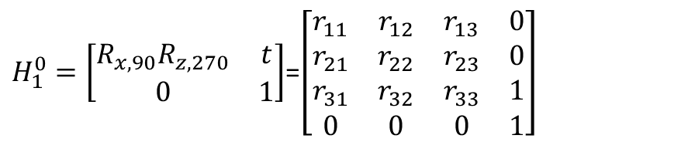
2.38 cont
Let us start by finding the $H_{1}^{0}$
$R= R_{x,90}$ $R_{z,270}$ ${(R}_{z,−90})$
t = [0 0 1]
$H_{1}^{0}=\left[\begin{matrix}R_{x,90}R_{z,270} & t \\ 0 & 1\end{matrix}\right]$=$\left[\begin{matrix}r_{11} & r_{12} & r_{13} & 0 \\ r_{21} & r_{22} & r_{23} & 0 \\ r_{31} & r_{32} & r_{33} & 1 \\ 0 & 0 & 0 & 1\end{matrix}\right]$

Slide 20
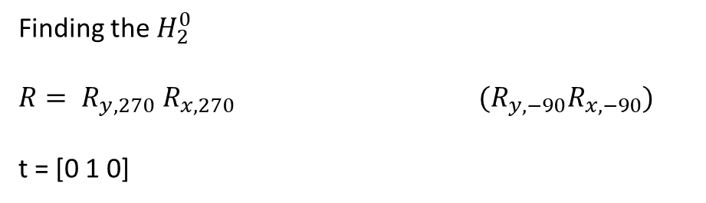
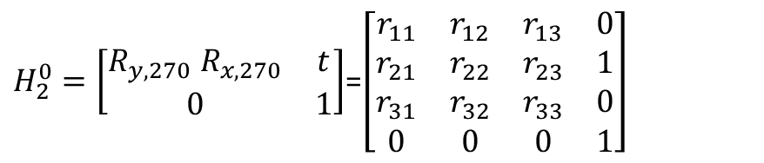
2.38 cont
Finding the $H_{2}^{0}$
$R= R_{y,270}$ $R_{x,270}$ $(R_{y,−90}R_{x,−90})$
t = [0 1 0]
$H_{2}^{0}=\left[\begin{matrix}R_{y,270} R_{x,270} & t \\ 0 & 1\end{matrix}\right]$=$\left[\begin{matrix}r_{11} & r_{12} & r_{13} & 0 \\ r_{21} & r_{22} & r_{23} & 1 \\ r_{31} & r_{32} & r_{33} & 0 \\ 0 & 0 & 0 & 1\end{matrix}\right]$

Slide 21
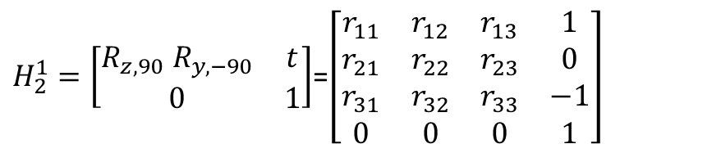
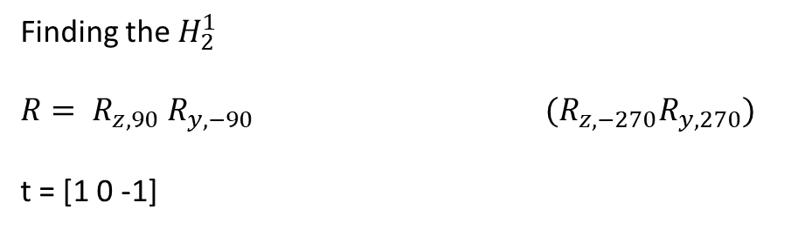
2.38 cont
Finding the $H_{2}^{1}$
$R= R_{z,90}$ $R_{y,−90}$ $(R_{z,−270}R_{y,270})$
t = [1 0 -1]
The coordinate frames can be considered on the same plane
$H_{2}^{1}=\left[\begin{matrix}R_{z,90} R_{y,−90} & t \\ 0 & 1\end{matrix}\right]$=$\left[\begin{matrix}r_{11} & r_{12} & r_{13} & 1 \\ r_{21} & r_{22} & r_{23} & 0 \\ r_{31} & r_{32} & r_{33} & −1 \\ 0 & 0 & 0 & 1\end{matrix}\right]$

Slide 22
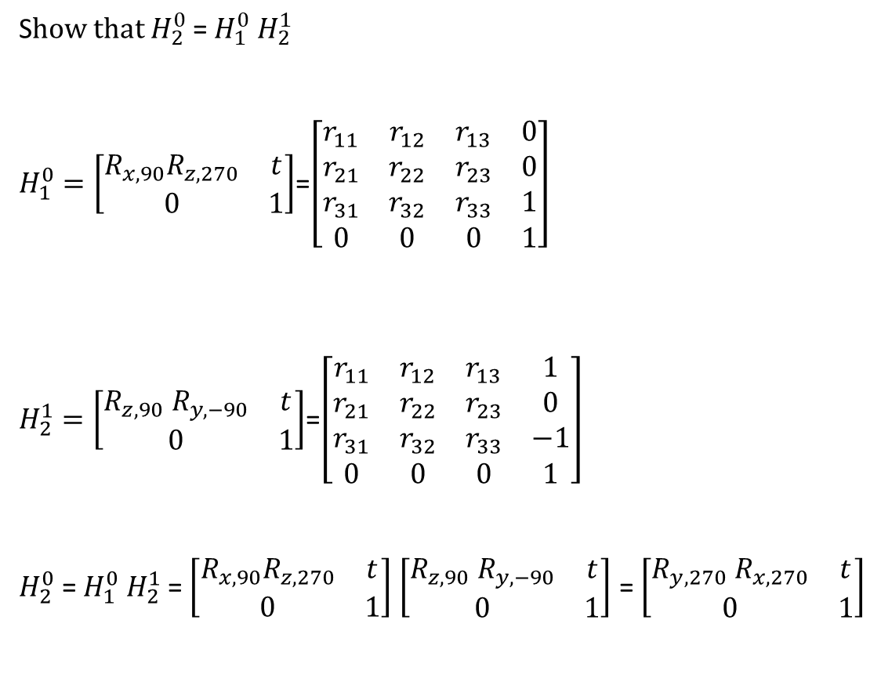
2.38 cont
S$how that H_{2}^{0}$ = $H_{1}^{0}$ $H_{2}^{1}$
$H_{1}^{0}=\left[\begin{matrix}R_{x,90}R_{z,270} & t \\ 0 & 1\end{matrix}\right]$=$\left[\begin{matrix}r_{11} & r_{12} & r_{13} & 0 \\ r_{21} & r_{22} & r_{23} & 0 \\ r_{31} & r_{32} & r_{33} & 1 \\ 0 & 0 & 0 & 1\end{matrix}\right]$
$H_{2}^{1}=\left[\begin{matrix}R_{z,90} R_{y,−90} & t \\ 0 & 1\end{matrix}\right]$=$\left[\begin{matrix}r_{11} & r_{12} & r_{13} & 1 \\ r_{21} & r_{22} & r_{23} & 0 \\ r_{31} & r_{32} & r_{33} & −1 \\ 0 & 0 & 0 & 1\end{matrix}\right]$
$H_{2}^{0}$ = $H_{1}^{0}$ $H_{2}^{1}$ = $\left[\begin{matrix}R_{x,90}R_{z,270} & t \\ 0 & 1\end{matrix}\right]$ $\left[\begin{matrix}R_{z,90} R_{y,−90} & t \\ 0 & 1\end{matrix}\right]$ = $\left[\begin{matrix}R_{y,270} R_{x,270} & t \\ 0 & 1\end{matrix}\right]$

Slide 23
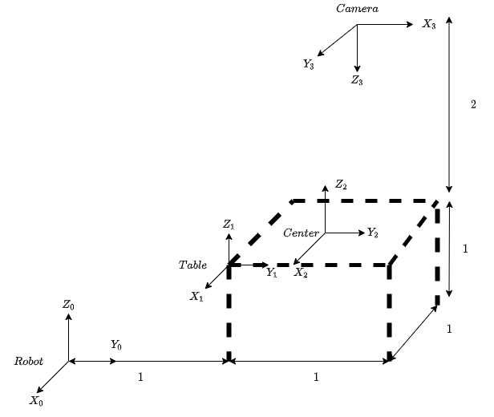

2.39
Try to solve 2.39 by hand. Get an idea how to rotate the coordinate frames using right hand rule.
Find $H_{1}^{0}$, $H_{2}^{0},H_{3}^{0}$ and $H_{3}^{2}$

Slide 24
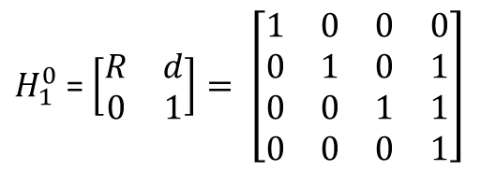

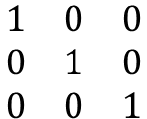

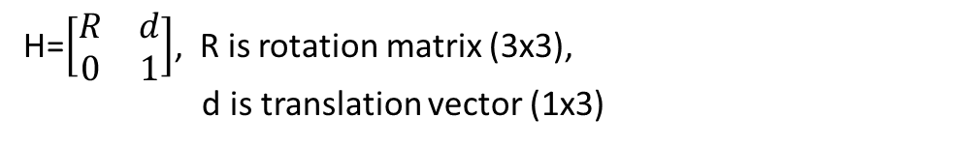
2.39 cont
Find $H_{1}^{0}$
H=$\left[\begin{matrix}R & d \\ 0 & 1\end{matrix}\right]$, R is rotation matrix (3x3),
d is translation vector (1x3)
$$t=[0 1 1]$$
$$\begin{matrix}1 & 0 & 0 \\ 0 & 1 & 0 \\ 0 & 0 & 1\end{matrix}$$
R =
$H_{1}^{0}$ = $\left[\begin{matrix}R & d \\ 0 & 1\end{matrix}\right]= \left[\begin{matrix}1 & 0 & 0 & 0 \\ 0 & 1 & 0 & 1 \\ 0 & 0 & 1 & 1 \\ 0 & 0 & 0 & 1\end{matrix}\right]$

Slide 25

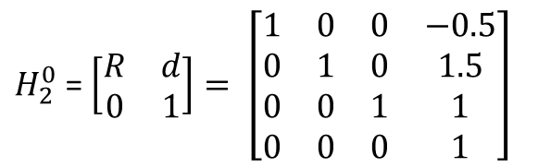
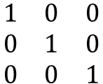
2.39 cont
Find $H_{2}^{0}$
T = [Tx Ty Tz] = [-0.5 1.5 1]
$$\begin{matrix}1 & 0 & 0 \\ 0 & 1 & 0 \\ 0 & 0 & 1\end{matrix}$$
R =
$H_{2}^{0}$ = $\left[\begin{matrix}R & d \\ 0 & 1\end{matrix}\right]= \left[\begin{matrix}1 & 0 & 0 & −0.5 \\ 0 & 1 & 0 & 1.5 \\ 0 & 0 & 1 & 1 \\ 0 & 0 & 0 & 1\end{matrix}\right]$

Slide 26

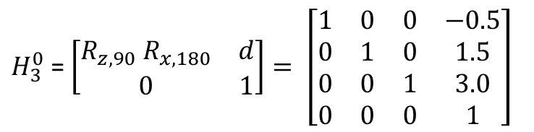

2.39 cont
z
Find $H_{3}^{0}$
First rotation
y
X
R = $R_{z,90}$ $R_{x,180}$
X
Second rotation
y
Z
T = [Tx Ty Tz] = [-0.5 1.5 3.0]
$H_{3}^{0}$ = $\left[\begin{matrix}R_{z,90} R_{x,180} & d \\ 0 & 1\end{matrix}\right]= \left[\begin{matrix}1 & 0 & 0 & −0.5 \\ 0 & 1 & 0 & 1.5 \\ 0 & 0 & 1 & 3.0 \\ 0 & 0 & 0 & 1\end{matrix}\right]$

Slide 27


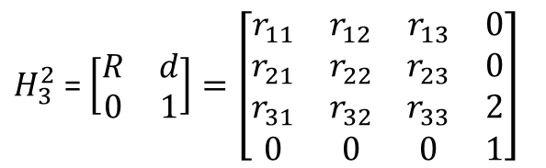
2.39 cont
Find $H_{3}^{2}$
R = $R_{z,90}$ $R_{x,180}$
T = [0 0 2]
$H_{3}^{2}$ = $\left[\begin{matrix}R & d \\ 0 & 1\end{matrix}\right]=\left[\begin{matrix}r_{11} & r_{12} & r_{13} & 0 \\ r_{21} & r_{22} & r_{23} & 0 \\ r_{31} & r_{32} & r_{33} & 2 \\ 0 & 0 & 0 & 1\end{matrix}\right]$

Slide 28
Next week
Forward kinematics, Denavit Hartenberg

