Slide 1
Group Session 09.04.2021
Email: hpnguyen@ifi.uio.no

Slide 2
Plans for today
Time differentation
Euler-Lagrange
Dynamic Model of planar robot arm

Slide 3
Recap!
Next group session, we will focus on deriving the Euler-Lagrange with our Lagrangian term!
$$τ_{k}=\frac{∂}{∂t}\frac{∂L}{∂{\dot{q}}_{k}}−\frac{∂L}{∂q_{k}}$$
Before easter we found the lagrangian term for planar manipulator and spherical manipulator
$$τ=D\left(q\right)\ddot{q}+C\left(q,\dot{q}\right)\dot{q}+g(q)$$
We will focus especially on time-differentation
(Tidsderivasjon med hensyn på q-variablene)
$$τ_{k}=\frac{∂}{∂t}\frac{∂L}{∂{\dot{q}}_{k}}−\frac{∂L}{∂q_{k}}$$

Slide 4

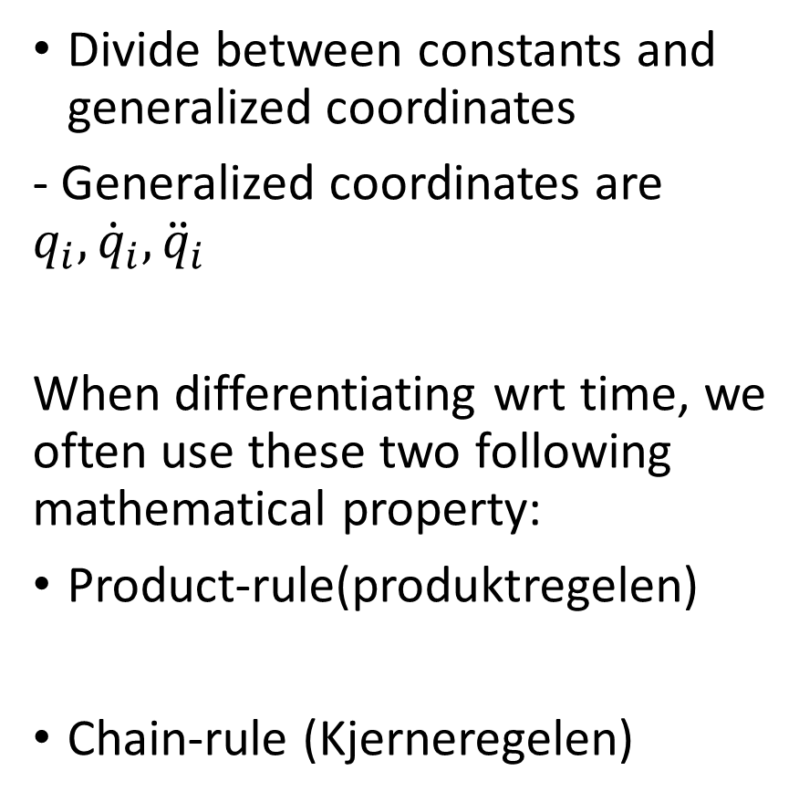
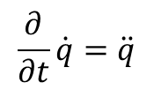
Tips and tricks for time-differentiation
Divide between constants and generalized coordinates
- Generalized coordinates are $q_{i},{\dot{q}}_{i},{\ddot{q}}_{i}$
When differentiating wrt time, we often use these two following mathematical property:
Product-rule(produktregelen)
Chain-rule (Kjerneregelen)
$$\frac{∂}{∂t}q=\dot{q}$$
$$\frac{∂}{∂t}\dot{q}=\ddot{q}$$

Slide 5















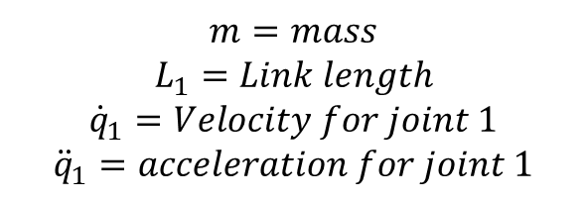

Examples:
$$m=mass$$
$$L_{1}=Link length$$
$${\dot{q}}_{1}=Velocity for joint 1$$
$${\ddot{q}}_{1}=acceleration for joint 1$$
$$f(g(x))$$
$$f(x)$$
Using product rule
$$mc_{1}{\dot{q}}_{1}$$
Using chain-rule
$$u=m$$
$$u′=0$$
$$u=c_{1}$$
$$u′={−s}_{1}{\dot{q}}_{1}$$
yields
$$v=c_{1}{\dot{q}}_{1}$$
$$v′=$$
$${v′=\ddot{q}}_{1}$$
$$u^{′}∗v+u∗v^{′}={−s}_{1}{\dot{q}}_{1}{\dot{q}}_{1}+c_{1}{\ddot{q}}_{1}={−s}_{1}{\dot{q}}_{1}^{2}+c_{1}{\ddot{q}}_{1}$$
$$v={\dot{q}}_{1}$$
$$u^{′}∗v+u∗v^{′}=0+m({−s}_{1}{\dot{q}}_{1}^{2}+c_{1}{\ddot{q}}_{1})=m({−s}_{1}{\dot{q}}_{1}^{2}+c_{1}{\ddot{q}}_{1})$$
Using product rule
NB! Multiplication is commutative so you can choose how you use the product rule, try it!
$$mL_{1}{\dot{q}}_{1}$$
$$u=mL_{1}$$
$$u′=0$$
$${v=\dot{q}}_{1}$$
$${v′=\ddot{q}}_{1}$$
$$u^{′}∗v+u∗v^{′}=0+mL_{1}{\ddot{q}}_{1}=mL_{1}{\ddot{q}}_{1}$$

Slide 6
Lagrangian term for planar manipulator
$$L=\left(\frac{L_{1}^{2}m_{1}{\dot{q}}_{1}^{2}}{2}+\frac{m_{2}(L_{1}^{2}{\dot{q}}_{1}^{2}+2c_{2}L_{1}L_{2}{\dot{q}}_{1}^{2}+2c_{2}L_{1}L_{2}{\dot{q}}_{1}{\dot{q}}_{2}+L_{2}^{2}{\dot{q}}_{1}^{2}+2L_{2}^{2}{\dot{q}}_{1}{\dot{q}}_{2}+L_{2}^{2}{\dot{q}}_{2}^{2})}{2}\right)−(m_{1}g s_{1}\frac{L_{1}}{2}+m_{2}g(s_{1}L_{1}+s_{12}\frac{L_{2}}{2}\text{)}\text{)}$$
Euler-lagrange for planar manipulator
$$τ_{1}=\frac{∂}{∂t}\frac{∂L}{∂{\dot{q}}_{1}}−\frac{∂L}{∂q_{1}}$$

Slide 7
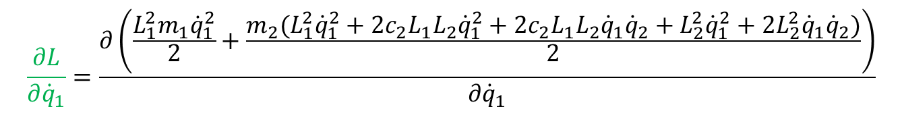
$$τ_{1}=\frac{∂}{∂t}\frac{∂L}{∂{\dot{q}}_{1}}−\frac{∂L}{∂q_{1}}$$
$$L=\left(\frac{L_{1}^{2}m_{1}{\dot{q}}_{1}^{2}}{2}+\frac{m_{2}(L_{1}^{2}{\dot{q}}_{1}^{2}+2c_{2}L_{1}L_{2}{\dot{q}}_{1}^{2}+2c_{2}L_{1}L_{2}{\dot{q}}_{1}{\dot{q}}_{2}+L_{2}^{2}{\dot{q}}_{1}^{2}+2L_{2}^{2}{\dot{q}}_{1}{\dot{q}}_{2}+L_{2}^{2}{\dot{q}}_{2}^{2})}{2}\right)−(m_{1}g s_{1}\frac{L_{1}}{2}+m_{2}g(s_{1}L_{1}+s_{12}\frac{L_{2}}{2}\text{)}\text{)}$$
$$\frac{∂L}{∂{\dot{q}}_{1}}=\frac{∂\left(\frac{L_{1}^{2}m_{1}{\dot{q}}_{1}^{2}}{2}+\frac{m_{2}(L_{1}^{2}{\dot{q}}_{1}^{2}+2c_{2}L_{1}L_{2}{\dot{q}}_{1}^{2}+2c_{2}L_{1}L_{2}{\dot{q}}_{1}{\dot{q}}_{2}+L_{2}^{2}{\dot{q}}_{1}^{2}+2L_{2}^{2}{\dot{q}}_{1}{\dot{q}}_{2}+L_{2}^{2}{\dot{q}}_{2}^{2})}{2}\right)−(m_{1}g s_{1}\frac{L_{1}}{2}+m_{2}g(s_{1}L_{1}+s_{12}\frac{L_{2}}{2}\text{))}}{∂{\dot{q}}_{1}}$$
$$\frac{∂L}{∂{\dot{q}}_{1}}=\frac{∂\left(\frac{L_{1}^{2}m_{1}{\dot{q}}_{1}^{2}}{2}+\frac{m_{2}(L_{1}^{2}{\dot{q}}_{1}^{2}+2c_{2}L_{1}L_{2}{\dot{q}}_{1}^{2}+2c_{2}L_{1}L_{2}{\dot{q}}_{1}{\dot{q}}_{2}+L_{2}^{2}{\dot{q}}_{1}^{2}+2L_{2}^{2}{\dot{q}}_{1}{\dot{q}}_{2}+L_{2}^{2}{\dot{q}}_{2}^{2})}{2}\right)−(m_{1}g s_{1}\frac{L_{1}}{2}+m_{2}g(s_{1}L_{1}+s_{12}\frac{L_{2}}{2}\text{))}}{∂{\dot{q}}_{1}}$$
$$\frac{∂L}{∂{\dot{q}}_{1}}=\frac{∂\left(\frac{L_{1}^{2}m_{1}{\dot{q}}_{1}^{2}}{2}+\frac{m_{2}(L_{1}^{2}{\dot{q}}_{1}^{2}+2c_{2}L_{1}L_{2}{\dot{q}}_{1}^{2}+2c_{2}L_{1}L_{2}{\dot{q}}_{1}{\dot{q}}_{2}+L_{2}^{2}{\dot{q}}_{1}^{2}+2L_{2}^{2}{\dot{q}}_{1}{\dot{q}}_{2})}{2}\right)}{∂{\dot{q}}_{1}}$$

Slide 8

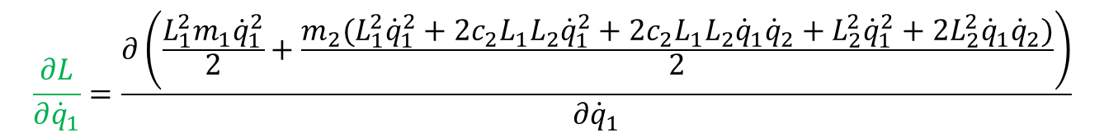


Differentiation of $\frac{∂L}{∂{\dot{q}}_{1}}$ wrt ${\dot{q}}_{1}$
$$\frac{∂L}{∂{\dot{q}}_{1}}=\frac{∂\left(\frac{L_{1}^{2}m_{1}{\dot{q}}_{1}^{2}}{2}+\frac{m_{2}(L_{1}^{2}{\dot{q}}_{1}^{2}+2c_{2}L_{1}L_{2}{\dot{q}}_{1}^{2}+2c_{2}L_{1}L_{2}{\dot{q}}_{1}{\dot{q}}_{2}+L_{2}^{2}{\dot{q}}_{1}^{2}+2L_{2}^{2}{\dot{q}}_{1}{\dot{q}}_{2})}{2}\right)}{∂{\dot{q}}_{1}}$$
Calculating $\frac{∂L}{∂{\dot{q}}_{1}}$
$$\frac{∂L}{∂{\dot{q}}_{1}}=\frac{∂\left(\frac{L_{1}^{2}m_{1}{\dot{q}}_{1}^{2}}{2}+\frac{m_{2}(L_{1}^{2}{\dot{q}}_{1}^{2}+2c_{2}L_{1}L_{2}{\dot{q}}_{1}^{2}+2c_{2}L_{1}L_{2}{\dot{q}}_{1}{\dot{q}}_{2}+L_{2}^{2}{\dot{q}}_{1}^{2}+2L_{2}^{2}{\dot{q}}_{1}{\dot{q}}_{2})}{2}\right)}{∂{\dot{q}}_{1}}$$
$$\frac{∂L}{∂{\dot{q}}_{1}}=m_{2}L_{1}^{2}{\dot{q}}_{1}+m_{2}L_{2}^{2}{\dot{q}}_{1}+m_{2}L_{2}^{2}{\dot{q}}_{2}+m_{2}2L_{1}L_{2}{\dot{q}}_{1}c_{2}+m_{2}L_{1}L_{2}{\dot{q}}_{2}c_{2}+L_{1}^{2}m_{1}{\dot{q}}_{1}$$

Slide 9

Differentiation of $\frac{∂}{∂t} \frac{∂L}{∂{\dot{q}}_{1}}$ wrt $t$
$$\frac{∂}{∂t} \frac{∂L}{∂{\dot{q}}_{1}}=\frac{∂}{∂t}(m_{2}L_{1}^{2}{\dot{q}}_{1}+m_{2}L_{2}^{2}{\dot{q}}_{1}+m_{2}L_{2}^{2}{\dot{q}}_{2}+m_{2}2L_{1}L_{2}{\dot{q}}_{1}c_{2}+m_{2}L_{1}L_{2}{\dot{q}}_{2}c_{2}+L_{1}^{2}m_{1}{\dot{q}}_{1})$$
We can divide each term and solve with respect to time
I
II
III
IV
V
VI
$$\frac{∂}{∂t} \frac{∂L}{∂{\dot{q}}_{1}}=\frac{∂}{∂t}{(m}_{2}L_{1}^{2}{\dot{q}}_{1}+m_{2}L_{2}^{2}{\dot{q}}_{1}+m_{2}L_{2}^{2}{\dot{q}}_{2}+m_{2}2L_{1}L_{2}{\dot{q}}_{1}c_{2}+m_{2}L_{1}L_{2}{\dot{q}}_{2}c_{2}+L_{1}^{2}m_{1}{\dot{q}}_{1})$$
Let us solve all of these terms individually and thorough

Slide 10



























Differentiation of $\frac{∂}{∂t} \frac{∂L}{∂{\dot{q}}_{1}}$ wrt $t$
I:
III:
$$m_{2}L_{2}^{2}{\dot{q}}_{2}$$
$$m_{2}L_{1}^{2}{\dot{q}}_{1}$$
$$u=m_{2}L_{1}^{2}$$
$$u′=0$$
$$u=m_{2}L_{1}^{2}$$
$$u′=0$$
$${v=\dot{q}}_{1}$$
$${v′=\ddot{q}}_{1}$$
$$v={\dot{q}}_{2}$$
$${v′=\ddot{q}}_{2}$$
$$u^{′}∗v+u∗v^{′}=0+m_{2}L_{1}^{2}{\ddot{q}}_{1}=m_{2}L_{1}^{2}{\ddot{q}}_{1}$$
$$u^{′}∗v+u∗v^{′}=0+m_{2}L_{1}^{2}{\ddot{q}}_{2}=m_{2}L_{1}^{2}{\ddot{q}}_{2}$$
IV:
$$m_{2}2L_{1}L_{2}{\dot{q}}_{1}c_{2}$$
Using chain-rule
II:
$$m_{2}L_{2}^{2}{\dot{q}}_{1}$$
$$u=m_{2}L_{2}^{2}$$
$$u′=0$$
$$u=m_{2}2L_{1}L_{2}$$
$$u′=0$$
$$u=c_{2}$$
$$u′={−s}_{2}{\dot{q}}_{2}$$
$${v=\dot{q}}_{1}$$
$${v′=\ddot{q}}_{1}$$
$$v={\dot{q}}_{1}c_{2}$$
$$v^{′}=$$
$$v={\dot{q}}_{1}$$
$${v′=\ddot{q}}_{1}$$
$$u^{′}∗v+u∗v^{′}={−s}_{2}{\dot{q}}_{2}{\dot{q}}_{1}+c_{2}{\ddot{q}}_{1}$$
$$u^{′}∗v+u∗v^{′}=0+m_{2}L_{2}^{2}{\ddot{q}}_{1}=m_{2}L_{2}^{2}{\ddot{q}}_{1}$$
$$u^{′}∗v+u∗v^{′}=0+m_{2}2L_{1}L_{2}({−s}_{2}{\dot{q}}_{2}{\dot{q}}_{1}+c_{2}{\ddot{q}}_{1})$$
$$=m_{2}2L_{1}L_{2}({−s}_{2}{\dot{q}}_{2}{\dot{q}}_{1}+c_{2}{\ddot{q}}_{1})$$

Slide 11















Differentiation of $\frac{∂}{∂t} \frac{∂L}{∂{\dot{q}}_{1}}$ wrt $t$ , cont.
V:
$$m_{2}L_{1}L_{2}{\dot{q}}_{2}c_{2}$$
VI:
$$L_{1}^{2}m_{1}{\dot{q}}_{1}$$
$$u=m_{2}L_{1}L_{2}$$
$$u′=0$$
$$u=L_{1}^{2}m_{1}$$
$$u′=0$$
$$v={\dot{q}}_{2}c_{2}$$
$$v^{′}=$$
$$v={\dot{q}}_{1}$$
$$v^{′}={\ddot{q}}_{1}$$
Using chain-rule
$$u^{′}∗v+u∗v^{′}=0+L_{1}^{2}m_{1}{\ddot{q}}_{1}=L_{1}^{2}m_{1}{\ddot{q}}_{1}$$
$$u=c_{2}$$
$$u′={−s}_{2}{\dot{q}}_{2}$$
$$v={\dot{q}}_{2}$$
$${v′=\ddot{q}}_{2}$$
$$u^{′}∗v+u∗v^{′}={−s}_{2}{\dot{q}}_{2}{\dot{q}}_{2}+c_{2}{\ddot{q}}_{1}={−s}_{2}{\dot{q}}_{2}^{2}+c_{2}{\ddot{q}}_{2}$$
$u^{′}∗v+u∗v^{′}=0+m_{2}L_{1}L_{2}({−s}_{2}{\dot{q}}_{2}^{2}+c_{2}{\ddot{q}}_{2})=$ $m_{2}L_{1}L_{2}({−s}_{2}{\dot{q}}_{2}^{2}+c_{2}{\ddot{q}}_{2})$

Slide 12

Putting it all together for $\frac{∂}{∂t} \frac{∂L}{∂{\dot{q}}_{1}}$
$$\frac{∂}{∂t} \frac{∂L}{∂{\dot{q}}_{1}}=\frac{∂}{∂t}{(m}_{2}L_{1}^{2}{\dot{q}}_{1}+m_{2}L_{2}^{2}{\dot{q}}_{1}+m_{2}L_{2}^{2}{\dot{q}}_{2}+m_{2}2L_{1}L_{2}{\dot{q}}_{1}c_{2}+m_{2}L_{1}L_{2}{\dot{q}}_{2}c_{2}+L_{1}^{2}m_{1}{\dot{q}}_{1})$$
$$\frac{∂}{∂t} \frac{∂L}{∂{\dot{q}}_{1}}=m_{2}L_{1}^{2}{\ddot{q}}_{1}+m_{2}L_{1}^{2}{\ddot{q}}_{2}+m_{2}L_{2}^{2}{\ddot{q}}_{1}+m_{2}2L_{1}L_{2}\left({−s}_{2}{\dot{q}}_{2}{\dot{q}}_{1}+c_{2}{\ddot{q}}_{1}\right)+m_{2}L_{1}L_{2}\left({−s}_{2}{\dot{q}}_{2}^{2}+c_{2}{\ddot{q}}_{2}\right)+L_{1}^{2}m_{1}{\ddot{q}}_{1}$$

Slide 13
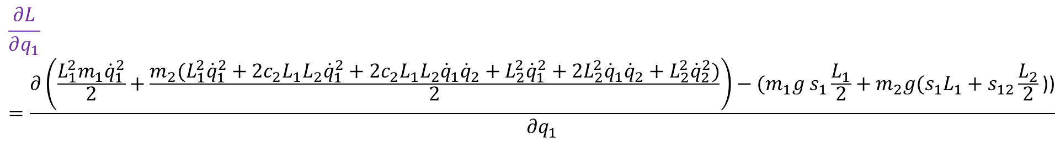


Differentiation of $\frac{∂L}{∂q_{1}}$wrt $q_{1}$
$$\frac{∂L}{∂q_{1}}=\frac{∂\left(\frac{L_{1}^{2}m_{1}{\dot{q}}_{1}^{2}}{2}+\frac{m_{2}(L_{1}^{2}{\dot{q}}_{1}^{2}+2c_{2}L_{1}L_{2}{\dot{q}}_{1}^{2}+2c_{2}L_{1}L_{2}{\dot{q}}_{1}{\dot{q}}_{2}+L_{2}^{2}{\dot{q}}_{1}^{2}+2L_{2}^{2}{\dot{q}}_{1}{\dot{q}}_{2}+L_{2}^{2}{\dot{q}}_{2}^{2})}{2}\right)−(m_{1}g s_{1}\frac{L_{1}}{2}+m_{2}g(s_{1}L_{1}+s_{12}\frac{L_{2}}{2}\text{))}}{∂q_{1}}$$
$$\frac{∂L}{∂q_{1}}=\frac{∂\left(\frac{L_{1}^{2}m_{1}{\dot{q}}_{1}^{2}}{2}+\frac{m_{2}(L_{1}^{2}{\dot{q}}_{1}^{2}+2c_{2}L_{1}L_{2}{\dot{q}}_{1}^{2}+2c_{2}L_{1}L_{2}{\dot{q}}_{1}{\dot{q}}_{2}+L_{2}^{2}{\dot{q}}_{1}^{2}+2L_{2}^{2}{\dot{q}}_{1}{\dot{q}}_{2}+L_{2}^{2}{\dot{q}}_{2}^{2})}{2}\right)−(m_{1}g s_{1}\frac{L_{1}}{2}+m_{2}g(s_{1}L_{1}+s_{12}\frac{L_{2}}{2}\text{))}}{∂q_{1}}$$
$$\frac{∂L}{∂q_{1}}=\frac{∂(m_{1}g s_{1}\frac{L_{1}}{2}+m_{2}g(s_{1}L_{1}+s_{12}\frac{L_{2}}{2}\text{))}}{∂q_{1}}$$

Slide 14


Differentiation of $\frac{∂L}{∂q_{1}}$wrt $q_{1}$, cont.
$$\frac{∂L}{∂q_{1}}=\frac{∂(m_{1}g s_{1}\frac{L_{1}}{2}+m_{2}g(s_{1}L_{1}+s_{12}\frac{L_{2}}{2}\text{))}}{∂q_{1}}$$
$$\frac{∂L}{∂q_{1}}=m_{2}gc_{12}\frac{L_{2}}{2}+m_{2}gc_{1}L_{1}+m_{1}gc_{1}\frac{L_{1}}{2}$$

Slide 15
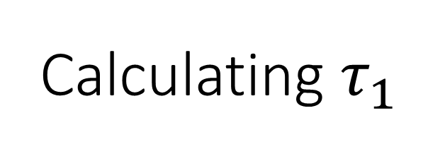

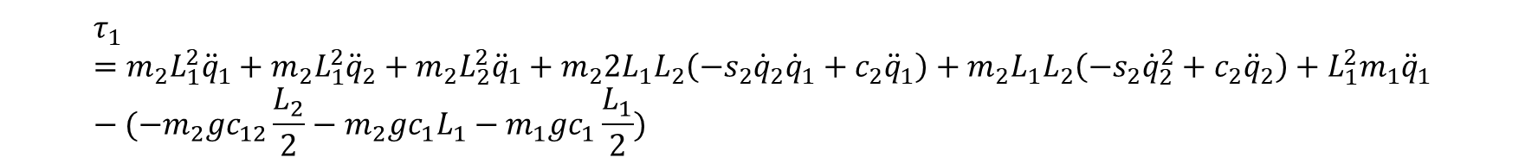
Calculating $τ_{1}$
$$τ_{1}=\frac{∂}{∂t}\frac{∂L}{∂{\dot{q}}_{1}}−\frac{∂L}{∂q_{1}}$$
$$\frac{∂}{∂t} \frac{∂L}{∂{\dot{q}}_{1}}=m_{2}L_{1}^{2}{\ddot{q}}_{1}+m_{2}L_{1}^{2}{\ddot{q}}_{2}+m_{2}L_{2}^{2}{\ddot{q}}_{1}+m_{2}2L_{1}L_{2}\left({−s}_{2}{\dot{q}}_{2}{\dot{q}}_{1}+c_{2}{\ddot{q}}_{1}\right)+m_{2}L_{1}L_{2}\left({−s}_{2}{\dot{q}}_{2}^{2}+c_{2}{\ddot{q}}_{2}\right)+L_{1}^{2}m_{1}{\ddot{q}}_{1}$$
$$\frac{∂L}{∂q_{1}}=−m_{2}gc_{12}\frac{L_{2}}{2}−m_{2}gc_{1}L_{1}−m_{1}gc_{1}\frac{L_{1}}{2}$$
$$τ_{1}=m_{2}L_{1}^{2}{\ddot{q}}_{1}+m_{2}L_{1}^{2}{\ddot{q}}_{2}+m_{2}L_{2}^{2}{\ddot{q}}_{1}+m_{2}2L_{1}L_{2}\left({−s}_{2}{\dot{q}}_{2}{\dot{q}}_{1}+c_{2}{\ddot{q}}_{1}\right)+m_{2}L_{1}L_{2}\left({−s}_{2}{\dot{q}}_{2}^{2}+c_{2}{\ddot{q}}_{2}\right)+L_{1}^{2}m_{1}{\ddot{q}}_{1}−(−m_{2}gc_{12}\frac{L_{2}}{2}−m_{2}gc_{1}L_{1}−m_{1}gc_{1}\frac{L_{1}}{2})$$
$$=m_{2}L_{1}^{2}{\ddot{q}}_{1}+m_{2}L_{1}^{2}{\ddot{q}}_{2}+m_{2}L_{2}^{2}{\ddot{q}}_{1}+m_{2}2L_{1}L_{2}\left({−s}_{2}{\dot{q}}_{2}{\dot{q}}_{1}+c_{2}{\ddot{q}}_{1}\right)+m_{2}L_{1}L_{2}\left({−s}_{2}{\dot{q}}_{2}^{2}+c_{2}{\ddot{q}}_{2}\right)+L_{1}^{2}m_{1}{\ddot{q}}_{1}+m_{2}gc_{12}\frac{L_{2}}{2}+m_{2}gc_{1}L_{1}+m_{1}gc_{1}\frac{L_{1}}{2})$$

Slide 16

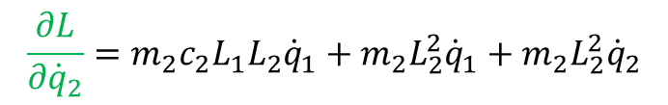
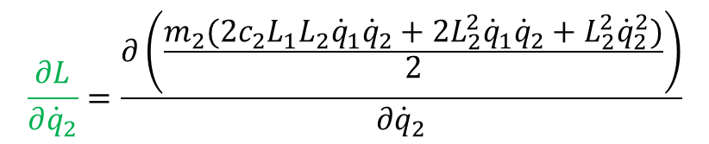
Differentiation of $\frac{∂L}{∂{\dot{q}}_{2}}$ wrt ${\dot{q}}_{2}$
$$τ_{2}=\frac{∂}{∂t}\frac{∂L}{∂{\dot{q}}_{2}}−\frac{∂L}{∂q_{2}}$$
$$\frac{∂L}{∂{\dot{q}}_{2}}=\frac{∂\left(\frac{L_{1}^{2}m_{1}{\dot{q}}_{1}^{2}}{2}+\frac{m_{2}(L_{1}^{2}{\dot{q}}_{1}^{2}+2c_{2}L_{1}L_{2}{\dot{q}}_{1}^{2}+2c_{2}L_{1}L_{2}{\dot{q}}_{1}{\dot{q}}_{2}+L_{2}^{2}{\dot{q}}_{1}^{2}+2L_{2}^{2}{\dot{q}}_{1}{\dot{q}}_{2}+L_{2}^{2}{\dot{q}}_{2}^{2})}{2}\right)−(m_{1}g s_{1}\frac{L_{1}}{2}+m_{2}g(s_{1}L_{1}+s_{12}\frac{L_{2}}{2}\text{))}}{∂{\dot{q}}_{2}}$$
$$\frac{∂L}{∂{\dot{q}}_{2}}=\frac{∂\left(\frac{L_{1}^{2}m_{1}{\dot{q}}_{1}^{2}}{2}+\frac{m_{2}(L_{1}^{2}{\dot{q}}_{1}^{2}+2c_{2}L_{1}L_{2}{\dot{q}}_{1}^{2}+2c_{2}L_{1}L_{2}{\dot{q}}_{1}{\dot{q}}_{2}+L_{2}^{2}{\dot{q}}_{1}^{2}+2L_{2}^{2}{\dot{q}}_{1}{\dot{q}}_{2}+L_{2}^{2}{\dot{q}}_{2}^{2})}{2}\right)−(m_{1}g s_{1}\frac{L_{1}}{2}+m_{2}g(s_{1}L_{1}+s_{12}\frac{L_{2}}{2}\text{))}}{∂{\dot{q}}_{2}}$$
$$\frac{∂L}{∂{\dot{q}}_{2}}=\frac{∂\left(\frac{m_{2}(2c_{2}L_{1}L_{2}{\dot{q}}_{1}{\dot{q}}_{2}+2L_{2}^{2}{\dot{q}}_{1}{\dot{q}}_{2}+L_{2}^{2}{\dot{q}}_{2}^{2})}{2}\right)}{∂{\dot{q}}_{2}}$$
$$\frac{∂L}{∂{\dot{q}}_{2}}=m_{2}c_{2}L_{1}L_{2}{\dot{q}}_{1}+m_{2}L_{2}^{2}{\dot{q}}_{1}+m_{2}L_{2}^{2}{\dot{q}}_{2}$$

Slide 17



Differentiation of $\frac{∂}{∂t} \frac{∂L}{∂{\dot{q}}_{2}}$ wrt $t$
$$\frac{∂L}{∂{\dot{q}}_{2}}=m_{2}c_{2}L_{1}L_{2}{\dot{q}}_{1}+m_{2}L_{2}^{2}{\dot{q}}_{1}+m_{2}L_{2}^{2}{\dot{q}}_{2}$$
We can divide each term and solve with respect to time
I
II
III
$$\frac{∂}{∂t} \frac{∂L}{∂{\dot{q}}_{2}}=\frac{∂}{∂t}(m_{2}c_{2}L_{1}L_{2}{\dot{q}}_{1}+m_{2}L_{2}^{2}{\dot{q}}_{1}+m_{2}L_{2}^{2}{\dot{q}}_{2})$$

Slide 18






















Differentiation of $\frac{∂}{∂t} \frac{∂L}{∂{\dot{q}}_{2}}$ wrt $t$, cont.
II:
$$m_{2}L_{2}^{2}{\dot{q}}_{1}$$
I:
$$m_{2}c_{2}L_{1}L_{2}{\dot{q}}_{1}$$
$$u=m_{2}L_{2}^{2}$$
$$u′=0$$
$$u=m_{2}L_{1}L_{2}$$
$$u′=0$$
$${v=\dot{q}}_{1}$$
$${v′=\ddot{q}}_{1}$$
$$v={\dot{q}}_{1}c_{2}$$
$$v^{′}=$$
Using chain-rule
$$u=c_{2}$$
$$u′={−s}_{2}{\dot{q}}_{2}$$
$$u^{′}∗v+u∗v^{′}=0+m_{2}L_{2}^{2}{\ddot{q}}_{1}=m_{2}L_{2}^{2}{\ddot{q}}_{1}$$
$$v={\dot{q}}_{1}$$
$${v′=\ddot{q}}_{1}$$
$$u^{′}∗v+u∗v^{′}={−s}_{2}{\dot{q}}_{2}{\dot{q}}_{1}+c_{2}{\ddot{q}}_{1}$$
III:
$$m_{2}L_{2}^{2}{\dot{q}}_{2}$$
$$u=m_{2}L_{2}^{2}$$
$$u′=0$$
$$v={\dot{q}}_{2}$$
$${v′=\ddot{q}}_{2}$$
$$u^{′}∗v+u∗v^{′}=0+m_{2}L_{1}L_{2}({−s}_{2}{\dot{q}}_{2}{\dot{q}}_{1}+c_{2}{\ddot{q}}_{1})$$
$$=m_{2}L_{1}L_{2}({−s}_{2}{\dot{q}}_{2}{\dot{q}}_{1}+c_{2}{\ddot{q}}_{1})$$
$$u^{′}∗v+u∗v^{′}=0+m_{2}L_{2}^{2}{\ddot{q}}_{2}=m_{2}L_{2}^{2}{\ddot{q}}_{2}$$

Slide 19


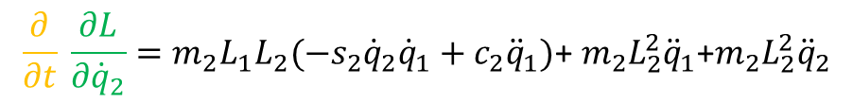
Putting it all together for $\frac{∂}{∂t} \frac{∂L}{∂{\dot{q}}_{2}}$
$$\frac{∂}{∂t} \frac{∂L}{∂{\dot{q}}_{2}}=\frac{∂}{∂t}(m_{2}c_{2}L_{1}L_{2}{\dot{q}}_{1}+m_{2}L_{2}^{2}{\dot{q}}_{1}+m_{2}L_{2}^{2}{\dot{q}}_{2})$$
$$\frac{∂}{∂t} \frac{∂L}{∂{\dot{q}}_{2}}=m_{2}L_{1}L_{2}({−s}_{2}{\dot{q}}_{2}{\dot{q}}_{1}+c_{2}{\ddot{q}}_{1})\text{+ }m_{2}L_{2}^{2}{\ddot{q}}_{1}\text{+}m_{2}L_{2}^{2}{\ddot{q}}_{2}$$

Slide 20



Differentiation of $\frac{∂L}{∂q_{2}}$ wrt $q_{2}$
$$\frac{∂L}{∂q_{2}}=\frac{∂\left(\frac{L_{1}^{2}m_{1}{\dot{q}}_{1}^{2}}{2}+\frac{m_{2}(L_{1}^{2}{\dot{q}}_{1}^{2}+2c_{2}L_{1}L_{2}{\dot{q}}_{1}^{2}+2c_{2}L_{1}L_{2}{\dot{q}}_{1}{\dot{q}}_{2}+L_{2}^{2}{\dot{q}}_{1}^{2}+2L_{2}^{2}{\dot{q}}_{1}{\dot{q}}_{2}+L_{2}^{2}{\dot{q}}_{2}^{2})}{2}\right)−(m_{1}g s_{1}\frac{L_{1}}{2}+m_{2}g(s_{1}L_{1}+s_{12}\frac{L_{2}}{2}\text{))}}{∂q_{2}}$$
$$\frac{∂L}{∂q_{2}}=\frac{∂\left(\frac{L_{1}^{2}m_{1}{\dot{q}}_{1}^{2}}{2}+\frac{m_{2}(L_{1}^{2}{\dot{q}}_{1}^{2}+2c_{2}L_{1}L_{2}{\dot{q}}_{1}^{2}+2c_{2}L_{1}L_{2}{\dot{q}}_{1}{\dot{q}}_{2}+L_{2}^{2}{\dot{q}}_{1}^{2}+2L_{2}^{2}{\dot{q}}_{1}{\dot{q}}_{2}+L_{2}^{2}{\dot{q}}_{2}^{2})}{2}\right)−(m_{1}g s_{1}\frac{L_{1}}{2}+m_{2}g(s_{1}L_{1}+s_{12}\frac{L_{2}}{2}\text{))}}{∂q_{2}}$$

Slide 21


Differentiation of $\frac{∂L}{∂q_{2}}$ wrt $q_{2}$, cont.
$$\frac{∂L}{∂q_{2}}=\frac{∂\left(\frac{m_{2}(2c_{2}L_{1}L_{2}{\dot{q}}_{1}^{2}+2c_{2}L_{1}L_{2}{\dot{q}}_{1}{\dot{q}}_{2})}{2}\right)−m_{2}g(s_{12}\frac{L_{2}}{2}\text{)}}{∂q_{2}}$$
$$\frac{∂L}{∂q_{2}}=\frac{∂(m_{2}c_{2}L_{1}L_{2}{\dot{q}}_{1}^{2}+m_{2}c_{2}L_{1}L_{2}{\dot{q}}_{1}{\dot{q}}_{2}−m_{2}gs_{12}\frac{L_{2}}{2}\text{)}}{∂q_{2}}$$
$$\frac{∂L}{∂q_{2}}=−m_{2}L_{1}L_{2}s_{2}{\dot{q}}_{1}^{2}−m_{2}L_{1}L_{2}{\dot{q}}_{2}s_{2}−m_{2}gc_{12}\frac{L_{2}}{2}$$

Slide 22

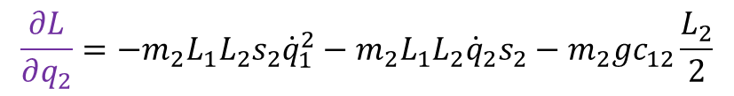

Calculating $τ_{2}$
$$τ_{2}=\frac{∂}{∂t}\frac{∂L}{∂{\dot{q}}_{2}}−\frac{∂L}{∂q_{2}}$$
$$\frac{∂}{∂t}\frac{∂L}{∂{\dot{q}}_{2}}=m_{2}L_{1}L_{2}({−s}_{2}{\dot{q}}_{2}{\dot{q}}_{1}+c_{2}{\ddot{q}}_{1})\text{+ }m_{2}L_{2}^{2}{\ddot{q}}_{1}\text{+}m_{2}L_{2}^{2}{\ddot{q}}_{2}$$
$$\frac{∂L}{∂q_{2}}=−m_{2}L_{1}L_{2}s_{2}{\dot{q}}_{1}^{2}−m_{2}L_{1}L_{2}{\dot{q}}_{2}s_{2}−m_{2}gc_{12}\frac{L_{2}}{2}$$
$$τ_{2}=m_{2}L_{1}L_{2}\left({−s}_{2}{\dot{q}}_{2}{\dot{q}}_{1}+c_{2}{\ddot{q}}_{1}\right)\text{+ }m_{2}L_{2}^{2}{\ddot{q}}_{1}\text{+}m_{2}L_{2}^{2}{\ddot{q}}_{2}−(−m_{2}L_{1}L_{2}s_{2}{\dot{q}}_{1}^{2}−m_{2}L_{1}L_{2}{\dot{q}}_{2}s_{2}−m_{2}gc_{12}\frac{L_{2}}{2})$$
$$τ_{2}=m_{2}L_{1}L_{2}\left({−s}_{2}{\dot{q}}_{2}{\dot{q}}_{1}+c_{2}{\ddot{q}}_{1}\right)\text{+ }m_{2}L_{2}^{2}{\ddot{q}}_{1}\text{+}m_{2}L_{2}^{2}{\ddot{q}}_{2}+m_{2}L_{1}L_{2}s_{2}{\dot{q}}_{1}^{2}+m_{2}L_{1}L_{2}{\dot{q}}_{2}s_{2}+m_{2}gc_{12}\frac{L_{2}}{2})$$

Slide 23
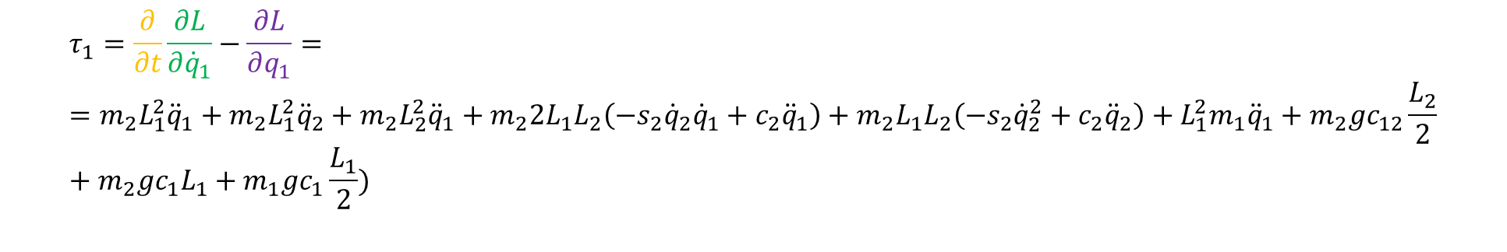
Dynamic model for the 2-DOF planar manipulator
$$τ_{1}=\frac{∂}{∂t}\frac{∂L}{∂{\dot{q}}_{1}}−\frac{∂L}{∂q_{1}}==m_{2}L_{1}^{2}{\ddot{q}}_{1}+m_{2}L_{1}^{2}{\ddot{q}}_{2}+m_{2}L_{2}^{2}{\ddot{q}}_{1}+m_{2}2L_{1}L_{2}\left({−s}_{2}{\dot{q}}_{2}{\dot{q}}_{1}+c_{2}{\ddot{q}}_{1}\right)+m_{2}L_{1}L_{2}\left({−s}_{2}{\dot{q}}_{2}^{2}+c_{2}{\ddot{q}}_{2}\right)+L_{1}^{2}m_{1}{\ddot{q}}_{1}+m_{2}gc_{12}\frac{L_{2}}{2}+m_{2}gc_{1}L_{1}+m_{1}gc_{1}\frac{L_{1}}{2})$$
$$τ_{2}=\frac{∂}{∂t}\frac{∂L}{∂{\dot{q}}_{2}}−\frac{∂L}{∂q_{2}}=m_{2}L_{1}L_{2}\left({−s}_{2}{\dot{q}}_{2}{\dot{q}}_{1}+c_{2}{\ddot{q}}_{1}\right)\text{+ }m_{2}L_{2}^{2}{\ddot{q}}_{1}\text{+}m_{2}L_{2}^{2}{\ddot{q}}_{2}+m_{2}L_{1}L_{2}s_{2}{\dot{q}}_{1}^{2}+m_{2}L_{1}L_{2}{\dot{q}}_{2}s_{2}+m_{2}gc_{12}\frac{L_{2}}{2})$$

Slide 24
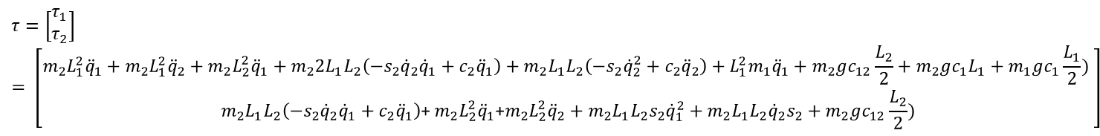
$$τ=\left[\begin{matrix}τ_{1} \\ τ_{2}\end{matrix}\right]= \left[\begin{matrix}m_{2}L_{1}^{2}{\ddot{q}}_{1}+m_{2}L_{1}^{2}{\ddot{q}}_{2}+m_{2}L_{2}^{2}{\ddot{q}}_{1}+m_{2}2L_{1}L_{2}\left({−s}_{2}{\dot{q}}_{2}{\dot{q}}_{1}+c_{2}{\ddot{q}}_{1}\right)+m_{2}L_{1}L_{2}\left({−s}_{2}{\dot{q}}_{2}^{2}+c_{2}{\ddot{q}}_{2}\right)+L_{1}^{2}m_{1}{\ddot{q}}_{1}+m_{2}gc_{12}\frac{L_{2}}{2}+m_{2}gc_{1}L_{1}+m_{1}gc_{1}\frac{L_{1}}{2}) \\ m_{2}L_{1}L_{2}\left({−s}_{2}{\dot{q}}_{2}{\dot{q}}_{1}+c_{2}{\ddot{q}}_{1}\right)\text{+ }m_{2}L_{2}^{2}{\ddot{q}}_{1}\text{+}m_{2}L_{2}^{2}{\ddot{q}}_{2}+m_{2}L_{1}L_{2}s_{2}{\dot{q}}_{1}^{2}+m_{2}L_{1}L_{2}{\dot{q}}_{2}s_{2}+m_{2}gc_{12}\frac{L_{2}}{2})\end{matrix}\right]$$
This is our equation of motion without inertia tensors.
$$τ=D\left(q\right)\ddot{q}+C\left(q,\dot{q}\right)\dot{q}+g(q)$$
Two ways of finding $C\left(q,\dot{q}\right)\dot{q}$
I) Given D(q)

Slide 25

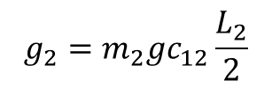
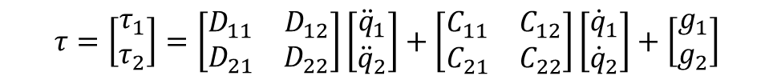

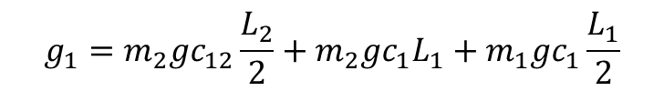




Dynamic model for the 2-DOF planar manipulator
$$τ=D\left(q\right)\ddot{q}+C\left(q,\dot{q}\right)\dot{q}+g(q)$$
NB! Something wrong here
$$τ=\left[\begin{matrix}τ_{1} \\ τ_{2}\end{matrix}\right]=\left[\begin{matrix}D_{11} & D_{12} \\ D_{21} & D_{22}\end{matrix}\right]\left[\begin{matrix}{\ddot{q}}_{1} \\ {\ddot{q}}_{2}\end{matrix}\right]+\left[\begin{matrix}C_{11} & C_{12} \\ C_{21} & C_{22}\end{matrix}\right]\left[\begin{matrix}{\dot{q}}_{1} \\ {\dot{q}}_{2}\end{matrix}\right]+\left[\begin{matrix}g_{1} \\ g_{2}\end{matrix}\right]$$
$$D_{11}=m_{2}L_{1}^{2}+m_{2}L_{2}^{2}+2L_{1}L_{2}m_{2}c_{2}$$
$$C_{11}=−2L_{1}L_{2}m_{2}s_{2}{\dot{q}}_{2}$$
$$g_{1}=m_{2}gc_{12}\frac{L_{2}}{2}+m_{2}gc_{1}L_{1}+m_{1}gc_{1}\frac{L_{1}}{2}$$
$$D_{12}=L_{1}L_{2}m_{2}c_{2}+m_{2}L_{2}^{2}$$
$$C_{12}=−2L_{1}L_{2}m_{2}s_{2}{\dot{q}}_{2}$$
$$C_{21}=L_{1}L_{2}m_{2}s_{2}{\dot{q}}_{1}$$
$$g_{2}=m_{2}gc_{12}\frac{L_{2}}{2}$$
$$D_{21}=m_{2}L_{2}^{2}+L_{1}L_{2}m_{2}c_{2}$$
$$C_{22}=−2L_{1}L_{2}m_{2}s_{2}{\dot{q}}_{1}$$
$$D_{22}=m_{2}L_{2}^{2}$$

Slide 26
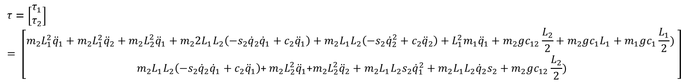
$$τ=\left[\begin{matrix}τ_{1} \\ τ_{2}\end{matrix}\right]= \left[\begin{matrix}m_{2}L_{1}^{2}{\ddot{q}}_{1}+m_{2}L_{1}^{2}{\ddot{q}}_{2}+m_{2}L_{2}^{2}{\ddot{q}}_{1}+m_{2}2L_{1}L_{2}\left({−s}_{2}{\dot{q}}_{2}{\dot{q}}_{1}+c_{2}{\ddot{q}}_{1}\right)+m_{2}L_{1}L_{2}\left({−s}_{2}{\dot{q}}_{2}^{2}+c_{2}{\ddot{q}}_{2}\right)+L_{1}^{2}m_{1}{\ddot{q}}_{1}+m_{2}gc_{12}\frac{L_{2}}{2}+m_{2}gc_{1}L_{1}+m_{1}gc_{1}\frac{L_{1}}{2}) \\ m_{2}L_{1}L_{2}\left({−s}_{2}{\dot{q}}_{2}{\dot{q}}_{1}+c_{2}{\ddot{q}}_{1}\right)\text{+ }m_{2}L_{2}^{2}{\ddot{q}}_{1}\text{+}m_{2}L_{2}^{2}{\ddot{q}}_{2}+m_{2}L_{1}L_{2}s_{2}{\dot{q}}_{1}^{2}+m_{2}L_{1}L_{2}{\dot{q}}_{2}s_{2}+m_{2}gc_{12}\frac{L_{2}}{2})\end{matrix}\right]$$
These two equations are the equal
$$τ=\left[\begin{matrix}τ_{1} \\ τ_{2}\end{matrix}\right]=\left[\begin{matrix}m_{2}L_{1}^{2}+m_{2}L_{2}^{2}+2L_{1}L_{2}m_{2}c_{2} & −2L_{1}L_{2}m_{2}c_{2}+m_{2}L_{2}^{2} \\ m_{2}L_{2}^{2}+L_{1}L_{2}m_{2}c_{2} & m_{2}L_{2}^{2}\end{matrix}\right]\left[\begin{matrix}{\ddot{q}}_{1} \\ {\ddot{q}}_{2}\end{matrix}\right]+\left[\begin{matrix}−2L_{1}L_{2}m_{2}s_{2}{\dot{q}}_{2} & −2L_{1}L_{2}m_{2}s_{2}{\dot{q}}_{2} \\ L_{1}L_{2}m_{2}s_{2}{\dot{q}}_{1} & −2L_{1}L_{2}m_{2}s_{2}{\dot{q}}_{1}\end{matrix}\right]\left[\begin{matrix}{\dot{q}}_{1} \\ {\dot{q}}_{2}\end{matrix}\right]+\left[\begin{matrix}m_{2}gc_{12}\frac{L_{2}}{2}+m_{2}gc_{1}L_{1}+m_{1}gc_{1}\frac{L_{1}}{2} \\ m_{2}gc_{12}\frac{L_{2}}{2}\end{matrix}\right]$$

Slide 27
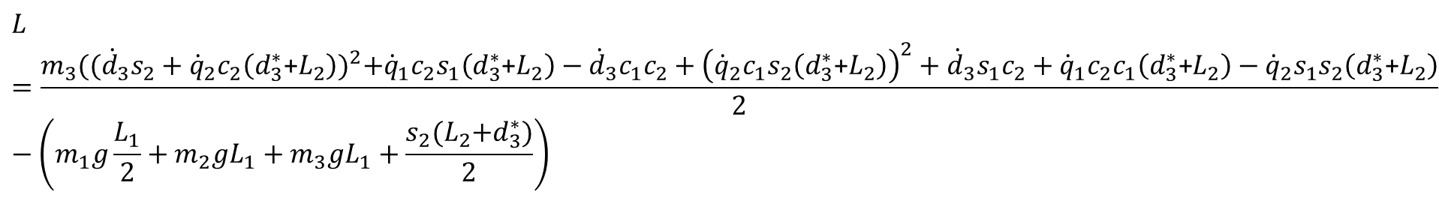
Lagrangian term for Spherical manipulator
$$L=\frac{m_{3}{(({\dot{d}}_{3}s_{2}+{\dot{q}}_{2}c_{2}\left(d_{3}^{∗}\text{+}L_{2}\right))}^{2}+{\dot{q}}_{1}c_{2}s_{1}\left(d_{3}^{∗}\text{+}L_{2}\right)−{\dot{d}}_{3}c_{1}c_{2}+{\left({\dot{q}}_{2}c_{1}s_{2}\left(d_{3}^{∗}\text{+}L_{2}\right)\right)}^{2}+{\dot{d}}_{3}s_{1}c_{2}+{\dot{q}}_{1}c_{2}c_{1}\left(d_{3}^{∗}\text{+}L_{2}\right)−{\dot{q}}_{2}s_{1}s_{2}\left(d_{3}^{∗}\text{+}L_{2}\right)}{2}−\left(m_{1}g\frac{L_{1}}{2}+m_{2}gL_{1}+m_{3}gL_{1}+\frac{s_{2}{(L}_{2}+d_{3}^{∗})}{2}\right)$$
Euler Lagrange for Spherical manipulator
$$τ_{1}=\frac{∂}{∂t}\frac{∂L}{∂{\dot{q}}_{1}}−\frac{∂L}{∂q_{1}}$$
$$τ_{2}=\frac{∂}{∂t}\frac{∂L}{∂{\dot{q}}_{2}}−\frac{∂L}{∂q_{2}}$$
$$τ_{3}=\frac{∂}{∂t}\frac{∂L}{∂{\dot{q}}_{3}}−\frac{∂L}{∂q_{3}}$$
I will not do this by hand,

Slide 28

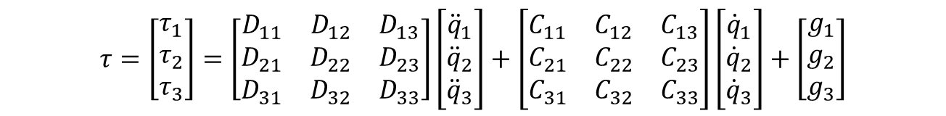
Dynamic model for the Spherical manipulator
$$τ=\left[\begin{matrix}τ_{1} \\ τ_{2} \\ τ_{3}\end{matrix}\right]$$
$$τ=D\left(q\right)\ddot{q}+C\left(q,\dot{q}\right)\dot{q}+g(q)$$
$$τ=\left[\begin{matrix}τ_{1} \\ τ_{2} \\ τ_{3}\end{matrix}\right]=\left[\begin{matrix}D_{11} & D_{12} & D_{13} \\ D_{21} & D_{22} & D_{23} \\ D_{31} & D_{32} & D_{33}\end{matrix}\right]\left[\begin{matrix}{\ddot{q}}_{1} \\ {\ddot{q}}_{2} \\ {\ddot{q}}_{3}\end{matrix}\right]+\left[\begin{matrix}C_{11} & C_{12} & C_{13} \\ C_{21} & C_{22} & C_{23} \\ C_{31} & C_{32} & C_{33}\end{matrix}\right]\left[\begin{matrix}{\dot{q}}_{1} \\ {\dot{q}}_{2} \\ {\dot{q}}_{3}\end{matrix}\right]+\left[\begin{matrix}g_{1} \\ g_{2} \\ g_{3}\end{matrix}\right]$$

Slide 29
FINISH

Slide 30
Hint: for mandatory assignment 3
The equation of motion or the dynamic model should be small for the simplified 2-DOF Crustcrawler robot in Task I.

