Slide 1
Group Session 24.03.2021
hpnguyen@ifi.uio.no

Slide 2
Plan for today:
Brief description of assignment III
Short explanation of Dynamics
Finding the lagrangian term this week, Euler-Lagrange will arrive next group session.
Lagrangian with the spherical robot and 2-link planar arm

Slide 3
Mandatory Assignment 3
- Deadline: 19.04.2021, 3-weeks
Probably the most difficult assignment(Start early and do proper attempt! Trust me, you do not «want second attempt» on this assignment especially if you have other difficult courses. )
Walkthrough of the mandatory assignment III
Expressions might be long, use Python or Matlab to solve the equations to verify your calculated expressions.

Slide 4
Mandatory Assignment 3 cont.
- Try to do «Task I» by hand for 2-DOF robot, very relevant for exams as you will be finding the dynamic equations for 2-DOF
Strongly advise using programming to verify your answers.
And
Try to do «Task II» by programming as you are finding the dynamic equations for 3-DOF. (I STRONGLY DISCOURAGE solving task II by hand, you will hate yourself beyond recognition)

Slide 5
Dynamics
From forward-kinematics, invers-kinematics and jacobian we are describing the motion of the robot without the forces that produces the motion.
How much force do each of the respective joints need in order to move?
How much force is needed to keep the respective joints in place?
For this, we need to first
- use «Virtual displacements subject to holonomic constraints»,
use «Principle of virtual work»,
use «D’alemberts Principle to derive Euler-Lagrange Equations of motion»
Euler-Lagrange
$$τ_{k}=\frac{∂}{∂t}\frac{∂L}{∂{\dot{q}}_{k}}−\frac{∂L}{∂q_{k}}$$
Modeling the robot for generalized coordinates
The Dynamic motion of the robotic manipulator
$$τ=D\left(q\right)\ddot{q}+C\left(q,\dot{q}\right)\dot{q}+g(q)$$

Slide 6










Dynamics cont.
The Dynamic motion of the robotic manipulator
$$τ=D\left(q\right)\ddot{q}+C\left(q,\dot{q}\right)\dot{q}+g(q)$$
Example: Given 2 DOF-robotic manipulator and 3-DOF manipulator
$$τ=\left[\begin{matrix}d_{11} & d_{12} \\ d_{21} & d_{22}\end{matrix}\right]\ddot{q}+\left[\begin{matrix}c_{11} & c_{12} \\ c_{21} & c_{22}\end{matrix}\right]\dot{q}+\left[\begin{matrix}g_{1} \\ g_{2}\end{matrix}\right]$$
2-DOF
$D\left(q\right)$ → Inertia
C$\left(q,\dot{q}\right)$ → Centrifugal and Coriolis
$g\left(q\right)$ → Gravity
$$D(q)$$
$$C(q,\dot{q})$$
$$g(q)$$
$$τ=\left[\begin{matrix}d_{11} & d_{12} & d_{13} \\ d_{21} & d_{22} & d_{23} \\ d_{31} & d_{32} & d_{33}\end{matrix}\right]\ddot{q}+\left[\begin{matrix}c_{11} & c_{12} & c_{13} \\ c_{21} & c_{22} & c_{23} \\ c_{31} & c_{32} & c_{33}\end{matrix}\right]\dot{q}+\left[\begin{matrix}g_{1} \\ g_{2} \\ g_{3}\end{matrix}\right]$$
3-DOF
$$D(q)$$
$$C(q,\dot{q})$$
$$g(q)$$

Slide 7



Dynamics cont.
- Very useful for Controller-systems
- Simulation and animation of robot motion
$$τ_{k}=\frac{∂}{∂t}\frac{∂L}{∂{\dot{q}}_{k}}−\frac{∂L}{∂q_{k}}$$
$$τ=D\left(q\right)\ddot{q}+C\left(q,\dot{q}\right)\dot{q}+g(q)$$
What is $\dot{q}$ and $\ddot{q}$
$\dot{q}$ is velocity of the joint variable
$\ddot{q}$ is acceleration of the joint variable

Slide 8
Lagrangian
Difference between Kinetic energy and Potential energy
With Kinetic and Potential energy, we can define a force-term known as torque using Euler-Lagrange.

Slide 9
1-DOF Manipulator
2-DOF Manipulator
f
$$τ_{2}=\frac{∂}{∂t}\frac{∂L}{∂{\dot{q}}_{2}}−\frac{∂L}{∂q_{2}}$$
y
y
$$τ_{1}=\frac{∂}{∂t}\frac{∂L}{∂{\dot{q}}_{1}}−\frac{∂L}{∂q_{1}}$$
mg
f
f
$$τ_{1}=\frac{∂}{∂t}\frac{∂L}{∂{\dot{q}}_{1}}−\frac{∂L}{∂q_{1}}$$
p
p
mg
mg
x
x

Slide 10

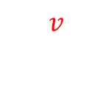
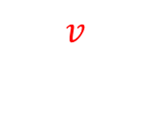

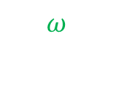
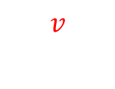
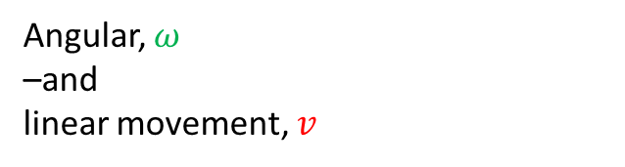


Revolute Joints
$$v$$
$$v$$
$$v$$
$$v$$
$$ω$$
$$ω$$
$$ω$$
$$ω$$
Angular, $ω$
–and
linear movement, $v$

Slide 11
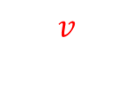
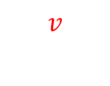

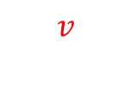
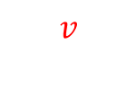
Prismatic Joints
$$v$$
$$v$$
$$v$$
$$v$$
Only linear movement, $v$

Slide 12


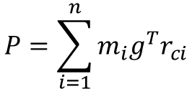
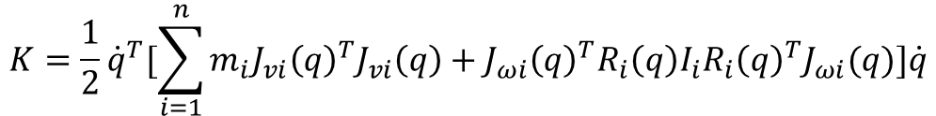

What do we need to find the Lagrangian?
Kinetic Energy
$$K= \frac{1}{2}mv^{T}v+\frac{1}{2}ω^{T}Iω$$
For one-link
$$K=\frac{1}{2}{\dot{q}}^{T}[\sum_{i=1}^{n}{m_{i}J_{vi}{\left(q\right)}^{T}J_{vi}\left(q\right)+J_{ωi}{\left(q\right)}^{T}R_{i}\left(q\right)I_{i}{R_{i}\left(q\right)}^{T}J_{ωi}(q)}]\dot{q}$$
For n-DOF links
Potential Energy
D(q)
$$P=mgh$$
For one-link
This is important for Euler-Lagrange, do not worry about this yet
$$P=\sum_{i=1}^{n}{m_{i}g^{T}r_{ci}}$$
For n-DOF links
Lagrangian
$$L=K − P$$

Slide 13



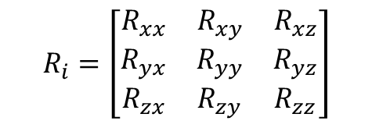
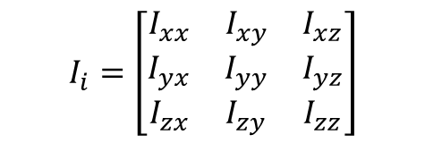
What do we need to find the Lagrangian?
Kinetic Energy:
$$v_{i}=J_{v}(q)\dot{q}$$
Linear velocity
$$ω_{i}=J_{ω}(q)\dot{q}$$
Angular velocity
$$I_{i}=\left[\begin{matrix}I_{xx} & I_{xy} & I_{xz} \\ I_{yx} & I_{yy} & I_{yz} \\ I_{zx} & I_{zy} & I_{zz}\end{matrix}\right]$$
Inertia tensor
$$R_{i}=\left[\begin{matrix}R_{xx} & R_{xy} & R_{xz} \\ R_{yx} & R_{yy} & R_{yz} \\ R_{zx} & R_{zy} & R_{zz}\end{matrix}\right]$$
Rotation Matrices from Forward-kinematics
Potential Energy:
- Assumption of mass-distribution for each link
$$h= r_{ci}$$
height

Slide 14
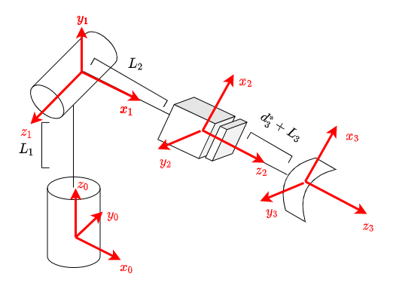
The spherical manipulator

Slide 15


Jacobian for the spherical manipulator
$$T_{1}^{0}=A_{1}=\left[\begin{matrix}c_{1} & 0 & s_{1} & 0 \\ s_{1} & 0 & {−c}_{1} & 0 \\ 0 & 1 & 0 & d_{1} \\ 0 & 0 & 0 & 1\end{matrix}\right]$$
$$T_{2}^{0}=A_{1}A_{2}=\left[\begin{matrix}c_{1} & 0 & s_{1} & 0 \\ s_{1} & 0 & {−c}_{1} & 0 \\ 0 & 1 & 0 & d_{1} \\ 0 & 0 & 0 & 1\end{matrix}\right]\left[\begin{matrix}c_{2+\frac{π}{2}} & 0 & s_{2+\frac{π}{2}} & 0 \\ s_{2+\frac{π}{2}} & 0 & −c_{2+\frac{π}{2}} & 0 \\ 0 & 1 & 0 & 0 \\ 0 & 0 & 0 & 1\end{matrix}\right]=\left[\begin{matrix}{−c}_{1}s_{2} & s_{1} & c_{1}c_{2} & 0 \\ {−s}_{1}s_{2} & {−c}_{1} & c_{2}s_{1} & 0 \\ c_{2} & 0 & s_{2} & d_{1} \\ 0 & 0 & 0 & 1\end{matrix}\right]$$
$T_{3}^{0}=A_{1}A_{2}A_{3}=\left[\begin{matrix}c_{1} & 0 & s_{1} & 0 \\ s_{1} & 0 & {−c}_{1} & 0 \\ 0 & 1 & 0 & d_{1} \\ 0 & 0 & 0 & 1\end{matrix}\right]\left[\begin{matrix}c_{2+\frac{π}{2}} & 0 & s_{2+\frac{π}{2}} & 0 \\ s_{2+\frac{π}{2}} & 0 & −c_{2+\frac{π}{2}} & 0 \\ 0 & 1 & 0 & 0 \\ 0 & 0 & 0 & 1\end{matrix}\right]\left[\begin{matrix}1 & 0 & 0 & 0 \\ 0 & 1 & 0 & 0 \\ 0 & 0 & 1 & d_{3}^{∗}\text{+}L_{2} \\ 0 & 0 & 0 & 1\end{matrix}\right]$= $\left[\begin{matrix}{−c}_{1}s_{2} & s_{1} & c_{1}c_{2} & c_{1}c_{2}(d_{3}^{∗}\text{+}L_{2}) \\ {−s}_{1}s_{2} & {−c}_{1} & c_{2}s_{1} & c_{2}s_{1}(d_{3}^{∗}\text{+}L_{2}) \\ c_{2} & 0 & s_{2} & L_{1}+s_{2}(d_{3}^{∗}\text{+}L_{2}) \\ 0 & 0 & 0 & 1\end{matrix}\right]$

Slide 16
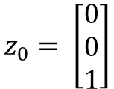

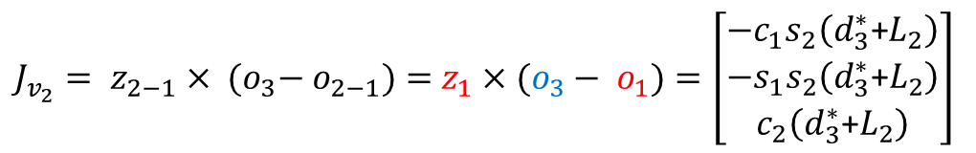

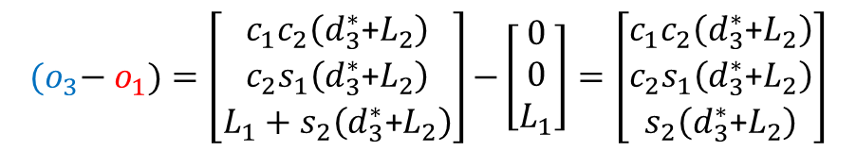
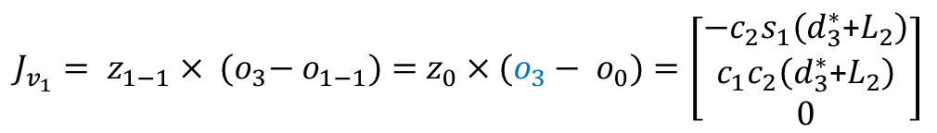


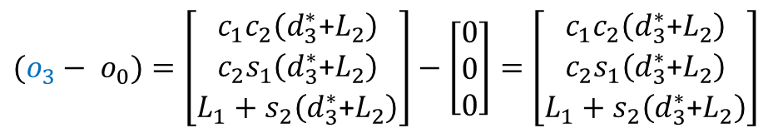


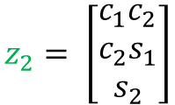
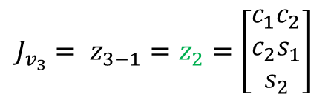
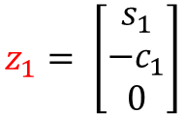

Helpful variables
$$J_{v_{i}}= z_{i−1}× {(o}_{n}− o_{i−1})$$
$$z_{0}= \left[\begin{matrix}0 \\ 0 \\ 1\end{matrix}\right]$$
$$z_{1}= \left[\begin{matrix}s_{1} \\ {−c}_{1} \\ 0\end{matrix}\right]$$
$$z_{2}= \left[\begin{matrix}c_{1}c_{2} \\ c_{2}s_{1} \\ s_{2}\end{matrix}\right]$$
$$J_{v_{i}}= z_{i−1}$$
$$J_{ω_{i}}= z_{i−1}$$
$$J_{ω_{i}}=0$$
$(o_{3}− o_{0})=\left[\begin{matrix}c_{1}c_{2}\left(d_{3}^{∗}\text{+}L_{2}\right) \\ c_{2}s_{1}\left(d_{3}^{∗}\text{+}L_{2}\right) \\ L_{1}+s_{2}\left(d_{3}^{∗}\text{+}L_{2}\right)\end{matrix}\right]−$ $\left[\begin{matrix}0 \\ 0 \\ 0\end{matrix}\right]=\left[\begin{matrix}c_{1}c_{2}\left(d_{3}^{∗}\text{+}L_{2}\right) \\ c_{2}s_{1}\left(d_{3}^{∗}\text{+}L_{2}\right) \\ L_{1}+s_{2}\left(d_{3}^{∗}\text{+}L_{2}\right)\end{matrix}\right]$
$${(o}_{3}− o_{1})=\left[\begin{matrix}c_{1}c_{2}\left(d_{3}^{∗}\text{+}L_{2}\right) \\ c_{2}s_{1}\left(d_{3}^{∗}\text{+}L_{2}\right) \\ L_{1}+s_{2}\left(d_{3}^{∗}\text{+}L_{2}\right)\end{matrix}\right]\text{−}\left[\begin{matrix}0 \\ 0 \\ L_{1}\end{matrix}\right]=\left[\begin{matrix}c_{1}c_{2}\left(d_{3}^{∗}\text{+}L_{2}\right) \\ c_{2}s_{1}\left(d_{3}^{∗}\text{+}L_{2}\right) \\ s_{2}\left(d_{3}^{∗}\text{+}L_{2}\right)\end{matrix}\right]$$
$J_{v_{1}}= z_{1−1}× {(o}_{3}− o_{1−1})=$ $z_{0}×(o_{3}− o_{0})=\left[\begin{matrix}−c_{2}s_{1}\left(d_{3}^{∗}\text{+}L_{2}\right) \\ c_{1}c_{2}\left(d_{3}^{∗}\text{+}L_{2}\right) \\ 0\end{matrix}\right]$
$J_{v_{2}}= z_{2−1}× {(o}_{3}− o_{2−1})=$ $z_{1}×(o_{3}− o_{1})=\left[\begin{matrix}−c_{1}s_{2}\left(d_{3}^{∗}\text{+}L_{2}\right) \\ {−s}_{1}s_{2}\left(d_{3}^{∗}\text{+}L_{2}\right) \\ c_{2}\left(d_{3}^{∗}\text{+}L_{2}\right)\end{matrix}\right]$
$$J_{v_{3}}= z_{3−1}=z_{2}=\left[\begin{matrix}c_{1}c_{2} \\ c_{2}s_{1} \\ s_{2}\end{matrix}\right]$$
$$J_{ω_{1}}= z_{1−1}=z_{0}$$
$$J_{ω_{2}}= z_{2−1}=z_{1}$$
$$J_{ω_{3}}=0$$

Slide 17
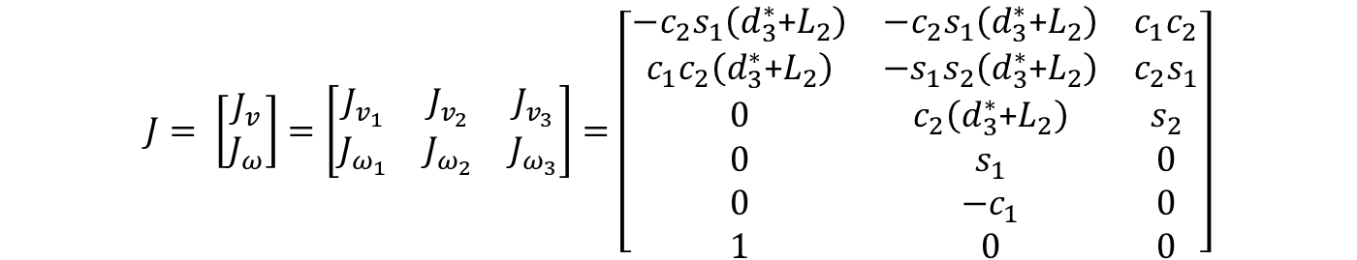
Jacobian
Putting all of it together yields the following Jacobian matrix
$$J= \left[\begin{matrix}J_{v} \\ J_{ω}\end{matrix}\right]=\left[\begin{matrix}J_{v_{1}} & J_{v_{2}} & J_{v_{3}} \\ J_{ω_{1}} & J_{ω_{2}} & J_{ω_{3}}\end{matrix}\right]=\left[\begin{matrix}−c_{2}s_{1}\left(d_{3}^{∗}\text{+}L_{2}\right) & −c_{2}s_{1}\left(d_{3}^{∗}\text{+}L_{2}\right) & c_{1}c_{2} \\ c_{1}c_{2}\left(d_{3}^{∗}\text{+}L_{2}\right) & {−s}_{1}s_{2}\left(d_{3}^{∗}\text{+}L_{2}\right) & c_{2}s_{1} \\ 0 & c_{2}\left(d_{3}^{∗}\text{+}L_{2}\right) & s_{2} \\ 0 & s_{1} & 0 \\ 0 & {−c}_{1} & 0 \\ 1 & 0 & 0\end{matrix}\right]$$
Jv
Jw

Slide 18


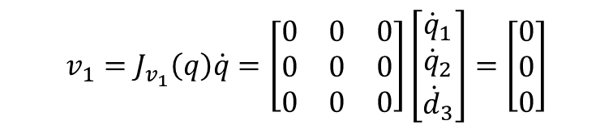
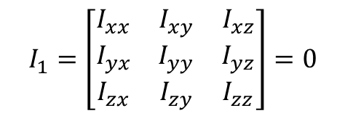
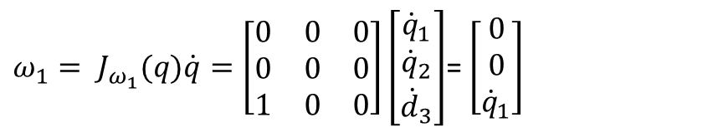
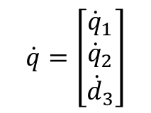
Finding $K_{1}$ for the spherical manipulator
- Setting $d_{3}$ and $L_{2}$ = 0, because they’re related to third joint
- Setting second and third column = 0, because they’re related to the second and third joint
$$J_{v}=\left[\begin{matrix}−c_{2}s_{1}\left(d_{3}^{∗}\text{+}L_{2}\right) & −c_{2}s_{1}\left(d_{3}^{∗}\text{+}L_{2}\right) & c_{1}c_{2} \\ c_{1}c_{2}\left(d_{3}^{∗}\text{+}L_{2}\right) & {−s}_{1}s_{2}\left(d_{3}^{∗}\text{+}L_{2}\right) & c_{2}s_{1} \\ 0 & c_{2}\left(d_{3}^{∗}\text{+}L_{2}\right) & s_{2}\end{matrix}\right]$$
$$J_{v_{1}}=\left[\begin{matrix}0 & 0 & 0 \\ 0 & 0 & 0 \\ 0 & 0 & 0\end{matrix}\right]$$
$$\dot{q}=\left[\begin{matrix}{\dot{q}}_{1} \\ {\dot{q}}_{2} \\ {\dot{d}}_{3}\end{matrix}\right]$$
$$J_{ω}=\left[\begin{matrix}0 & s_{1} & 0 \\ 0 & {−c}_{1} & 0 \\ 1 & 0 & 0\end{matrix}\right]$$
$$J_{ω_{1}}=\left[\begin{matrix}0 & 0 & 0 \\ 0 & 0 & 0 \\ 1 & 0 & 0\end{matrix}\right]$$
$$I_{1}=\left[\begin{matrix}I_{xx} & I_{xy} & I_{xz} \\ I_{yx} & I_{yy} & I_{yz} \\ I_{zx} & I_{zy} & I_{zz}\end{matrix}\right]=0$$
$$v_{1}=J_{v_{1}}\left(q\right)\dot{q}=\left[\begin{matrix}0 & 0 & 0 \\ 0 & 0 & 0 \\ 0 & 0 & 0\end{matrix}\right]\left[\begin{matrix}{\dot{q}}_{1} \\ {\dot{q}}_{2} \\ {\dot{d}}_{3}\end{matrix}\right]=\left[\begin{matrix}0 \\ 0 \\ 0\end{matrix}\right]$$
$ω_{1}= J_{ω_{1}}(q)\dot{q}=\left[\begin{matrix}0 & 0 & 0 \\ 0 & 0 & 0 \\ 1 & 0 & 0\end{matrix}\right]\left[\begin{matrix}{\dot{q}}_{1} \\ {\dot{q}}_{2} \\ {\dot{d}}_{3}\end{matrix}\right]$= $\left[\begin{matrix}0 \\ 0 \\ {\dot{q}}_{1}\end{matrix}\right]$

Slide 19
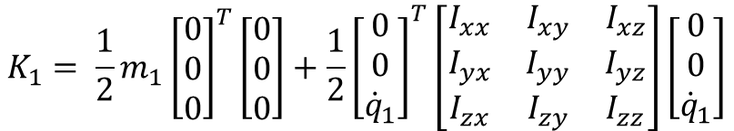


$$K_{1}= \frac{1}{2}m_{1}{v_{1}}^{T}v_{1}+\frac{1}{2}{ω_{1}}^{T}I_{1}ω_{1}$$
Plotting all of it together and receive the following
$$K_{1}= \frac{1}{2}{m_{1}\left[\begin{matrix}0 \\ 0 \\ 0\end{matrix}\right]}^{T}\left[\begin{matrix}0 \\ 0 \\ 0\end{matrix}\right]+\frac{1}{2}{\left[\begin{matrix}0 \\ 0 \\ {\dot{q}}_{1}\end{matrix}\right]}^{T}\left[\begin{matrix}I_{xx} & I_{xy} & I_{xz} \\ I_{yx} & I_{yy} & I_{yz} \\ I_{zx} & I_{zy} & I_{zz}\end{matrix}\right]\left[\begin{matrix}0 \\ 0 \\ {\dot{q}}_{1}\end{matrix}\right]$$
$$= 0$$

Slide 20
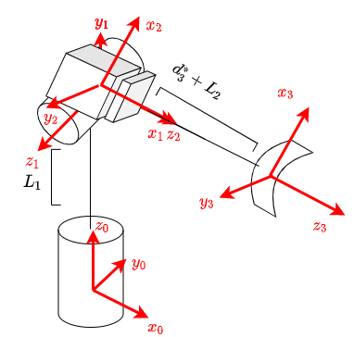
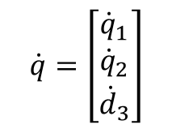

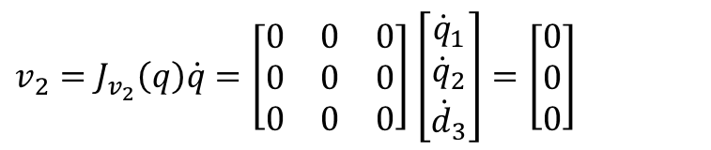
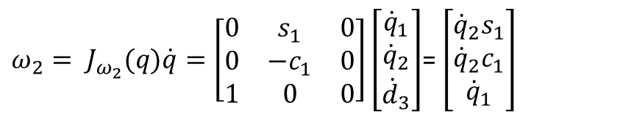
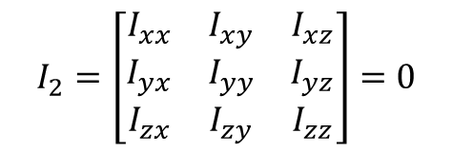
Finding $K_{2}$ for the spherical manipulator
- Setting $d_{3}$ and $L_{2}$ = 0, because they’re related to third joint
- Setting third column = 0, because they’re related to the third joint
$$J_{v}=\left[\begin{matrix}−c_{2}s_{1}\left(d_{3}^{∗}\text{+}L_{2}\right) & −c_{2}s_{1}\left(d_{3}^{∗}\text{+}L_{2}\right) & c_{1}c_{2} \\ c_{1}c_{2}\left(d_{3}^{∗}\text{+}L_{2}\right) & {−s}_{1}s_{2}\left(d_{3}^{∗}\text{+}L_{2}\right) & c_{2}s_{1} \\ 0 & c_{2}\left(d_{3}^{∗}\text{+}L_{2}\right) & s_{2}\end{matrix}\right]$$
$$J_{v_{2}}=\left[\begin{matrix}0 & 0 & 0 \\ 0 & 0 & 0 \\ 0 & 0 & 0\end{matrix}\right]$$
$$J_{ω}=\left[\begin{matrix}0 & s_{1} & 0 \\ 0 & {−c}_{1} & 0 \\ 1 & 0 & 0\end{matrix}\right]$$
$$J_{ω_{2}}=\left[\begin{matrix}0 & s_{1} & 0 \\ 0 & {−c}_{1} & 0 \\ 1 & 0 & 0\end{matrix}\right]$$
$$\dot{q}=\left[\begin{matrix}{\dot{q}}_{1} \\ {\dot{q}}_{2} \\ {\dot{d}}_{3}\end{matrix}\right]$$
$$I_{2}=\left[\begin{matrix}I_{xx} & I_{xy} & I_{xz} \\ I_{yx} & I_{yy} & I_{yz} \\ I_{zx} & I_{zy} & I_{zz}\end{matrix}\right]=0$$
$v_{2}=J_{v_{2}}\left(q\right)\dot{q}=\left[\begin{matrix}0 & 0 & 0 \\ 0 & 0 & 0 \\ 0 & 0 & 0\end{matrix}\right]$ $\left[\begin{matrix}{\dot{q}}_{1} \\ {\dot{q}}_{2} \\ {\dot{d}}_{3}\end{matrix}\right]=\left[\begin{matrix}0 \\ 0 \\ 0\end{matrix}\right]$
$ω_{2}= J_{ω_{2}}(q)\dot{q}=\left[\begin{matrix}0 & s_{1} & 0 \\ 0 & {−c}_{1} & 0 \\ 1 & 0 & 0\end{matrix}\right]\left[\begin{matrix}{\dot{q}}_{1} \\ {\dot{q}}_{2} \\ {\dot{d}}_{3}\end{matrix}\right]$= $\left[\begin{matrix}{\dot{q}}_{2}s_{1} \\ {\dot{q}}_{2}c_{1} \\ {\dot{q}}_{1}\end{matrix}\right]$

Slide 21
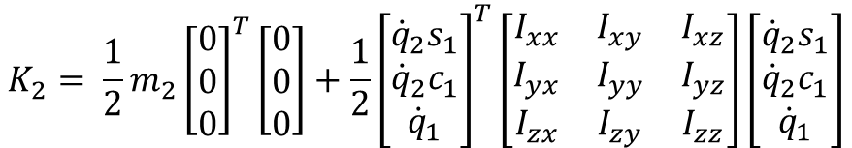

$$K_{2}= \frac{1}{2}m_{2}{v_{2}}^{T}v_{2}+\frac{1}{2}{ω_{2}}^{T}I_{2}ω_{2}$$
Plotting all of it together and receive the following
$$K_{2}= \frac{1}{2}{m_{2}\left[\begin{matrix}0 \\ 0 \\ 0\end{matrix}\right]}^{T}\left[\begin{matrix}0 \\ 0 \\ 0\end{matrix}\right]+\frac{1}{2}{\left[\begin{matrix}{\dot{q}}_{2}s_{1} \\ {\dot{q}}_{2}c_{1} \\ {\dot{q}}_{1}\end{matrix}\right]}^{T}\left[\begin{matrix}I_{xx} & I_{xy} & I_{xz} \\ I_{yx} & I_{yy} & I_{yz} \\ I_{zx} & I_{zy} & I_{zz}\end{matrix}\right]\left[\begin{matrix}{\dot{q}}_{2}s_{1} \\ {\dot{q}}_{2}c_{1} \\ {\dot{q}}_{1}\end{matrix}\right]$$
$$= 0$$

Slide 22

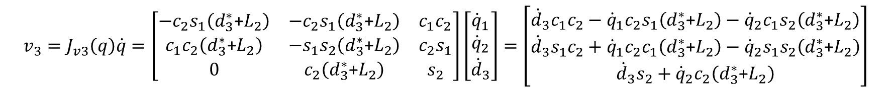

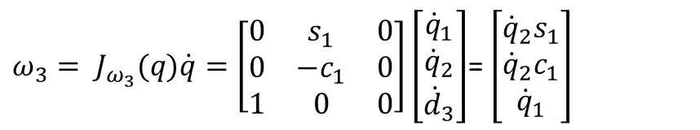
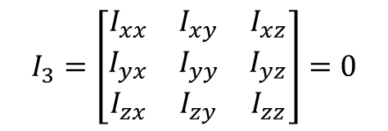
Finding $K_{3}$ for the spherical manipulator
$$J_{v}=\left[\begin{matrix}−c_{2}s_{1}\left(d_{3}^{∗}\text{+}L_{2}\right) & −c_{2}s_{1}\left(d_{3}^{∗}\text{+}L_{2}\right) & c_{1}c_{2} \\ c_{1}c_{2}\left(d_{3}^{∗}\text{+}L_{2}\right) & {−s}_{1}s_{2}\left(d_{3}^{∗}\text{+}L_{2}\right) & c_{2}s_{1} \\ 0 & c_{2}\left(d_{3}^{∗}\text{+}L_{2}\right) & s_{2}\end{matrix}\right]$$
$$J_{v_{3}}=\left[\begin{matrix}−c_{2}s_{1}\left(d_{3}^{∗}\text{+}L_{2}\right) & −c_{2}s_{1}\left(d_{3}^{∗}\text{+}L_{2}\right) & c_{1}c_{2} \\ c_{1}c_{2}\left(d_{3}^{∗}\text{+}L_{2}\right) & {−s}_{1}s_{2}\left(d_{3}^{∗}\text{+}L_{2}\right) & c_{2}s_{1} \\ 0 & c_{2}\left(d_{3}^{∗}\text{+}L_{2}\right) & s_{2}\end{matrix}\right]$$
$$J_{ω}=\left[\begin{matrix}0 & s_{1} & 0 \\ 0 & {−c}_{1} & 0 \\ 1 & 0 & 0\end{matrix}\right]$$
$$J_{ω_{3}}=\left[\begin{matrix}0 & s_{1} & 0 \\ 0 & {−c}_{1} & 0 \\ 1 & 0 & 0\end{matrix}\right]$$
$$\dot{q}=\left[\begin{matrix}{\dot{q}}_{1} \\ {\dot{q}}_{2} \\ {\dot{d}}_{3}\end{matrix}\right]$$
$$I_{3}=\left[\begin{matrix}I_{xx} & I_{xy} & I_{xz} \\ I_{yx} & I_{yy} & I_{yz} \\ I_{zx} & I_{zy} & I_{zz}\end{matrix}\right]=0$$
$$v_{3}=J_{v3}\left(q\right)\dot{q}=\left[\begin{matrix}−c_{2}s_{1}\left(d_{3}^{∗}\text{+}L_{2}\right) & −c_{2}s_{1}\left(d_{3}^{∗}\text{+}L_{2}\right) & c_{1}c_{2} \\ c_{1}c_{2}\left(d_{3}^{∗}\text{+}L_{2}\right) & {−s}_{1}s_{2}\left(d_{3}^{∗}\text{+}L_{2}\right) & c_{2}s_{1} \\ 0 & c_{2}\left(d_{3}^{∗}\text{+}L_{2}\right) & s_{2}\end{matrix}\right]\left[\begin{matrix}{\dot{q}}_{1} \\ {\dot{q}}_{2} \\ {\dot{d}}_{3}\end{matrix}\right]=\left[\begin{matrix}{\dot{d}}_{3}c_{1}c_{2}−{\dot{q}}_{1}c_{2}s_{1}\left(d_{3}^{∗}\text{+}L_{2}\right)−{\dot{q}}_{2}c_{1}s_{2}\left(d_{3}^{∗}\text{+}L_{2}\right) \\ {\dot{d}}_{3}s_{1}c_{2}+{\dot{q}}_{1}c_{2}c_{1}\left(d_{3}^{∗}\text{+}L_{2}\right)−{\dot{q}}_{2}s_{1}s_{2}\left(d_{3}^{∗}\text{+}L_{2}\right) \\ {\dot{d}}_{3}s_{2}+{\dot{q}}_{2}c_{2}\left(d_{3}^{∗}\text{+}L_{2}\right)\end{matrix}\right]$$
$ω_{3}= J_{ω_{3}}(q)\dot{q}=\left[\begin{matrix}0 & s_{1} & 0 \\ 0 & {−c}_{1} & 0 \\ 1 & 0 & 0\end{matrix}\right]\left[\begin{matrix}{\dot{q}}_{1} \\ {\dot{q}}_{2} \\ {\dot{d}}_{3}\end{matrix}\right]$= $\left[\begin{matrix}{\dot{q}}_{2}s_{1} \\ {\dot{q}}_{2}c_{1} \\ {\dot{q}}_{1}\end{matrix}\right]$

Slide 23
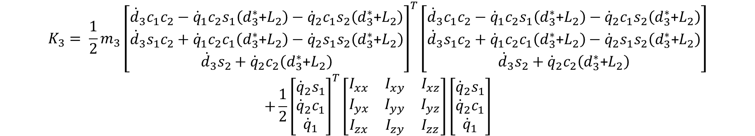

$$K_{3}= \frac{1}{2}m_{3}{v_{3}}^{T}v_{3}+\frac{1}{2}{ω_{3}}^{T}I_{3}ω_{3}$$
Plotting all of it together and receive the following
$$K_{3}= \frac{1}{2}{m_{3}\left[\begin{matrix}{\dot{d}}_{3}c_{1}c_{2}−{\dot{q}}_{1}c_{2}s_{1}\left(d_{3}^{∗}\text{+}L_{2}\right)−{\dot{q}}_{2}c_{1}s_{2}\left(d_{3}^{∗}\text{+}L_{2}\right) \\ {\dot{d}}_{3}s_{1}c_{2}+{\dot{q}}_{1}c_{2}c_{1}\left(d_{3}^{∗}\text{+}L_{2}\right)−{\dot{q}}_{2}s_{1}s_{2}\left(d_{3}^{∗}\text{+}L_{2}\right) \\ {\dot{d}}_{3}s_{2}+{\dot{q}}_{2}c_{2}\left(d_{3}^{∗}\text{+}L_{2}\right)\end{matrix}\right]}^{T}\left[\begin{matrix}{\dot{d}}_{3}c_{1}c_{2}−{\dot{q}}_{1}c_{2}s_{1}\left(d_{3}^{∗}\text{+}L_{2}\right)−{\dot{q}}_{2}c_{1}s_{2}\left(d_{3}^{∗}\text{+}L_{2}\right) \\ {\dot{d}}_{3}s_{1}c_{2}+{\dot{q}}_{1}c_{2}c_{1}\left(d_{3}^{∗}\text{+}L_{2}\right)−{\dot{q}}_{2}s_{1}s_{2}\left(d_{3}^{∗}\text{+}L_{2}\right) \\ {\dot{d}}_{3}s_{2}+{\dot{q}}_{2}c_{2}\left(d_{3}^{∗}\text{+}L_{2}\right)\end{matrix}\right]$$
$$+\frac{1}{2}{\left[\begin{matrix}{\dot{q}}_{2}s_{1} \\ {\dot{q}}_{2}c_{1} \\ {\dot{q}}_{1}\end{matrix}\right]}^{T}\left[\begin{matrix}I_{xx} & I_{xy} & I_{xz} \\ I_{yx} & I_{yy} & I_{yz} \\ I_{zx} & I_{zy} & I_{zz}\end{matrix}\right]\left[\begin{matrix}{\dot{q}}_{2}s_{1} \\ {\dot{q}}_{2}c_{1} \\ {\dot{q}}_{1}\end{matrix}\right]$$
$$=\frac{m_{3}{(({\dot{d}}_{3}s_{2}+{\dot{q}}_{2}c_{2}\left(d_{3}^{∗}\text{+}L_{2}\right))}^{2}+{\dot{q}}_{1}c_{2}s_{1}\left(d_{3}^{∗}\text{+}L_{2}\right)−{\dot{d}}_{3}c_{1}c_{2}+{\left({\dot{q}}_{2}c_{1}s_{2}\left(d_{3}^{∗}\text{+}L_{2}\right)\right)}^{2}+{\dot{d}}_{3}s_{1}c_{2}+{\dot{q}}_{1}c_{2}c_{1}\left(d_{3}^{∗}\text{+}L_{2}\right)−{\dot{q}}_{2}s_{1}s_{2}\left(d_{3}^{∗}\text{+}L_{2}\right)}{2}$$

Slide 24





Finding $P_{1}\text{for} \text{the} \text{spherical} \text{manipulator}$
We assume the link is uniformly distributed, hence the mass center is centered
$$P_{1}=m_{1}gh_{1}=m_{1}gr_{c1}$$
Center of mass
$$P_{1}=m_{1}gh_{1}=m_{1}g\frac{L_{1}}{2}$$
$$L_{1}$$
$$r_{c,1}=\frac{L_{1}}{2}$$

Slide 25





Finding $P_{2}$ for the spherical manipulator
We assume the link is uniformly distributed, hence the mass center is centered
$$P_{2}=m_{2}gh_{2}=m_{2}gr_{c2}$$
$$P_{2}=m_{2}gh_{2}=m_{2}gL_{1}$$
$$L_{1}$$
$$r_{c,2}=L_{1}$$

Slide 26


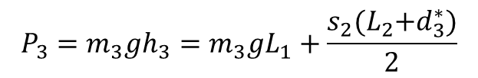




Finding $P_{3}$ for the spherical manipulator
$$L_{2}+d_{3}^{∗}$$
We assume the link is uniformly distributed, hence the mass center is centered
$$P_{3}=m_{3}gh_{3}=m_{3}gr_{c3}$$
y
$$P_{3}=m_{3}gh_{3}=m_{3}gL_{1}+\frac{s_{2}{(L}_{2}+d_{3}^{∗})}{2}$$
x
$$y=r∗sin⁡(θ)$$
$$L_{1}$$
$$r_{c,3}=L_{1}+\sin{(θ_{2})\frac{{(L}_{2}+d_{3}^{∗})}{2}}=L_{1}+\frac{s_{2}{(L}_{2}+d_{3}^{∗})}{2}$$

Slide 27


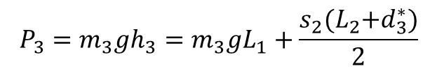

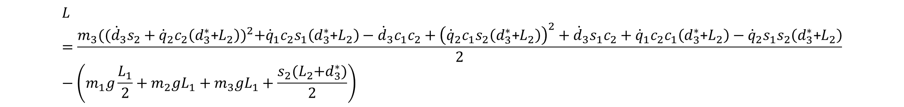

Lagrangian for the Spherical manipulator
$$K_{1}=0$$
$$K_{2}=0$$
$$K_{3}=\frac{m_{3}{(({\dot{d}}_{3}s_{2}+{\dot{q}}_{2}c_{2}\left(d_{3}^{∗}\text{+}L_{2}\right))}^{2}+{\dot{q}}_{1}c_{2}s_{1}\left(d_{3}^{∗}\text{+}L_{2}\right)−{\dot{d}}_{3}c_{1}c_{2}+{\left({\dot{q}}_{2}c_{1}s_{2}\left(d_{3}^{∗}\text{+}L_{2}\right)\right)}^{2}+{\dot{d}}_{3}s_{1}c_{2}+{\dot{q}}_{1}c_{2}c_{1}\left(d_{3}^{∗}\text{+}L_{2}\right)−{\dot{q}}_{2}s_{1}s_{2}\left(d_{3}^{∗}\text{+}L_{2}\right)}{2}$$
$$P_{1}=m_{1}gh_{1}=m_{1}g\frac{L_{1}}{2}$$
Lagrangian term
$$P_{2}=m_{2}gh_{2}=m_{2}gL_{1}$$
$$L=K −P$$
$$P_{3}=m_{3}gh_{3}=m_{3}gL_{1}+\frac{s_{2}{(L}_{2}+d_{3}^{∗})}{2}$$
$$L=\left(K_{1}+K_{2}+K_{3}\right)−(P_{1}+P_{2}+P_{3})$$
$$L=\frac{m_{3}{(({\dot{d}}_{3}s_{2}+{\dot{q}}_{2}c_{2}\left(d_{3}^{∗}\text{+}L_{2}\right))}^{2}+{\dot{q}}_{1}c_{2}s_{1}\left(d_{3}^{∗}\text{+}L_{2}\right)−{\dot{d}}_{3}c_{1}c_{2}+{\left({\dot{q}}_{2}c_{1}s_{2}\left(d_{3}^{∗}\text{+}L_{2}\right)\right)}^{2}+{\dot{d}}_{3}s_{1}c_{2}+{\dot{q}}_{1}c_{2}c_{1}\left(d_{3}^{∗}\text{+}L_{2}\right)−{\dot{q}}_{2}s_{1}s_{2}\left(d_{3}^{∗}\text{+}L_{2}\right)}{2}−\left(m_{1}g\frac{L_{1}}{2}+m_{2}gL_{1}+m_{3}gL_{1}+\frac{s_{2}{(L}_{2}+d_{3}^{∗})}{2}\right)$$

Slide 28
5 minutes break!

Slide 29



2-Link Planar Arm
$$Y_{0}$$
$$Z_{0}$$
$$X_{0}$$

Slide 30
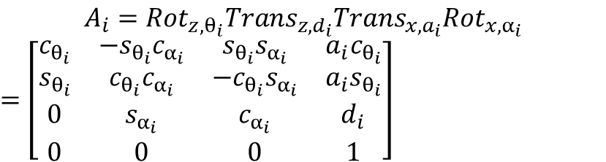
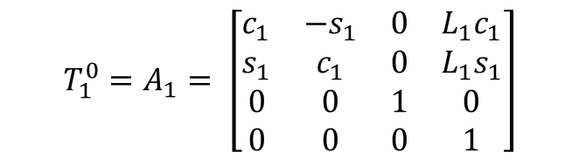
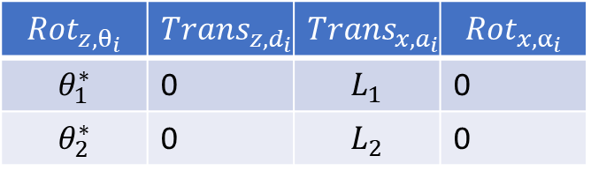
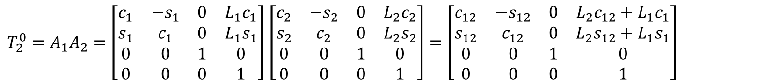


Forward-kinematics for the 2-Link planar Robot
DH-Table
$${Rot}_{z,θ_{i}}$$ | $${Trans}_{z,d_{i}}$$ | $${Trans}_{x,a_{i}}$$ | $${Rot}_{x,α_{i}}$$
$$θ_{1}^{∗}$$ | 0 | $$L_{1}$$ | 0
$$θ_{2}^{∗}$$ | 0 | $$L_{2}$$ | 0
Forward-kinematics
$$T_{1}^{0}=A_{1}= \left[\begin{matrix}c_{1} & {−s}_{1} & 0 & {L_{1}c}_{1} \\ s_{1} & c_{1} & 0 & {L_{1}s}_{1} \\ 0 & 0 & 1 & 0 \\ 0 & 0 & 0 & 1\end{matrix}\right]$$
$$A_{i}={Rot}_{z,θ_{i}}{Trans}_{z,d_{i}}{Trans}_{x,a_{i}}{Rot}_{x,α_{i}}$$
$=$ $\left[\begin{matrix}c_{θ_{i}} & −s_{θ_{i}}c_{α_{i}} & s_{θ_{i}}s_{α_{i}} & {a_{i}c}_{θ_{i}} \\ s_{θ_{i}} & c_{θ_{i}}c_{α_{i}} & −c_{θ_{i}}s_{α_{i}} & {a_{i}s}_{θ_{i}} \\ 0 & s_{α_{i}} & c_{α_{i}} & d_{i} \\ 0 & 0 & 0 & 1\end{matrix}\right]$
$$A_{1}=\left[\begin{matrix}c_{1} & {−s}_{1} & 0 & {L_{1}c}_{1} \\ s_{1} & c_{1} & 0 & {L_{1}s}_{1} \\ 0 & 0 & 1 & 0 \\ 0 & 0 & 0 & 1\end{matrix}\right]$$
$T_{2}^{0}=A_{1}A_{2}=\left[\begin{matrix}c_{1} & {−s}_{1} & 0 & {L_{1}c}_{1} \\ s_{1} & c_{1} & 0 & {L_{1}s}_{1} \\ 0 & 0 & 1 & 0 \\ 0 & 0 & 0 & 1\end{matrix}\right]$ $\left[\begin{matrix}c_{2} & {−s}_{2} & 0 & {L_{2}c}_{2} \\ s_{2} & c_{2} & 0 & {L_{2}s}_{2} \\ 0 & 0 & 1 & 0 \\ 0 & 0 & 0 & 1\end{matrix}\right]=\left[\begin{matrix}c_{12} & {−s}_{12} & 0 & {L_{2}c}_{12}+{L_{1}c}_{1} \\ s_{12} & c_{12} & 0 & {L_{2}s}_{12}+{L_{1}s}_{1} \\ 0 & 0 & 1 & 0 \\ 0 & 0 & 0 & 1\end{matrix}\right]$
$$A_{2}=\left[\begin{matrix}c_{2} & {−s}_{2} & 0 & {L_{2}c}_{2} \\ s_{2} & c_{2} & 0 & {L_{2}s}_{2} \\ 0 & 0 & 1 & 0 \\ 0 & 0 & 0 & 1\end{matrix}\right]$$

Slide 31
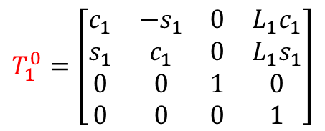

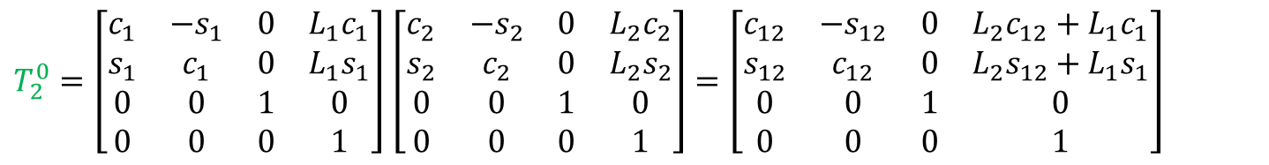




Jacobian for the 2-Link planar Robot
$$T_{1}^{0}=\left[\begin{matrix}c_{1} & {−s}_{1} & 0 & {L_{1}c}_{1} \\ s_{1} & c_{1} & 0 & {L_{1}s}_{1} \\ 0 & 0 & 1 & 0 \\ 0 & 0 & 0 & 1\end{matrix}\right]$$
$T_{2}^{0}=\left[\begin{matrix}c_{1} & {−s}_{1} & 0 & {L_{1}c}_{1} \\ s_{1} & c_{1} & 0 & {L_{1}s}_{1} \\ 0 & 0 & 1 & 0 \\ 0 & 0 & 0 & 1\end{matrix}\right]$ $\left[\begin{matrix}c_{2} & {−s}_{2} & 0 & {L_{2}c}_{2} \\ s_{2} & c_{2} & 0 & {L_{2}s}_{2} \\ 0 & 0 & 1 & 0 \\ 0 & 0 & 0 & 1\end{matrix}\right]=\left[\begin{matrix}c_{12} & {−s}_{12} & 0 & {L_{2}c}_{12}+{L_{1}c}_{1} \\ s_{12} & c_{12} & 0 & {L_{2}s}_{12}+{L_{1}s}_{1} \\ 0 & 0 & 1 & 0 \\ 0 & 0 & 0 & 1\end{matrix}\right]$
$$z_{0}=[0 0 1]$$
$$O_{0}=[0 0 0]$$
$$z_{1}=[0 0 1]$$
$$O_{1}=[{L_{1}c}_{1}; {L_{1}s}_{1}; 0;]$$
$$z_{2}=[0 0 1]$$
$$O_{2}=[{L_{2}c}_{12}+{L_{1}c}_{1}; {L_{2}s}_{12}+{L_{1}s}_{1}; 0;]$$

Slide 32


Jacobian for the 2-Link planar Robot cont.
The following robotic manipulator is (RR) so this gives us the following jacobian matrix:
$$J= \left[\begin{matrix}J_{v1} & J_{v2} \\ J_{ω1} & J_{ω2}\end{matrix}\right]=\left[\begin{matrix}z_{0}×(O_{2}− O_{0}) & z_{1}×(O_{2}− O_{1}) \\ z_{0} & z_{1}\end{matrix}\right]$$
$$J_{v1}=z_{0}×\left(O_{2}−O_{0}\right)=\left[0 0 1\right]×(\left[{L_{2}c}_{12}+{L_{1}c}_{1}; {L_{2}s}_{12}+{L_{1}s}_{1}; 0;\right]−[0 0 0]$$
$$J_{v2}=z_{1}×\left(O_{2}−O_{1}\right)=\left[0 0 1\right]×(\left[{L_{2}c}_{12}+{L_{1}c}_{1}; {L_{2}s}_{12}+{L_{1}s}_{1}; 0;\right]−\left[{L_{1}c}_{1}; {L_{1}s}_{1}; 0;\right])$$
$$J_{ω1}=z_{0}=[0 0 1]$$
$$J_{ω2}=z_{1}=[ 0 0 1]$$

Slide 33
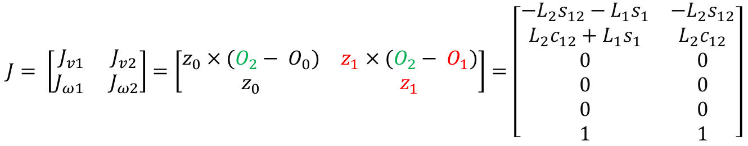
Jacobian for the 2-Link planar Robot cont.
$$J= \left[\begin{matrix}J_{v1} & J_{v2} \\ J_{ω1} & J_{ω2}\end{matrix}\right]=\left[\begin{matrix}z_{0}×(O_{2}− O_{0}) & z_{1}×(O_{2}− O_{1}) \\ z_{0} & z_{1}\end{matrix}\right]=\left[\begin{matrix}−L_{2}s_{12}−L_{1}s_{1} & −L_{2}s_{12} \\ L_{2}c_{12}+L_{1}s_{1} & L_{2}c_{12} \\ 0 & 0 \\ 0 & 0 \\ 0 & 0 \\ 1 & 1\end{matrix}\right]$$

Slide 34
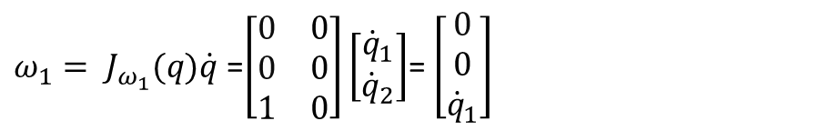
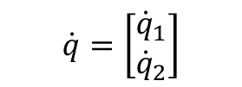





Finding $K_{1}$ for 2-Link planar manipulator
- Setting $L_{2}$ = 0, because they’re related to second joint
- Setting second column = 0, because they’re related to the second joint
$$\left[\begin{matrix}−L_{2}s_{12}−L_{1}s_{1} & −L_{2}s_{12} \\ L_{2}c_{12}+L_{1}c_{1} & L_{2}c_{12} \\ 0 & 0 \\ 0 & 0 \\ 0 & 0 \\ 1 & 1\end{matrix}\right]$$
$$\left[\begin{matrix}−L_{1}s_{1} & 0 \\ L_{1}c_{1} & 0 \\ 0 & 0 \\ 0 & 0 \\ 0 & 0 \\ 1 & 0\end{matrix}\right]$$
$$\dot{q}=\left[\begin{matrix}{\dot{q}}_{1} \\ {\dot{q}}_{2}\end{matrix}\right]$$
$$J_{ω_{1}}=\left[\begin{matrix}0 & 0 \\ 0 & 0 \\ 1 & 0\end{matrix}\right]$$
$$J_{v_{1}}=\left[\begin{matrix}−L_{1}s_{1} & 0 \\ L_{1}c_{1} & 0 \\ 0 & 0\end{matrix}\right]$$
$v_{1}=J_{v1}\left(q\right)\dot{q}$=$\left[\begin{matrix}−L_{1}s_{1} & 0 \\ L_{1}c_{1} & 0 \\ 0 & 0\end{matrix}\right]$ $\left[\begin{matrix}{\dot{q}}_{1} \\ {\dot{q}}_{2}\end{matrix}\right]$= $\left[\begin{matrix}−{\dot{q}}_{1}L_{1}s_{1} \\ {\dot{q}}_{1}L_{1}c_{1} \\ 0\end{matrix}\right]$
$$I_{1}=\left[\begin{matrix}I_{xx} & I_{xy} & I_{xz} \\ I_{yx} & I_{yy} & I_{yz} \\ I_{zx} & I_{zy} & I_{zz}\end{matrix}\right]=0$$
$ω_{1}= J_{ω_{1}}(q)\dot{q}$ =$\left[\begin{matrix}0 & 0 \\ 0 & 0 \\ 1 & 0\end{matrix}\right]\left[\begin{matrix}{\dot{q}}_{1} \\ {\dot{q}}_{2}\end{matrix}\right]$= $\left[\begin{matrix}0 \\ 0 \\ {\dot{q}}_{1}\end{matrix}\right]$

Slide 35



$$K_{1}= \frac{1}{2}m_{1}{v_{1}}^{T}v_{1}+\frac{1}{2}{ω_{1}}^{T}I_{1}ω_{1}$$
Plotting all of it together and receive the following
$$K_{1}= \frac{1}{2}{m_{1}\left[\begin{matrix}−{\dot{q}}_{1}L_{1}s_{1} \\ {\dot{q}}_{1}L_{1}c_{1} \\ 0\end{matrix}\right]}^{T}\left[\begin{matrix}−{\dot{q}}_{1}L_{1}s_{1} \\ {\dot{q}}_{1}L_{1}c_{1} \\ 0\end{matrix}\right]+\frac{1}{2}{\left[\begin{matrix}0 \\ 0 \\ {\dot{q}}_{1}\end{matrix}\right]}^{T}\left[\begin{matrix}I_{xx} & I_{xy} & I_{xz} \\ I_{yx} & I_{yy} & I_{yz} \\ I_{zx} & I_{zy} & I_{zz}\end{matrix}\right]\left[\begin{matrix}0 \\ 0 \\ {\dot{q}}_{1}\end{matrix}\right]$$
$$K_{1}=\frac{L_{1}^{2}m_{1}{\dot{q}}_{1}^{2}}{2}$$

Slide 36






Finding $K_{2}$ for 2-Link planar manipulator
$$J_{v_{2}}=\left[\begin{matrix}−L_{2}s_{12}−L_{1}s_{1} & −L_{2}s_{12} \\ L_{2}c_{12}+L_{1}s_{1} & L_{2}c_{12} \\ 0 & 0\end{matrix}\right]$$
$$\left[\begin{matrix}−L_{2}s_{12}−L_{1}s_{1} & −L_{2}s_{12} \\ L_{2}c_{12}+L_{1}s_{1} & L_{2}c_{12} \\ 0 & 0 \\ 0 & 0 \\ 0 & 0 \\ 1 & 1\end{matrix}\right]$$
$$\left[\begin{matrix}−L_{2}s_{12}−L_{1}s_{1} & −L_{2}s_{12} \\ L_{2}c_{12}+L_{1}s_{1} & L_{2}c_{12} \\ 0 & 0 \\ 0 & 0 \\ 0 & 0 \\ 1 & 1\end{matrix}\right]$$
Using the whole jacobian
$$J_{ω2}=\left[\begin{matrix}0 & 0 \\ 0 & 0 \\ 1 & 1\end{matrix}\right]$$
$$\dot{q}=\left[\begin{matrix}{\dot{q}}_{1} \\ {\dot{q}}_{2}\end{matrix}\right]$$
$v_{2}=J_{v2}\left(q\right)\dot{q}$=$\left[\begin{matrix}−L_{2}s_{12}−L_{1}s_{1} & −L_{2}s_{12} \\ L_{2}c_{12}+L_{1}s_{1} & L_{2}c_{12} \\ 0 & 0\end{matrix}\right]\left[\begin{matrix}{\dot{q}}_{1} \\ {\dot{q}}_{2}\end{matrix}\right]$= $\left[\begin{matrix}−{\dot{q}}_{1}\left(L_{2}s_{12}+L_{1}s_{1}\right)−L_{2}{\dot{q}}_{2}s_{12} \\ {\dot{q}}_{1}\left(L_{2}c_{12}+L_{1}c_{1}\right)+L_{2}{\dot{q}}_{2}c_{12} \\ 0\end{matrix}\right]$
$$I_{2}=\left[\begin{matrix}I_{xx} & I_{xy} & I_{xz} \\ I_{yx} & I_{yy} & I_{yz} \\ I_{zx} & I_{zy} & I_{zz}\end{matrix}\right]=0$$
$ω_{2}= J_{ω_{2}}(q)\dot{q}$=$\left[\begin{matrix}0 & 0 \\ 0 & 0 \\ 1 & 1\end{matrix}\right]\left[\begin{matrix}{\dot{q}}_{1} \\ {\dot{q}}_{2}\end{matrix}\right]$= $\left[\begin{matrix}0 \\ 0 \\ {\dot{q}}_{1}+{\dot{q}}_{2}\end{matrix}\right]$

Slide 37

$$K_{2}= \frac{1}{2}m_{2}{v_{2}}^{T}v_{2}+\frac{1}{2}{ω_{2}}^{T}I_{2}ω_{2}$$
Plotting all of it together and receive the following
$$K_{2}= \frac{1}{2}{m_{2}\left[\begin{matrix}−{\dot{q}}_{1}\left(L_{2}s_{12}+L_{1}s_{1}\right)−L_{2}{\dot{q}}_{2}s_{12} \\ {\dot{q}}_{1}\left(L_{2}c_{12}+L_{1}c_{1}\right)−L_{2}{\dot{q}}_{2}c_{12} \\ 0\end{matrix}\right]}^{T}\left[\begin{matrix}−{\dot{q}}_{1}\left(L_{2}s_{12}+L_{1}s_{1}\right)−L_{2}{\dot{q}}_{2}s_{12} \\ {\dot{q}}_{1}\left(L_{2}c_{12}+L_{1}c_{1}\right)−L_{2}{\dot{q}}_{2}c_{12} \\ 0\end{matrix}\right]+\frac{1}{2}{\left[\begin{matrix}0 \\ 0 \\ {\dot{q}}_{1}+{\dot{q}}_{2}\end{matrix}\right]}^{T}\left[\begin{matrix}I_{xx} & I_{xy} & I_{xz} \\ I_{yx} & I_{yy} & I_{yz} \\ I_{zx} & I_{zy} & I_{zz}\end{matrix}\right]\left[\begin{matrix}0 \\ 0 \\ {\dot{q}}_{1}+{\dot{q}}_{2}\end{matrix}\right]$$
$$K_{2}=\frac{m_{2}(L_{1}^{2}{\dot{q}}_{1}^{2}+2c_{2}L_{1}L_{2}{\dot{q}}_{1}^{2}+2c_{2}L_{1}L_{2}{\dot{q}}_{1}{\dot{q}}_{2}+L_{2}^{2}{\dot{q}}_{1}^{2}+2L_{2}^{2}{\dot{q}}_{1}{\dot{q}}_{2}+L_{2}^{2}{\dot{q}}_{2}^{2})}{2}$$

Slide 38





Finding $P_{1}$ for 2-link planar manipulator
We assume the link is uniformly distributed, hence the mass center is centered
$$P_{1}=m_{1}gh_{1}=m_{1}gr_{c1}$$
$P_{1}=m_{1}gh_{1}=m_{1}g$ $s_{1}\frac{L_{1}}{2}$
y
Center of mass
x
$$y=r∗sin⁡(x)$$
$$r_{c,2}=s_{1}\frac{L_{1}}{2}$$

Slide 39




Finding $P_{2}$ for 2-link planar manipulator
We assume the link is uniformly distributed, hence the mass center is centered
$$P_{2}=m_{2}gh_{2}=m_{2}gr_{c2}$$
Center of mass
$P_{2}=m_{2}gh_{2}=m_{2}g(s_{1}L_{1}+s_{12}\frac{L_{2}}{2}$)
$$r_{c,2}=s_{1}L_{1}+s_{12}\frac{L_{2}}{2}$$

Slide 40



Lagrangian for the 2-link Planar robot
$$K_{1}=\frac{L_{1}^{2}m_{1}{\dot{q}}_{1}^{2}}{2}$$
$$K_{2}=\frac{m_{2}(L_{1}^{2}{\dot{q}}_{1}^{2}+2c_{2}L_{1}L_{2}{\dot{q}}_{1}^{2}+2c_{2}L_{1}L_{2}{\dot{q}}_{1}{\dot{q}}_{2}+L_{2}^{2}{\dot{q}}_{1}^{2}+2L_{2}^{2}{\dot{q}}_{1}{\dot{q}}_{2}+L_{2}^{2}{\dot{q}}_{2}^{2})}{2}$$
$P_{1}=m_{1}gh_{1}=m_{1}g$ $s_{1}\frac{L_{1}}{2}$
$P_{2}=m_{2}gh_{2}=m_{2}g(s_{1}L_{1}+s_{12}\frac{L_{2}}{2}$)
Lagrangian
$$L=K −P$$
$$L=\left(K_{1}+K_{2}\right)−(P_{1}+P_{2})$$
$$L=\left(\frac{L_{1}^{2}m_{1}{\dot{q}}_{1}^{2}}{2}+\frac{m_{2}(L_{1}^{2}{\dot{q}}_{1}^{2}+2c_{2}L_{1}L_{2}{\dot{q}}_{1}^{2}+2c_{2}L_{1}L_{2}{\dot{q}}_{1}{\dot{q}}_{2}+L_{2}^{2}{\dot{q}}_{1}^{2}+2L_{2}^{2}{\dot{q}}_{1}{\dot{q}}_{2}+L_{2}^{2}{\dot{q}}_{2}^{2})}{2}\right)−(m_{1}g s_{1}\frac{L_{1}}{2}+m_{2}g(s_{1}L_{1}+s_{12}\frac{L_{2}}{2}\text{)}\text{)}$$

Slide 41
Thats it for now!
Next group session, we will focus on deriving the Euler-Lagrange with our Lagrangian term!
$$τ_{k}=\frac{∂}{∂t}\frac{∂L}{∂{\dot{q}}_{k}}−\frac{∂L}{∂q_{k}}$$
$$τ=D\left(q\right)\ddot{q}+C\left(q,\dot{q}\right)\dot{q}+g(q)$$
We will focus especially on time-differentation
(Tidsderivasjon med hensyn på q-variablene)
$$τ_{k}=\frac{∂}{∂t}\frac{∂L}{∂{\dot{q}}_{k}}−\frac{∂L}{∂q_{k}}$$

Slide 42
Inertia tensor
- Describes the mass-distribution/density of a joint
- how much force and energy is needed to rotate it.

