Slide 1
Network layer
IN2140:
Introduction to Operating Systems and Data Communication
Routing

Slide 2
Network layer
IN2140:
Introduction to Operating Systems and Data Communication
Routing - repetition

Slide 3
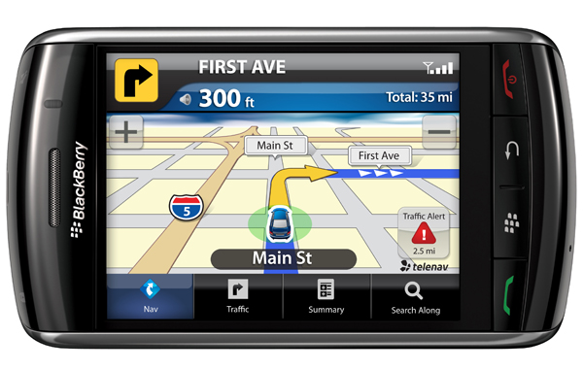
Network Layer
Primary task from a layer model perspective
  To provide service to the transport layer
    Connectionless or connection-oriented service
    Uniform addressing
    Internetworking: provide transitions between networks
    Routing
    Congestion control
    Quality of Service (QoS)

Slide 4
Routing
The main L3 task is
  enable data transfer from
  end system to end system
    several hops, (heterogeneous) subnetworks
    compensate for differences between end systems during transmission
The Intermediate Systems are often called Routers
routing depends on actual connections between intermediate systems (routers)
in many case, the organization into subnetworks coincides with routing borders and provides clues
but it is not essential for routing
network
is sub-network
(subnet) of
network
end system
intermediate
system
routing algorithms work on graphs

Slide 5
Inside the Network Layer
An L3 packet includes
for connection-oriented service:
route label
headers and trailer to specify service requirements
in particular:
information required by intermediate systems for forwarding
OR
for connectionless service:
end system address of the destination
IPv6 Header
virtual circuits require routing during connection setup
route label is used later
packet switching requires routing for every packet
destination address is used for every packet
Version
DSCP
ECN
Flow label
Payload length
Next header
Hop Limit
Source address
(128 bit)
Destination Address
(128 bit)
L4 Data

Slide 6
Network layer
IN2140:
Introduction to Operating Systems and Data Communication
Routing - foundations

Slide 7
Routing: Foundations
Task
  To define the route of packets through the network
    From the source
    To the destination system
Routing algorithm
  Defines on which outgoing line an incoming packet will be transmitted
Route determination
  Packet
    Routing algorithm makes individual decision for each packet
  Virtual circuit
    Routing algorithm runs only during connect (session routing)

Slide 8
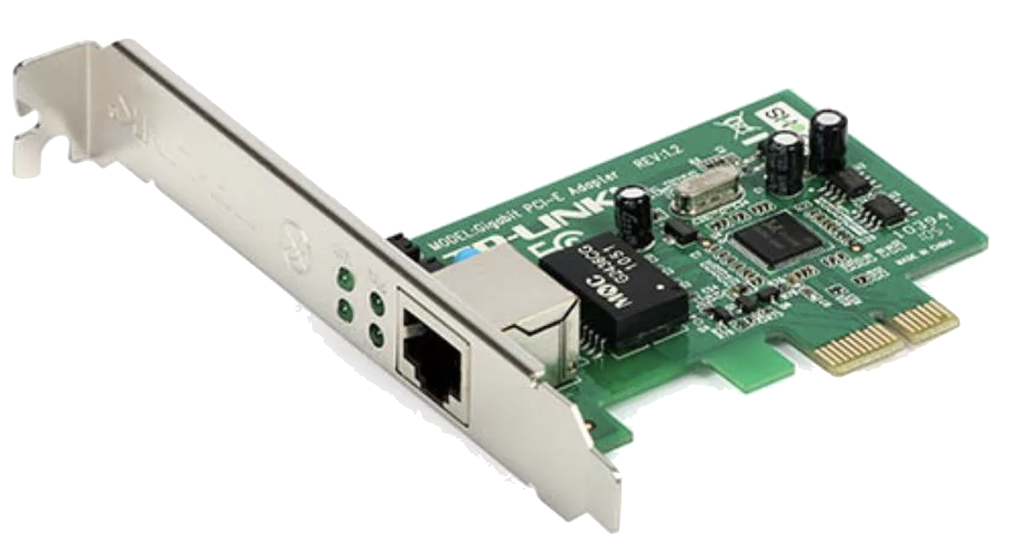
Routing: Routing and Forwarding
selecting an outgoing line
Router
Incoming
lines
Outgoing
lines
ES
IS
ES
ES
ES

Slide 9
Routing: Routing and Forwarding
Distinction can be made
  Routing: makes decision which route to use
  Forwarding: what happens when a packet arrives
Topology, link utilization, etc.
information
Router
Routing
Process
desti-
nation
link
A
0
Routing
table
Fills & Updates
B
2
C
1
Uses & Looks up
D
2
Data packets
Incoming
lines
Forwarding
Process
Outgoing
lines

Slide 10
Good Properties for Routing Algorithms
Correctness
Simplicity
  Minimize load of ISes
Robustness
  Compensation for IS and link failures
  Handling of topology and traffic changes
Stability
  Consistent results
  No volatile adaptations to new conditions
Fairness
  Among different sources compared to each other
Optimality

Slide 11
Routing Algorithms: Conflicting Properties
Often conflicting: fairness and optimization
Some different optimization criteria
  average packet delay
  total throughput
  individual delay
    conflict
a
b
c
x
IS
IS
IS
IS
IS
IS
X
Example:
  communication among
  a → A, b → B, c → C uses full capacity of horizontal line
  optimized throughput, but
  no fairness for x → X – Tradeoff between fairness and optimization
A
B
C
Therefore often
  hop minimization per packet
    it tends to reduce delays and decreases required bandwidth
    also tends to increase throughput

Slide 12
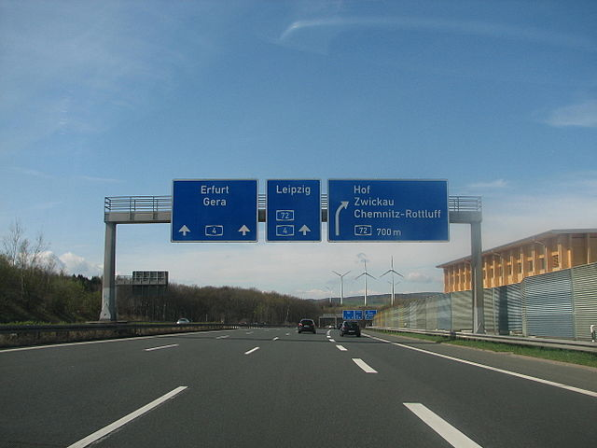
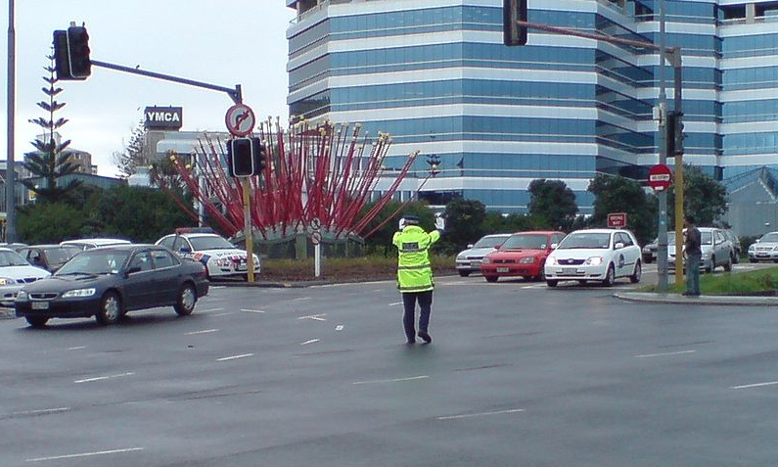
Classes of Routing Algorithms
Class: Non-adaptive Algorithms
  Current network state not taken into consideration
    Assume average values
    All routes are defined off-line before the network is put into operation
    No change during operation (static routing)
  With knowledge of the overall topology
    Spanning tree
    Flow-based routing
  Without knowledge of the overall topology
    Flooding
Class: Adaptive Algorithms
  Decisions are based on current network state
    Measurements / estimates of the topology and the traffic volume
  Further sub-classification into
    Centralized algorithms
    Isolated algorithms
    Distributed algorithms
[Inkowik@wikipedia, CC BY SA 2.0]
[Ingolfsson@wikipedia]
Notes:
Inkowik@wikipedia -

Slide 13
Optimality Principle and Sink Tree
Starting idea: using a route has a cost
  number of hops, delay, …
General statement about optimal routes
  if router J is on the optimal path from router I to router K
  then the optimal path from router J to router K uses the same route
Idea of the proof
  best route from I to K is like this:
    r1: from I to J, then
    r2: from J to K
  then r2 is also the best route from J to K
  if better route r3 from J to K
  would exist
    then concatenation of r1 and r3 would improve route from I to K
Set of optimal routes
  from all sources
  to a given destination
  form a tree rooted at the destination: Sink Tree
r2
r1
I
J
K
r3

Slide 14
Sink Tree
Sink Tree for Destination B
B
0
A
1
B
C
1
B
A
C
F
2
C
D
2
D
E
D
E
I
2
J
G
J
J
2
F
F
I
N
3
I
H
N
E
3
L
H
N
L
H
3
K
K
G
3
K
3
M
O
M
O
L
4
O
4
M
4

Slide 15
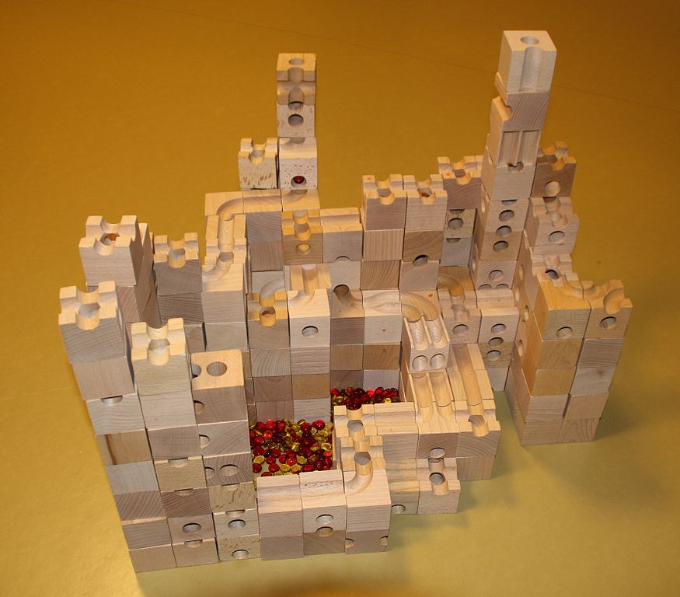
Sink Tree
Sink Tree for Destination B
B
[Adrian Michael@Wikipedia, CC BY 3.0]

Slide 16
Sink Tree
B
B
A
C
C
D
E
D
E
J
Sink Tree for
Destination B
F
G
J
F
I
I
H
N
L
H
N
L
K
K
M
O
M
O
Comments
  tree: no loops
    each optimal route is finite with bounded number of hops
  not necessarily unique
    other trees with same path lengths may exist
Goal of all routing algorithms
  discover and use the Sink Trees for all routers
Not realistic to use Sink Trees as real-life routing algorithm
  need complete information about topology
  Sink Tree is only a benchmark for routing algorithms

Slide 17
Methodology & Metrics
Compute the shortest path between a given pair of routers
Different metrics for path lengths can be used
  can lead to different results
  sometime even combined
Metrics for the "ideal" route, e.g., a "short" route
  number of hops
  geographical distance
  bandwidth
  average data volume
  cost of communication
  delay in queues
  ...

