Slide 1
Transport layer
IN2140:
Introduction to Operating Systems and Data Communication
Congestion Control in TCP

Slide 2
Global congestion collapse
Craig Partridge, Research Director for the Internet Research Department at BBN Technologies:
  Bits of the network would fade in and out, but usually only for TCP. You could ping. You could get a UDP packet through. Telnet and FTP would fail after a while. And it depended on where you were going (some hosts were just fine, others flaky) and time of day (I did a lot of work on weekends in the late 1980s and the network was wonderfully free then).
  Around 1pm was bad (I was on the East Coast of the US and you could tell when those pesky folks on the West Coast decided to start work...).
  Another experience was that things broke in unexpected ways - we spent a lot of time making sure applications were bullet-proof against failures. (..)
  Finally, I remember being startled when Van Jacobson first described how truly awful network performance was in parts of the Berkeley campus. It was far worse than I was generally seeing. In some sense, I felt we were lucky that the really bad stuff hit just where Van was there to see it.

Slide 3
Internet congestion control: history
around 1986: first congestion collapse
1988: "Congestion Avoidance and Control" (Jacobson)
Combined congestion/flow control for TCP
(also: variation change to RTO calculation algorithm)
Idea: packet loss = congestion, so throttle the rate; increase otherwise
Goal: stability - in equilibrum, no packet is sent into the network until an old packet leaves
  ack clocking, “conservation of packets“ principle
  made possible through window based stop+go - behaviour
Superposition of stable systems = stable →
network based on TCP with congestion control = stable

Slide 4
TCP Congestion Control
TCP limits sending rate as a function of perceived network congestion
  little traffic – increase sending rate
  much traffic – reduce sending rate
Congestion algorithm has three major “components”:
  additive-increase, multiplicative-decrease (AIMD)
  slow-start
  reaction to timeout events

Slide 5
TCP Congestion Control Algorithms
TCP Westwood+
TCP BIC
TCP Westwood
TCP Cubic
the original TCP had no congestion control
TCP New Reno
Compound TCP
TCP Vegas
TCP PRR
TCP
TCP Reno
TCP BBR
TCP Tahoe
TCP Prague
0
1
2
3
4
5
6
7
8
9
0
1
2
3
4
5
6
7
8
9
0
1
2
3
4
5
6
7
8
9
0
1
2
3
4
5
6
7
8
9
0
1
2
3
4
5
6
7
8
9
197x
198x
199x
200x
201x

Slide 6
TCP Congestion Control
Basic terms:
congestion window (cwnd)
  largest amount of data (of a connection) that can be in the network at a time
maximum segment size [MSS]
  largest number of bytes that a TCP entity sends at once
  always in IPv6 and usually in IPv4: largest payload that fits into an IP packet behind the TCP header
  TCP header size is minimal 20 bytes
  with options maximal 60 bytes
Testing for available bandwidth
  Ideally: send as fast as possible (cwnd as large as possible) without loss
  Increase cwnd until you have loss
  If loss, reduce cwnd, try increasing again

Slide 7
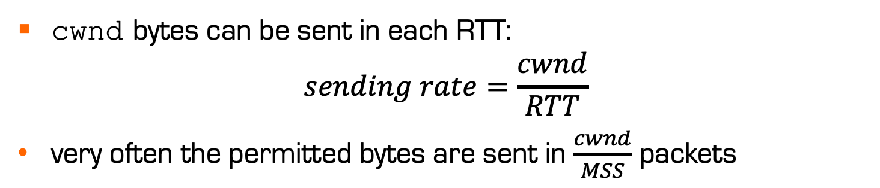
TCP Congestion Control
End-to-end control (no support from the network layer)
Send rate is limited by the size of a congestion window, cwnd (counted in bytes)
already
ack’d
sendable, not
sent yet
sent, not
ack’d yet
not sendable
yet
cwnd
cwnd bytes can be sent in each RTT:
$$sending rate=\frac{cwnd}{RTT}$$
very often the permitted bytes are sent in $\frac{cwnd}{MSS}$ packets

Slide 8
TCP Congestion Control
sender
receiver
Initially, cwnd size is a few MSS
in this example: 1 MSS
round 1
Then, the size increases by 1 for each
received ACK (until threshold ssthresh is reached or an ACK is missing)
sent packets
per round
(cwnd)
round 2
16
round 3
8
4
round 4
2
1
time

Slide 9
TCP Congestion Control
Historically, initial ssthresh was 65 K, now in Linux it starts with ∞
Losing a packet (TCP Tahoe):
ssthresh drops to half cwnd
cwnd back to 1
sent packets
per round
(cwnd)
80
Losing a single packet (TCP Reno):
ssthresh drops to half cwnd
cwnd back to new threshold
75
70
65
ssthresh
16
60
55
50%
50
45
40
35
ssthresh
8
30
25
20
4
15
2
10
1
5
time
Notes:
Why infinite ssthresh – try to get networking to work with a wide variety of bandwidth: 64 kbps modem in bad phone or countryside houses -> 10 GBps at IFI
Get to the right speed quickly !

Slide 10
TCP Congestion Control
Slow Start
TCP will always return to a slow start when a packet loss is detected by timeout (instead of duplicate ACKs). That means that it starts from scratch with only one segment per RTT, then 2, then 4, etc.
sent packets
per round
(congestion window)
80
75
Congestion avoidance
phase
70
65
ssthresh
60
55
50
45
40
Slow-start phase
35
ssthresh
30
Additive Increase
One more segments sent after 1 RTT without loss in congestion avoidance phase
25
Today smallest
cong. window can
be as big as 10
(thanks to Google)
20
15
Multiplicative Decrease
Performed when loss is detected in slow-phase and in congestion avoidance phase
10
5
time

Slide 11
TCP Fairness
Goal of fairness
  When N TCP streams share a bottleneck,
  each TCP stream should receive an n^{th} of the bottleneck bandwidth
more realistic demand
  When N TCP streams with the same RTT and loss rate share a bottleneck,
  and they are infinitely long,
  each TCP stream receives an n^{th} of the bottleneck bandwidth
but the approximation is in many cases good

Slide 12
TCP Congestion Control
How does the AIMD algorithm achieve congestion control?
  interpret every packet loss as a congestion signal
  force TCP entities to slow down when loss is experienced
available bandwidth
same share of bandwidth
throughput of stream 2
stream 1 has experienced loss
backs off,
stream 2 can increase BW consumption
stream 1 can increase BW consumption
stream 2 is backing off
consumes less than its share
throughput of stream 1

