Slide 1
Transport layer
IN2140:
Introduction to Operating Systems and Data Communication
Introduction to
Congestion Control

Slide 2
Congestion
Traffic
  All traffic from all sources
Persistent congestion
  Router stays congested for a long time
  Excessive traffic offered
Transient congestion
  Congestion occurs for a while
  Router is temporarily overloaded
  Often due to burstiness
Notes:
DRAW A TOKEN BUCKET!!!

Slide 3
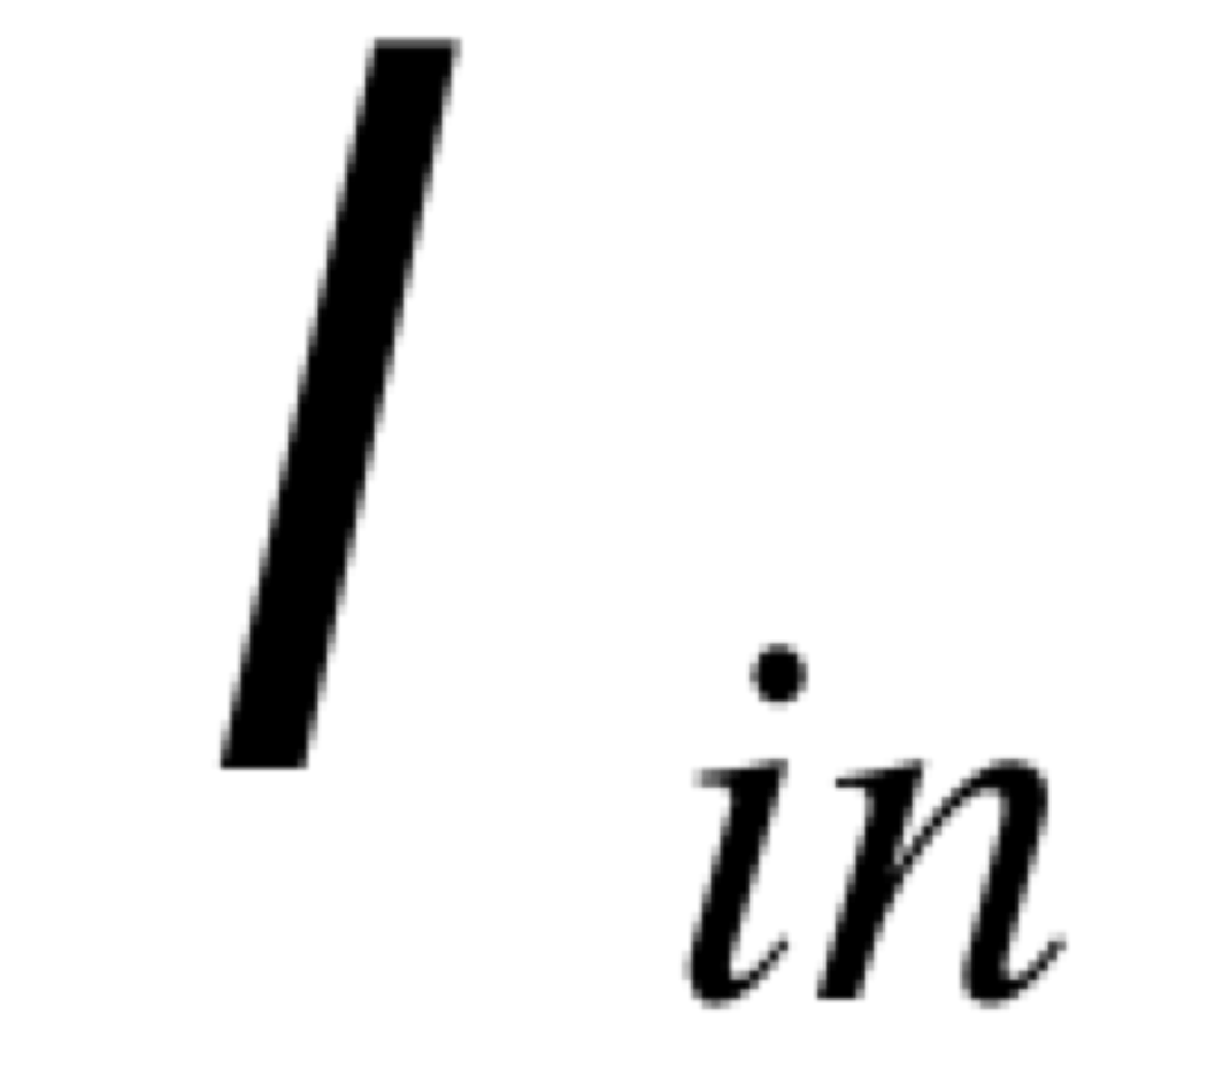
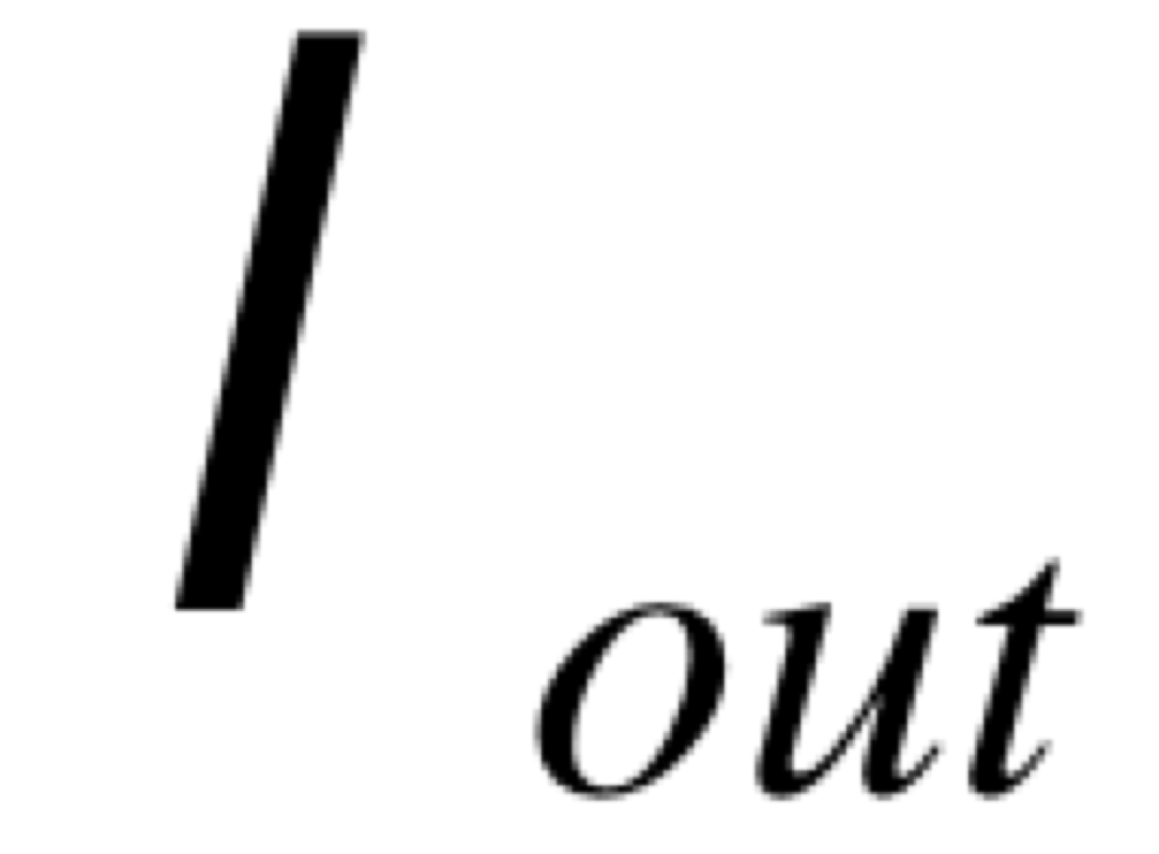

Reasons for congestion
Two senders, two receivers
One router, infinite buffers
No retransmissions
C
C/2
Router with infinite buffers
packets/second
receveived by I_{iout}
packets/second sent from I_{in}
C/2
Maximum utilization of the networks
Very long delays in case of congestion
$$∞$$
avg delay
packets/second sent from I_{in}

Slide 4
Reasons for congestion
Two senders, two receivers
One router, finite buffers
No retransmissions
C
C/2
packets/second
receveived by I_{out}
Router with finite buffers
When ∑I_{in} exceeds C, I_{out} is missing some data
packets/second sent from I_{in}
no packet losses, empty queue
queue fills up, packets get lost
queue is full
C/2
avg delay
delay
example
queue is filling up
packets/second sent from I_{in}
time

Slide 5
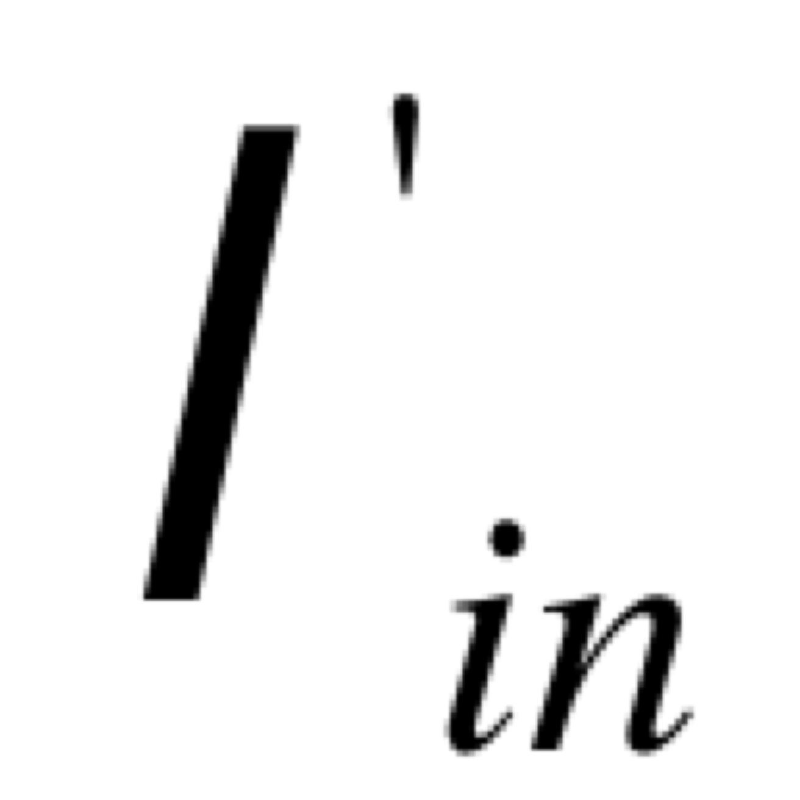
Reasons for congestion
Two senders, two receivers
One router, finite buffers
Retransmission of lost packets
C
Router with finite buffers
Data rate sent by the application
Higher data rate sent by the transport layer including retransmissions

Slide 6
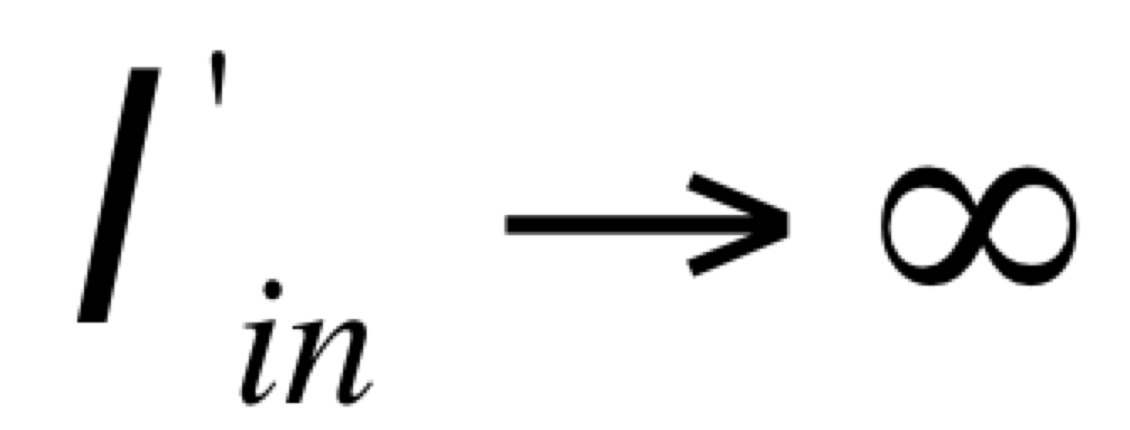

Reasons for congestion
Retransmission means that I_{out} receives all data that I_{in} sends
When there is loss, retransmission is happening, and I’_{in} > I_{out}
Retransmission of delayed (but not lost) packets increases I’_{in} above the perfect value, without increasing I_{out}
“Cost of congestion”:
  More work (retransmissions) for a desired throughput
  Useless retransmissions, some links transmit several copies of the same packet
Constant bitrate (non-bursty) traffic
other rates for I_{n}
C/2
I_{n}
no congestion
persistent
congestion
C/2
time
$${I′}_{n}=I_{n}$$
Notes:
ASK QUESTIONS
BLACKBOARD !!!!!!!!!

Slide 7

Reasons for congestion
Retransmission means that I_{out} receives all data that I_{in} sends
When there is loss, retransmission is happening, and I’_{in} > I_{out}
Retransmission of delayed (but not lost) packets increases I’_{in} above the perfect value, without increasing I_{out}
“Cost of congestion”:
  More work (retransmissions) for a desired throughput
  Useless retransmissions, some links transmit several copies of the same packet
Bursty traffic
ideal line
C/2
C/2
transient congestion
I_{n}
$${I′}_{n}$$
time

Slide 8
Conclusion
Protocols should implement congestion control
Congestion control algorithms:
  algorithms to adapt the offered load (I’_{n})
  to the capacity at the bottleneck router
There are quite many algorithms that can achieve this
  at several layers
We are going to look mainly at TCP’s approach to congestion control

