Slide 1
Transport layer
IN2140:
Introduction to Operating Systems and Data Communication
Flow Control

Slide 2
Flow Control on Transport Layer
Fast sender shall not flood slow receiver
Application
Layer
Transport
Layer
Network
Layer
Data Link
Layer
Link layer
Few connections
(one per host)
Short distances
Physical
Layer
Transport layer
Potentially many connections
(several per application)
Potentially long distances
Flow control mechanisms:
Stop-and-wait
Sliding window
  Go-back-N / no buffer allocation
  Selective repeat / static buffer allocation
  Credit mechanism / dynamic buffer allocation

Slide 3
Transport layer
IN2140:
Introduction to Operating Systems and Data Communication
Flow Control:
sequence number space

Slide 4
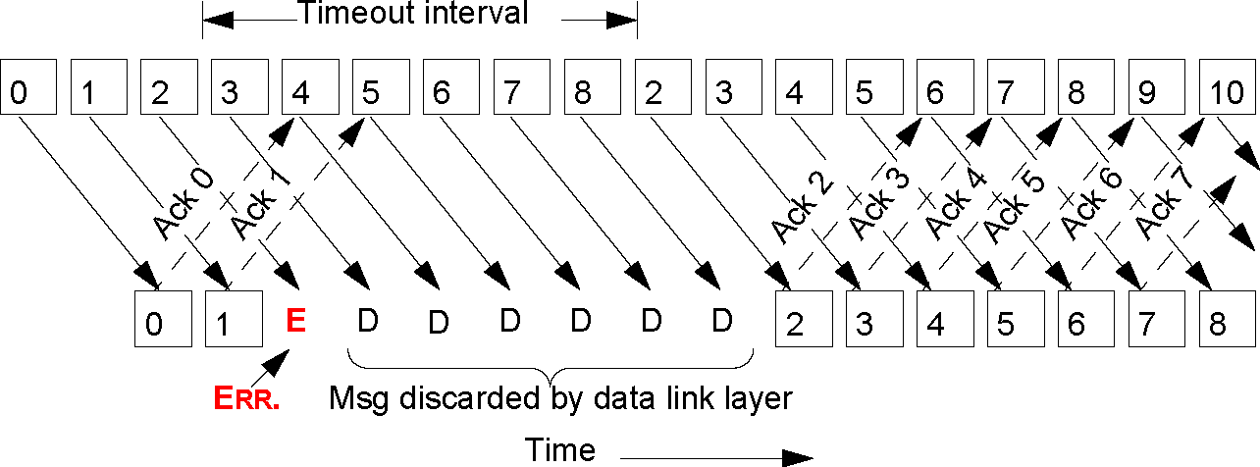
Sliding Window: Go-Back-N
Example: sender: error detection by timeout
© Ralf Steinmetz, Technische Universität Darmstadt

Slide 5
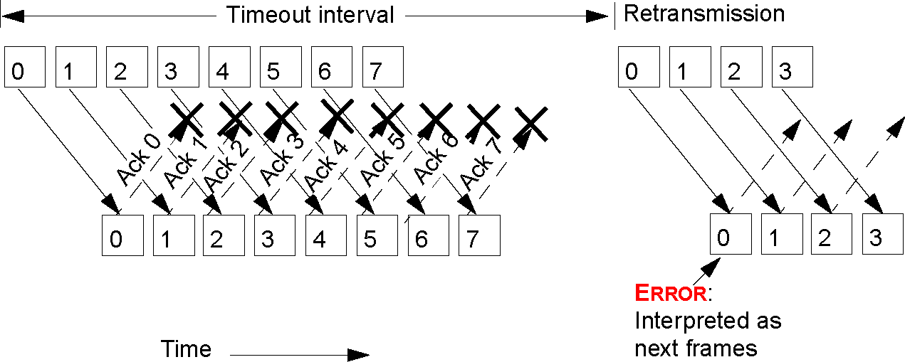
Sliding Window: Go-Back-N
Correlation between
window size and
number of possible sequence numbers
→ at least max. window size strictly less than range of sequence numbers
Example for incorrect window size:
  amount of sequence numbers 8
  window size 8
  all ACKs lost

Slide 6
Sliding Window: Go-Back-N
Correlation between
window size and
number of possible sequence numbers
at least max. window size strictly less than range of sequence numbers
Example for correct window size:
amount of sequence numbers 8
window size 7
all ACKs lost
sender
receiver
LB
UB
seq 0
0
7
seq 1
seq 2
seq 3
ACK 0
1
seq 4
ACK 1
2
0
seq 5
ACK 2
3
1
seq 6
ACK 3
4
2
ACK 4
5
3
ACK 5
6
4
ACK 6
7
5
Timeout
6
seq 0
ACK 0
7
6
receiver discards packet 0 and resends ACK 0
everything OK

Slide 7
Sliding Window: Go-Back-N
Correlation between
window size and
number of possible sequence numbers
at least max. window size strictly less than range of sequence numbers
Example for incorrect window size:
amount of sequence numbers 8
window size 8
all ACKs lost
sender
receiver
LB
UB
seq 0
0
0
seq 1
seq 2
seq 3
ACK 0
1
seq 4
ACK 1
2
1
seq 5
ACK 2
3
2
seq 6
ACK 3
4
3
seq 7
ACK 4
5
4
ACK 5
6
5
ACK 6
7
6
Timeout
ACK 7
0
7
0
seq 0
ACK 0
1
1
receiver accepts new packet 0, sends ACK 0 for a ”new” packet with sequence number 0

Slide 8
Sliding Window: Selective Repeat
Timeout
0
1
2
3
4
5
6
7
X
0
Correlation between
window size and
number of possible sequence numbers
→ max. window size <= 1/2 range of sequence numbers
Example for incorrect window size:
  amount of sequence numbers 8
  window size 5
  all ACKs are lost, and the packet that has been lost last is the first one to arrive at the receiver again

Slide 9
Sliding Window: Selective Repeat
Timeout
0
1
2
3
4
5
6
7
X
X
0
1
Correlation between
window size and
number of possible sequence numbers
→ max. window size <= 1/2 range of sequence numbers
Example for incorrect window size:
  amount of sequence numbers 8
  window size 5
  all ACKs are lost, and the packet that has been lost last is the first one to arrive at the receiver again

Slide 10
Sliding Window: Selective Repeat
Timeout
0
1
2
3
4
5
6
7
X
X
X
0
1
2
Correlation between
window size and
number of possible sequence numbers
→ max. window size <= 1/2 range of sequence numbers
Example for incorrect window size:
  amount of sequence numbers 8
  window size 5
  all ACKs are lost, and the packet that has been lost last is the first one to arrive at the receiver again

Slide 11
Sliding Window: Selective Repeat
Timeout
0
1
2
3
4
5
6
7
X
X
X
X
0
1
2
3
Correlation between
window size and
number of possible sequence numbers
→ max. window size <= 1/2 range of sequence numbers
Example for incorrect window size:
  amount of sequence numbers 8
  window size 5
  all ACKs are lost, and the packet that has been lost last is the first one to arrive at the receiver again

Slide 12
Sliding Window: Selective Repeat
Timeout
no ACKs arrived at the sender
must wait for timeout
0
1
2
3
4
5
6
7
X
X
X
X
X
0
1
2
3
4
Correlation between
window size and
number of possible sequence numbers
→ max. window size <= 1/2 range of sequence numbers
Example for incorrect window size:
  amount of sequence numbers 8
  window size 5
  all ACKs are lost, and the packet that has been lost last is the first one to arrive at the receiver again

Slide 13
Sliding Window: Selective Repeat
no values have been ACKed, so they are all retransmitted
Timeout
Timeout
Timeout
0
1
2
3
4
5
6
7
0
1
2
3
4
0
1
window has slid 5 steps, so new values 0 and 1 fit into the tail although old values 0 and 1 were never successfully ACKed
Correlation between
window size and
number of possible sequence numbers
→ max. window size <= 1/2 range of sequence numbers
Example for incorrect window size:
  amount of sequence numbers 8
  window size 5
  all ACKs are lost, and the packet that has been lost last is the first one to arrive at the receiver again

Slide 14
Sliding Window: Selective Repeat
Timeout
0
1
2
3
4
5
6
7
X
X
X
0
1
2
3
4
5
6
0
1
Correlation between
window size and
number of possible sequence numbers
→ max. window size <= 1/2 range of sequence numbers
Example for incorrect window size:
  amount of sequence numbers 8
  window size 5
  all ACKs are lost, and the packet that has been lost last is the first one to arrive at the receiver again

Slide 15
Go-back-N vs Selective Repeat – a clear choice?
Burst errors are rare
  Selective Repeat repeats exactly the missing/bad packet
  Go-back-N discards lots of safely arrived packets
Burst errors are frequent
  Selective Repeat waits for a timeout for every packet separately
  Go-back-N recovers quickly after the first timeouts
Error-free transmission
  Selective Repeat senders must wait after sending ½ sequence number space packets
  Go-back-N senders must wait after sending sequence number space-1 packets

Slide 16
Transport layer
IN2140:
Introduction to Operating Systems and Data Communication
Flow Control:
credit mechanism

Slide 17
Credit Mechanism
Flow control
  Credit mechanism
Buffer reservation
  Receiver allocates buffers dynamically for the connections
  Allocation depends on the actual situation
Principle
  Sender requests required buffer amount
  Receiver reserves as many buffers as the actual situation permits
  Receiver returns ACKs and buffer-credits separately
    ACK: confirmation only (does not imply buffer release)
    CREDIT: buffer allocation
  Sender is blocked when all credits are used up

Slide 18
Credit Mechanism
Dynamic adjustment to
  Buffer situation
  Number of open connections
  Type of connections
    high throughput: many buffers
    low throughput: few buffers

Slide 19
Credit Mechanism
Sender: A
Receiver: B
A wants 8 buffers
A has 3 buffers left
<req 8 buffers>
B grants messages 0-3 only
<cred=4>
A has 2 buffers left
<seq=0, data=m0>
Message lost
<seq=1, data=m1>
Message lost but A thinks it has 1 left
<seq=2, data=m2>
B acknowledges 0 and 1
permits 2-4
<ack=1, cred=3>
A has 1 buffer left
<seq=3, data=m3>
Everything acknowledged
but no free buffers
<seq=4, data=m4>
A has 0 buffer left, must stop
A times out and retransmits
<seq=2, data=m2>
B found a new buffer
somewhere
<ack=4, cred=0>
A still blocked
<ack=4, cred=1>
<ack=4, cred=2>
A may now send next msg.
<seq=5, data=m5>
A has 1 buffer left
<seq=6, data=m6>
B acks everything but has
no buffer
<ack=6, cred=0>
A is now blocked again
<ack=6, cred=4>
A still blocked
time
time

Slide 20
Transport layer
IN2140:
Introduction to Operating Systems and Data Communication
Flow Control:
TCP

Slide 21
TCP Flow Control
Variable window sizes (credit mechanism)
  Implementation
    The actual window size is also transmitted with each acknowledgement
    Permits dynamic adjustment to existing buffer
Version
IHL
Type of service
Sequence number and
acknowledgements
PRE
ToS
Total length
Identification
D
M
Fragment offset
Time to live
Protocol
Header checksum
Source address
Destination Address
Credit
Options
Source port
Destination port
Sequence number
THL – TCP header length
U: URG – urgent
A: ACK – acknowledgement
P: PSH – push
R: RST – reset
S: SYN – sync
F: FIN – finalize
Piggyback acknowledgement
THL
unused
U
A
P
R
S
F
Window
Checksum
Urgent pointer
Options (0 or more 32 bit words)
Data

Slide 22
TCP Flow Control
“Sliding window” mechanism
Sequence number space is limited
sequence number up to 2³² bytes
window up to 2¹⁶ units
  originally: units = bytes
  today: Window Scale Option, multiply window with scale factor 2^{N} bytes, with 0 ≤ N ≤ 14
Acknowledgement and sequence number
  Acknowledgments refer to byte positions
  Sequence numbers refer to the byte position of a TCP connection
Positive acknowledgement
  Cumulative acknowledgements
    Byte position in the data stream up to which all data has been received correctly
    Reduces overhead and adds tolerance to ACK loss
Notes:
Make a formula for the number of bytes that can be in flight.
Use a second slide for it.

Slide 23
TCP Flow Control
Sender
Receiver
Application does
a 2K write
4K buffer
2K / SEQ=0
Sender is blocked
ACK=2048 WIN=2048
2K
Application does
a 2K write
2K / SEQ=2048
Sender is blocked
ACK=4096 WIN=0
Application reads 2K
ACK=4096 WIN=2048
2K
Sender could send 2K
but application does
only a 1K write
1K / SEQ=4096
time
time
1K
2K

